Slide 1



Hog Contest 2025 Awards
def final_strategy(score, opponent_score):
# I’ll win the game!!!
return 6
NJU SICP’25 TA Team
(Sponsored by )

Slide 2

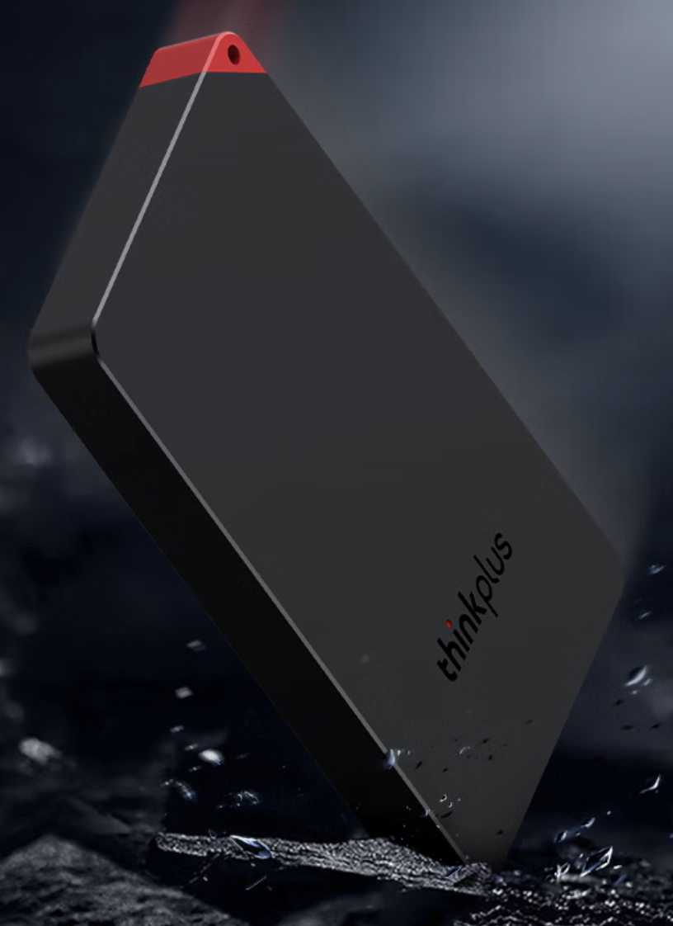




Awards
ThinkPlus
1TB SSD * 1
ThinkPlus
256GB UFD * 2
Winners
Lucky Dogs

Slide 3
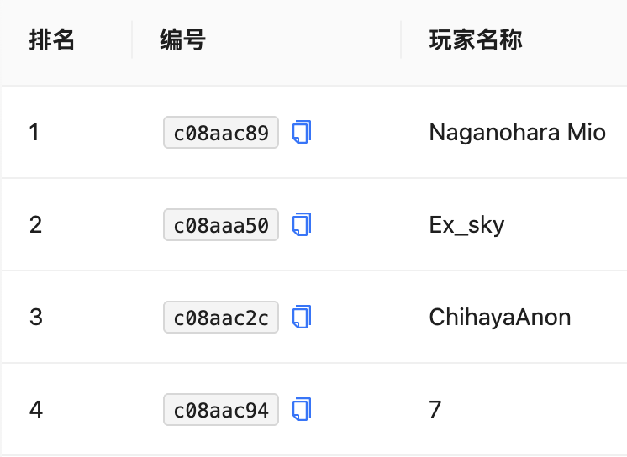

Winners
ThinkPlus
1TB SSD * 1
ThinkPlus
256GB UFD * 2
😈
🏅
🥈
🥉
(Check the Leaderboard)

Slide 4
Awards
ThinkPlus
1TB SSD * 1
ThinkPlus
256GB UFD * 2
Winners
Lucky Dogs

Slide 5
Lucky Dogs
WWPD: What Would Python Display?
>>> # import some magical functions
>>> from time import time
>>> from random import seed, randint
>>> seed(time())
>>> # Get A Lucky Dog
>>> randint(5, 69)
?

Slide 6
Lucky Dogs
WWPD: What Would Python Display?
>>> # import some magical functions
>>> from time import time
>>> from random import seed, randint
>>> seed(time())
>>> # Get A Lucky Dog
>>> randint(5, 69)
?
(No Magic, Only Documentation!)

Slide 7
Awards
ThinkPlus
1TB SSD * 1
ThinkPlus
256GB UFD * 2
Winners
Lucky Dogs

Slide 8
Awards
Winners
Lucky Dogs

