Slide 1
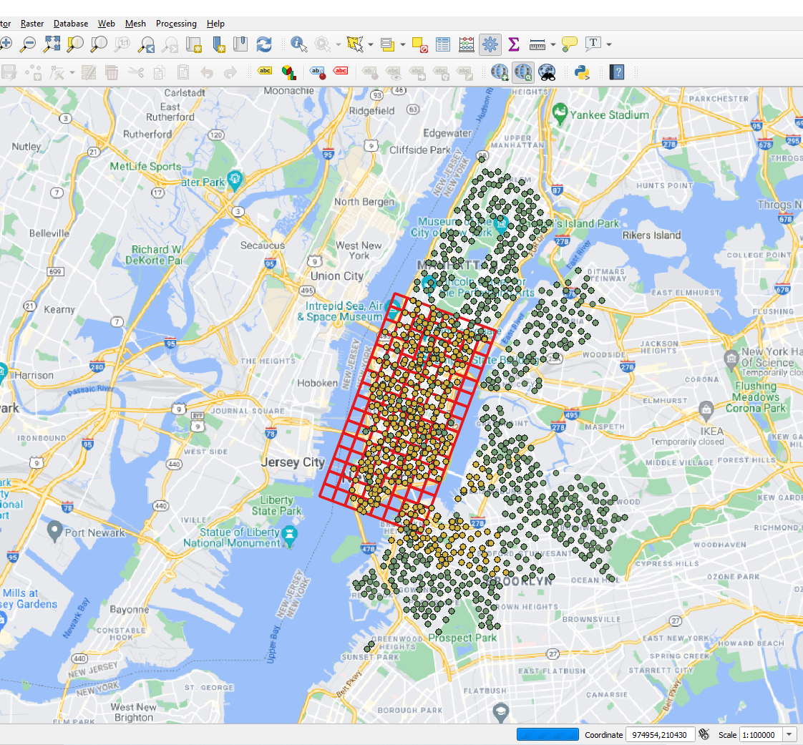
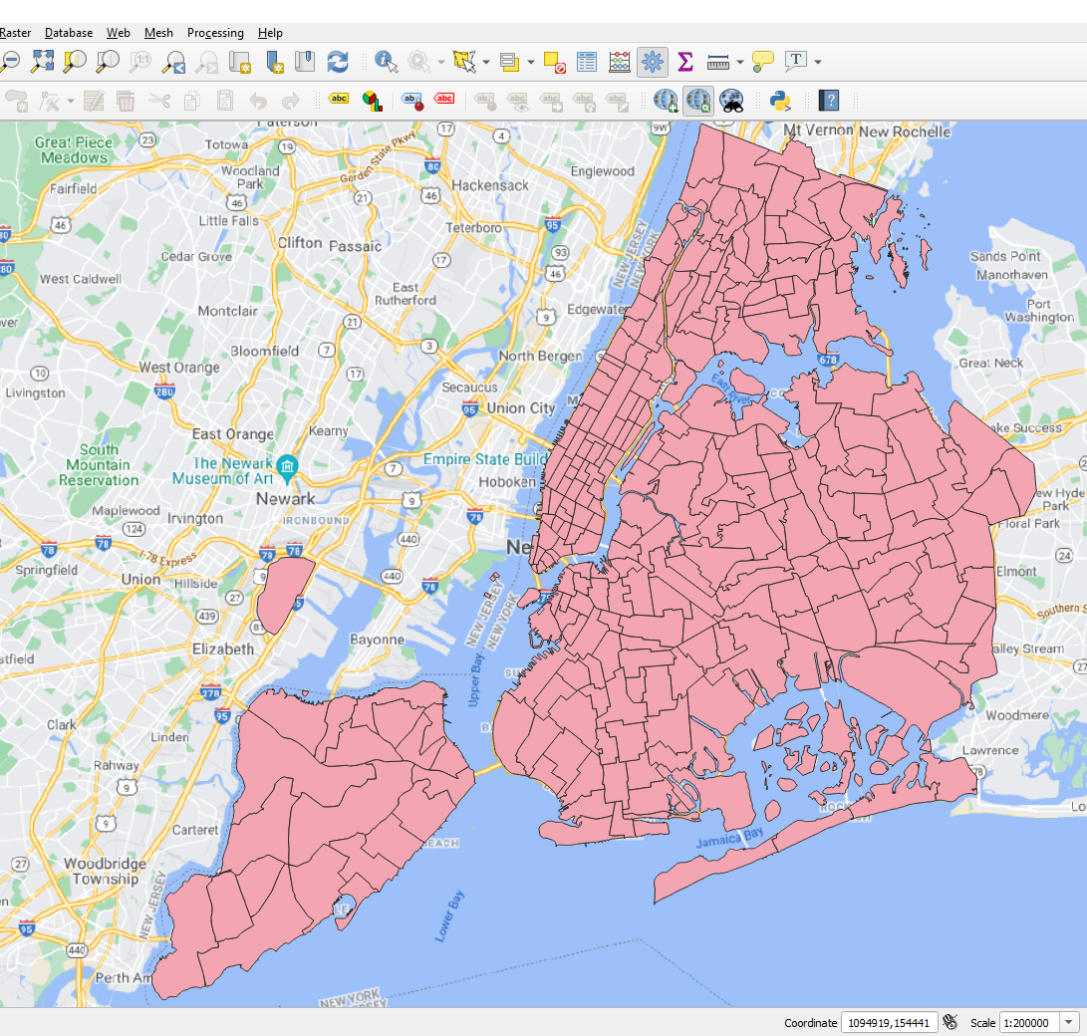
https://www1.nyc.gov/site/tlc/about/tlc-trip-record-data.page

Slide 2
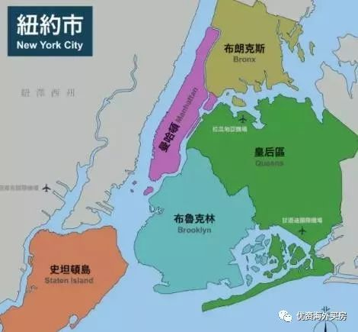
Data Required
https://www1.nyc.gov/site/tlc/about/tlc-trip-record-data.page
只处理 yellow car
时间范围=2015, 2019, 2020
时间粒度= 1小时
Station ID
grid样式 (Euclidean) n*m
NYC 16x8 500x500m NAD83 (EPSG:2263) Top: 40.7738362 -73.9985950 Left: 40.7062855 -74.0315102 Right: 40.7613036 -73.9541783 Bottom: 40.6937655 -73.9871323
region样式 (Graph, non-Euclidean) n
2014.1; 2020.1
Grid: in/outflow 744*16*8*2, OD flow 744*128*128*1
Region: in/outflow 744*n*2, OD flow 744*n*n*1
https://www1.nyc.gov/assets/tlc/images/content/pages/about/taxi_zone_map_manhattan.jpg

Slide 3
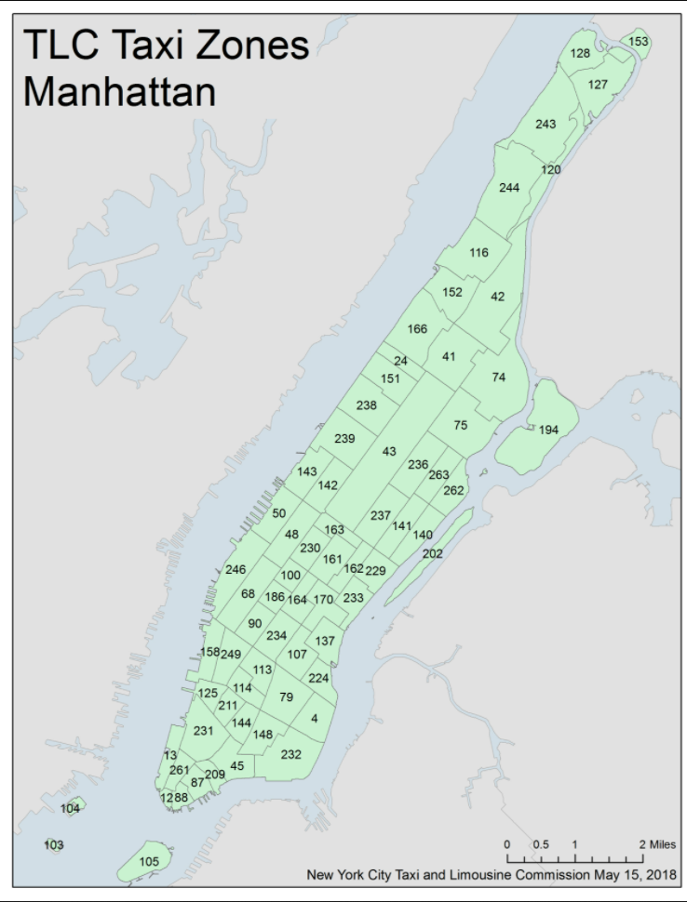
https://www1.nyc.gov/site/tlc/about/tlc-trip-record-data.page
https://www1.nyc.gov/assets/tlc/images/content/pages/about/taxi_zone_map_manhattan.jpg
Week1 | 数据下载与预处理 | 生成四个张量 收集并熟悉其他种类数据

