Slide 1

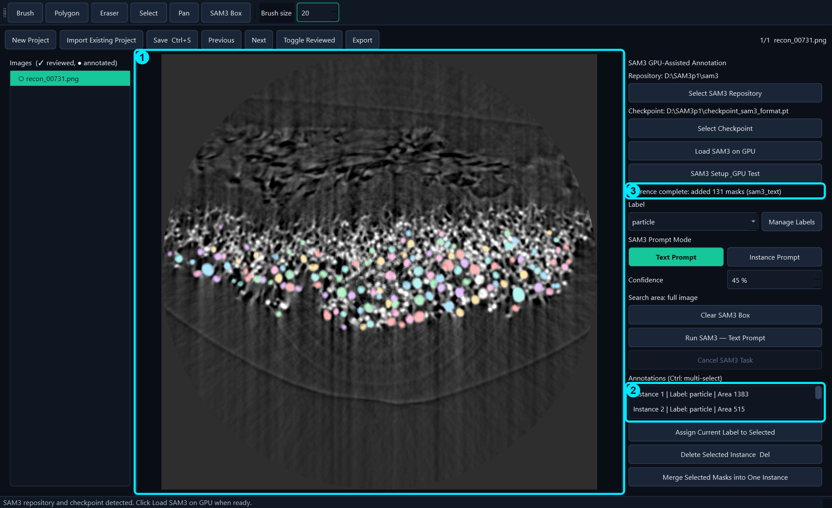
BL62 Label GUI
Quick Start Guide
English Edition · 2026-10-12
Example: recon_00731.png

Slide 2
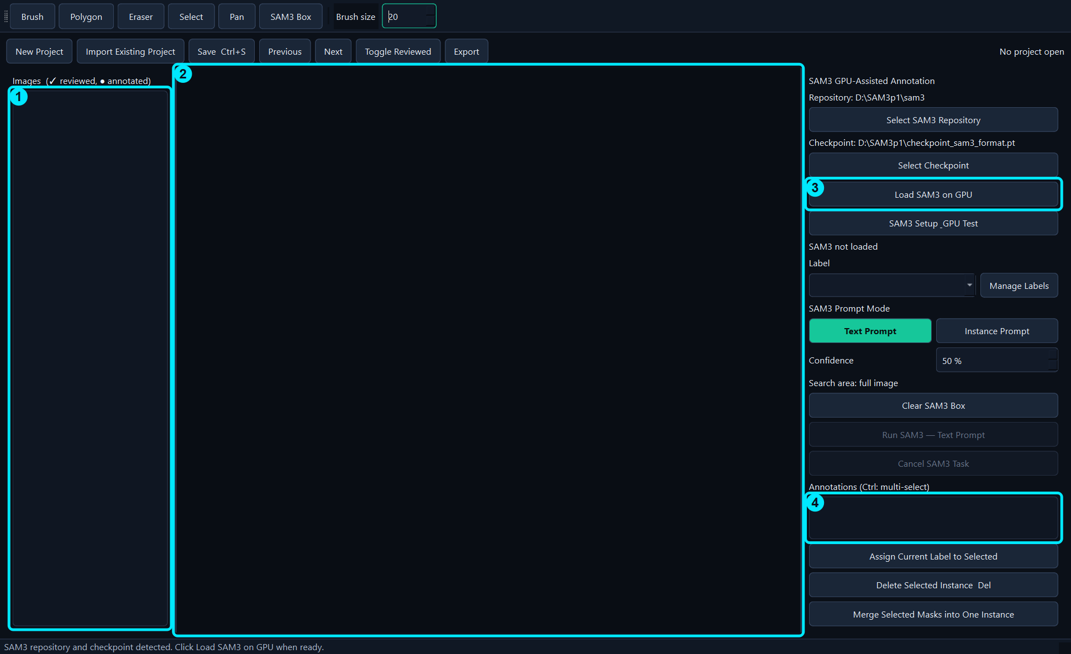
What the GUI Does
• Combines SAM3-assisted and manual instance segmentation.
• Supports multiple labels in one image.
• Exports COCO training data and QA outputs.
Overview

Slide 3
Interface Overview
• 1 Image list
• 2 Image canvas
• 3 SAM3 and label controls
• 4 Annotation list
Project → SAM3 → Annotation → Review → Export

Slide 4
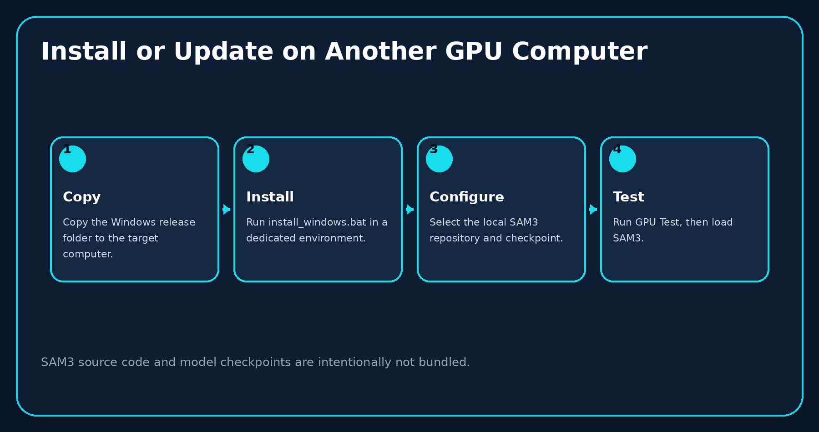
Install or Update
• Use the dedicated release folder and environment.
• Keep SAM3 source and checkpoint outside the package.
• Run GPU Test after installation.
Installation

Slide 5
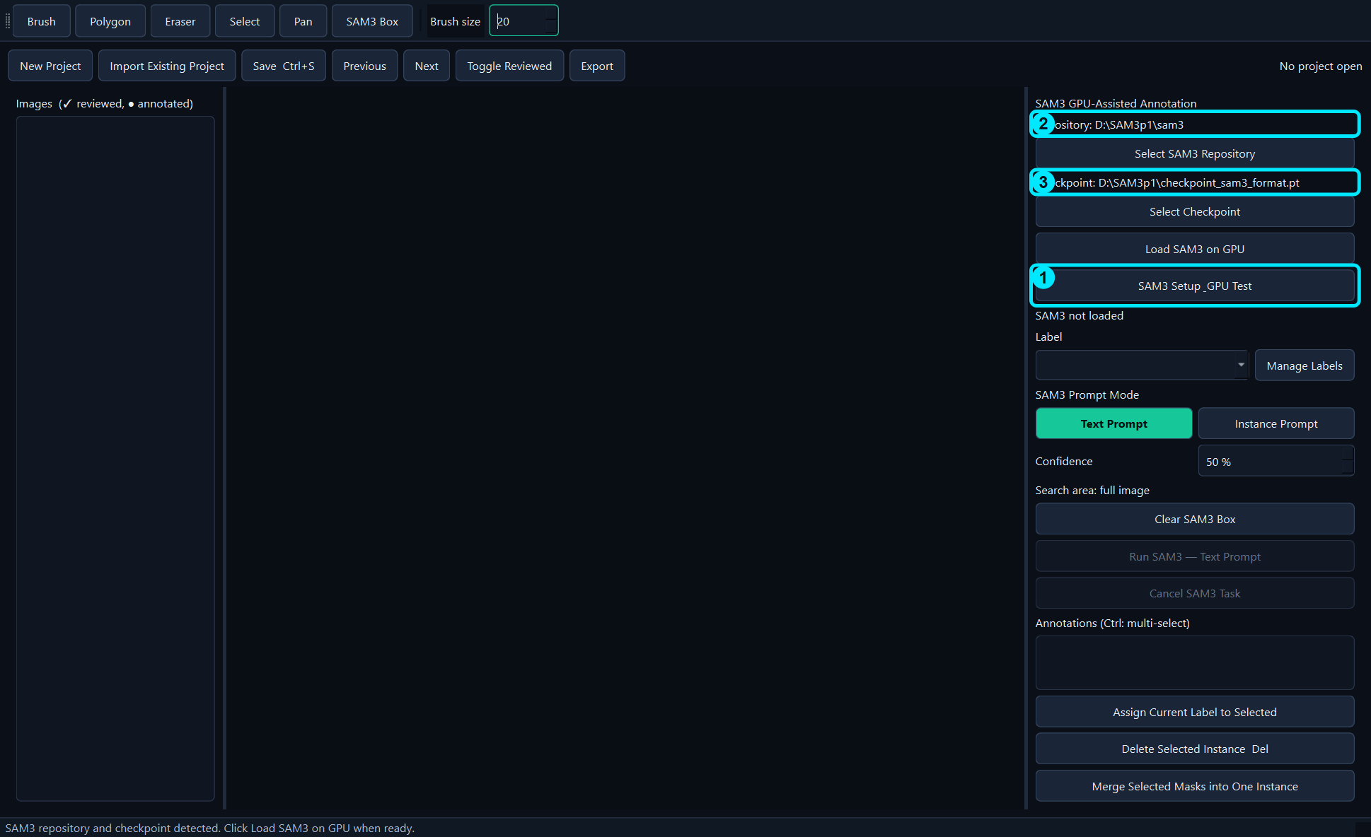
Configure SAM3
• Open SAM3 Setup & GPU Test.
• Select repository and checkpoint.
• Run GPU Test and save configuration.
SAM3 setup

Slide 6
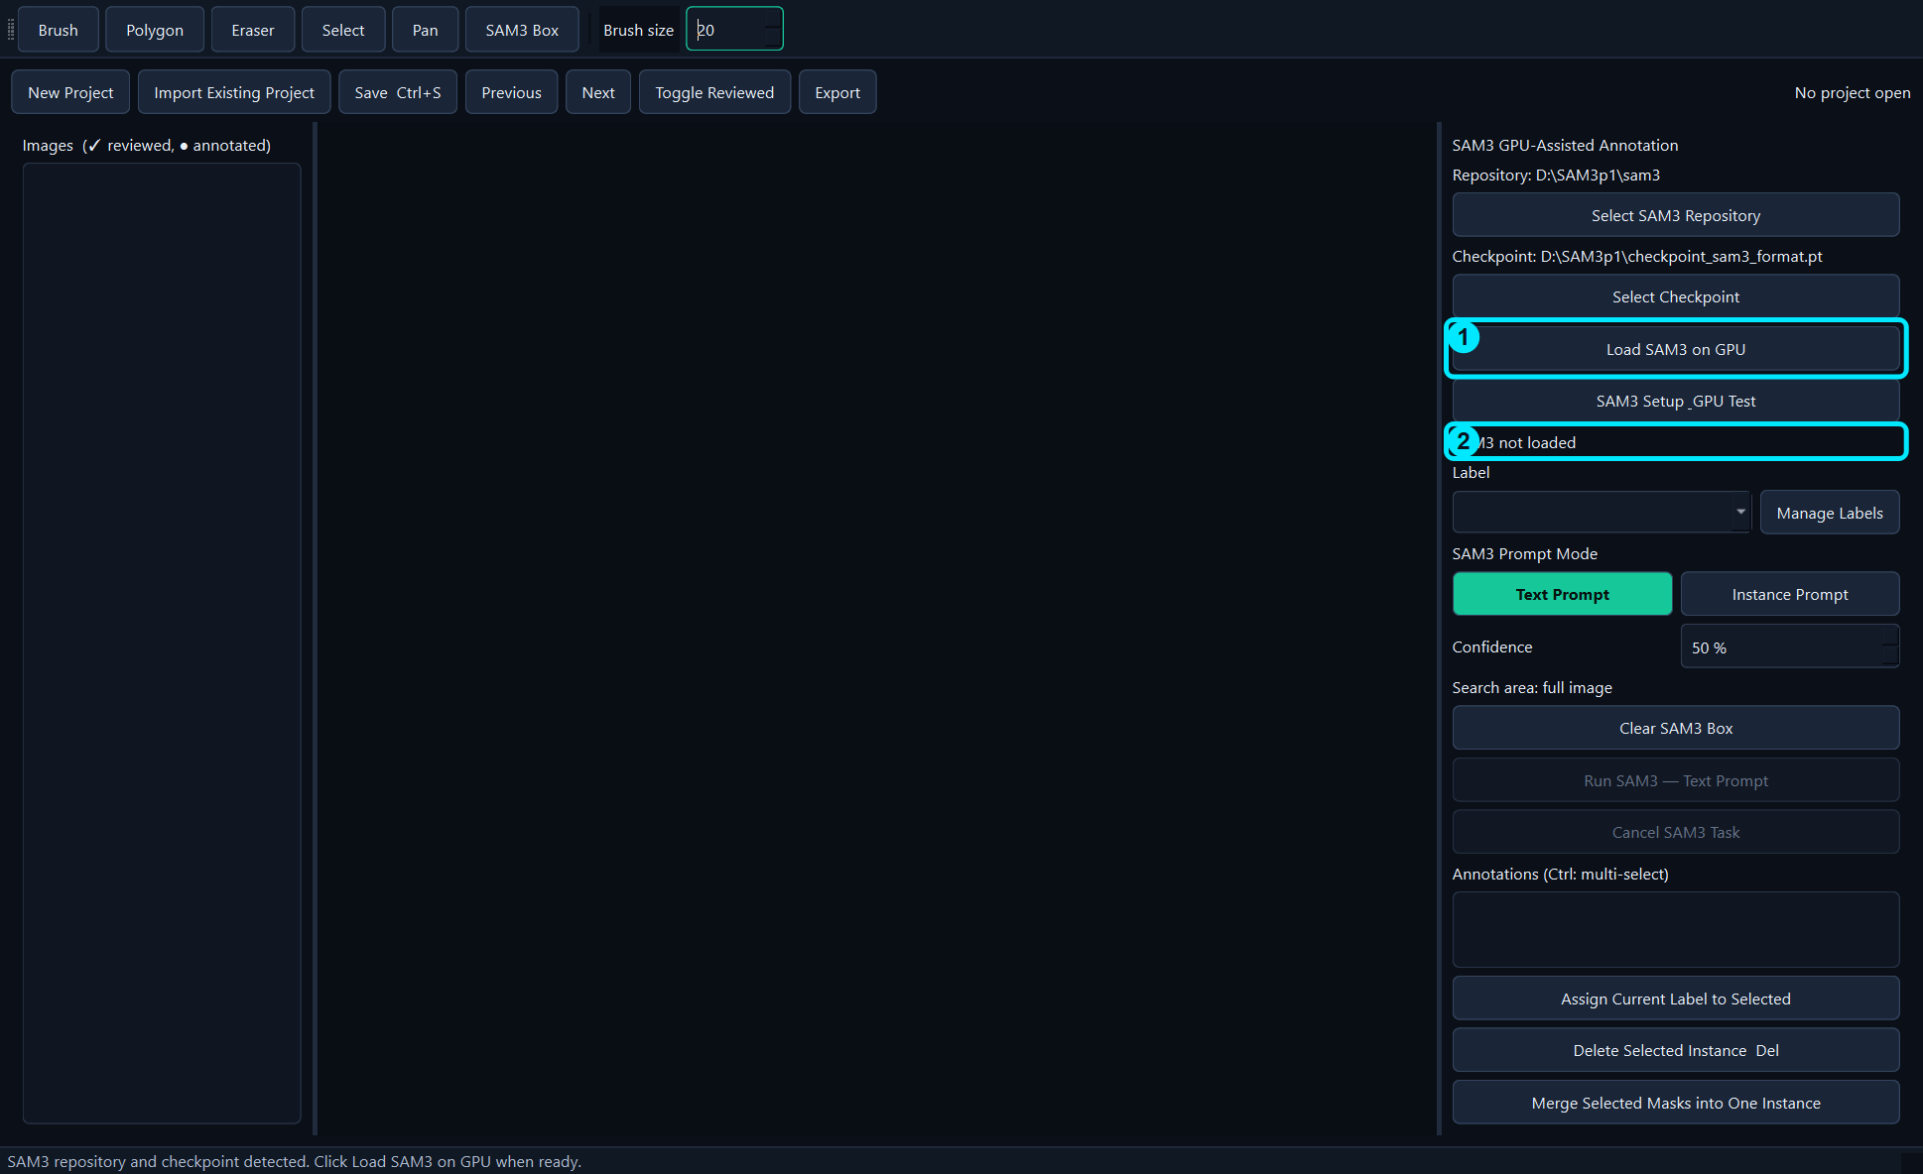
Load SAM3
• Click Load SAM3 on GPU.
• The GUI remains responsive during loading.
• Cancel only when necessary.
SAM3 setup

Slide 7
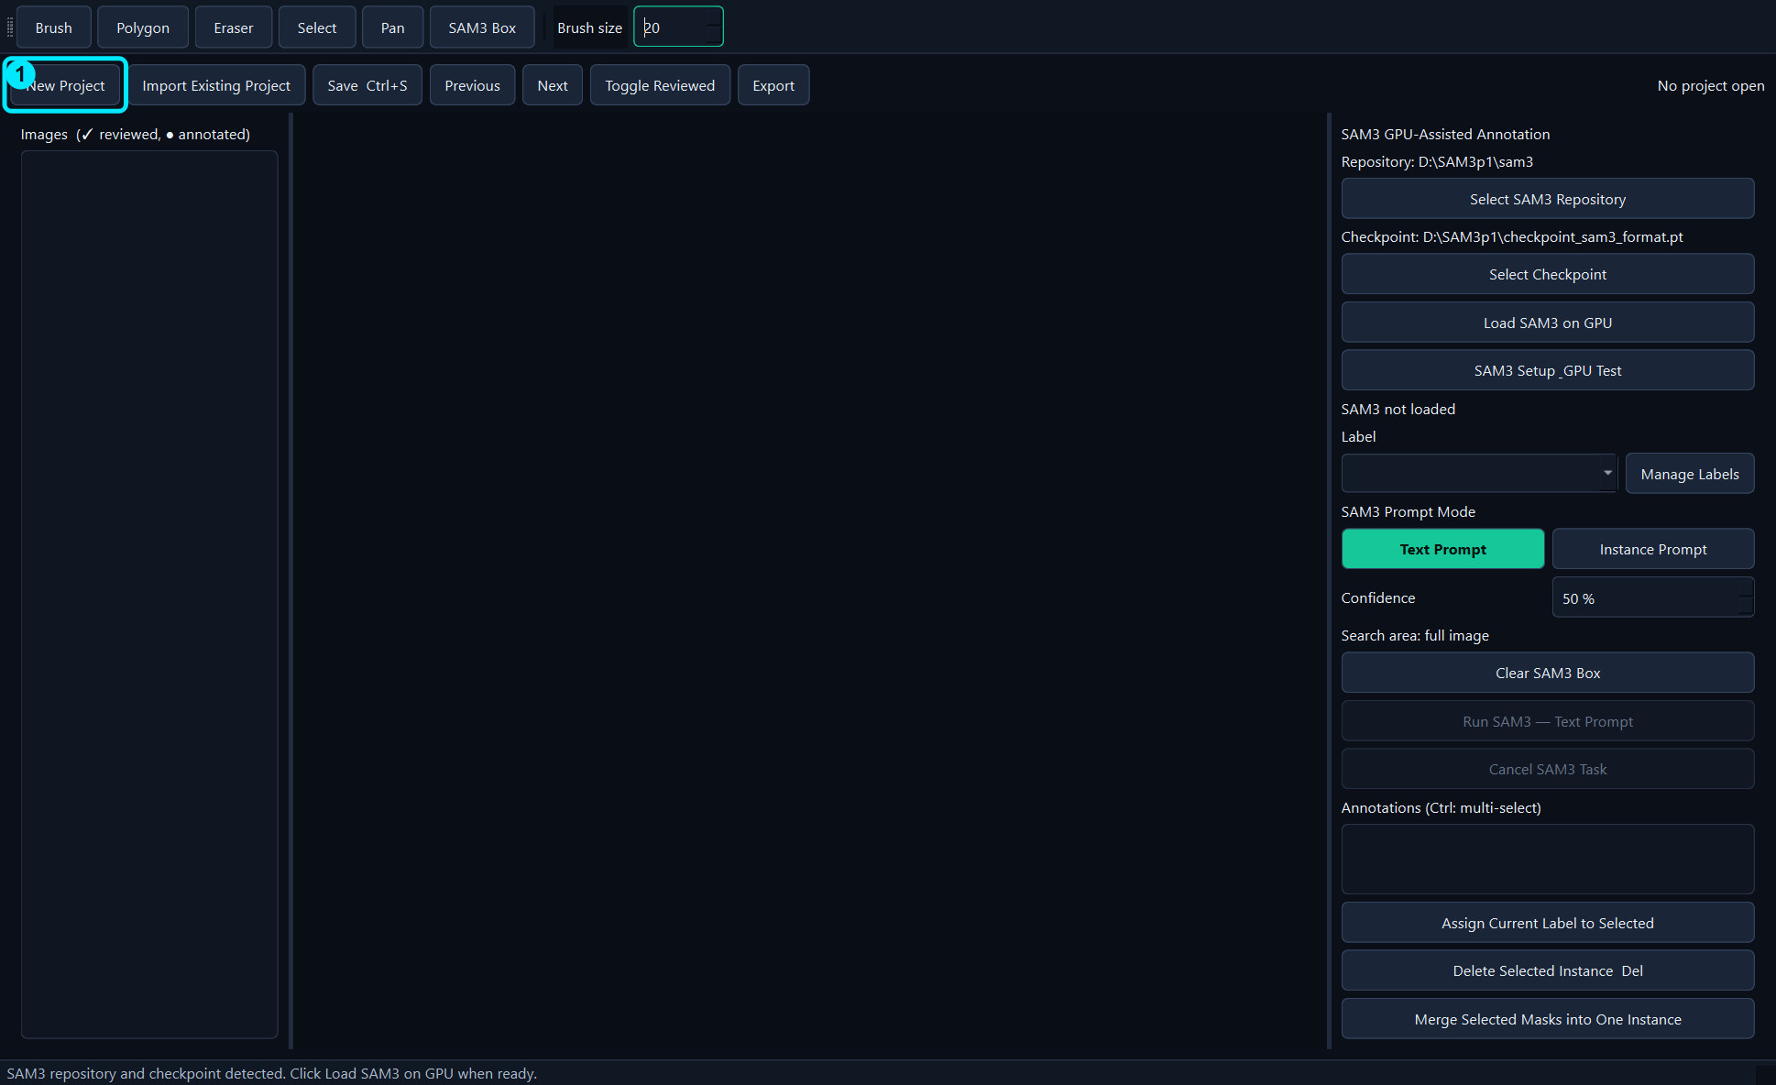
Create a New Project
• Click New Project for a folder or selected images.
• Fastest one-image method: drag the image into an empty GUI.
Project

Slide 8
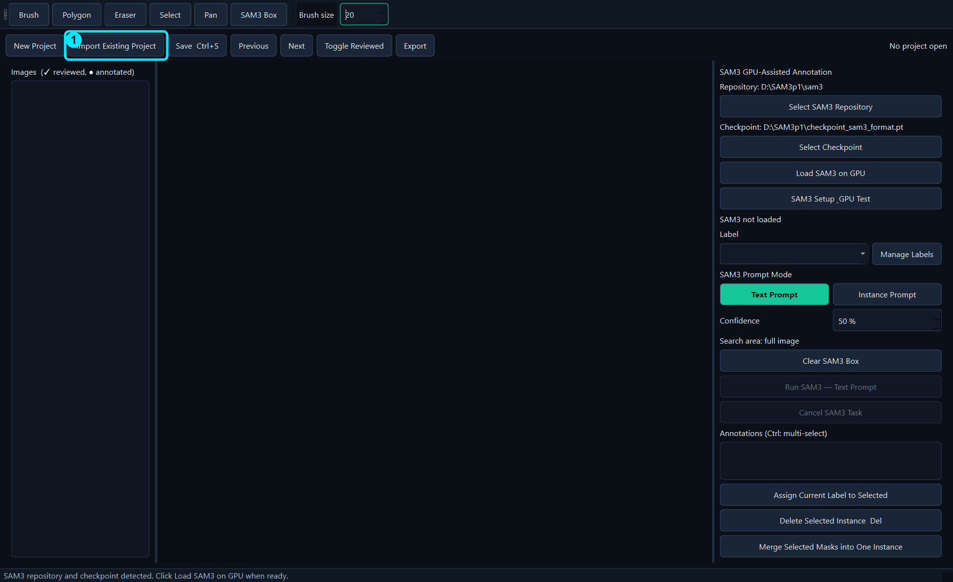
Import an Existing Project
• Click Import Existing Project.
• Select annotations.json.
• Verify restored images and masks.
Project

Slide 9
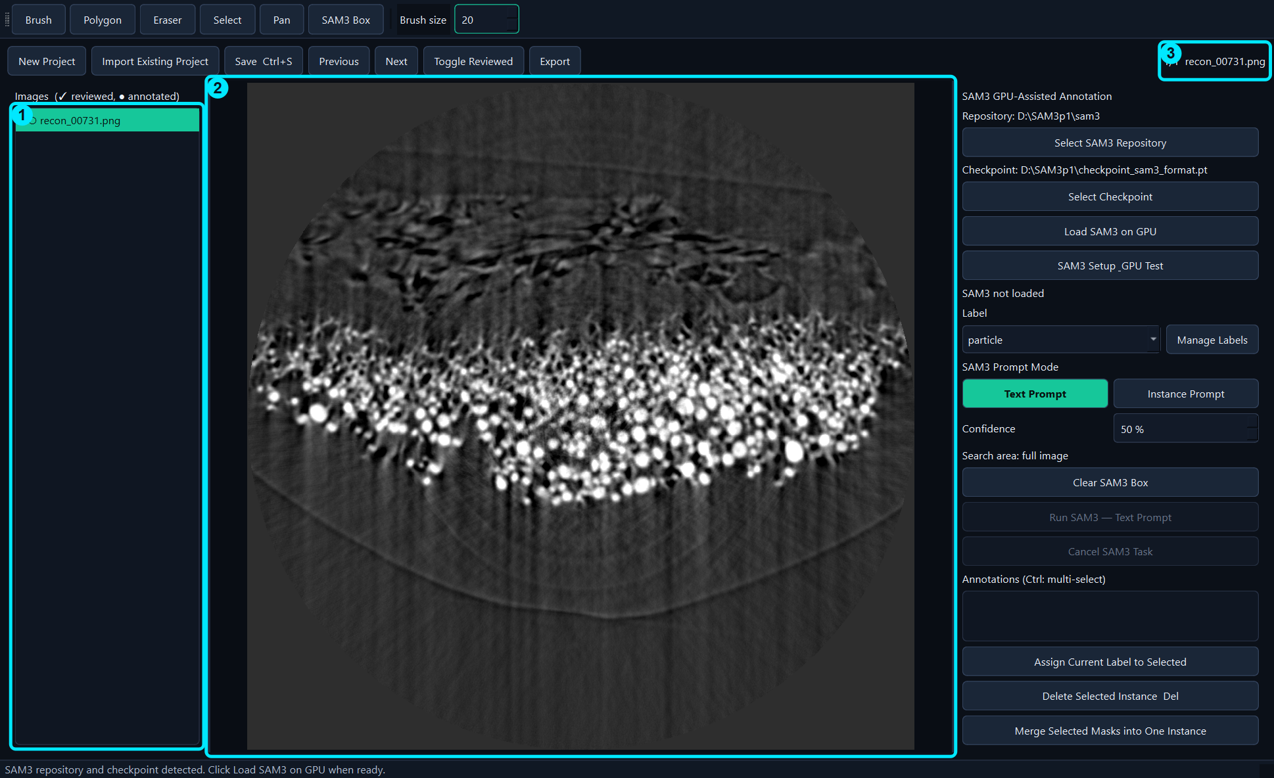
Load the Example Image
• This manual always uses recon_00731.png.
• Confirm the image appears in the list and canvas.
Project

Slide 10
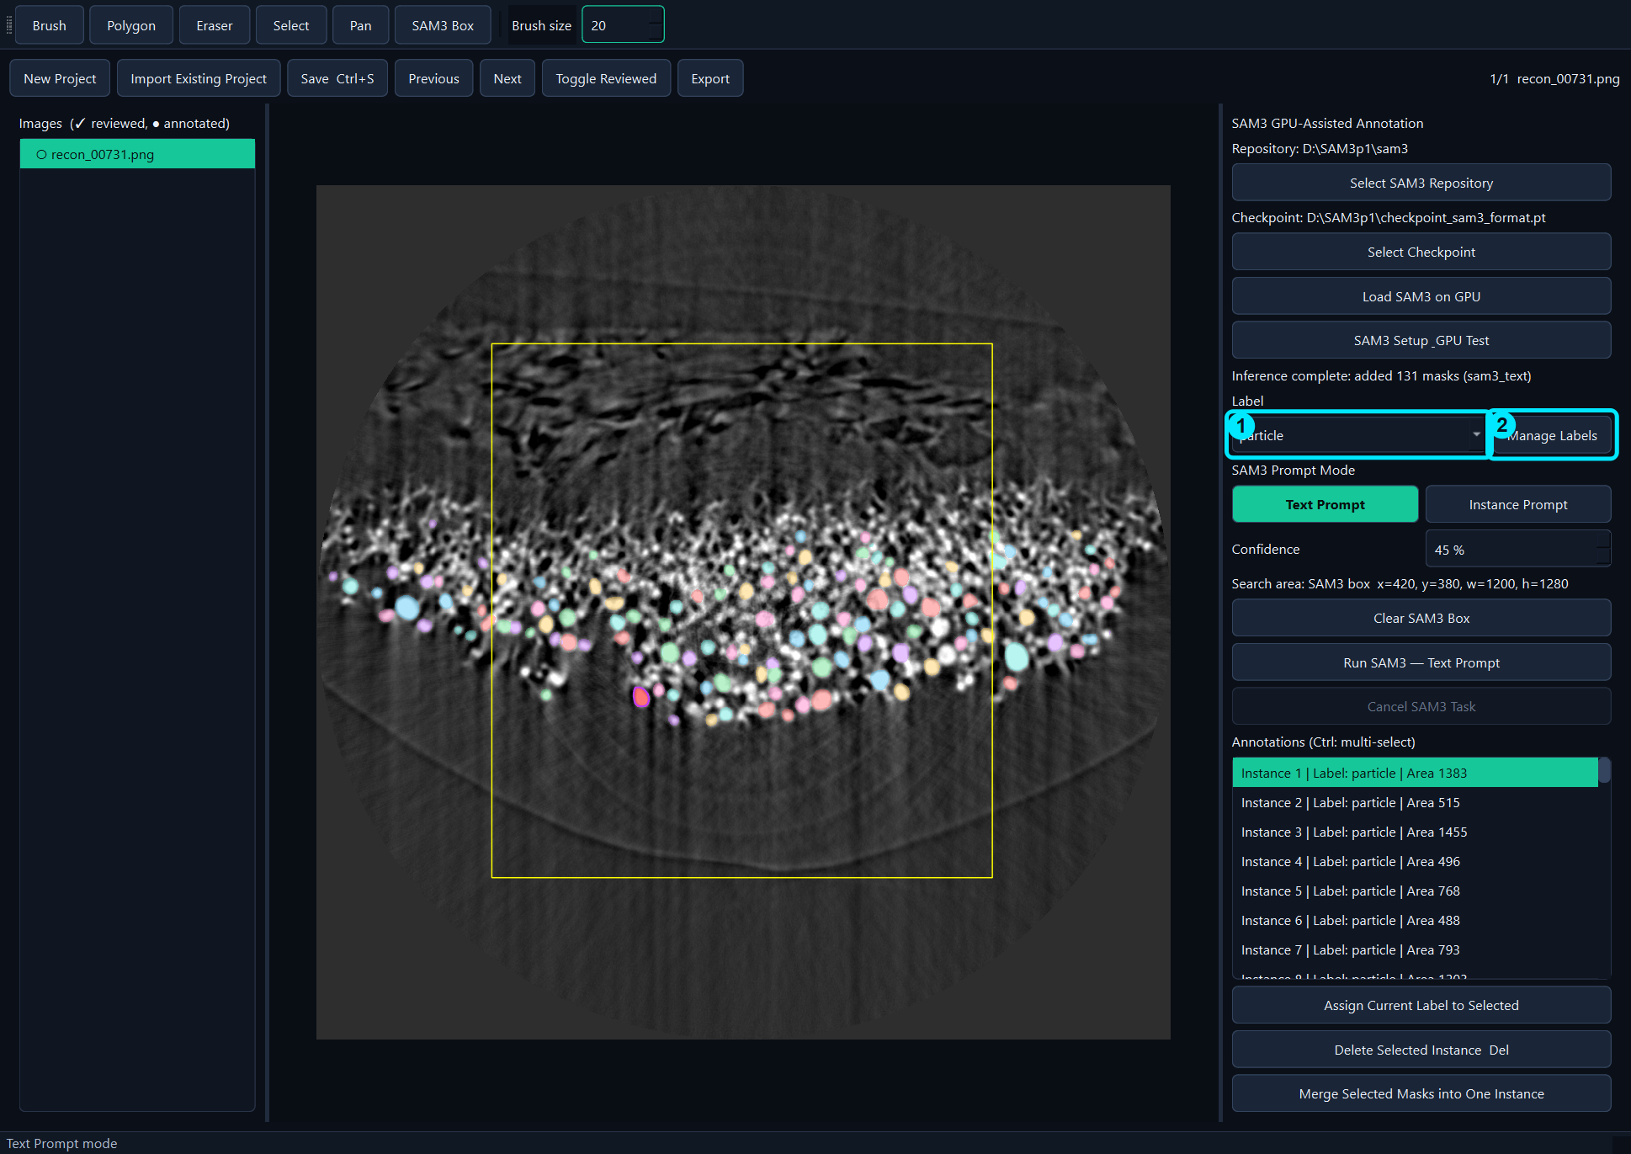
Select a Label
• Choose particle before drawing or inference.
• Manage Labels creates, renames, merges, or deletes classes.
Annotation

Slide 11
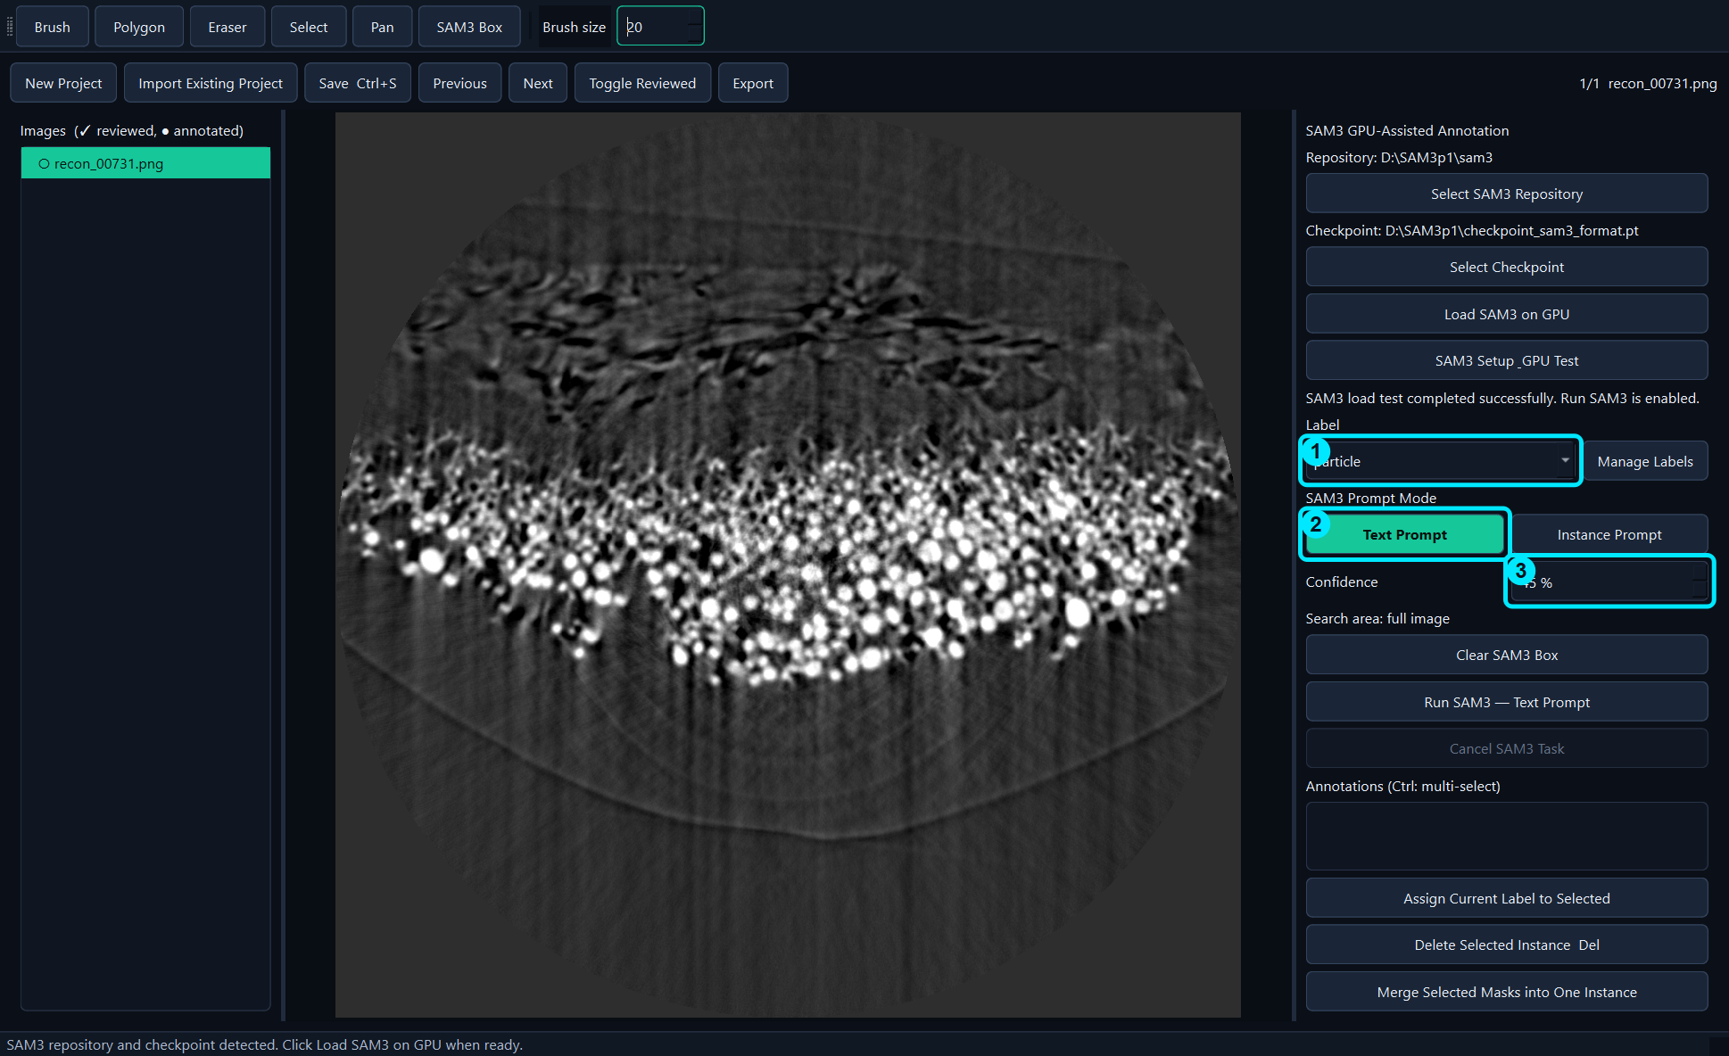
Configure Text Prompt
• Select Text Prompt.
• Use particle as the Label.
• Set Confidence to 45% for this example.
SAM3 inference

Slide 12
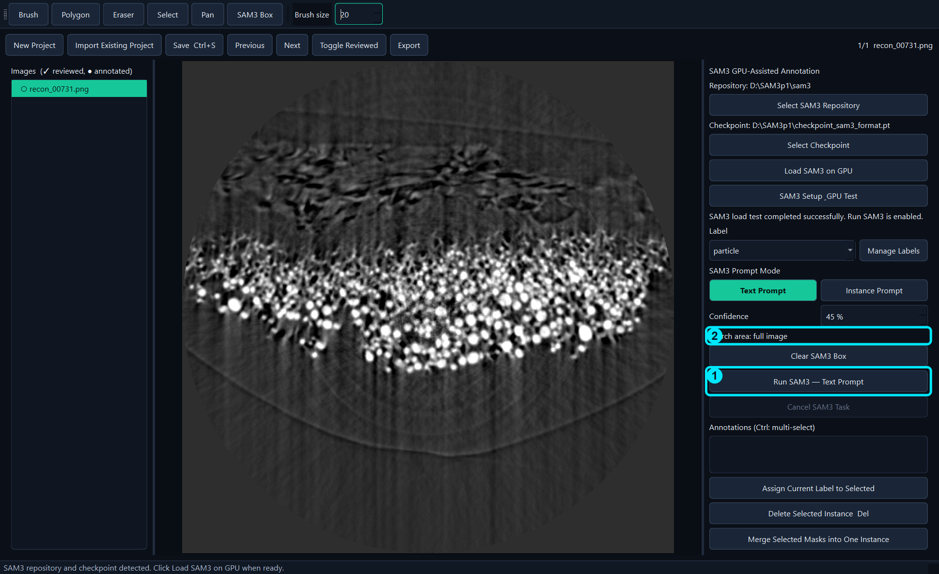
Run Text Prompt
• Use full image or an optional SAM3 Box.
• Click Run once and wait for completion.
SAM3 inference

Slide 13
Review SAM3 Results
• Actual example result: 131 masks.
• Check every prediction before review/export.
Review

Slide 14
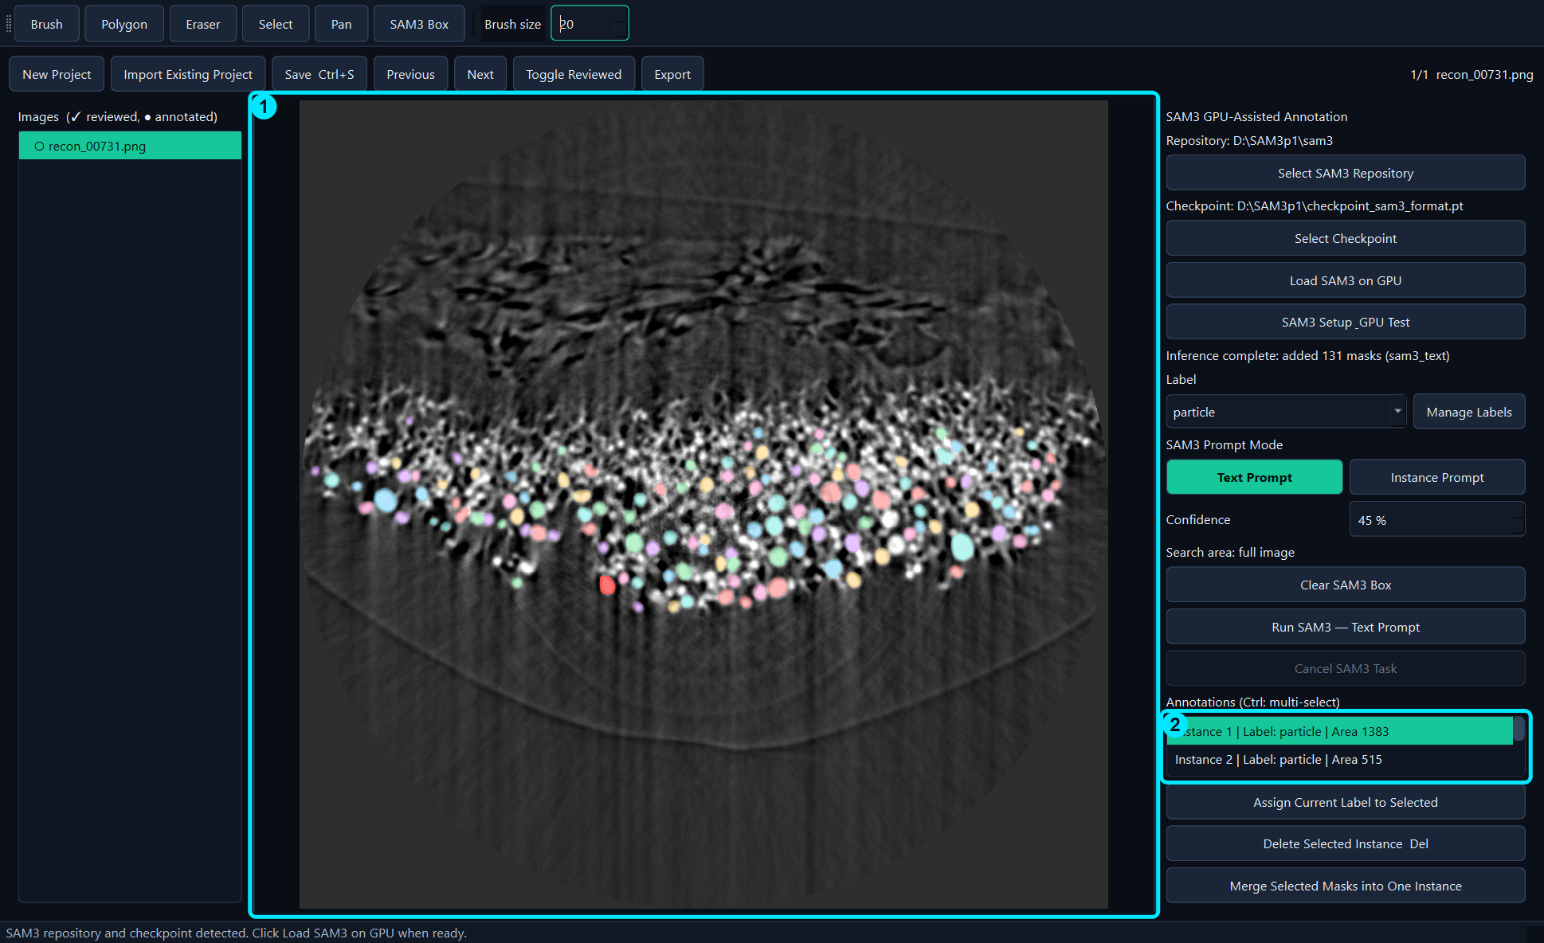
Select a Mask
• Click the colored mask or its list row.
• Canvas and annotation list stay synchronized.
Review

Slide 15

Correct with Brush
• Select a mask to add pixels.
• With no selection, Brush creates a new instance.
• Press Enter to finish.
Manual correction

Slide 16
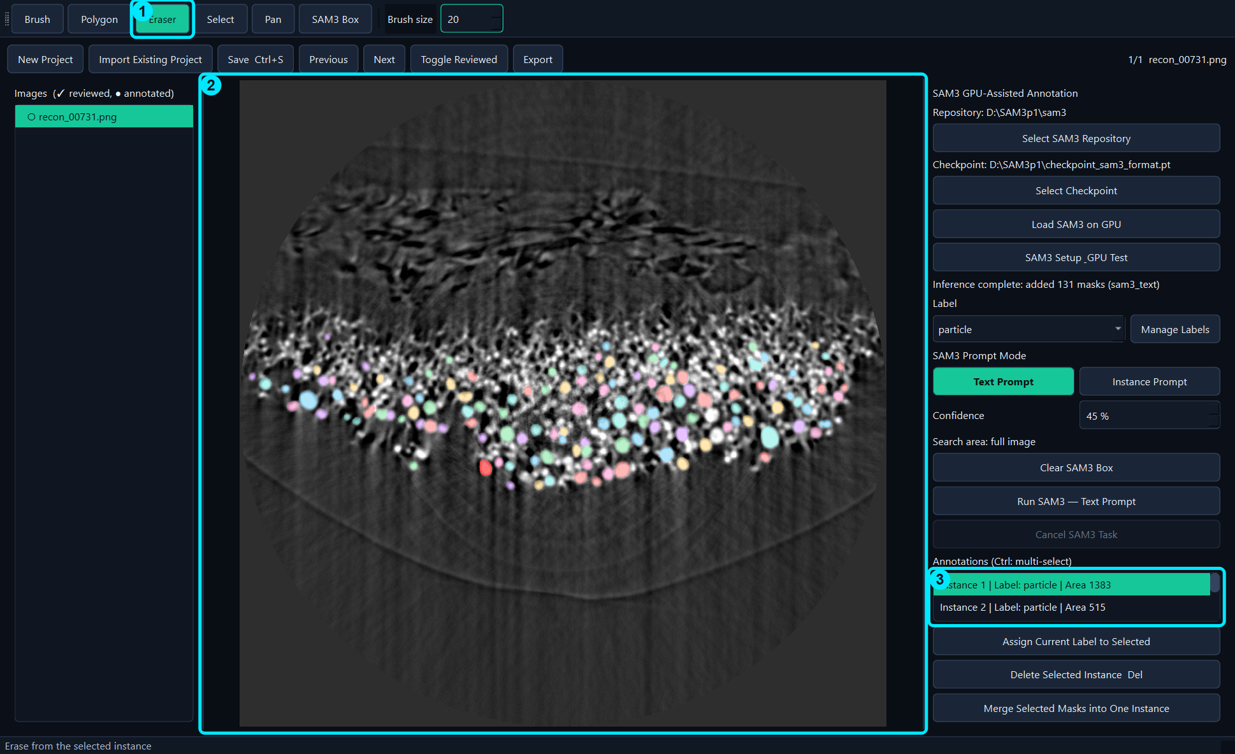
Correct with Eraser
• Select the target mask first.
• Erase unwanted pixels.
• Press Enter to finish.
Manual correction

Slide 17
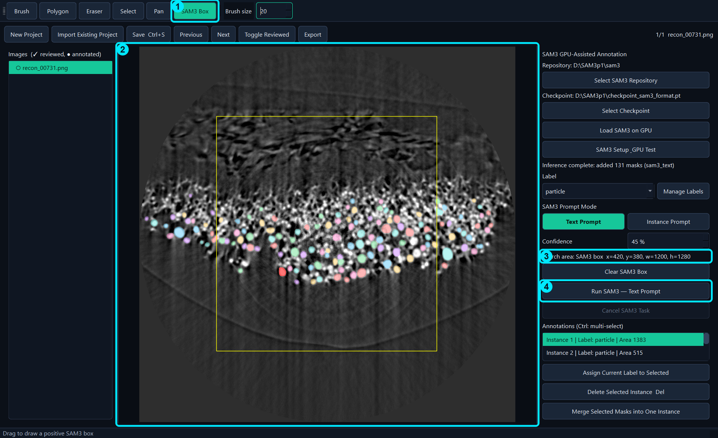
Restrict Search with SAM3 Box
• Drag a box around the target region.
• Check Search area.
• Clear the box to return to full-image search.
SAM3 inference

Slide 18
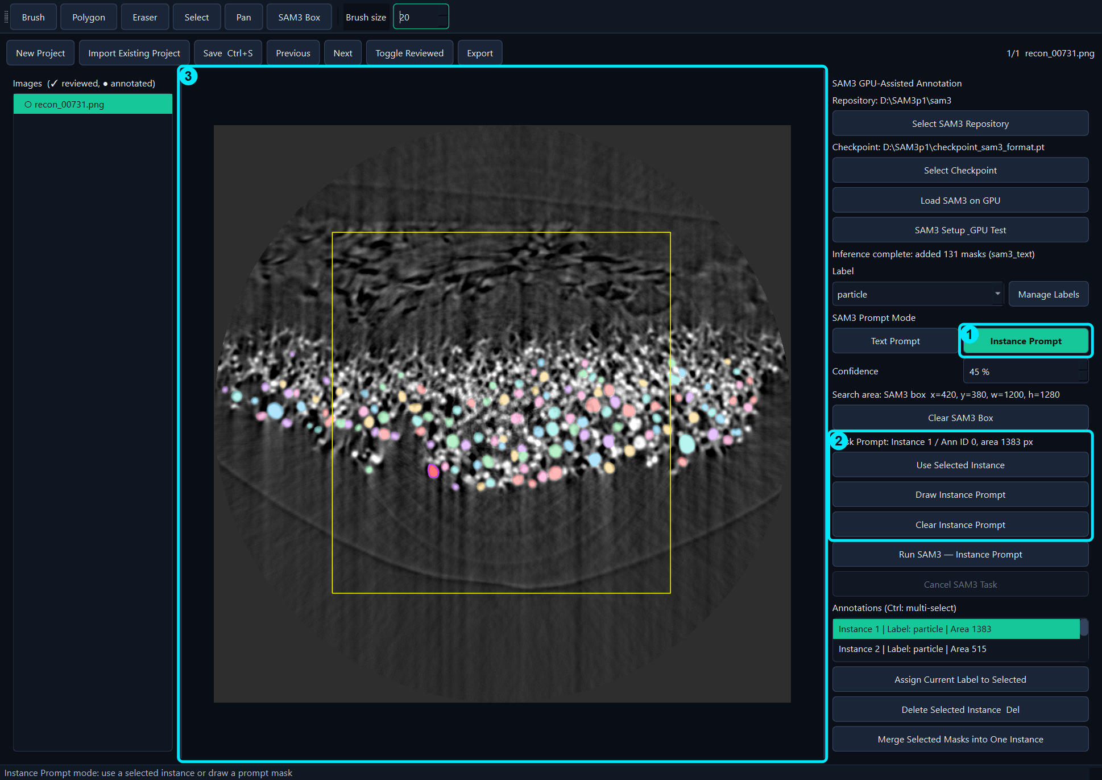
Use Instance Prompt
• Select a high-quality example instance.
• Use Selected Instance or draw a prompt mask.
• Run Instance Prompt and review results.
SAM3 inference

Slide 19
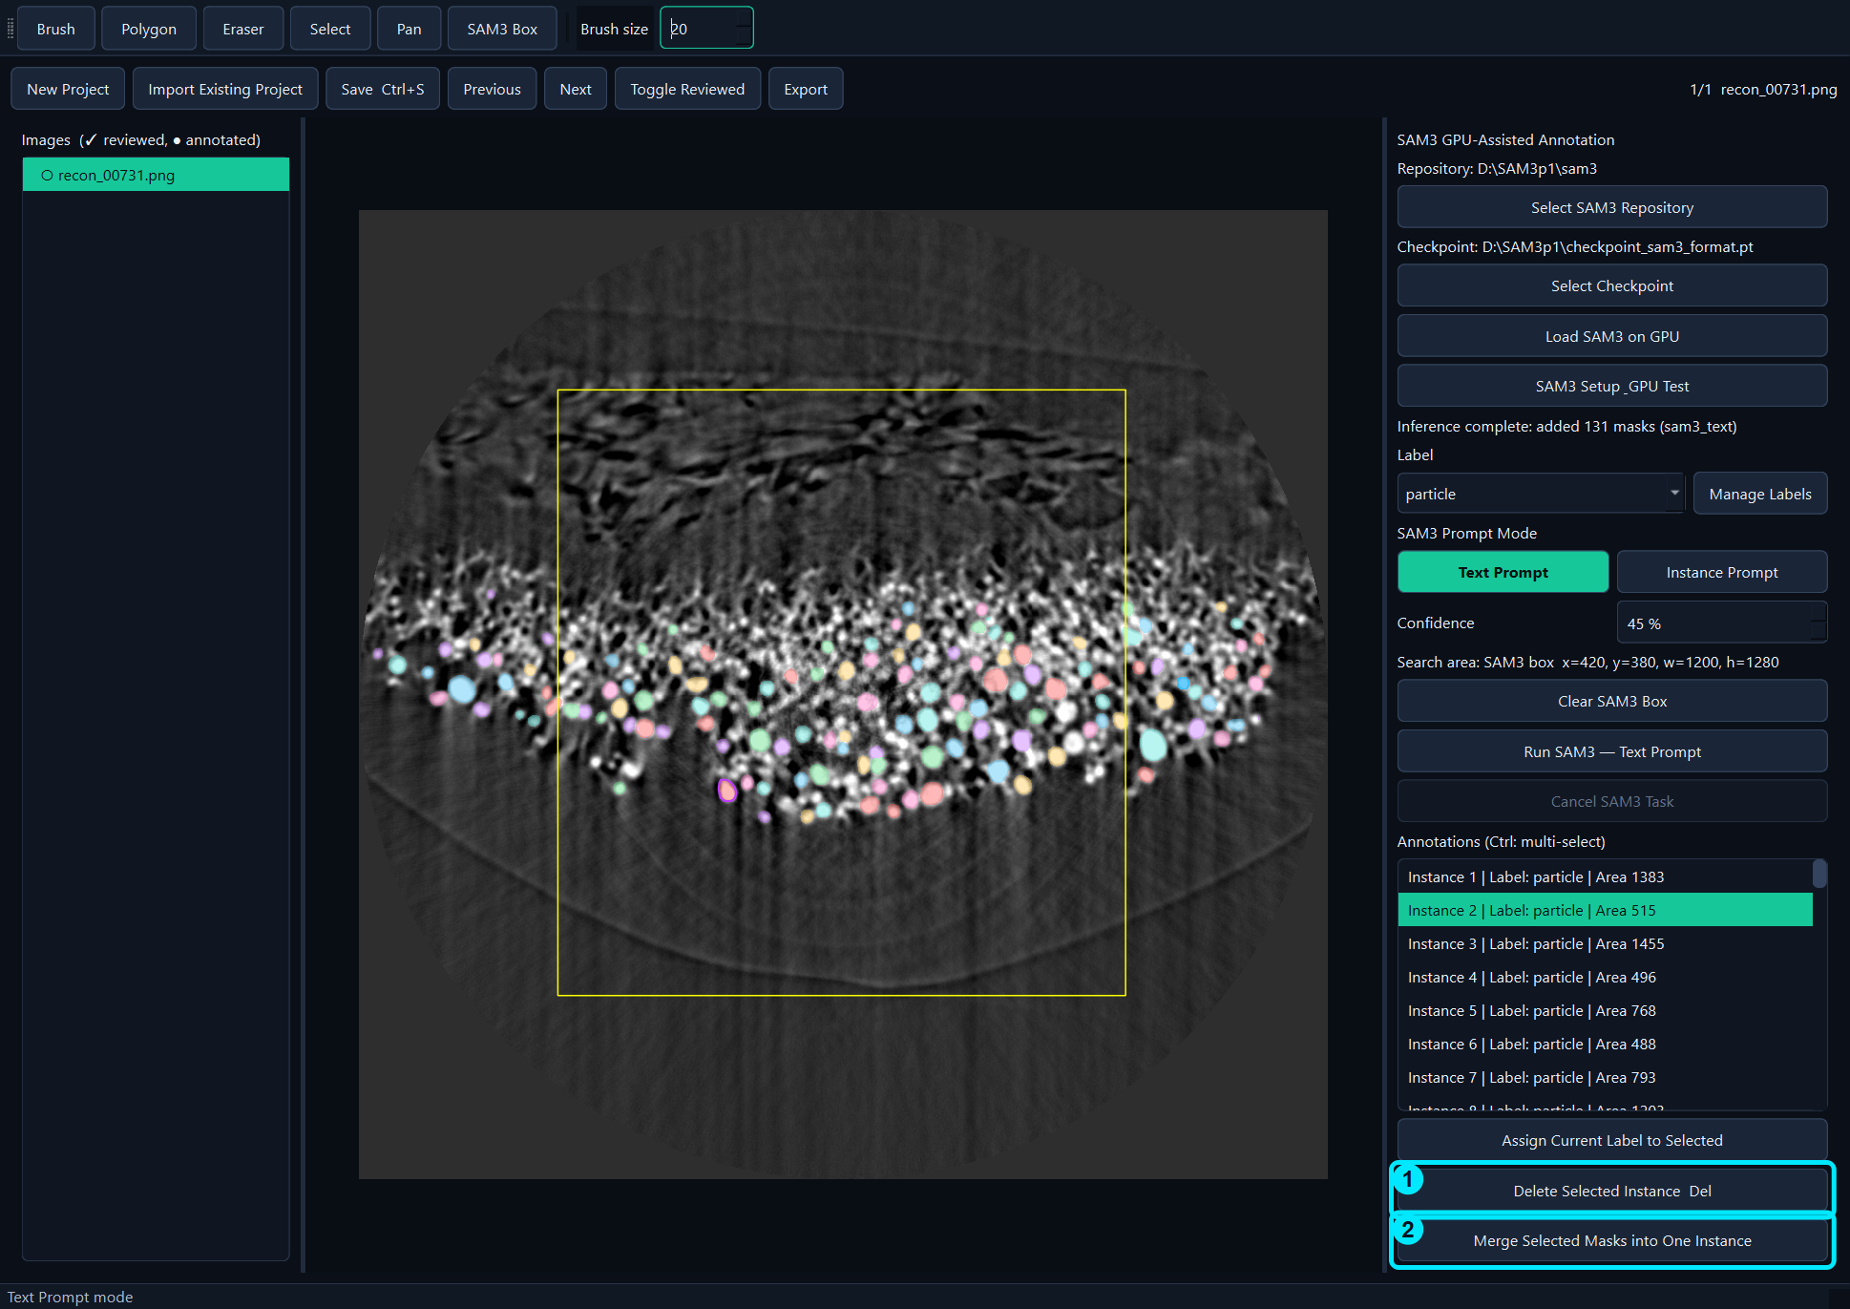
Delete, Merge, or Relabel
• Ctrl-click for multi-selection.
• Delete incorrect masks.
• Merge fragments that belong to one object.
Review

Slide 20
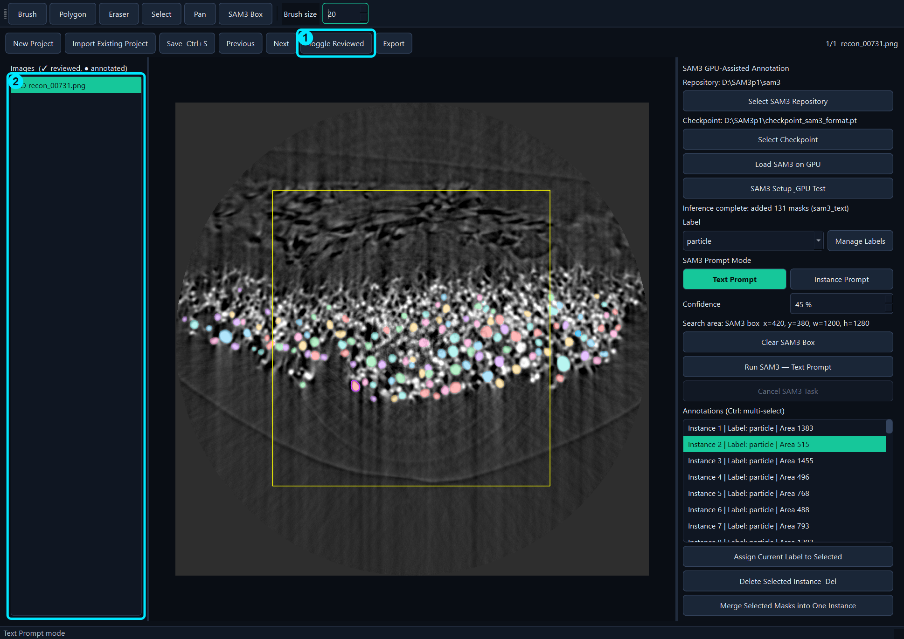
Mark the Image Reviewed
• Review is a user quality-control status.
• Mark only after inspecting all instances.
Review

Slide 21
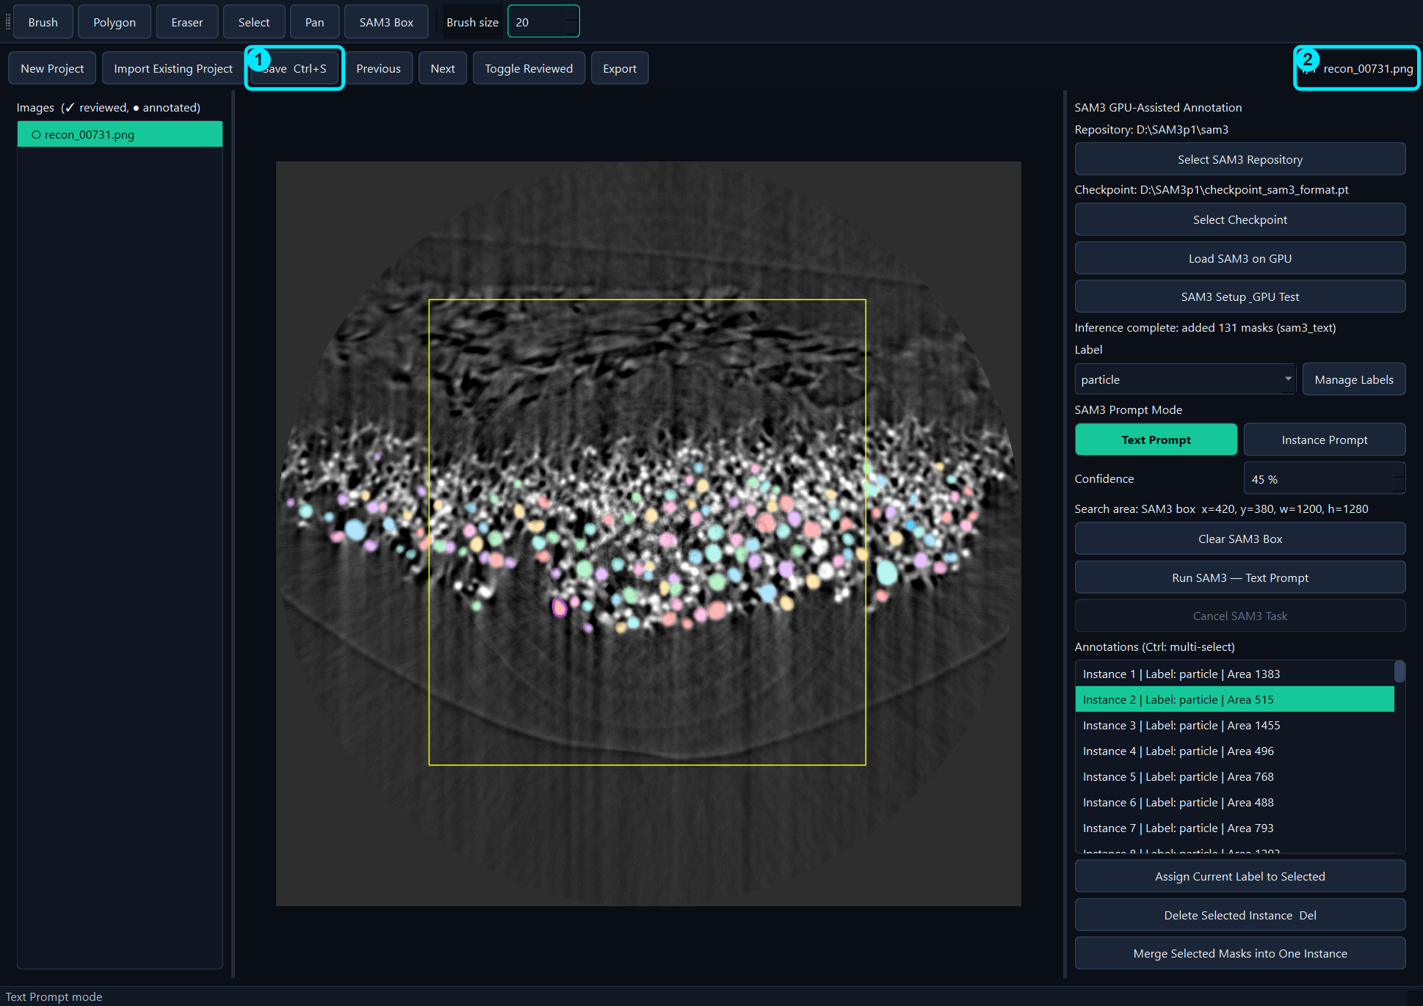
Save the Project
• Save updates the working annotations.json.
• Use Ctrl+S frequently.
• Save is different from Export.
Save

Slide 22
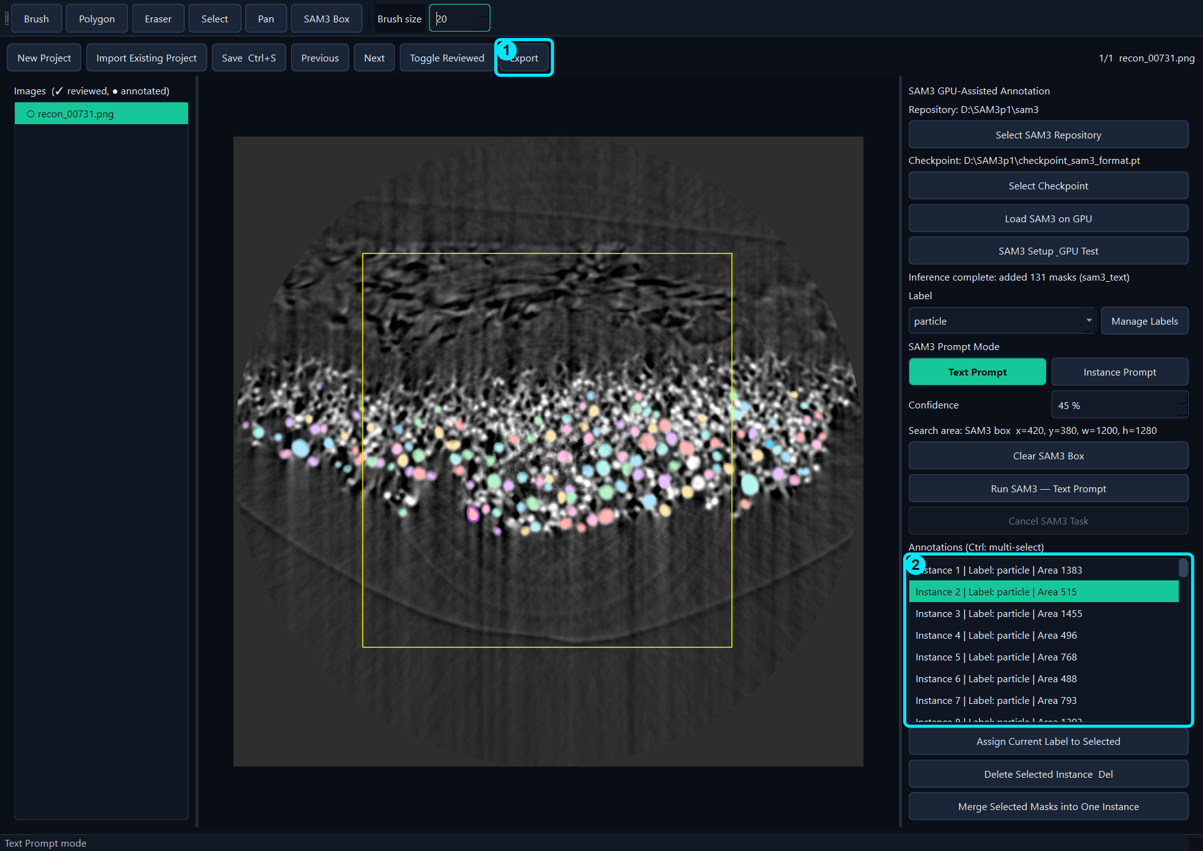
Export the Dataset
• Choose an output folder.
• Monitor progress or cancel safely.
• Do not use incomplete exports for training.
Export

Slide 23
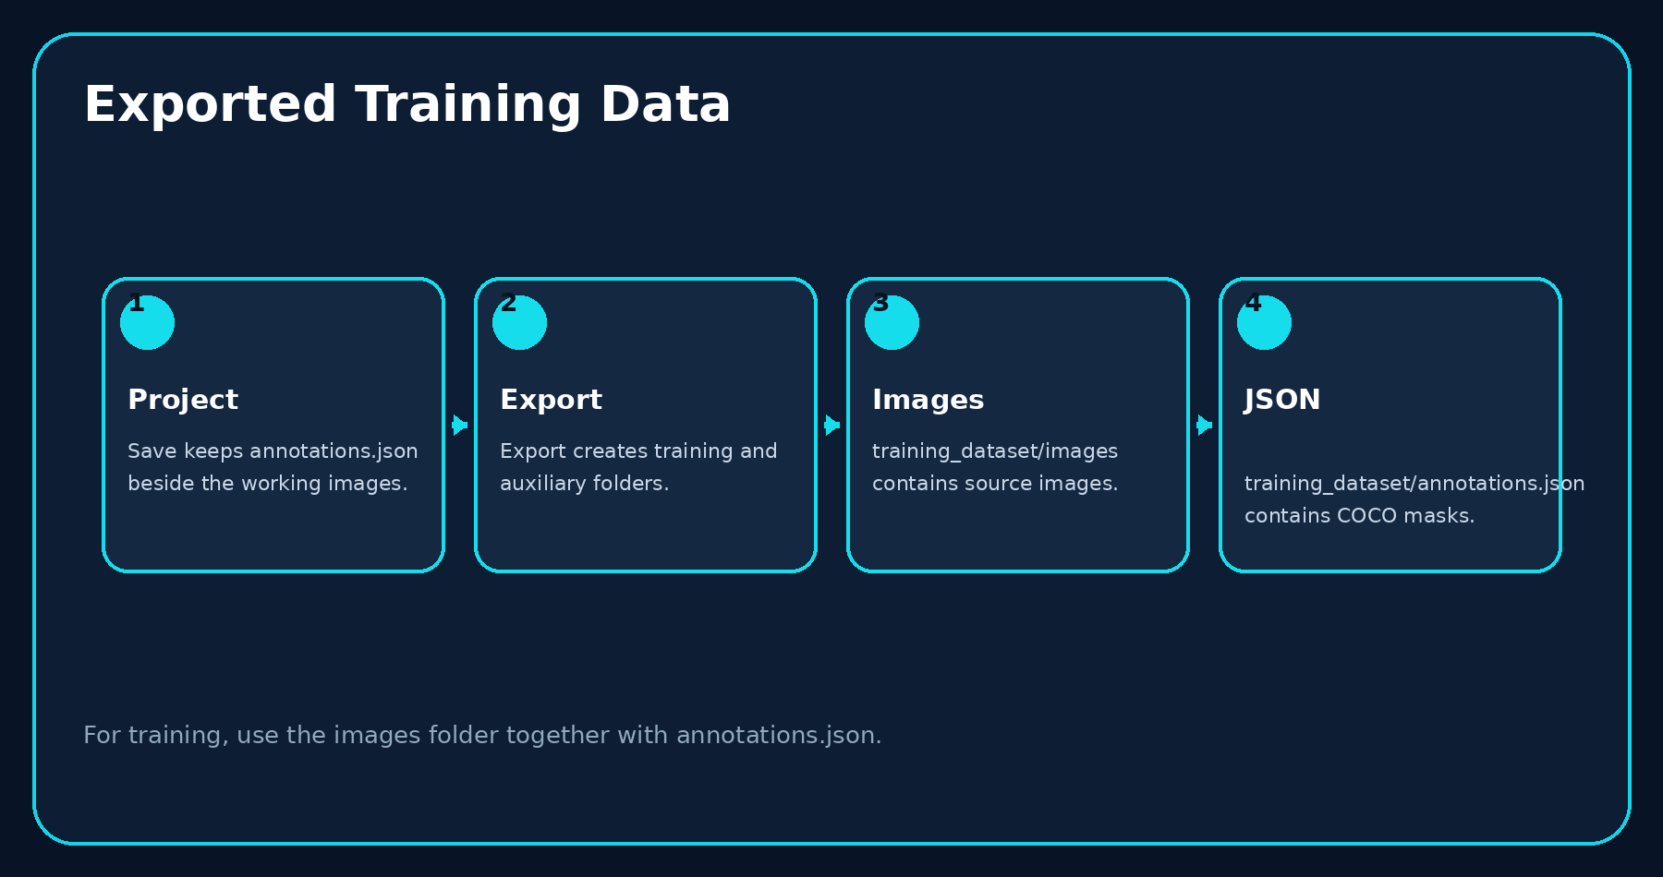
Training Files
• Use training_dataset/images.
• Use training_dataset/annotations.json.
• Auxiliary outputs are for QA, not required for training.
Export

Slide 24
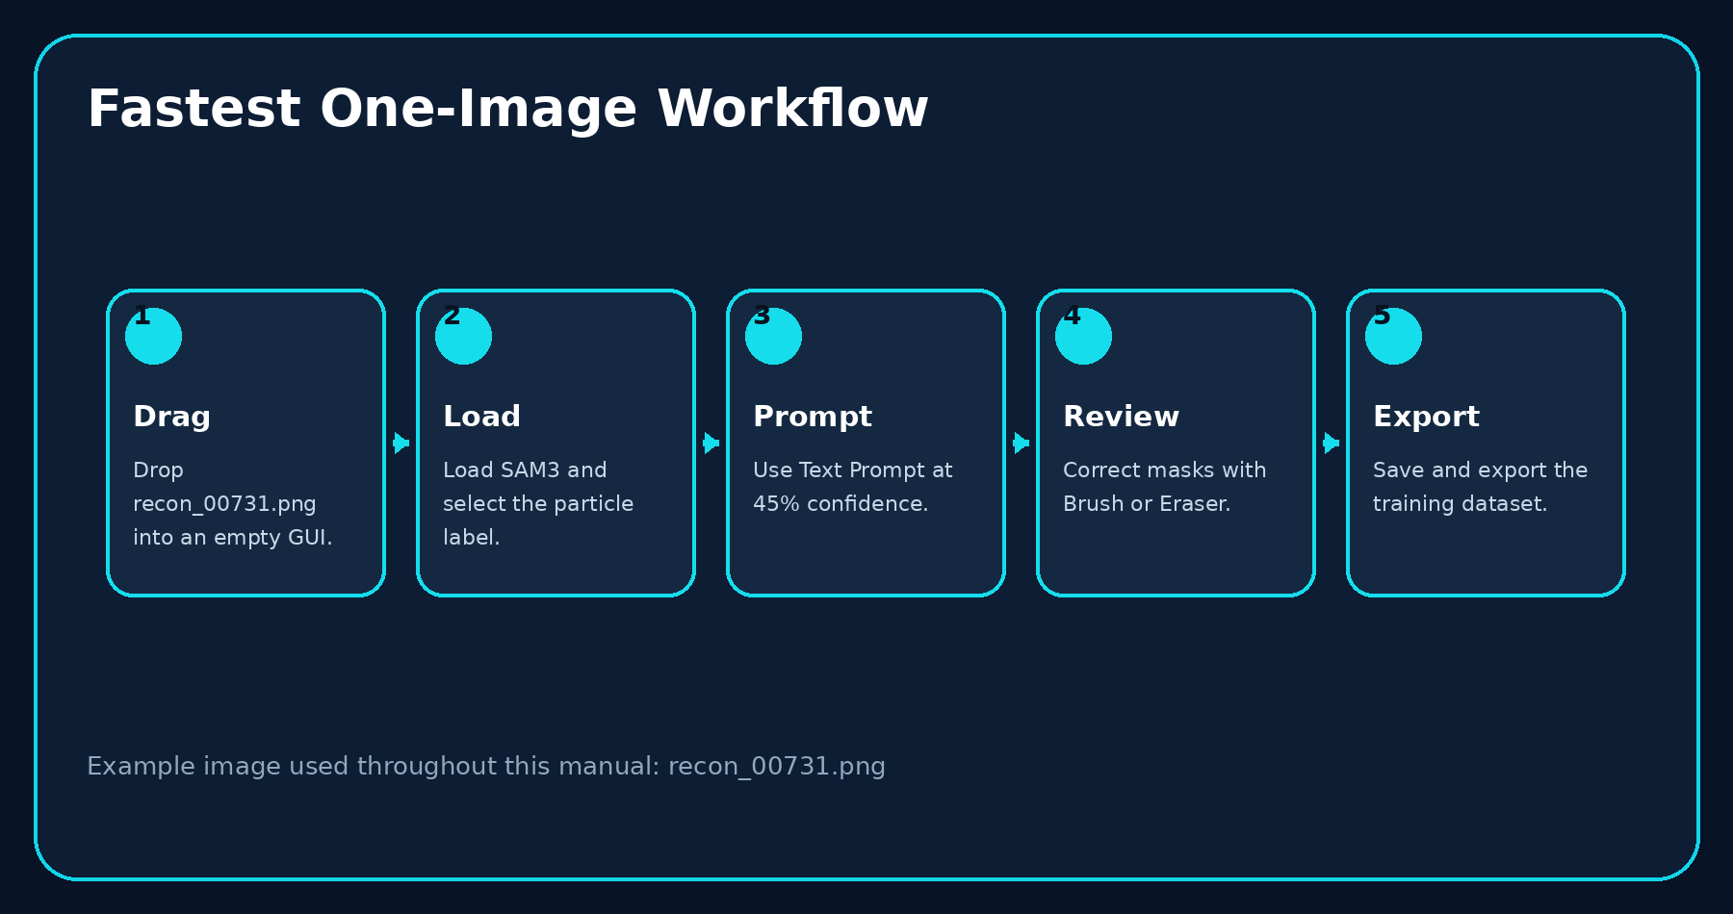
Fastest One-Image Workflow
• Drag → Load → Prompt → Review → Export
• This is the recommended minimum-click procedure.
One-image example

Slide 25
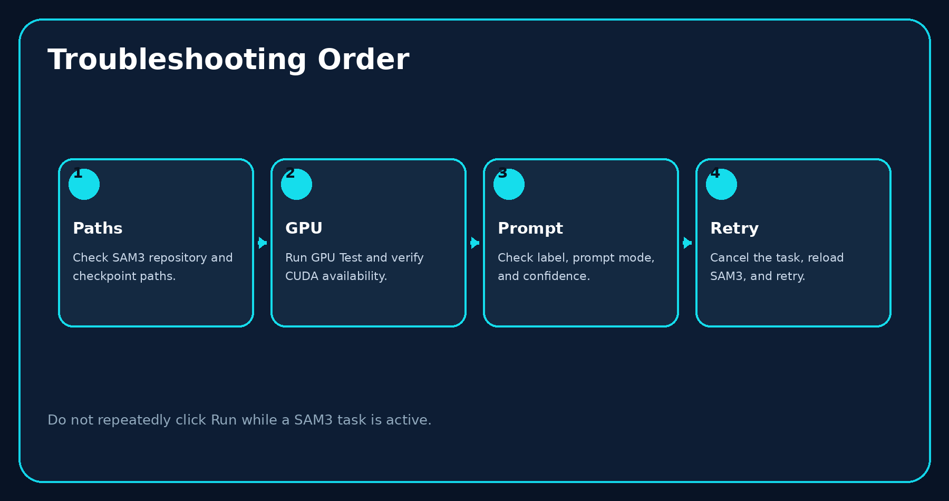
Troubleshooting
• Check paths first.
• Run GPU Test.
• Check prompt mode, label, confidence, and SAM3 Box.
• Cancel and retry only after the process stops.
Support

Slide 26
Finish
• Save the working project.
• Export and verify training files.
• Back up both project and training dataset.
BL62 Label GUI

