Slide 1

Employment Outcome Analysis

Slide 2
About me
MSc Statistics from Andhra University
It sticks to my core.
Content developer (Statistics) and recently started Data research work which helps to find datasets for our website.

Slide 3
Objective
We aim to understand and analyze salary trends among Engineering graduates across various specializations, levels of experience, and roles.

Slide 4
Summary of the Data
The dataset was released by Aspiring Minds from the Aspiring Mind Employment Outcome 2015 (AMEO).
This dataset mainly consists of the standardized test scores from three different areas – cognitive skills, technical skills, and personality skills.
The Dataset comprises 40 independent variables and 4000 data points.
Float columns: 10
Int columns: 18
Object columns: 12 This column includes Date columns too

Slide 5
FEATURES
ID
Salary
DOJ
DOL
Designation
JobCity
Gender
DOB
10percentage
10board
12graduation
12percentage
12board
CollegeID
CollegeTier
Degree
Specialization
collegeGPA
CollegeCityID
CollegeCityTier
CollegeState
GraduationYear
English
Logical
Quant
Domain
ComputerProgramming
ElectronicsAndSemicon
ComputerScience
MechanicalEngg
ElectricalEngg
TelecomEngg
CivilEngg
conscientiousness
agreeableness
extraversion
nueroticism
openess_to_experience

Slide 6
Data Cleaning And Manipulation
There are no Duplicates and Nan values in this dataset.
Observed “-1” in categorical and numerical column irrespective of the other data points in the column. Action: Assuming the employee is absent or not attempted this test… replaced with “nan” for categorical column and with “0” in numerical columns.
Replaced “present” term in “DOL” column with datetime.now().
Type Casted few columns to their corresponding data types.

Slide 7
Feature Engineering
Transformed the target feature “Salary” from right skewed to normal using log transformation.
Dropped unwanted features according to
Added new columns:
Age
Experience
Experience Level as Seniority
Region

Slide 8
Univariate Analysis

Slide 9
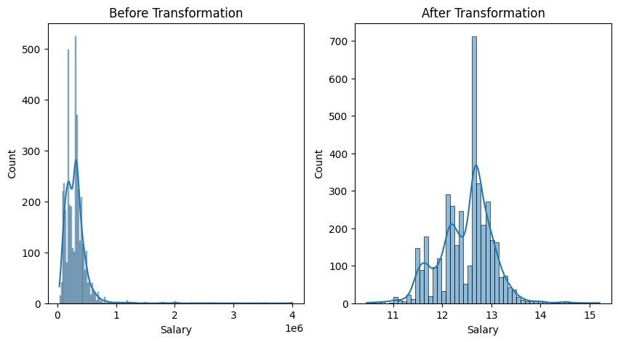
Salary Analysis
Target Feature:
The data concentration is heavy on left side of the graph indicating more employees earn below 10,00,000 rupees.
Since it’s clearly left skewed data… To achieve Normal Distribution use log transformation.
After transformation, the kde or density plot on histogram is a near Normal curve.

Slide 10
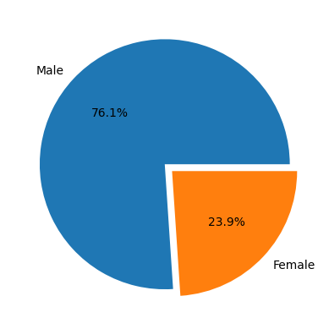
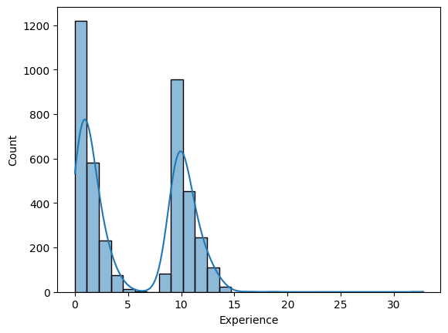
Grouped data Observations
Gender:
Near three-fourths of our data are Male, indicating male dominant data in Engineering branches
Experience:
There are two peaks followed by a gradual low. This shows hiring was more for the fresher and before 10 years

Slide 11
Bivariate Analysis

Slide 12
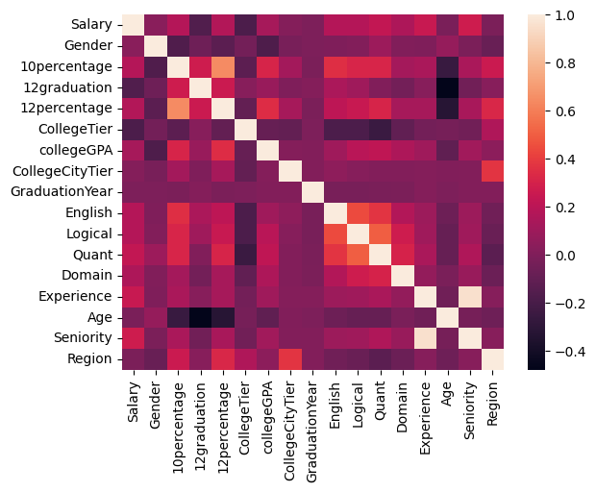
Correlation
The range of correlation is -0.4 to 1
Indicating no strong negative correlation
No strong positive correlation though unless related columns.

Slide 13
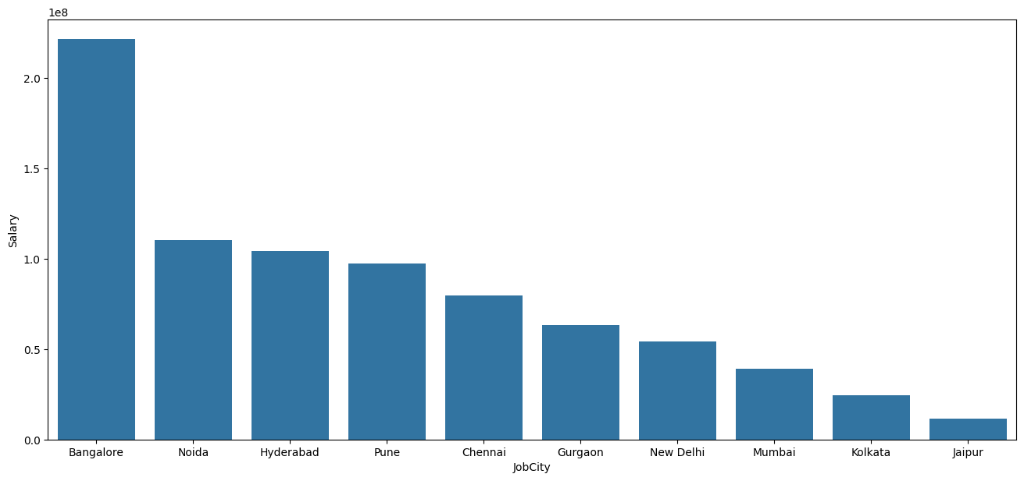
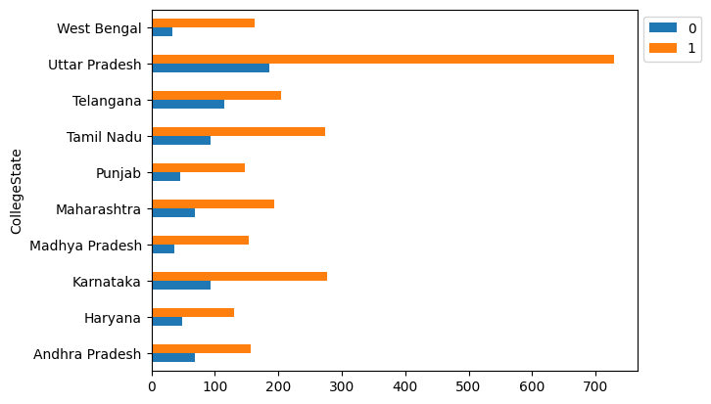
Regional Analysis
College State Vs Gender:
Uttar Pradesh has the highest frequency of both genders, as well as each gender individually.
JobCity Vs Salary:
The three highest-earning cities, located in South India, collectively accumulate a total salary sum exceeding 37,50,00,000 rupees.

Slide 14
Multivariate Analysis

Slide 15
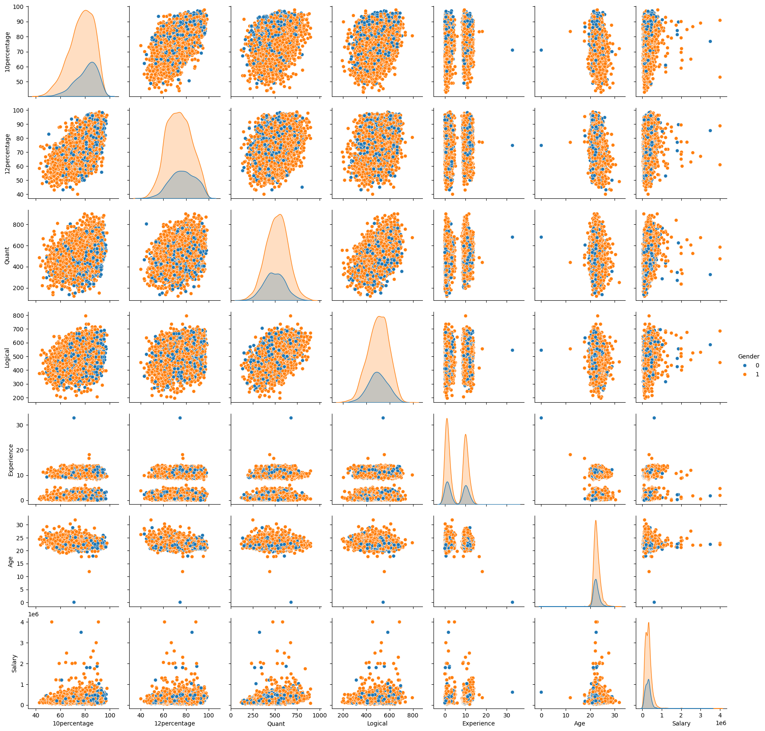
Pair Plot with Gender
Age: Observed between 20 to 30 years.
Females consistently exhibit higher percentages in both 10th and 12th grades, even after accounting for their representation of 25% in the dataset.
The same trend persists across other exams, such as Quantitative and Logical.

Slide 16
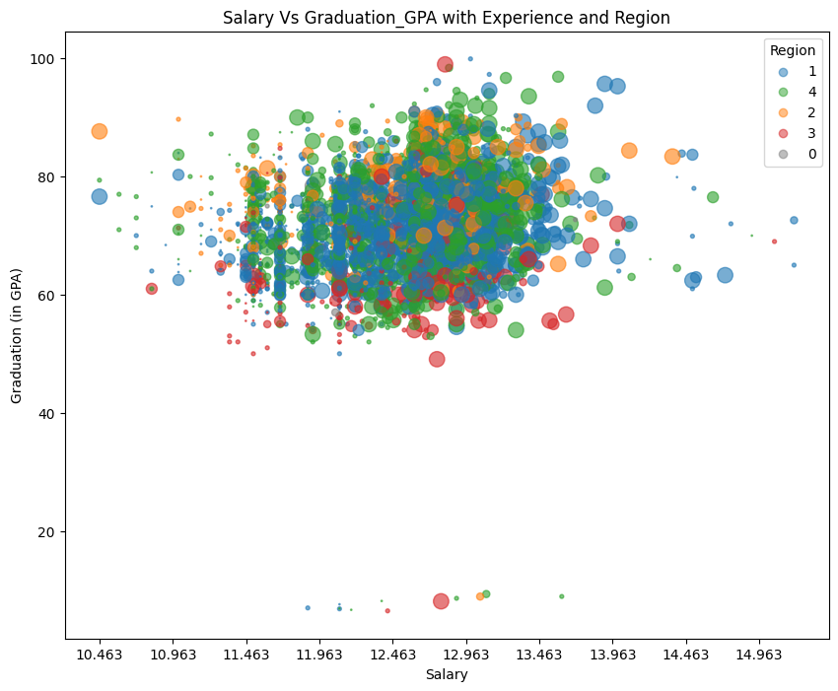
Current Market Price Vs EPS Percentage
Key Observations:
The North Region shows the highest salaries, particularly among mid-seniority individuals.
Notably, there are instances in the top left quadrant where both fresher and mid-seniority levels earn equivalent salaries.
Conversely, the West Region exhibits notably lower GPAs compared to other regions.
1: North
2: South
3: East
4: West
5: Union Territories

Slide 17
Research Hypothesis

Slide 18
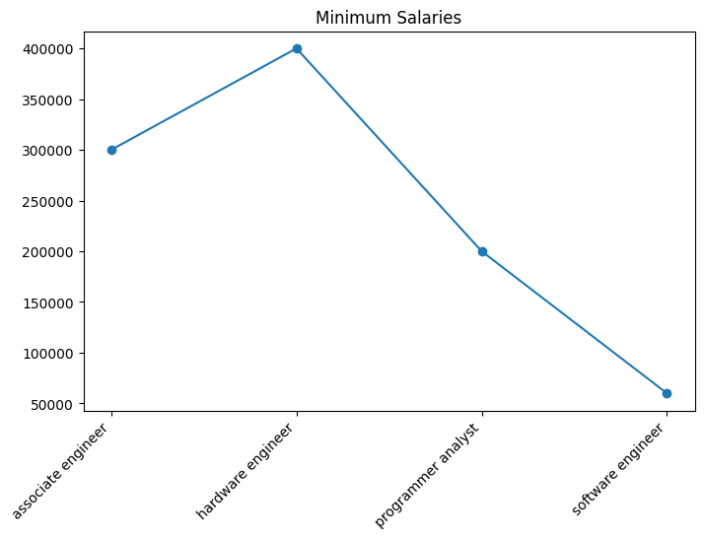
Claim1: After doing your UG if you take up jobs as a Programming Analyst, Software Engineer, Hardware Engineer and Associate Engineer you can earn up to 2.5-3 lakhs as a fresh graduate.
Except a Programmer Analyst no fresher is earning a least salary of 2.5 lakhs.
index | Designation | t_score | p_value | Critical Value | test_result
0 | programmer analyst | 5.696 | 0.0 | 2.5 | Reject Null Hypothesis (H0)
1 | software engineer | 1.657 | 0.05 | 2.365 | Fail to Reject Null Hypothesis (H0)
2 | hardware engineer | NaN | NaN | NaN | Fail to Reject Null Hypothesis (H0)
3 | associate engineer | NaN | NaN | NaN | Fail to Reject Null Hypothesis (H0)

Slide 19
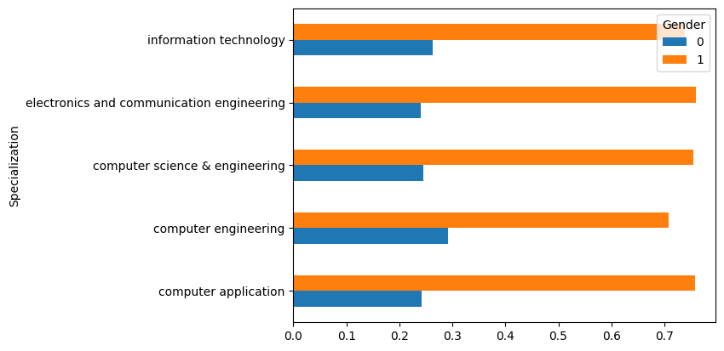
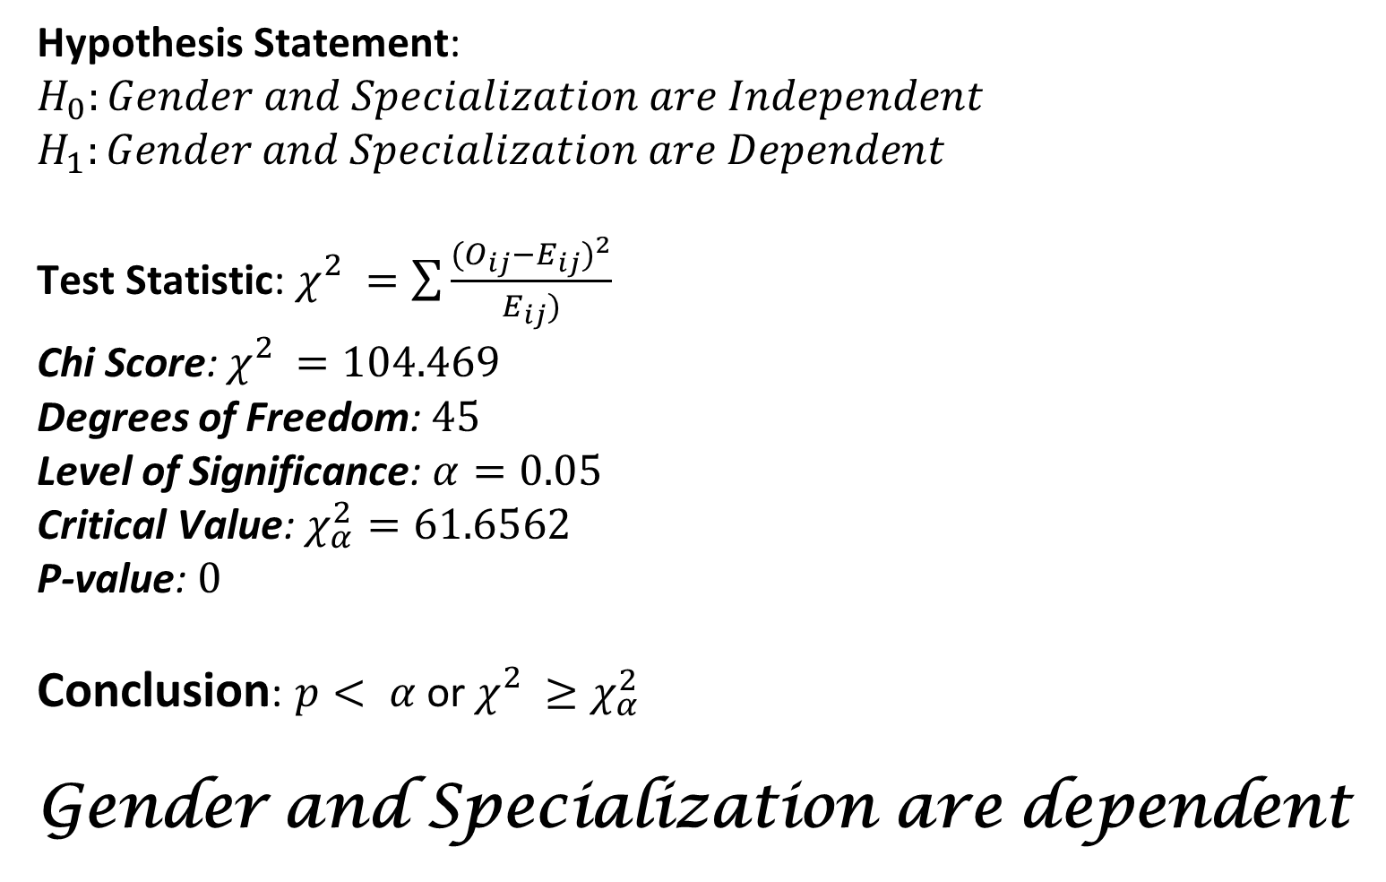
Claim2: Gender and Specialization are Dependent
Hypothesis Statement:
$$H_{0}:Gender and Specialization are Independent$$
$$H_{1}:Gender and Specialization are Dependent$$
Test Statistic: $χ_{}^{2}=\sum{\frac{{(O_{ij}−E_{ij})}^{2}}{E_{ij})}}$
Chi Score: $χ_{}^{2}=104.469$
Degrees of Freedom: $45$
Level of Significance: $α=0.05$
Critical Value: $χ_{α}^{2}=61.6562$
P-value: $0$
Conclusion: $p< α$ or$χ_{}^{2}≥χ_{α}^{2}$
Gender and Specialization are dependent

Slide 20
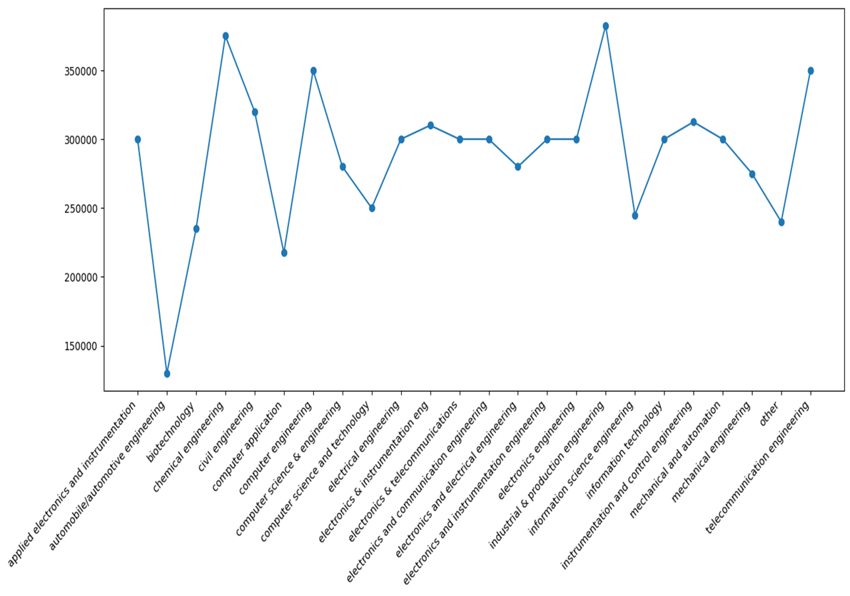

Claim3: A CSE graduate earns more than a ECE graduate
$μ_{1}$ is mean salary of a CSE graduate,
$μ_{2}$ is mean salary of an ECE graduate.
Hypothesis Statement:
$$H_{0}:μ_{1}=μ_{2}$$
$$H_{1}:μ_{1}>μ_{2}$$
Test Statistic: $t−test statistic$ for independent
samples with unknown and unequal variances.
t score: $t_{\frac{α}{2}}^{}=−2.256$
Level of Significance: $α=0.05$
P-value: $0.988$
Conclusion: Since, $p< α$
There is no significant evidence that CSE graduates earn more than ECE students.

Slide 21
Conclusion
Though the female population constitutes a lesser proportion, their tenth and twelfth-grade scores are considerably high.
It's evident that only two age groups exhibit a significantly higher frequency of similar experiences.
The median salary of Industrial and Production engineering has the highest Median Salary.
Gender and Specialization are related.
A programming analyst can earn up to 2.5 lakhs after graduation.
Salary is not directly proportional to one’s Experience.
There is no significant evidence that CSE graduates earn more than ECE students.

Slide 22

THANK YOU

