Slide 1
Magist Not A Strategic Fit for Eniac’s Brazilian Market Entry.

Slide 2
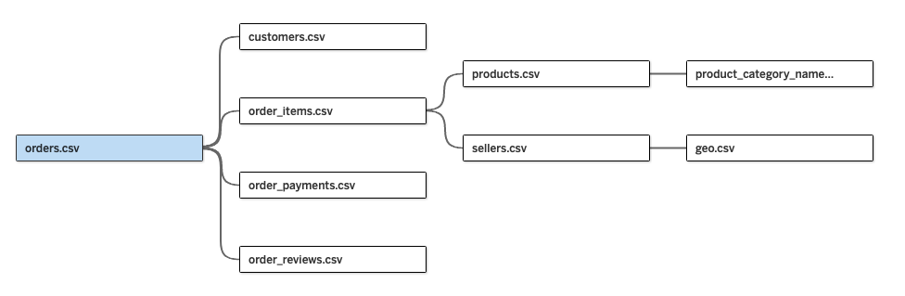
Magist dataset - at a glance
Magist: Software as a Service (SaS) Company
Centralized order management platform
connecting small and medium-sized retailers with major Brazilian marketplaces.
Comprehensive after-sales services
including inventory management, shipping, and customer support.
Dataset: 2016-2018

Slide 3
Our concerns
Is Magist a good fit for high-end tech products?
Are orders delivered on time?

Slide 4
Magist deals with 8% Tech products
33k
Total catalogue
products
2.5k
Tech products

Slide 5
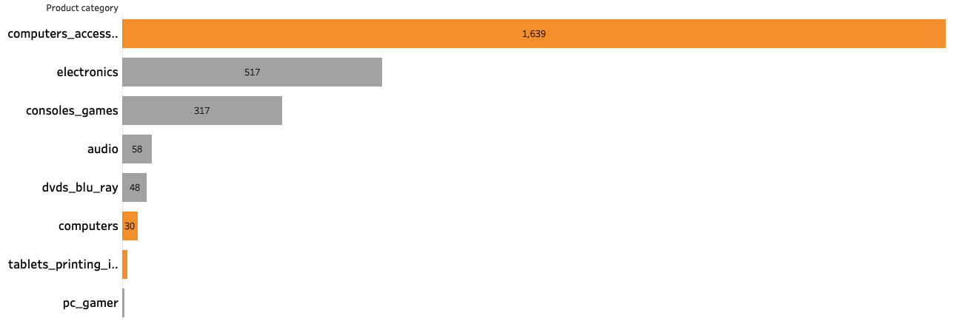
60% of Tech Products coming from computer accessories

Slide 6
Magist sales have 10% of Tech products
113k
Total products sold
in 3-years
12k (10%)
Tech products sold
in 3-years
Magist lacks high-end tech depth
120€
Average price of
Tech Product
540€
Average item price - Eniac
Vs.

Slide 7
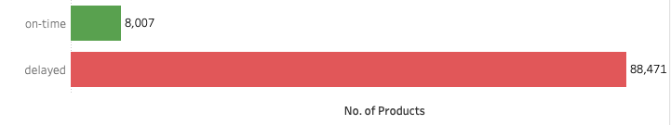
Magist Delivers…… Eventually
12d
Average delivery time for all products
12.5d
Average delivery for
Tech products

Slide 8
In a nutshell…..
"Magist supports only a limited range of high-end tech products, and
its delivery performance has been underwhelming,
making it an unsuitable fit for our portfolio."

Slide 9
Thank you!
Any questions?
Presented by Sutanni, Krishna, Marc

Slide 10
Presentation Appendix

Slide 11
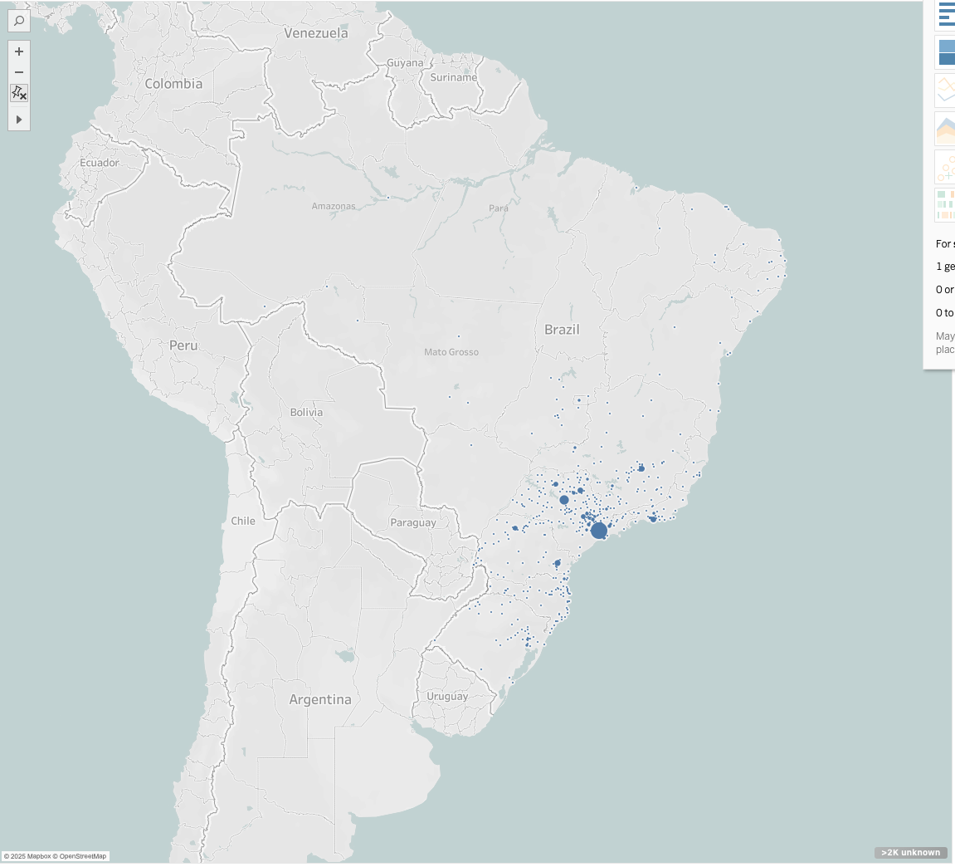
Delayed deliveries not linked to rural orders
∼50,000 orders are from major cities

Slide 12
Magist has a very good review score
56593
85% 3+ star rating
18929
8120
3152
11571

Slide 13
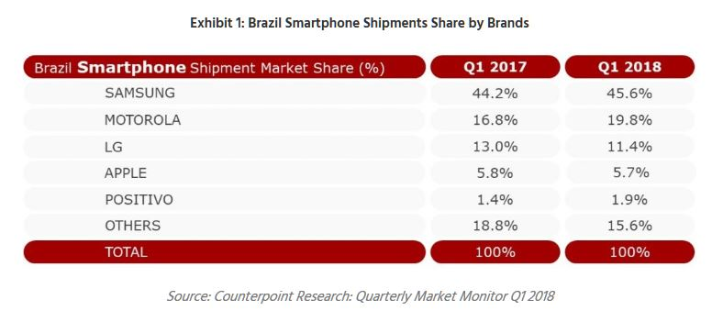
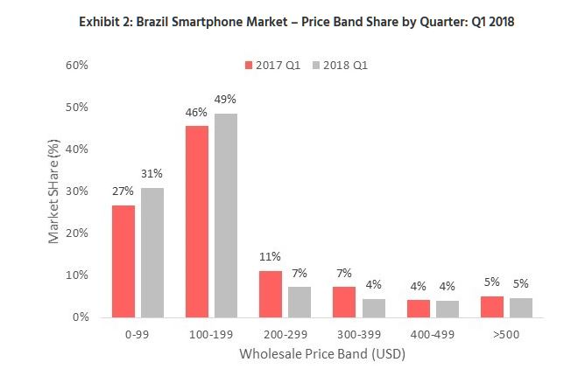
Apple sales are stagnant in Brazil

Slide 14



Global Shopaholics - potential competitor

Slide 15
Open Questions
Who is our customer?
from major cities of Brazil only?
OR
from throughout the country?

