Slide 1
Agenda
Data Cleaning
Data Analysis
Deciding KPIs
Data Visualization

Slide 2
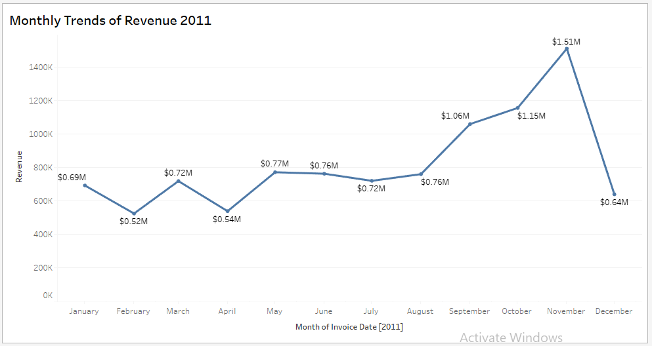
Monthly Trends of Revenue 2011

Slide 3
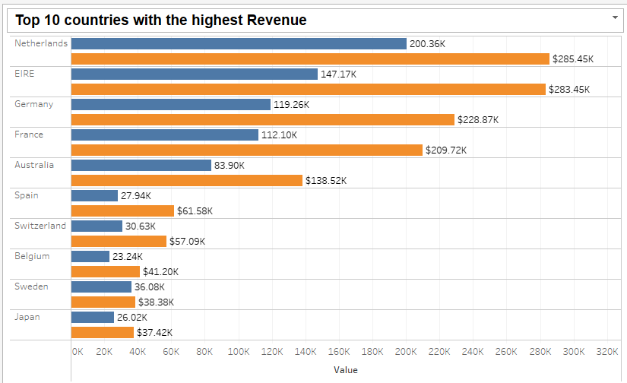
Top 10 countries with the highest Revenue

Slide 4
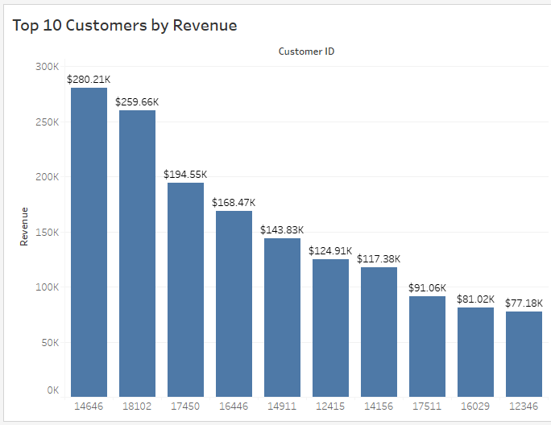
Top 10 Customers by Revenue

Slide 5
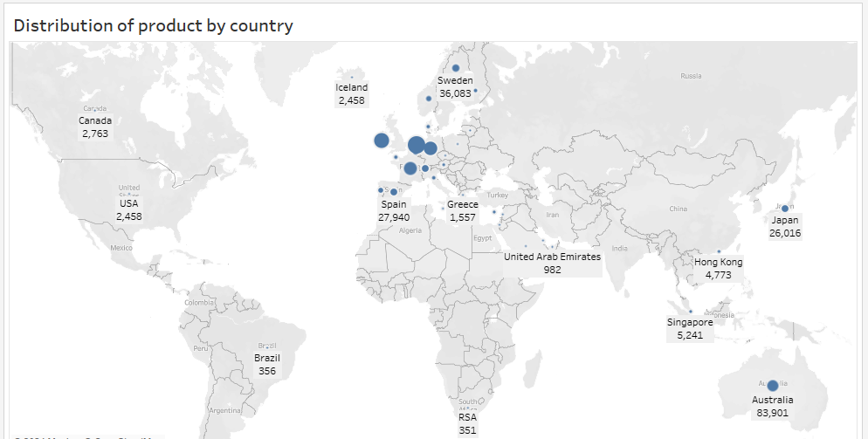
Distribution of product by country

