Slide 1


SMART INDIA HACKATHON 2025
TITLE PAGE
Problem Statement ID – 26007​
Problem Statement Title - safe and Efficient Operation of Mine Vehicles in Fog and Low-Visibility Conditions in Open Cast Iron Ore Mines.
Theme - Smart Automation
PS Category- Hardware
Team ID-
Team Name – SMYGN32

Slide 2
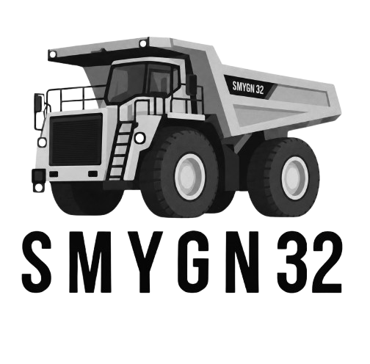


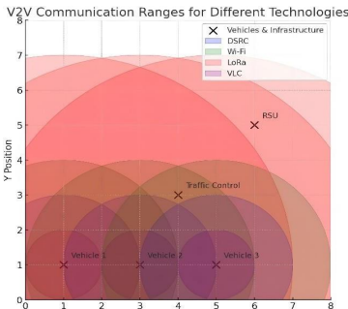
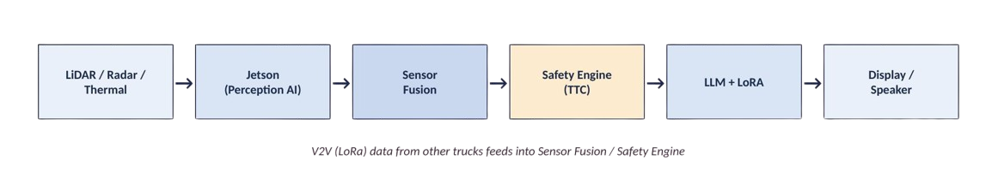
SMYGN32: V2V-Enabled Collision and Trajectory Risk Assessment for Safe Mine Vehicle Operation
PROBLEM- Monsoon fog at Bailadila cuts haul-road visibility to 3–5m, forcing HEMM dumpers to stop or risk collision. Optical aids fail in fog, causing production losses and safety risk
OUR SOLUTION –
SMYGN32 fuses LiDAR/radar/thermal sensing with V2V communication and AI module reasoning to give drivers real-time collision warnings, independent of visibility.
Innovation/Uniqueness:
Works in fog using LiDAR, radar, thermal sensing not optical
V2V shares hazard data across trucks, not just one truck's view
Fully on-device AI on Jetson, no cloud dependency
Real-time TTC engine, auto-alerts below 2.5s
LoRA-tuned LLM gives plain-language voice/display alerts

Slide 3
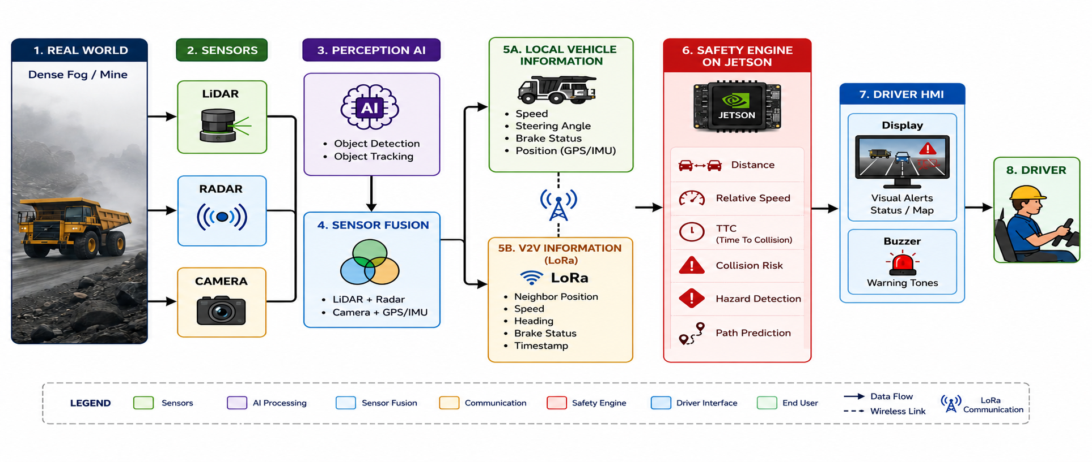
TECHNICAL APPROACH

Slide 4
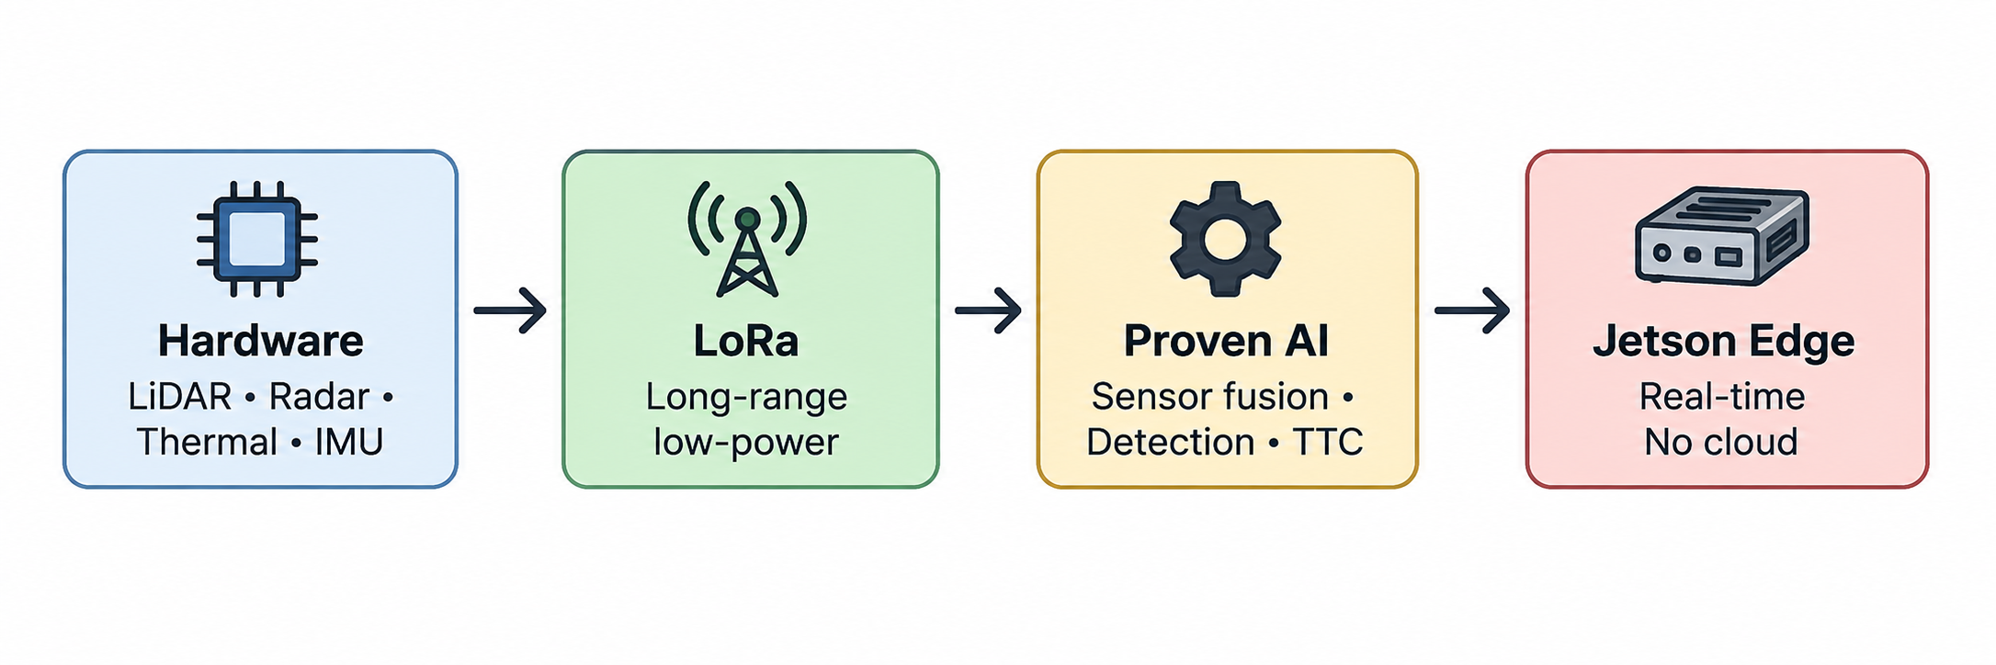
FEASIBILITY AND VIABILITY
Feasibility Analysis
Mature Hardware: Proven, off-the-shelf LiDAR, radar, thermal camera, GPS/IMU, and Jetson Orin Nano.
Reliable Communication: LoRa provides long-range, low-power communication for mine-scale deployment.
Proven Algorithms: Sensor fusion, object detection, and TTC are well-established techniques.
Edge Processing: Jetson processes data locally, enabling real-time decisions without cloud or internet.
LoRa is too slow (about 1 second of latency) and can't push much data, so it just can't keep up with something as time critical as collision avoidance between moving vehicles. For that, you need faster (and pricier) V2V radios that trade cost for speed.
Challenges & How We Handle Them
⚠️ Challenge | ✅ Our Approach
📡 LoRa bandwidth is limited | Low-latency V2V radio for critical alerts; LoRa for non-urgent data
🌡️ Jetson heating / processing limits | Use optimized, lightweight AI models
🚨 False alerts may reduce trust | Fuse multiple sensors before triggering alerts

Slide 5
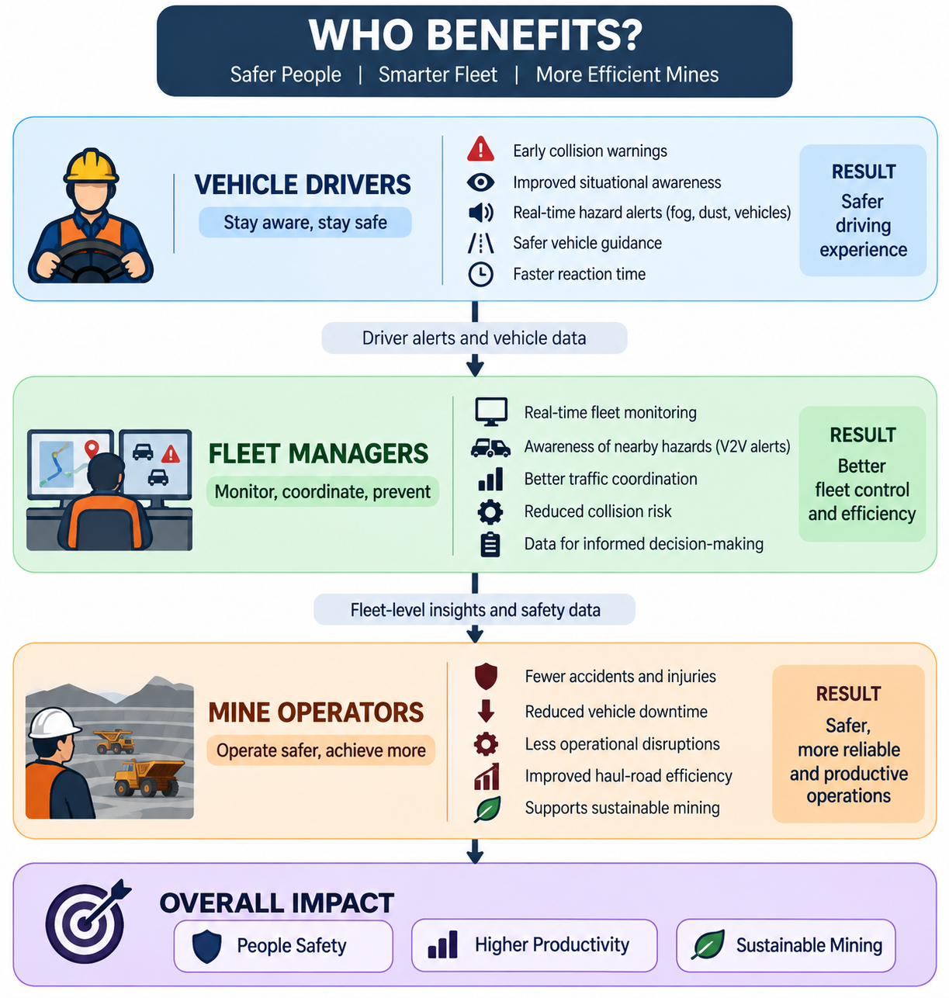
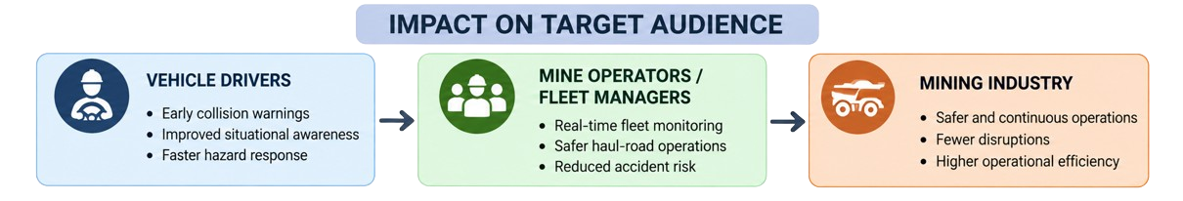
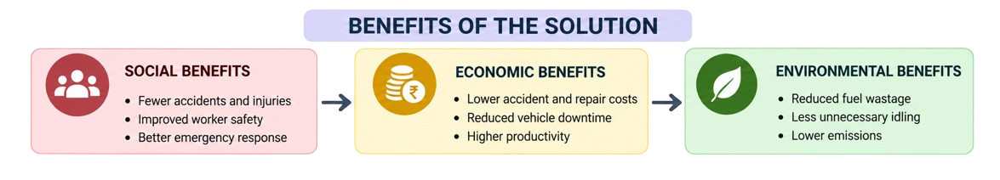
IMPACT AND BENEFITS
By reducing safety-related disruptions and vehicle downtime, the system supports more continuous haulage and improves overall mine productivity.

Slide 6
RESEARCH AND REFERENCES
V2V-LMM — Vehicle-to-Vehicle Communication Cooperative perception & information sharing between vehicles 🔗 https://eddyhkchiu.github.io/v2vllm.github.io/
A Comparative Survey of V2V Communication Technologies: DSRC, Wi-Fi, LoRa and VLC 🔗 https://ieeexplore.ieee.org/stamp/stamp.jsp?tp=&arnumber=11448776/
Which runs its YOLO model locally on a Jetson to avoid cloud dependency in low-connectivity field settings
🔗 https://ieeexplore.ieee.org/stamp/stamp.jsp?tp=&arnumber=11604261/

