Slide 1
CSE541
Computer Vision
Project 1: Object detection techniques (in case of small objects) on AU Drone dataset
AU2140122 - Kushalkumar Suthar
AU2140023 - Rohit Rathi
AU2140064 - Dhruvin Prajapati
AU2140039 - Nish Parikh
Group: 11

Slide 2
Data Set Explanation: Visdrone2019
There are eight entities:
Xc
Yc
W
H
Score
Object category ID
Truncation
Occlusion

Slide 3
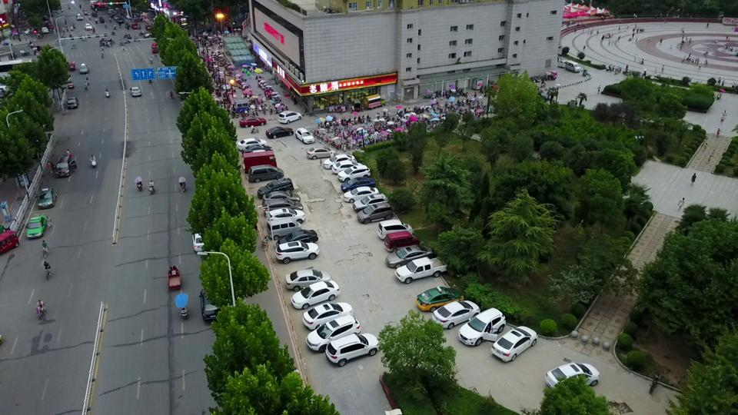
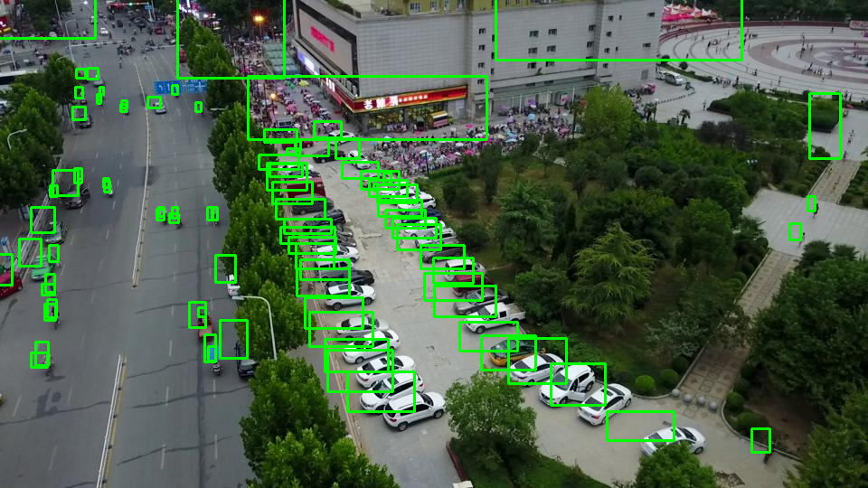
Data Set Explanation: Visdrone2019
Xc | Yc | W | H | Score | Object ID | Truncation | Occlusion
684 | 8 | 273 | 116 | 0 | 0 | 0 | 0

Slide 4
Comparison:
Method | AP[%]
QueryDet | 33.91
RetinaNet | 33.95
Author links open overlay panel Onur Can Koyun a et al., “Focus-and-detect: A small object detection framework for aerial images,” Signal Processing: Image Communication, https://www.sciencedirect.com/science/article/pii/S0923596522000273 (accessed Apr. 8, 2024).

Slide 5
Model Description:
RetinaNet Architecture | Faster-RCNN Architecture
Single Stage detector | Two State detector
Backbone : ResNet50 | Backbone : ResNet50
Focal Loss function | Cross Entropy loss function

Slide 6
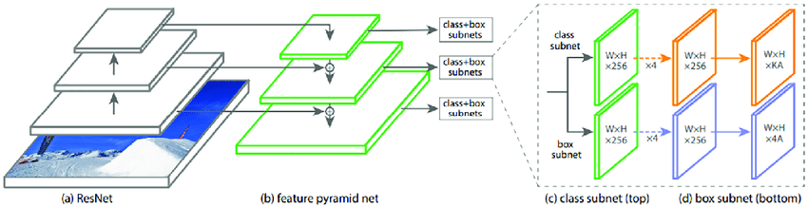
RetinaNet Architecture
https://www.researchgate.net/figure/The-network-architecture-of-RetinaNet-RetinaNet-uses-the-Feature-Pyramid-Network-FPN_fig1_327737749

Slide 7
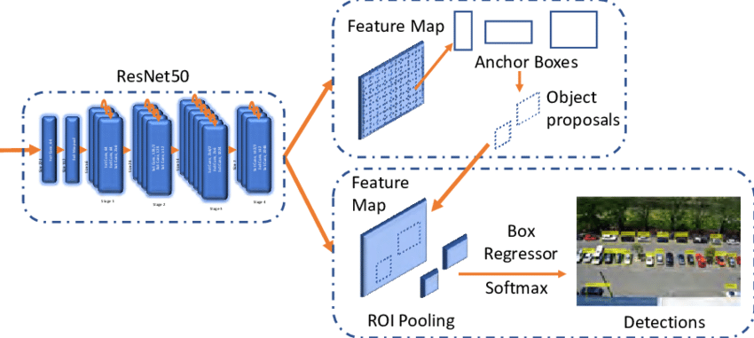
Faster RCNN Architecture
[1]“Architecture of Faster R-CNN with ResNeXt as the backbone,” ResearchGate. https://researchgate.net/figure/Architecture-of-Faster-R-CNN-with-ResNeXt-X-101-as-the-backbone_fig4_359721197

Slide 8
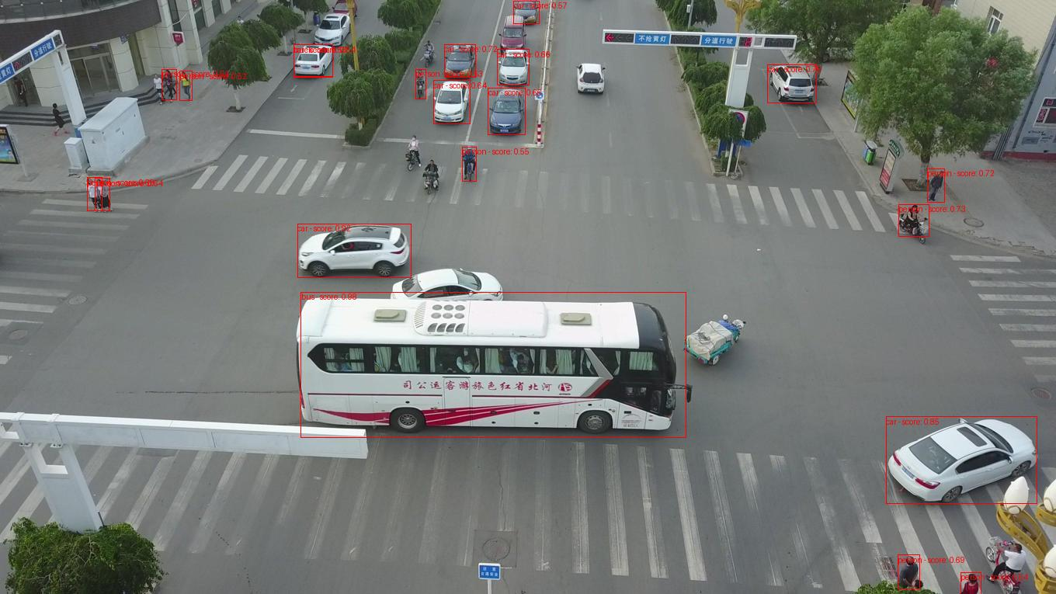
RetinaNet: on Visdrone-2019 dataset
Notes:
We will be applying QueryDet Model on the VisDrone Dataset. Furthermore

Slide 9
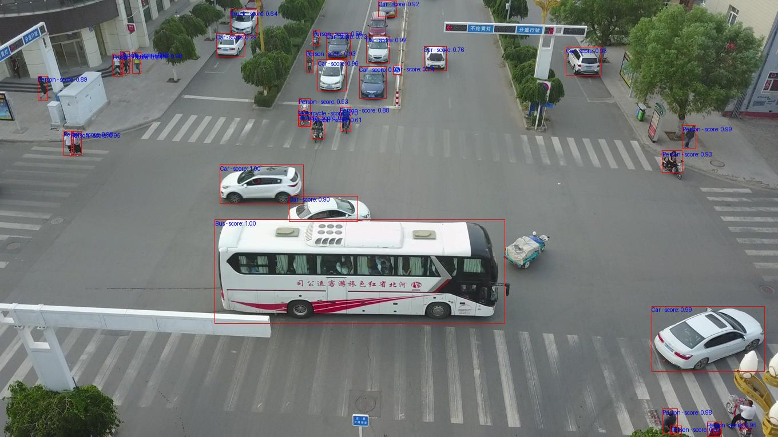
Faster-RCNN: on Visdrone-2019 dataset
Notes:
We will be applying QueryDet Model on the VisDrone Dataset. Furthermore

Slide 10
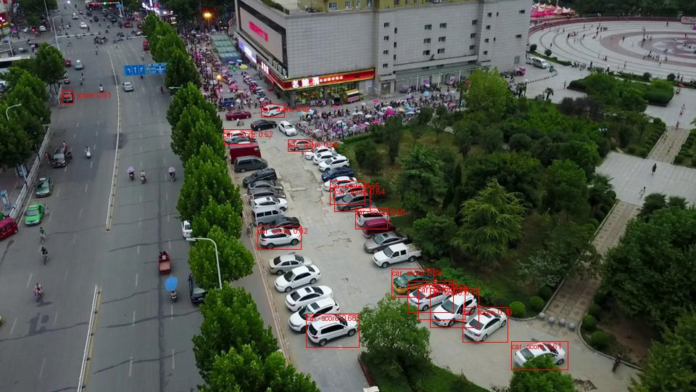
RetinaNet: on Visdrone-2019 dataset
Notes:
We will be applying QueryDet Model on the VisDrone Dataset. Furthermore

Slide 11
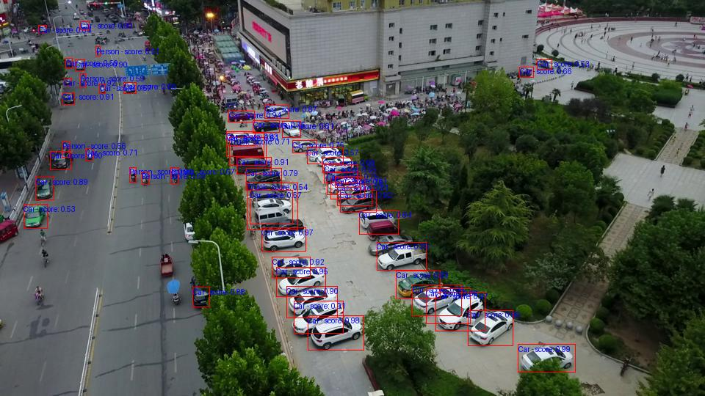
Faster-RCNN: on Visdrone-2019 dataset
Notes:
We will be applying QueryDet Model on the VisDrone Dataset. Furthermore

Slide 12

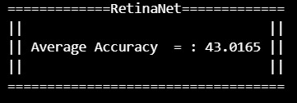
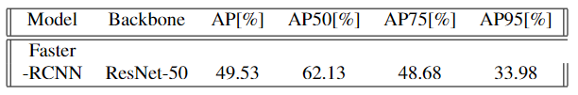

Results:
RetinaNet
Faster-RCNN
Notes:
We will be applying QueryDet Model on the VisDrone Dataset. Furthermore

Slide 13
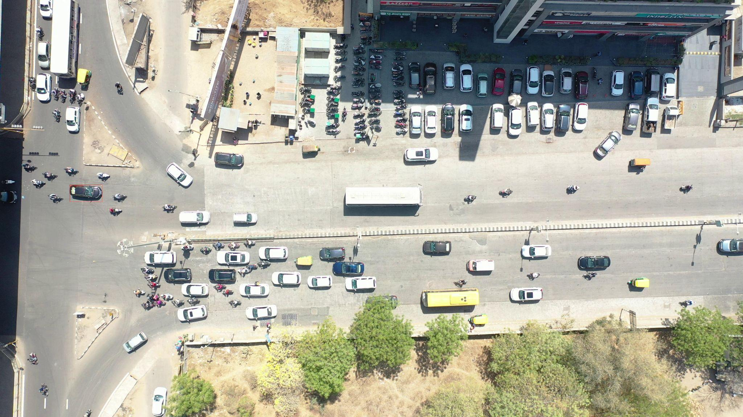
RetinaNet- on AU drone dataset
Notes:
We will be applying QueryDet Model on the VisDrone Dataset. Furthermore

Slide 14

Faster-RCNN- on AU drone dataset
Notes:
We will be applying QueryDet Model on the VisDrone Dataset. Furthermore

Slide 15
Possible improvements:
Training model over a dataset with different perspectives will help improve the accuracy
Data Augmentation and Regularization
Backbone Replacement or Modification
Hyperparameter Tuning
Feature Pyramid Networks (FPN):
Loss functions can be tried and tested for better detection
Notes:
The basic idea behind FPNs is to create a pyramid of feature maps with different spatial resolutions, where higher levels of the pyramid represent semantically stronger features but have lower spatial resolution, while lower levels have higher spatial resolution but capture more fine-grained details. This pyramid structure enables the network to effectively capture both global context and local details, making it robust to objects of different scales.

Slide 16
References
Wikimedia Foundation. (2024, January 2). Small object detection. Wikipedia. https://en.wikipedia.org/wiki/Small_object_detection
Author links open overlay panelOnur Can Koyun a et al., “Focus-and-detect: A small object detection framework for aerial images,” Signal Processing: Image Communication, https://www.sciencedirect.com/science/article/pii/S0923596522000273 (accessed Apr. 8, 2024).
Chenhongyi Yang, Zehao Huang, and Naiyan Wang. QueryDet: Cascaded sparse query for accelerating high resolution small object detection. arXiv preprint arXiv:2103.09136, 2021.
Tsung-Yi Lin, Priya Goyal, Ross Girshick, Kaiming He, and Piotr Dollár. Focal loss for dense object detection. In Proceedings of the IEEE international conference on computer vision, pages 2980–2988, 2017.
Jingtao Xu, Yali Li, and Shengjin Wang. AdaZoom: Adaptive zoom network for multi-scale object detection in large scenes. arXiv preprint arXiv:2106.10409, 2021.
VisDrone, “VisDrone/Visdrone-Dataset: The dataset for drone based detection and tracking is released, including both image/video, and annotations.,” GitHub, https://github.com/VisDrone/VisDrone-Dataset (accessed Apr. 8, 2024).

Slide 17
Thank you

