Slide 1
CSE541
Computer Vision
Project 1: Object detection techniques (in case of small objects) on AU Drone dataset
AU2140122 - Kushalkumar Suthar
AU2140023 - Rohit Rathi
AU2140064 - Dhruvin Prajapati
AU2140039 - Nish Parikh
Group: 11

Slide 2
QueryDet Model Analysis
> QueryDet model is basically an approach for object detection, which focuses on improving the efficiency and performance of detecting small objects.
> Two Step-Pipeline process.
> Why we chose QueryDet Model for first analysis?
→ As it specially designed for addresses the same challenge, and it involves using the Visdrone 2019 dataset for training. The pipeline approach it is using, improves its efficiency.
Notes:
> It uses a two step pipeline: it first predicts the coarse locations of small objects on low-resolution features and then computes the accurate detection results using high resolution features sparsely guided by the coarse position. It benefits in the way that it avoids unnecessary computation for the background area.

Slide 3
Data Set Explanation: Visdrone2019
There are seven entities:
Xc
Yc
W
H
Score
Object category ID
Truncation
Occlusion

Slide 4
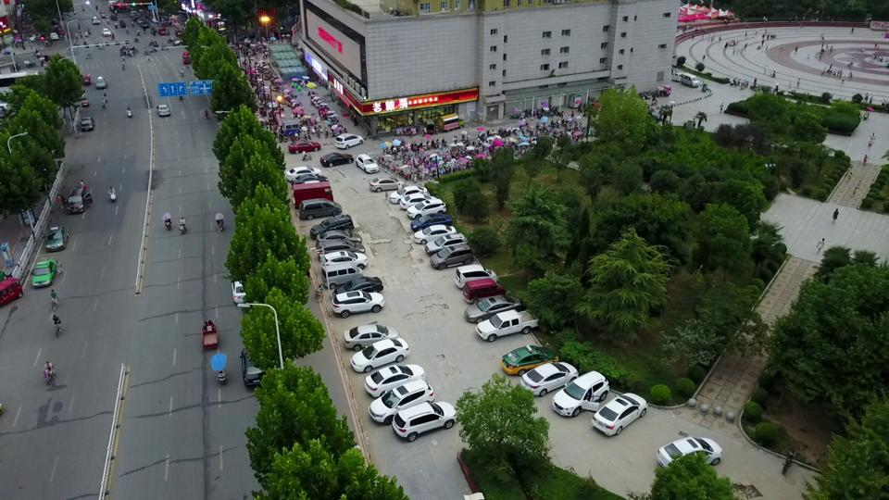
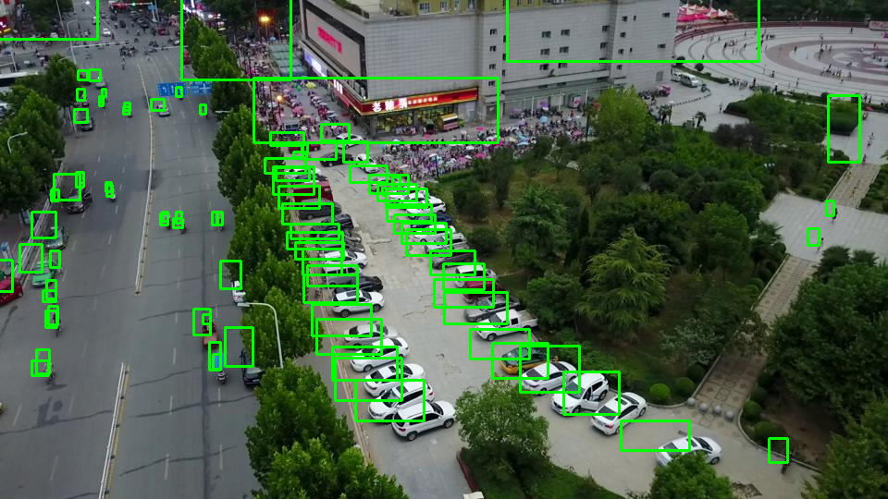
Data Set Explanation: Visdrone2019
Xc | Yc | W | H | Score | Object ID | Truncation | Occlusion
684 | 8 | 273 | 116 | 0 | 0 | 0 | 0

Slide 5
Future work
Apply QueryDet Model on the VisDrone Dataset.
Find and improve Performance metrics.
Refining the outputs of the model by improving the score.
> Target to improve the bounding box accuracy.
Lastly compare Results of QueryDet with other models like HoughNet, RetinaNet and EfficientDet.
Notes:
We will be applying QueryDet Model on the VisDrone Dataset. Furthermore

Slide 6
References
Wikimedia Foundation. (2024, January 2). Small object detection. Wikipedia. https://en.wikipedia.org/wiki/Small_object_detection
Yang, C., Huang, Z., & Wang, N. (2022, March 24). Querydet: Cascaded sparse query for accelerating high-resolution small object detection. arXiv.org. https://arxiv.org/abs/2103.09136
VisDrone. (n.d.-a). VisDrone/Visdrone-Dataset: The dataset for drone based detection and tracking is released, including both image/video, and annotations. Retrieved from https://github.com/VisDrone/VisDrone-Dataset

Slide 7
Thank you

