Slide 1
INDEPENDENT RESEARCH EXTENSION · QM9 MULTI-TASK LEARNING
AIM, tested on two
encoders
Does a learned gradient-conflict policy generalize across model architectures — or only work on the one it was benchmarked on? A from-scratch MPNN and a pretrained Uni-Mol transformer, run through the identical training protocol, answer that question.
Author Nisha Suthar
Base method Minot & Schneider, NeurIPS AI4Science 2025 · arXiv:2509.25955
Dataset QM9

Slide 2
01 THE PROBLEM
One encoder, several targets, competing gradients
Predicting several molecular properties from one shared encoder is efficient — but the tasks don't always agree. When two tasks' gradients point in conflicting directions, updating for one can quietly undo progress on the other.
BASELINE
BASELINE
THIS METHOD
Linear scalarization
Just sum the per-task losses. Cheap, but conflicting gradients are never resolved — one task can dominate.
PCGrad
A fixed geometric rule: if two gradients conflict, project one onto the other's normal plane. Static — the same rule at epoch 1 and epoch 300.
AIM
Learns how much conflicting gradient to project out, per task pair, via a trained policy — instead of a hand-set rule.

Slide 3
02 THE METHOD
AIM learns a per-task-pair threshold, jointly with the model
For every ordered task pair (i, j), a policy learns a threshold τ deciding how much of task j's conflicting gradient component gets suppressed from task i's update — trained end-to-end alongside the encoder.
→
→
→
01
Shared forward pass
One encoder, per-task gradients pulled via torch.autograd.grad.
02
Policy scores conflict
Per task-pair threshold τ, sigmoid-gated at temperature k, decides suppression strength.
03
Guidance + regularizers
Guidance loss (λ_g) plus magnitude-preservation (λ_m) and progress-on-hard-tasks (λ_p) terms.
04
Intervened update
Combined, conflict-adjusted gradient applied to the shared encoder.
Two policy variants are compared throughout: AIM Scalar (one τ per task pair) and AIM Matrix (τ allowed to differ by direction, i→j vs j→i).

Slide 4
03 THIS PROJECT'S CONTRIBUTION
The paper benchmarks one backbone. This repo tests a second.
The original paper only evaluates AIM on its own GNN. The paper's own future-work section asks whether the policy generalizes “across diverse model architectures beyond the GNN used here” — that's the gap this repository fills.
GNN — trained from scratch
An MPNN (Gilmer et al., 2017). Full encoder trained on QM9 from random initialization.
Uni-Mol — pretrained, fine-tuned
An SE(3)-Transformer pretrained on ~19M molecules, fine-tuned here with the last 2 layers trainable.
Fairness constraint — every hyperparameter not intrinsically tied to a specific encoder (epochs, batch size, both learning rates, policy temperature, all three loss weights, task-head width) is kept identical between the two pipelines. Only the encoder differs. aim_optimizer.py, baselines.py, and metrics.py are byte-identical across both.

Slide 5
04 DESIGN DECISION
Choosing tasks that actually conflict
AIM only has something to do if the tasks disagree. Two of QM9's most commonly paired targets turned out not to.
Uni-Mol pilot — μ, U₀, U
U₀ and U (internal energy at 0K vs 298K) correlate at r = 1.00 in raw QM9 labels — they differ only by a small thermal correction. Almost no real gradient conflict for AIM to resolve on that pair.
GNN pilot — μ, ε_LUMO
Dipole moment and LUMO energy correlate at r = −0.39 — the strongest conflict among physically distinct QM9 properties. Chosen specifically to stress-test gradient-conflict resolution before scaling to the paper's full 11-task setup.
Result: on the near-duplicate U₀/U pair, plain scalarization wins almost by construction — not a fair test of conflict resolution. The 2-task pilot exists to correct that.

Slide 6
05 EXPERIMENT DESIGN
The method × scale × seed grid
Five methods, three training-set sizes, three seeds, both backbones — run under one shared training and evaluation protocol.
Methods compared
— STL — one head trained alone, per task (upper-bound reference)
— LS — linear scalarization
— PCGrad — fixed gradient-surgery rule
— AIM Scalar / AIM Matrix — learned policy
Sweep coverage
seeds 42, 123, 7
n_train 5,000 / 10,000 / 15,000 (GNN)
lr_model 5e-5 default, 5e-4 sweep
epochs up to 300
metric Mean Rank + Δm%(μ) vs. STL
Δm% is signed against the STL baseline for μ — positive means the multi-task method beats training on that task alone.

Slide 7
06 RESULT
Across three seeds, the simplest baseline wins on both backbones
Mean Rank (lower is better) and Δm%(μ) vs. STL (positive is better), n_train = 5,000, lr_model = 5e-4, averaged over seeds 42 / 123 / 7.
BACKBONE | METHOD | MEAN RANK | ΔM%(Μ)
Uni-Mol | LS | 1.33 ± 0.33 | −5.07 ± 2.57
Uni-Mol | AIM Scalar | 2.67 ± 0.88 | −8.38 ± 2.77
Uni-Mol | PCGrad | 3.00 ± 1.00 | −8.91 ± 1.79
Uni-Mol | AIM Matrix | 3.00 ± 0.88 | −7.41 ± 0.53
GNN | LS | 1.11 ± 0.19 | +19.36 ± 10.77
GNN | PCGrad | 2.78 ± 0.38 | −6.21 ± 10.36
GNN | AIM Scalar | 3.00 ± 0.58 | −5.07 ± 9.30
GNN | AIM Matrix | 3.11 ± 0.77 | −9.20 ± 11.95
Not the expected result — in this replication, plain linear scalarization takes rank 1 on both backbones at this scale. AIM and PCGrad's gradient surgery underperform LS rather than beating it.

Slide 8
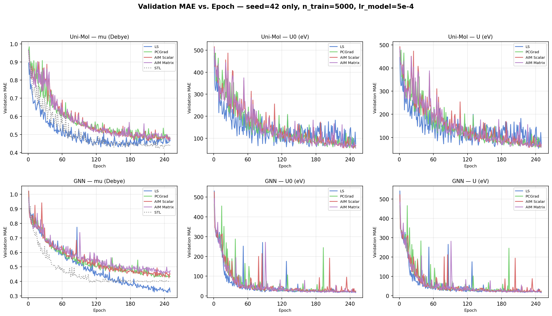
07 EVIDENCE
The pattern holds architecture-to-architecture
Validation MAE per task, per method, seed 42, n_train = 5,000, lr_model = 5e-4 — Uni-Mol (top row) and GNN (bottom row) side by side.
src/comparison_all — Unimol/results/mae_vs_epoch_seed42.png · On μ specifically, LS (blue) separates cleanly below AIM/PCGrad on both backbones — the gap is not a one-backbone fluke.

Slide 9
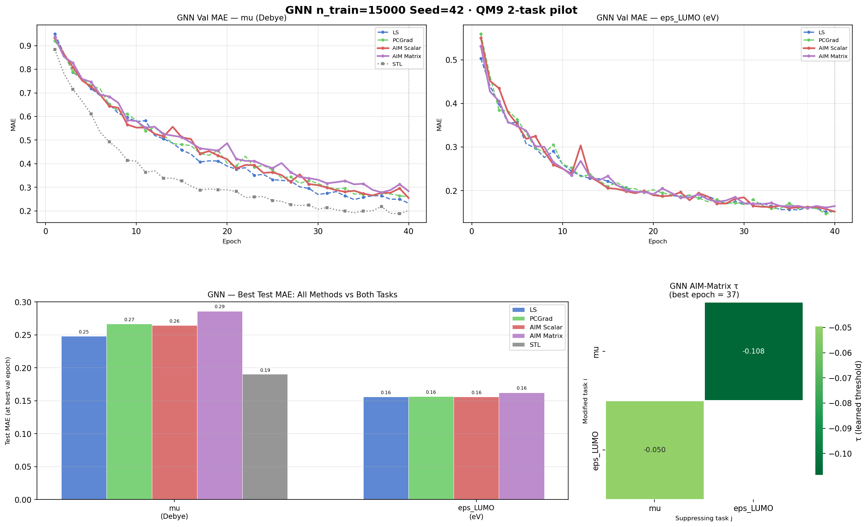
08 SCALE CHECK
Scaling data doesn't reverse it
GNN, 2-task pilot (μ, ε_LUMO) — the conflict-heavy subset — at n_train = 15,000, 3× the seed-sweep size.
STL still leads outright
A head trained on μ alone reaches 0.19 MAE; every multi-task method (LS included) lands at 0.25–0.29. Multi-tasking still costs μ accuracy here, even before comparing methods against each other.
AIM-Matrix τ is small
Learned suppression thresholds of −0.05 to −0.11 — the policy is finding very little to intervene on, consistent with LS already doing fine without it.

Slide 10
09 SECONDARY OBSERVATION
The 3-task pilot shows training instability, independent of method
At n_train = 10,000 on the legacy 3-task subset (μ, U₀, U), every method — not just AIM — shows sharp, recurring validation-MAE spikes on U₀ and U across training.
What's consistent
Spikes appear in LS, PCGrad, AIM Scalar, and AIM Matrix alike, on the same near-duplicate task pair flagged earlier — pointing to the task subset, not the conflict-resolution method, as the likely source.
Why it matters
It reinforces the case for the μ/ε_LUMO 2-task pilot as the cleaner testbed going forward, ahead of scaling to the paper's full 11-task QM9 setup.

Slide 11
10 STATUS
Pipelines validated end-to-end. Benchmarking is still running.
● FULL METHOD × SEED MATRIX IN PROGRESS
Done
— Both backbones: data → train → checkpoint → analysis, end to end
— Shared, byte-identical AIM / baseline / metrics code across backbones
— Seed × scale sweep at 5K, plus single-seed checks at 10K / 15K
— Cross-backbone comparison tooling (table + plots + τ diagnostics)
Open questions
— Does AIM's edge over LS reappear at the paper's full 11-task scale?
— Why does gradient surgery underperform LS here specifically — policy undertrained, or genuinely low conflict once μ/ε_LUMO is isolated?
— Full seed sweep still owed at 10K and 15K, both backbones
Repository: independent extension by Nisha Suthar of Minot & Schneider, AIM: Adaptive Intervention for Deep Multi-task Learning of Molecular Properties, NeurIPS AI4Science 2025.

