Slide 1
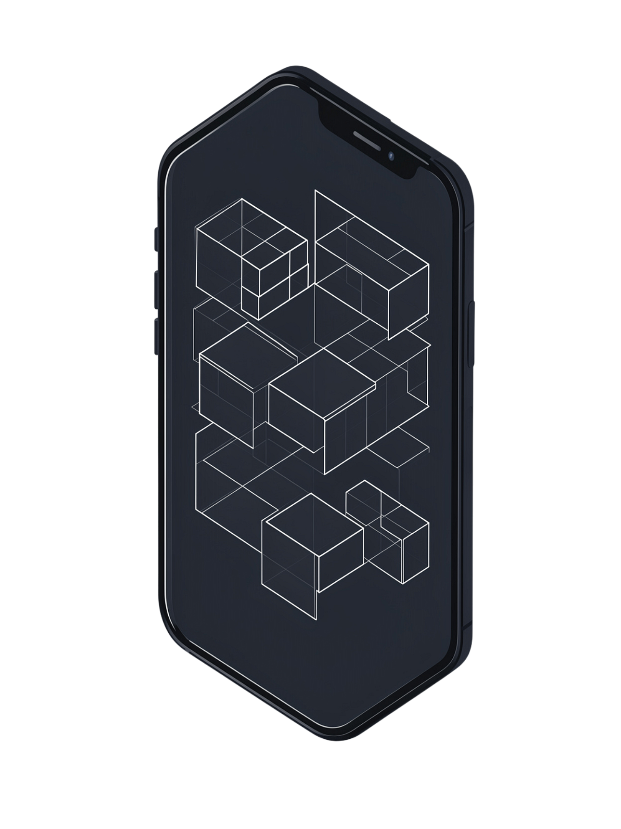
Android Layouts: Building Responsive User Interfaces
Mastering Linear, Relative, and Constraint Layouts

Slide 2
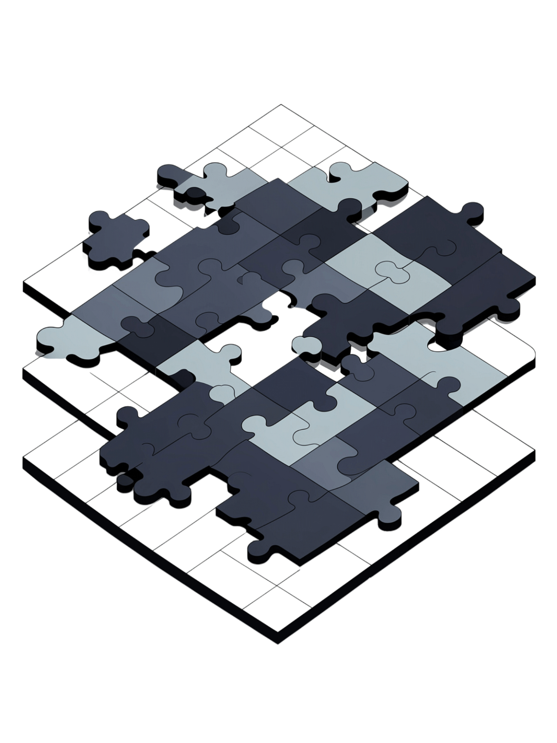
What is an Android Layout?
View
ViewGroup
Individual UI components — buttons, text fields, images, and other interactive elements the user sees and touches.
Invisible containers that manage the positioning and sizing of their child Views on screen.
Layout
The blueprint that defines how UI elements appear, align, and respond across different screen sizes and orientations.

Slide 3
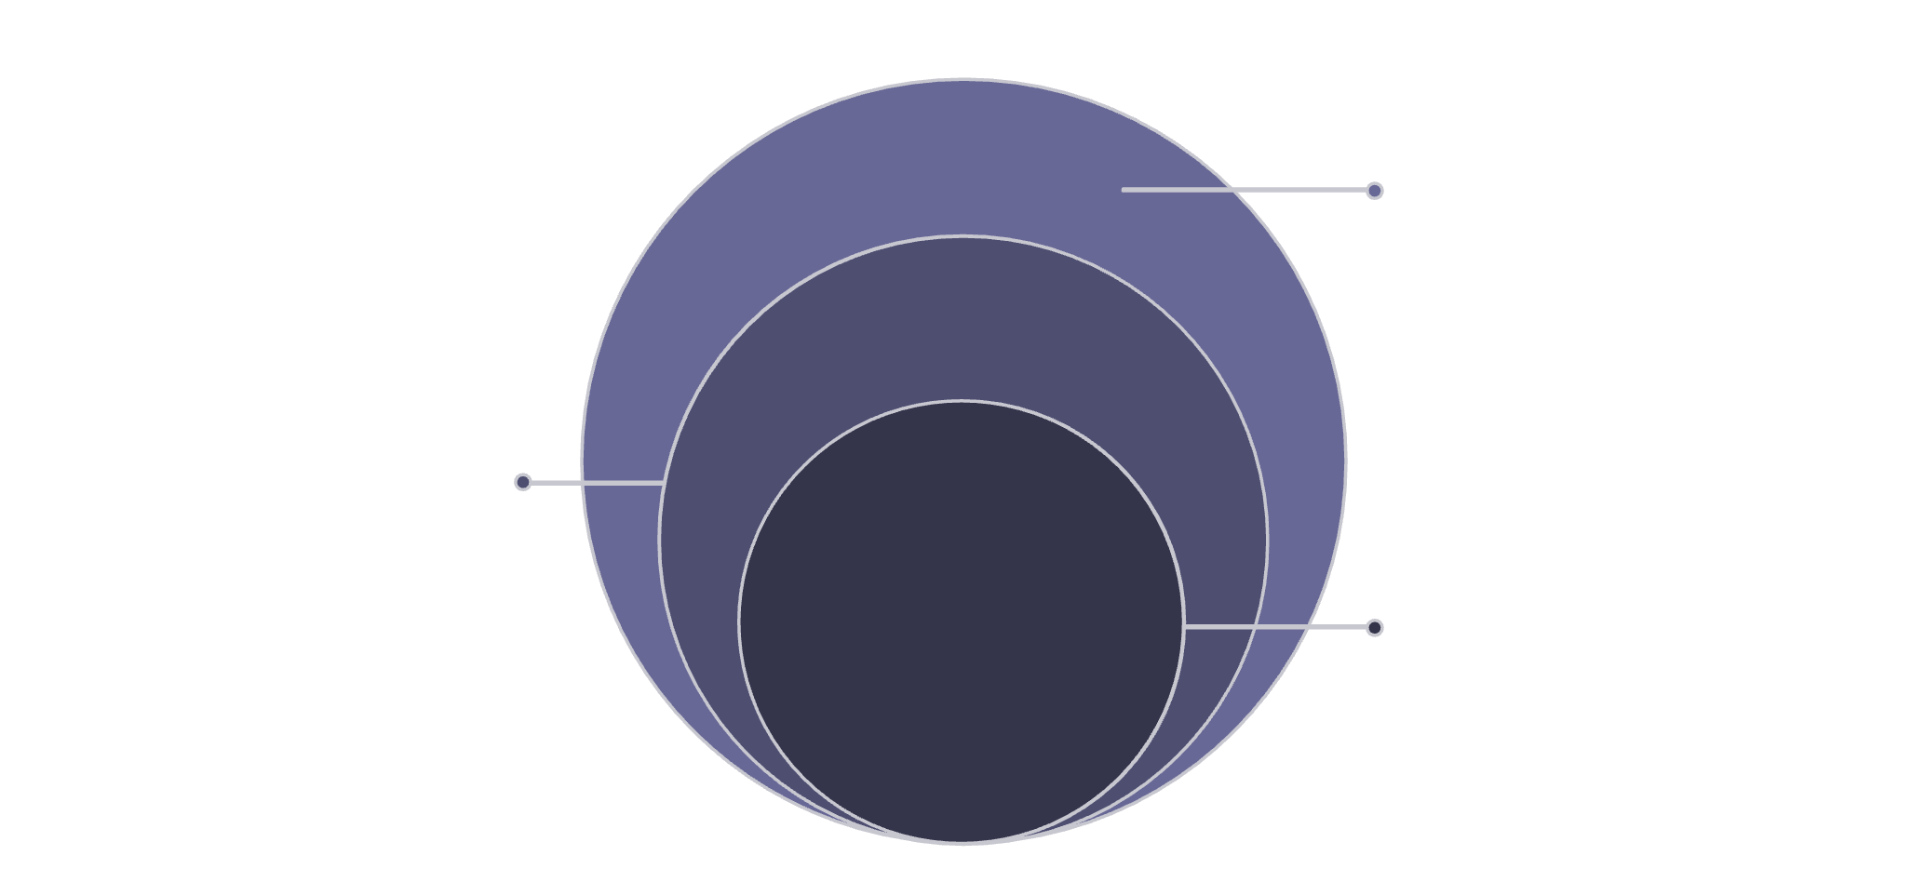

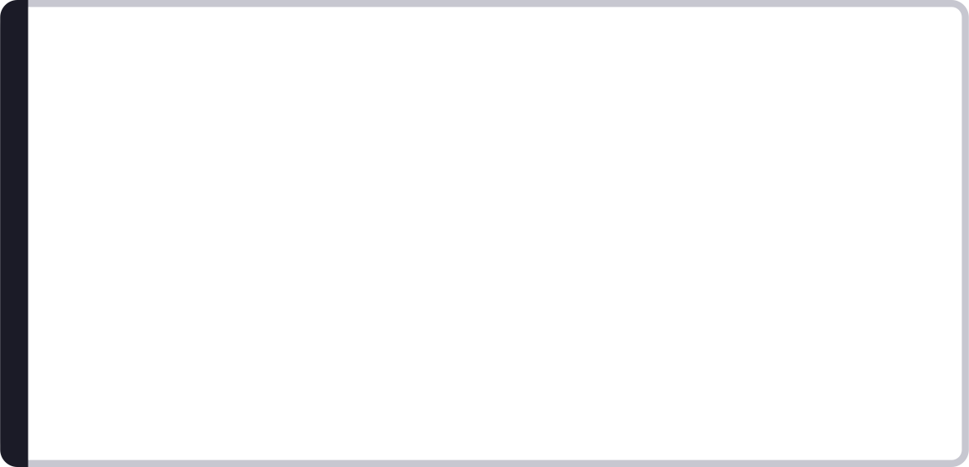
The View Hierarchy
Why Hierarchy Depth Matters
View
Deep Hierarchies
Leaf elements rendered on screen
Trigger multiple measure, layout, and draw passes — increasing frame render time and risking dropped frames.
ViewGroup
Two child groups managing layout
Root
Top-level container for the screen
Flat Hierarchies
Fewer passes, faster rendering, and smoother 60fps animations. Always the preferred architecture.
Android renders every screen as a nested tree of Views and ViewGroups — each node measured, laid out, and drawn in sequence.

Slide 4

Evolution of Android Layouts
Early Era
Classic Era
AbsoluteLayout — deprecated. Fixed pixel positions broke on every screen size.
LinearLayout & RelativeLayout — reliable, widely adopted, still used today.
1
2
3
4
Foundation
Modern Standard
FrameLayout — single child focus, limited composition capability.
ConstraintLayout — flat, flexible, GPU-friendly and the recommended approach.
Choosing the right layout ensures device compatibility and responsive design across the full Android ecosystem.

Slide 5
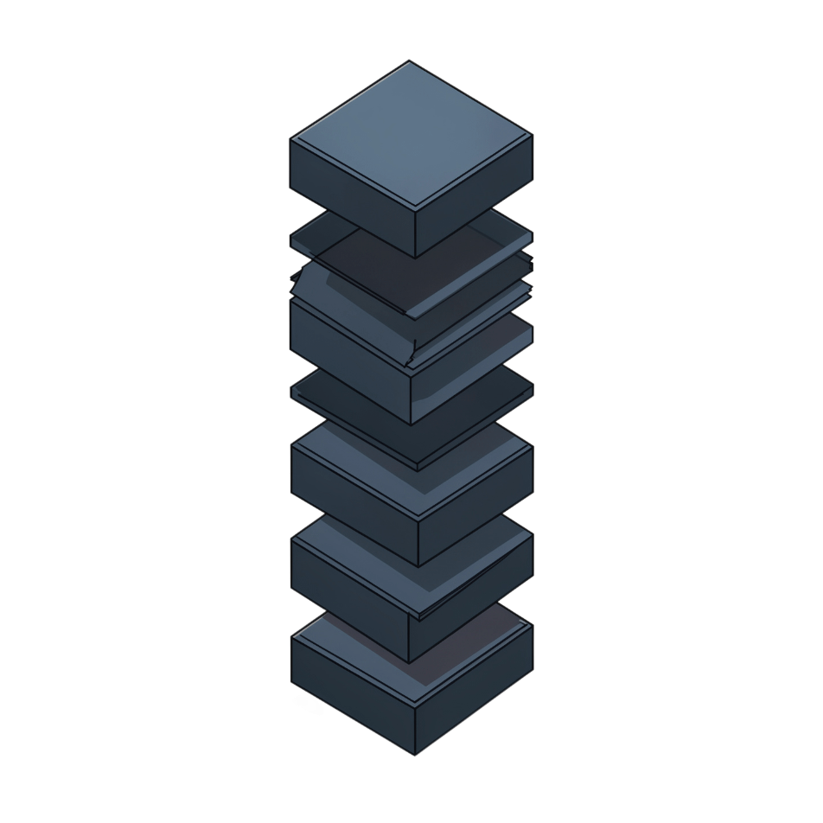
Introduction to Linear Layout
How It Works
LinearLayout arranges all child Views in a single row (horizontal) or single column (vertical) — one after another with no overlapping.
Key Attributes
orientation — horizontal or vertical
layout_weight — distributes remaining space proportionally among children
gravity — aligns content within the container
<LinearLayout
android:orientation="vertical"
android:layout_weight="1"
android:gravity="center">
<Button android:text="Submit" />
<EditText android:hint="Name" />
</LinearLayout>

Slide 6
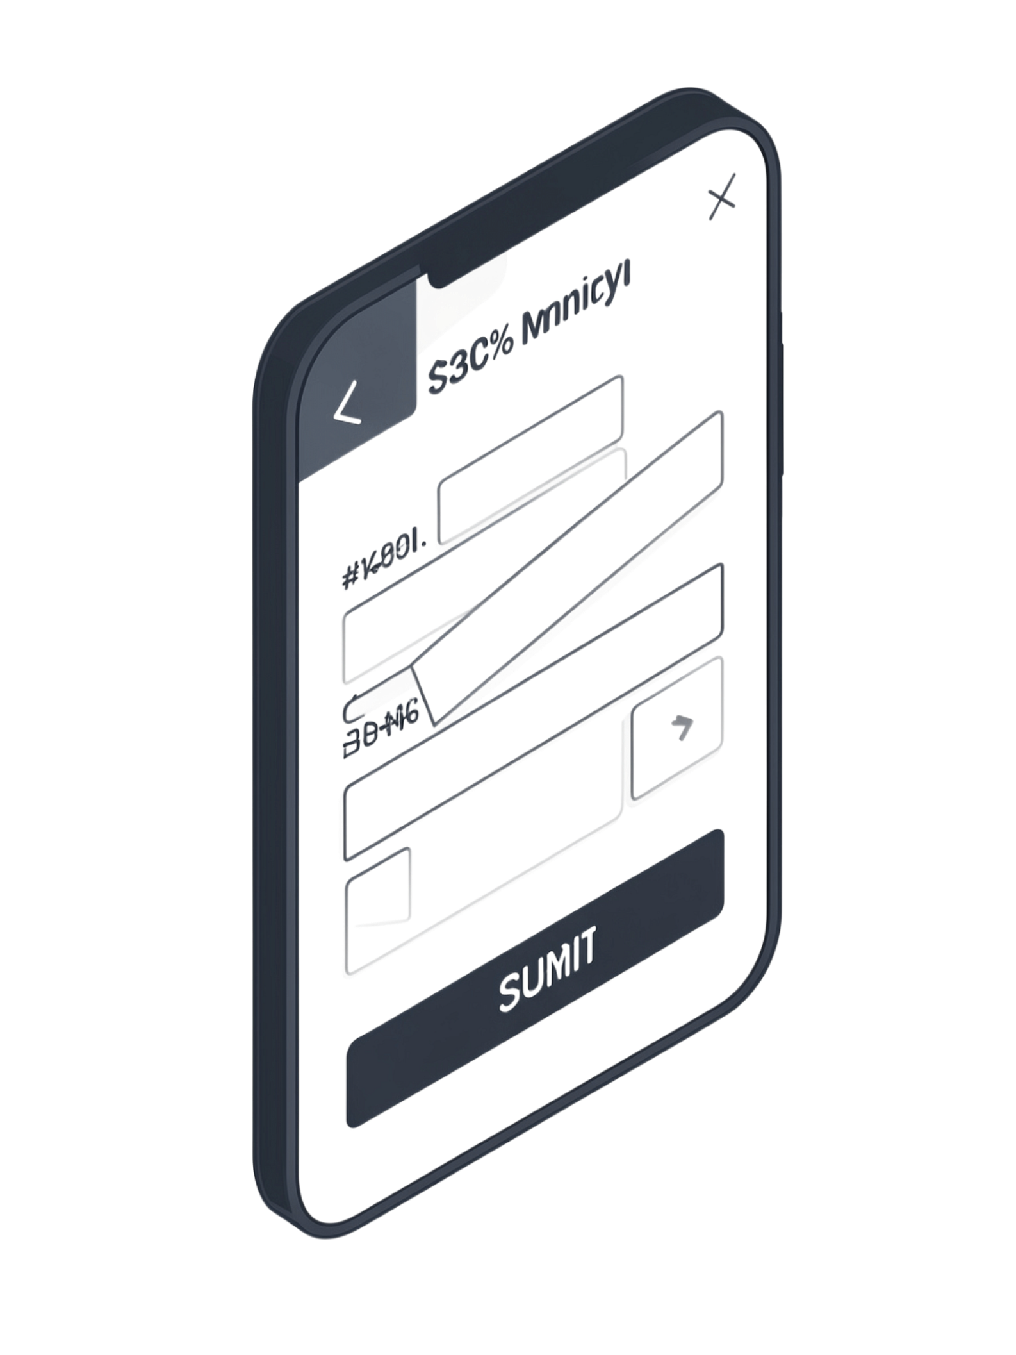
Linear Layout in Action
Best Use Cases
Weight Distribution
Login and registration forms
Horizontal toolbar button rows
Simple vertical content stacks
Weight-based flexible sizing
Assign layout_weight values to let children share available space proportionally — no hard pixel widths required.
<EditText
android:layout_weight="1"
android:layout_width="0dp" />
<Button
android:layout_weight="0"
android:layout_width="wrap_content" />
Key Limitation
Nesting LinearLayouts to build complex UIs creates deep hierarchies — triggering extra measurement passes and causing measurable performance penalties.

Slide 7
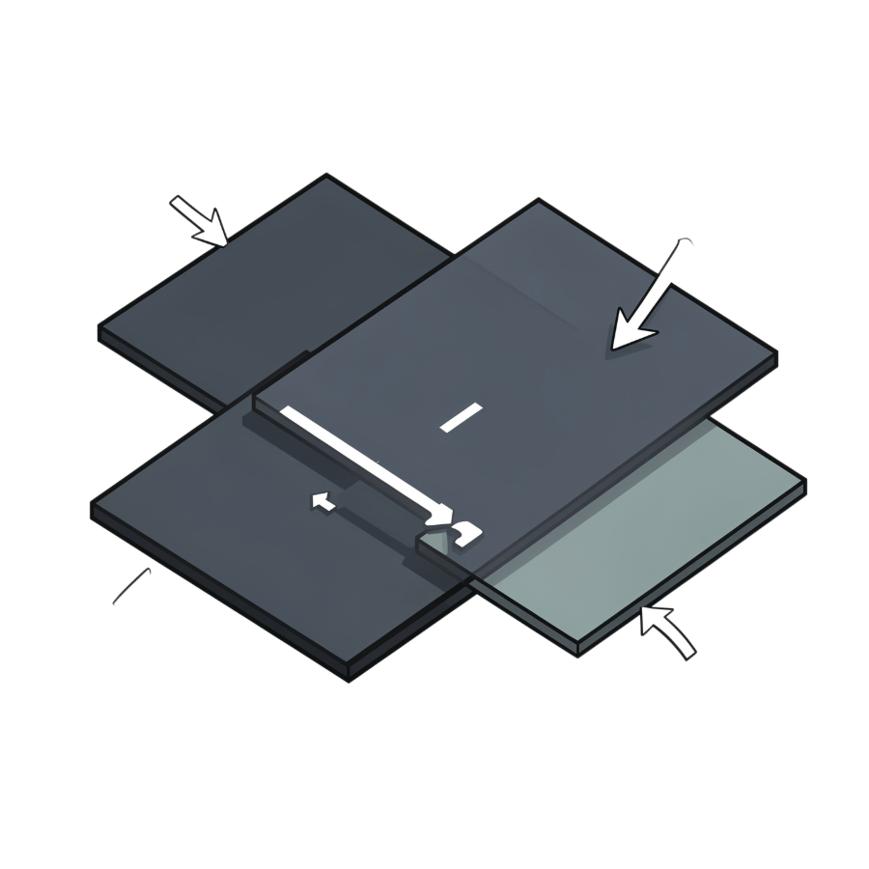
Introduction to Relative Layout
Positioning by Relationship
RelativeLayout positions each child View relative to its siblings or the parent container — eliminating the need to nest multiple LinearLayouts.
Essential Attributes
layout_toRightOf / layout_toLeftOf
layout_below / layout_above
layout_alignParentTop / Bottom / Start
layout_centerInParent
<RelativeLayout>
<TextView
android:id="@+id/label"
android:layout_alignParentTop="true"/>
<Button
android:layout_below="@id/label"
android:layout_centerHorizontal="true"/>
</RelativeLayout>

Slide 8



Relative Layout in Practice
Flat Hierarchies
Two-Pass Trade-off
Dependency Complexity
A single RelativeLayout with multiple sibling Views often replaces three or four nested LinearLayouts — significantly reducing rendering overhead.
RelativeLayout measures children twice per layout pass to resolve dependencies. On older or lower-end devices this can cause noticeable slowdowns.
As layouts grow, sibling dependency chains become difficult to read, debug, and maintain — making large RelativeLayouts fragile to change.

Slide 9
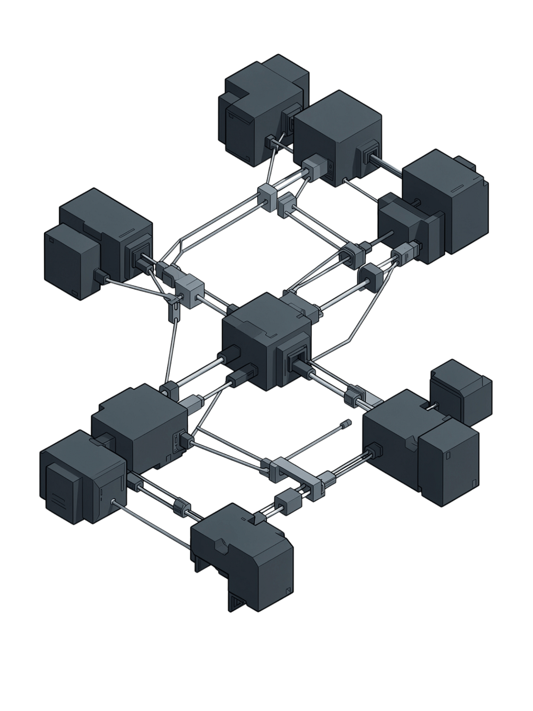
Introduction to Constraint Layout
The modern standard for Android UI development — designed from the ground up to flatten hierarchies and maximize rendering performance.
Constraint-Based Positioning
Flat by Design
Complex UIs that previously required deeply nested ViewGroups can be expressed in a single flat hierarchy — one pass, maximum performance.
Every view is positioned via constraints connecting its edges to other views, guidelines, barriers, or the parent itself.
Flexible & Responsive
Guidelines and barriers dynamically adapt positioning to any screen size, orientation, or density without hardcoded values.

Slide 10
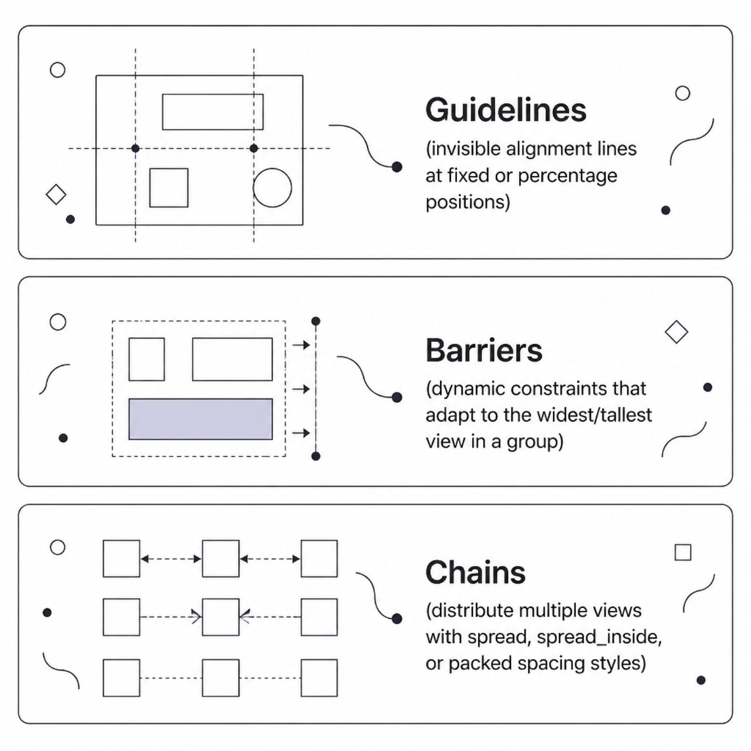
Key Features of Constraint Layout
Guidelines
Invisible reference lines placed at a fixed dp or percentage position — snap multiple views to a consistent alignment without nesting.
app:layout_constraintStart_toStartOf="guideline"
Barriers
A dynamic constraint that tracks the largest child in a group, automatically shifting dependent views when content changes size.
Chains
Link a row or column of views into a chain and choose a spread style: spread, spread_inside, or packed.
app:layout_constraintHorizontal_chainStyle
="spread_inside"

Slide 11
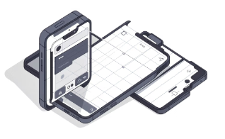
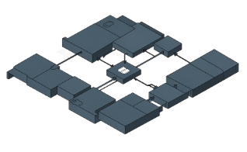
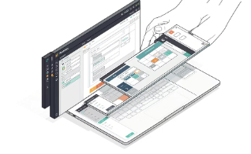
Constraint Layout in Action
Responsive to Any Orientation
One Flat Hierarchy
Visual Editor in Android Studio
A ConstraintLayout with 10 sibling views outperforms an equivalent nested LinearLayout/RelativeLayout stack — single-pass measurement, every time.
Percentage-based guidelines and bias values ensure layouts reflow gracefully between portrait and landscape — no duplicate XML files needed.
Drag views onto the canvas, snap constraints visually, and preview on multiple device sizes — constraint creation without writing a single line of XML.
ConstraintLayout is the recommended layout for all new Android projects — start here and reach for LinearLayout only when its simplicity is a genuine fit.

