Slide 1
SDG 11 · SDG 3
AirSense
An AI-Powered Air Quality Health Advisory Assistant
1M1B AI for Sustainability Virtual Internship
In collaboration with IBM SkillsBuild & AICTE
Suthirtha Dey
Institute of Engineering & Management, Kolkata

Slide 2
The Problem
Cities publish AQI numbers — but residents don't know what to do with them.
Why the gap exists
Who is affected
AQI is published as a single number (e.g. "187") with little explanation of real-world meaning
No personalization — a healthy adult and an asthma patient get the identical, generic reading
Vulnerable groups (children, elderly, respiratory patients) face the highest risk but the least guidance
Most people check weather apps daily, but rarely check air quality — it's invisible until symptoms appear
A
Children & parents of toddlers
B
Asthma / COPD patients
C
Elderly residents
D
Daily commuters & outdoor workers

Slide 3
SDG Alignment & Problem Statement
11
Sustainable Cities
& Communities
3
Good Health
& Well-being
PRIMARY SDG
SECONDARY SDG
PROBLEM STATEMENT
How might we use AI to translate raw air quality data into personalized, actionable health guidance, so that city residents — especially vulnerable groups — can reduce their exposure to air pollution?

Slide 4
How AirSense Works
A two-stage AI pipeline: prediction, then personalized advisory generation
1
2
3
4
Data Input
→
Prediction Model
→
User Profile
→
Advisory Engine
Live AQI feed: PM2.5, PM10, NO₂, O₃,
humidity, wind, traffic index
ML classifier estimates AQI
category (Good → Severe)
Age group, health condition,
planned activity (optional input)
Prompt-based AI generates plain-
language, personalized guidance
Output: "Air quality is Poor today. Limit outdoor activity for your toddler to under 15 minutes..."
Tools used: prompt engineering · scikit-learn classifier · Granite / LLM-based advisory prompting

Slide 5
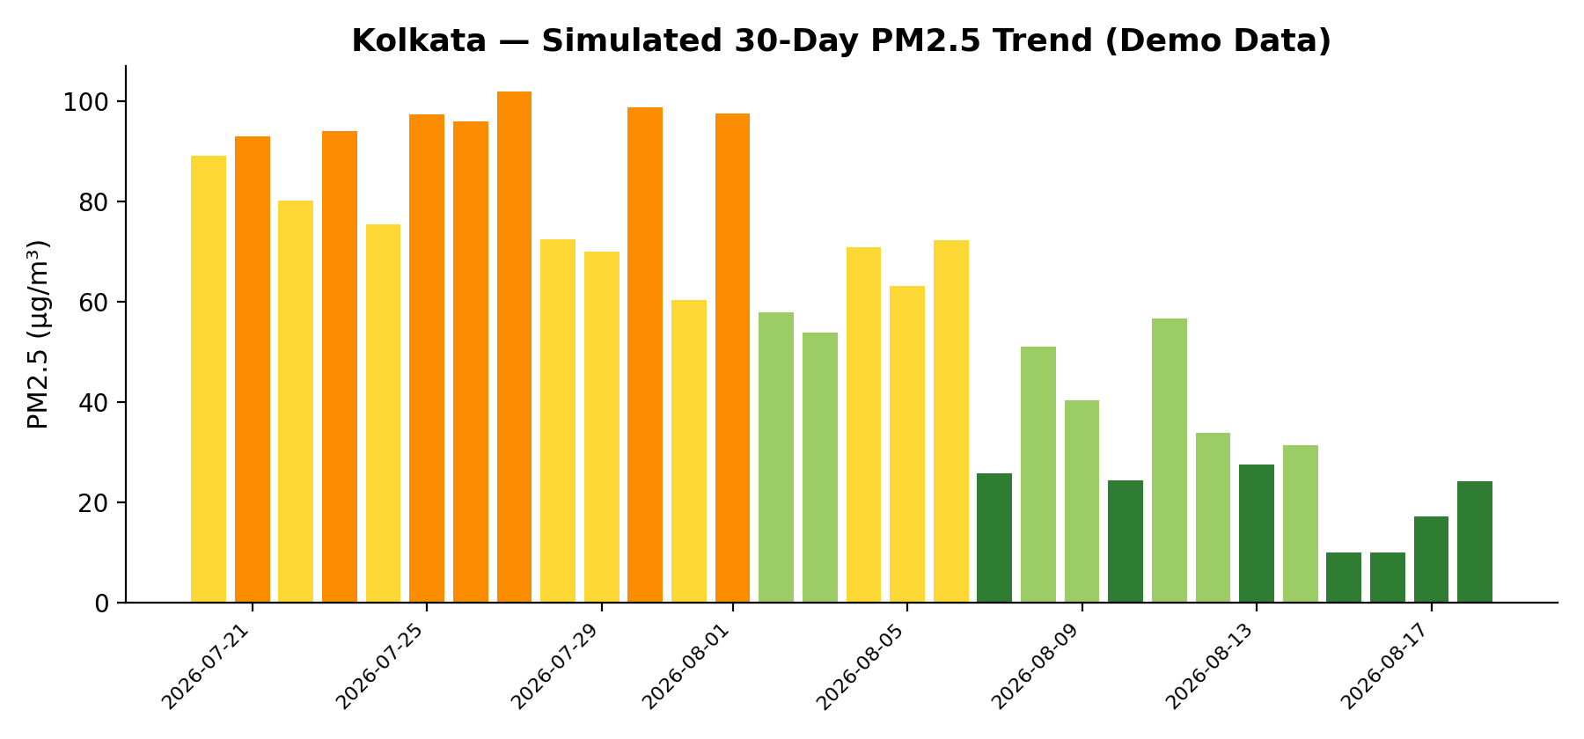
Prototype — Part 1: Prediction Model
A Random Forest classifier trained to predict AQI category from pollutant & weather inputs
80.7%
classification accuracy on held-out test data
Top predictors
PM10 concentration
Traffic density index
NO₂ level & wind speed
Note: trained on a synthetic dataset built to CPCB AQI breakpoint standards (demo purposes). Production version would train on live CPCB / OpenAQ sensor feeds — pipeline and model logic remain identical.

Slide 6
Prototype — Part 2: Personalized Advisory
Same AQI reading → three different, personalized outputs
Input: AQI = Poor (PM2.5 118 µg/m³) · Location: Kolkata · Time: 8:30 AM
General Resident
Asthma / COPD Patient
Parent of Toddler (age 3)
Air quality is Poor today. Reduce prolonged outdoor exertion, especially near traffic. Prefer indoor exercise until evening, when pollution typically eases.
Poor air quality raises symptom risk. Keep reliever medication handy, avoid outdoor exercise, and wear an N95 mask if you must step out. Contact your doctor if breathing feels labored.
Limit your toddler's outdoor play to under 15 minutes, ideally before 8 AM. Keep windows closed during peak traffic hours (8–10 AM). Watch for coughing and consult a pediatrician if it persists.

Slide 7
Responsible AI Considerations
⚖
Fairness
🔍
Transparency
Advisory logic works across income levels — suggests low-cost alternatives (cloth masks, ventilation) alongside purifiers, not purifiers only.
Every recommendation shows the underlying AQI number and category — never a black-box suggestion with no visible reasoning.
🩺
Ethics
🔒
Privacy
The assistant gives general guidance only — never a medical diagnosis — and always directs serious symptoms to a doctor.
User profile (age group, health condition) is used only within the session for personalization and is never stored or shared.

Slide 8
Expected Impact
What changes if AirSense is implemented city-wide
Daily
Targeted
Scalable
actionable guidance instead of
a once-glanced-at number
advice for vulnerable groups,
not generic warnings
to any city with a public
AQI / sensor feed
Who benefits, and how
Residents plan daily activity (commute timing, outdoor exercise, mask use) around real health risk, not a raw number
Vulnerable groups (children, elderly, asthma/COPD patients) get proactive, condition-specific guidance
City health & environment departments gain a low-cost public communication layer on top of existing AQI infrastructure

Slide 9
Clean air, clear decisions.
AirSense turns air quality data into guidance people can actually act on.
Suthirtha Dey · Institute of Engineering & Management, Kolkata
1M1B AI for Sustainability Virtual Internship · IBM SkillsBuild & AICTE

