Slide 1

SAMSUNG PRISM
Generative AI
Hackathon
3rd Edition 2026 – 27
Theme ID - 2
Team Name – Aether X
College Name – Vellore Institute of Technology, Vellore
Member Name & Email 1 - Deepak PT deepak.pt2024@vitstudent.ac.in
Member Name & Email 2 - Suthish S suthish.2024@vitstudent.ac.in
Member Name & Email 3 - Malini S malini.s2024@vitstudent.ac.in
Member Name & Email 4 - Gayathri M gayathri.m2024@vitstudent.ac.in
Submission Github link - https://github.com/Suthish-S-lone/SamsungPrism_AetherX
Notes:
Opening slide for the 3rd edition of the PRISM Generative AI Hackathon. Replace the SAMSUNG PRISM pill with the official PRISM logo image if you have the asset. Confirm the academic year label (2026-27) before circulating.

Slide 2
Theme 2: The Smart Guided Troubleshooting Engine
THE ISSUE
OUR ANSWER
“My phone dies before lunch.”
SmartGuide
A grounded natural-language troubleshooting engine
Users describe device problems in layman’s terms, not technical language.
1
Translates user complaints into technical symptoms
COMMON PROBLEMS
Battery drain
Erratic brightness
Guides through step-by-step actions with rationales
2
Camera freezing
Sluggish performance
3
Leads users to the exact settings screen via prototype:// deep links
The gap: keyword systems need precise technical language or fail — causing frustration and unproductive service-centre visits.
4
Confirms the fix, or simulates escalation
Notes:
Open with the relatable complaint: 'my phone dies before lunch'. Real users never say 'abnormal background wakelock usage' - they describe symptoms in everyday words. Keyword search fails on this, so users hit dead ends and visit service centres unnecessarily. SmartGuide (right) is our answer: it translates the complaint, guides step by step with reasons, takes the user to the exact settings screen, and confirms the fix or escalates.

Slide 3
Existing Solutions & Gaps
Existing approach: keyword-based troubleshooting
How SmartGuide closes the gaps
Gap 1
Can’t understand slang or non-specific requests; precise technical terms are needed
Query canonicalization turns casual speech into technical symptoms
✓
Gap 2
Leads to dead ends and multiple service-centre visits
Hybrid BM25 + neural search finds the right issue and avoids hallucination
✓
Gap 3
Only tells users what to do, not where to go; never reaches the right screen
Deep-linked steps + an interactive One UI phone simulator
✓
Gap 4
Reasoning is opaque, and it never checks whether the issue was resolved
Inspector drawer shows signals, candidate rankings and latency; resolution check with escalation
✓
Notes:
Existing tools rely on keyword matching. We identified four gaps: (1) they can't handle everyday language, (2) users hit dead ends and revisit service centres, (3) they say what to do but not where to go, and (4) they are opaque and never verify the fix. Each SmartGuide component on the right maps to exactly one gap - walk across the rows left to right.

Slide 4
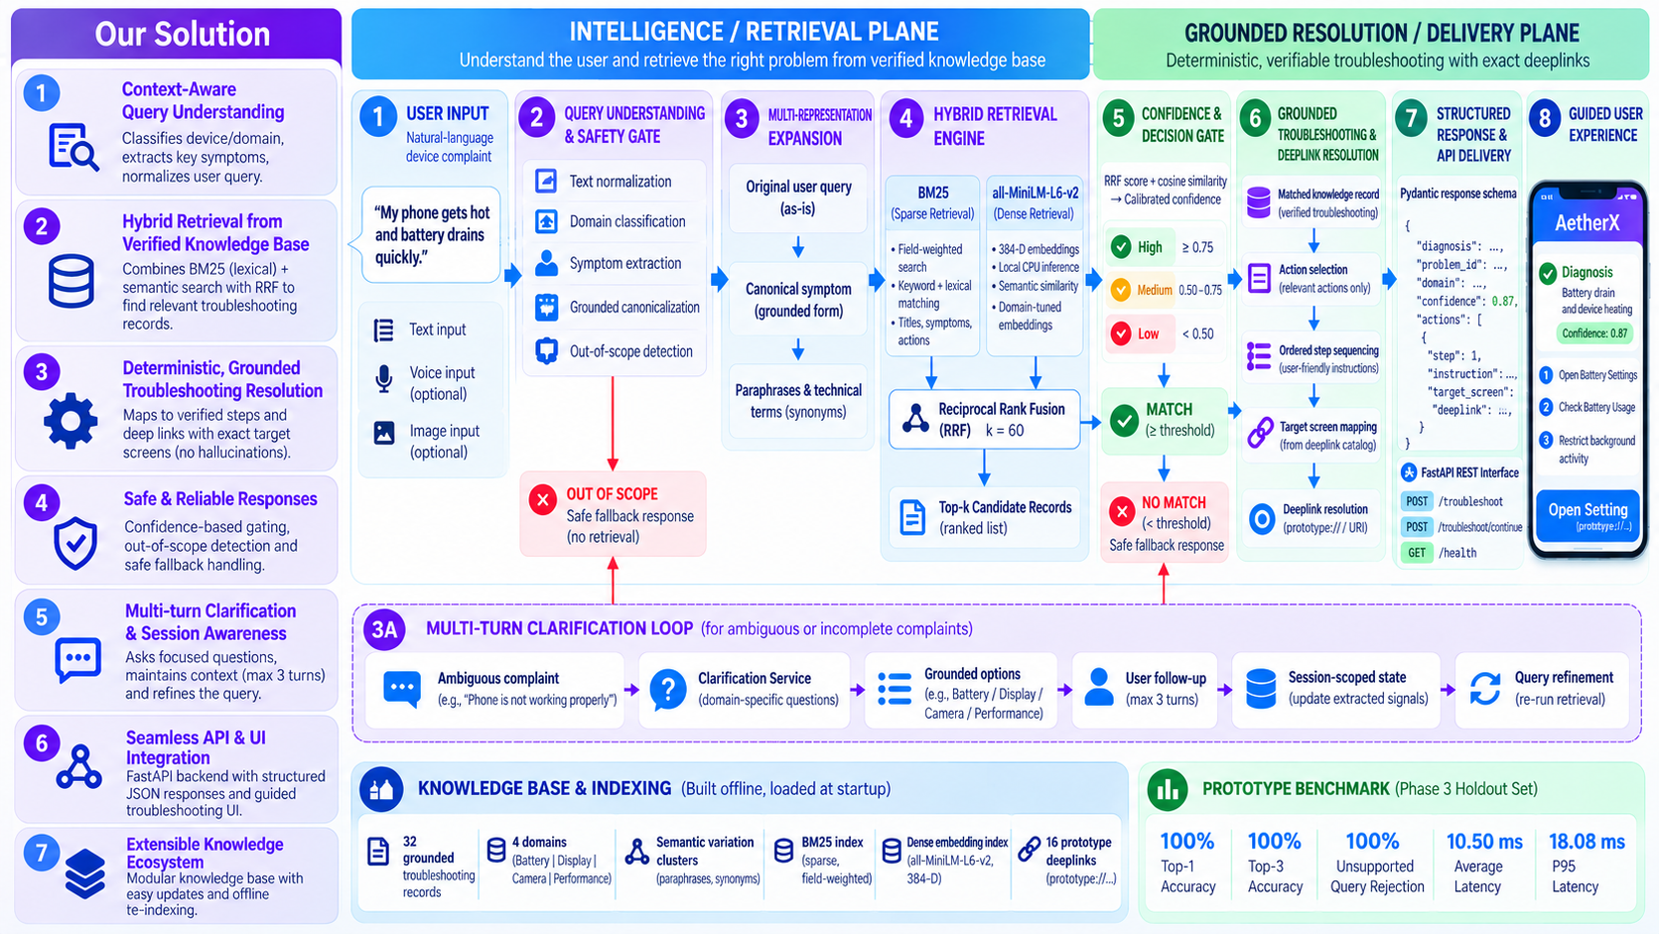
Our Solutions & Architecture Diagram

Slide 5
Demo & Product Walkthrough
Drive Link: https://drive.google.com/drive/folders/1WOhcyM7IJ1Eaqlwwx5GtKsKeJh3BnXIL?usp=sharing

Slide 6
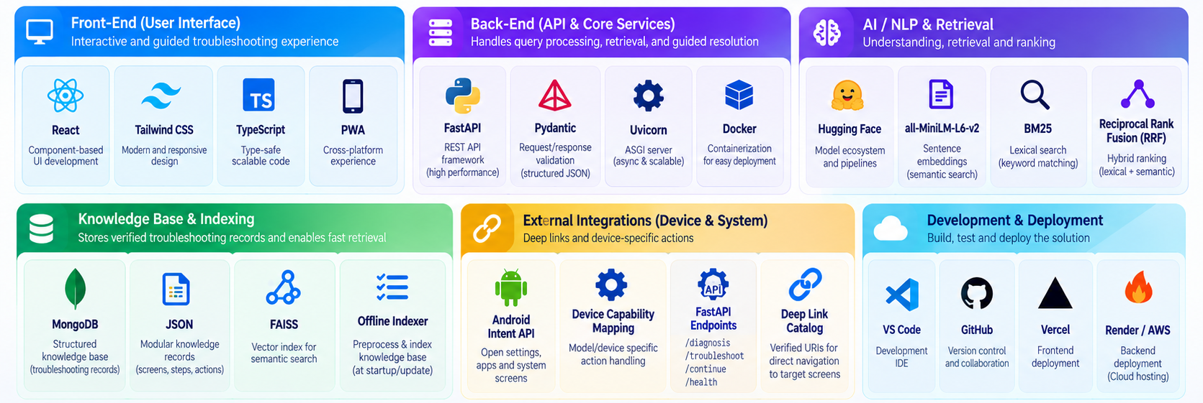
Tools and tech stack used

Slide 7
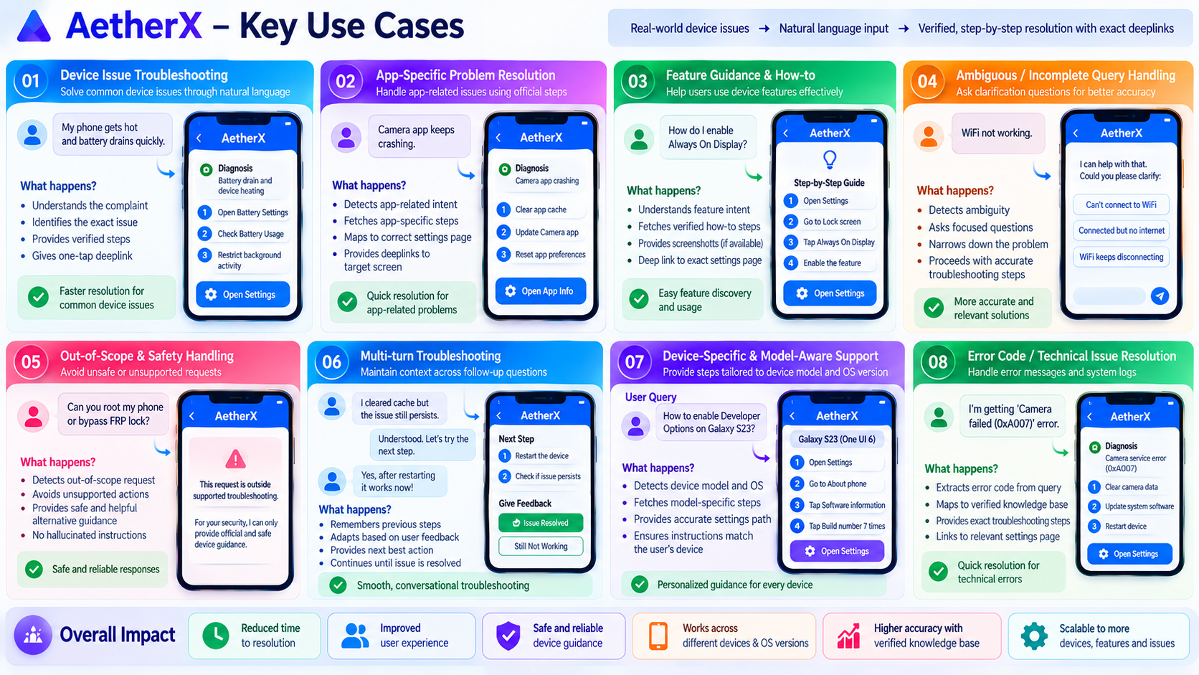
Impact & Use case

Slide 8
8. Innovation, Results & Limitations
PROTOTYPE • VALIDATED
What makes SmartGuide technically useful — and where the prototype still stops
INNOVATION
RESULTS
LIMITATIONS
↔
Hybrid retrieval
83.9%
93.6%
↗
Simulated device navigation
Combines BM25 keyword matching with dense semantic retrieval, then ranks candidates using RRF.
Top-1 accuracy
Top-3 accuracy
The current Settings destinations use prototype:// links and a One UI-inspired simulator.
Natural-language understanding
100%
16.87 ms
Development-scale knowledge base
AI
DB
Canonicalizes colloquial complaints before matching them to the troubleshooting knowledge base.
Unsupported rejection
Avg. turn latency
Current prototype contains 32 troubleshooting records across Battery, Display, Camera and Performance.
Guided, not generic
1.74
→
Mean diagnostic turns
!
No physical hardware checks
Maps the diagnosis to ordered actions and an exact Settings destination using a simulated deeplink.
It does not yet read live device telemetry or verify physical hardware faults.
Multi-turn + verification
DEMO EVIDENCE
✓
Can ask clarifying questions and lets the user verify the recommended setting after the guided step.
95% match confidence shown for the displayed-brightness demo scenario.
→
Production integration pending
Samsung internal systems, production deeplinks and real escalation channels are future work.

Slide 9
What’s next — engineering roadmap
INGEST
INDEX
ENRICH
RETRIEVE
GENERATE
VERIFY
Scenario + Settings data
Sparse + semantic
Normalize query
Top candidates
Structured JSON
Outcome feedback
01
Knowledge representation
02
Two-stage LLM pipeline
03
Hybrid retrieval
10k+ scenario target
Normalize → structured response
BM25 + semantic + RRF
Store each scenario as symptom → diagnosis → ordered actions → Settings deeplink. Version mappings so fixes remain auditable.
Stage 1 converts colloquial text into a technical query. Stage 2 consumes retrieved evidence and emits a predictable troubleshooting schema.
Sparse retrieval protects exact Settings/device terminology; semantic retrieval handles paraphrases. Fuse ranked lists before generation.
DATA CONTRACT
MODEL CONTRACT
RETRIEVAL LAYER
04
Fast-path serving
05
Context & disambiguation
06
Evaluation loop
Cache validated answers
Model + One UI / OS
Accuracy / latency / cost
Pre-validated scenarios can bypass the full generation path. Problem statement targets cached answers under 300 ms.
Use supported device/software metadata to avoid mapping the same symptom to an incompatible Settings destination.
Measure step-level correctness, response latency and cost/query; feed failed cases back into scenario mappings and validation.
LATENCY PATH
CONTEXT LAYER
QUALITY LOOP
PRODUCTION PATH
REST/API → normalize → retrieve → structured JSON → deeplink → cache / verify → metrics

Slide 10
Brownie points / technical depth
END-TO-END INFERENCE PATH
WHY THIS IS NOT A GENERIC FAQ
1
2
3
4
5
6
• Action-oriented: every answer ends in ordered troubleshooting steps.
• Destination-aware: steps are paired with Settings deeplinks.
• Hybrid retrieval: exact terminology + semantic paraphrase handling.
• Latency-aware: fast-path cache for validated scenarios.
• Measurable: step accuracy, latency and cost/query are explicit evaluation axes.
USER QUERY
ENRICH
RETRIEVE
GENERATE
MAP
VERIFY
“Wi‑Fi keeps dropping”
technical query + context
BM25 ∪ semantic → RRF
ordered JSON actions
Settings deeplink
resolved / retry
RETRIEVAL FUSION
STRUCTURED OUTPUT CONTRACT
RRF(d) = Σ 1 / (k + rank(d))
{
"diagnosis": "…",
"actions": [
{"step": 1, "text": "…",
"deeplink": "settings://…"}
],
"confidence": "…"
}
Why RRF: BM25 and semantic scores are on different scales. Fusion by rank avoids raw-score calibration and rewards candidates that rank well across signals.
TECHNICAL VALUE
RANK-LEVEL
HYBRID
Executable data > free-form answer
NLP → retrieval → decision structure → action
01
RETRIEVAL QUALITY
02
GENERATION SAFETY
03
SYSTEM FEEDBACK
Sparse signal
Evidence-grounded output
Outcome-driven learning
Exact tokens such as Settings labels, device terms and feature names remain searchable even when semantic similarity is weak. Semantic retrieval covers paraphrases and colloquial descriptions.
The generator should use retrieved scenario evidence, emit ordered steps, and attach the corresponding Settings destination instead of inventing a path.
Log query → retrieved scenario → generated steps → user outcome. Failed resolutions become candidates for new mappings, better ranking or cache invalidation.

Slide 11
Checklist- Updated on Public GitHub
Working prototype code — public or shared GitHub repo (Yes)
README with reproducible setup instructions (Yes)
Demo video, max 5 minutes (Drive link)
Presentation file (PPT or PDF) (Yes)

Slide 12
Thank you
Notes:
Closing slide. Add the Google Form URL and a contact email before sharing. Edition 2 organising team for reference: Language AI - Sourabh Tiwari, Gaurav, Sanjeeth Pothireddy, Gorang Maniar; PRISM - Binny Lakra, Prakhar Chandrakar, Vishu Kumar; Kick-off and mentors - Giridhar Jakki, Deepraj Prabhakar Patkar (Language AI), Srimanu Prasad Nagaraju, Ashish Kumar (Tech Strategy).

