Slide 1
THEMES of MINIMAL MISTAKES
DEFAULT, DARK or MINT

Slide 2
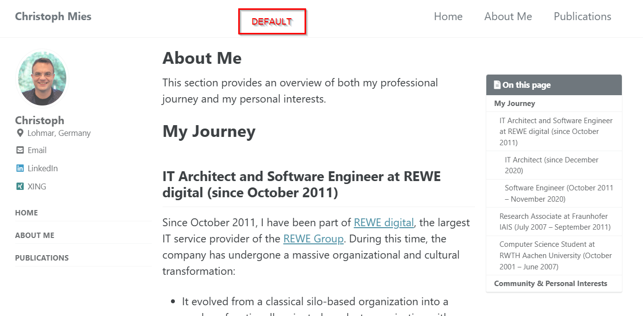
DEFAULT

Slide 3
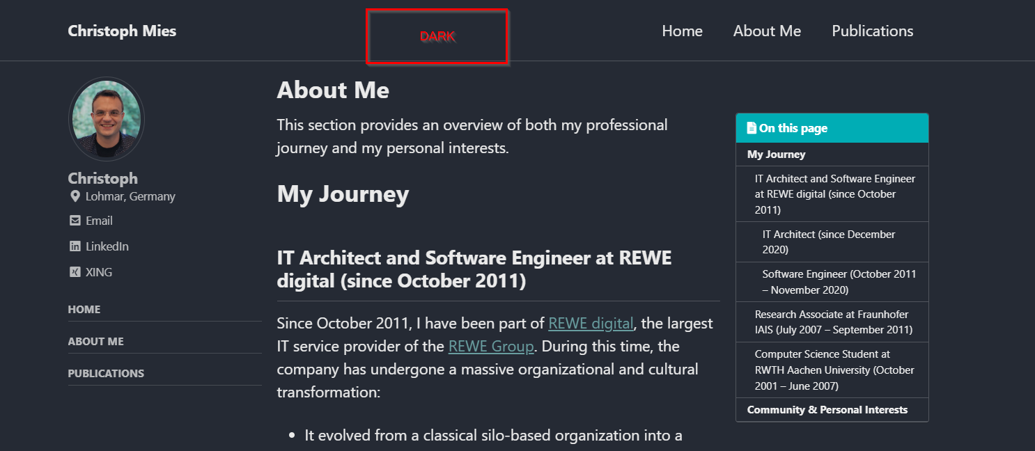
DARK

Slide 4
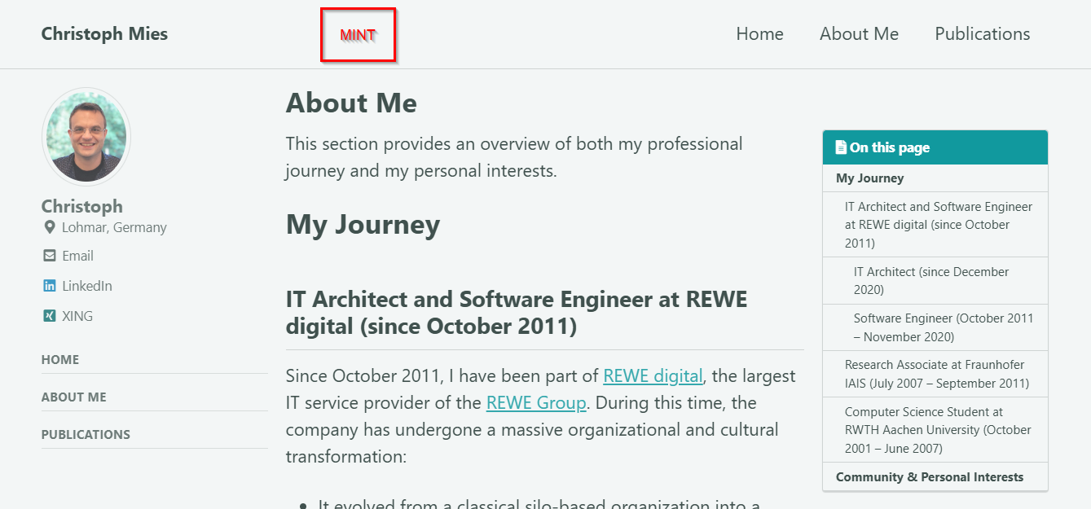
MINT

Slide 5
THEMES of MINIMAL MISTAKES
all

Slide 6
DEFAULT

Slide 7
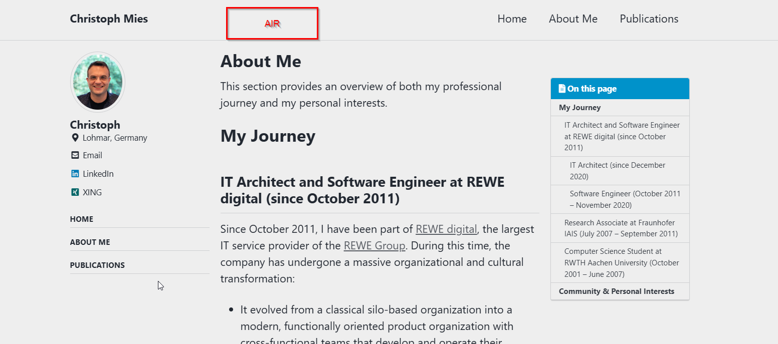
AIR

Slide 8
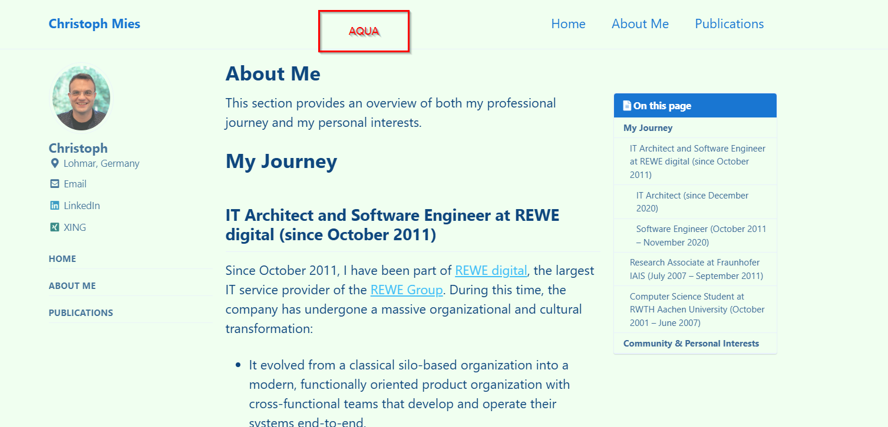
AQUA

Slide 9
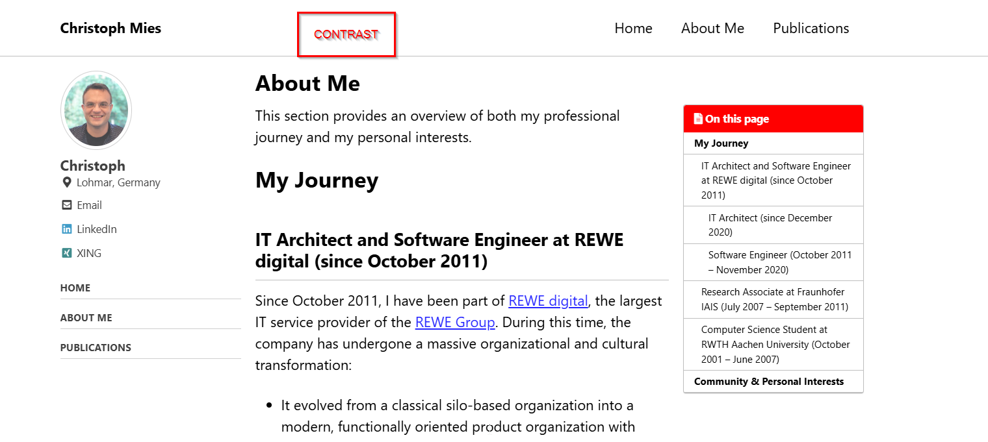
CONTRAST

Slide 10
DARK

Slide 11
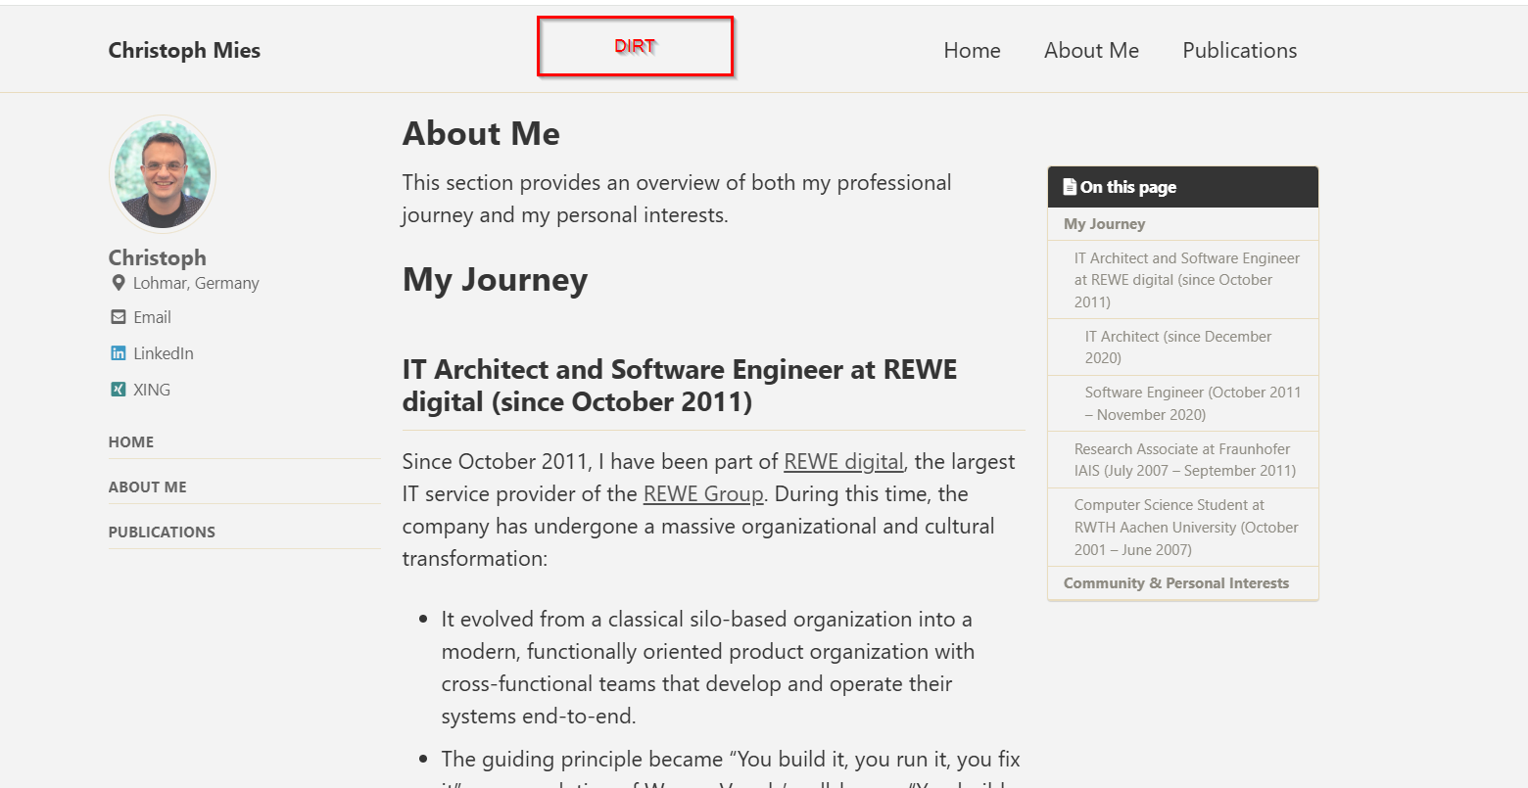
DIRT

Slide 12
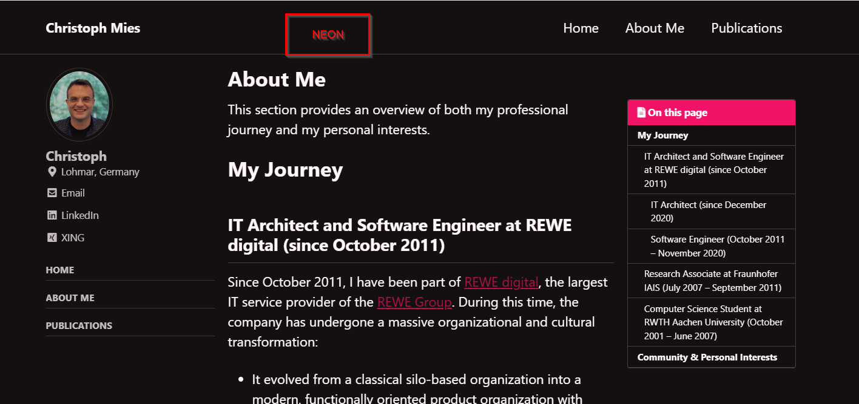
NEON

Slide 13
MINT

Slide 14
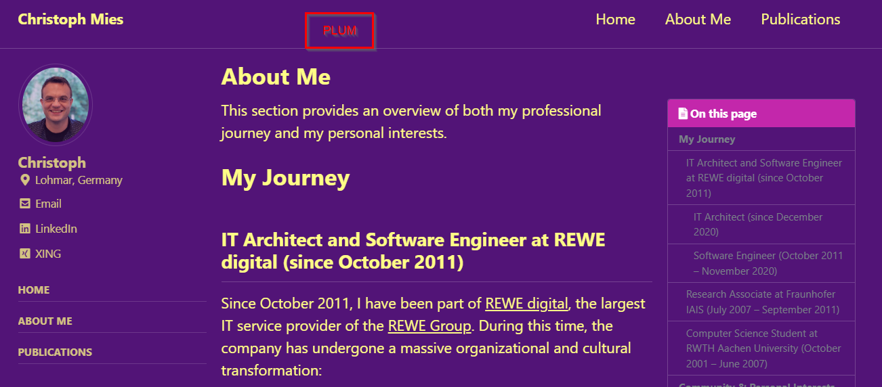
PLUM

Slide 15
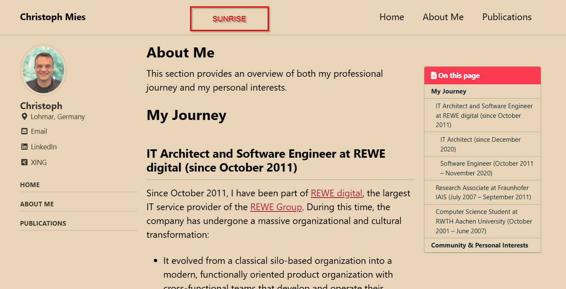
SUNRISE

