Slide 1

QWorld 2023
Quantum machine learning of large datasets
Mentor: Louis Chen
Lead: Harshdeep Singh
Interns: Sutirtha Biswas, Aditya Chari S, Yuri Han

Slide 2
Motivations & Task
To develop and optimize QML algorithms that utilize randomized measurements for measuring quantum kernels, effectively addressing the limitations associated with conventional methods.
Motivations
Aimed to create a Quantum Machine Learning algorithm that optimizes large and high-dimensional data and encoding into a quantum computer by integrating with Quantum Self-Attention Network Layer.
Tasks
Literature Survey
Read and understand the structure of Quantum Self-Attention Network (QSAN) from the paper
Ren-xin Zhao, JinJing Shi et al., “QSAN: A Near-term Achievable Quantum Self-Attention Network”, arXiv:2207.07563.
Algorithmic Tasks
Create a feature map (ex. ZZ Feature map) to encode classical data into a quantum state
Create a neural network layer using pyTorch
Integrate the built algorithm with a QSAN Layer

Slide 3

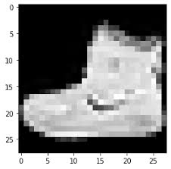
The Hybrid SAN Architecture
ReLU
ReLU
Qiskit’s EstimatorQNN
Tanh * Π/2
Fashion-MNIST
Dropout 0.4
Dropout 0.3
Cross Entropy Loss
Parameterized Ansatz QSAN layer
Measurement / Observables
Quantum encoder /
Parameterized Feature Map
10
(#classes)
28x28 = 784
256
64
8
Dimensionality Reduction
Backpropagation
Qiskit’s TorchConnector

Slide 4
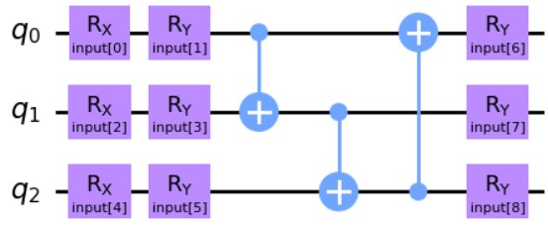
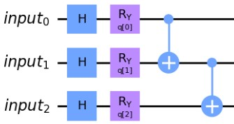
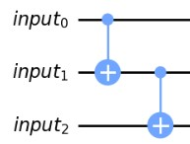
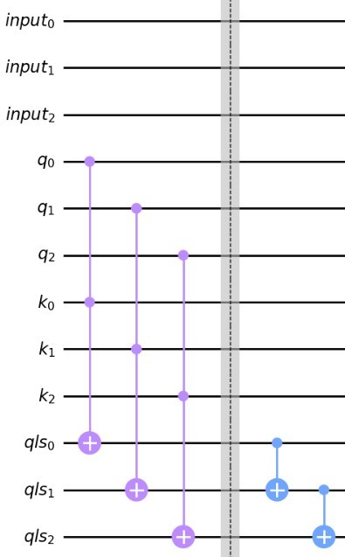
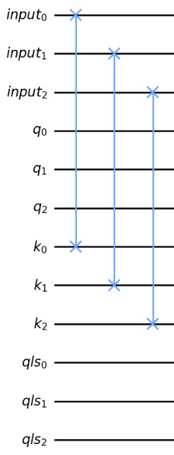
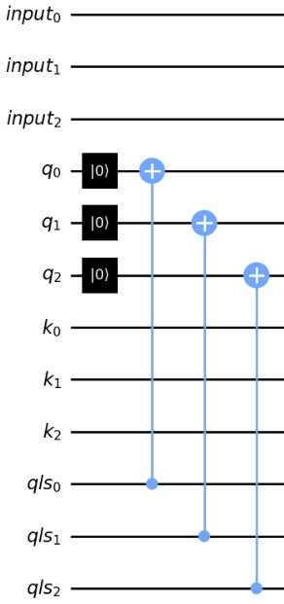
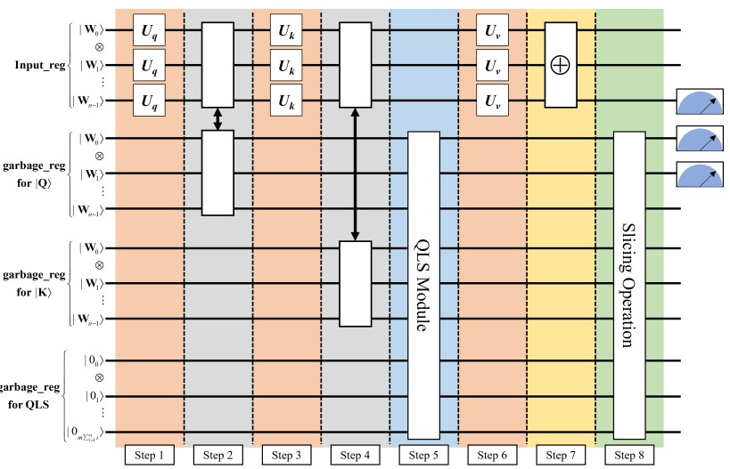

The EstimatorQNN Module
Quantum Encoder/ Feature Map
Uq/Uk/Uv : Step 1,3,6
Compression: Step 7
Ansatz : QSAN
QLS Module: Step 5
Barbell: Step 2,4
Slicing: Step 8

Slide 5
Results
For testing the model we have used the Fashion MNIST dataset (10 categories division) and we have run the model in Google Colab TPU with varying the number of qubits used (2 and 3).
For Number of qubits = 2:-
Epoch: 1 |Train Loss: 2.3588763236999513 | Train Accuracy: 9.5 | Test Loss: 2.246659517288208 | Test Accuracy: 13.333333333333334
Epoch: 2 |Train Loss: 2.333886647224426 | Train Accuracy: 14.0 | Test Loss: 2.2691702842712402 | Test Accuracy: 20.0
Epoch: 3 |Train Loss: 2.316146159172058 | Train Accuracy: 20.0 | Test Loss: 2.242501735687256 | Test Accuracy: 23.333333333333332
Epoch: 4 |Train Loss: 2.3064623832702638 | Train Accuracy: 14.5 | Test Loss: 2.2205288410186768 | Test Accuracy: 20.0
Epoch: 5 |Train Loss: 2.290626549720764 | Train Accuracy: 15.5 | Test Loss: 2.222637891769409 | Test Accuracy: 20.0
Epoch: 6 |Train Loss: 2.294108009338379 | Train Accuracy: 17.5 | Test Loss: 2.2340269088745117 | Test Accuracy: 20.0
Epoch: 7 |Train Loss: 2.2834161043167116 | Train Accuracy: 17.5 | Test Loss: 2.2061641216278076 | Test Accuracy: 23.333333333333332
Time Taken :- 19mins ; Epochs = 7.
Runtime used:- TPU
Observation:- Train Accuracy = 17.5% and test accuracy = 23.3%;

Slide 6
Results (Continuation….)
Now testing on same dataset with no. of qubits = 3.
For Number of qubits = 3:-
Epoch: 1 |Train Loss: 2.2724218368530273 | Train Accuracy: 14.0 | Test Loss: 2.2400310039520264 | Test Accuracy: 20.0
Epoch: 2 |Train Loss: 2.215902876853943 | Train Accuracy: 20.5 | Test Loss: 2.225329637527466 | Test Accuracy: 16.666666666666668
Epoch: 3 |Train Loss: 2.1963553190231324 | Train Accuracy: 23.0 | Test Loss: 2.1791791915893555 | Test Accuracy: 30.0
Epoch: 4 |Train Loss: 2.1787861585617065 | Train Accuracy: 23.0 | Test Loss: 2.173187255859375 | Test Accuracy: 20.0
Epoch: 5 |Train Loss: 2.1611469268798826 | Train Accuracy: 24.0 | Test Loss: 2.1502532958984375 | Test Accuracy: 23.333333333333332
Epoch: 6 |Train Loss: 2.1585278272628785 | Train Accuracy: 23.5 | Test Loss: 2.1358399391174316 | Test Accuracy: 30.0
Epoch: 7 |Train Loss: 2.1618845462799072 | Train Accuracy: 23.5 | Test Loss: 2.1479225158691406 | Test Accuracy: 23.333333333333332
Time Taken :- 1hr 2mins ;Epochs:- 7 ; Runtime Used:- TPU
Observation:- Train Accuracy: 23.5% and Test Accuracy : 23.3%.
Compared to the previous result:-
This model gives more accuracy but its way more computationally expensive than previous one .
In both models the accuracy is very low, subjecting to conclusion that these models are failing to capture the complexity of the data set well.

