Slide 1
The Linkages Between Oil Market Uncertainty and Islamic Stock Markets: Evidence from Quantile-on-Quantile Approach
Authors: Boqiang Lin, Tong Su
Presenter: Tong Su

Slide 2
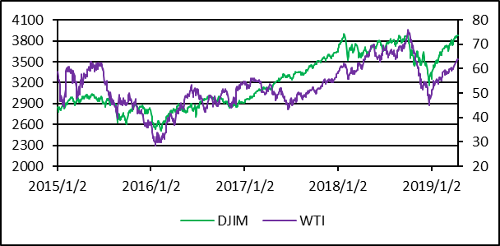
Background and Motivation
2018: $ 2.4 Trillion
ISLAMIC
ASSETS
2023: $ 3.8 Trillion
Islamic financial assets have achieved a huge volume and Islamic stock market gains rapid growth so that attracting many international investors.
Notes:
Refinitiv
金融服务以利息为基础
博彩业
生产或售卖非清真产品或相关产品
统保险
伊斯兰教义下不允许的娱乐活动
生产或售卖烟草为基本的产品或相关产品
股票经纪或股票交易涉及不符合伊斯兰教义股项，以及
其他被视为不被伊斯兰教义允许的活动

Slide 3
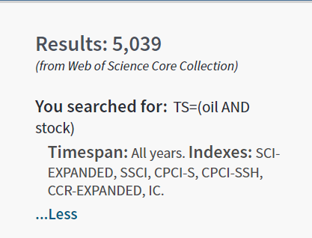
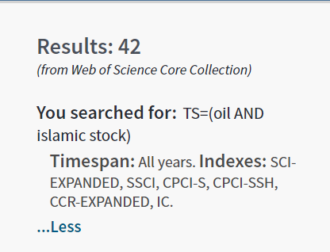
Background and Motivation
It’s still a new area
There are thousands of literatures investigate the oil-stock nexus, but in which Islamic stock markets still gained little attention. At the same time, relevant researches in this field are gradually emerging.

Slide 4
Background and Motivation
Literatures | Main findings
Mongi, A. (2019) | There is a long-term relationship between DJIM Emerging Markets Index and oil futures prices.
Narayan et. al (2019) | Oil prices will affect some Islamic stock returns, and oil prices have a predictive effect on Islamic stock indices.
Mishra et. Al (2019) | The impact of global crude oil prices on the DJIM Islamic stock index is asymmetric, heterogeneous.
Hassan et. Al (2019) | The correlation between oil prices and the BRIC Islamic stock indices is not high, especially in China and India.
Ftiti and Hadhri (2019) | Brent crude oil price Granger leads to Islamic index.
Badeeb and Lean (2018) | The nature and sensitivity of Islamic stock price responses to oil price shocks vary widely between sectors.
Shahzad (2018) | There are upside and downside risk spillovers from the oil to Islamic stock markets， while downside risk spillovers are always more considerable.
1.The oil market does have an impact on the Islamic stock market
2. This effect is generally asymmetric and heterogeneous
3. This effect is different for different Islamic stock markets.
4. Lack of analysis from the perspective about oil uncertainty.
Notes:
Most of the existing researcher only analyze the relationship between the two markets from the perspective of oil prices, paying insufficient attention to uncertainty from the entire oil market. Meanwhile, research on the analysis of Islamic stocks from the national level is also lacking. So we want to fill in this gap.

Slide 5
Core question and derivation
How are the linkages between the oil market uncertainty and national Islamic stock indices? Especially the asymmetry and heterogeneity between them.
From the perspective of financial theory
Volatility feedback theory
Conservative bias theory
The increase in uncertainty (expected volatility) will decrease the current stockholders' expected return, causing the stock price to fall.
After receiving the positive (bad) news, the investors will remain (deteriorate) their passive (optimistic) attitude for the stocks that were previously bullish (bearish)
The linkages or effect will be -
There may be overreaction/ underreaction in their links

Slide 6

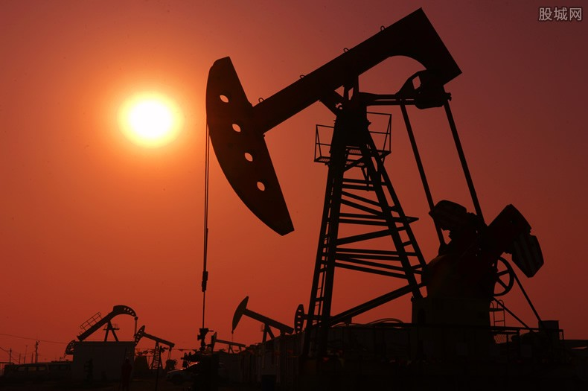
Core question and theoretical derivation
From the perspective of reality
Risk sharing
Oil trade
Islamic stocks are risk-sharing, so the impact of a minor risk shock should not be particularly noticeable. At the same time, the phenomenon of overreaction and insufficient reaction will be relatively small.
The stock market of oil-exporting countries is more closely linked to the oil market, so the overall impact on Islamic stock markets will be greater.
Market reaction may be different for countries specific situation
Market reaction may be greater for net oil exporters.

Slide 7
Variables and data
Dependent Variable
Independent Variable
All the daily data are from the Datastream database, the sample periods are same from 25 April 2013 to 15 April 2019 (In accordance with the availability of data) . All the time series are calculated as the logarithmic difference to represent the continuously returns.
Islamic stock indices:
DowJones Islamic stock indices
(The national samples are USA, British, Malaysia, Turkey and Kuwait, since they are representative)
Oil market uncertainty:
OVX index
(Since that it contains both historical and future information thus has a better capability to measure the oil market uncertainty)

Slide 8
Descriptive and Basic Analysis
 | OVX | British | USA | Kuwait | Malaysia | Turkey
Mean | 0.0000 | 0.0000 | 0.0003 | -0.0001 | -0.0002 | -0.0005
Std.Dev | 0.048 | 0.015 | -0.097 | 0.008 | 0.008 | 0.018
Minimum | -0.440 | -0.100 | 0.117 | -0.052 | -0.046 | -0.167
Maximum | 0.425 | 0.117 | 0.012 | 0.079 | 0.050 | 0.080
Skewness | 0.765 | -0.181 | -0.197 | 0.134 | 0.113 | -0.783
Kurtosis | 13.034 | 11.364 | 13.925 | 13.479 | 7.217 | 10.444
Jarque-Bera | 1400.50*** | 9088.70*** | 15497.00*** | 6432.50*** | 1044.30*** | 3387.70***
Islamic stock market | British | USA | Kuwait | Malaysia | Turkey
r_{t-1} | 0.0434 | -0.0347 | 0.0116 | 0.1014 | 0.0395
(p-value) | (0.0920) | (0.1700) | (0.6630) | (0.0000) | (0.1320)
Oil market uncertainty | -0.0585 | -0.0616 | -0.0103 | -0.0294 | -0.0711
(p-value) | (0.0000) | (0.0000) | (0.0300) | (0.0000) | (0.0000)
Constant | 0.0001 | 0.0004 | -0.0001 | -0.0002 | -0.0005
(p-value) | (0.7980) | (0.0440) | (0.6290) | (0.3780) | (0.3340)

Slide 9
Methodology
Nonlinear (nonparametric) estimation
Detect complexities and heterogeneities in the linkages
Visualize relationships between variables
Quantile-on-quantile regression
(QQR)
By Sim and Zhou (2015)
(Main QQR function)
(Robustness test function)

Slide 10
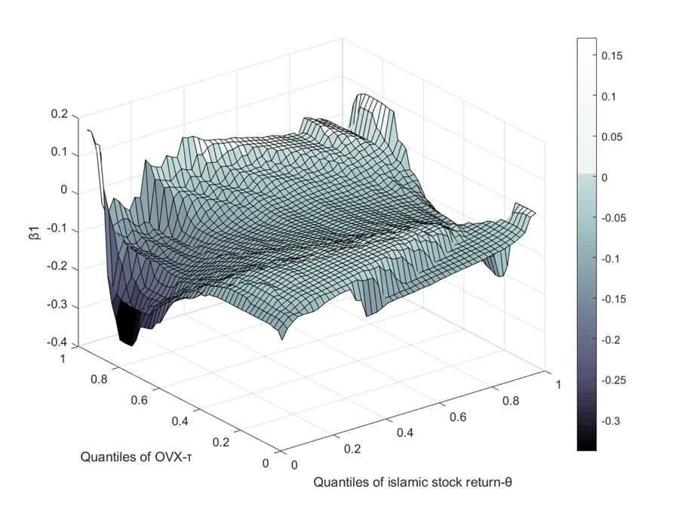
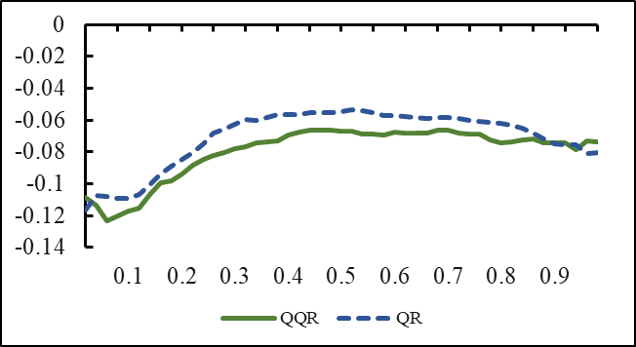
Results: USA
Overall negative effect
Underreact
Overreact
Robustness
Notes:
There are more international investors and non-Muslim participating markets

Slide 11
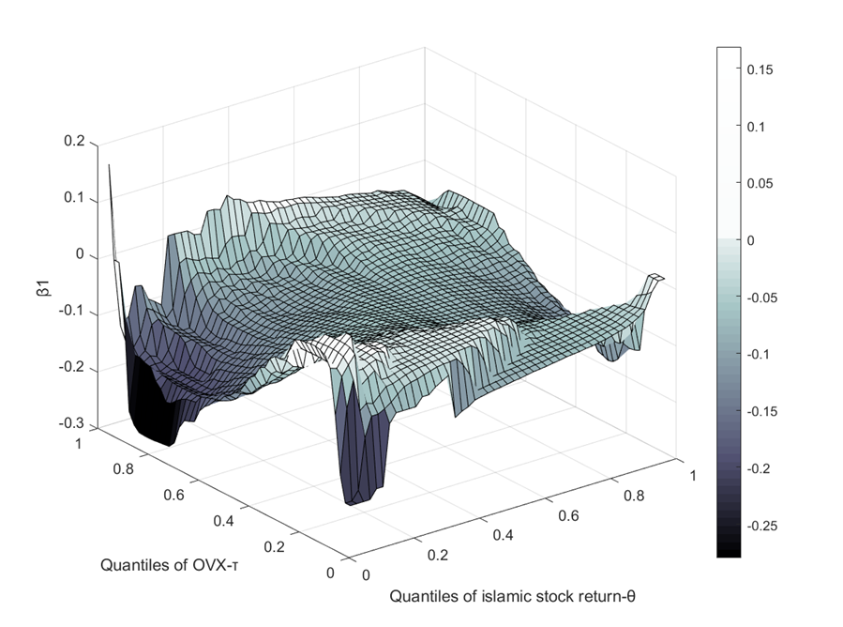
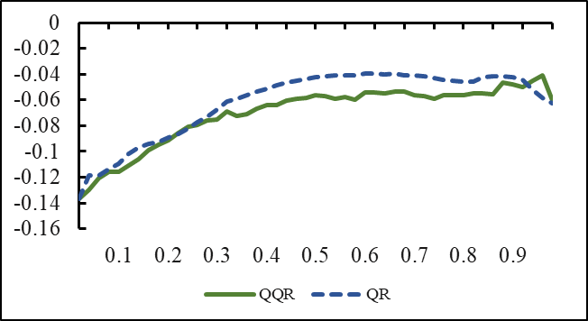
Results: British
Less underreaction

Slide 12
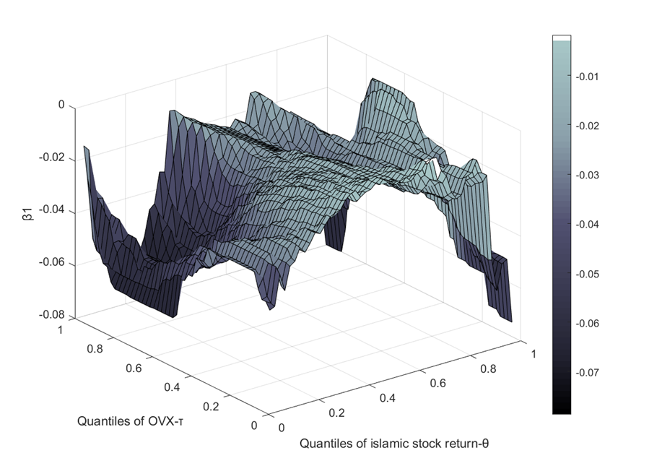
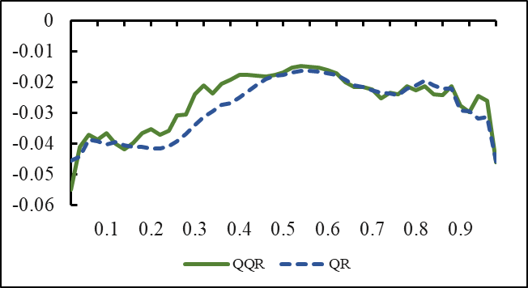
Results: Malaysia
Inverted U shape linkages
Weak effect in middle quantiles of oil market uncertainty

Slide 13
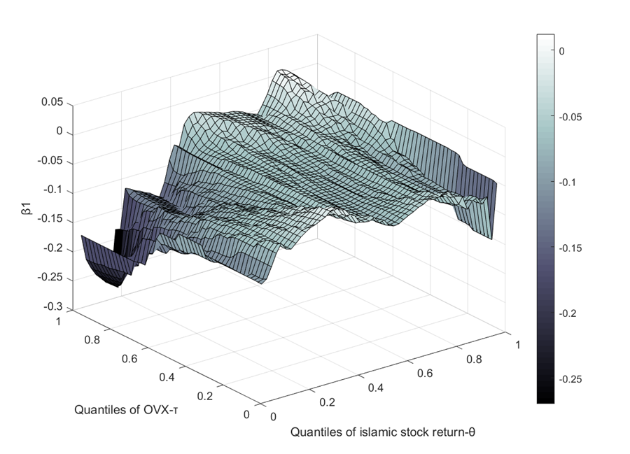
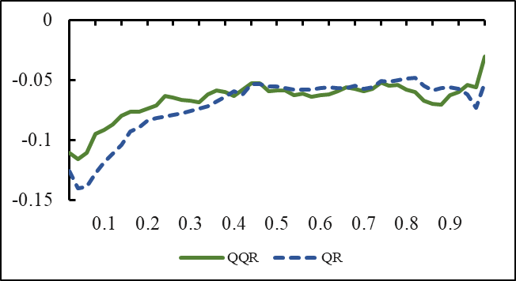
Results: Turkey
More obvious in high quantiles of oil market uncertainty, reflecting “risk-sharing” principle can help to hedge the risk from oil market.

Slide 14
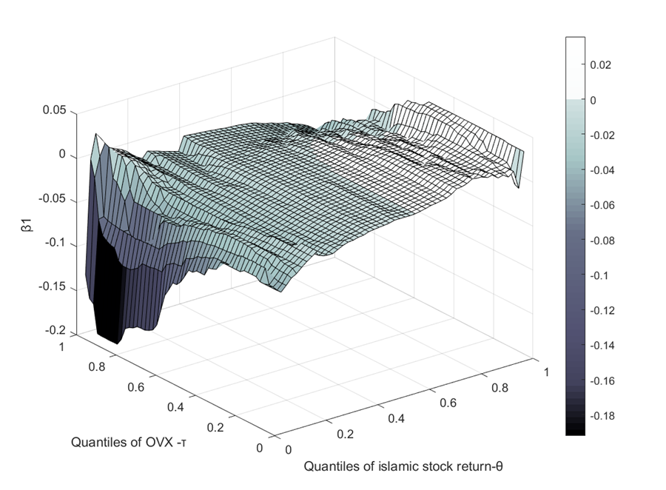
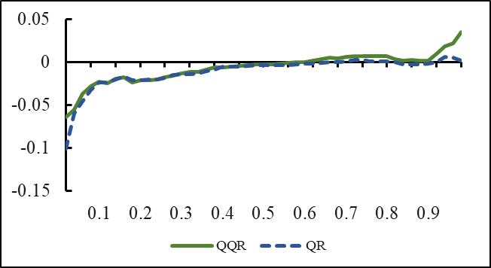
Results: Kuwait
There are even positive effects in bullish market of Islamic stock. (When the stock market rises, the possibility of higher oil prices is greater.)

Slide 15
Conclusion:
The increase in oil market uncertainty will significantly negatively affect the Islamic stock market, which can be proved by all samples.
The relationship between oil market uncertainty and the Islamic stock markets does have heterogeneity. That is, the impacts between different markets are different, which are influenced by the situation of countries’ Islamic degree and oil trade.
The relationship between oil market uncertainty and the Islamic stock markets does have asymmetry. That is, the impacts from positive and negative uncertainty shocks are different, which can be explained by some behavioral theory.

Slide 16
Thanks for your watching
Presenter: Tong Su

