Slide 1
Files and its locations:
Transmitter bits
data
Coding
QAM Modulator
OFDM Transmitter
Transmitter OFDM symbols
Channel
Received data
Viterbi Decoder
QAM Demodulator
OFDM Receiver
Receiver Coded Symbols

Slide 2
Parametes: | OFDM Symbols | Transmitter Bits | Receiver Coded Symbols
Sample Time | tS | tS/(48*20*log2(M)*codeRate)*64*24 | tS/(48*20)*64*24
Output buffer size | 64*24 | (48*20*log2(M)*codeRate) | 48*20
Error Rate Calculation Computation Delay |  | (48*20*log2(M)*codeRate)
Sample Time tS = 1/fS, where fS is sample frequency (20 MHz)
64*24 – 64 carrier (frequency domain) for 24 samples (time domain) – is size of one OFDM-frame
48*20 – 48 carrier with data (frequency domain) for 20 samples with date (time domain) –
is size of one OFDM-frame that consist of data bits
log2(M) – because for frame was used OAM modulation
codeRate – using Encoder increases number of transmitted bits

Slide 3
OFDM Receiver:
1. Split Preamble and Data in 2 row vectors
2. Reshape Data in 2D matrix with 64 carriers
3. FFT + normalization
4. Shift
5. Remove zeros, pilots and DC carrier
6. Reshape in one column vector 2D

Slide 4
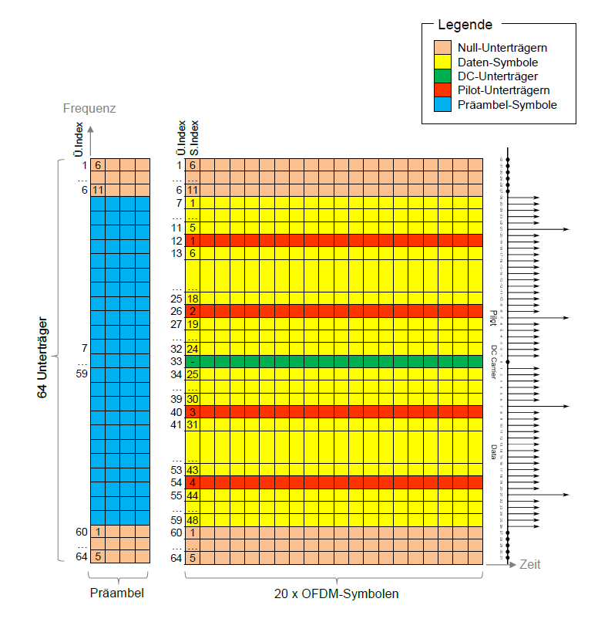
1. Split Preamble and Data
Index:
1… 64*4, 64*20+1 … 64*24
2. Reshape Data in 2D matrix with 64 carriers
64
20

Slide 5
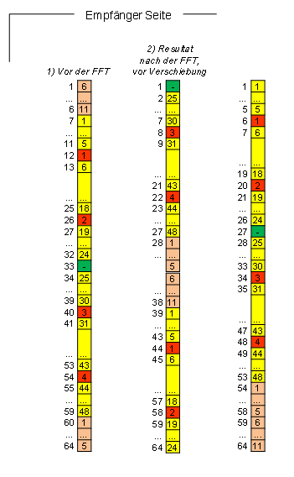
4. Shift
Manually -Using Selector
5. Remove zeros, pilots and DC carrier
Just select the indexes with data
Tip for both procedure – it’s still matrix now, you are working with 2 dimensions, and in time domain wants all samples for the given frequencies
Auto
Shift by FFT
Manuel
Shift

