Slide 1
Assessment 1 Presentation
Presented by – Suu Myat noe wai
Tutor name – andy tai Hock Lin
Date – 28 Oct, 2026

Slide 2
Problem 1: Dataset Exploration of UCI Bike sharing dataset

Slide 3
Data Initial Inspection
Analysis of the UCI Bike Sharing Dataset during 2011 – 2012
Focus on rental trends, seasons, and weather
Contains 731 rows and 16 columns
Has 0 missing values and duplicate rows
Need to change date columns to date time format

Slide 4
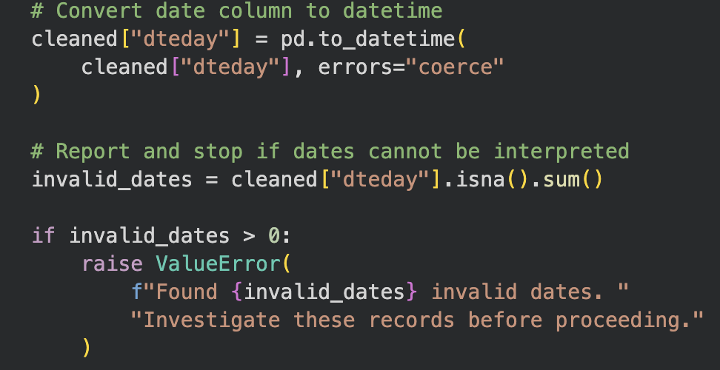
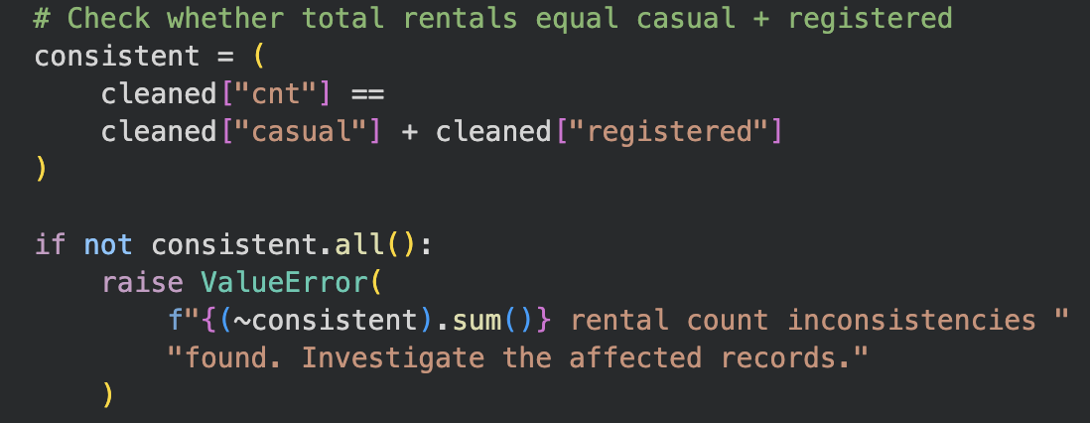
Data Cleaning
Converted dates into datetime format.
Checked that cnt = casual + registered.
(cnt = casual + registered)
Removed exact duplicate rows if present.
Checked required fields for missing values.
Converted season codes into season names.

Slide 5
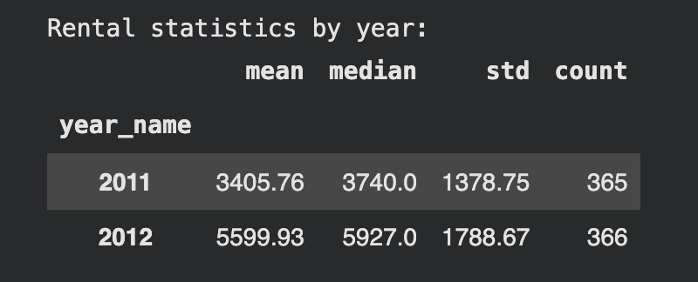
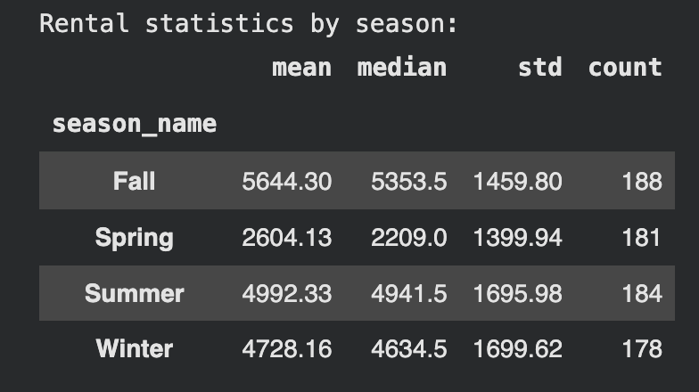
Summary Statistics
2012 has higher rental rate then 2011
Fall season has highest rental rate

Slide 6
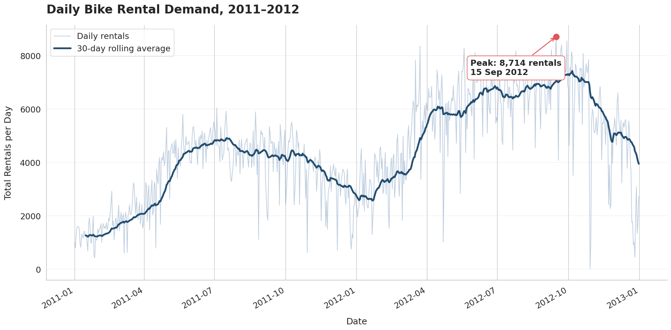
Visualisation 1
Q: How does bike rental demand change over time?
Use Time Series Line chart
Demand increased during much of 2011.
Rentals increased substantially from spring 2012.
Demand remained relatively high through summer and early autumn 2012.
Rentals declined towards the end of the study period.

Slide 7
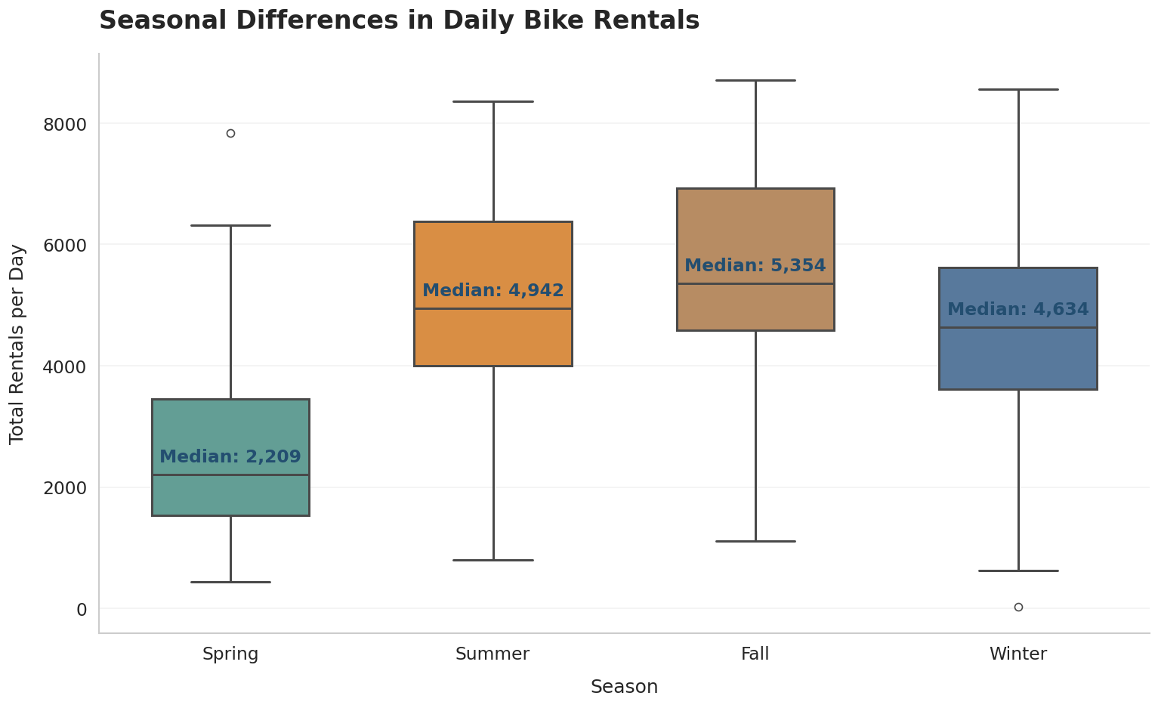
Visualisation 2
Q: How does rental demand differ across the four seasons?
Uses Boxplot Chart
records the lowest median at 2,209 during spring
records the highest median daily rental demand at 5,354 rentals during fall
contains some outliers, including an unusually high observation in Spring and a near-zero observation in Winter

Slide 8
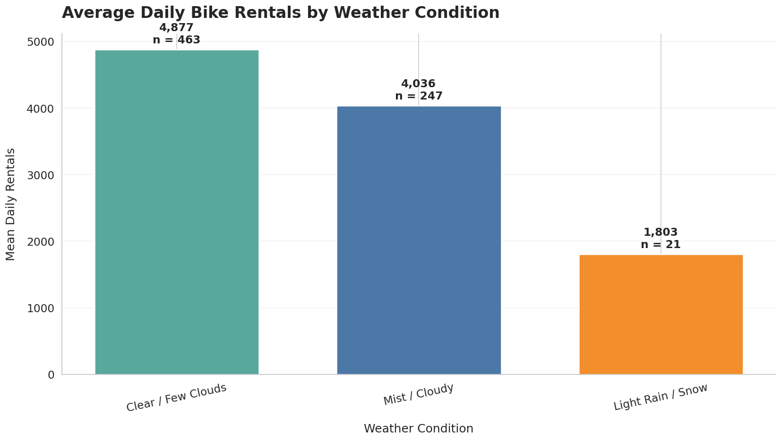
Visualisation 3
Q: How is rental demand associated with different weather conditions?
Uses Bar chart
Demands rental highest under clearer conditions
Demands lowest under light rain or snow.
establishes an association, not a causal relationship.

Slide 9
Problem 2: Visualisation Critique and Redesign

Slide 10
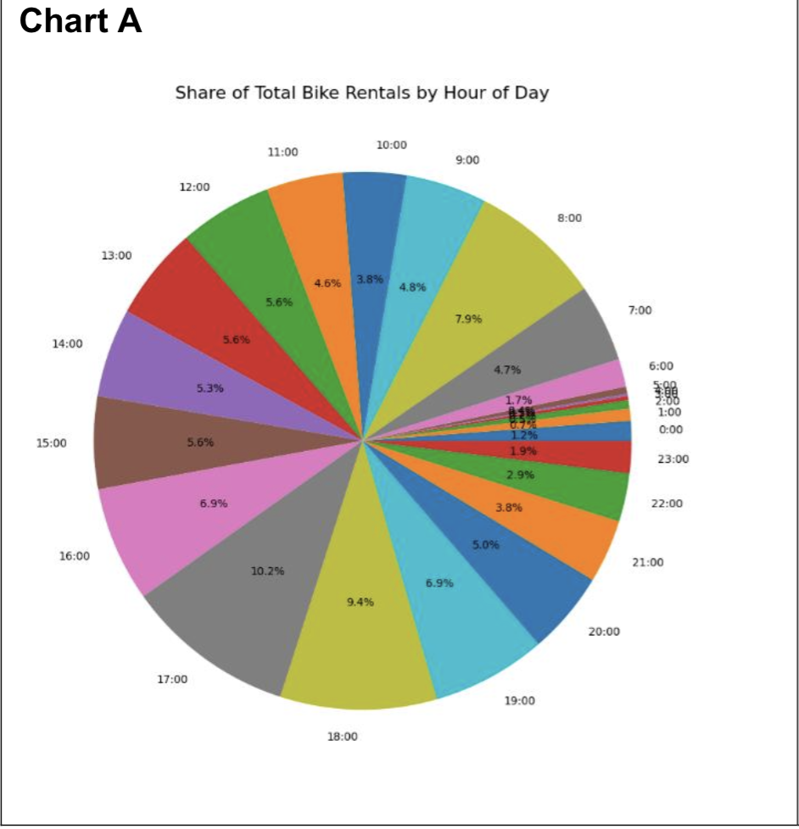
Critique of the Original Chart A
Strengths
Displays the percentage contribution of each hour.
Identifies periods with higher and lower rental activity.
Provides an overall view of the distribution across 24 hours.
Weakness
Does not clearly show the ordered hourly pattern.
crowded or overlapping labels, visual distraction
Difficult to compare 24 similar-sized pie slice

Slide 11
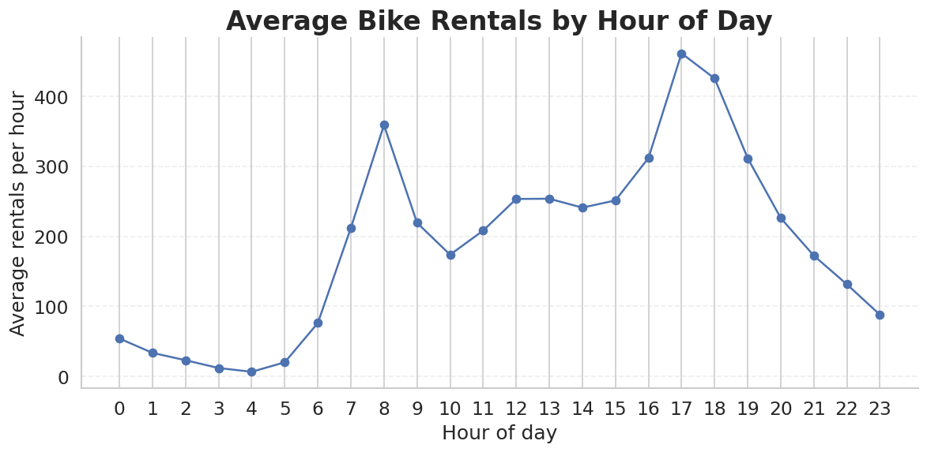
Redesign of chart A
Uses Line Chart
clear axis labels and reduced visual clutter also improve readability
makes it easier to identify changes in demand throughout the day
reaches its strongest peak demand in the late afternoon.

Slide 12
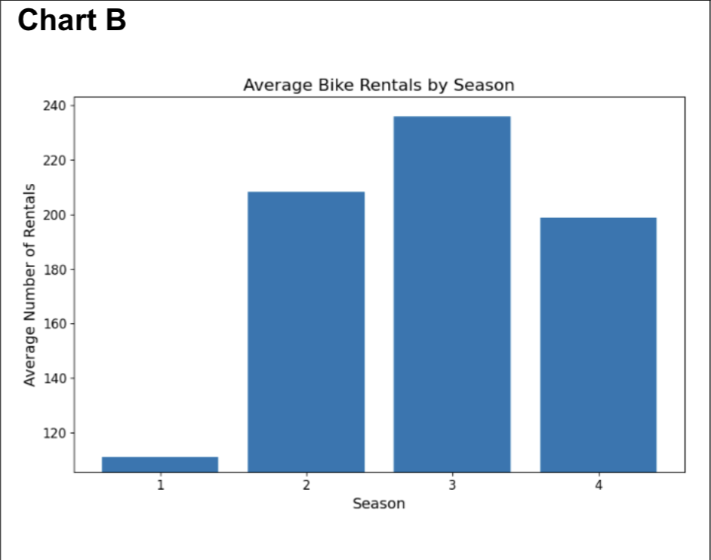
Critique of the Original Chart B
Strengths
Bar heights make seasonal comparisons straightforward.
A single color keeps the design simple.
The chart clearly presents differences in average rental counts.
Weakness
Numerical season codes are less meaningful than season names.
A vertical axis that does not start at zero can exaggerate differences.
Actual values are not labelled above the bars.

Slide 13
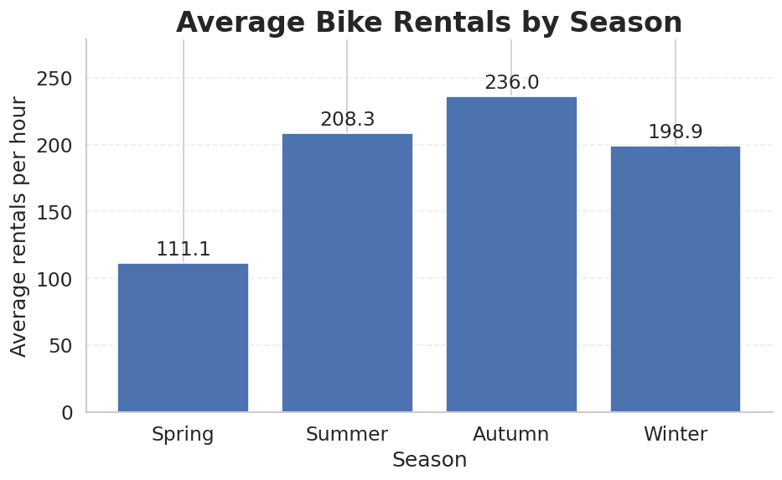
Redesign of chart B
Replaced numerical codes with season names.
Started the vertical axis at zero.
Added numerical labels above the bars.
Included subtle horizontal gridlines.
Retained the bar chart for direct comparison.

Slide 14
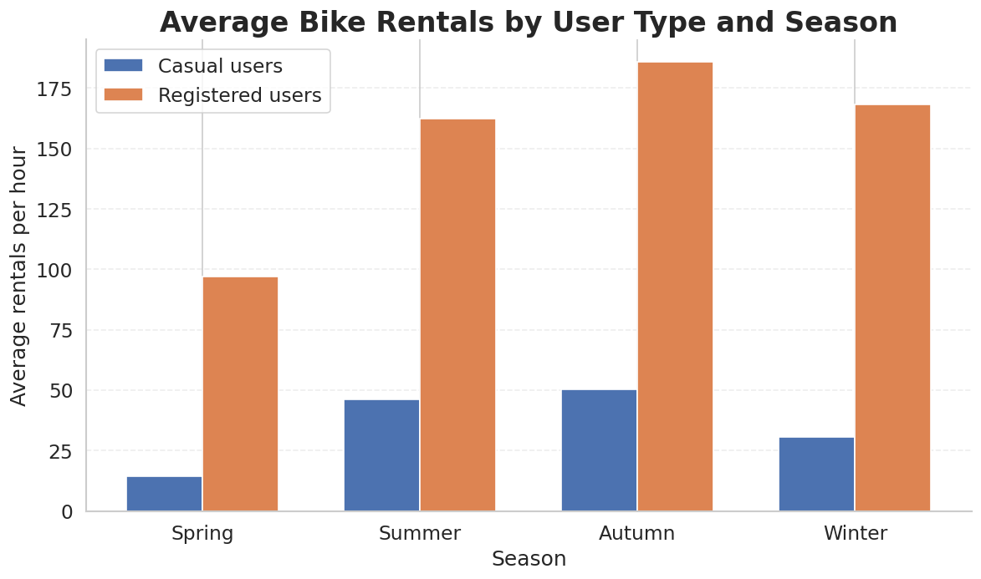
Additional Visualisation: Casual vs Registered Users
Q: How does bike rental activity differ between casual and registered users across the four seasons?
Registered users have more rentals than casual users in every season.
Autumn has the highest average rentals for both groups
Spring has the lowest average rentals for both groups
Seasonal patterns are similar for casual and registered users, although registered-user rental counts are consistently much higher.

Slide 15
Future Insights and Prediction
Seasonality: Autumn may continue to experience relatively high rental demand, while spring may have lower demand.
User behaviours: Registered users are likely to remain an important contributor to total rentals if the observed pattern continues.
Weather effects: Unfavourable weather may be associated with reduced rental activity.
Demand planning: Seasonal patterns and weather conditions can help operators plan bike availability, maintenance and resource allocation.

Slide 16
Thank You
Any Questions?

