Slide 1

2026 Gaming Laptops Market API
COMP3011 Coursework Presentation
[Xu Ji] [201635415]

Slide 2
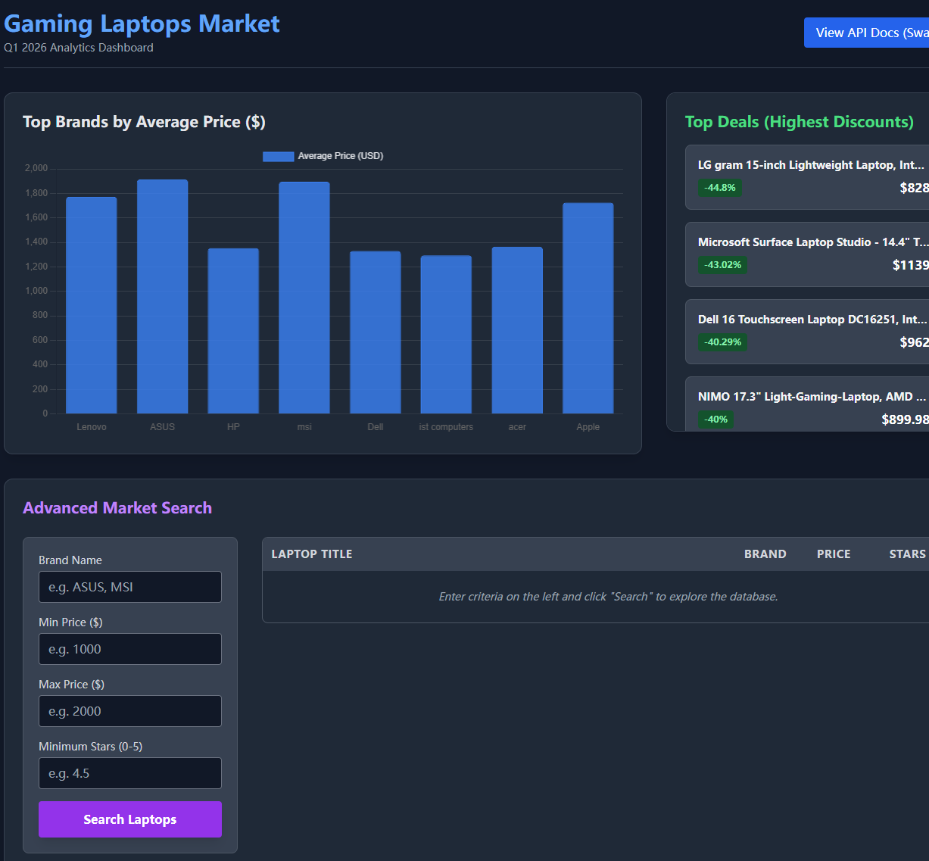
Project Overview: What We Built & Achieved
Objective: A RESTful API to manage and analyze a dataset of ~600 gaming laptops.
Core Deliverables:
Fully functional backend API.
Interactive, server-delivered frontend dashboard.
Automated testing suite (pytest).

Slide 3
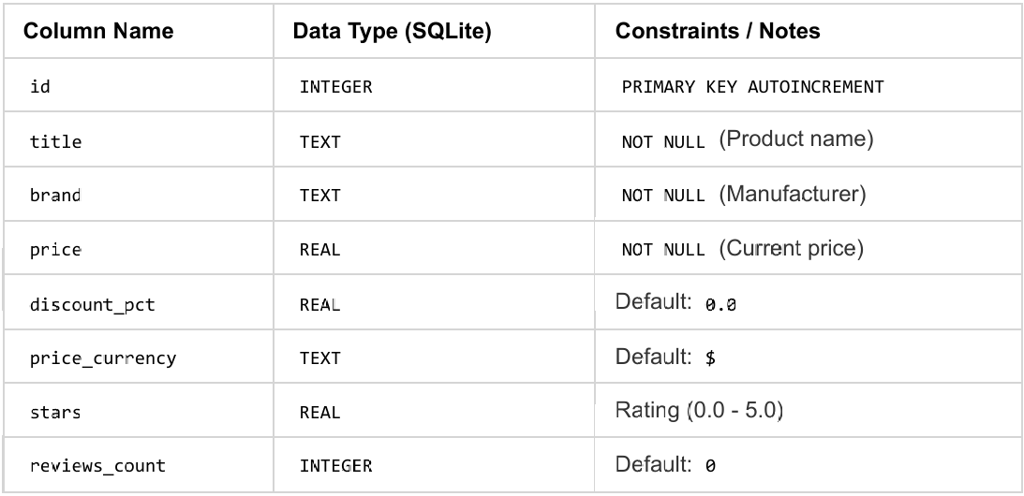
Tech Stack & Database Architecture
Backend: Python + FastAPI (Fast, async, auto-docs).
Frontend: Vanilla HTML, Tailwind CSS, Chart.js.
Database: SQLite3 (Monolithic table, zero-config).
Data Mapping: Cleaned Kaggle CSV data directly mapped to strict SQL types.
Database schema

Slide 4
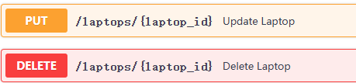
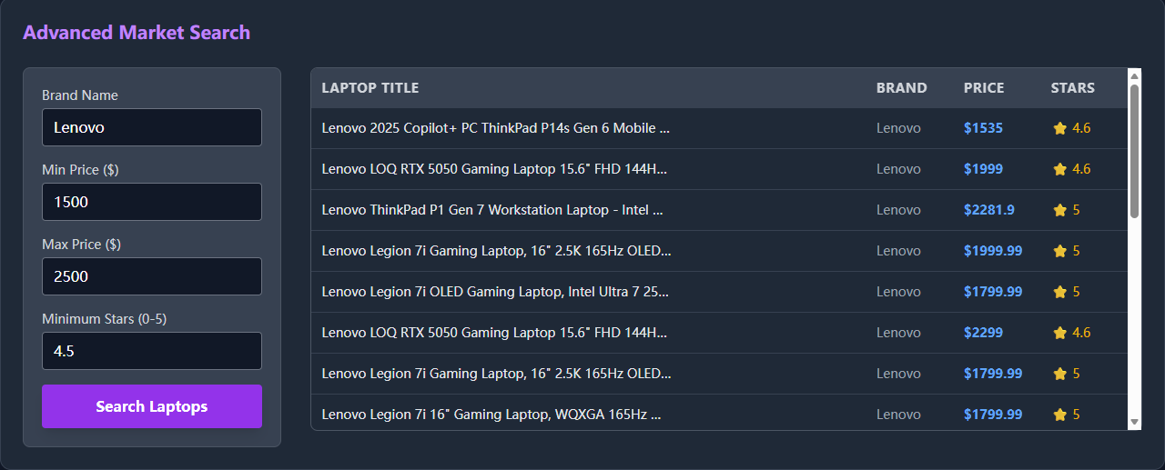
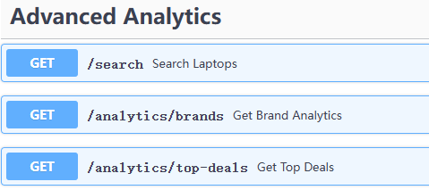
Web App Features (API Endpoints)
Public Access (Data Retrieval):
GET /laptops: Paginated list & single item lookup.
GET /search: Multi-parameter dynamic filtering.
GET /analytics/...: SQL aggregations (GROUP BY, HAVING).
Protected Access (State Modification):
POST, PUT, DELETE routes.
Secured via HTTP Basic Authentication.
Examples of searching laptops:

Slide 5
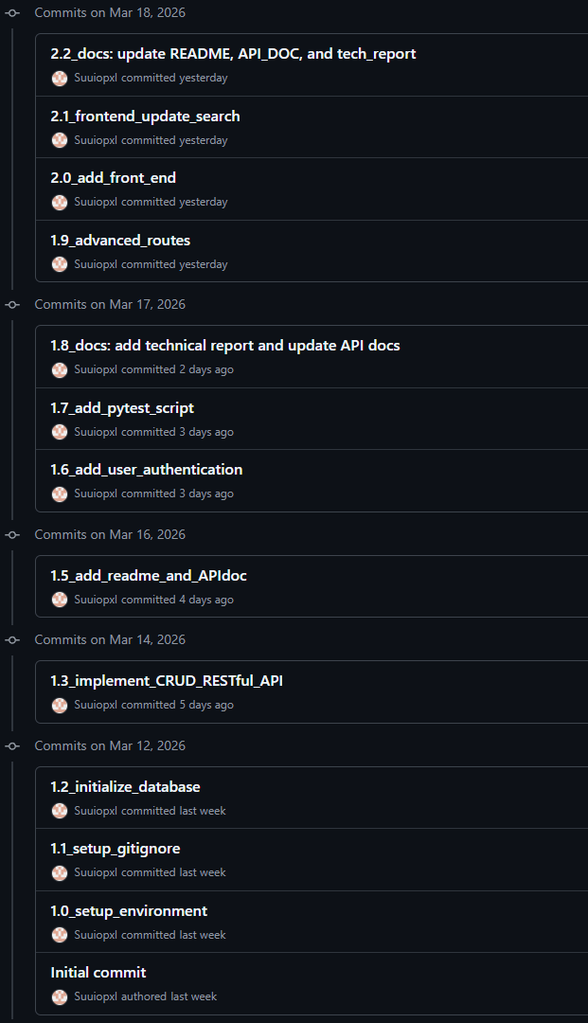
Version Control & Deployment
Version Control & CI/CD Practices:
Platform: Git & GitHub.
Iterative Development Strategy (Key Milestones):
Commit 1.2: Initial DB setup and data ingestion prototype.
Commit 1.3: Core CRUD endpoints implementation.
Commit 1.6&1.7: Security upgrade (Basic Auth) & automated tests.
Commit 2.0: Frontend dashboard integration.

Slide 6
GenAI Integration & Human Oversight
Generative AI Contribution
Role of AI: Used as a concept explainer, designer and accelerator.
What AI Did: Planning the development cycle, prototype the database, FastAPI, initial data cleaning scripts, and frontend CSS layouts.
Human Oversight:
Identified and fixed AI's database schema flaws.
Refactored naive queries into secure, parameterized SQL to prevent injection.
Implemented Basic Auth middleware that the initial AI prototype lacked.

Slide 7
Thank you!
Any questions?

