Slide 1

Offer-to-Join
Conversion Analysis
AWS_P02_A5
Titas Debnath
Charitha Gandikota
Sujay Kumar
Ritankar Bhattacharya
Vedant
Srinath Neogi

Slide 2

Content :
11. Machine Learning Model Building
12. Model Evaluation
10. AWS
7. SQL – ER Diagram & ER Schema
9. Big Data Analysis Using PySpark and Hive
8. Power BI Visualization
6. Feature Engineering
5. Data Preprocessing
4. Data Cleaning
3. About the Data Set
2. Project Objective and Our Approach
1. Problem Statement
Notes:
Tags: path, journey, roadmap, signs

Slide 3
Problem Statement :
TalentXcel Solutions Pvt Ltd understands that client service heavily relies on the quality of the people involved in delivering business outcomes. One of the prominent challenges faced by HRWorks and its clients revolves around effectively managing a high-quality workforce. Despite investing significant time and effort into creating a supportive and thriving work environment, organizations often experience employee attrition as individuals seek better opportunities elsewhere. This cycle of attrition necessitates constant recruitment efforts, resulting in a continuous loop of hiring and the associated costs and disruptions.
That’s why a Predictive Model is required to Check a particular candidate is willing to Join or Not before hand.

Slide 4
Project Objective :
Develop a robust predictive model that accurately assesses the likelihood of a candidate joining a company after accepting a job offer
Enable organizations to optimize their talent acquisition strategies and minimize resource wastage
Classify candidates as "Joined" or "Not Joined" and gain valuable insights into the factors influencing candidate decisions
Help organizations break free from the cycle of attrition and continuous recruitment
Our Approach :
Integrated and cleaned 9 raw data files to build a reliable, analysis-ready dataset.
Performed Data Cleaning and PreProcessing to identify key factors influencing candidate joining decisions.
Engineered new features and applied appropriate encoding strategies for model readiness.
Addressed class imbalance using SMOTE to ensure unbiased model training.
Trained and compared 6 ML models evaluated on key classification metrics.
Selected the best-performing model(s), and saved for Future use.

Slide 5
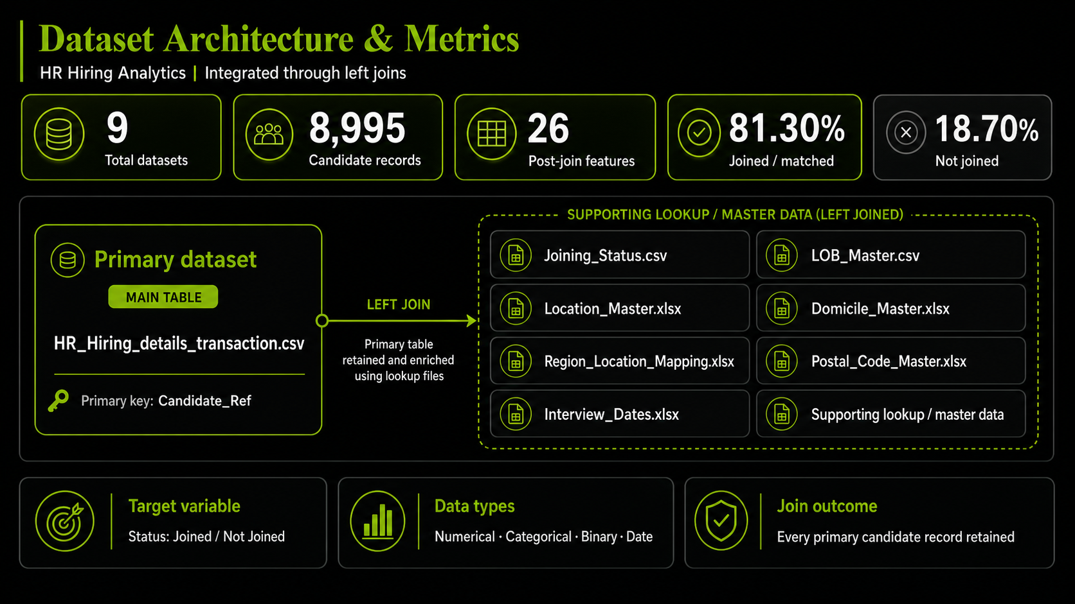
About The Data Set :
The analytical dataset HR_HIRING_ANALYTICS.csv was built by performing a series of Left Joins, keeping HR_Hiring_details_transaction.csv as the primary table. Seven supporting master/lookup files were joined to it to enrich each candidate record with contextual information such as job location, home state, line of business, and interview date. The Left Join strategy was deliberately chosen to ensure that every candidate record from the main table is retained, even when a matching entry is absent in a lookup file — preserving the complete hiring pipeline without any data loss.
HR_Hiring_details_transaction.csv (Primary Table) – Primary Key : Candidate_Ref
Joining_Status.csv — Linked via Candidate_Ref - Adds the Target Variable (Joined / Not Joined)
LOB_Master.csv — Linked via LOB_Id - Adds Line of Business name (e.g., BFSI, EAS, ERS, INFRA)
Location_Master.xlsx — Linked via Location_ID - Adds Job Location city name
Domicile_Master.xlsx — Linked via Domicile_Id - Adds candidate's Home State name
Region_Location_Mapping.xlsx — Linked via Location_ID - Adds Geographic Region (North / South / East / West)
Postal_Code_Master.xlsx — Linked via Postal_Code - Adds area-level location descriptor
Interview_Dates.xlsx — Linked via Candidate_Ref - Adds Date of Interview for time-based features
Final Dataset at a Glance:
Total Records: 8,995 candidates , Total Features: 26 columns (post-join, pre-cleaning)
Target Variable: Status : Joined: 81.30% | Not Joined: 18.70%
Data Types: Numerical, Categorical, Binary (Yes/No), Date

Slide 6
Data Cleaning :
Data Ingestion & Integration :
  Loaded 9 raw files — HR_Hiring_details_transaction.csv, Joining_Status.csv, Interview_Dates.xlsx, Domicile_Master.xlsx, LOB_Master.csv, Location_Master.xlsx, Postal_Code_Master.xlsx, Region_Location_Mapping.xlsx
  Merged all files into a single master dataset (HR_HIRING_ANALYTICS.csv) using Left Joins on key column.
  Changed Some column Names to More relatable and meaningful names.
Duplicate Treatment :
  Checked for Duplicate values : There are no Duplicate Valeus in our Dataset.
NULL Value Treatment :
  Numerical columns → filled with Median (robust to outliers)
  Categorical columns → filled with Mode (most frequent value) where the Columns were Imbalanced (e.g. Offered_Band) and for Region_Name and Location_name, Replaced NULL with ‘Unknown’ as the Column Categories are balanced.

Slide 7
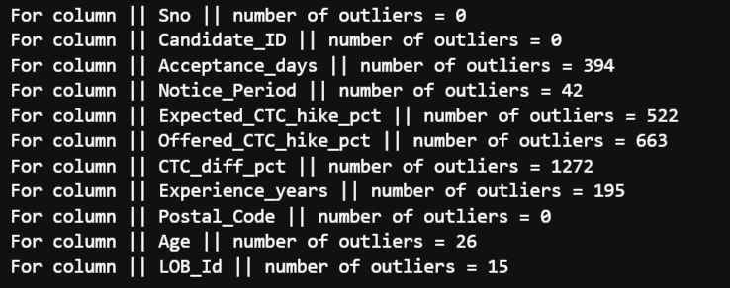
Data Preprocessing :
Outlier Detection & Treatment :
  Tested 2 IQR-based methods — finalized Q1/Q2 -+ 3×IQR for balanced outlier detection
  Applied clipping to bounds on: Acceptance_days, Expected_CTC_hike_pct, Offered_CTC_hike_pct, CTC_diff_pct, Experience_years, Age, Notice_Period.
Date Column Treatment :
  Converted Date_of_Interview from string → datetime64
  Extracted: Interview_Year, Interview_Month, Interview_Quarter.
  But found that the correlations of these columns with Target are very low, so haven’t included them in main dataset.

Slide 8
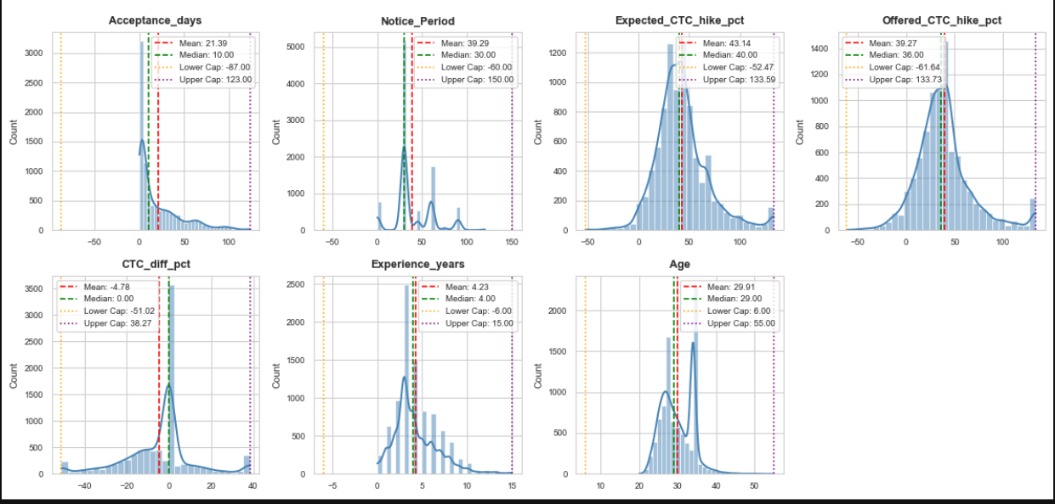
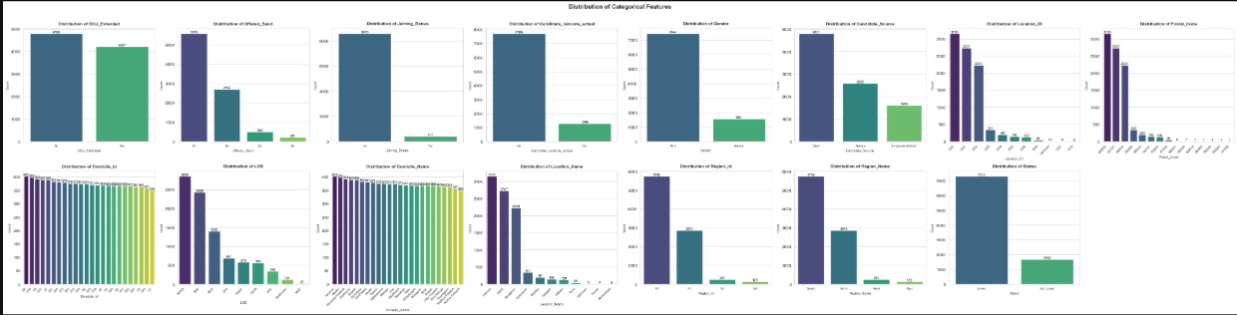
Feature Engineering :
Distribution Analysis — Numerical Columns
  Plotted Histograms & KDE plots for all numerical columns to check skewness, spread, and distribution shape.
  Identified right-skewed features (e.g., Acceptance_Days) and Left-Skewed Features (e.g. CTC_diff_pct).
Categorical Analysis — Categorical Columns
  Created Bar charts for all categorical columns to understand frequency distribution across categories
  Identified high-cardinality column (e.g., Postal Code)

Slide 9
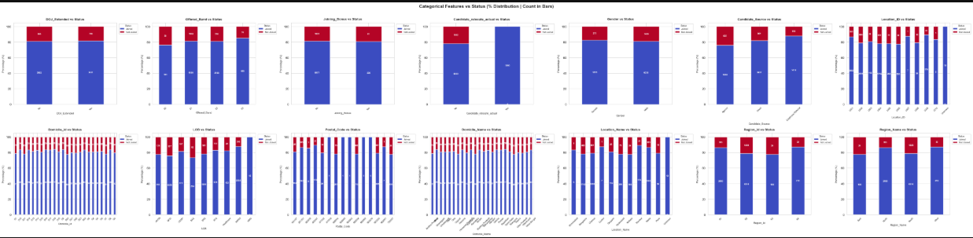
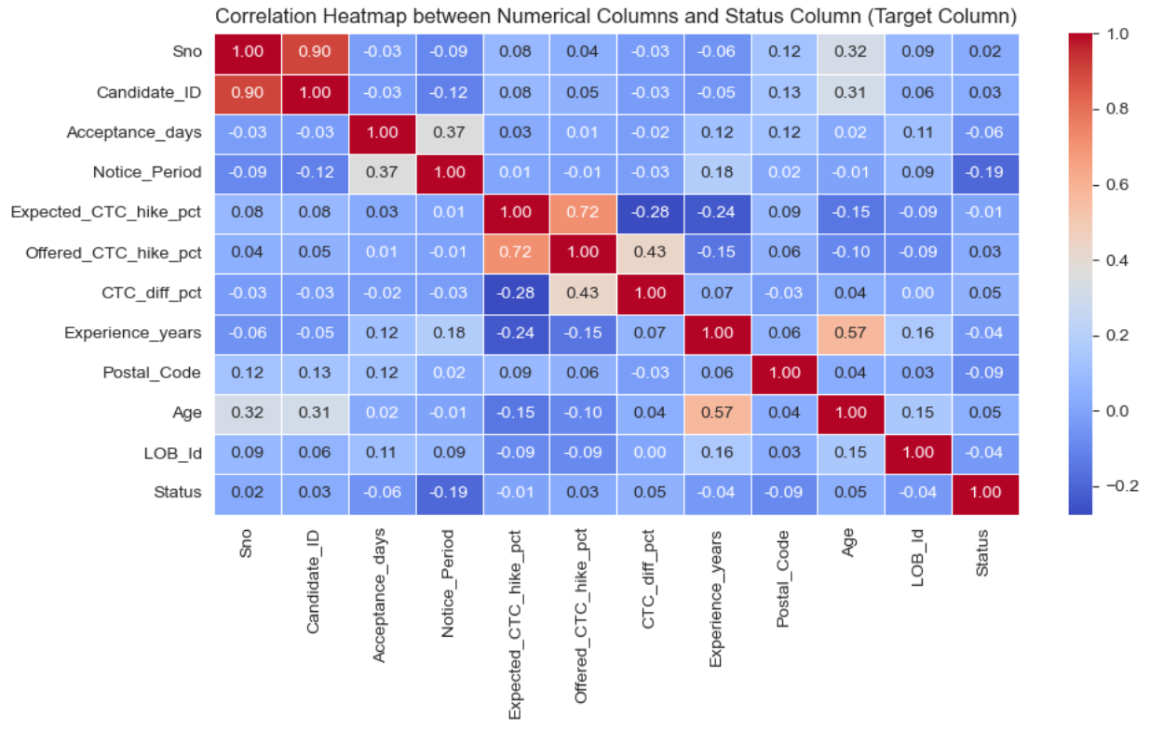
Feature Engineering :
Statistical Analysis — All Columns vs Status
  Numerical columns → groupby('Status').mean() to compare averages across groups
  Categorical columns → Cross-tabulation & proportion analysis to find influential categories
Correlation Heatmap
  Plotted Pearson Correlation Heatmap for all numerical features
  Identified highly correlated features flagged for possible potential removal

Slide 10
Feature Engineering :
Dropped Unnecessary Columns
  Removed Sno, Candidate_ID, Location_ID, Region_Id, Domicile_Id, LOB_Id, Date_of_Interview, Postal_Code — IDs, duplicates of name columns, or low ML relevance
Encoding of Categorical Columns
  Label Encoding → DOJ_Extended, Joining_Bonus, Candidate_relocate_actual (No=0, Yes=1) & Gender (Male=0, Female=1)
  Target Encoding → Status : Joined = 0, Not Joined = 1
  Ordinal Encoding → Offered_Band : natural order preserved (E0>E1>E2>E3)
  One-Hot Encoding → LOB, Domicile_Name, Location_Name, Region_Name, Candidate_Source → Final shape: 43 columns

Slide 11
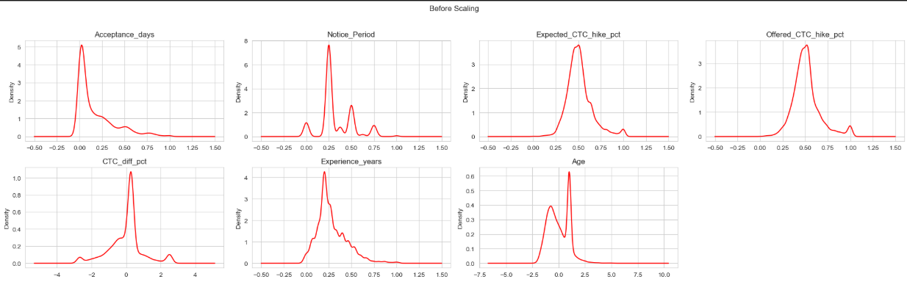
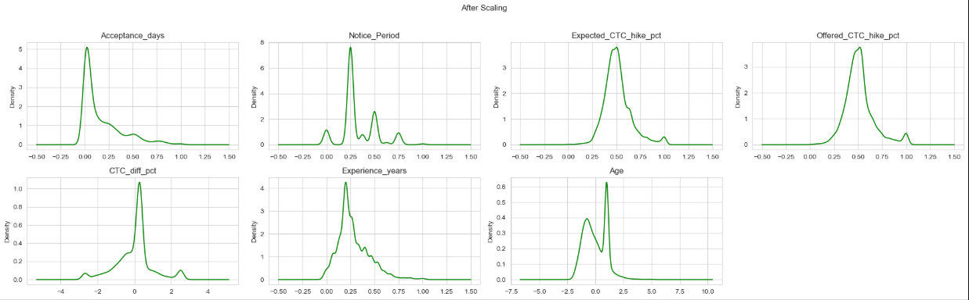
Feature Engineering :
Scaling Strategy (Skewness Test) :
  Used Skewness threshold (±0.5) to decide scaling per column
  Standardization (mean=0, std=1) → CTC_diff_pct (skew= -0.137), Age (skew= 0.398) — near-normal distribution
  Min-Max Scaling (0 to 1) → Acceptance_days, Notice_Period, Expected_CTC_hike_pct, Offered_CTC_hike_pct, Experience_years — skewed distributions
Class Imbalance :
  SMOTE applied on training data → balanced from 4.3:1 to 1:1 (5850 : 5850)
  Final ML-ready shape → X: (8995 × 43) & y: Joined=7313, Not Joined=1682
Before
Scaling
After
Scaling

Slide 12
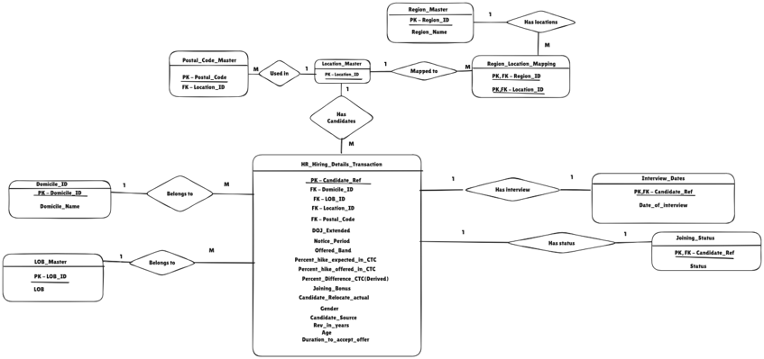
SQL :
ER Schema:

Slide 13
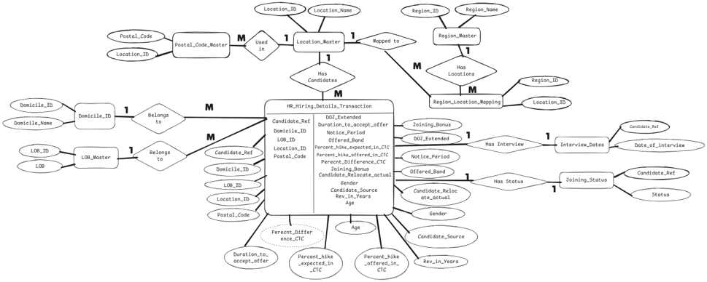
SQL :
ER Diagram:

Slide 14
SQL :
ER Diagram:

Slide 15
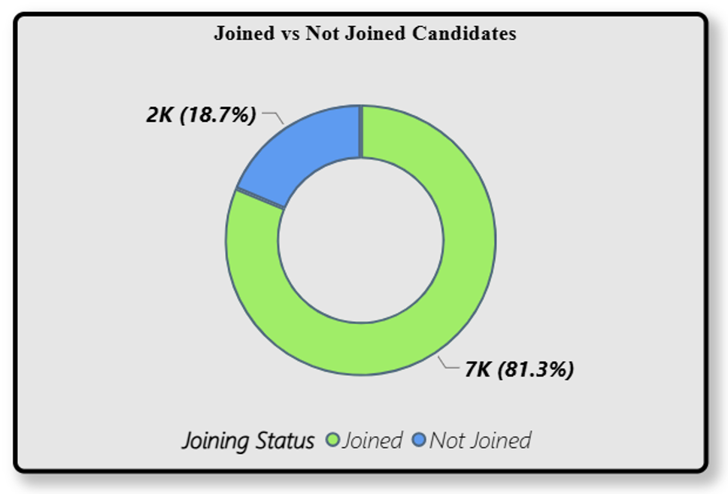
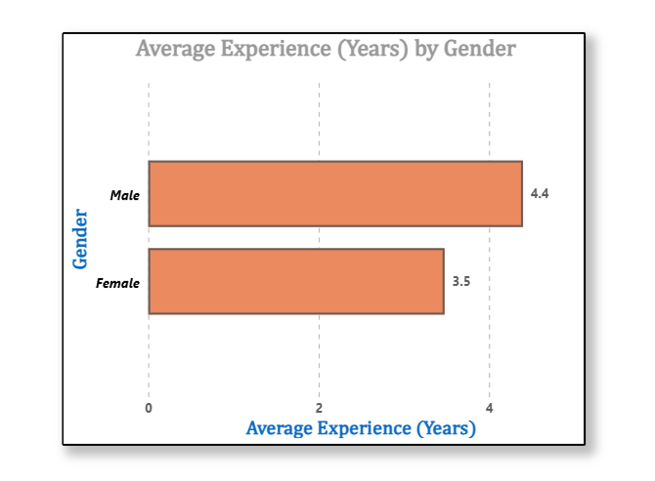
Power BI Visualization :
Visualization of target feature (Status)
Gender having the highest number of experience in the dataset

Slide 16
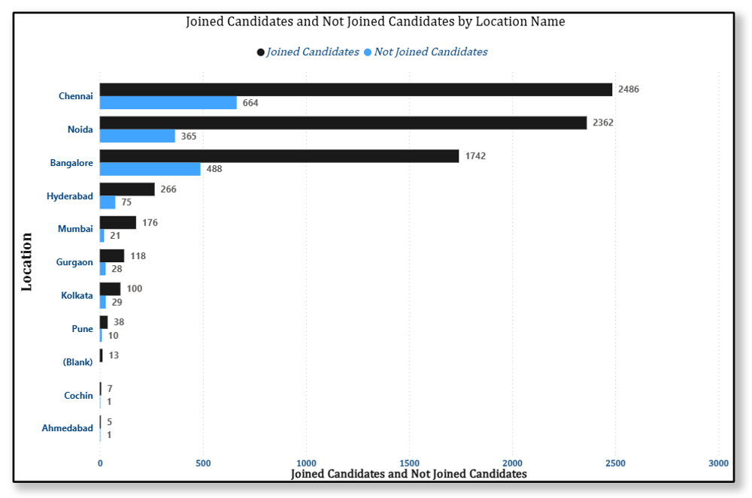
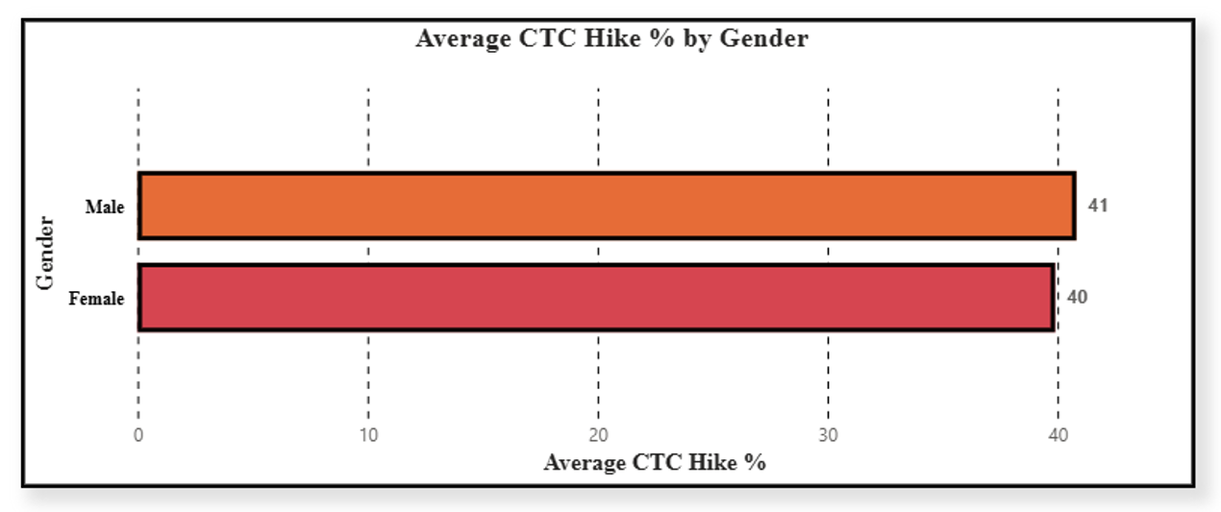
Power BI Visualization :
Location that witnessed the highest number of joinees
Gender earning the highest Average of percent hike in CTC

Slide 17
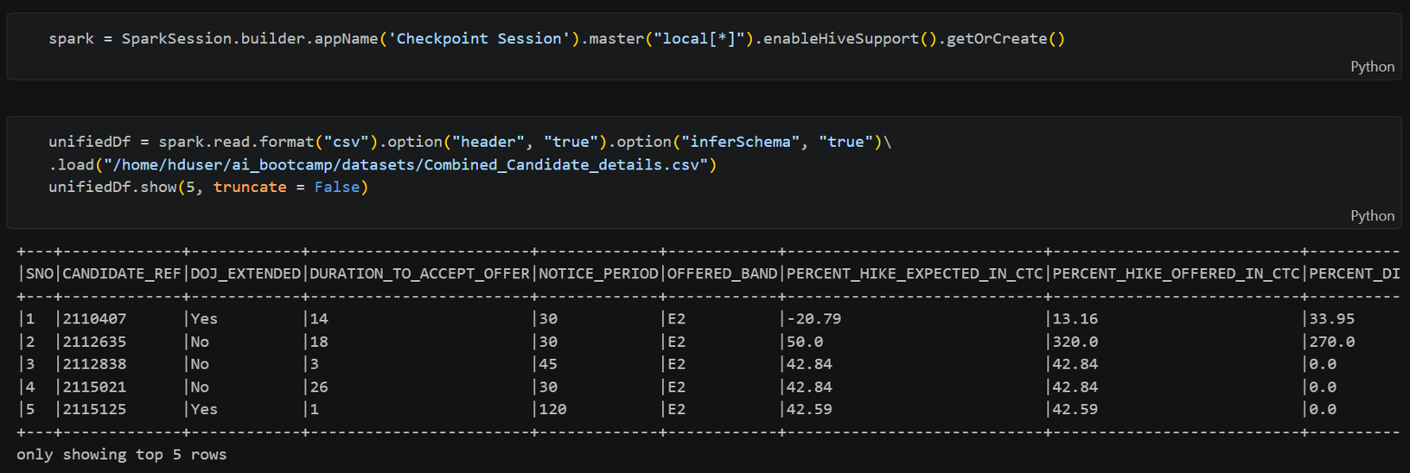

Big Data Analysis Using PySpark and Hive
Creating Spark session

Slide 18
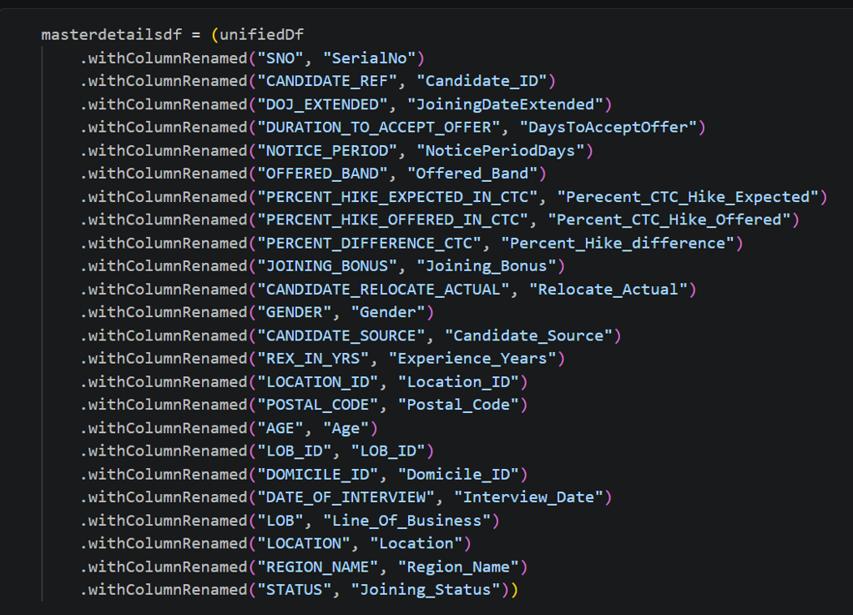
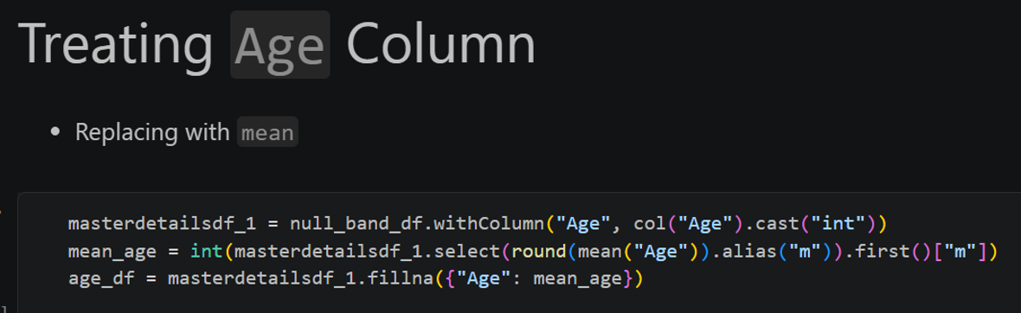
Big Data Analysis Using PySpark and Hive
Changing columns' name
Fixing Null Values

Slide 19
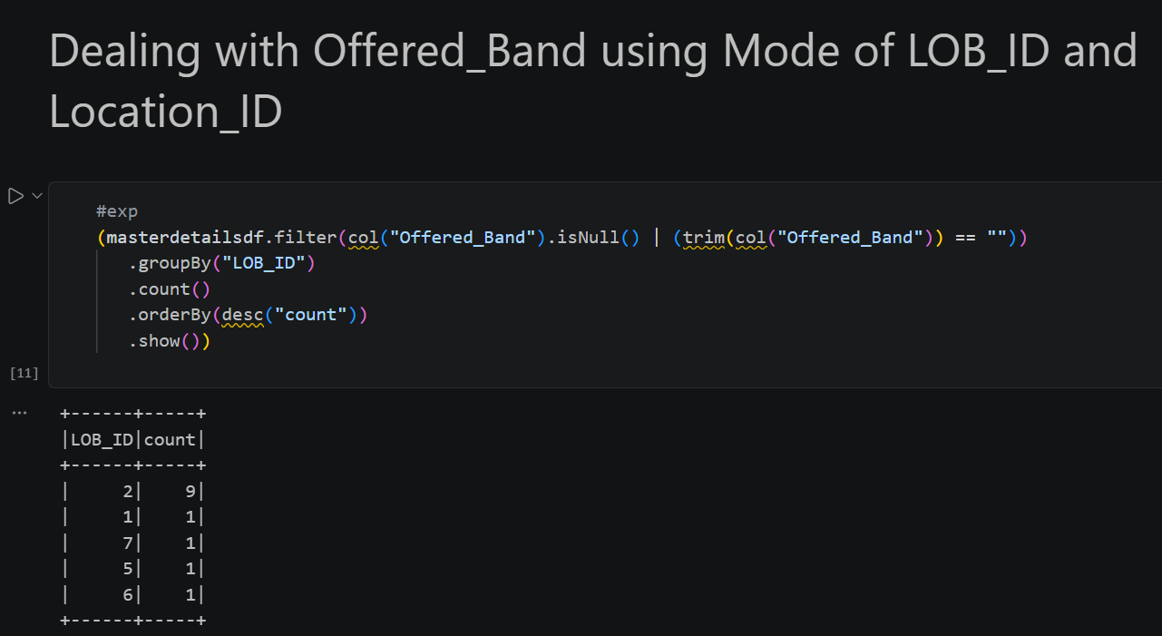
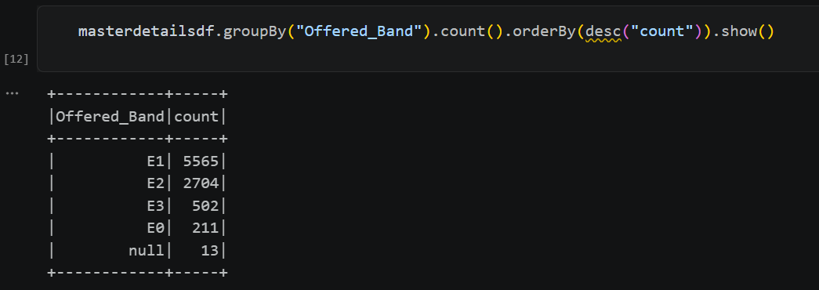
Big Data Analysis Using PySpark and Hive
Fixing Null Values

Slide 20
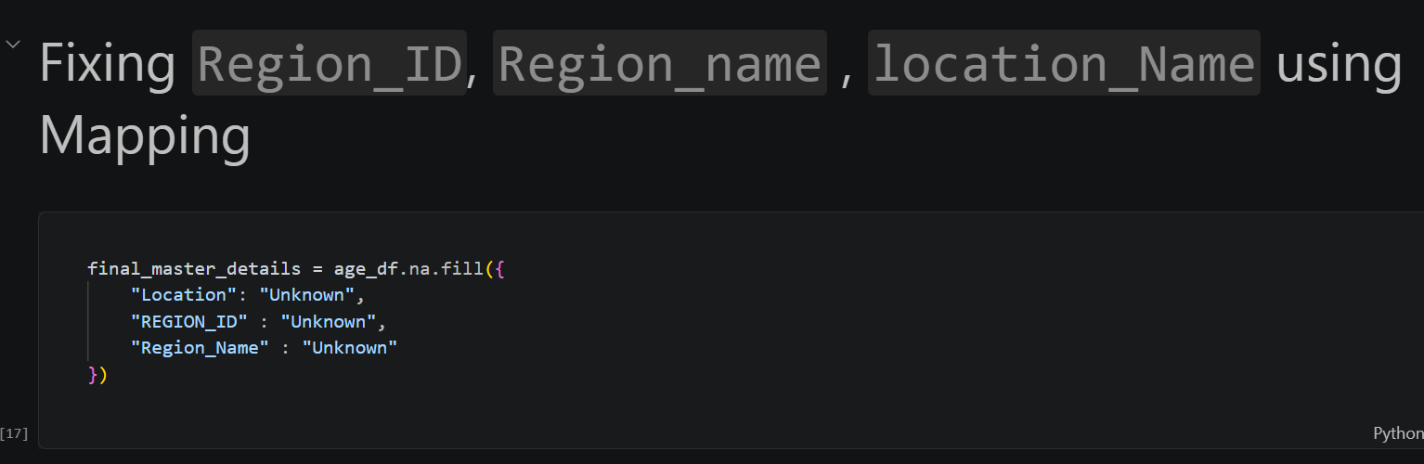
Big Data Analysis Using PySpark and Hive
Fixing Null Values

Slide 21
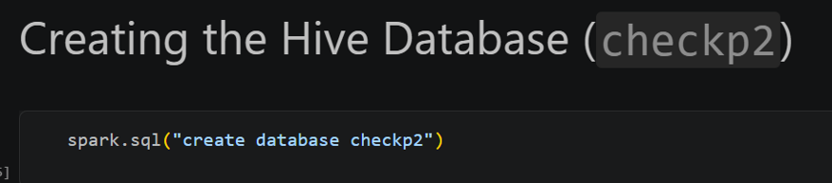
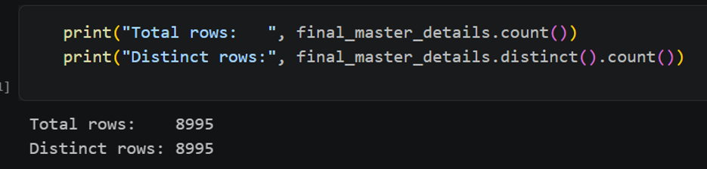
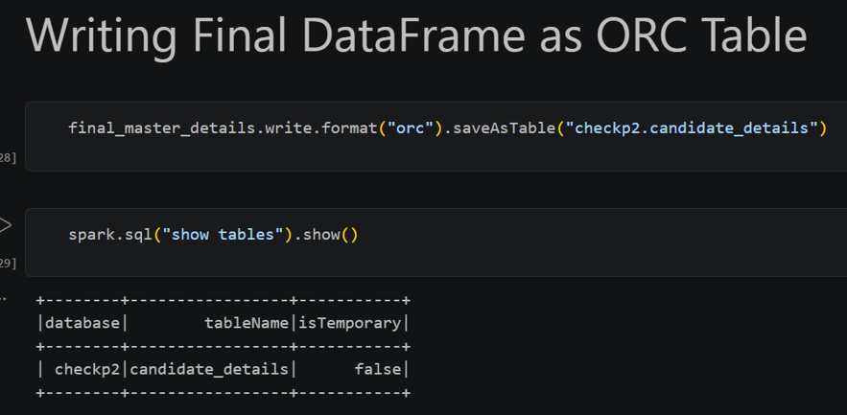
Big Data Analysis Using PySpark and Hive
Handling Duplicates
Saving into HIVE table

Slide 22
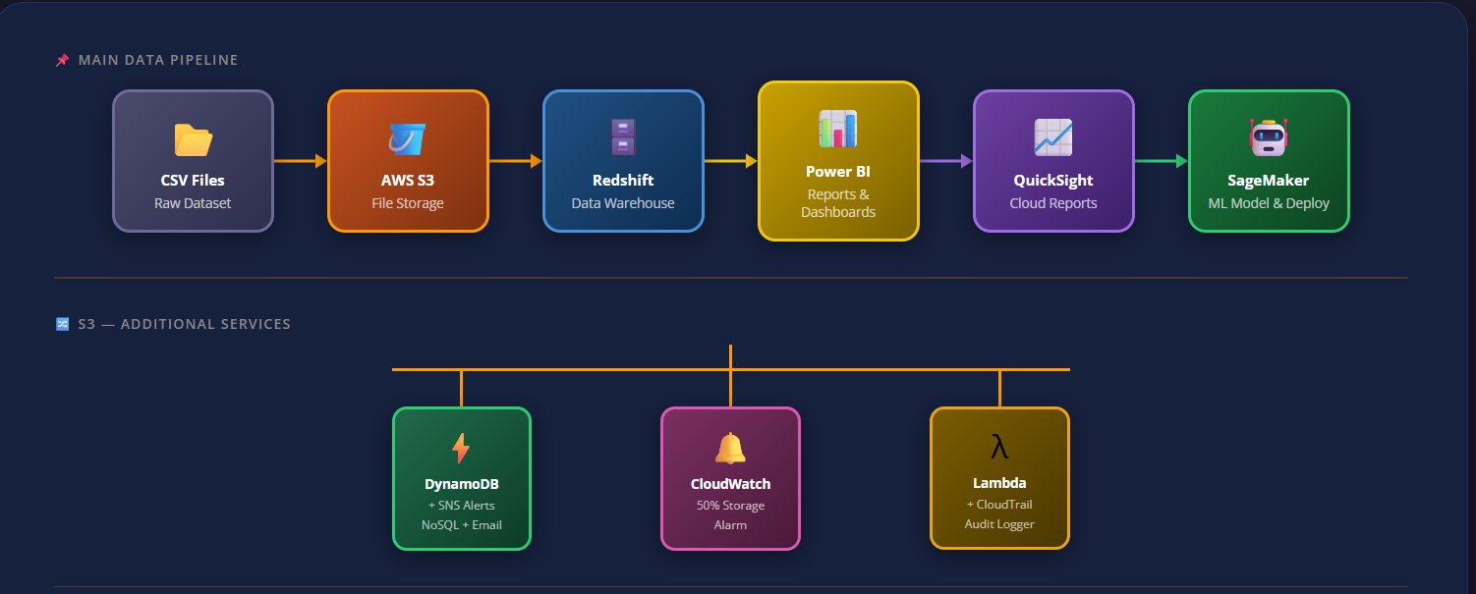
AWS Entire Workflow
Csv Files
AWS S3
Redshift
Power BI
Quicksight
Cloudwatch & Lambda
Sagemaker

Slide 23
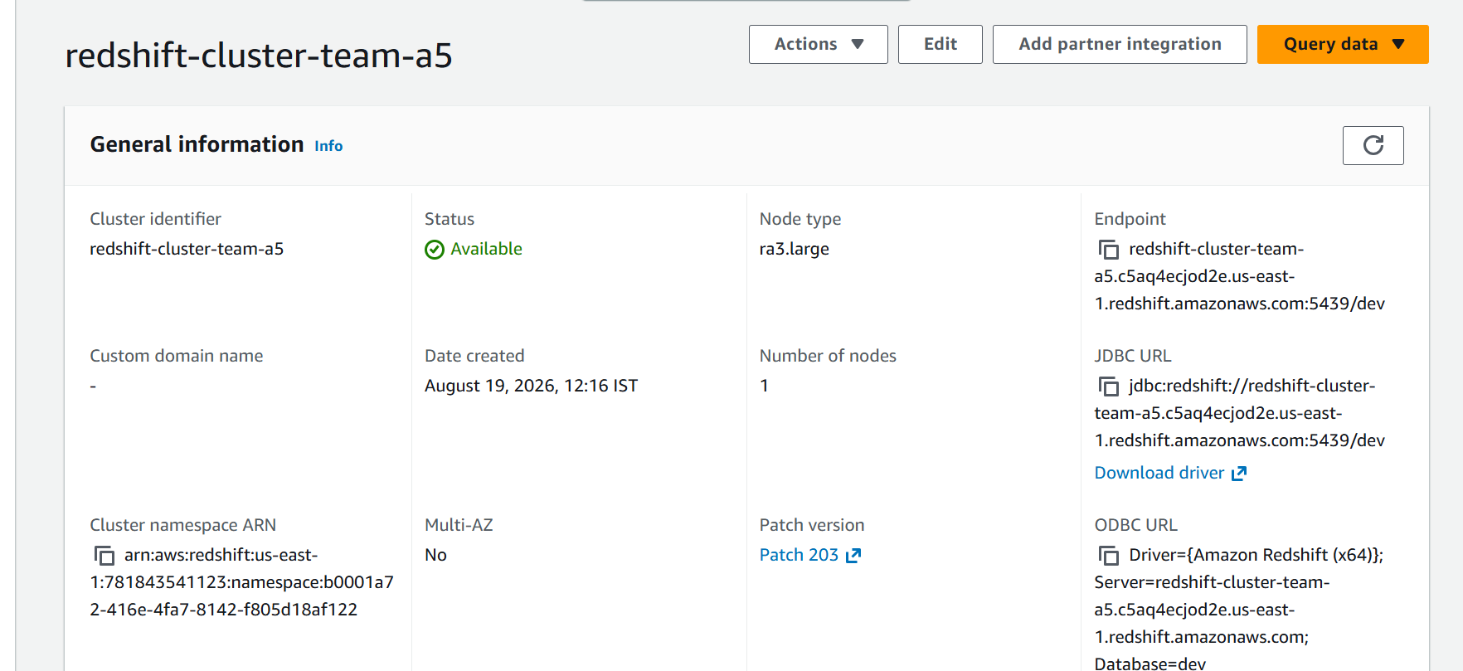
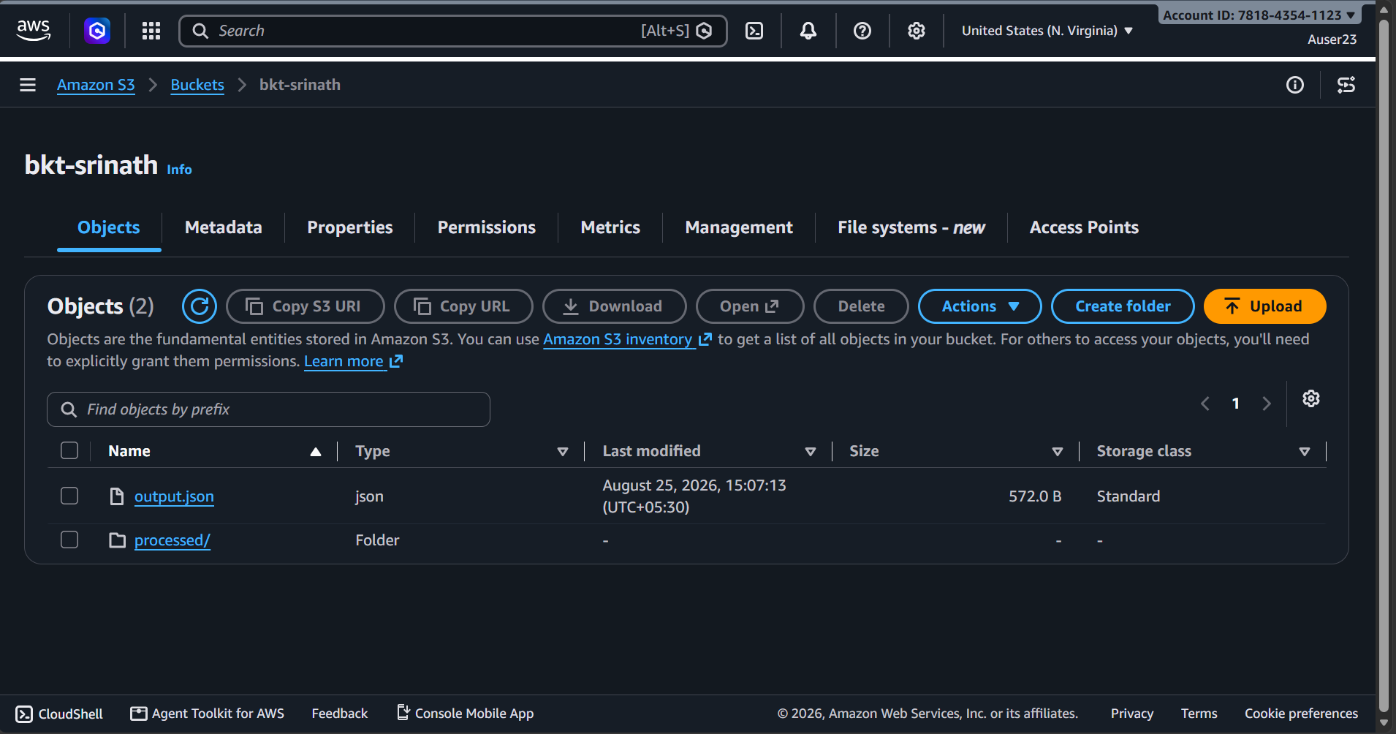
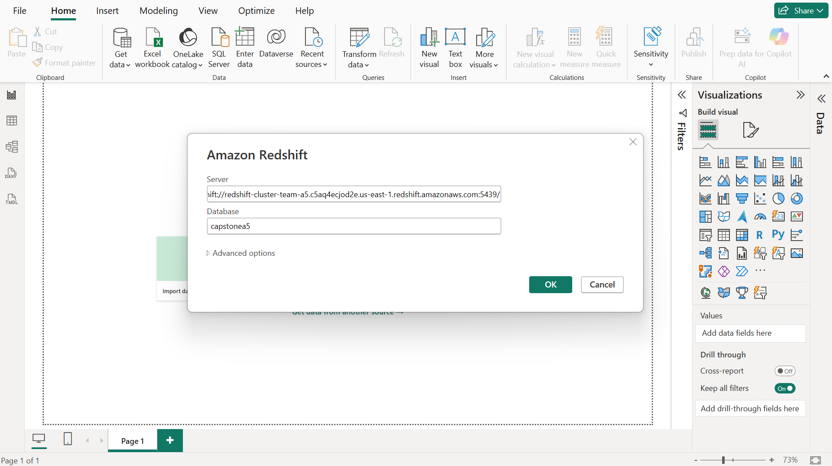
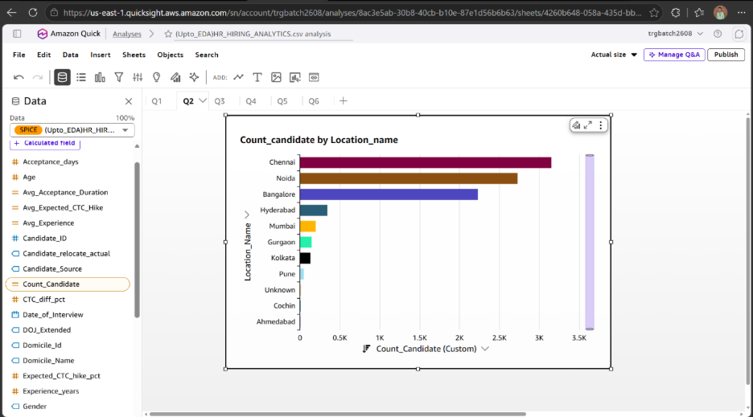
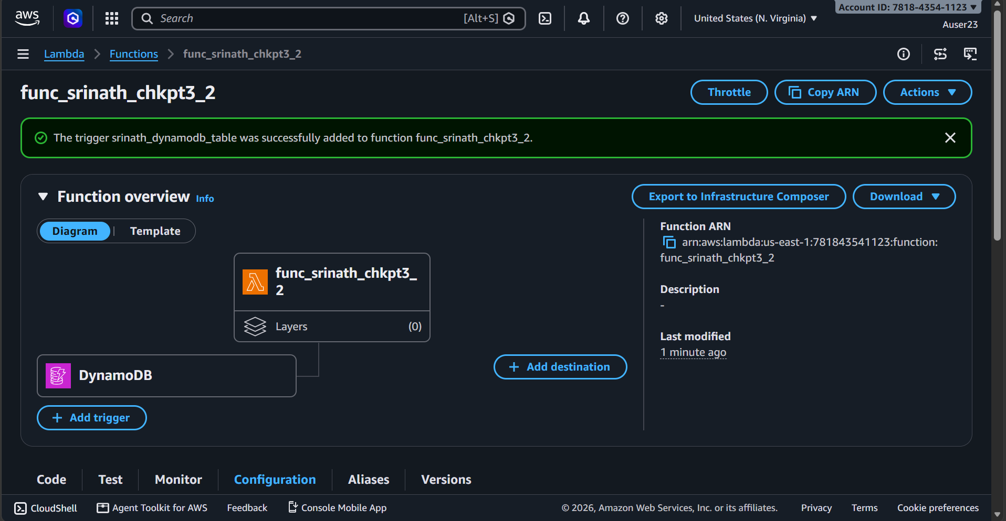
AWS Flow
This part includes us performing all the AWS Scenarios upto Cloudwatch and Lambda
1
CSV Files
Hr_hiring_analytics.csv
3
2
Redshift
AWS S3
4
Power BI
5
Quick-Sight
6
Cloudwatch and Lambda

Slide 24
Machine Learning Model Building
Train-Test Split
  Split: 80% Train / 20% Test using train_test_split(stratify=y, random_state=42) from scikit-learn
  stratify=y used to maintain the same class proportion in both training & testing datasets
  X_train: (7196 × 43) | X_test: (1799 × 43)
  y_train: {Joined: 5850, Not Joined: 1346} & y_test: {Joined: 1463, Not Joined: 336}
Model Training via sklearn :
  All 6 models trained on SMOTE-balanced train set, evaluated on original unbalanced test set.
  All Models are trained on AWS SageMaker and their Performance is monitored.
Models we have used :
  Logistic Regression : Probability of an observation belongs to a particular class
  Decision Tree : Series of Rule-based decision making
  Random Forest : Multiple decision trees
  Naïve Bayes : Probability-based classification based on Bayes' theorem
  KNN : Nearest-neighbor classification
  6. XGBoost : Boosted Decision trees

Slide 25
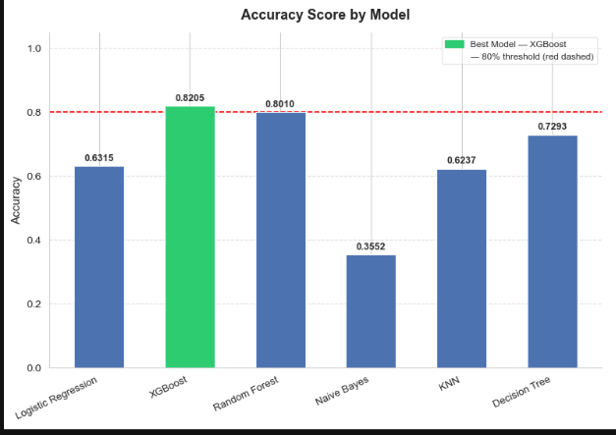
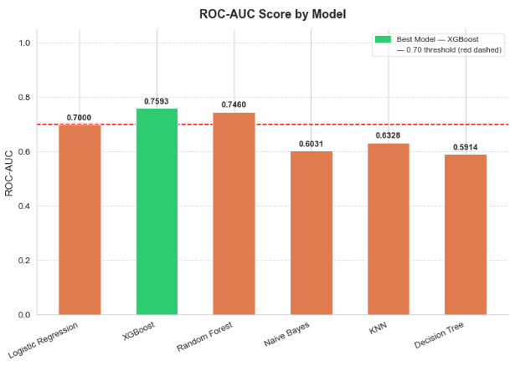
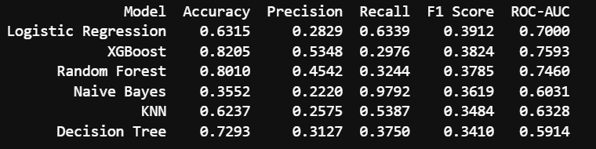
Model Evaluation :
Performance Metrices after Machine Learning Model Training :
Performance Summary Table :
  XGBoost showcases as the Best Performing Model with a Accuracy of 82% and ROC-AUC of 76%
  Random Forest comes as the Second Best Performing Model with a Accuracy of 80% and ROC-AUC score of 75%.

Slide 26
THANK YOU

