Slide 1
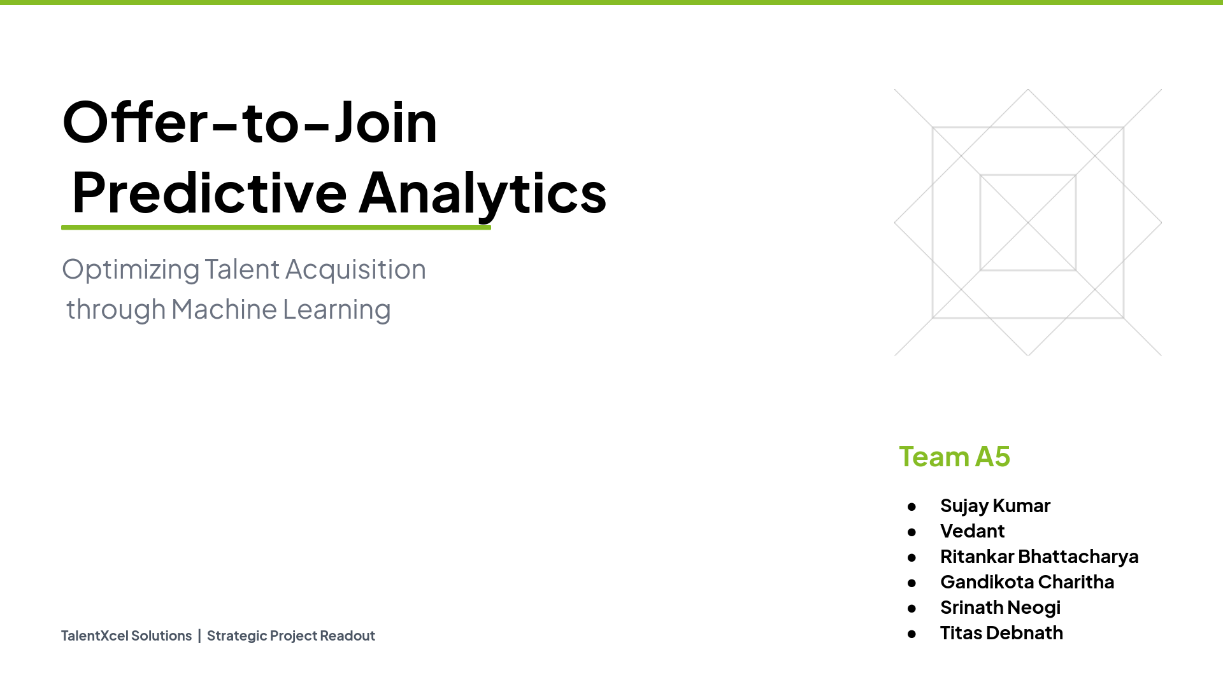

Slide 2
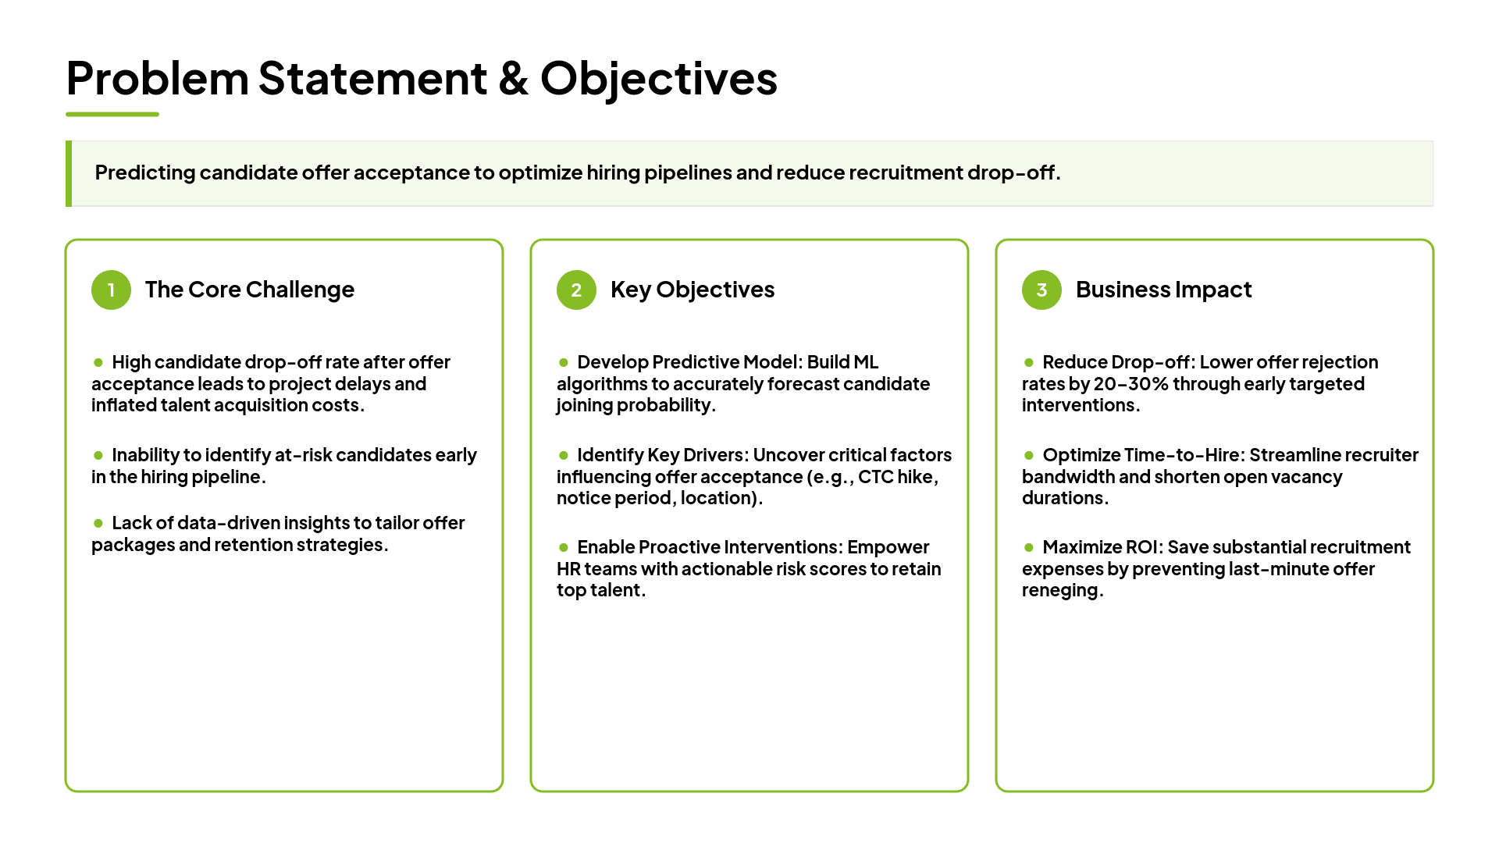

Slide 3
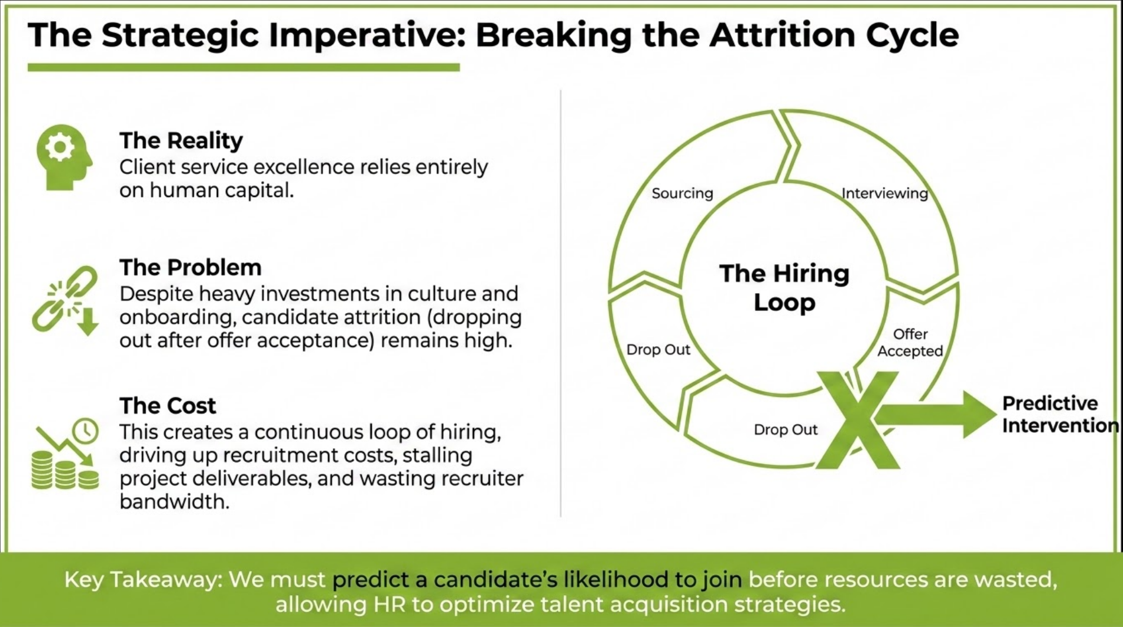
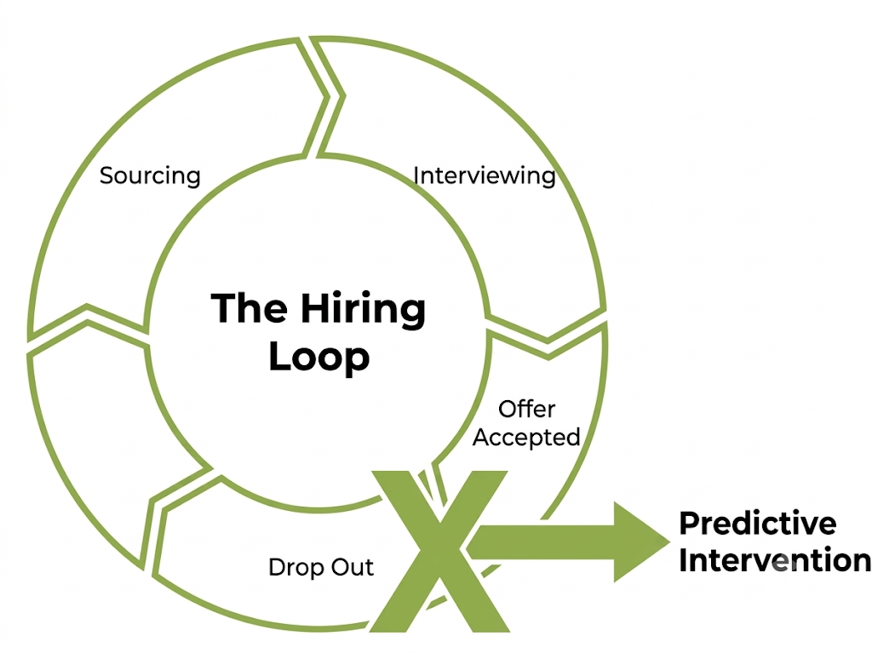

Joined

Slide 4
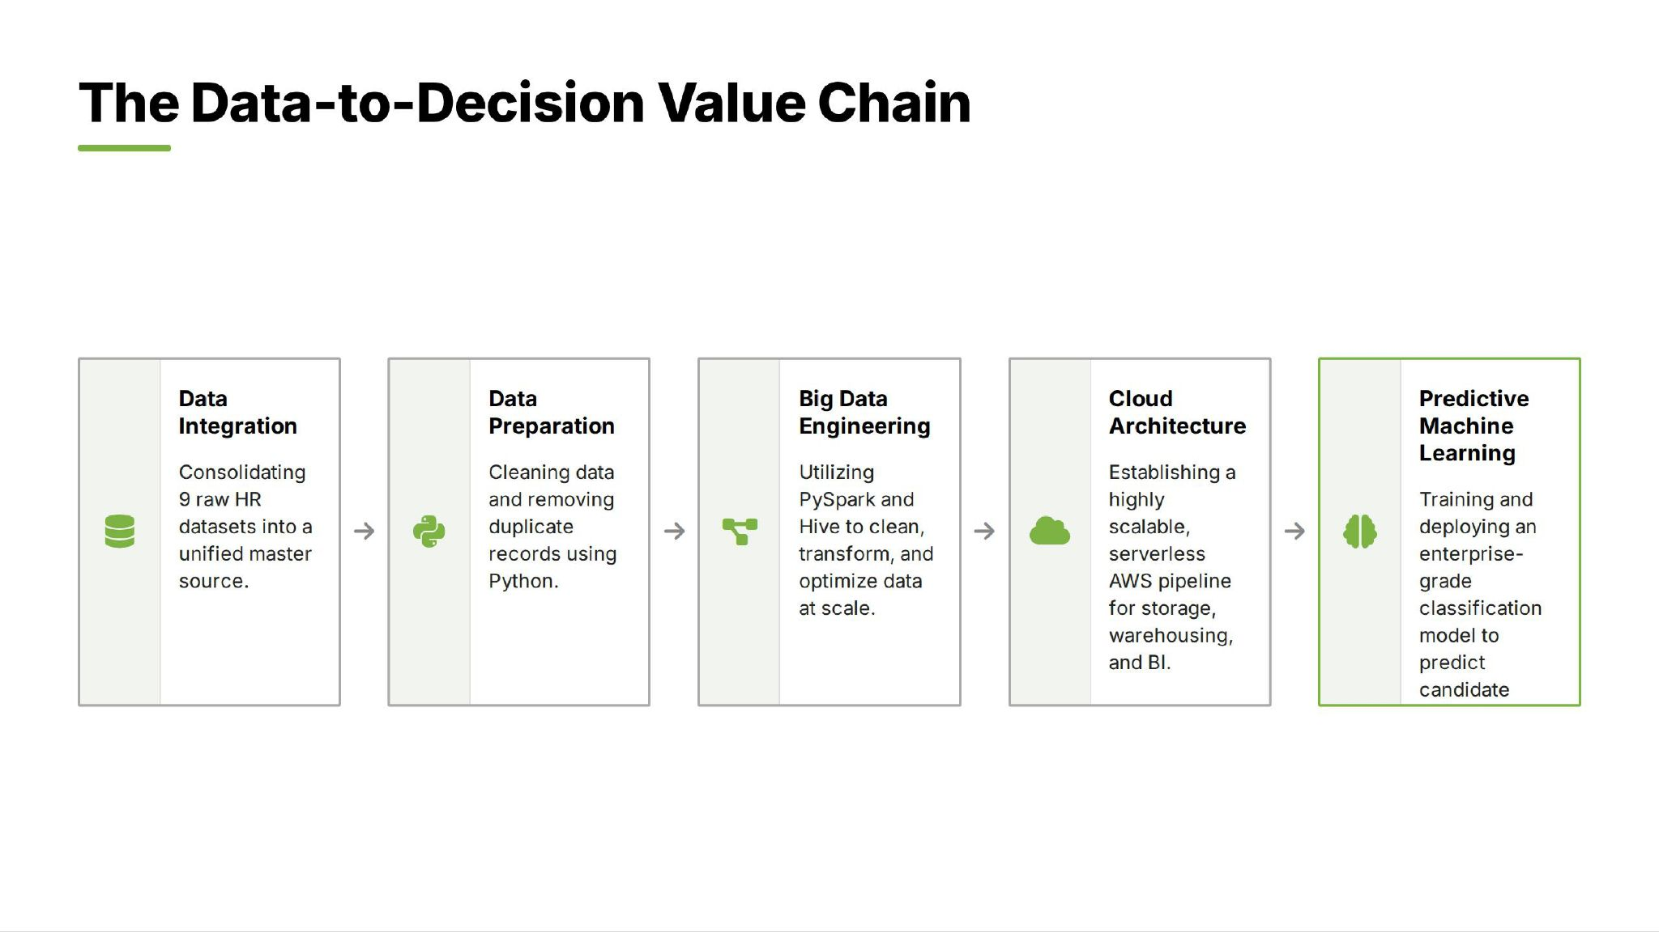

Slide 5
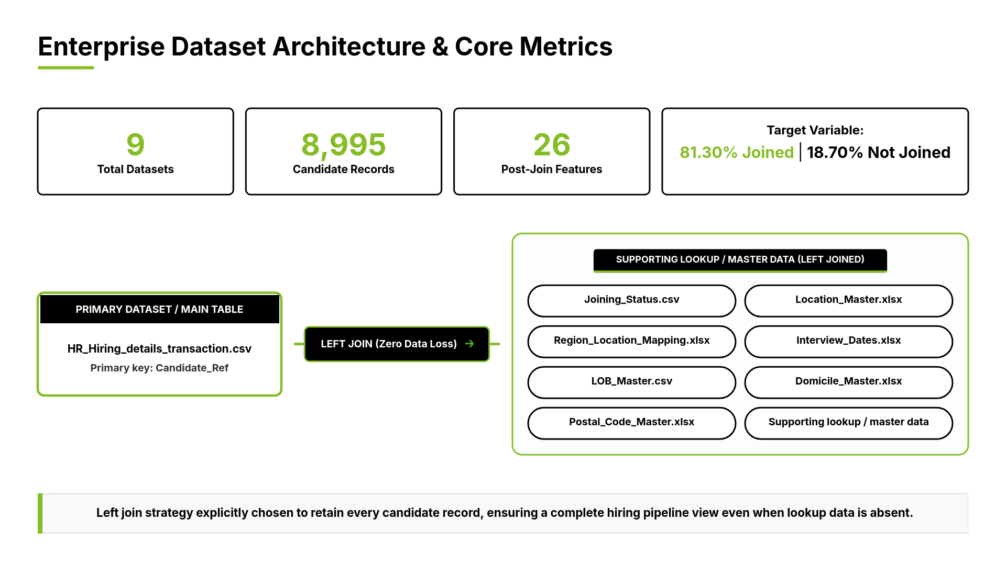
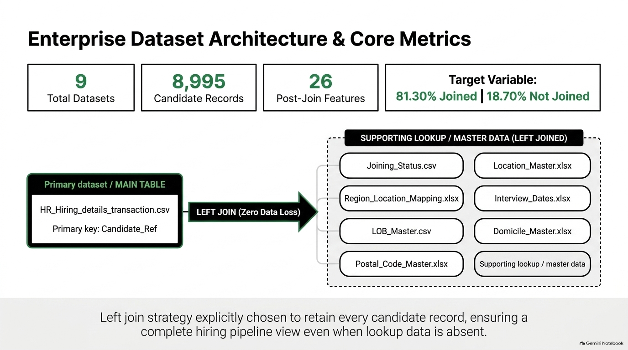


Slide 6
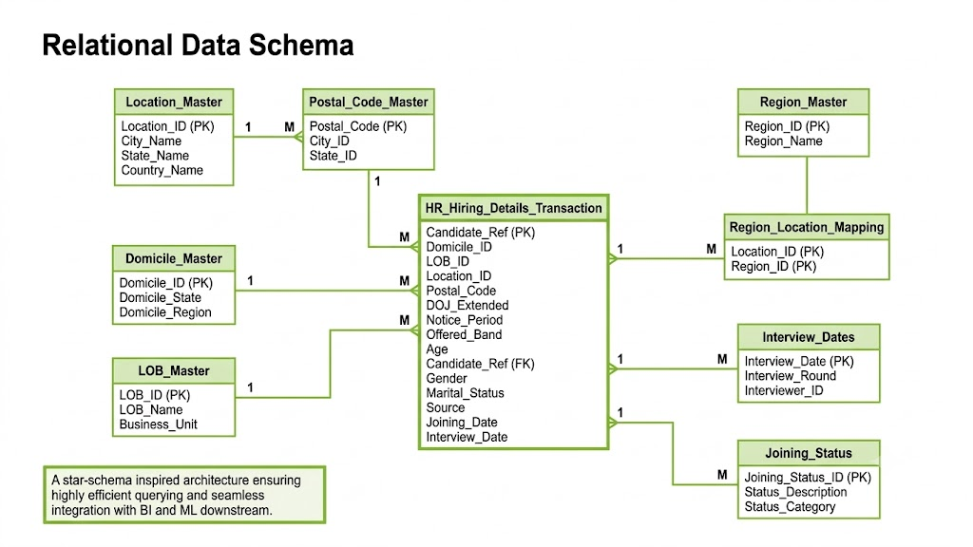
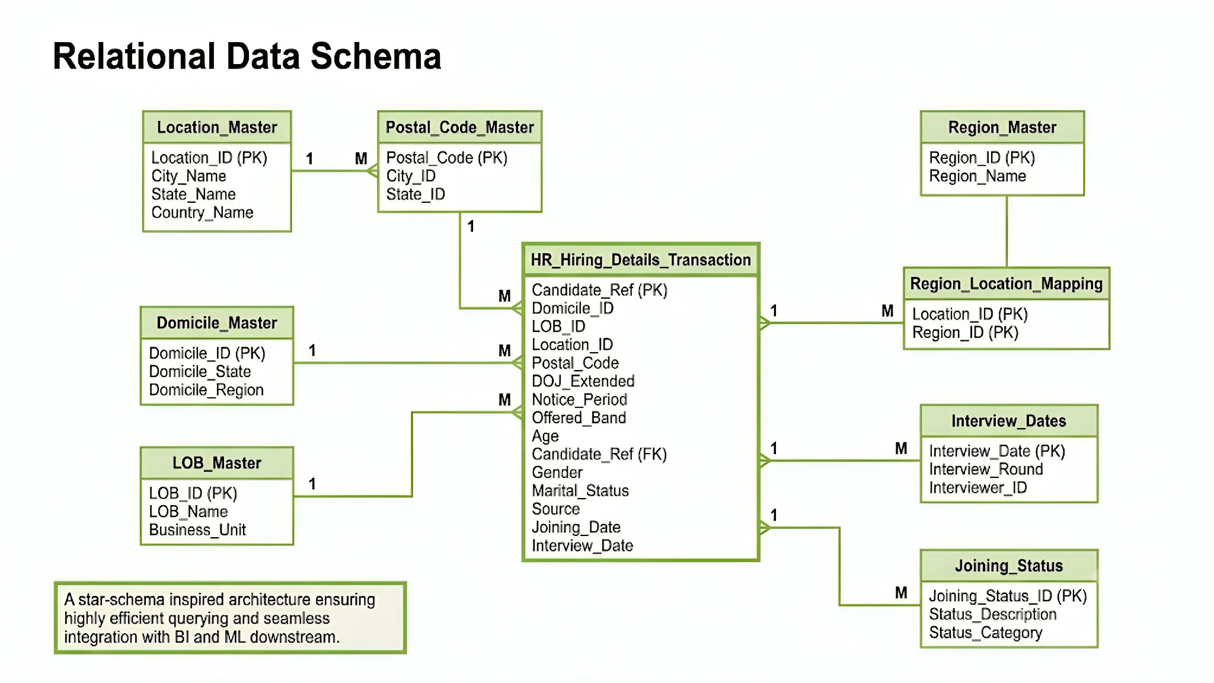
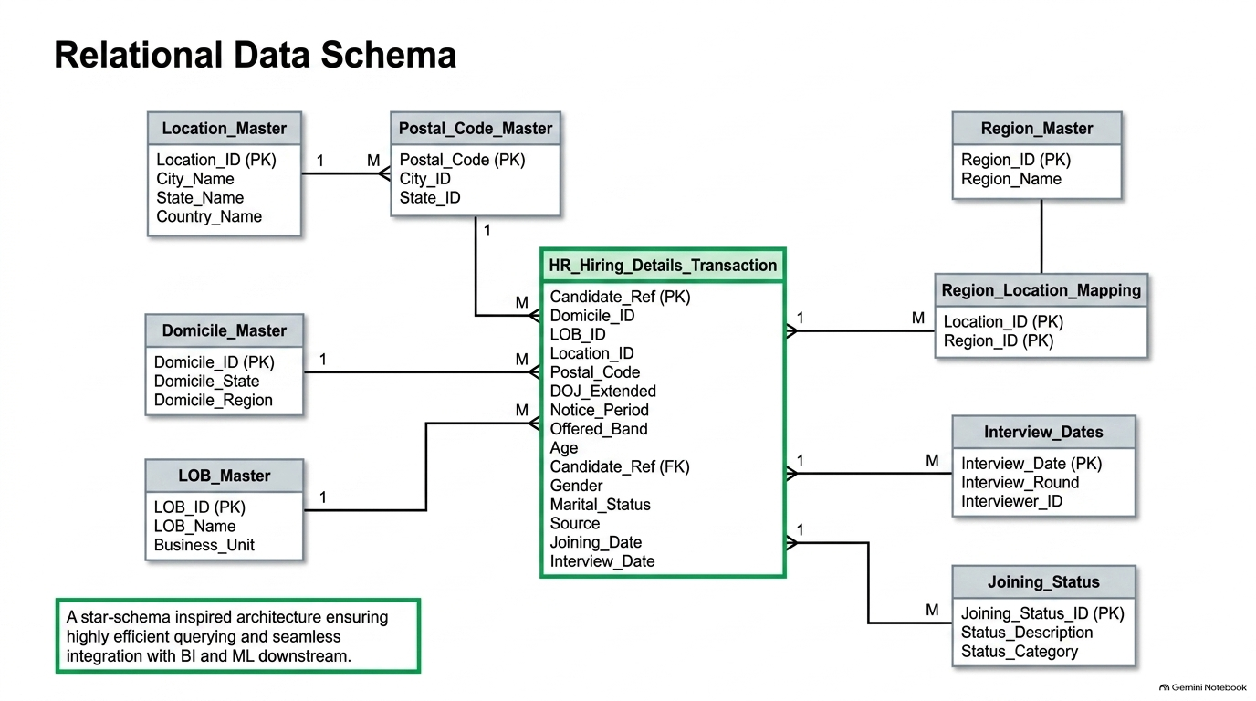

Slide 7
From Data to Decisions: Five Strategic SQL Queries
TalentXcel Solutions
Turning offer-acceptance data into a prioritized action list for recruiters
1
Fast-Accepting Relocators
2
Confirmed vs. Slow Deciders
3
25%+ CTC Hike Impact
4
The Ideal Offer Combo
5
Source Conversion Rates
Highest-intent candidates (<30 days + relocation-ready); prioritize onboarding, reduce follow-up overhead.
Flags at-risk offers stalling past 10 days; enables early intervention before slots go empty.
Quantifies whether higher pay moves acceptance; right-sizes future offers effectively.
Hike + fast accept + relocation + bonus = gold-standard package; gives recruiters a repeatable template.
Joined vs. declined by channel; redirects budget to high-conversion sourcing channels.
These five queries convert raw offer data into a prioritized action list — who to trust, who to chase, what to offer, and where to recruit — breaking the expensive hire-then-lose-the-candidate cycle.

Slide 8
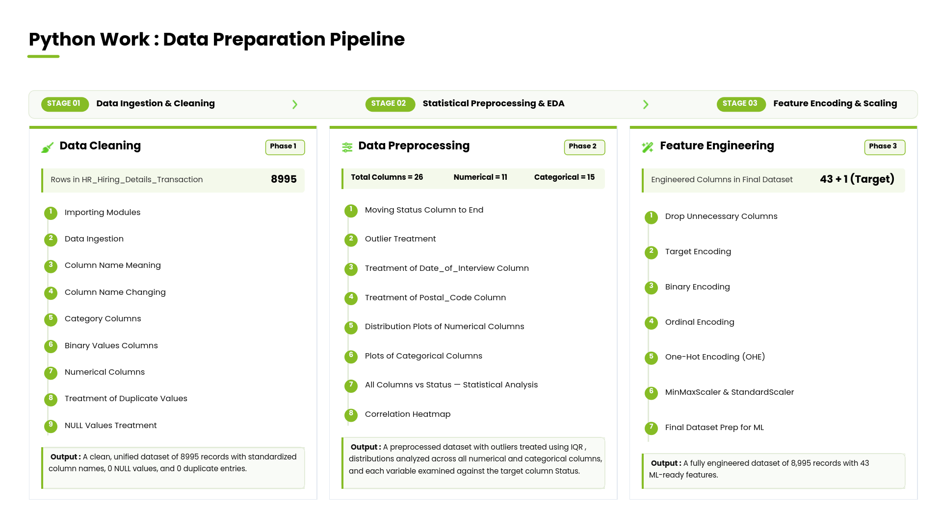

Slide 9
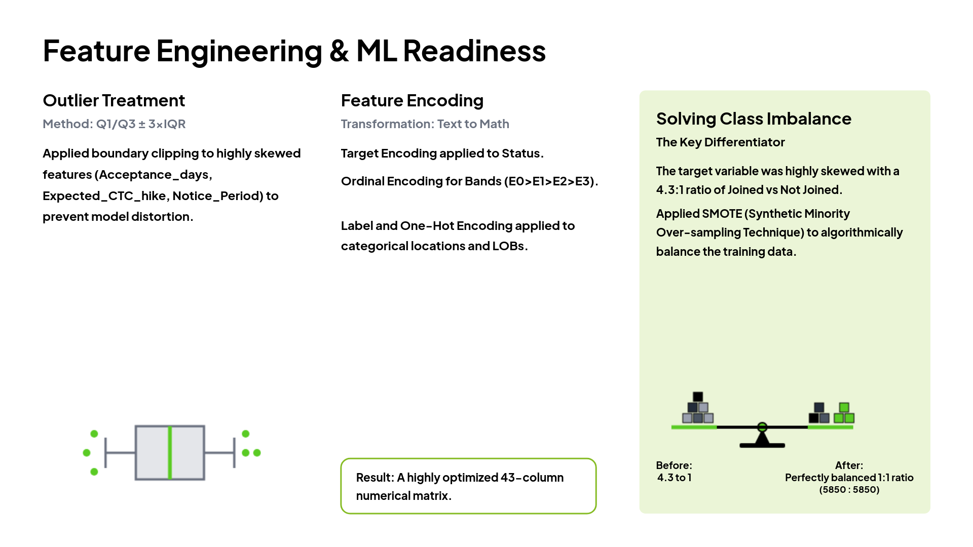

Slide 10
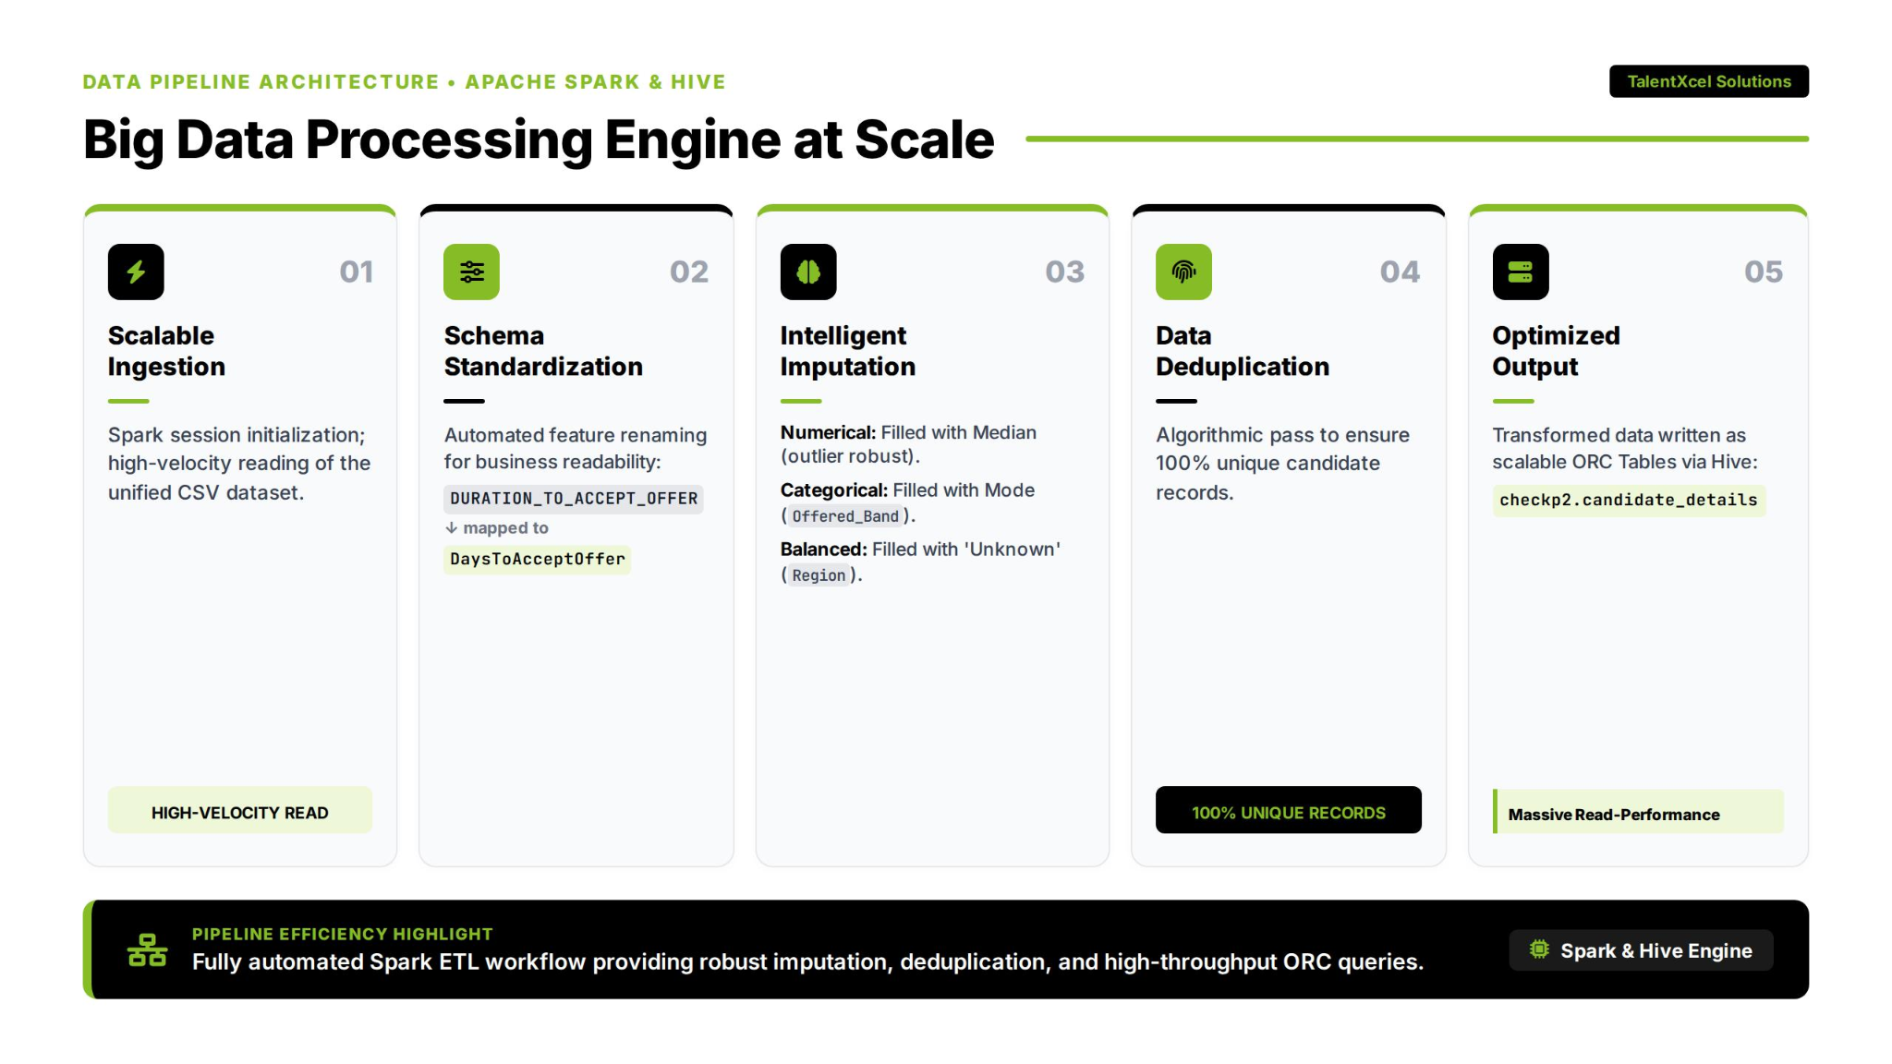

Slide 11
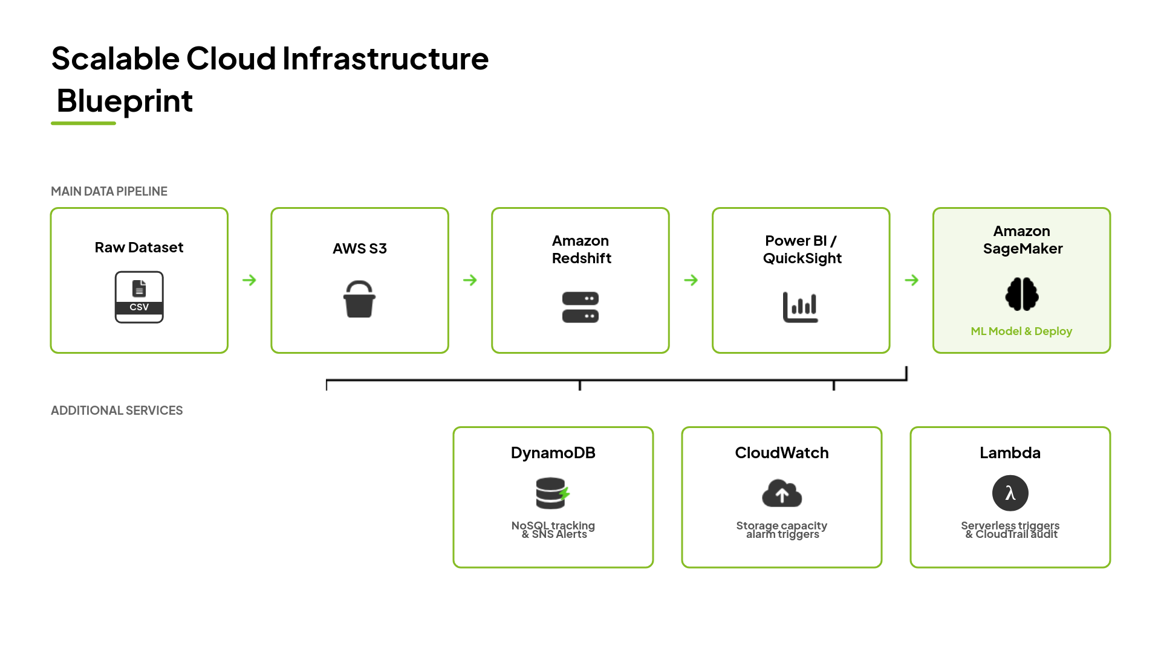
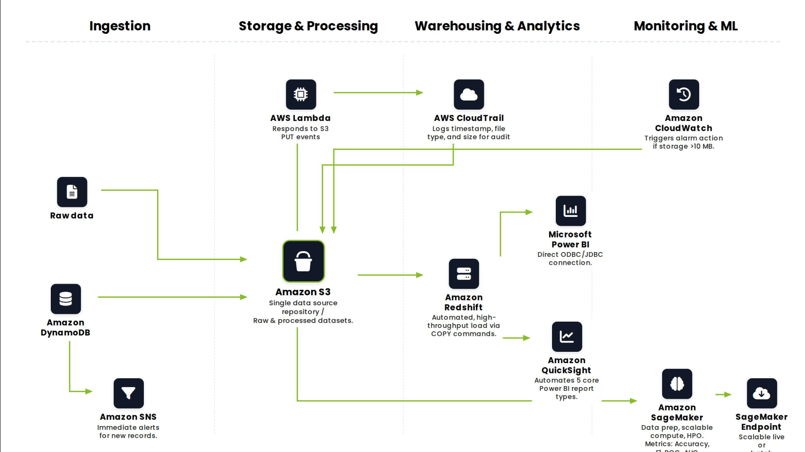

Slide 12
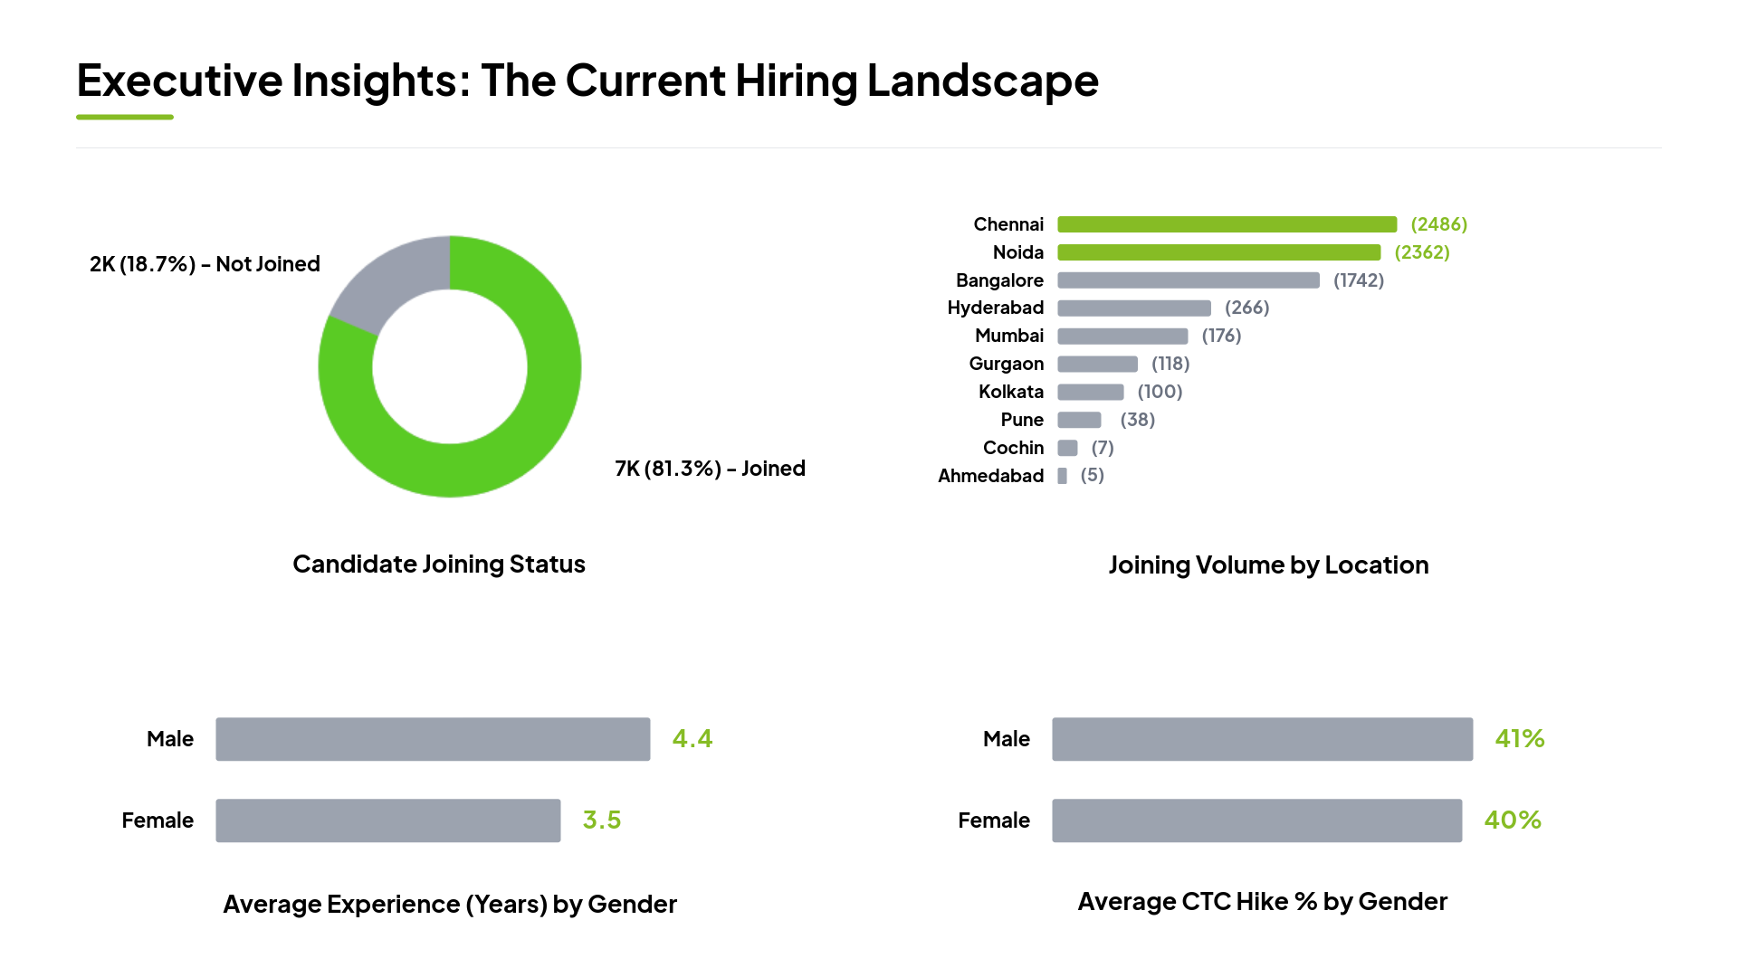

Slide 13


Model Selection: Six Algorithms Evaluated
LINEAR
TREE-BASED
ENSEMBLE - BAGGING
Logistic Regression
Decision Tree
Random Forest
Predicts Yes or No by drawing a simple dividing line between outcomes.
Makes predictions by asking a series of Yes/No questions step by step.
Runs hundreds of question trees together and takes the majority vote.
PROBABILISTIC
DISTANCE-BASED
ENSEMBLE - BOOSTING
Naive Bayes
KNN
XGBoost
Predicts outcome based on the probability of past similar candidate profiles.
Finds the most similar past candidates and predicts based on their outcome.
Learns from its own mistakes repeatedly, delivering the most refined prediction.

Slide 14
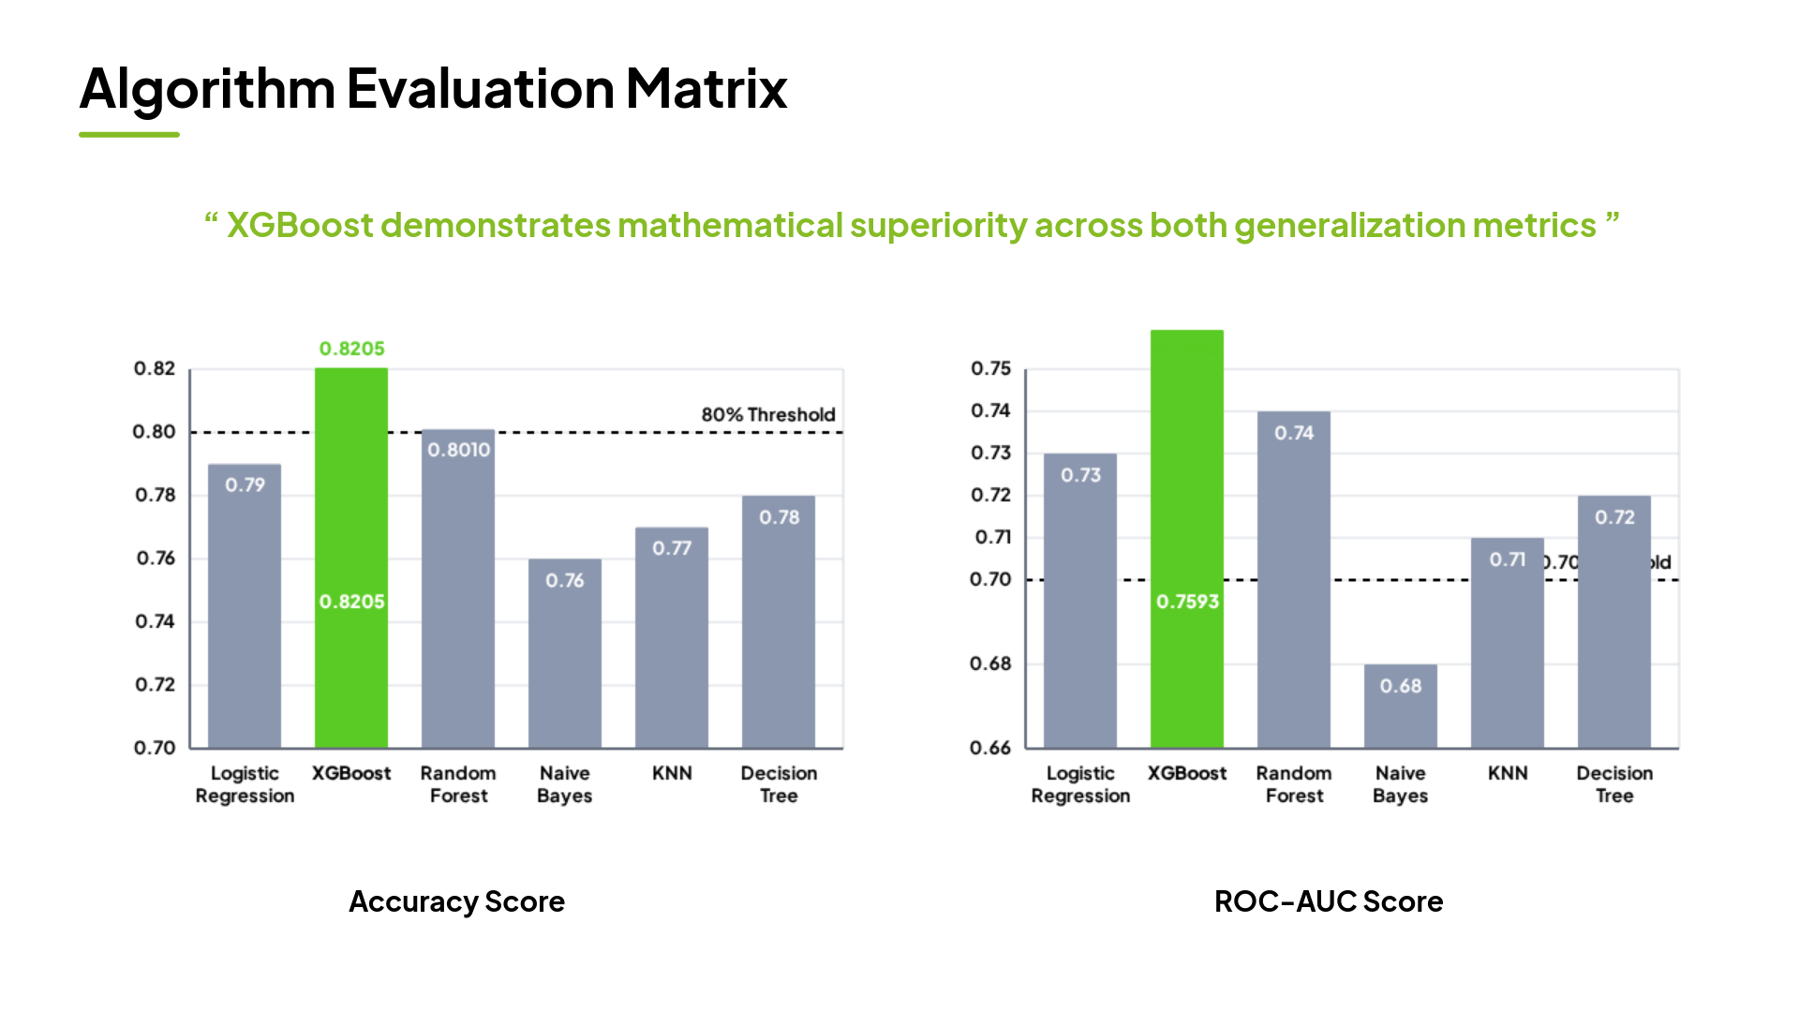

Slide 15
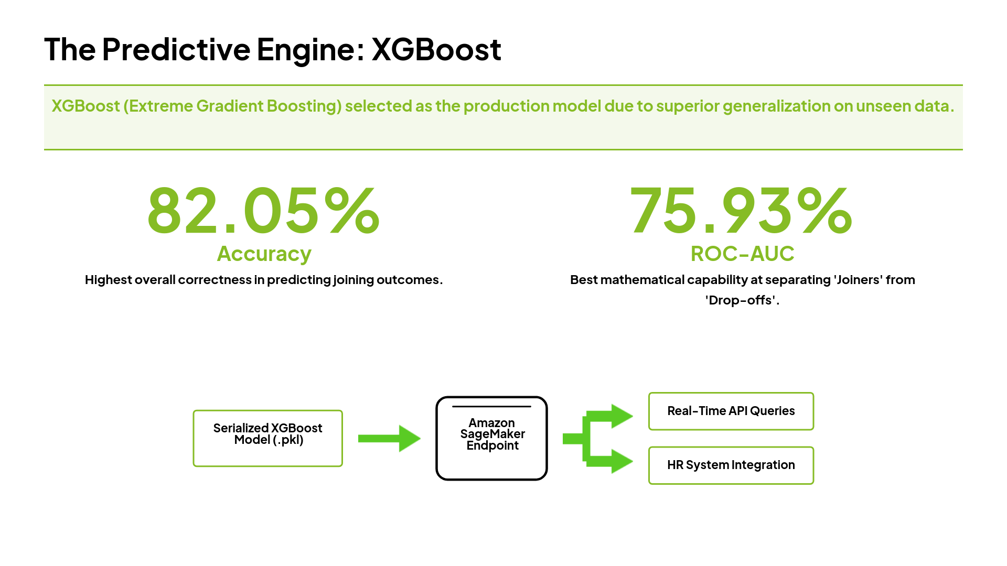

Slide 16
