Slide 1
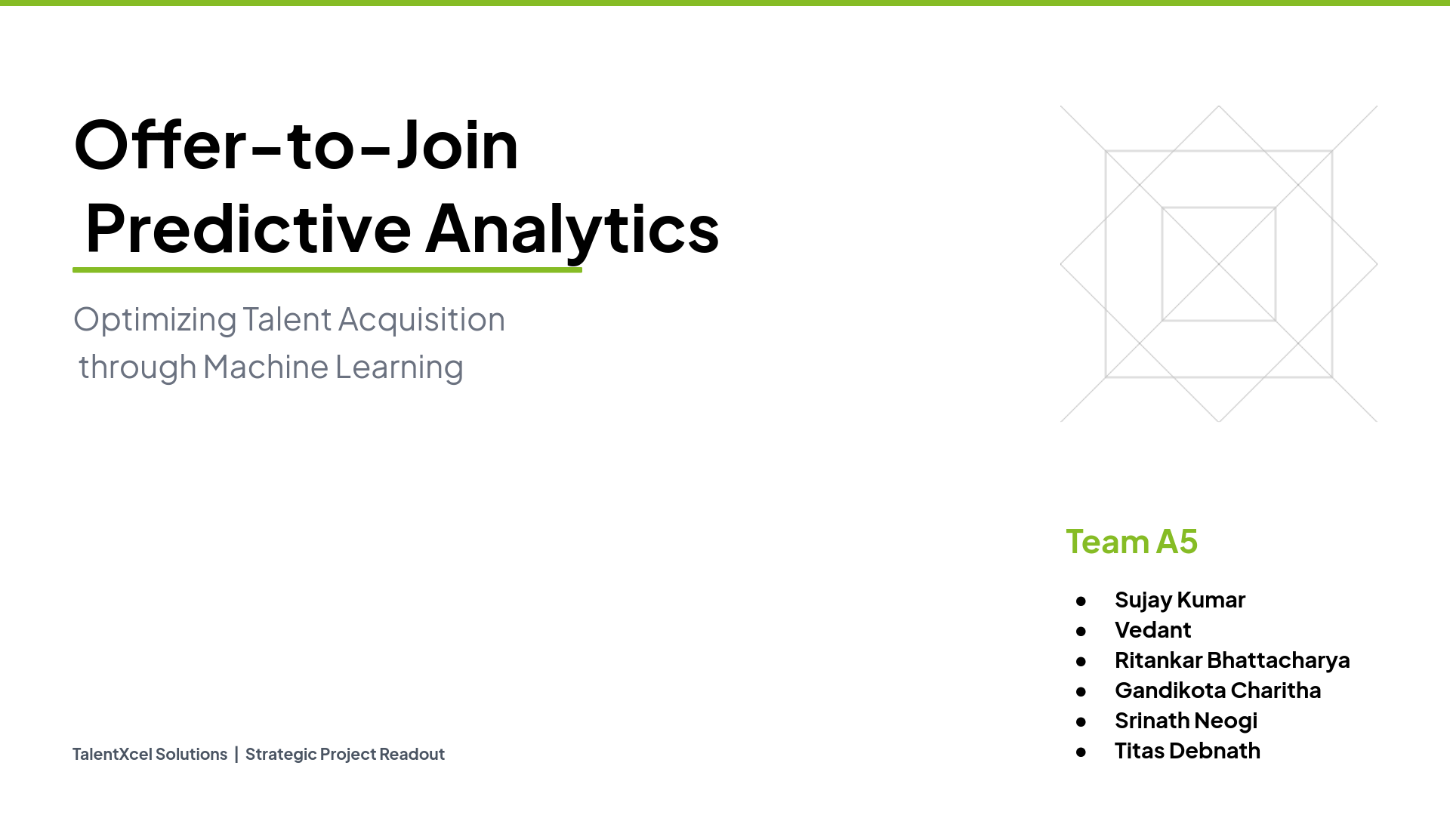

Slide 2
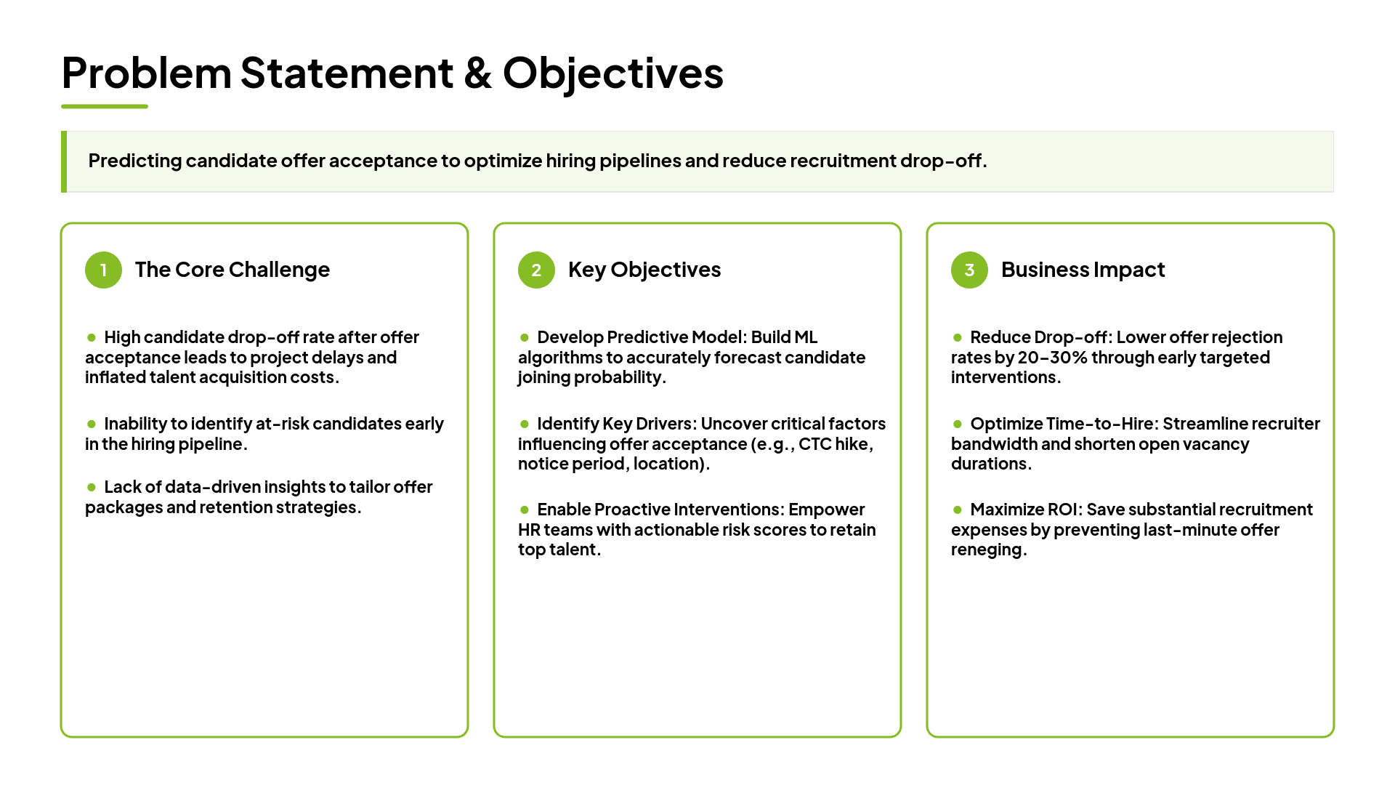

Slide 3
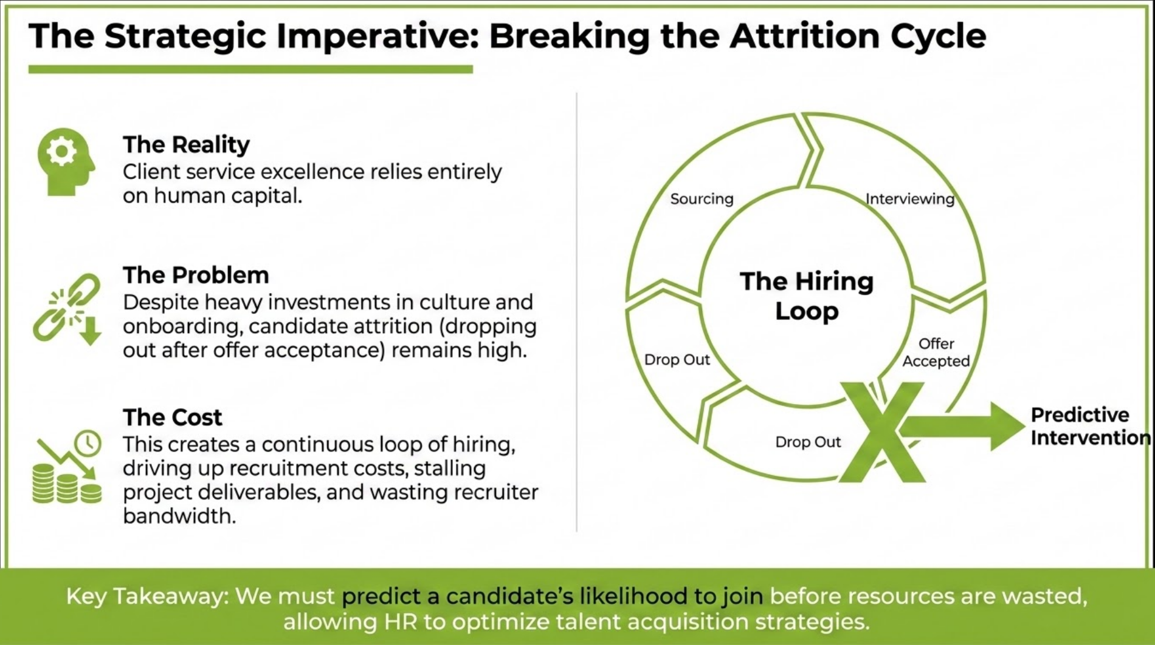
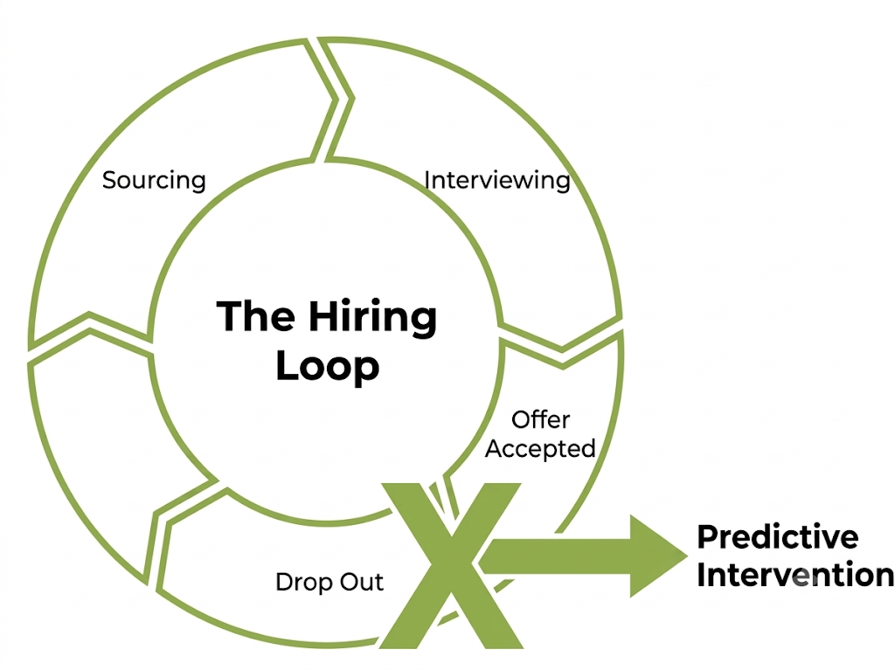

Joined

Slide 4
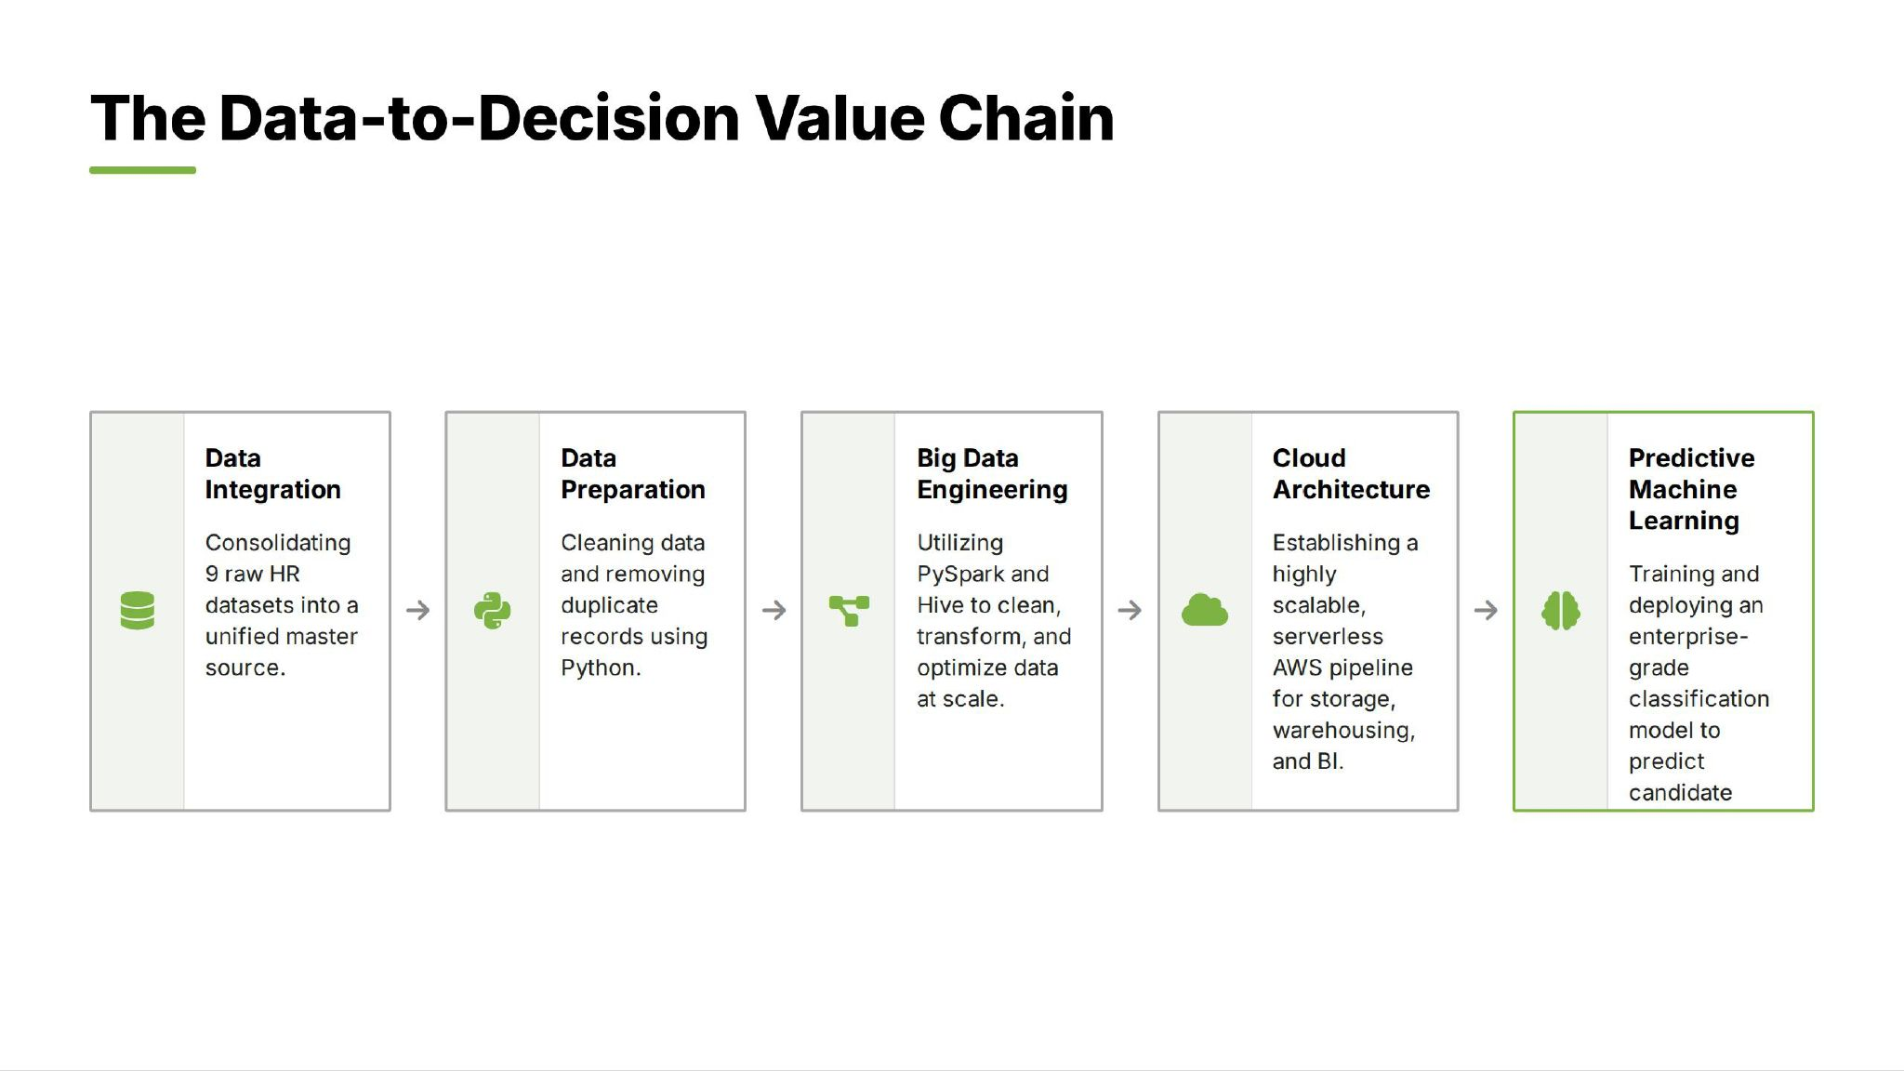

Slide 5
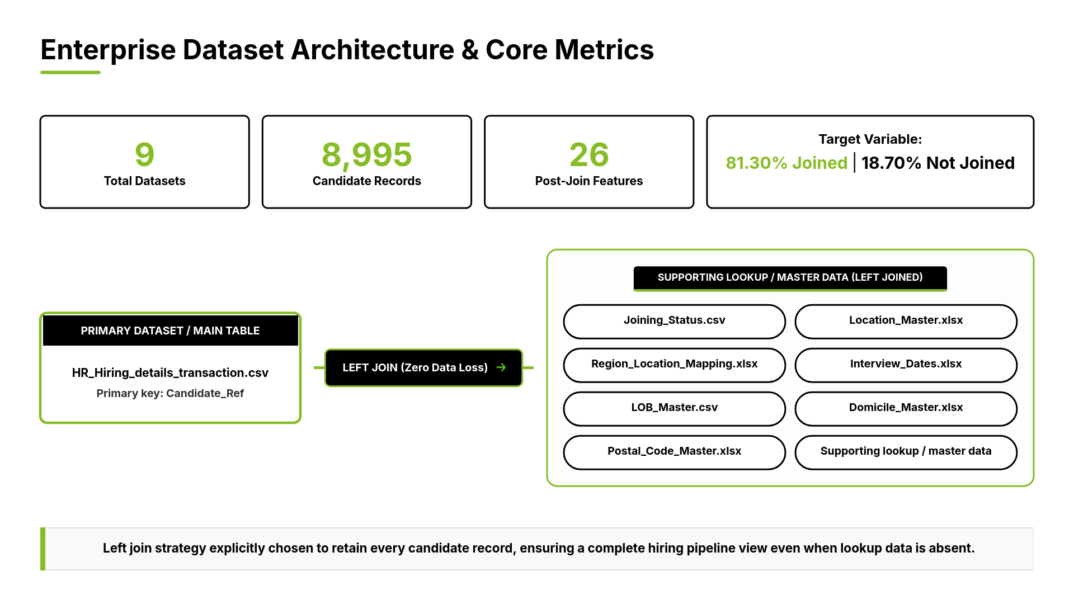
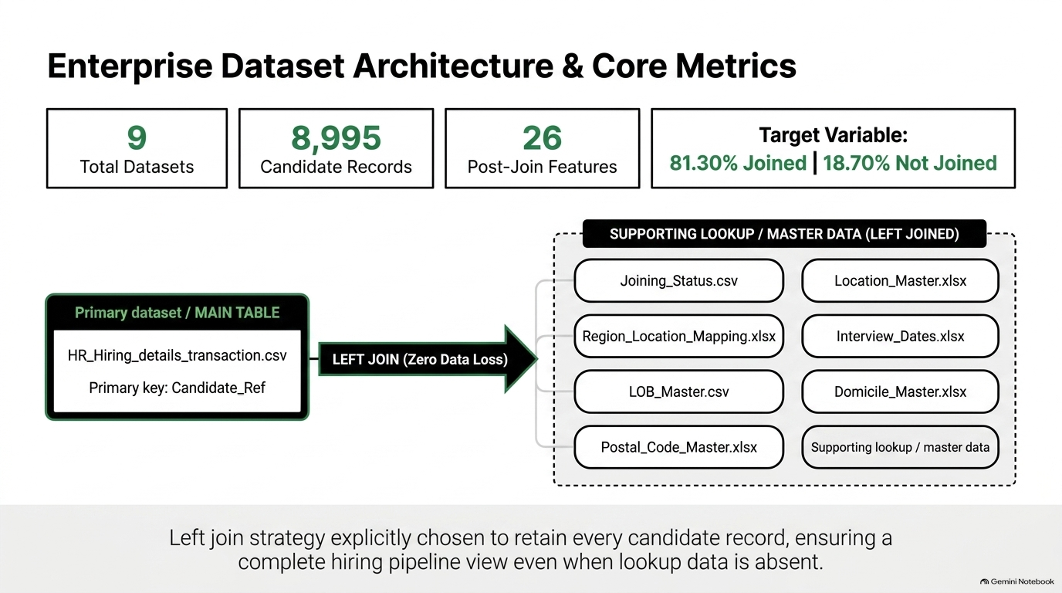


Slide 6
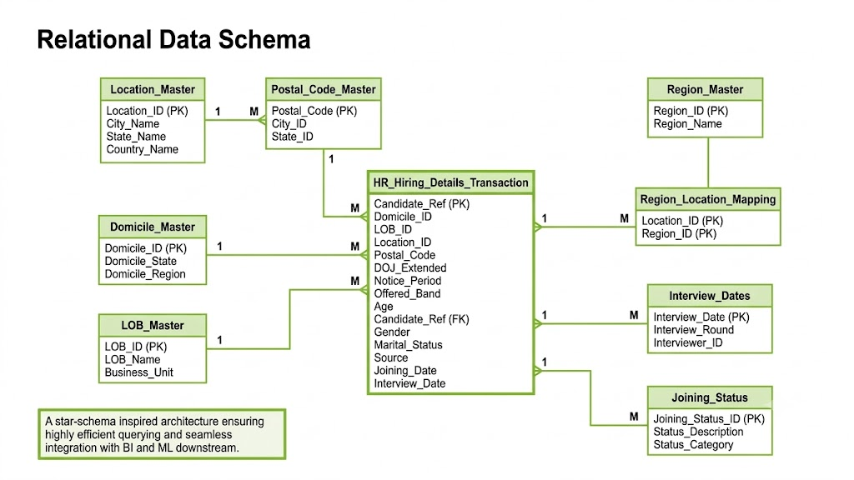
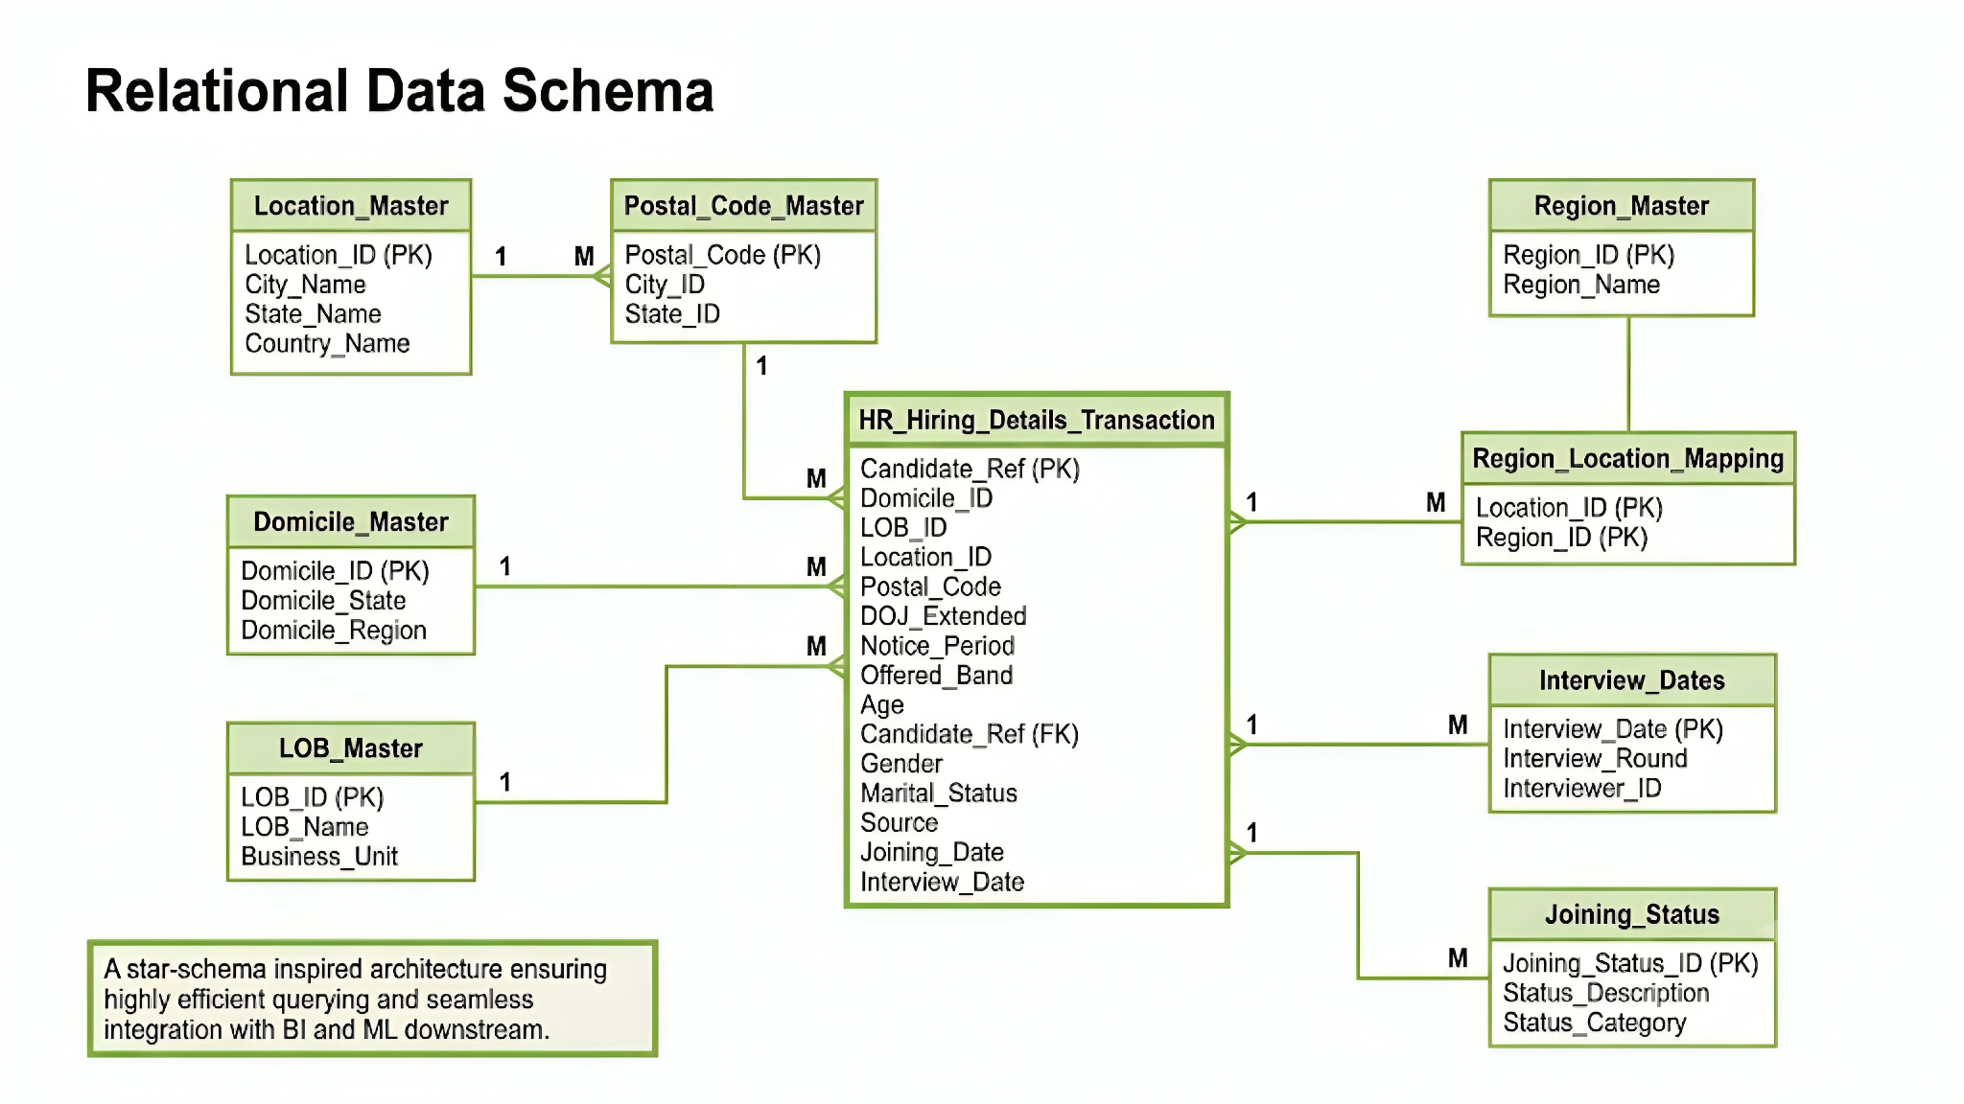
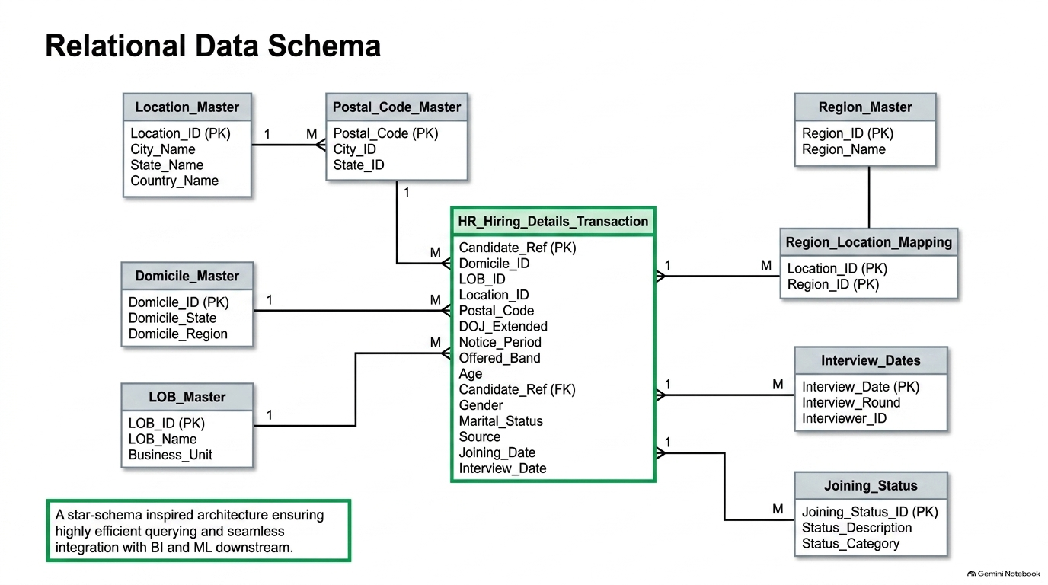

Slide 7
From Data to Decisions: Five Strategic SQL Queries
TalentXcel Solutions
Turning offer-acceptance data into a prioritized action list for recruiters
1
Fast-Accepting Relocators
2
Confirmed vs. Slow Deciders
3
25%+ CTC Hike Impact
4
The Ideal Offer Combo
5
Source Conversion Rates
Highest-intent candidates (<30 days + relocation-ready); prioritize onboarding, reduce follow-up overhead.
Flags at-risk offers stalling past 10 days; enables early intervention before slots go empty.
Quantifies whether higher pay moves acceptance; right-sizes future offers effectively.
Hike + fast accept + relocation + bonus = gold-standard package; gives recruiters a repeatable template.
Joined vs. declined by channel; redirects budget to high-conversion sourcing channels.
These five queries convert raw offer data into a prioritized action list — who to trust, who to chase, what to offer, and where to recruit — breaking the expensive hire-then-lose-the-candidate cycle.

Slide 8
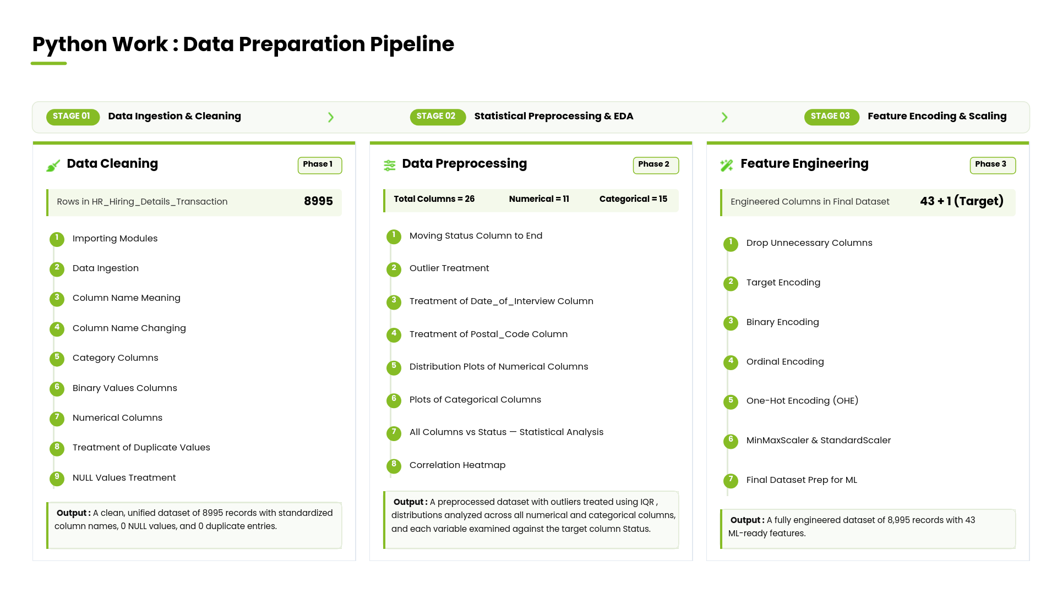

Slide 9
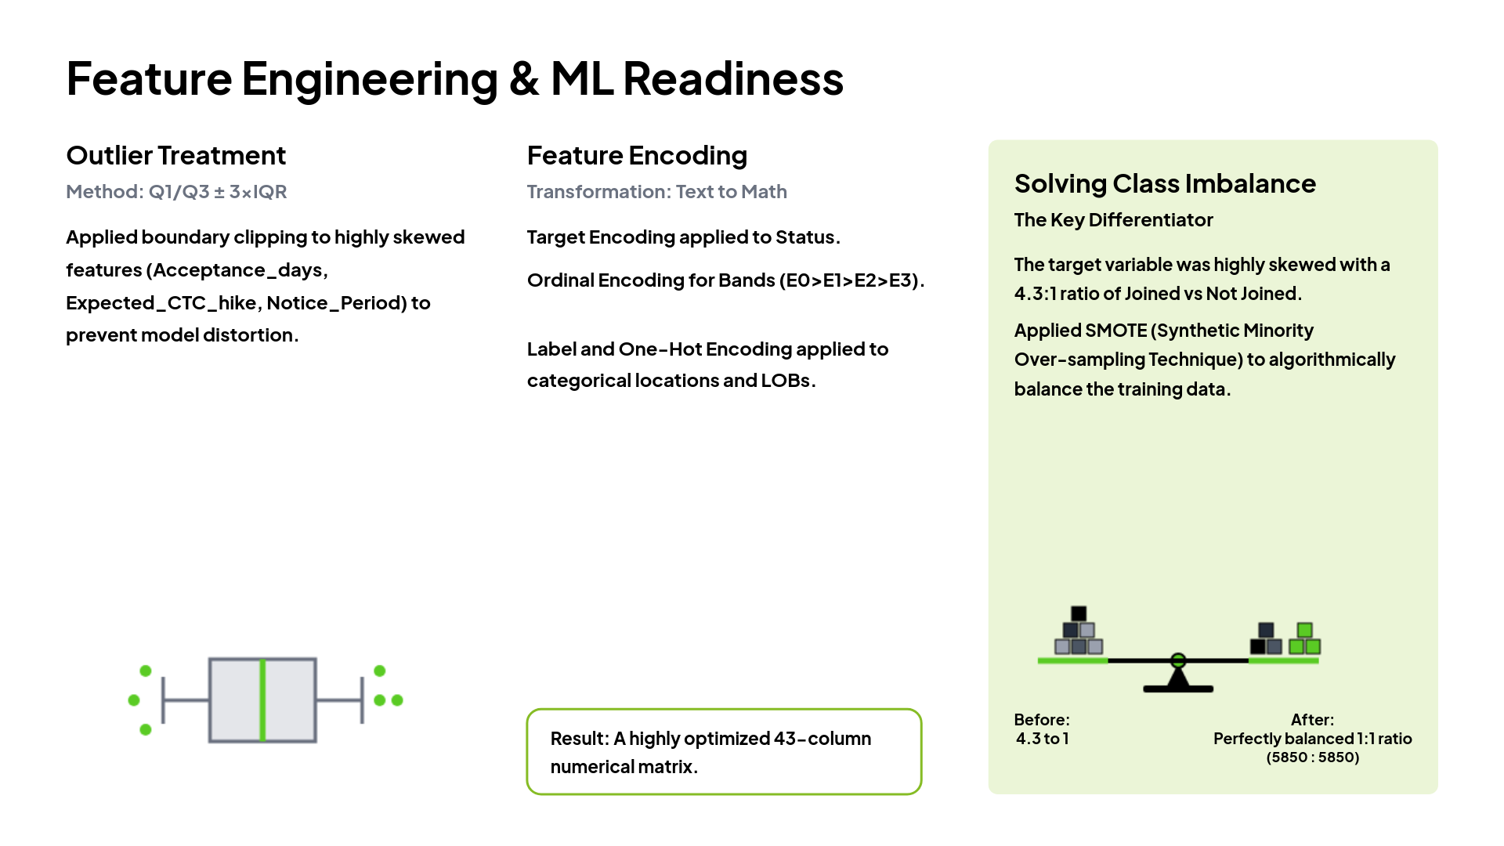

Slide 10
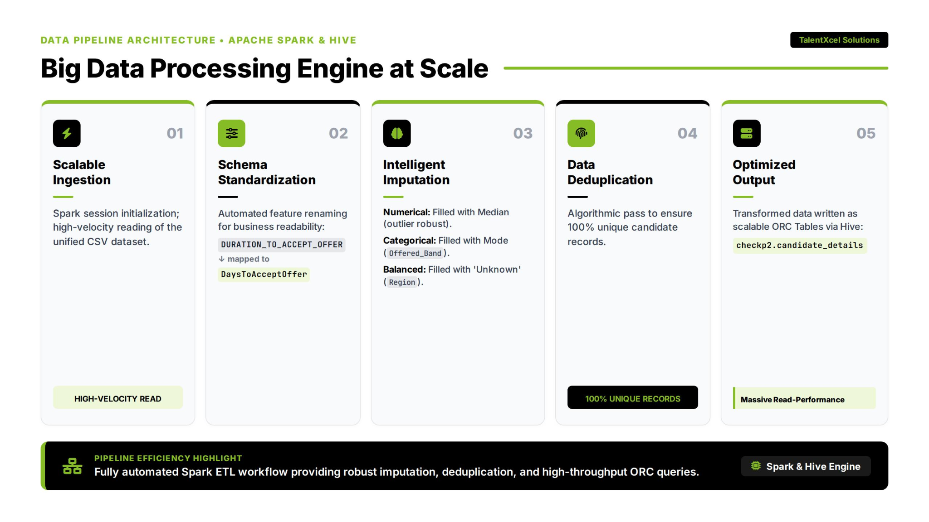

Slide 11
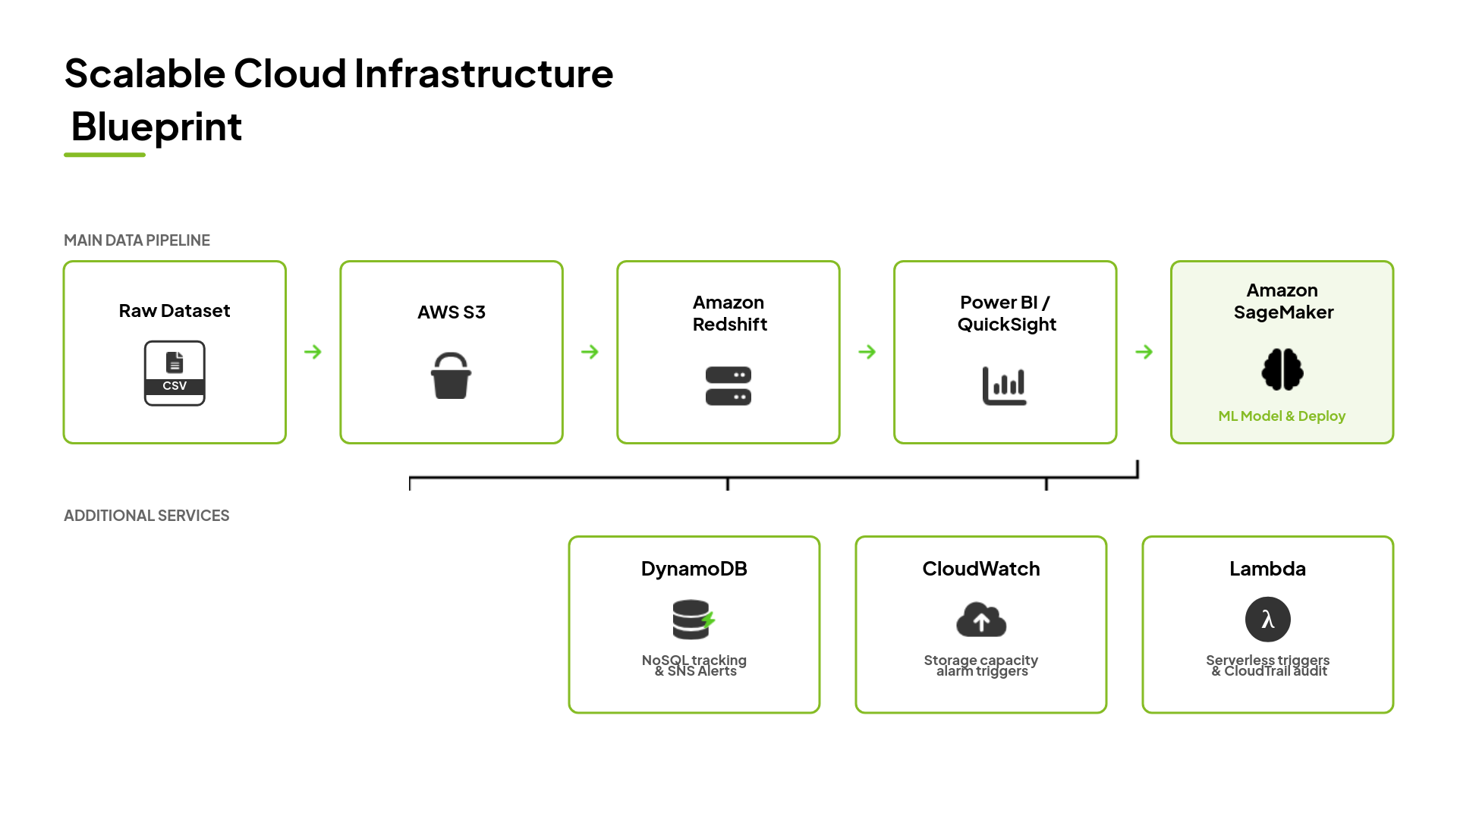
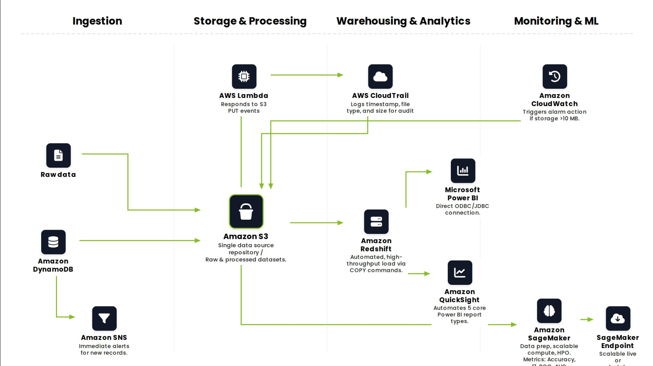

Slide 12
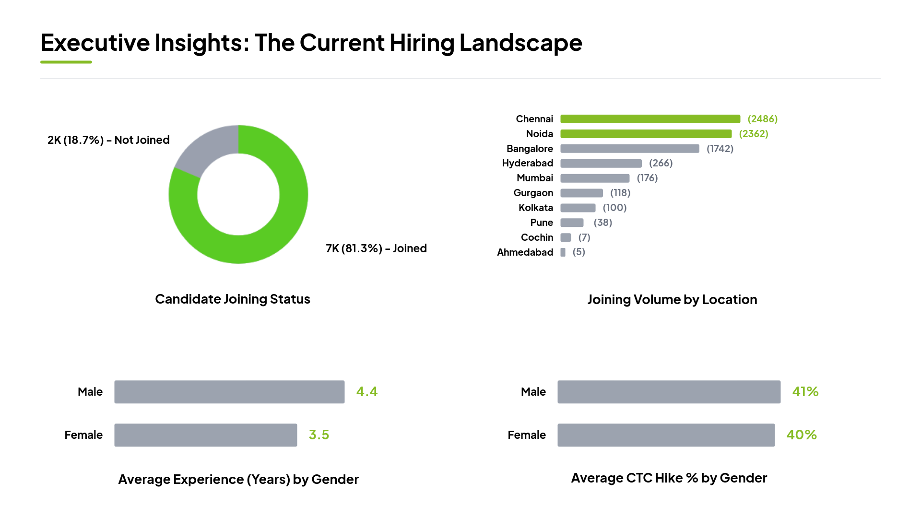

Slide 13
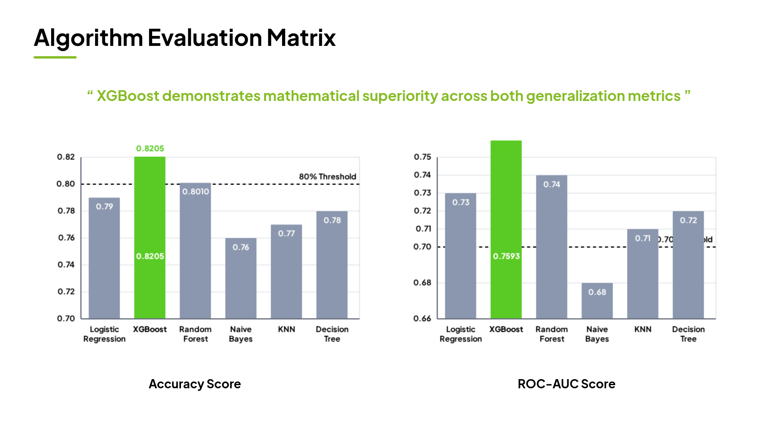

Slide 14
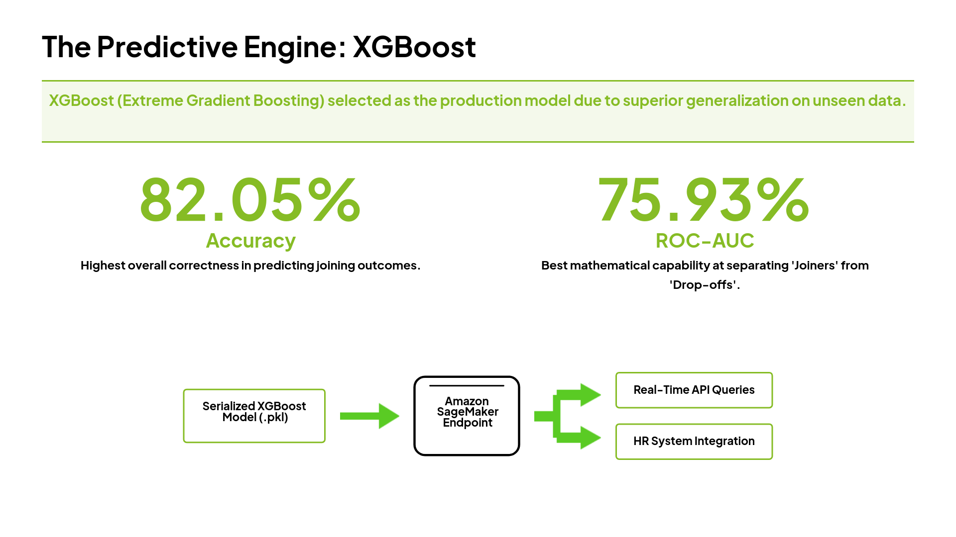

Slide 15
