Slide 1

“Fitness Tracker and Goal Setter”
Sanjivani Rural Education Society’s
Sanjivani College of Engineering, Kopargaon 423 603
(Affiliated to Savitribai Phule Pune University, Pune )
Department of Computer Engineering
Prepared By
Miss. Suvarna Gadhe[UCS23F1037]
Miss. Shraddha Dange [UCS23F1026]
Guided By,
Prof. S. S. Gawali

Slide 2
Contents
Sanjivani Rural Education Society’s
Sanjivani College of Engineering, Kopargaon 423 603
(Affiliated to Savitribai Phule Pune University, Pune )
Department of Computer Engineering Research Center
Introduction of project
Functionality of project
Details about Data types used in project
Details about predefine module/libraries used in project
Details about predefined function.
Output of Code.

Slide 3
Introduction
Sanjivani Rural Education Society’s
Sanjivani College of Engineering, Kopargaon 423 603
(Affiliated to Savitribai Phule Pune University, Pune )
In today's digital age, the need for local businesses to establish a strong online presence is more crucial than ever.
Our platform aims to bridge the gap between traditional brick-and-mortar stores and the vast online market, providing local businesses with a powerful platform to thrive in the digital landscape.
Objectives
Our primary goal is to support and promote local businesses by offering them a dedicated online platform to reach a wider audience.
We aim to create a seamless shopping experience for consumers, allowing them to discover and purchase products from local businesses with ease.

Slide 4
Functionality of Project
Sanjivani Rural Education Society’s
Sanjivani College of Engineering, Kopargaon 423 603
(Affiliated to Savitribai Phule Pune University, Pune )
Display: This function displays details of available products.
Search: It searches for the product that the user wants to buy and shows its details.
Buy: This function allows the user to purchase products according to the required quantities.
Bill: It generates a bill for the user, including any applicable discounts.

Slide 5
Details about Data types used in project
Sanjivani Rural Education Society’s
Sanjivani College of Engineering, Kopargaon 423 603
(Affiliated to Savitribai Phule Pune University, Pune )
Strings: Used for name, fitness_goal, fitness_level, progress_summary, message, and keys/values in various dictionaries.
Integers: Used for age.
Floats: Used for weight and height.
Lists: Used for workout_schedule.
Dictionaries: Used for user_profile and workout_suggestions.

Slide 6
Details about predefine module/libraries used in project
Sanjivani Rural Education Society’s
Sanjivani College of Engineering, Kopargaon 423 603
(Affiliated to Savitribai Phule Pune University, Pune )
tkinter: Used for creating the main application window and various GUI elements like labels, entries, buttons, etc.
ttk: Provides themed widgets for a modern-looking interface.
messagebox: Used for displaying message boxes (dialogs) for showing information, warnings, errors, etc..

Slide 7
Details about predefined function
Sanjivani Rural Education Society’s
Sanjivani College of Engineering, Kopargaon 423 603
(Affiliated to Savitribai Phule Pune University, Pune )
_init_(self, root): Initializes the FitnessApp class.
save_profile(self): Saves user profile data entered in the GUI.
track_progress(self): Tracks user's fitness progress and displays a summary.
recommend_workouts(self, fitness_level): Recommends workouts based on fitness level.
set_fitness_goal(self): Sets the user's fitness goal.
calculate_bmi(weight_kg, height_m): Calculates BMI.
determine_fitness_level(bmi, age): Determines fitness level based on BMI and age.

Slide 8
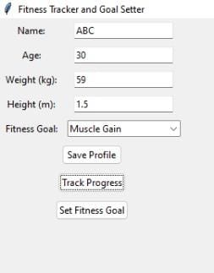
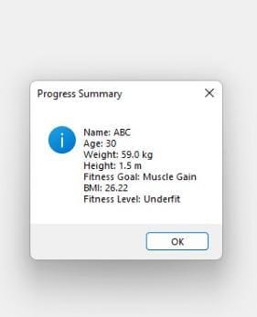
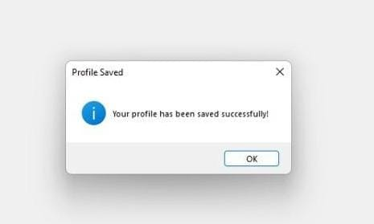
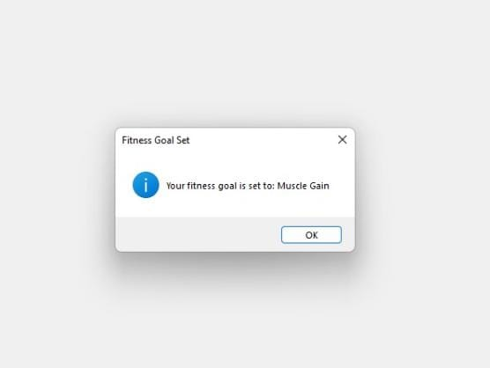
Output
Sanjivani Rural Education Society’s
Sanjivani College of Engineering, Kopargaon 423 603
(Affiliated to Savitribai Phule Pune University, Pune )

Slide 9
Thank You
Sanjivani Rural Education Society’s
Sanjivani College of Engineering, Kopargaon 423 603
(Affiliated to Savitribai Phule Pune University, Pune )

