Slide 1
Loan Eligibility Prediction using PySpark
Suvajyoti Chakraborty
Roll No.: A21034
Praxis Business School

Slide 2

INTRODUCTION
Loan Eligibility is defined as set of Criteria basis which a financial institution evaluates to decide the eligibility of a customer for a particular loan.

Slide 3

PROBLEM STATEMENT
Loan eligibility is decided after a long an intensive process of verification of documents and validation of set of criteria's which takes up huge amount of time .
The most needed loan applicants have to wait for long amount of time.

Slide 4
PREFERRED SOLUTION
Automation of the process reduce significant amount of time
Identifying the real segment of customers those are eligible for loan
This time consuming process can be solved by developing a system decided a person could take a loan or not using Machine Learning model.

Slide 5
TOOLS AND TECHNIQUES USED
GOOGLE COLAB
SPARK
PYTHON
MATPLOTLIB

Slide 6
STEPWISE DOINGS
Collect Dataset (Uploaded on GitHub Repository)
Setting up Spark Ecosystem
Import dataset
Null value imputation
Exploratory Data Analysis
Feature Engineering
Data Preprocessing
Model Preparation
Model Building
Conclusion

Slide 7
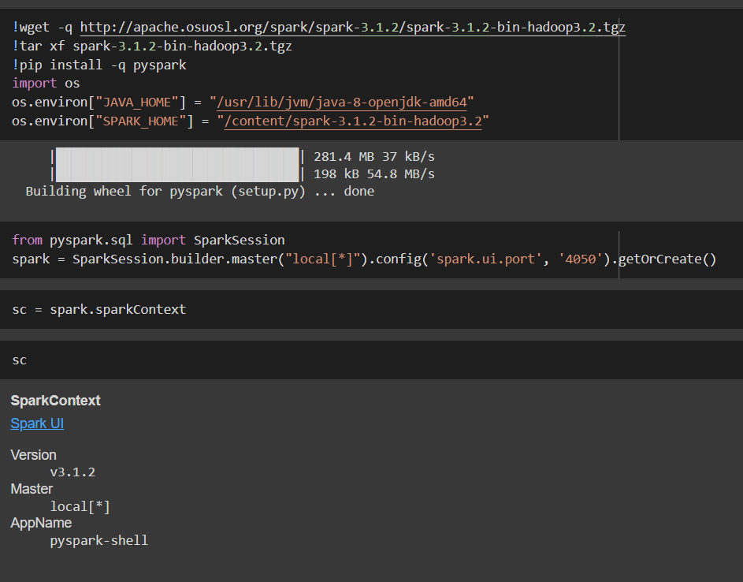
SETTING UP SPARK ENVIRONMENT
Using google colab for this assignment.
Using !wget command first installed the Spark
!tar is the unzip programme of linux.
Then install pyspark which allows to access spark with the help of python.
Created local spark instance to check and run the spark.

Slide 8
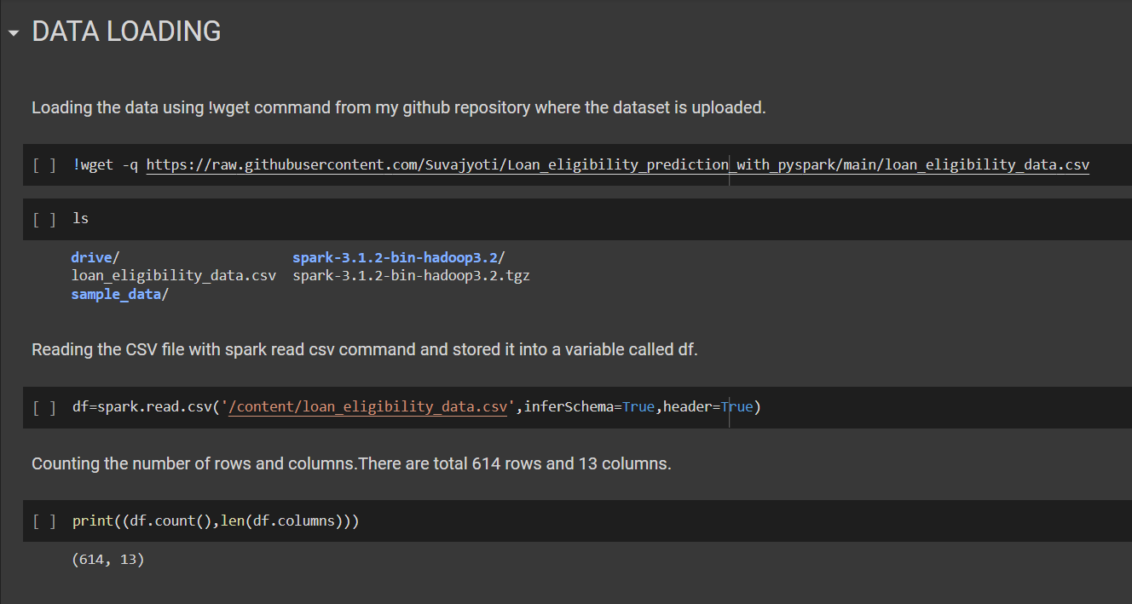
IMPORTING THE DATA SET
The dataset is already uploaded in my github repository
Using !wget command loaded the data in the spark ecosystem.
Read the data
Count the number of rows and columns for cross checking.

Slide 9
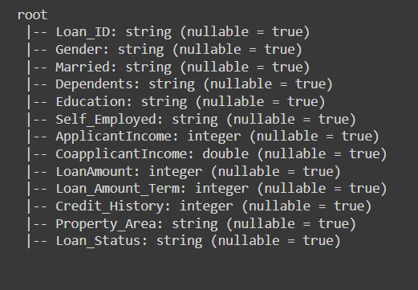
SCHEMA OF THE DATASET
Loan_ID is the unique id against each customer who have applied for the loan.
Gender, Married, Dependents, Education, Self Employed, Property Area, Loan Status are categorical data.
Applicant Income, Co-applicant Income, Loan Amount, Loan Amount Term, Credit History are numerical data.
In total 614 rows and 13 columns.

Slide 10
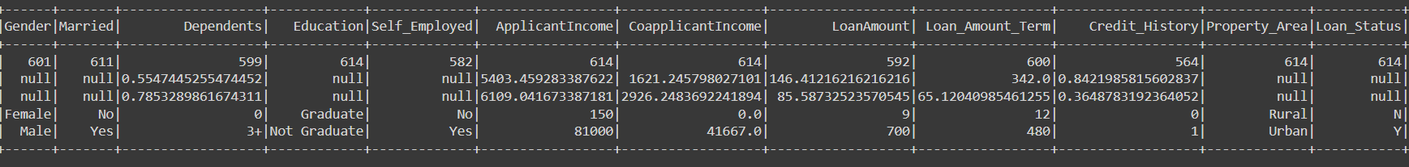
SUMMARY OF THE DATASET
Checking Five Summary Statistics
Count, Mean, Standard Deviation, Minimum Range and Maximum Range
Dropped Loan Id column

Slide 11
NULL VALUE HANDLING 1
Null/Missing values are present in the dataset.
No null value is present in the target column.
For numerical column mean and median and for categorical column mode will be used to impute the null/missing values.

Slide 12
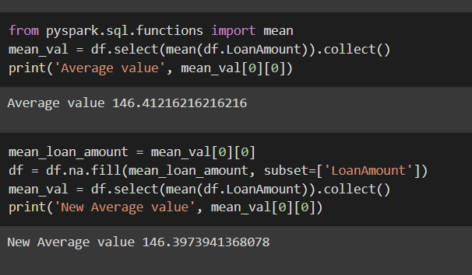
NULL VALUE HANDLING 2
First calculated the average loan amount of the column LoanAmount. The Average value is 146.412.
Then imputed the average value,
new average turns out to
146.39.

Slide 13
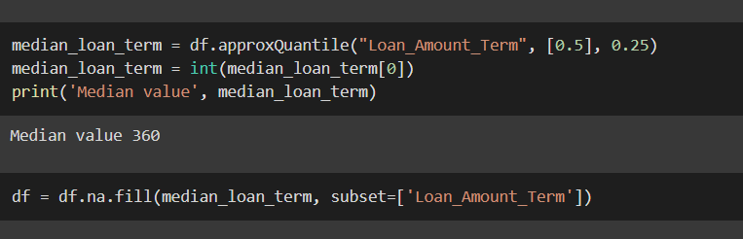
NULL VALUE HANDLING 3
First Calculated Medium of the Loan Amount Term. The median value is 360.
Imputed the median value.

Slide 14
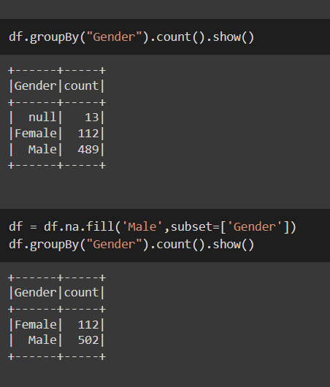
NULL VALUE HANDLING 4
At first counted the null, female and male. Male count is much higher than the Female.Using Mode imputed the null values with Male.
Same way imputed the null value for variable Married, dependents, self employed and credit history.

Slide 15
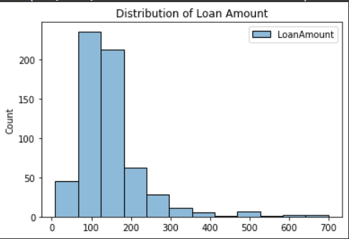
EXPLORATORY DATA ANALYSIS 1
Histogram of Loan Amount clearly depicts that it is rightly skewed
Mean value is greater than median value.

Slide 16
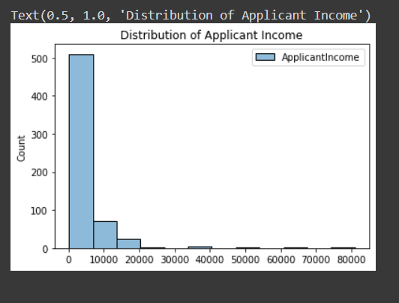
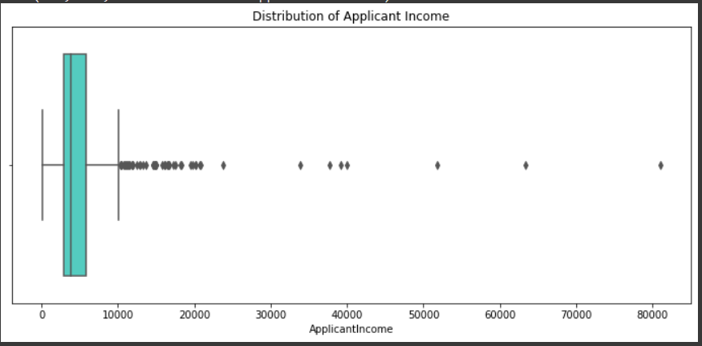
EXPLORATORY DATA ANALYSIS 2
Histogram of Applicant Income clearly depicts that it is rightly skewed
Mean value is greater than median value.
Presence of outliers has been observed.

Slide 17
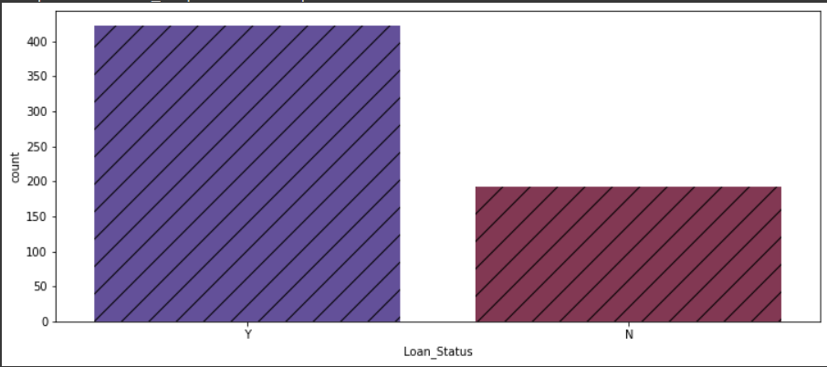
EXPLORATORY DATA ANALYSIS 3
Target column Loan Status has high number of approval mentioned as yes.
For modelling stratified sampling of train and test data will be required for good prediction.

Slide 18
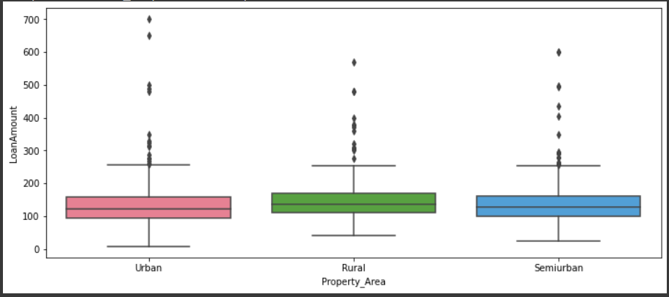
EXPLORATORY DATA ANALYSIS 4
Median Loan Amount provided to Rural Area is slightly higher than Urban.
There are some people in Urban who has got higher loan amounts compared to Rural or Semi urban.

Slide 19
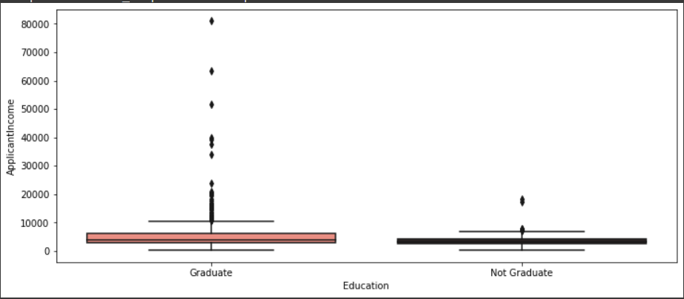
EXPLORATORY DATA ANALYSIS 5
Some of the graduates are generally have more income than the not graduates.
There is no huge difference between their mean income.

Slide 20
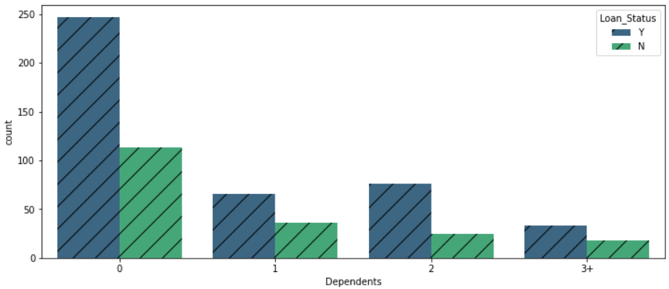
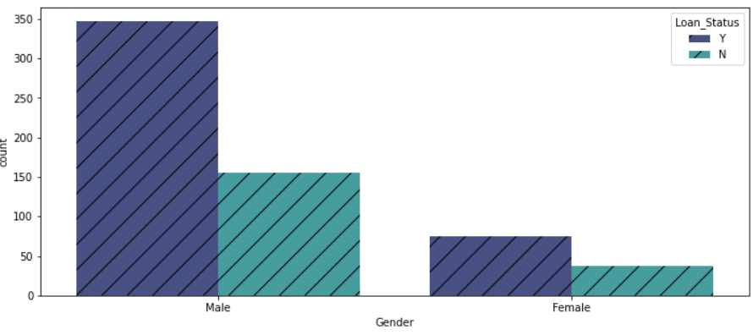
EXPLORATORY DATA ANALYSIS 6
Dependent 2 received more chance of getting loan.
Loan Applicants are more in Male than the female but the chances of getting loan to the each category is almost equal.

Slide 21
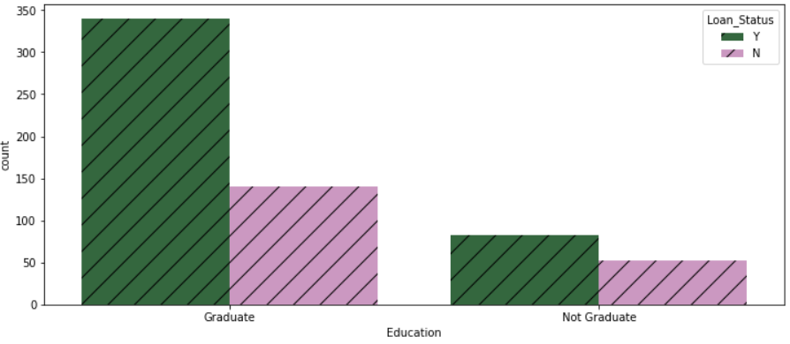
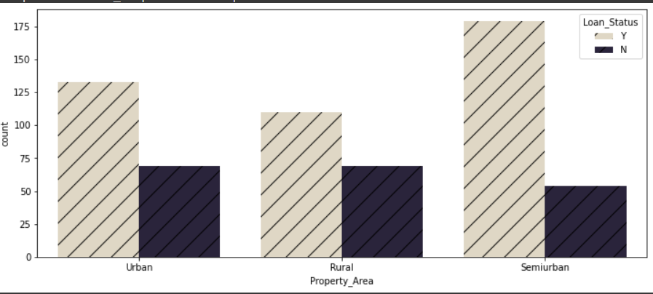
EXPLORATORY DATA ANALYSIS 7
Graduates have more chance of getting loan approved.
Semi urban areas have much higher chance of getting loan than the other areas.

Slide 22
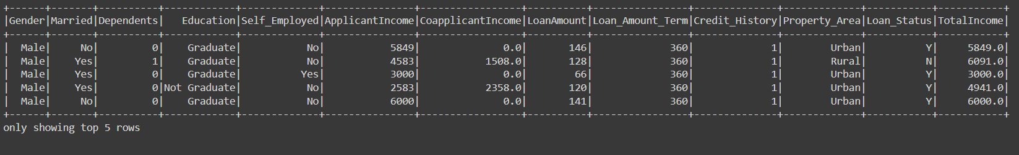
FEATURE ENGINEERING 1
Creating a Total Income column to sum the amount of income of Applicant Income and co applicant income.

Slide 23
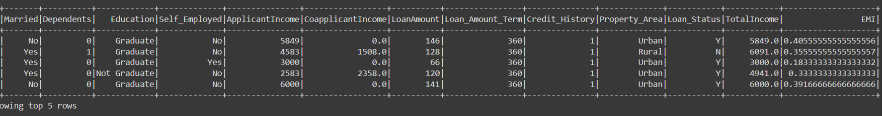
FEATURE ENGINEERING 2
Creating EMI column by dividing the loan amount by the loan amount term.

Slide 24
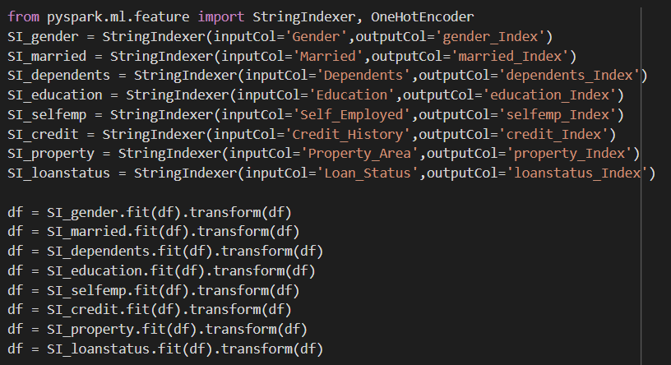
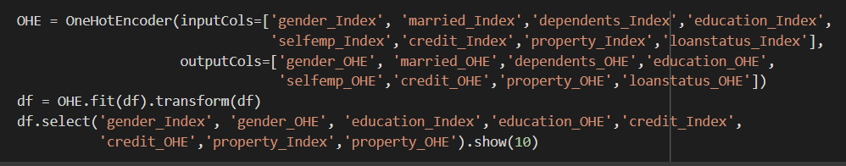
DATA PREPROCESSING – STRING INDEXER & OHE
StringIndexer encodes a string column of labels to a column of label indices. If the input column is numeric, we cast it to string and index the string values. The indices are in [0, numLabels).
One Hot Encoding is used for converting categorical attributes into a numeric vector that machine learning models can understand.

Slide 25
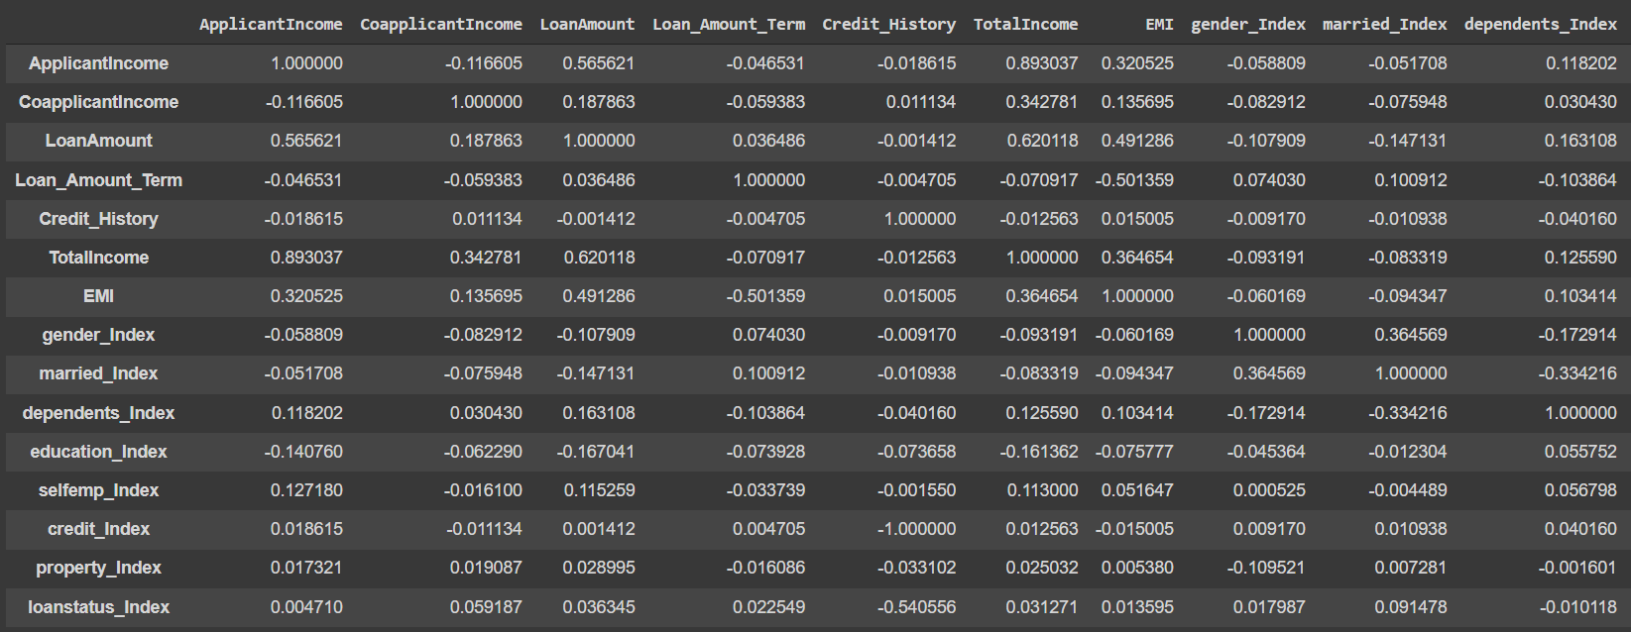
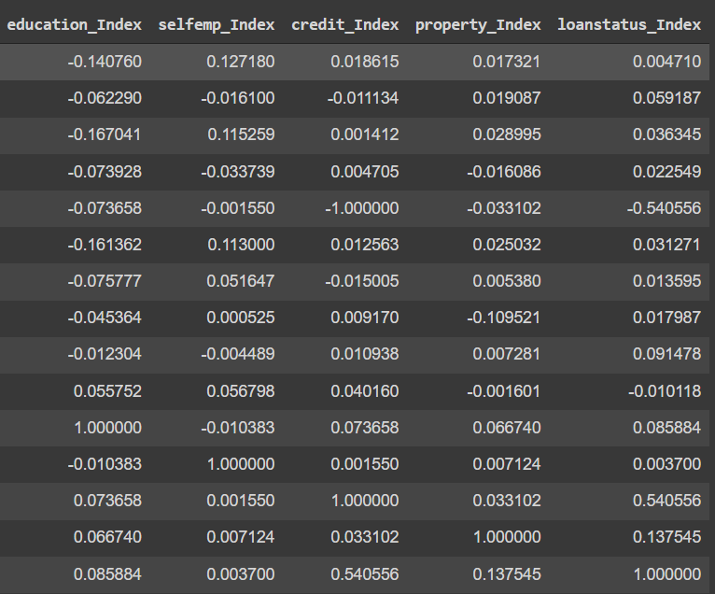
DATA PREPROCESSING – CHECKING CORRELATION
Applicant Income and Total Income are highly Correlated with each other.
Loan Amount Term and Credit History are negatively correlated.

Slide 26
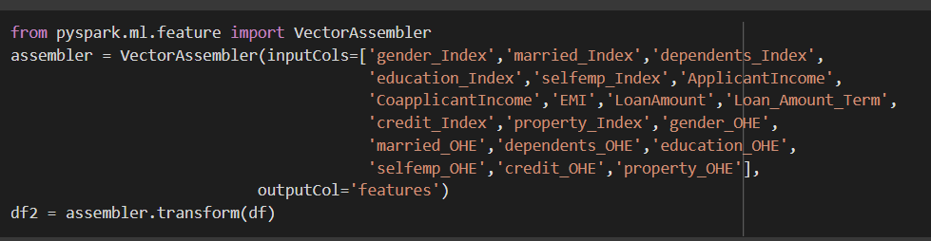
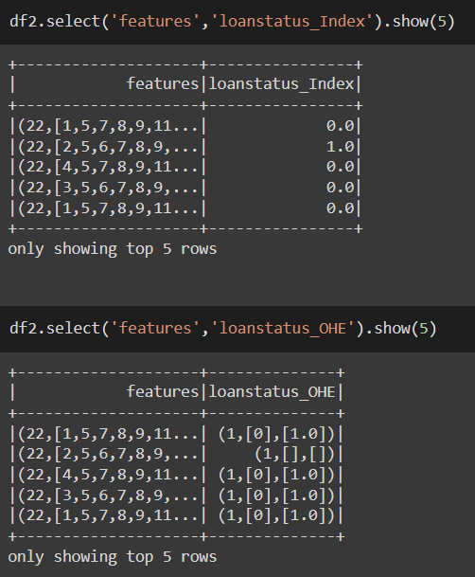
DATA PREPROCESSING – VECTOR ASSEMBLER
Using Vector assembler to merge multiple column into a vector column and taken output as a single feature column. Inputs are given for all the necessary columns.
Showing the transformed vector as features column with the loan status index column.

Slide 27
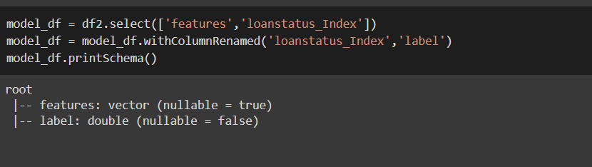
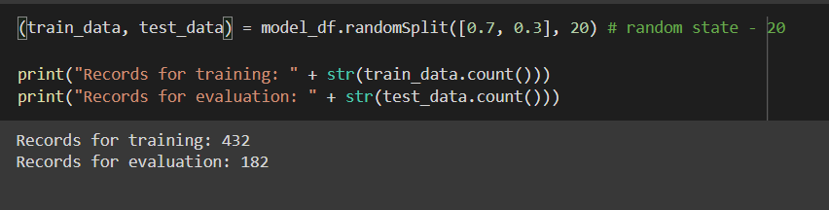
MODEL PREPARATION
Renaming the loan status index column as label column.
Splitting the data into training dataset and test dataset to perform Machine learning model building and verifying it. Choose random state 20.

Slide 28
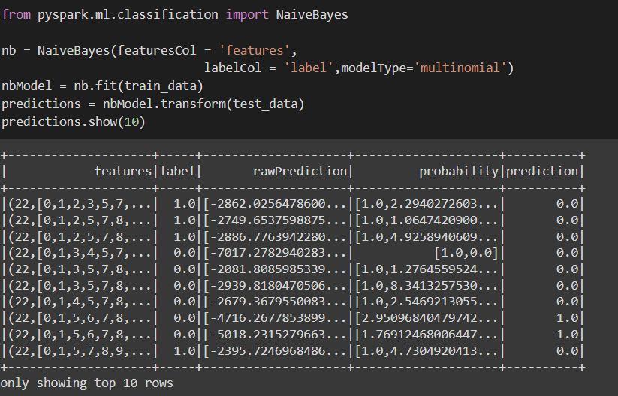
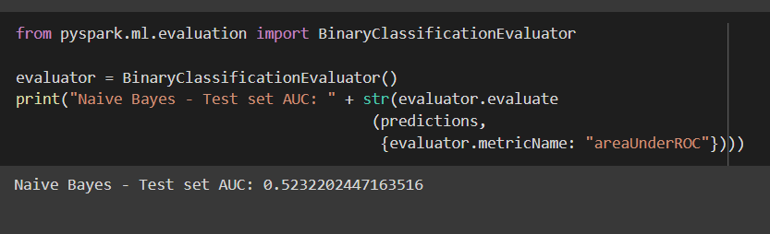
MODEL BUILDING – STEP 1
Naive Bayes classification is simply based on probabilistic classification with the assumption of independence between the feature variables. It is a conditional probability model.
For implementing the model from pyspark ml classification model imported the naive bayes classifier. Created a instance of that with mentioning the feature columns , label columns and model type. Fit the model into the train data and performed prediction with test data.
For evaluation of the performance of the model from pyspark ml evaluation imported the Binary Classification Evaluator and measured the AUC(Area under the curve).More the AUC better the prediction.
AUC is 0.52.

Slide 29
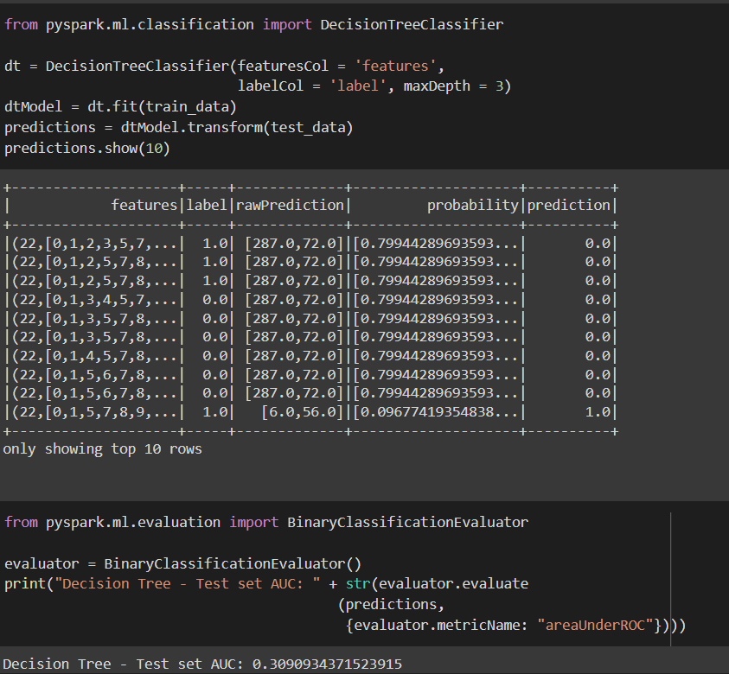
MODEL BUILDING – STEP 2
Decision Tree is a Supervised learning technique that can be used for both classification and Regression problems, but mostly it is preferred for solving Classification problems. It is a tree-structured classifier, where internal nodes represent the features of a dataset, branches represent the decision rules and each leaf node represents the outcome.
AUC is 0.31.

Slide 30
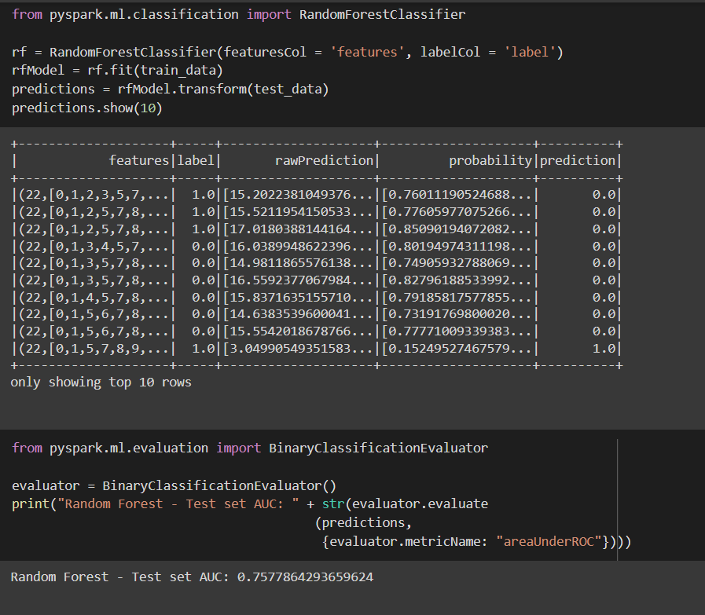
MODEL BUILDING – STEP 3
Random Forest is a popular machine learning algorithm that belongs to the supervised learning technique. It can be used for both Classification and Regression problems in ML. It is based on the concept of ensemble learning, which is a process of combining multiple classifiers to solve a complex problem and to improve the performance of the model.
AUC is 0.75

Slide 31
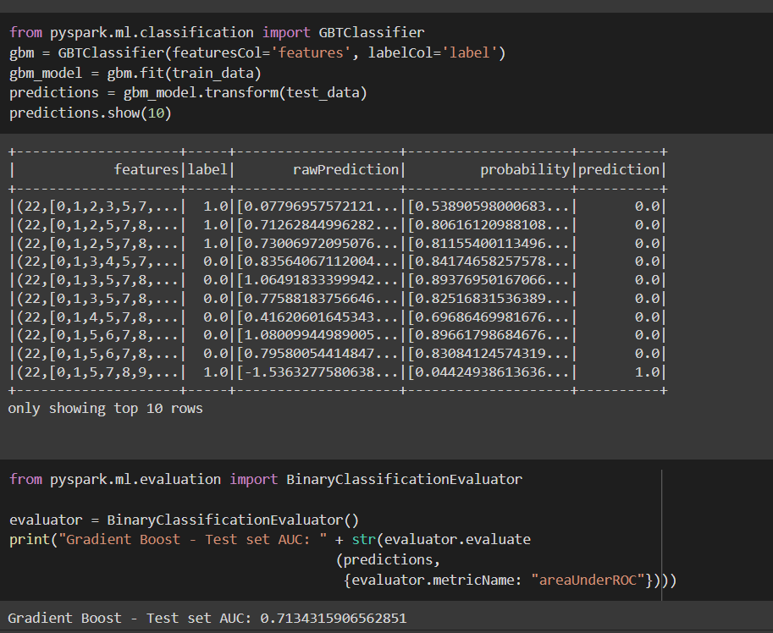
MODEL BUILDING – STEP 4
Gradient Boosting algorithm is one of the most powerful algorithms in the field of machine learning. As we know that the errors in machine learning algorithms are broadly classified into two categories i.e. Bias Error and Variance Error. As gradient boosting is one of the boosting algorithms it is used to minimize bias error of the model.
AUC is 0.71

Slide 32
CONCLUSION
Among the four models Random Forest preforms best. So, will use Random Forest for model building.
Build a model which can automate the loan eligible process and will reduce time significantly.

Slide 33
THANK YOU!

