Slide 1
Medical X-Ray
Anomaly Detection
CNN Classification + GAN-Based Minority Class Augmentation
Suvam Patel
CS 435 — Applied Deep Learning | Oregon State University
Prof. Ami Gates | Spring 2026

Slide 2
BACKGROUND
The Problem
300M+
2/3
47 : 1
Chest X-rays taken
worldwide each year
of the world lacks
adequate radiology coverage
Imbalance ratio —
No Finding vs. Cardiomegaly

Slide 3
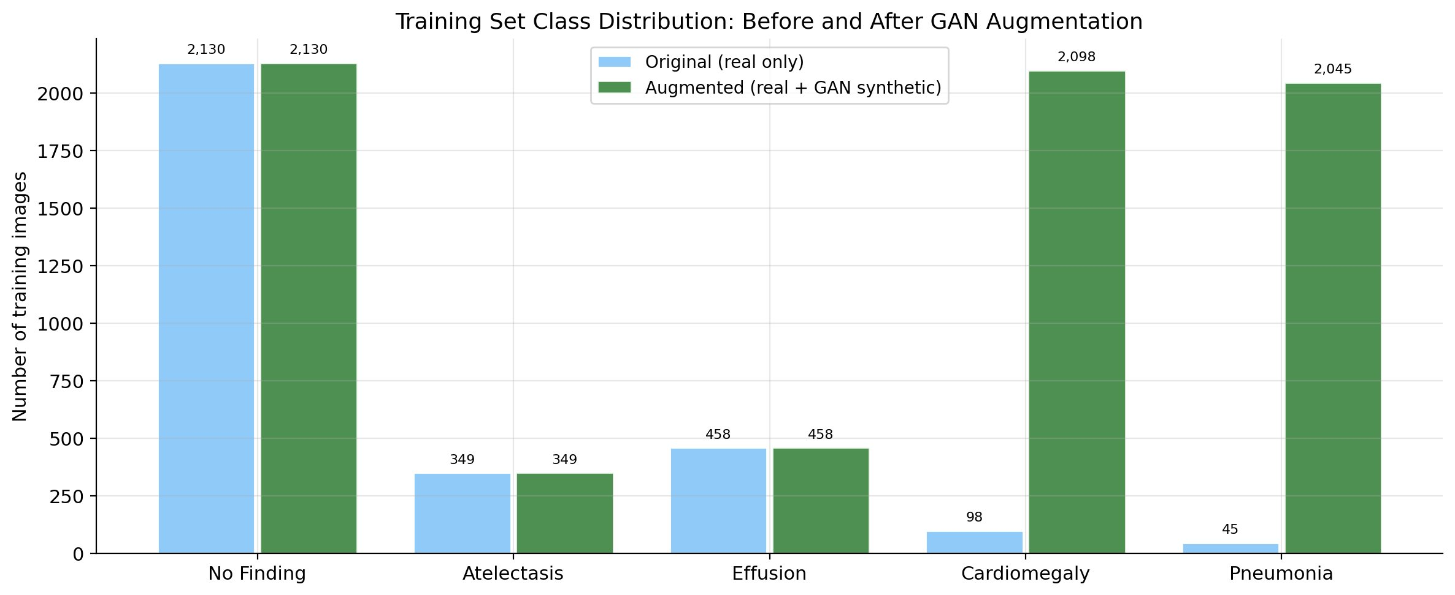
THE DATA
Class Imbalance in the Training Set
Cardiomegaly: 98 real images (47:1 imbalance) | Pneumonia: 45 real images (22:1 imbalance) | GAN augmentation raised both to 2,000+

Slide 4
APPROACH
A Two-Part Pipeline
Phase 1–2
Phase 3
Phase 4–5
Baseline CNN
DCGAN
Augmented CNN
Train classifier on
real data only.
Measure performance
on rare classes.
Train GAN to synthesize
realistic X-rays for
Cardiomegaly &
Pneumonia classes.
Retrain same CNN
with real + synthetic
data. Compare results
vs. baseline.
▶
▶
Only the training data changes between Phase 2 and Phase 4 — ensuring a controlled, valid comparison.

Slide 5
DATASET
NIH Chest X-Ray14 Sample Dataset
Source
Preprocessing Pipeline
Kaggle: nih-chest-xrays/sample
(CC0-1.0 license)
1
Load
Read raw bytes from disk with tf.io.read_file
Size
5,606 grayscale PNG images
Original: 1024×1024 → Resized: 224×224
2
Decode
tf.image.decode_image — handles PNG & JPEG
Labels
3
Resize
Pipe-separated string per image
Parsed into 5-column one-hot encoding
Bilinear interpolation → 224×224 pixels
Split
4
Normalize
70% train / 15% val / 15% test
Stratified on No Finding column
Cast to float32, divide by 255 → [0.0, 1.0]
Test set
5
Pipeline
Real images only — never modified
All evaluation on genuine unseen data
tf.data: shuffle → batch(32) → prefetch(AUTOTUNE)

Slide 6
MODEL
CNN Classifier Architecture
Input
224×224×1
Conv Block 1
Conv2D(32)
BN+ReLU
MaxPool
Dropout(0.25)
Conv Block 2
Conv2D(64)
BN+ReLU
MaxPool
Dropout(0.25)
Conv Block 3
Conv2D(128)
BN+ReLU
MaxPool
Dropout(0.25)
Global Avg
Pooling
Dense(256)
BN+ReLU
Dropout(0.5)
Output
Dense(5)
sigmoid
→
→
→
→
→
→
Multi-label output:
Sigmoid (not softmax) — patients can have multiple conditions simultaneously
Loss function:
Binary cross-entropy — each class treated as an independent binary problem
Callbacks:
EarlyStopping (patience=5) | ModelCheckpoint | ReduceLROnPlateau

Slide 7
GAN
DCGAN Architecture
GENERATOR
DISCRIMINATOR
Noise vector (100,)
→ Dense(256×4×4) → Reshape(4,4,256)
→ Conv2DTranspose ×4 (stride=2)
4 → 8 → 16 → 32 → 64 pixels
→ Conv2D(tanh) → 64×64 image
BatchNorm + LeakyReLU after each block
Output range: [-1, 1] (tanh)
64×64 image (real or fake)
→ Conv2D(64, stride=2) + LeakyReLU
→ Conv2D(128, stride=2) + BN
→ Conv2D(256, stride=2) + BN
→ Flatten → Dropout(0.4)
→ Dense(1, sigmoid)
Output: 1 = real | 0 = fake
vs.
One GAN trained per minority class | 200 epochs | 2,000 synthetic images per class

Slide 8
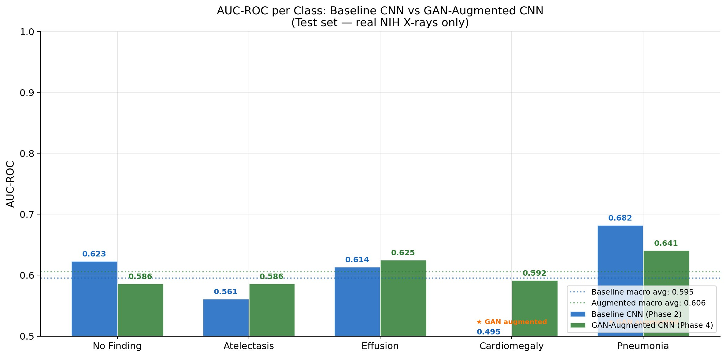
RESULTS
AUC-ROC Results by Class
AUC-ROC measures ranking quality across all thresholds — preferred over accuracy on imbalanced multi-label data

Slide 9
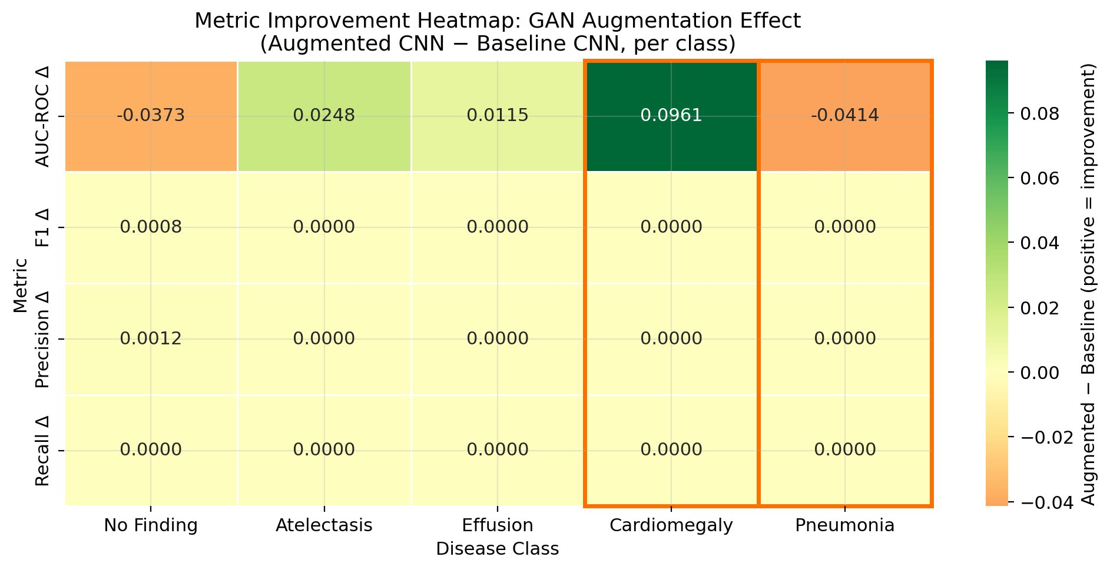
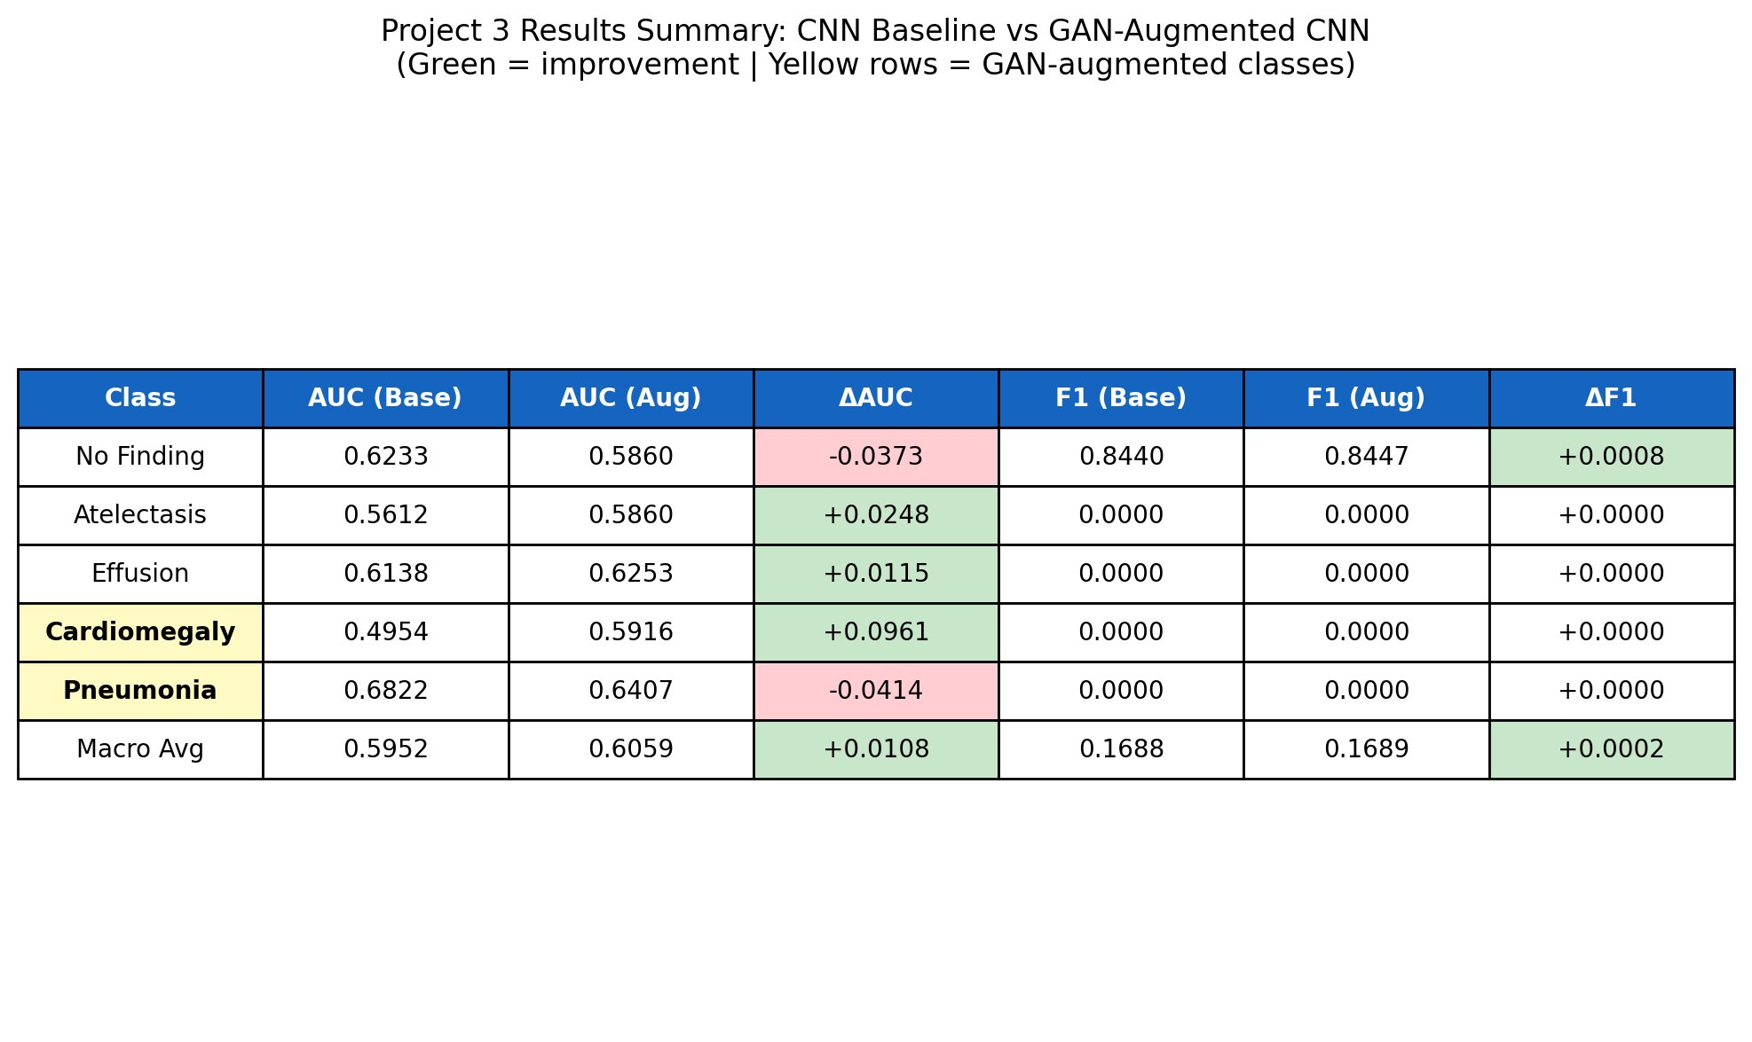
RESULTS
Improvement Heatmap & Results Scorecard
Cardiomegaly
Pneumonia
Macro Avg
+0.096 AUC
−0.041 AUC
+0.011 AUC
Largest improvement
Insufficient GAN data
Overall net positive
Note: F1/Precision/Recall deltas near zero reflect threshold sensitivity on imbalanced data — not a model failure. AUC is the correct primary metric.

Slide 10
TAKEAWAYS
Three Key Takeaways
1
GAN quality depends on real data quantity
Cardiomegaly improved (+0.096) because the GAN had 98 real images to learn from. Pneumonia declined because it had only 45 — not enough to produce realistic, diverse synthetic X-rays.
2
Choose the right evaluation metric
AUC-ROC told the real story here. F1 at a fixed threshold of 0.5 collapsed to zero on imbalanced classes — a known limitation of threshold-based metrics, not a model failure.
3
Controlled experiments require one variable change
Identical architecture, optimizer, loss function, and test set across both phases means any performance difference is directly attributable to the training data change.

Slide 11
CONCLUSIONS
Conclusions & Next Steps
What this project demonstrated:
Future directions:
GAN augmentation can improve rare disease detection
Effectiveness depends on generator quality and data size
Macro AUC improved despite mixed per-class results
Complete 5-phase pipeline built and validated end-to-end
Train on full NIH dataset (112,000+ images)
Extend GAN training to 500+ epochs
Explore conditional GAN architectures
Deploy as a clinical triage screening tool
Not a replacement for radiologists — a triage tool that extends specialist expertise
to under-resourced communities where access to diagnostic care is most limited.

