Slide 1

Name : Suvansh Vaid Location: Melbourne Team: Data and Analytics Date: 11-March-2021

Slide 2
Agenda
Executive Summary
Problem Statement
Approach
EDA
Recommendations

Slide 3
Executive Summary
Problem Statement:
XYZ is a private firm in US. Due to remarkable growth in the Cab Industry in last few years and multiple key players in the market, it is planning for an investment in Cab industry and as per their Go-to-Market(G2M) strategy .
Objective:
Provide XYZ with actionable insights to help them identify the right company to make their investment.
Approach:
Exploring the data
Profit Analysis
Seasonality in profit
Customer reach
Customer Demographics
Providing insights and recommendations

Slide 4
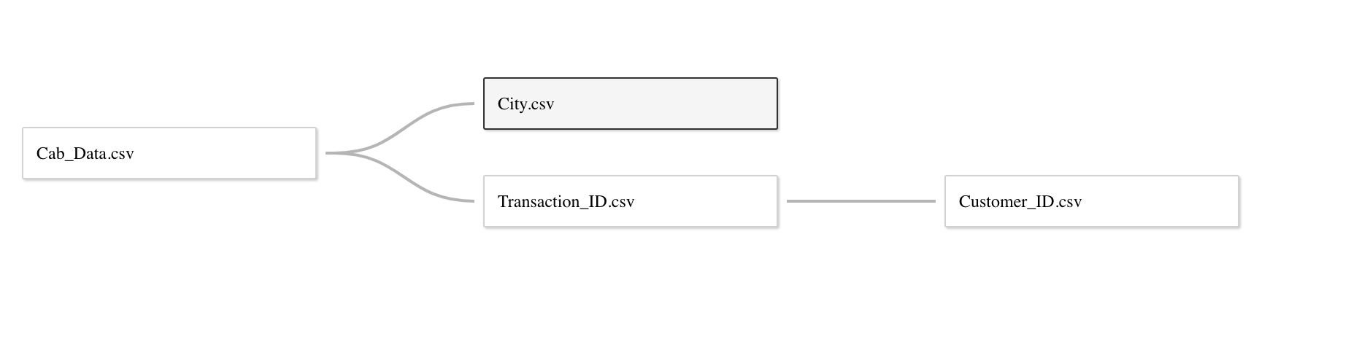
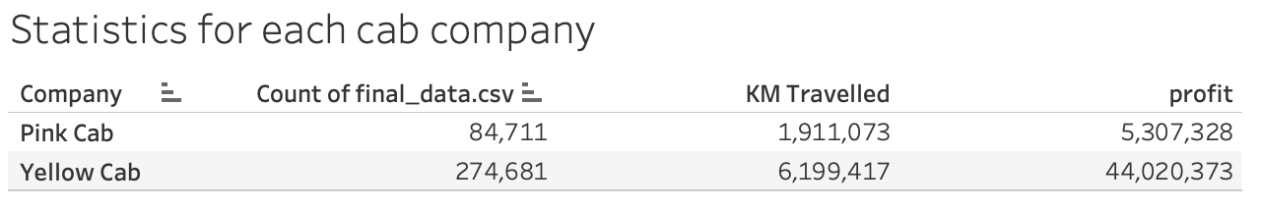
Exploring Data
4 individual data sets provided for the time period between 31/01/2016 and 31/12/2018.
Cab Data contains 359,392 rows.
Joined the data based on appropriate join attributes to create Master data

Slide 5
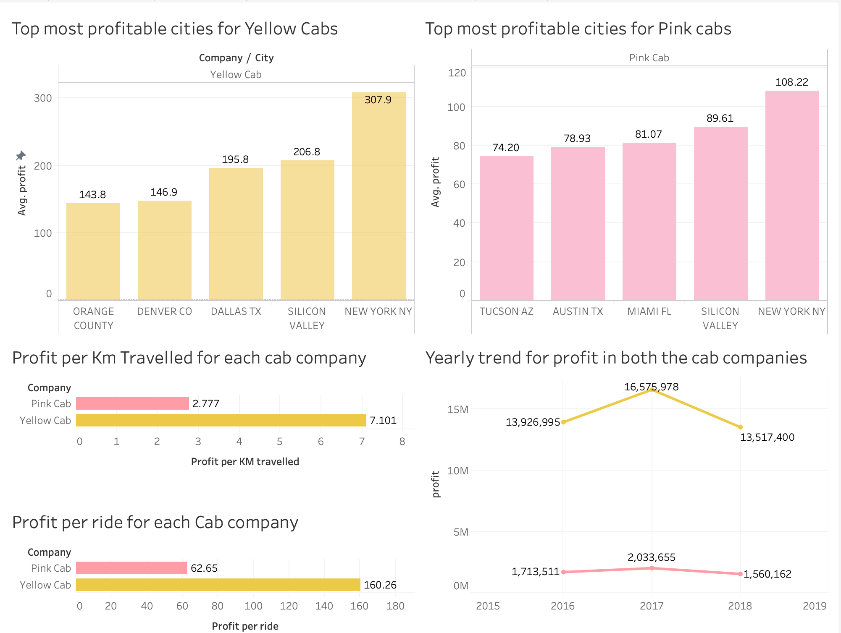
Profit Analysis
Key Findings:
Top 2 profitable cities for Yellow cabs and Pink cabs are NY and Silicon Valley, although the other 3 from top 5 differ for both.
Yellow cabs have more profit per Km as well as per ride as compared to Pink cabs.
The yearly trend for both the cab companies shows that profit has been decreasing since 2017.

Slide 6
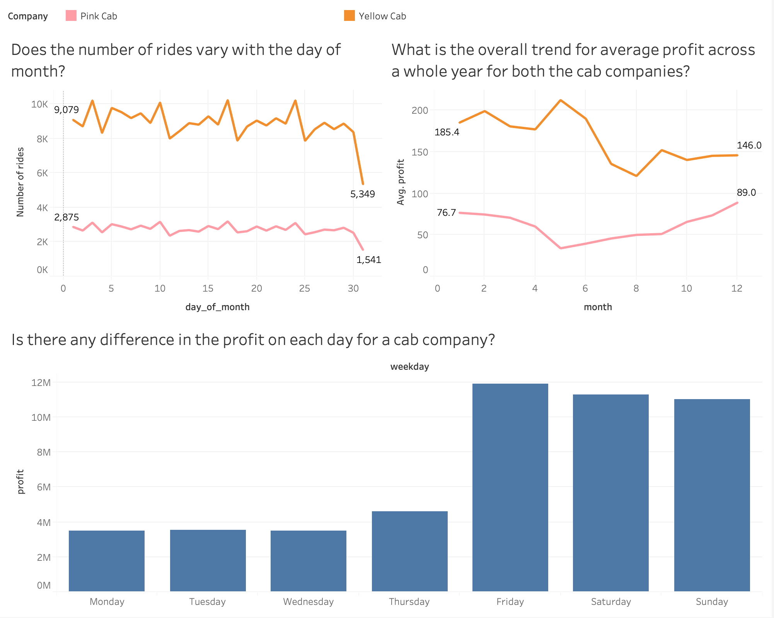
Seasonality in Profit
Key Findings:
On average, the profit for Yellow cabs increases till May then declines. On the other hand, profit for Pink cabs decreases till May and then steadily increases till December. Both the companies seem to follow contrasting trend.
On average, the number of rides for both the companies seem to decline sharply during the last few days of a month.
The weekends seem to be the most profitable days for the companies.

Slide 7
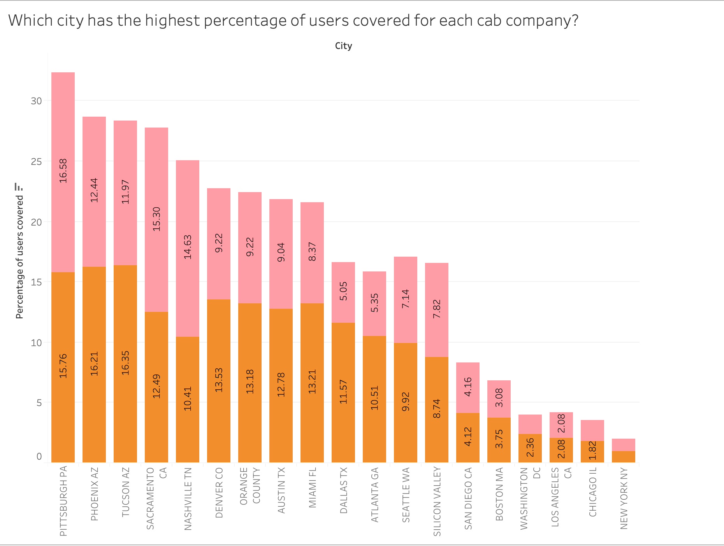
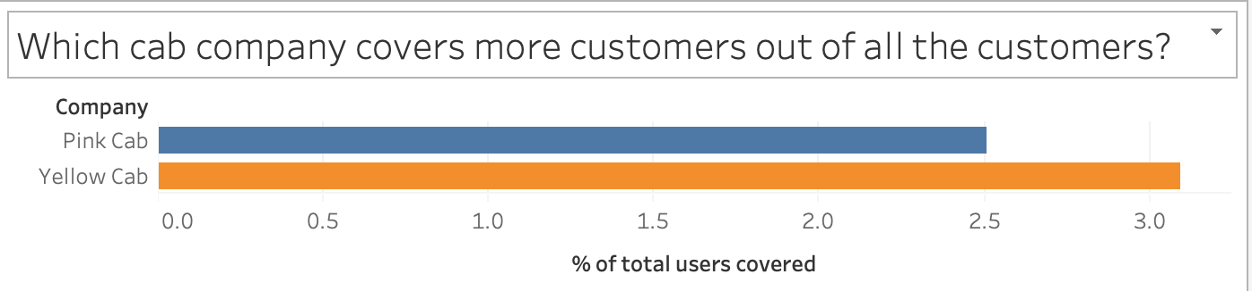
Profit & Customer reach
Key Findings:
Yellow cabs have higher percentage of users covered for most of the cities, however, for Dallas, Nashville, Sacramento and Pittsburgh, Pink cabs have higher customer reach.
Overall, yellow cabs covers more customers than the Pink cabs.
Also, Cities like Pittsburgh, Phoenix, Tucson have customer reach amongst the highest whereas profitable cities such as New York, Chicago have low customer reach suggesting a potential in these cities for future profitability.

Slide 8
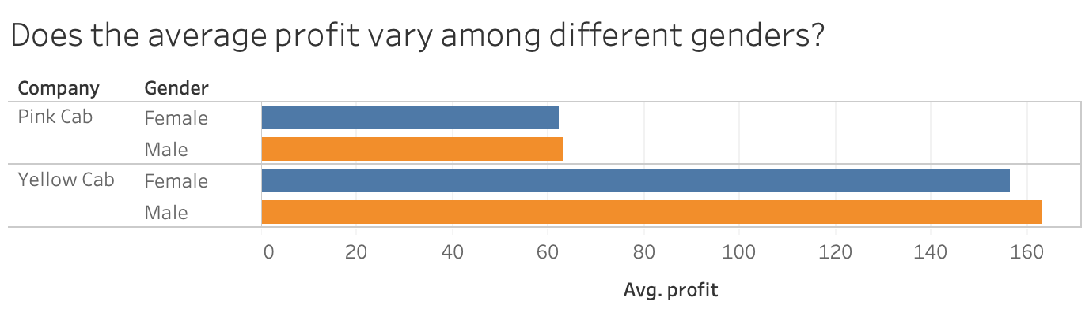
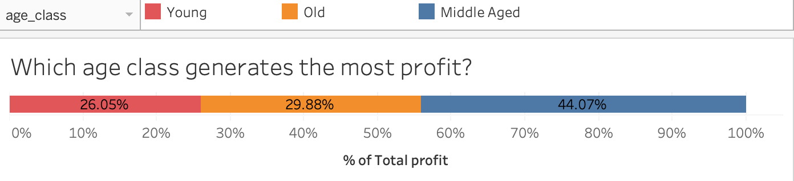
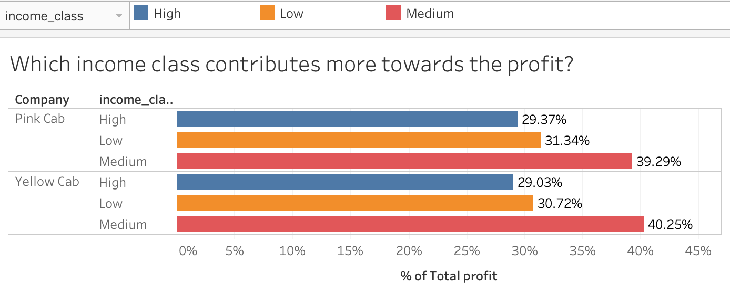
Profit & Customer Demographics
Key findings:
There is no significant difference in the average profit for both the gender categories.
Middle aged class ( < 40 ) seems to generate the majority of profit .
For both the cab companies, Medium income class has the highest percentage contribution to the profit.

Slide 9
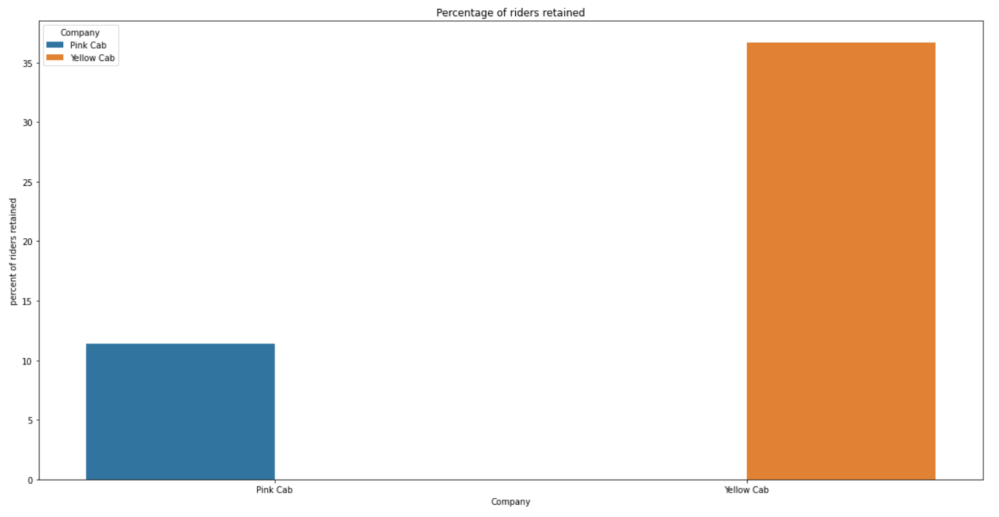
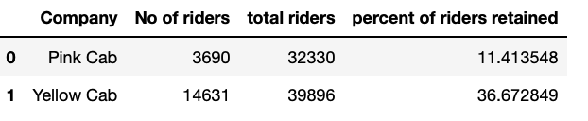
Customer Retention
Key finding:
Based on the condition of a customer being retained if they have more than 5 rides with a cab company, the customer retention rate of Yellow cabs is much better than that of pink cabs.

Slide 10
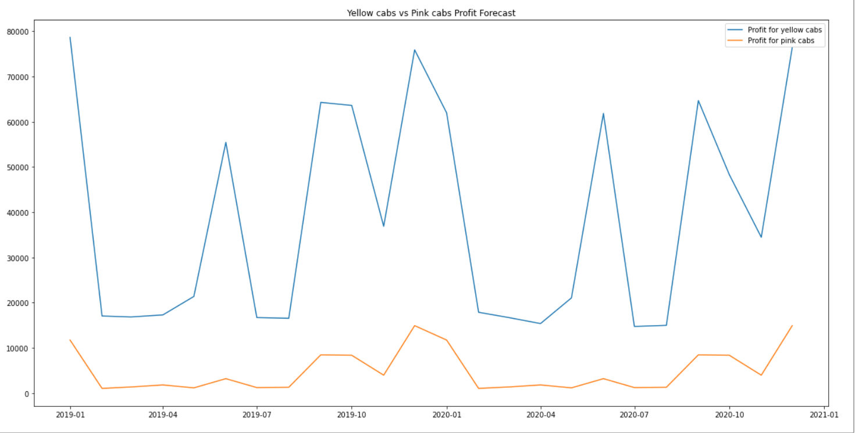
Profit forecast for next 2 years
Key finding: Future profit for yellow cabs is predicted to be far more than that of pink cabs.

Slide 11
Recommendations
Based on the extensive analysis done above, we have found the Yellow cabs better than the Pink cabs in most of the aspects and have the following recommendations based on key factors:
Profit per ride/Km: Yellow cabs have more profit per ride (as well as per Km) as compared to Pink cabs.
Top performing cities: New York and Silicon Valley are the most profitable cities and should be the top priority for investment.
Target group: The mid-aged (less than 40 years old) and medium level income commuters generate majority of profit and should be the focus of marketing campaigns.
Customer Reach: Yellow cabs have a higher percentage of users covered in most of the cities and thus would prove to be more profitable if able to maintain the user reach.
Customer Retention: The customer retention rate of yellow cabs is much higher than that of pink cabs suggesting higher customer satisfaction rates and a profitable future.
Future profitability: Based on profit forecasts for the next two years, Yellow cabs is predicted to outperform Pink cabs by a huge margin and thus, is a better choice for investment.

Slide 12
Thank You

