Slide 1
JDBC
Suvarchala Gatla

Slide 2
CONTENTS
1. What is JDBC
2. Architecture of JDBC
3. Connection
4. Different Types Of Statements

Slide 3
What Is JDBC
JDBC acronym of java Database connectivity; though Sun Microsystems claims that it is not the full form.
JDBC is a standard java API for independent database connection between a java program and wide range of relational database.
It is present in the "java.sql" package

Slide 4
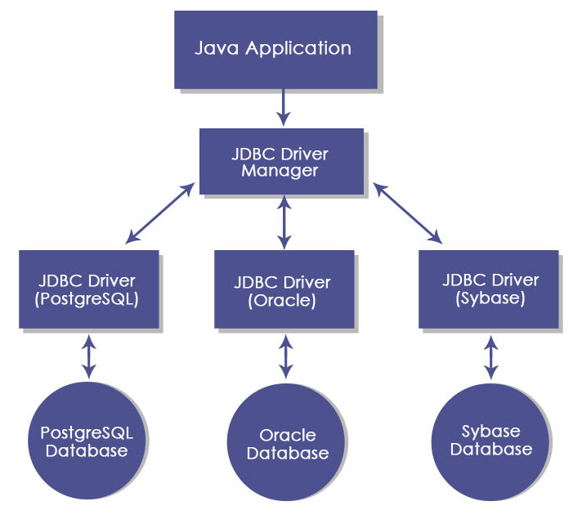
Architechture Of JDBC

Slide 5
Steps To Connect
Define the connection URL.
Established the connection.
Create the Statement object.
Execute a query
Process the results.
Close the connection.

Slide 6
Steps To Connect
Define the Driver Registration URL:
Class.forName();
Example to register the OracleDriver class Class.forName("oracle.jdbc.driver.OracleDriver");
Example to register the MySqlDriver class 4 Class.forName("com.mysql.jdbc.Driver");
Example to register the Derby Client
Class.forName("org.apache.derby.jdbc.ClientDriver

Slide 7
Steps To Connect
Established the Connection:-
Connection con-DriverManager.getConnection( "URL", "username","password");
Example to Established the Connection using MySql:-
Connection con-DriverManager.getConnection( "jdbc:mysql://localhost:3306/sandeep", "root","root");

Slide 8
Steps To Connect
Create a Statement Object:
Statement stmt-con.createStatement();
There are three types of Statement available in Statement class:-
Statement
PreparedStatement
CallableStatement

Slide 9
Statement
This represent a simple sql/mysql statement.
Statement stmt=con.createStatement
PreparedStatement
It allows to execute the query multiple times and we can set the values according to our need.
PreparedStatement psmt=con.prepareStatement();
CallableStatement
This allows the access of stored procedures; that are stored on the database.
CallableStatement csmt=con.prepareCall();

Slide 10
Steps To Connect
Execute the Query:
For the SELECT Query:
String sql="Select * from emp"; stmt.executeQuery(sq;
For Insert/Update Query:
String sql="Insert into emp values(101, sandeep'); stmt.executeUpdate(sql);

Slide 11
Steps To Connect
Process the result:
ResultSet rs-stmt.executeQuery(sql);
while(rs.next())
{
System.out.println(rs.getInt(1)+" "+rs.getString(2));
}
Close the Connection:
Release all the resources that the Connection is holding.
stmt.close();
con.close();

Slide 12
THANK YOU

