Slide 1
INFOSYS SPRINGBOARD VIRTUAL INTERNSHIP
Project title: KNOWMAP CROSS DOMAIN KNOWLEDGE MAPPING
Submitted by: janapati Lakshmi Sai suvarnika

Slide 2
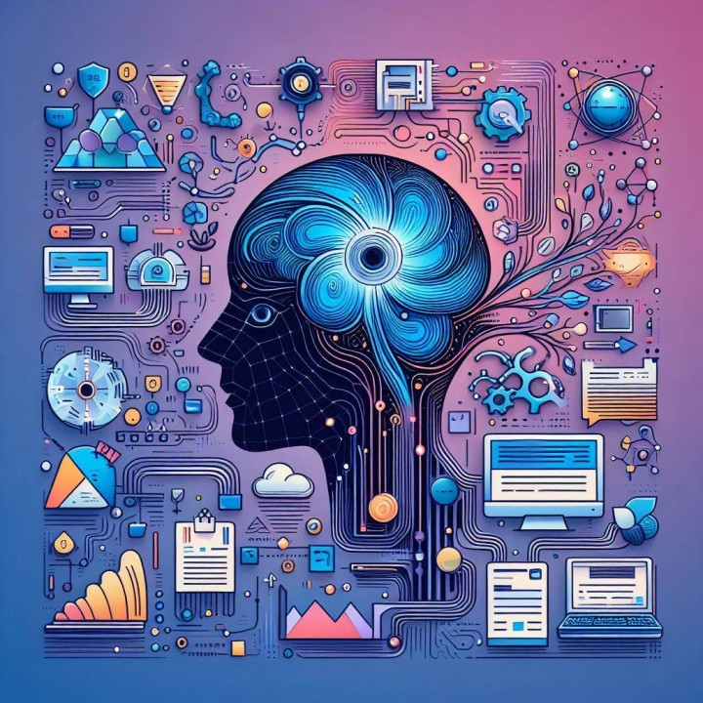
INTRODUCTION
This project converts unstructured text into meaningful knowledge using AI and NLP techniques. It extracts relationships as Subject–Relation–Object triples and visualizes them as an interactive knowledge graph with semantic search for intelligent information retrieval.

Slide 3
Milestone-1- User Authentication and dataset upload
In this milestone, a secure user login system and dataset upload feature were developed. Users can log in with a username and upload CSV files for validation and preview. This step ensures controlled access and prepares the data for further knowledge extraction in later stages.

Slide 4
Milestone 2 – Knowledge Extraction In this milestone, the system extracts meaningful information from text using Natural Language Processing (NLP). It identifies Subject–Relation–Object (SVO) triples from sentences, converting unstructured text into structured data. These extracted triples form the foundation for building the knowledge graph in the next stage.

Slide 5
Milestone 3 – Visualization and Semantic Search In this milestone, the extracted triples are transformed into an interactive knowledge graph for easy understanding of relationships. A semantic search feature is also added, allowing users to ask natural language questions and retrieve the most relevant information using AI-based similarity matching.

Slide 6
Milestone 4 – Admin Dashboard and Feedback System In this milestone, an admin dashboard was developed to manage and refine the knowledge graph. Admins can edit or merge nodes, monitor system statistics, and collect user feedback. This ensures continuous improvement, accuracy, and effective maintenance of the knowledge mapping system.

Slide 7
A Cycle of Improvement in Cross-Domain Mapping
1️⃣ Knowledge Extraction The system extracts Subject–Relation–Object triples from text using NLP, creating structured knowledge from raw data.
2️⃣ Visualization & Interaction Extracted knowledge is visualized as a graph. Users explore connections and identify missing or incorrect relationships.
3️⃣ Feedback & Refinement User feedback and admin edits are collected to correct errors, merge nodes, and enhance relationship accuracy.
4️⃣ Continuous Learning The refined data improves the next round of extraction and mapping, ensuring the system becomes smarter and more domain-adaptive over time.

Slide 8
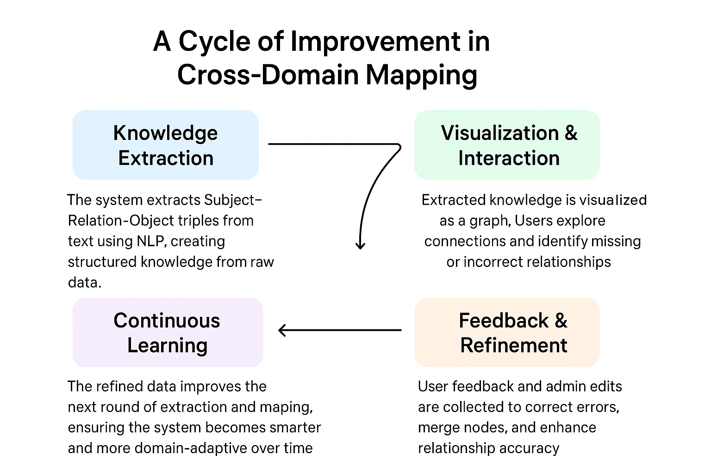

Slide 9
The KnowMap Journey
From Data to Discovery
1️⃣ M1: User Workspace & Data Management Secure login, user workspace, and dataset upload established a foundation for managing and organizing knowledge inputs.
2️⃣ M2: Knowledge Extraction Engine Implemented AI-based text analysis using spaCy to extract meaningful subject–predicate–object triples from textual data.
3️⃣ M3: Visualization & Semantic Search Developed an interactive knowledge graph with semantic search powered by SentenceTransformer to connect and explore relationships across domains.
4️⃣ M4: Admin Dashboard & Continuous Refinement Built an admin panel for node editing, merging, and feedback collection — enabling an ongoing cycle of cross-domain improvement and learning.

Slide 10
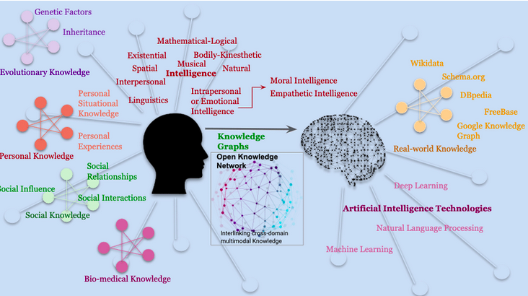
Ready for Global Knowledge Exploration
KnowMap has evolved from a research concept into a fully functional, scalable, and interactive AI-driven knowledge mapping system. The platform intelligently connects concepts across domains using NLP, semantic search, and dynamic graph visualization — enabling discovery, insight, and continuous improvement.
The final result:
A production-ready AI application designed to bridge domains, uncover hidden insights, and promote cross-disciplinary knowledge discovery worldwide.

