Slide 1
Mobile Application Development
Assignment II Storyboard
System: Quiz Game
Student: Gregory E. Hatt Jr
Student #: w0269804
Date: October 28th, 2014

Slide 2
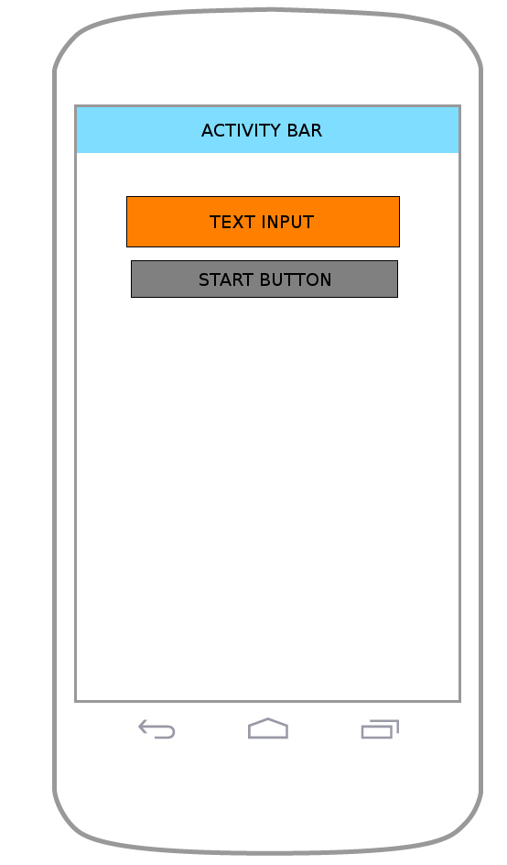
Welcome Screen

Slide 3
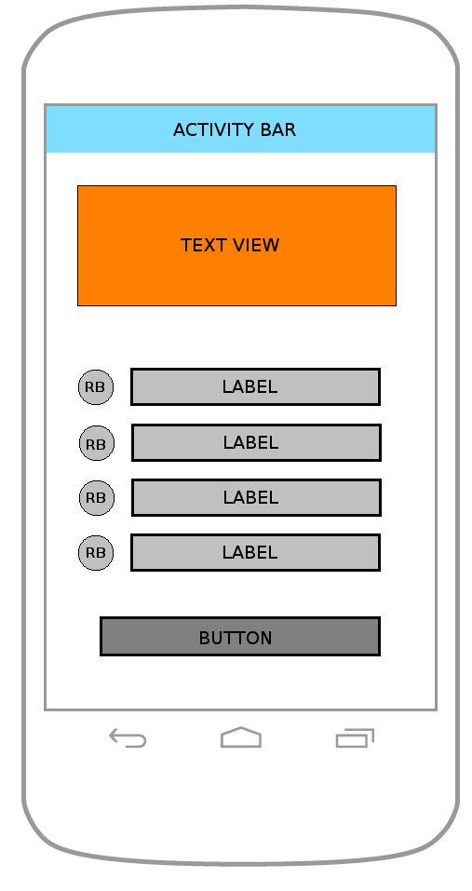
Questions Screen

Slide 4
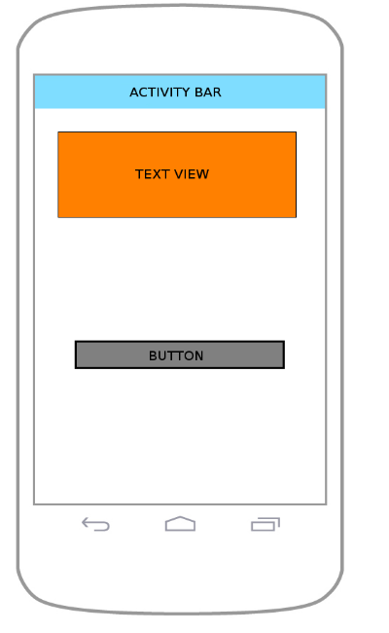
Evaluation Screen

