Slide 1
IBM University Engagement Project Submission
“Exploring the Power of Agentic AI with IBM Granite and LangFlow”

Slide 2

Project Title – InterviewAce AI – Agentic Interview Trainer using IBM Granite and LangFlow
Domain of Project – Education & Career Development
Student Name | Recent Passport Photo | Email ID | Mobile number [WhatsApp]
Suvasini |  | suvasinihuleppa95@gmail.com | +91-8884260594

Slide 3
Problem Statement -
Problem Statement : Interview Trainer Agent (Problem Statement No. 22)
The Challenge
Preparing for job interviews can be difficult due to the lack of personalized guidance, role-specific preparation, and real-time feedback. Candidates often struggle to identify relevant technical questions, HR scenarios, and industry expectations. Many students are unable to practice effectively because existing platforms provide generic content rather than tailored interview preparation. An AI-powered Interview Trainer can solve this problem by generating personalized interview questions, model answers, and improvement suggestions based on the user's profile, skills, experience level, and job role.
The Objective
Build an AI-powered Interview Trainer Agent that delivers personalized interview preparation support. The solution should:
Generate role-specific technical interview questions.
Provide HR and behavioral interview preparation.
Analyze resumes and identify candidate strengths.
Suggest model answers and improvement tips.
Support mock interview simulations.
Deliver personalized feedback and confidence scores.

Slide 4
Technology Used
Tech Stack (Mandatory)
LangFlow + IBM watsonx.ai + Granite Models
I used LangFlow + IBM watsonx.ai + Granite Models
Technologies Used:
LangFlow
IBM watsonx.ai
IBM Granite Models (Granite-4.0-8B-Instruct)
Retrieval-Augmented Generation (RAG)
Python
FAISS Vector Database
GitHub

Slide 5
Proposed Solution -
Proposed Solution: AI-Powered Interview Trainer Agent
The proposed solution is a multi-agent AI-powered Interview Trainer built using LangFlow, IBM watsonx.ai, and IBM Granite Models. The system assists students and job seekers in preparing for technical, HR, and behavioral interviews through personalized and intelligent guidance.
The solution uses a Retrieval-Augmented Generation (RAG) architecture to retrieve role-specific interview questions, company expectations, and industry best practices from trusted knowledge sources.
The system consists of four key agents:
Resume Analysis Agent – Extracts skills, projects, and experience from the candidate profile.
Technical Question Agent – Generates role-specific technical questions based on job role and skills.
HR Interview Agent – Creates behavioral and HR interview scenarios.
Feedback Agent – Evaluates answers and provides improvement suggestions and confidence scores.
The solution provides personalized interview preparation, mock interview sessions, and targeted feedback that improves candidate confidence and interview performance.

Slide 6
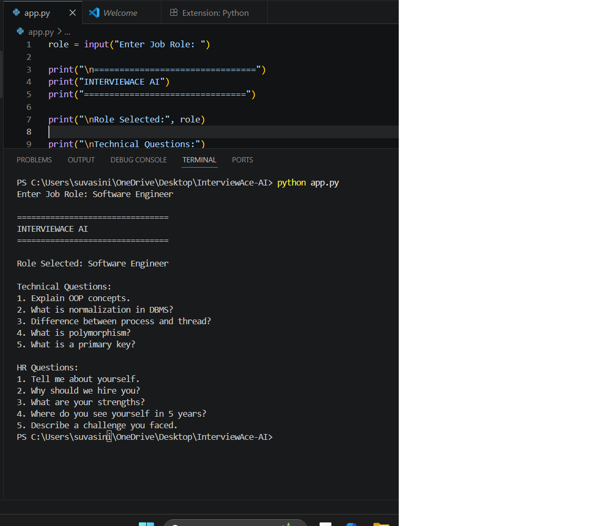
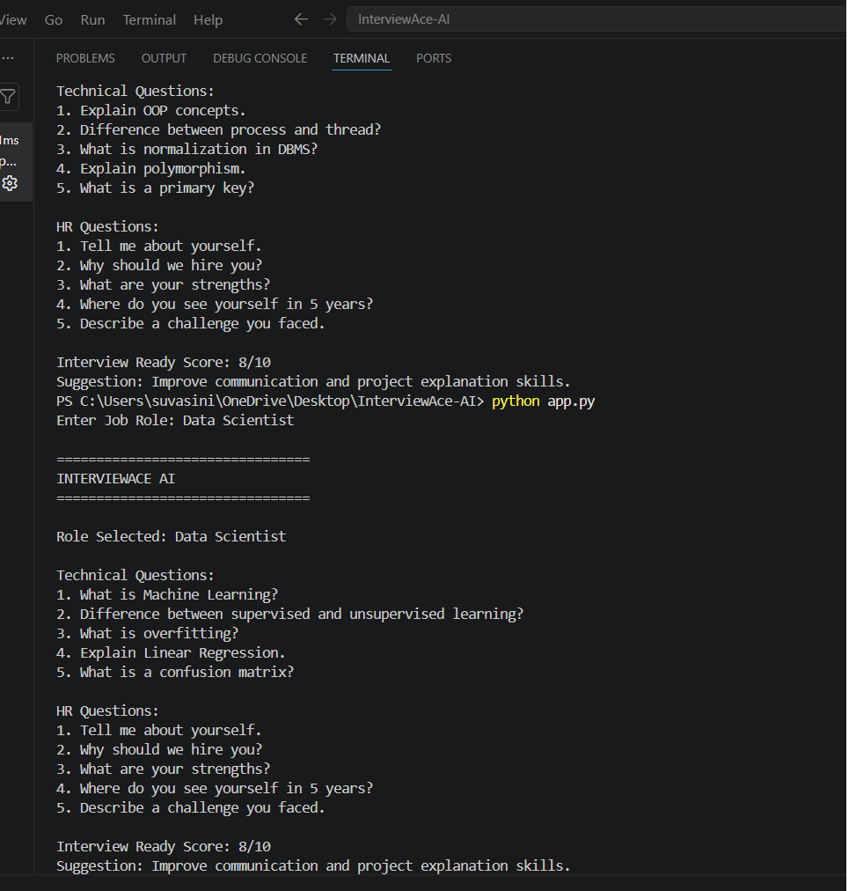

Slide 7
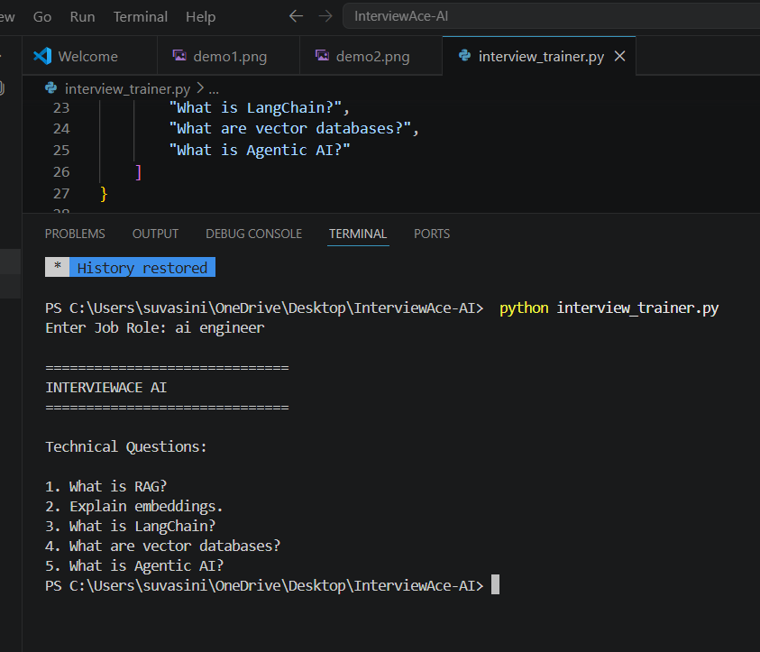
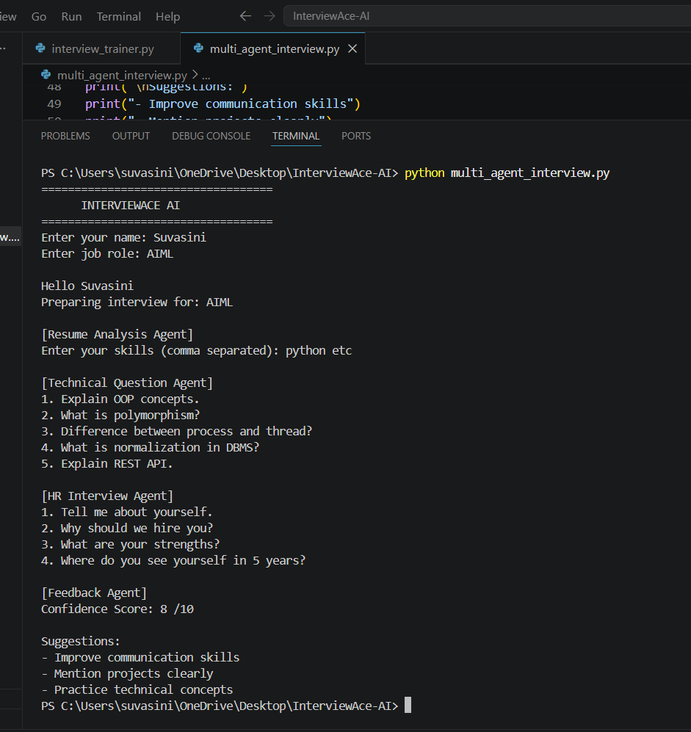

Slide 8
Langflow component Used -
1) Chat Input – Accepts candidate profile, job role, and interview preferences.
2) IBM watsonx AI Agent – Processes candidate information and generates interview content using Granite models.
3) Name of IBM Granite model – Granite-4.0-8B-Instruct
4) Chat Output – Displays interview questions, model answers, and feedback.
5) File Component – Stores resumes, interview datasets, and candidate information.
6) FAISS Vector Store – Retrieves relevant interview questions and knowledge using RAG.

Slide 9
Langflow workflow -
Candidate Input
Resume Analysis Agent
Technical Question Agent
HR Interview Agent
Feedback Agent
IBM Granite Model
Interview Preparation Report

Slide 10
Architecture blueprint
User
Interview Dashboard
LangFlow Controller
Resume Analysis Agent
Technical Question Agent
HR Interview Agent
Feedback Agent
IBM Granite Model
RAG Knowledge Base (FAISS)
Interview Report

Slide 11

Role of Agentic AI in the solution
Role of Agentic AI in Interview Trainer Agent
Agentic AI enables the Interview Trainer Agent to function as an intelligent and autonomous interview preparation assistant rather than a simple chatbot. The Resume Analysis Agent understands candidate profiles and identifies skills and experience.
The Technical Question Agent generates role-specific technical questions, while the HR Interview Agent prepares behavioral and soft-skill interview scenarios.
The Feedback Agent evaluates candidate responses and provides improvement suggestions and confidence scores.
This multi-agent architecture enables personalized, context-aware, and adaptive interview preparation.
Overall, Agentic AI helps candidates improve confidence and performance through tailored, interactive practice.

Slide 12
Technology Used
LangFlow Platform – For designing and orchestrating multi-agent workflows visually.
IBM Granite Model – For natural language understanding, interview question generation, reasoning, and personalized feedback.
IBM Cloud – Provides infrastructure for deployment and scalability of the Interview Trainer Agent.
RAG – Retrieves relevant interview questions, company expectations, and industry-specific knowledge.
IBM watsonx.ai – For model deployment, embeddings, and AI governance.
Vector Database (FAISS) – For efficient storage and retrieval of interview knowledge.

Slide 13
Novelty and Uniqueness
The proposed Interview Trainer Agent stands out by combining Agentic AI, RAG, and personalization into a single intelligent system.
Multi-Agent Intelligence – Multiple specialized agents collaborate to deliver personalized interview preparation.
Resume-Based Personalization – Questions are generated based on candidate skills and experience.
Adaptive Interview Generation – Dynamic interview scenarios based on role and difficulty level.
Automated Feedback System – Provides answer evaluation and improvement suggestions.
Technical and HR Coverage – Supports both technical and behavioral interview preparation.
Enterprise-Ready Architecture – Built using IBM Granite Models and LangFlow.
This makes the solution a smart, adaptive, and proactive digital interview coach.

Slide 14
Git Hub Link
GitHub Repository:
https://github.com/Suvasini911/InterviewAce-AI.git
Repository contains:
• app.py
• README.md
• app.json
• problemstatement.pdf
• projectpresentation.pptx
• screenshots

Slide 15
Future Scope
Voice-Based Mock Interviews
Conduct real-time voice interviews and evaluate communication skills.
Resume PDF Analysis
Automatically extract skills, education, and projects from resumes.
Video Interview Assessment
Analyze facial expressions and confidence levels.
Multilingual Support
Support interview preparation in multiple languages.
Company-Specific Preparation
Generate customized interview questions for companies such as Amazon, Microsoft, Google, and TCS.
·
·
·

Slide 16


