Slide 1
TruthLens AI
Verify Before You Trust
AI-Powered Misinformation & Deepfake Detection Platform
Team TruthLens AI Suvasini • CSE, CMR University, Bengaluru Bharat Academix CodeQuest 2026

Slide 2
The Problem
Misinformation spreads faster than truth
1
Viral Fake News
2
Deepfake Media
Fabricated stories spread across platforms in minutes, faster than fact-checkers can respond.
AI-generated images and videos blur the line between real and synthetic content.
3
Low Public Trust
4
No Quick Verification
Audiences struggle to distinguish credible journalism from manipulated content.
Most users have no easy, transparent way to check a story before sharing it.
TruthLens AI • Verify Before You Trust
Bharat Academix CodeQuest 2026

Slide 3
Our Solution
TruthLens AI — one platform, instant verification
A unified AI platform that verifies text, source URLs and images, returns an explainable trust score, and generates a downloadable PDF verification report.
Multi-Modal Verification
Explainable AI
Analyzes text credibility, source URL & image authenticity in one flow.
Shows WHY content is suspicious — not just a number.
Instant Trust Score
PDF Verification Report
0–100 score with Low / Medium / High risk classification.
One-click downloadable, timestamped audit trail.
TruthLens AI • Verify Before You Trust
Bharat Academix CodeQuest 2026

Slide 4
ASEEV Verification Framework
Our unique 5-step methodology
A
S
E
E
V
Analyze Content
Score Credibility
Evaluate Risk
Explain Findings
Verify Information
Analyze text, source URLs and images.
Generate a trust score from 0–100.
Classify as Low, Medium or High Risk.
Transparent reasoning behind every result.
Assess source reliability and generate a report.
Output: Professional PDF Verification Report
TruthLens AI • Verify Before You Trust
Bharat Academix CodeQuest 2026

Slide 5
System Architecture
End-to-end verification pipeline
User Input
React Frontend
FastAPI Verification API
ASEEV Analysis Engine
Trust Scoring
Risk Assessment
Verification Report Generator
PDF Report
Note: Future Enhancements: MongoDB-based source reputation database and Transformer-powered NLP analysis.
TruthLens AI • Verify Before You Trust
Bharat Academix CodeQuest 2026

Slide 6
Live Features & Tech Stack
What works in the demo today
Live Features
Tech Stack
Text & URL credibility analysis
Trust Score (0–100) with risk level
Explainable AI verdicts & reasons
ASEEV framework workflow
PDF Verification Report
• One-click report download
• Timestamped verification
• Professional audit trail
Trust Heatmap (Authenticity & Credibility)
Frontend
React + Vite
Backend
FastAPI (Python) verification API
AI Engine
ASEEV rule-based scoring engine
Reports
Client-side PDF generation
Planned
MongoDB · Transformers · Sentiment AI
TruthLens AI • Verify Before You Trust
Bharat Academix CodeQuest 2026

Slide 7
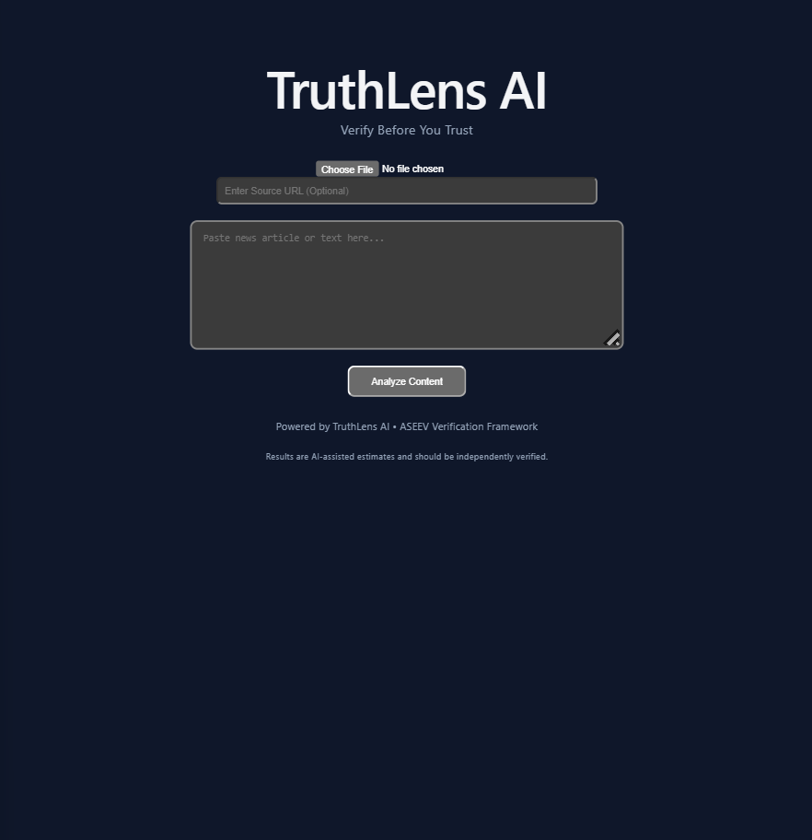
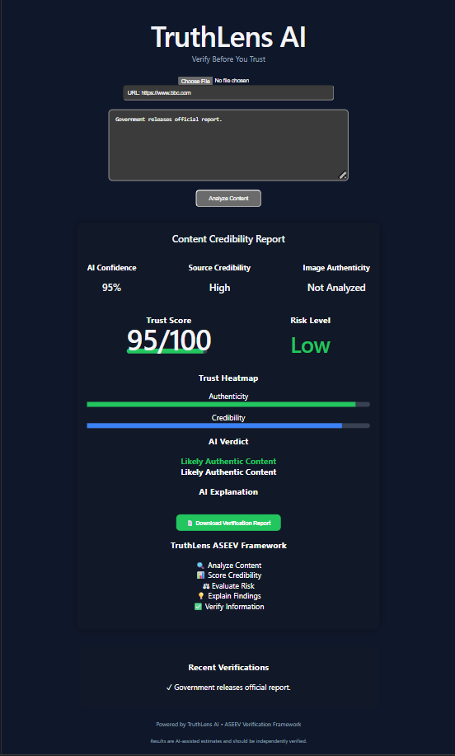
Live Prototype
Real screenshots from the working demo
Homepage
BBC test result
TruthLens AI • Verify Before You Trust
Bharat Academix CodeQuest 2026

Slide 8
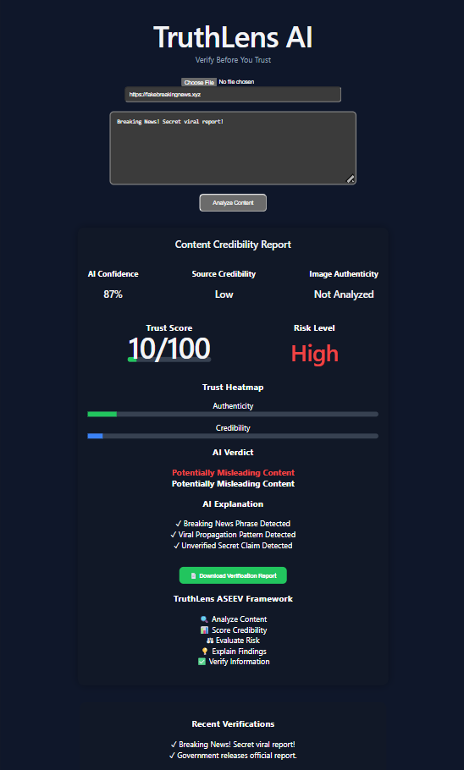
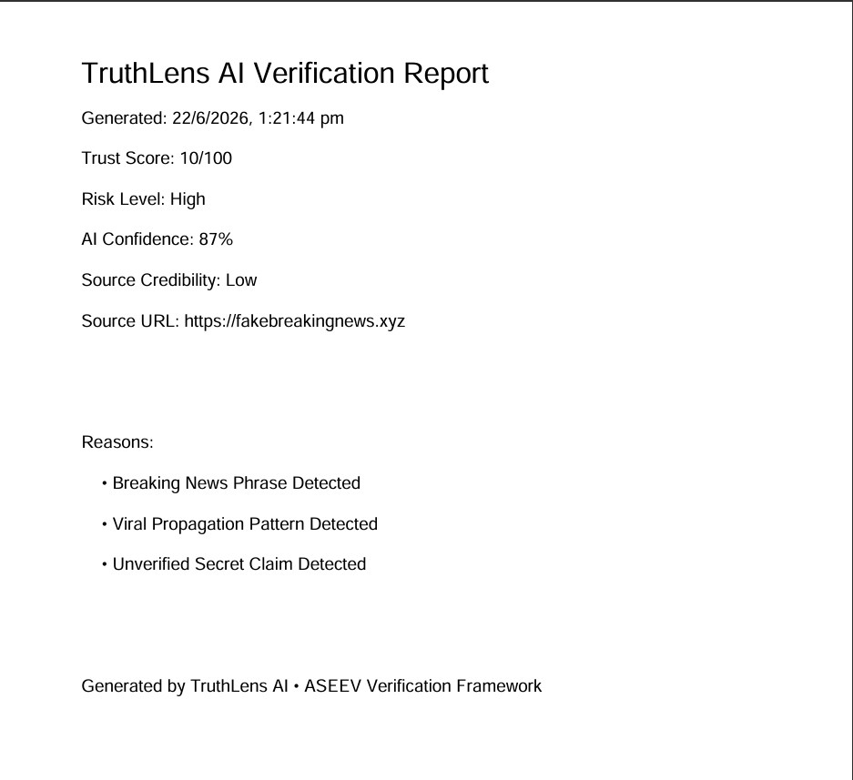
Live Prototype
Real screenshots from the working demo
Fake URL test result
Downloadable PDF Verification Report
TruthLens AI • Verify Before You Trust
Bharat Academix CodeQuest 2026

Slide 9
Competitive Advantage
What makes TruthLens different
Downloadable Verification Reports (PDF)
ASEEV Verification Framework
✓
✓
Source Credibility Analysis
Explainable AI Reasoning
✓
✓
Multi-Modal: text + URL + image
Instant trust score & risk level
✓
✓
TruthLens AI • Verify Before You Trust
Bharat Academix CodeQuest 2026

Slide 10
Demo Flow
User journey through ASEEV
User Input
ASEEV Framework
Analyze Content
Score Credibility
Evaluate Risk
Explain Findings
Verify Information
Generate PDF Report
TruthLens AI • Verify Before You Trust
Bharat Academix CodeQuest 2026

Slide 11
Market Opportunity
Who benefits from TruthLens AI
Students & Researchers
Journalists & Editors
Verify sources before citing in academic work.
Quick credibility check on tips & viral claims.
NGOs & Public Orgs
Everyday Readers
Counter misinformation campaigns at scale.
Decide what to trust before sharing on social media.
TruthLens AI • Verify Before You Trust
Bharat Academix CodeQuest 2026

Slide 12
Roadmap
From prototype to production
Phase 1 — Now
Phase 2 — Next
Phase 3 — Vision
ASEEV rule-based engine
Trust score & risk level
PDF verification report
Transformer-based NLP
Source reputation DB (MongoDB)
Browser extension
Deepfake face detection
AI fact verification
Multilingual support
TruthLens AI • Verify Before You Trust
Bharat Academix CodeQuest 2026

Slide 13
Expected Impact & Benefits
Benefits
Reduces the spread of misinformation
Encourages responsible content sharing
Improves digital and media literacy
Enables rapid credibility assessment
Provides transparent AI-driven explanations
Generates downloadable verification reports for auditing
TruthLens AI • Verify Before You Trust
Bharat Academix CodeQuest 2026

Slide 14
Thank You
Verify Before You Trust
AI-Powered Misinformation & Deepfake Detection Platform
Team TruthLens AI Suvasini • CMR University, Bengaluru Bharat Academix CodeQuest 2026

