Slide 1
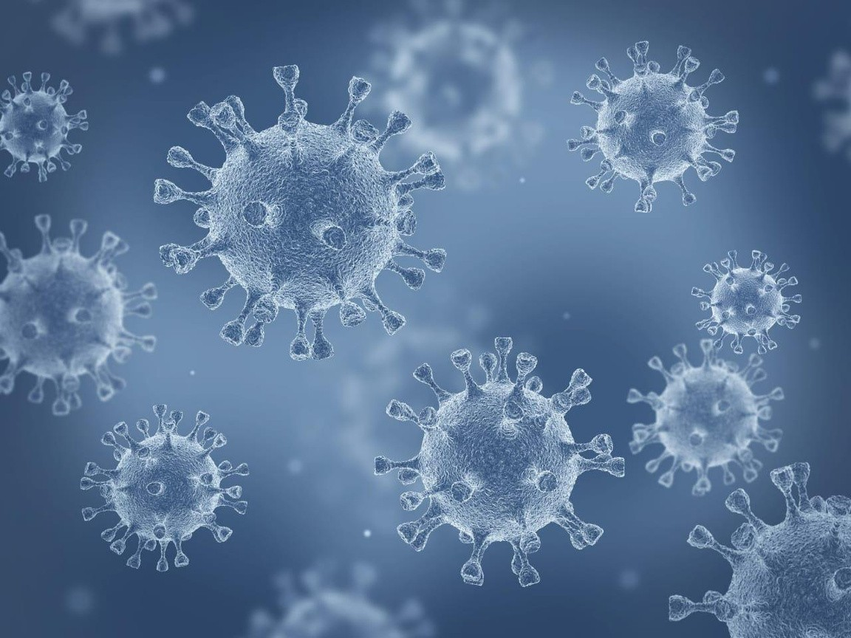








Slide 2
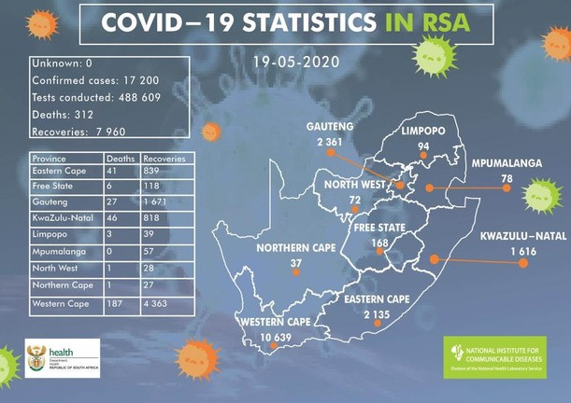
COVID – 19
Coronavirus disease 2019 (COVID-19) is the official name given by the World Health Organization (WHO) to the by SARS-CoV-2, the new coronavirus that surfaced in disease caused in 2019 and spread around the globe.
Wuhan, China

Slide 3
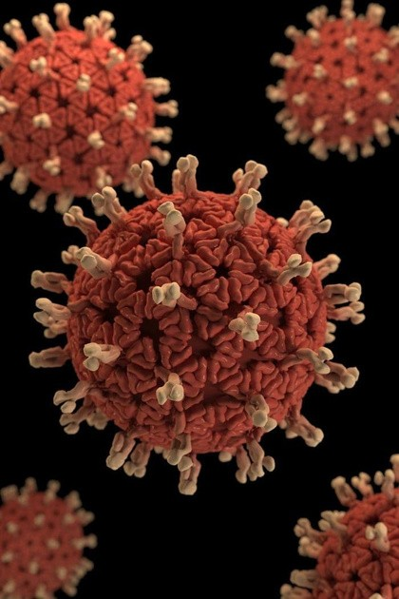

INTRODUCTION
WHAT IS COVID-19? DATA EXTRACTION
HANDLING THE MISSING VALUE DATA VISUALIZATION
PIE CHART
IMPACT OF COVID
EVIDENCE OF COVID INFECTIONS GLOBAL COVID OVERVIEW CONCLUSION

Slide 4

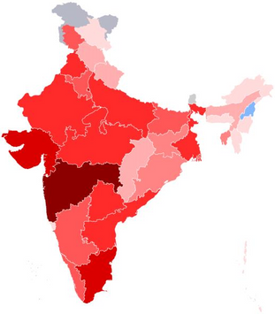


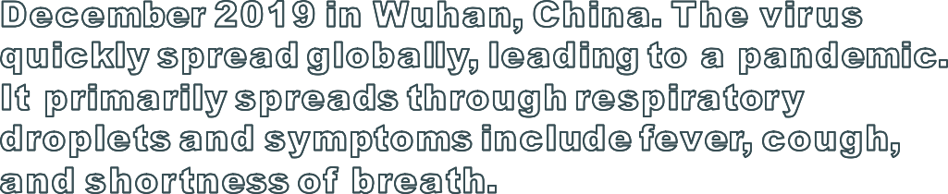
INTRODUCTION
The COVID-19 pandemic, caused by the novel coronavirus SARS-CoV-2, has had a profound and lasting impact on global health, economies, and daily life. Since its
emergence in late 2019, COVID-19 has spread rapidly across the
world, leading to millions of infections and deaths. Understanding and
analyzing the various aspects of this pandemic, such as its epidemiology,
public health responses, medical developments, and societal consequences, is essential for both present and future preparedness.

Slide 5

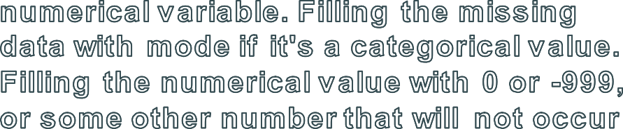

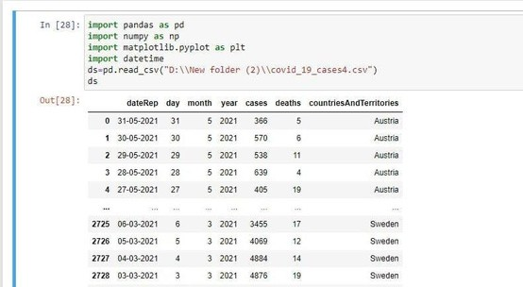
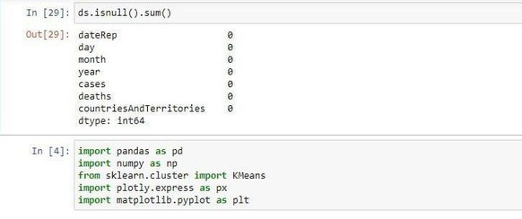
DATA EXTRACTION
Data extraction is the process of obtaining raw data from a source and
replicating that data somewhere else. The raw data can come from various sources, such as a database, Excel spreadsheet, an SaaS platform, web scraping, or others.

Slide 6
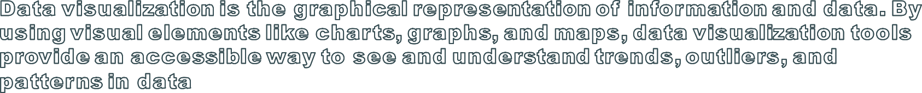
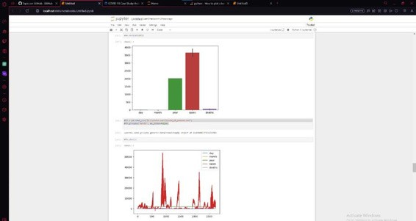
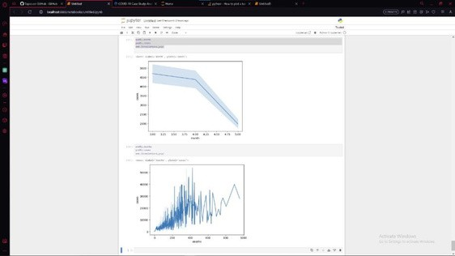

Slide 7
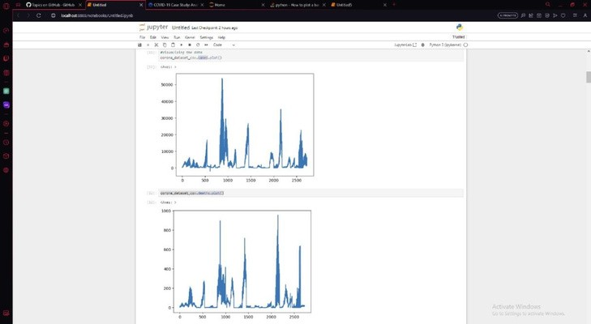
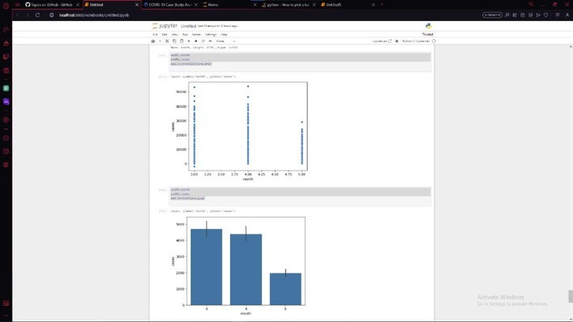

Slide 8
PIE CHART

Slide 9

IMPACTS BY CORONA
The rapid spread of the COVID-19 pandemic has led to a high death rate and, therefore, negatively impacts mental health, thus causing
social concerns due to government restrictions (confinement, curfew, etc.)
EVIDENCE OF COVID INFECTION
Fever or chills
Cough
Shortness of breath or difficulty breathing

Slide 10
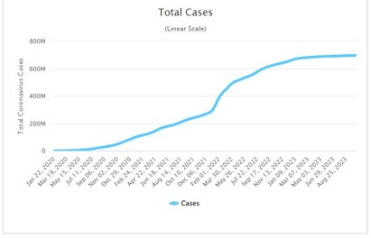
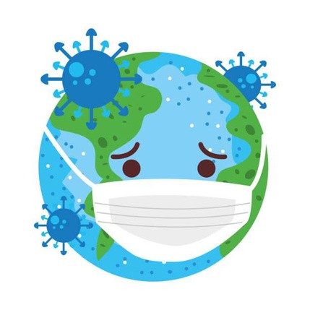
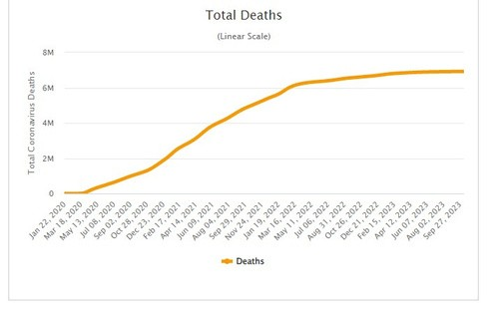
Global covid overview
WHO provides a overview of the World level corona.
Corona case – 696443247 Recovery cases – 689518130
Death rates - 6925117

Slide 11

The COVID-19 pandemic has had a significant impact on the world. It has highlighted the importance of preparedness, collaboration, and innovation. While the future outlook is uncertain, we have learned many lessons that will help us better prepare for future pandemics.
Stay home Stay safe

