Slide 1
CRO BRIEFING | OCTOBER 2026
14,685
Seeing portfolio risk earlier
loan accounts, 10,000 customers
$601M
Credit Risk Portfolio Monitor: score, explain and watch every loan account, with analysts in control.
original exposure
16.1%
default rate (21.1% by exposure)
A working prototype on 14,685 loan accounts

Slide 2



See risk earlier and keep humans in control
THE SHORT VERSION
Risk is concentrated and hidden.
THE ASK
Mortgages are 10% of accounts but 52% of exposure and 65% of defaulted exposure. Customers under $60k income are 22% of exposure but 34% of defaulted exposure.
Approve a 90-day pilot on real bank data
Behaviour gives early warning.
Missed payments in the first 12 months lift default from 12.9% to 34.1%. The score is moderate (AUC 0.684) but well calibrated, and explains itself per account.
Data access and the default definition
Independent model validation
Shadow mode with a small analyst team
AI proposes, analysts decide.
Anomaly watch ranks unusual accounts for review. Every decision is logged, and nothing acts automatically.

Slide 3
Mortgages: 10% of accounts, 65% of defaulted exposure
WHERE THE RISK SITS
52%
of exposure sits in 1,432 mortgages, which default at 24.7% vs 16.1% overall
14%
of the whole book is South mortgages ($84M) at a 27.3% default rate
So what
Set limits and monitoring by product first, then region by product. Region alone is flat (15% to 17%).

Slide 4
Income drives default, but pricing does not respond
WHO DEFAULTS
Default rate by income band
Average interest rate by income band
22% vs 34%
31% vs 21%
So what
Rates stay near 12% while default spans 9.5% to 32%. Low-income borrowers are not priced for risk.
Customers under $60k: share of exposure vs share of defaulted exposure
Unemployed vs salaried default at the same income (40-60k band)

Slide 5


Behaviour is the strongest early-warning signal
EARLY SIGNALS
Default rate by missed payments in months 1-12
Default rate by loan amount / annual income
33% vs 14%
Aggregates beat raw fields
Default for customers with 3+ bureau lines at 30+ days past due vs none
Features are built from bureau and 12-month repayment history, plus the customer's other loans

Slide 6

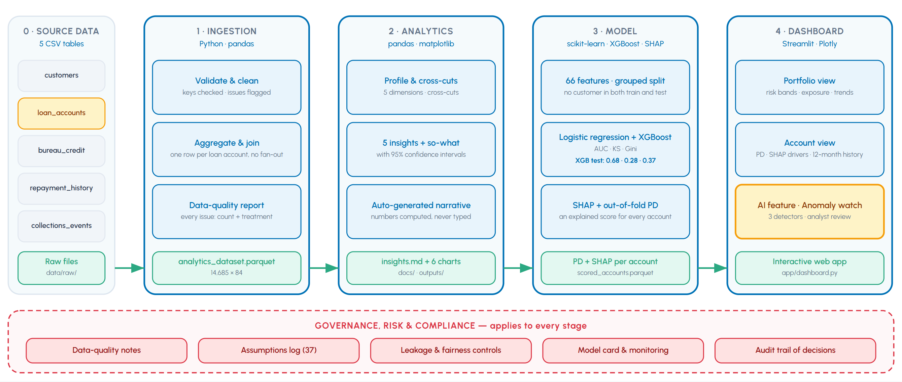

One pipeline, one dashboard, governed end to end
THE SOLUTION
One artefact per stage
Each stage produces a file the next stage consumes.
AI lives in the dashboard
Anomaly watch is part of the product, not a side tool.
Governance spans every stage
Checks, assumptions and audit trail travel with the data.

Slide 7
A moderate score that is honest about itself
THE MODEL
Test AUC by feature group (0.50 = random)
Calibration by risk band
AUC
0.68
Band | % accts | Predicted | Observed
Low | 30% | 7.8% | 8%
Medium | 45% | 14.2% | 13.9%
High | 20% | 25.7% | 26.3%
Very High | 5% | 42.6% | 41.7%
held-out test
Gini
0.37
2 x AUC - 1
Two scoring points
At application: application + bureau features (AUC 0.66)
At 12 months on book: full model (AUC 0.68)
KS
0.28
XGBoost (0.684) and logistic regression (0.689) are statistically tied. XGBoost is used for exact SHAP reasons and missing-data handling; logistic regression stays as the benchmark.
max separation

Slide 8
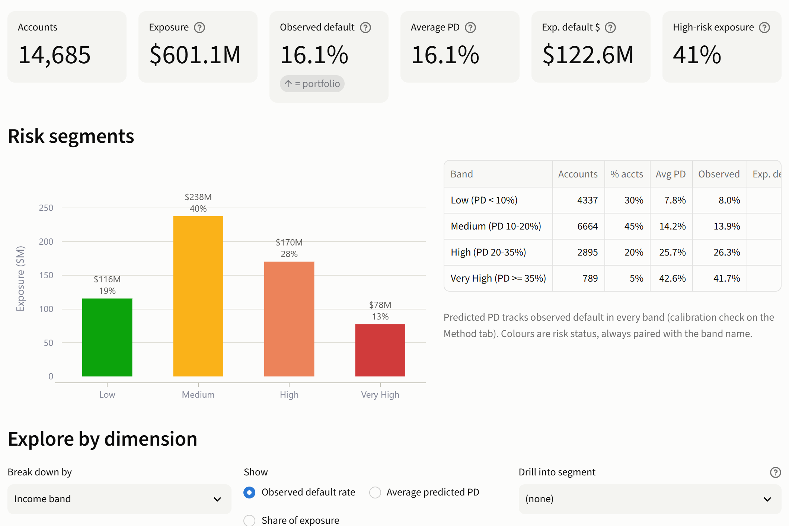
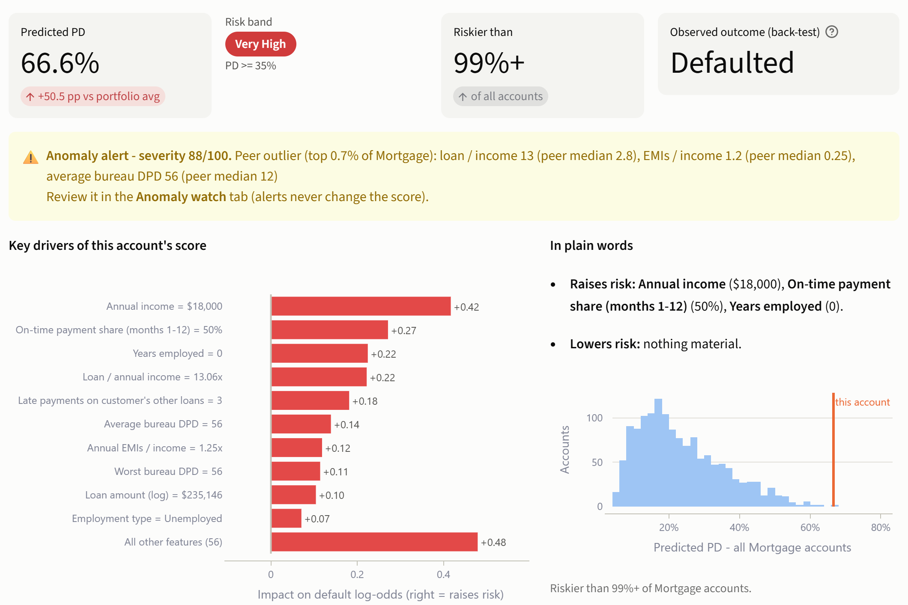
What the analyst sees: segments, scores, reasons
THE DASHBOARD
Portfolio view
Account view
Risk bands, exposure, filters, drill-down, cross-cuts and vintage trends.
Score, band, anomaly alert and SHAP drivers; repayment and bureau detail below.

Slide 9
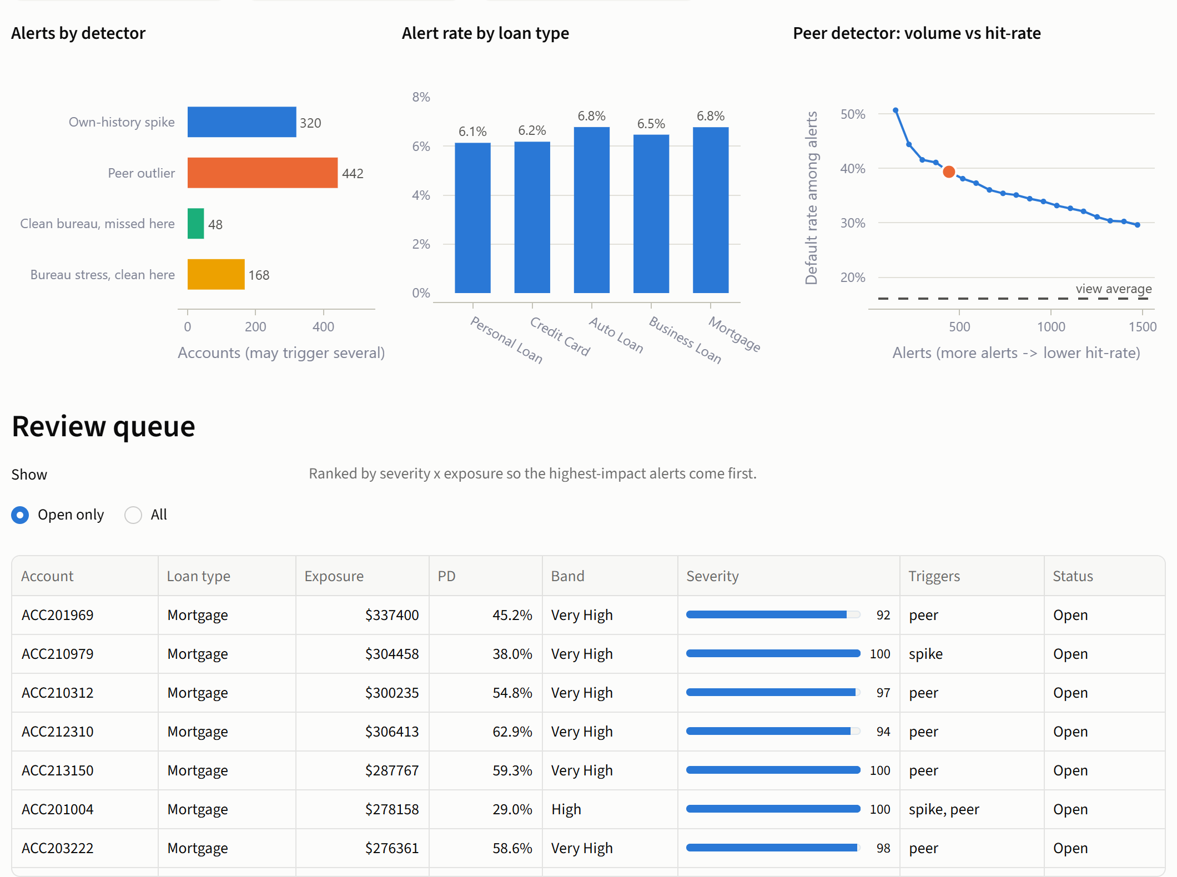


AI proposes, analysts decide
AI FEATURE: ANOMALY WATCH
Detect
Own-history DPD spike, peer-segment outlier, bureau-vs-repayment divergence. Unsupervised.
Rank
Severity x exposure puts the highest-impact alerts first; live sliders set the volume.
Review
Analyst confirms, dismisses, asks for info or escalates. Nothing acts automatically.
Learn
Every decision is logged. A detector dismissed over 70% of the time gets retuned.
6.4%
39% vs 15%
44%
of accounts alerted
default: peer outliers vs rest
of alerts rated Low/Medium by PD
False positive: one bounced debit after 11 clean months; the analyst dismisses it.
False negative: a default with no warning in the data.

Slide 10





Built for model-risk review from day one
RISK & COMPLIANCE
Leakage-proof by design
Protected attributes excluded
Age flagged for compliance
Collections (post-delinquency) are excluded. Customer-grouped splits and out-of-fold scores: no account is scored by a model that saw it.
Gender and marital status are not inputs and are fairness-tested. Gender approval impact ratio: 0.98.
Age is an input. Approval impact ratio for under-30s is 0.66 under a decline-the-riskiest-20% policy; needs a compliance ruling.
Explainable per account
Monitored after launch
Human in the loop, audited
Exact SHAP reasons for every score; a logistic-regression benchmark is kept alongside.
Weekly score PSI, monthly feature CSI, vintage AUC and KS. Retrain on PSI over 0.25 or an AUC drop over 0.03; champion / challenger.
Alerts never act. Every analyst decision is logged with the thresholds in force.

Slide 11
What it takes to ship, and what we don't yet know
READINESS
1
2
What we don't yet know
The default definition and dated outcomes
Point-in-time bureau pulls at application
Discrimination is moderate (AUC 0.684) on noisy synthetic data
The default definition is inferred, not documented
No recovery data, so no loss-given-default or expected-loss view
All 37 assumptions are logged, each with what the bank must provide
3
4
Dated monthly repayments and balances
Recovery data for loss given default
5
6
SSO, role-based access and a case-management API
Compliance ruling on age and adverse-action reasons

Slide 12

NEXT STEP
A 90-day pilot on real data
Days 0-30
Days 31-60
Days 61-90
Get the data right
Prove it on real data
Run it in shadow mode
Data access and feeds
Agree the default definition
Point-in-time bureau pull
Back-test the score
Independent validation
Fairness and compliance review
Small analyst team
Alert review and audit log
Track confirm rate and PSI
Decision requested today
Approve the pilot, nominate a data owner and an independent validation partner.

