Slide 1
Recipe Management System
ABDULAZIZ SUVONKULOV: 220456
AZIZBEK YOKUBOV: 220517

Slide 2
OVERVIEW
Introduction
Project Idea
Tools
Database Design Schema
Development Process
Future Direction
Summary

Slide 3
Tools:
HTML, CSS, BOOTSTRAPT, JAVASCRIPT
NODE JS (Express JS)
POSTGRESQL, DataGrip, VSCode

Slide 4
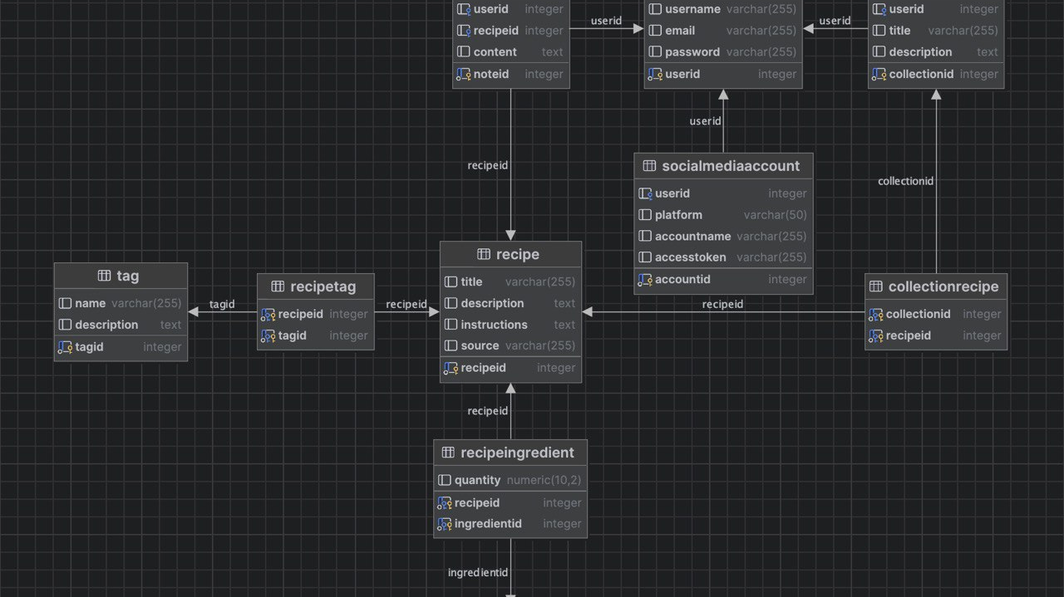

Slide 5
Development Process

Slide 6
Future Direction

Slide 7
Summary

