Slide 1

National Research University Higher School of Economics
Faculty of Computer Science
Case study: Evaluating purchases In Google Merchandise store to propose advices to increase website income Data Analysis, Research Project
Presenter: mSSE21 student, Nikolai M. Suvorov
Moscow, 2022

Slide 2

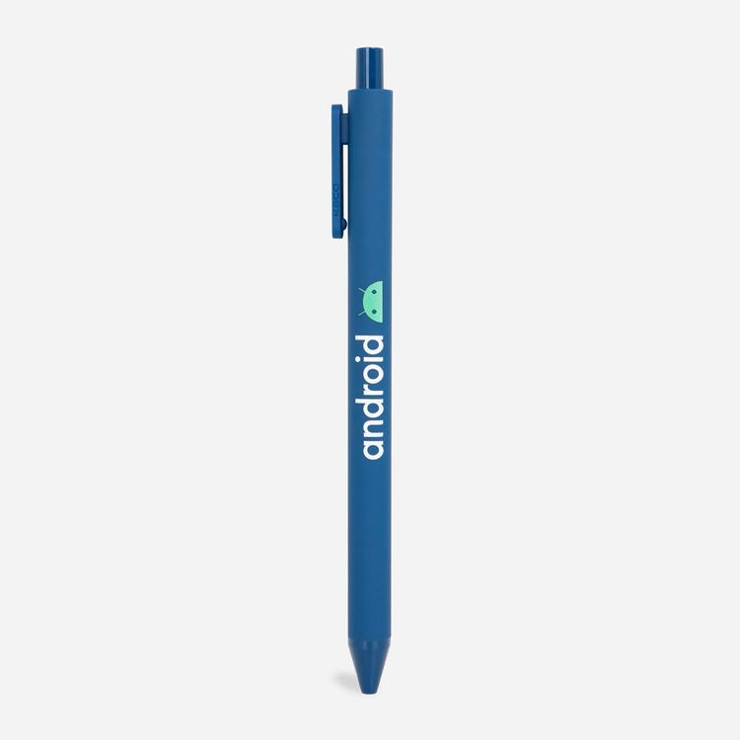
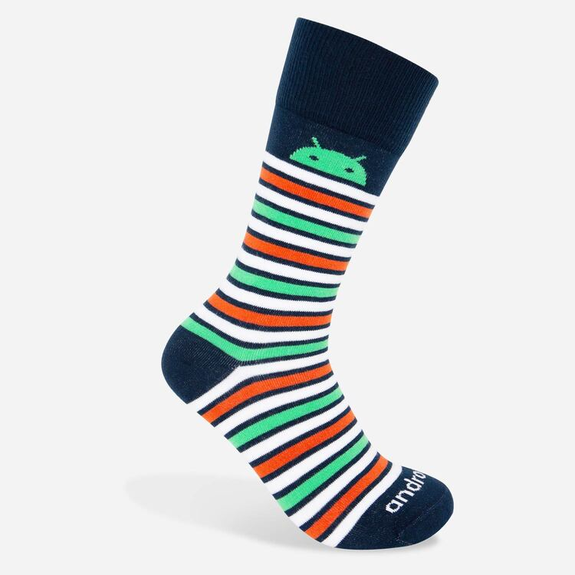


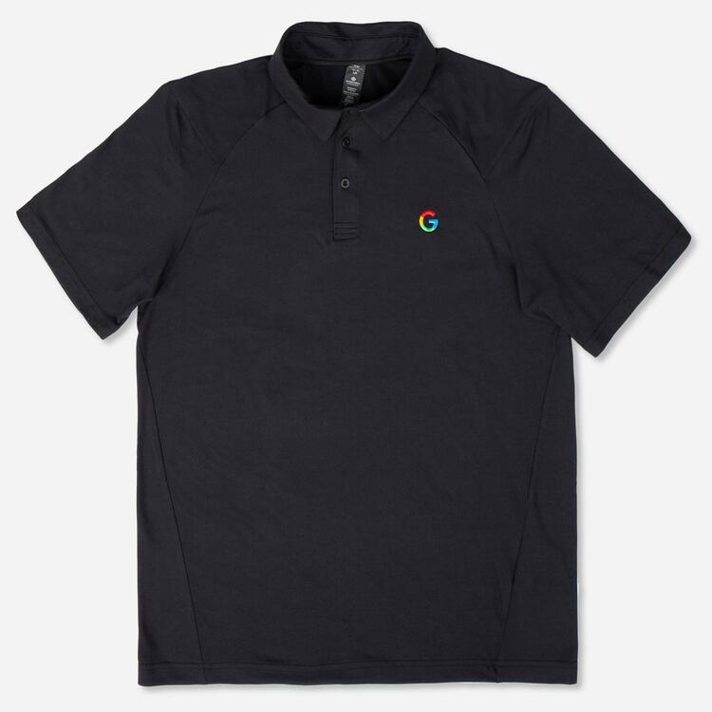
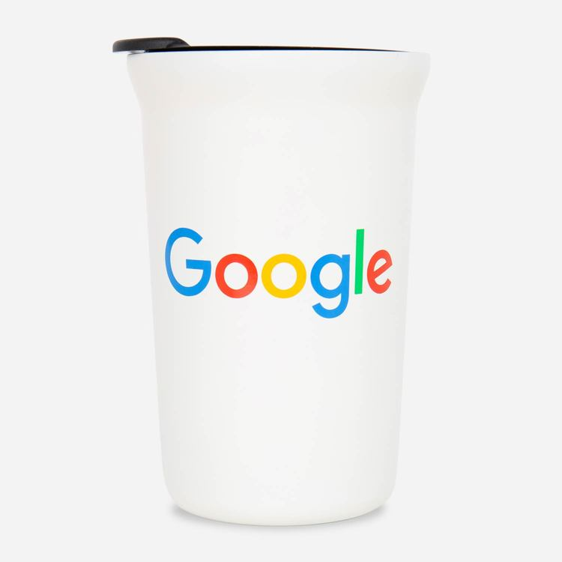

Research relevance:
background
2

Slide 3
Research relevance:
Dataset
Source: https://www.kaggle.com/competitions/ga-customer-revenue-prediction/data?select=train.csv
Data fields:
fullVisitorId- A unique identifier for each user of GMS.
channelGrouping - The channel via which the user came to the Store.
date - The date on which the user visited the Store.
device - The specifications for the device used to access the Store.
geoNetwork - Information about the geography of the user.
totals - Aggregate values across the session.
trafficSource - Traffic Source from which the session originated.
visitNumber - The session number for this user.
903 650 rows
3

Slide 4
Research relevance:
Questions
What are the key factors that significantly influence the chance to perform a purchase? Idea: construct a logistic regression with Y as a chance to perform a purchase.
What is the influence of visit parameters on the amount spent on purchases? Idea: construct a linear regression with Y as a transaction revenue of a purchase.
What are the groups of visits in the GMS that need special attention? Idea: perform a cluster analysis of all visits to GMS.
4

Slide 5
Research relevance:
Questions
What are the key factors that significantly influence the chance to perform a purchase? Idea: construct a logistic regression with Y as a chance to perform a purchase.
What is the influence of visit parameters on the amount spent on purchases? Idea: construct a linear regression with Y as a transaction revenue of a purchase.
What are the groups of visits in the GMS that need special attention? Idea: perform a cluster analysis of all visits to GMS.
Based on the answers provided, some advices to management should be formed.
5
Notes:
Descriptive analysis is a must to justify the answers for each research question.

Slide 6
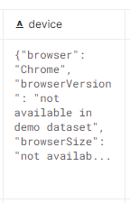
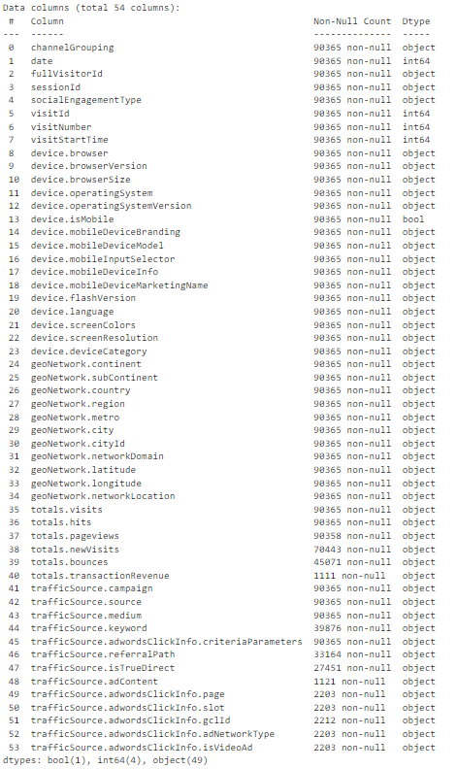
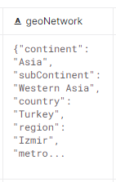
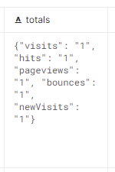
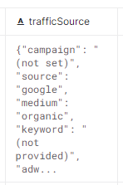
Preprocessing
6
Notes:
Descriptive analysis is a must to justify the answers for each research question.

Slide 7
Preprocessing
903 650 rows
90 365 rows chosen randomly
7
Notes:
Descriptive analysis is a must to justify the answers for each research question.

Slide 8
Preprocessing
903 650 rows
90 365 rows chosen randomly
Columns without nulls
(substitution based on column type)
Columns with nulls
8
Notes:
Descriptive analysis is a must to justify the answers for each research question.

Slide 9
Preprocessing
903 650 rows
90 365 rows chosen randomly
Columns without nulls
(substitution based on column type)
Columns with nulls
Columns with reduced number of categories (added ‘Others’)
Columns with many categories
9
Notes:
Descriptive analysis is a must to justify the answers for each research question.

Slide 10
Preprocessing
903 650 rows
90 365 rows chosen randomly
Columns without nulls
(substitution based on column type)
Columns with nulls
Columns with reduced number of categories (added ‘Others’)
Columns with many categories
Date
Day of the week
10
Notes:
Descriptive analysis is a must to justify the answers for each research question.

Slide 11
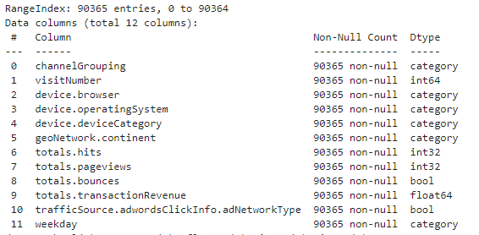
Preprocessing
11
Notes:
Descriptive analysis is a must to justify the answers for each research question.

Slide 12
Result Dataset
Dataset contains 90365 entries. Each row describes a visit into a GMS (Google Merchandise Store).
Columns description:
channelGrouping - how the redirect to GMS website is performed.
visitNumber - the session number.
device.browser - browser used to access the website.
device.operatingSystem - OS used to access the website.
device.deviceCategory - type of device.
geoNetwork.continent - continent from which the request is performed.
totals.hits - number of website hits during the session.
totals.pageviews - number of pages viewed during the session.
totals.bounces – is payment cancelled.
totals.transactionRevenue - amount of money spent during the session.
trafficSource.adwordsClickInfo.adNetworkType - was the click on ads performed.
weekday - weekday of the session
12
Notes:
Descriptive analysis is a must to justify the answers for each research question.

Slide 13
Descriptive analysis
What is described:
Distribution of categorical vars.
Distribution of numerical vars.
Crosstabs for all categorical vars (relationships between each categorical variable).
Correlation for all numerical vars.
Relations between predictors and a transaction revenue (logarithm of a revenue).
Relations between predictors and a chance to perform a purchase (a case when revenue > 0).
Based on this description:
“totals.pageviews” is removed.
“totals.transactionRevenue” is replaced with “log_transactionRevenue”.
13
Notes:
Descriptive analysis is a must to justify the answers for each research question.

Slide 14
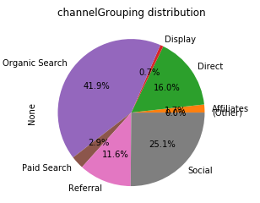
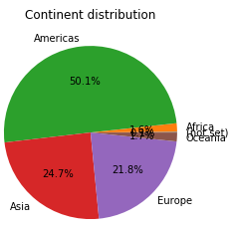
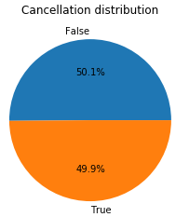
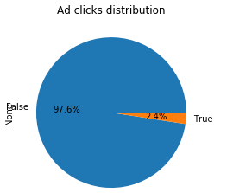
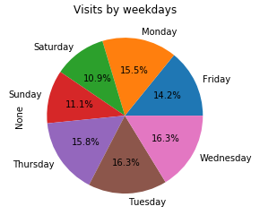
Descriptive analysis:
Categorical variable distribution
14
Notes:
Descriptive analysis is a must to justify the answers for each research question.

Slide 15
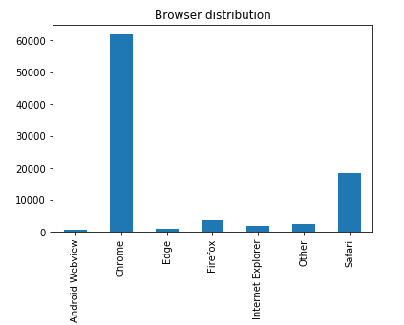
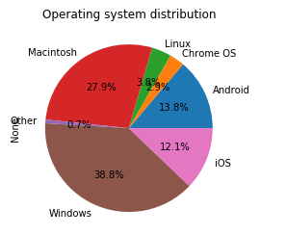
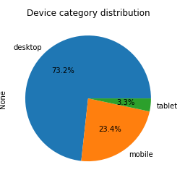
Descriptive analysis:
Categorical variable distribution
15
Notes:
Descriptive analysis is a must to justify the answers for each research question.

Slide 16
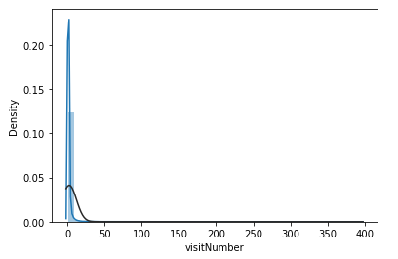
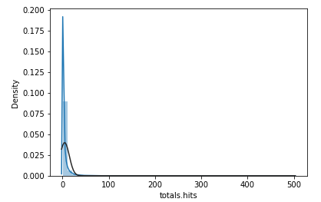
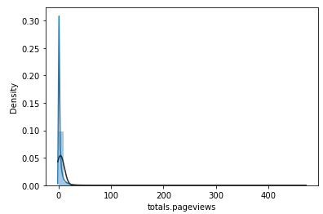
Descriptive analysis:
Numerical variable distribution
16
Notes:
Descriptive analysis is a must to justify the answers for each research question.

Slide 17
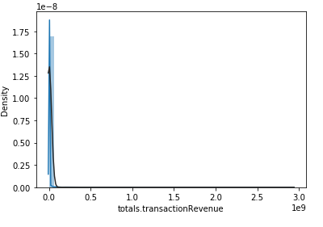
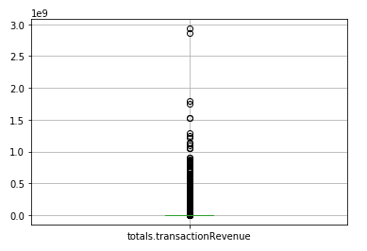
Descriptive analysis:
Numerical variable distribution
17
Notes:
Descriptive analysis is a must to justify the answers for each research question.

Slide 18
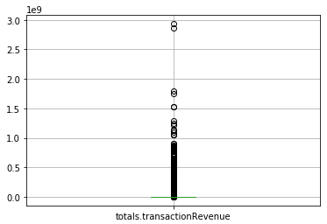
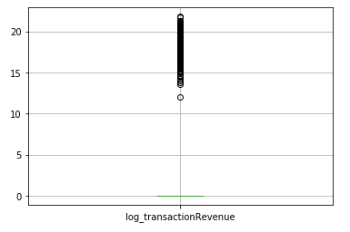
Descriptive analysis:
Dependent as Logarithm
$log_transactionRevenue =ln⁡(1+\text{totals}\text{.}\text{transactionRevenue}$)
18
Notes:
Descriptive analysis is a must to justify the answers for each research question.

Slide 19
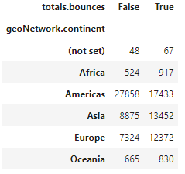
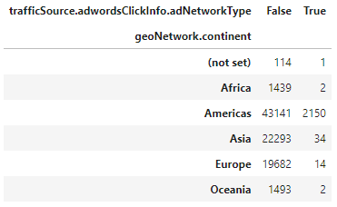
Descriptive analysis:
Relations between categoricals
Payment cancellation in Americas is far less often than in all other continents
Clicks on ads are mainly done in Americas
19
Notes:
Descriptive analysis is a must to justify the answers for each research question.

Slide 20
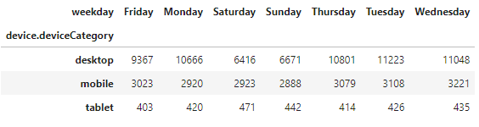
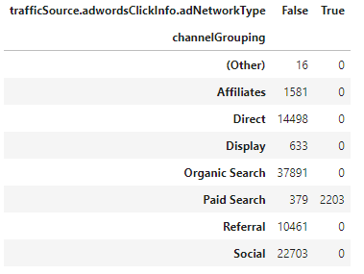
Descriptive analysis:
Relations between categoricals
Mobiles and tablets are used equally among the weekdays, while desktop is used less in weekends
The adds are clicked only through the paid search. The variable is not quite representative, however, in some paid searches ads are not clicked.
20
Notes:
Descriptive analysis is a must to justify the answers for each research question.

Slide 21
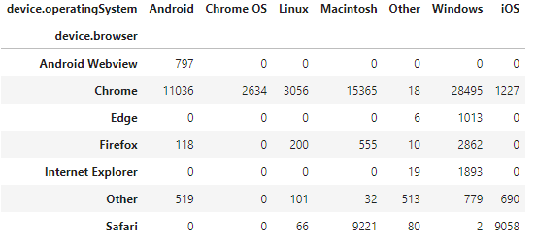
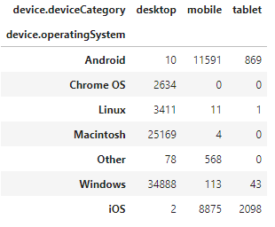
Descriptive analysis:
Relations between categoricals
Some browsers are linked with operation systems. Thus, these variables can very roughly describe each other.
Here all the relationships can be explained by close relations of OS and type of devices.
21
Notes:
Descriptive analysis is a must to justify the answers for each research question.

Slide 22
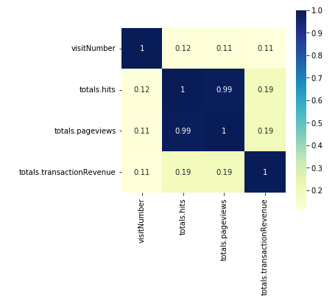
Descriptive analysis:
Relations between Numericals
It is seen that there is a linear relationship between 'totals.hits' and 'totals.pageviews'. Since one variable describes another one, one of them can be dropped.
22
Notes:
Descriptive analysis is a must to justify the answers for each research question.

Slide 23
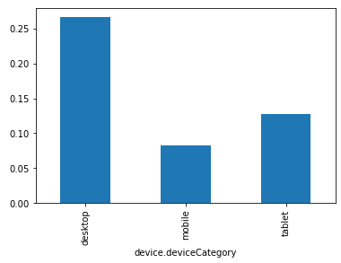
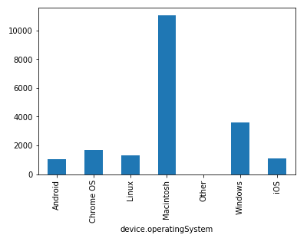
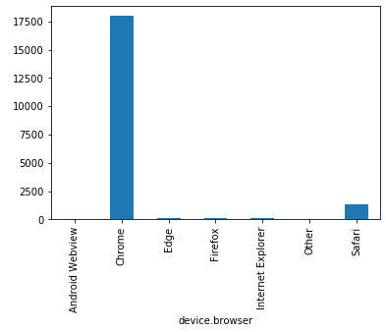
Descriptive analysis:
predictors VS Log(revenue)
23
Notes:
Descriptive analysis is a must to justify the answers for each research question.

Slide 24
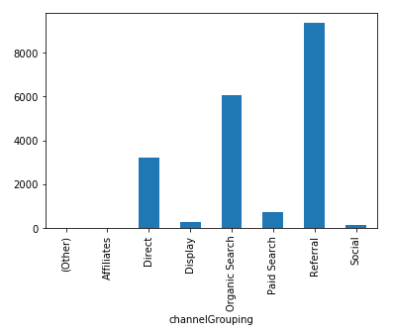
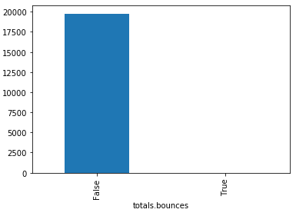
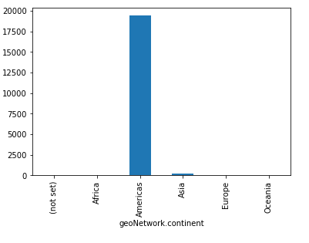
Descriptive analysis:
predictors VS Log(revenue)
24
Notes:
Descriptive analysis is a must to justify the answers for each research question.

Slide 25
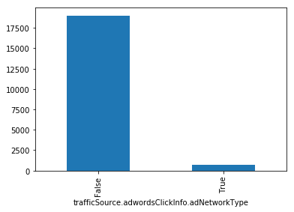
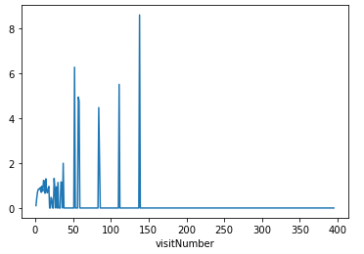
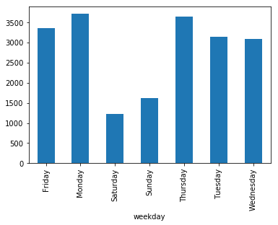
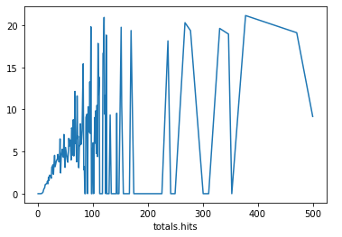
Descriptive analysis:
predictors VS Log(revenue)
25
Notes:
Descriptive analysis is a must to justify the answers for each research question.

Slide 26
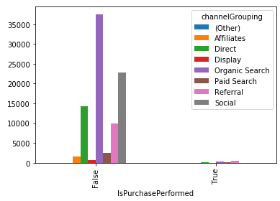
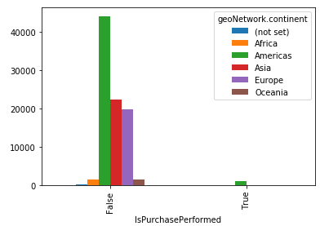
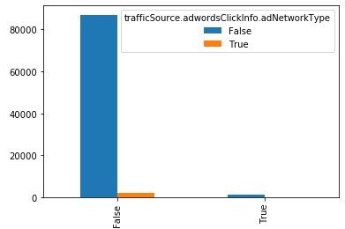
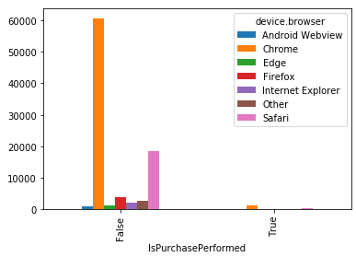
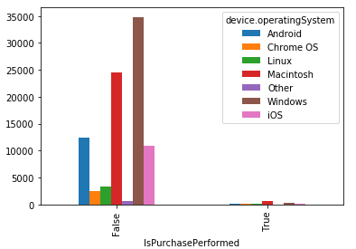
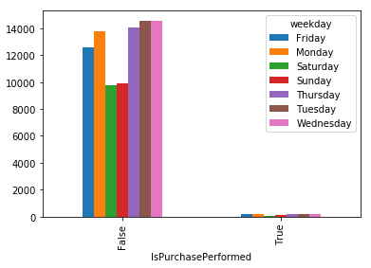
Descriptive analysis:
predictors VS Chance to purchase
26
Notes:
Descriptive analysis is a must to justify the answers for each research question.

Slide 27
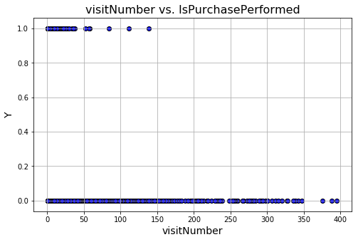
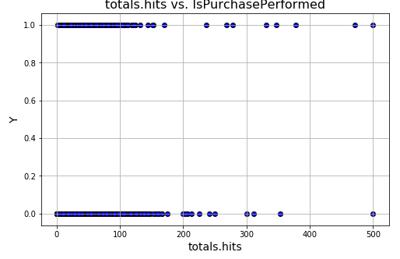
Descriptive analysis:
predictors VS Chance to purchase
27
Notes:
Descriptive analysis is a must to justify the answers for each research question.

Slide 28


Factor analysis
We have only 2 numerical variables; thus, factor analysis is not purposeful, but we examined its results on 2 variables:
Bartlett's Test of Sphericity : $5.5e^{−51}$
KMO: 0.499999
there are statistically significant relations between variables
data is only miserably suited for the factor analysis
28
Notes:
Descriptive analysis is a must to justify the answers for each research question.

Slide 29



Factor analysis
We have only 2 numerical variables; thus, factor analysis is not purposeful, but we examined its results on 2 variables:
Variables fit well into the model, however, communalities are not very high
The factor describes only 52% of variance of initial variables, which is not good enough
Both the variables provide a high impact on the model
Factor could be called as 'Visit number and hits’, but it was decided not to add such a factor due to low variance description
29
Notes:
Descriptive analysis is a must to justify the answers for each research question.

Slide 30




Cluster analysis:
the Whole dataset – clustering by numericals
Calinski-Harabasz Index:
5 clusters
Number of elements in each cluster:
30
Notes:
Descriptive analysis is a must to justify the answers for each research question.

Slide 31


Cluster analysis:
the Whole dataset
Cluster 1: Money Generators
Cluster 2: Visits from Windows with the highest sequential number and without cancellation and purchases
Cluster 3: Visits from Mac with low sequential number and without cancellation and purchases
Cluster 4: Visits from Windows with lowest sequential number, lowest total hits, cancellation and without purchases
Cluster 5: Visits from Windows with high sequential number and without cancellation and purchases
31
Notes:
Descriptive analysis is a must to justify the answers for each research question.

Slide 32
Cluster analysis:
Money generators – clustering by all
Steps:
1. Computation of Gower distances between all the records.
2. Using Density-Based Spatial Clustering of Applications with Noise (DBSCAN) technique on the distance matrix obtained at the previous step.
3. Evaluate averages of variable values among columns
32
Notes:
Descriptive analysis is a must to justify the answers for each research question.

Slide 33

Cluster analysis:
Money generators – clustering by all
Steps:
1. Computation of Gower distances between all the records.
2. Using Density-Based Spatial Clustering of Applications with Noise (DBSCAN) technique on the distance matrix obtained at the previous step.
3. Evaluate averages of variable values among columns
33
Notes:
Descriptive analysis is a must to justify the answers for each research question.

Slide 34
Cluster analysis:
Money generators – clustering by all
Steps:
1. Computation of Gower distances between all the records.
2. Using Density-Based Spatial Clustering of Applications with Noise (DBSCAN) technique on the distance matrix obtained at the previous step.
3. Evaluate averages of variable values among columns
34
Notes:
Descriptive analysis is a must to justify the answers for each research question.

Slide 35
Cluster analysis:
Money generators – clustering by all
Steps:
1. Computation of Gower distances between all the records.
2. Using Density-Based Spatial Clustering of Applications with Noise (DBSCAN) technique on the distance matrix obtained at the previous step.
3. Evaluate averages of variable values among columns
Mean() for numerical Mode() for categorical
35
Notes:
Descriptive analysis is a must to justify the answers for each research question.

Slide 36


Cluster analysis:
Money generators – clustering by all
Cluster 0: Referral visits from Chrome and Mac with most profits
Cluster 1: Paid search visits from Chrome and Mac with medium profits
Cluster 2: Newcomer paid search visits from Firefox and Windows with lower profits
36
Notes:
Descriptive analysis is a must to justify the answers for each research question.

Slide 37

Linear Regression for Log(Revenue)
Model is statistically significant.
Model describes 17% variance of the dependent variable.
Only 2 variables are statistically significant:
visitNumber,
total.Hits
An increase in visitNumber by one, on average, leads to an increase of the revenue by 1.21%
An increase in totals.hits by one, on average, leads to an increase of the revenue by 0.79%
37
Notes:
Descriptive analysis is a must to justify the answers for each research question.

Slide 38



Linear Regression for Log(Revenue)
Diagnostics
Residuals
Heteroscedasticity
> 10
Multicollinearity
38
Notes:
Descriptive analysis is a must to justify the answers for each research question.

Slide 39




Linear Regression for Log(Revenue)
Diagnostics
Only 1 with $|dffits|>2.5$
Only 1 with $|resid|>4$
Influential cases
Potential outliers
Influence of such cases on the model is not very high
39
Notes:
Descriptive analysis is a must to justify the answers for each research question.

Slide 40

Logistic Regression for IsPurchasePerformed
Model is statistically significant.
Model describes 40% variance of the dependent variable.
Statistically significant variables:
total.Hits,
channelGrouping_Social,
device.operatingSystem_Chrome OS,
device.operatingSystem_Macintosh,
geoNetwork.continent_Asia,
geoNetwork.continent_Europe,
weekday_Saturday,
weekday_Tuesday
40
Notes:
Descriptive analysis is a must to justify the answers for each research question.

Slide 41
Logistic Regression for IsPurchasePerformed
One hit increase in totals.hits will increase the odds to make a purchase by 6%.
For visits from social channels the odds to perform a purchase are 98% lower than for visits from non-detected channels
For visits from Chrome OS the odds to perform a purchase are 5 times higher than for visits from Androids.
For visits from Mac the odds to perform a purchase are 6.5 times higher than for visits from Androids.
For visits made from Asia the odds to perform a purchase are 97% lower than for visits from a the non-set continent.
For visits made from Europe the odds to perform a purchase are 99% lower than for visits from a the non-set continent.
For visits made on Saturdays the odds to perform a purchase are 35% lower than for visits on Fridays.
For visits made on Tuesdays the odds to perform a purchase are 25% lower than for visits on Fridays.
41
Notes:
Descriptive analysis is a must to justify the answers for each research question.

Slide 42


Logistic Regression for IsPurchasePerformed
Confusion matrix
42
Notes:
Descriptive analysis is a must to justify the answers for each research question.

Slide 43


Logistic Regression for IsPurchasePerformed:
Diagnostics
Residuals
> 10
Multicollinearity
43
Notes:
Descriptive analysis is a must to justify the answers for each research question.

Slide 44
Answers to research questions
What are the key factors that significantly influence the chance to perform a purchase?
Mainly: total.hits.
one hit increase in totals.hits increases the odds to make a purchase by 6%
Partially: channelGrouping, device.operatingSystem, geoNetwork.continent, weekday.
For visits from social channels the odds to perform a purchase are 98% lower than for visits from non-detected channels
For visits from Chrome OS the odds to perform a purchase are 5 times higher than for visits from Androids.
For visits from Mac the odds to perform a purchase are 6.5 times higher than for visits from Androids.
For visits made from Asia the odds to perform a purchase are 97% lower than for visits from a the non-set continent.
For visits made from Europe the odds to perform a purchase are 99% lower than for visits from a the non-set continent.
For visits made on Saturdays the odds to perform a purchase are 35% lower than for visits on Fridays.
For visits made on Tuesdays the odds to perform a purchase are 25% lower than for visits on Fridays.
44
Notes:
Descriptive analysis is a must to justify the answers for each research question.

Slide 45
Answers to research questions
What are the key factors that significantly influence the chance to perform a purchase?
Average visit in the GMS that generates a purchase:
Below average visit number (3.1).
High number of total hits (39.7).
The website is accessed through Referral links.
Device category is desktop.
Continent is Americas.
No clicks on ads.
Browser is Chrome.
OS is Macintosh.
No cancellation is faced.
The visit is often performed on Fridays.
45
Notes:
Descriptive analysis is a must to justify the answers for each research question.

Slide 46
Answers to research questions
What are the key factors that significantly influence the chance to perform a purchase?
Average visit in the GMS that generates a purchase:
Below average visit number (3.1).
High number of total hits (39.7).
The website is accessed through Referral links.
Device category is desktop.
Continent is Americas.
No clicks on ads.
Browser is Chrome.
OS is Macintosh.
No cancellation is faced.
The visit is often performed on Fridays.
Advices:
Invest into marketing program to increase accessing the website through referral links.
Pay attention to develop a usability-friendly interface for the desktop, perform additional QA-sessions to increase overall quality of the desktop version.
Investigate the sources of cancellations on the website.
Make the main focus of the interface on the Americans.
Examine groups of visits that always do not provide any purchase, determine the reasons for such fact - maybe some actions can be performed to inspire people perform purchases
46
Notes:
Descriptive analysis is a must to justify the answers for each research question.

Slide 47
Answers to research questions
What is the influence of visit parameters on the amount spent on purchases?
An increase in visitNumber by one, on average, leads to an increase of the revenue by 1.21%
An increase in totals.hits by one, on average, leads to an increase of the revenue by 0.79%
Parameter | High trans. rev. | Medium trans. rev. | Low trans. rev.
Visit number | above average | average | low
Total hits | high | low | high
Clicks on ads | No | Yes | Yes
Group Channel | Referral link | Paid Search | Paid Search
Browser | Chrome | Chrome | Mozilla
OS | Mac | Mac | Windows
Weekday | Tuesday | Wednesday | Friday, Tuesday
47
Notes:
Descriptive analysis is a must to justify the answers for each research question.

Slide 48
Answers to research questions
What is the influence of visit parameters on the amount spent on purchases?
Advices:
Invest more in referral searches as they generate more cash.
Make the website interface convenient for Macinstosh users.
Evaluate effectivess of ads on the website - maybe they can be removed and cash obtained could be even increased.
Make website updates strictly not on Tuesdays - preferably, on weekends, when the quantity of users is lower and purchases are lower as well.
Estimate effectiveness of spending cash for Paid Search and compare it with investing in referrals: maybe some cash can be reallocated to generate more profits.
48
Notes:
Descriptive analysis is a must to justify the answers for each research question.

Slide 49
Answers to research questions
What are the groups of visits in the GMS that need special attention?
‘Indecisives’: very high visit number, below average total hits and zero revenue. The users are interested in production of GMS but still not buy anything. Possibly, some advertising can be done to force them make a purchase.
‘Newcomers with cancellations’: lowest visit number, lowest total hits, faced cancellation and zero revenue. It is important to study the problem, why a cancellation occurs since a cancellation = no cash. In addition, some attractive features may be developed to keep the user on the website and encourage him/her to make a purchase.
‘Main Money Generators’: above average visit number (3.6), quite high total hits and the highest revenue. This group generates the main amount of cash. Enough attention should be paid to this group of visits not to lose them in future. The main aim here is to maintain or increase frequency of such visits.
‘Newcomers with small purchases’: quite a low visit number (1.5), quite high total hits number and lower transaction revenue. What the website needs is to increase the cash that these users generate. Potentially, the website can propose other products to buy or perform some promos to encourage people to spend more money.
49
Notes:
Descriptive analysis is a must to justify the answers for each research question.

Slide 50
Thanks for attention!
Presenter: Suvorov Nikolai Mikhailovich
E-mail: nmsuvorov@edu.hse.ru

