Slide 1
AIRLINE TICKET PRICE
Ml_miniproject

Slide 2
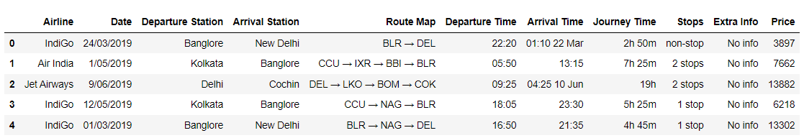
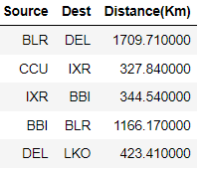
DATA SET
Airline
Date
Departure Station
Arrival Station
Route Map
Departure Time
Arrival Time
Journey Time
Stops
Extra Info
Price
Source
Destination
Distance(km)

Slide 3
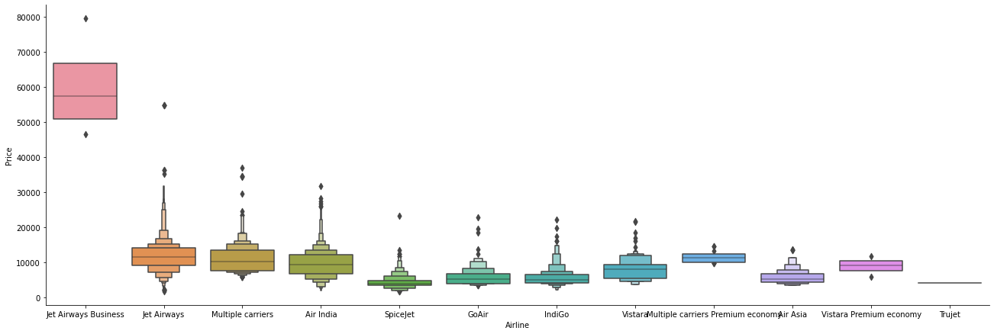
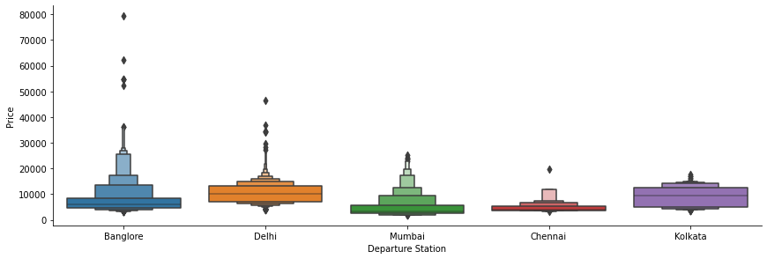
DATA MANIPULATION
CONVERT THE DATE AND TIME INTO SEPARATE COLUMNS SO THAT NO CATEREGORICAL DATAS CONTAINS ANY ALPHABETS. SEPARATE MONTHS AND DAYS IN DIFFERENT COLUMNS. CONVERT CATEGORICAL DATA TO NUMERICAL DATA BY REPLACING METHODS. (fare["Stops"].replace({"non-stop": 0, "1 stop": 1, "2 stops": 2, "3 stops": 3, "4 stops": 4}, inplace = True))
Perform OneHotEncoding for Nominal Categorical data.
Plotting Airline vs Price and Destination vs Price to see the relationship with prices.
From Airline vs Price graph we can see that Jet Airways Business have the highest Price. Apart from the first Airline almost all are having similar median.
From Destination vs Price graph we can see that almost all are having similar median.

Slide 4
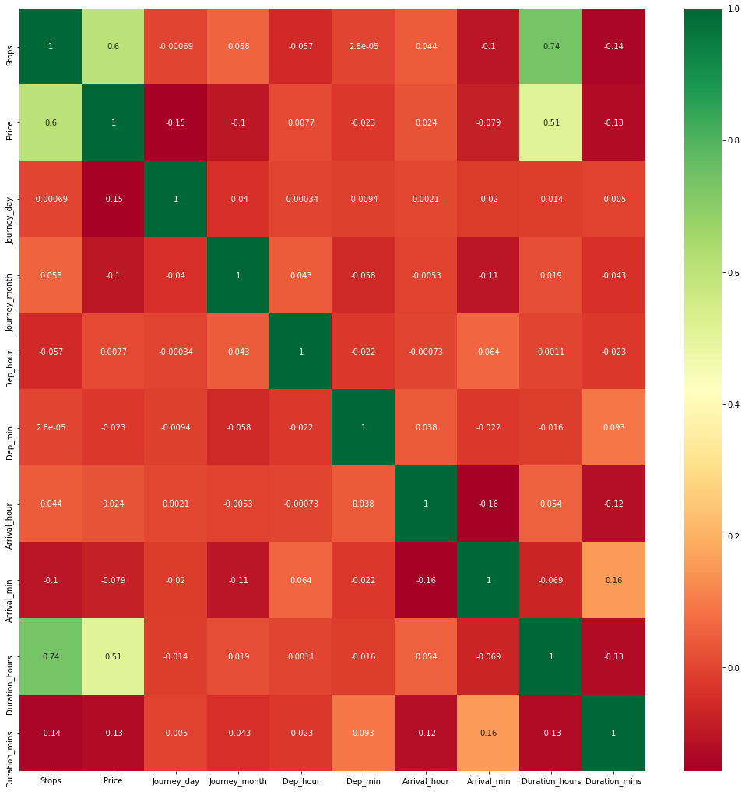
CORRELATION
Finds correlation between Independent and dependent attributes
plt.figure(figsize = (18,18))
sns.heatmap(fare.corr(), annot = True, cmap = "RdYlGn")
plt.show()
Darker place contains much more correlation

Slide 5
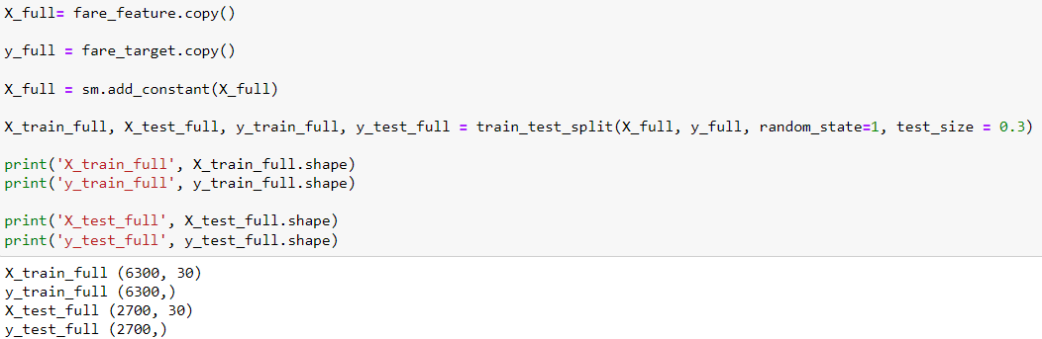
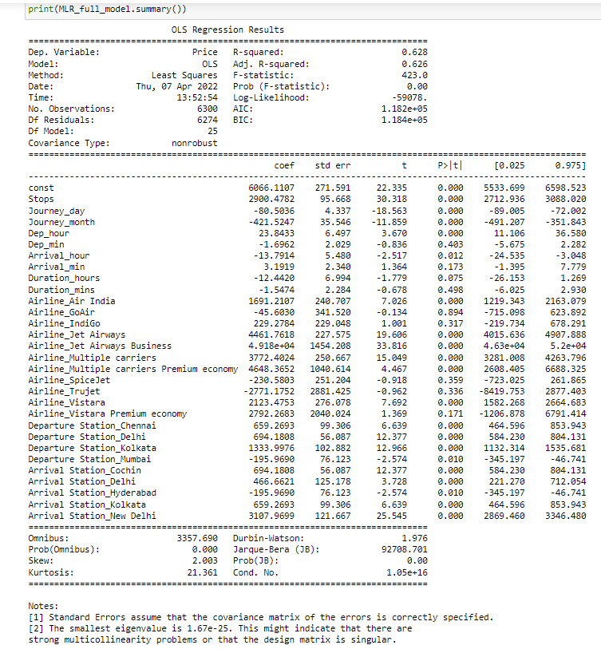
MLR Model after TEST TRAIN SPLIT Test
FROM THE MLR MODEL WE CAN PREDICT THE DEPENDENT VARIABLE

Slide 6
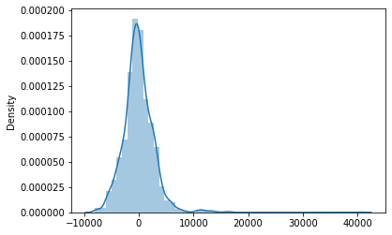
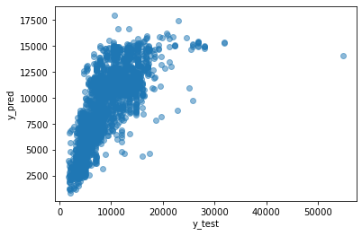
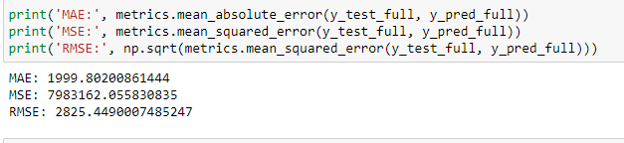
PLOTTING AND ERROR VALUE
y_test_full VS y_pred_full (DISTPLOT)
y_test_full VS y_pred_full (SCATTER PLOT)
Mean absolute error (y_test_full, y_pred_full)
Mean squared error (y_test_full, y_pred_full)
Mean squared error (y_test_full , y_pred_full)

Slide 7
BY SUVODEEP DAS
THANK YOU

