Slide 1
Proof of Concept: Forecasting Pandemic Confirmed Cases
Generic Approach and Proof of Concept Details
Amendment History
Version | Date | Description of Changes | Author
0.1 | 04-13-20 | Initial Draft | Rajesh . Y
0.2 | 04-14-20 | Slide Improvements | Rajesh . Y
TCS Confidential

Slide 2
Use Case Synopsis
Background
Pandemics are Generally highly infectious and affects several people
having low immunity.
The objective of this Use-Case :
The objective of the current POC is to forecast the confirmed cases that may be affected by the Pandemic using forecasting models.
The predictive engine will be trained from the given set of historical cases affected by the pandemic.
The objective ofThe objective of the current POC is to perform automated claim scoring & segmentation module using machine learning and deep learning models through TCS’ Cognitive Computing Suite.
The predictive engine will be trained from the given set of historical claim cases approved/rejected by rule engine or human associates.
the current POC is to perform automated claim scoringman associates.
Data Set
Source : Given set of historical confirmed cases affected by the Covid pandemic.n set of historical claim cases approved/rejected by rule engine or human associates.
The Data file is time series data which contains total number of
affected cases.
Target Output :
Forecast of the expected number of confirmed cases.
Model & Algorithm
Since the problem was to predict the expected number of confirmed cases we decided to use forecasting models.
The growth pattern shows exponential pattern.
scipy.optimize.curve_fit python package is used to fit the
exponential function
.
Output & Benefit
Output :
Forecasting Expected number of confirmed cases
Benefit :
Forecasting will help the preparedness and will help to decrease the mortality rate.
TCS Confidential
Notes:
2
# Tx predicted as Fraud

Slide 3
Data Set : Data Understanding

Slide 4
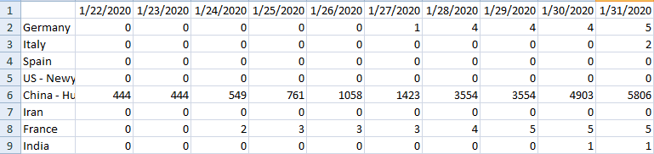

Slide 5
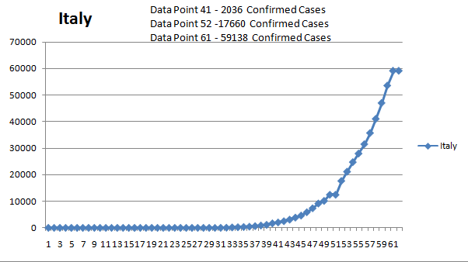
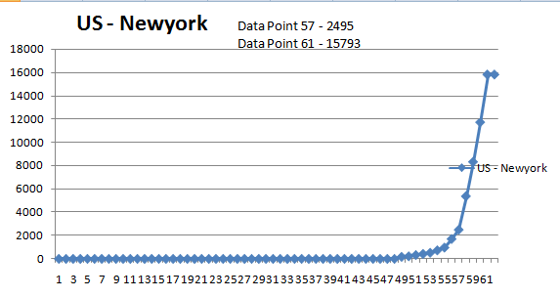
a * np.exp(b * x) + c (increasing trend)

Slide 6
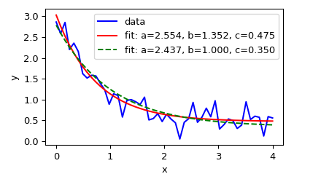
a * np.exp(-b * x) + c (Decreasing trend)

Slide 7
Solution Overview

Slide 8
Approach Derivation
Problem
Forecast the number of confirmed cases during Pandemic
Machine
Learning
Problem
To Provide approximate forecast which will be helpful for the preparation steps to be taken and to reduce the mortality rate.
.
Machine
Learning
Questions
How to Forecast the number of confirmed cases?
Solution
Approach
scipy.optimize based Mathematical Model
TCS Confidential

Slide 9
Low-Level Data Flow Diagram
Pandemic
Forecasting
Data Understanding
Data Pre processing
Extract the
Required Features
Share the forecasted results
Data (Input)
Get the Forecast
Using Trained Model

Slide 10
Output: Model output & Conclusions

Slide 11
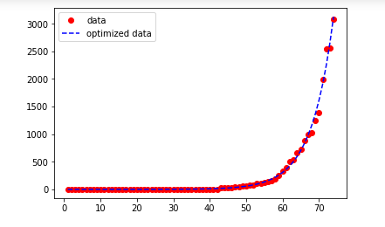
Model output
Date | 4/5/2020 | 4/6/2020 | 4/7/2020 | 4/8/2020 | 4/9/2020 | 4/10/2020 | 4/11/2020 | 4/12/2020 | 4/13/2020
Actual | 3588 | 4778 | 5311 | 5916 | 6725 | 7598 | 8446 | 9205 | 10453
Forecast | 3688 | 4352 | 5137 | 6062 | 7154 | 8443 | 9964 | 11759 | 13878
error | -100 | 426 | 174 | -146 | -429 | -845 | -1518 | -2554 | -3425
adserror | 100 | 426 | 174 | 146 | 429 | 845 | 1518 | 2554 | 3425
error percent | 2.787068 | 8.915864 | 3.276219 | 2.467884 | 6.379182 | 11.121348 | 17.973005 | 27.74579 | 32.765713
Accuracy | 97.21293 | 91.08414 | 96.72378 | 97.53212 | 93.62082 | 88.878652 | 82.026995 | 72.25421 | 67.234287
Conclusions :
Forecast the Pandemic Growth using Model.
Get Data Insights which can help for preparedness and reduce Mortality rate.

Slide 12
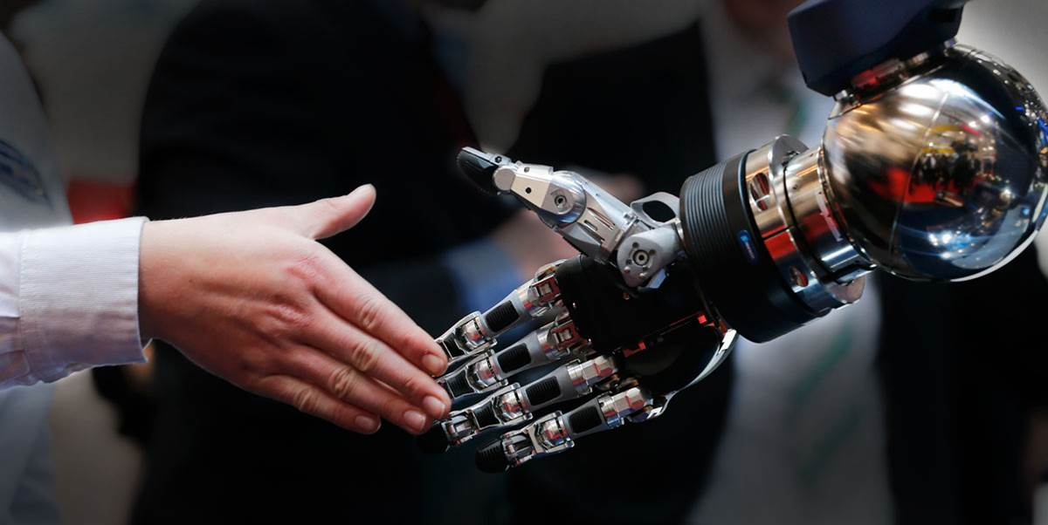
Thank You
Thank You

