Slide 1
Proof of Concept: Forecasting Pandemic Confirmed Cases
Generic Approach and Proof of Concept Details
TCS Confidential

Slide 2
Use Case Synopsis
Background
Pandemics are Generally highly infectious and affects several people
having low immunity.
The objective of this Use-Case :
The objective of the current POC is to forecast the confirmed cases that may be affected by the Pandemic using forecasting models.
The predictive engine will be trained from the given set of historical cases affected by the pandemic.
The objective ofThe objective of the current POC is to perform automated claim scoring & segmentation module using machine learning and deep learning models through TCS’ Cognitive Computing Suite.
The predictive engine will be trained from the given set of historical claim cases approved/rejected by rule engine or human associates.
the current POC is to perform automated claim scoringman associates.
Data Set
Source : Given set of historical confirmed cases affected by the Covid pandemic.n set of historical claim cases approved/rejected by rule engine or human associates.
The Data file is time series data which contains total number of
affected cases.
Target Output :
Forecast of the expected number of confirmed cases.
Model & Algorithm
Since the problem was to predict the expected number of confirmed cases we decided to use forecasting models.
The growth pattern shows exponential pattern.
scipy.optimize.curve_fit python package is used to fit the
exponential function
.
Output & Benefit
Output :
Forecasting Expected number of confirmed cases
Benefit :
Forecasting will help the preparedness and will help to decrease the mortality rate.
TCS Confidential
Notes:
2
# Tx predicted as Fraud

Slide 3
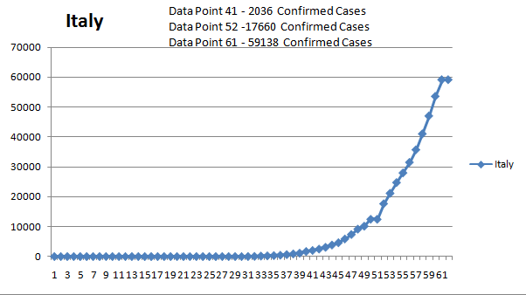
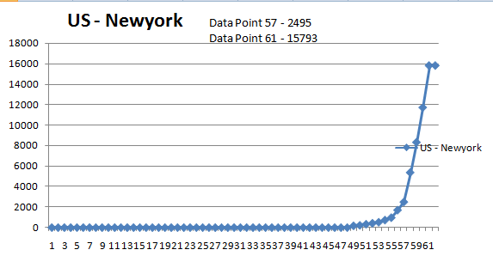
EDA Graph Increasing Trend
a * np.exp(b * x) + c (increasing trend)

Slide 4
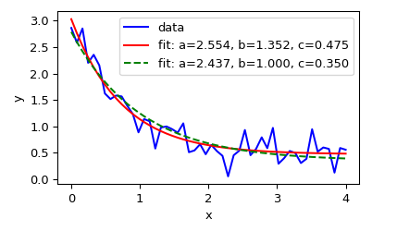
EDA graph example for Decreasing Trend
a * np.exp(-b * x) + c (Decreasing trend)

Slide 5
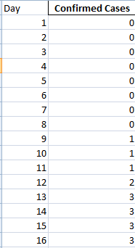
Input Data Format

Slide 6
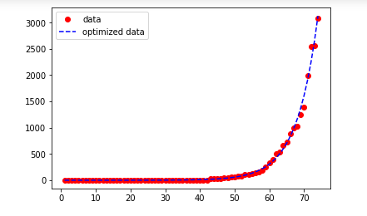
output
Date | 4/5/2020 | 4/6/2020 | 4/7/2020 | 4/8/2020 | 4/9/2020 | 4/10/2020 | 4/11/2020 | 4/12/2020 | 4/13/2020
Actual | 3588 | 4778 | 5311 | 5916 | 6725 | 7598 | 8446 | 9205 | 10453
Forecast | 3688 | 4352 | 5137 | 6062 | 7154 | 8443 | 9964 | 11759 | 13878
error | -100 | 426 | 174 | -146 | -429 | -845 | -1518 | -2554 | -3425
adserror | 100 | 426 | 174 | 146 | 429 | 845 | 1518 | 2554 | 3425
error percent | 2.787068 | 8.915864 | 3.276219 | 2.467884 | 6.379182 | 11.121348 | 17.973005 | 27.74579 | 32.765713
Accuracy | 97.21293 | 91.08414 | 96.72378 | 97.53212 | 93.62082 | 88.878652 | 82.026995 | 72.25421 | 67.234287
Conclusions :
Forecast the Pandemic Growth using Model.
Get Data Insights which can help for preparedness and reduce Mortality rate.

