Slide 1
SPOOFING WEBSITE DETECTION
By
MACHNE LEARNING TECHNIQUES
Presented By:-
Vallem Vijay Kumar - S190205
Mohammad Karimullah -S190489
Shaik Lal basha -S190490

Slide 2

CONTENTS:-
Abstract
Introduction
Why this project?
How it works?
Existing Method
References

Slide 3
ABSTRACT
spoofing is an internet scam in which an attacker sends out fake messages that look to come from a trusted source. A URL or file will be included in the mail, which when clicked will steal personal information or infect a computer with a virus. Traditionally, phishing attempts were carried out through wide-scale spam campaigns that targeted broad groups of people indiscriminately. The goal was to get as many people to click on a link or open an infected file as possible.
There are various approaches to detect this type of attack. One of the approaches is machine learning. The URL’s received by the user will be given input to the machine learning model then the algorithm will process the input and display the output whether it is phishing or legitimate. There are various ML algorithms like SVM, Neural Networks, Random Forest, Decision Tree, XG boost etc. that can be used to classify these URLs. The proposed approach deals with the Random Forest, Decision Tree classifiers. The proposed approach effectively classified the Phishing and Legitimate URLs with an accuracy of 87.0% and 82.4% for Random Forest and decision tree classifiers respectively.
Keywords: Random forest, SVM,Decision tree

Slide 4

INTRODUCTION
Spoofing is first and foremost a cybercrime. In a phishing scam, a target is contacted by email, telephone or text message by someone posing as a close personal contact or on behalf of a legitimate institution.
The objective is to get people to reveal sensitive data such as their account numbers, home address, banking/credit card details and usernames/passwords.

Slide 5
Spoofing is still one of the best and most successful ways for hackers to cheat us out of our money and steal our personal and financial information.
Machine learning can be a powerful tool in detecting spoofing websites. By training machine learning algorithms on a large dataset of both legitimate and fraudulent websites, the algorithms can learn to distinguish between the two. This can lead to the development of effective spoofing detection systems that can automatically identify and warn users about potentially dangerous websites.

Slide 6
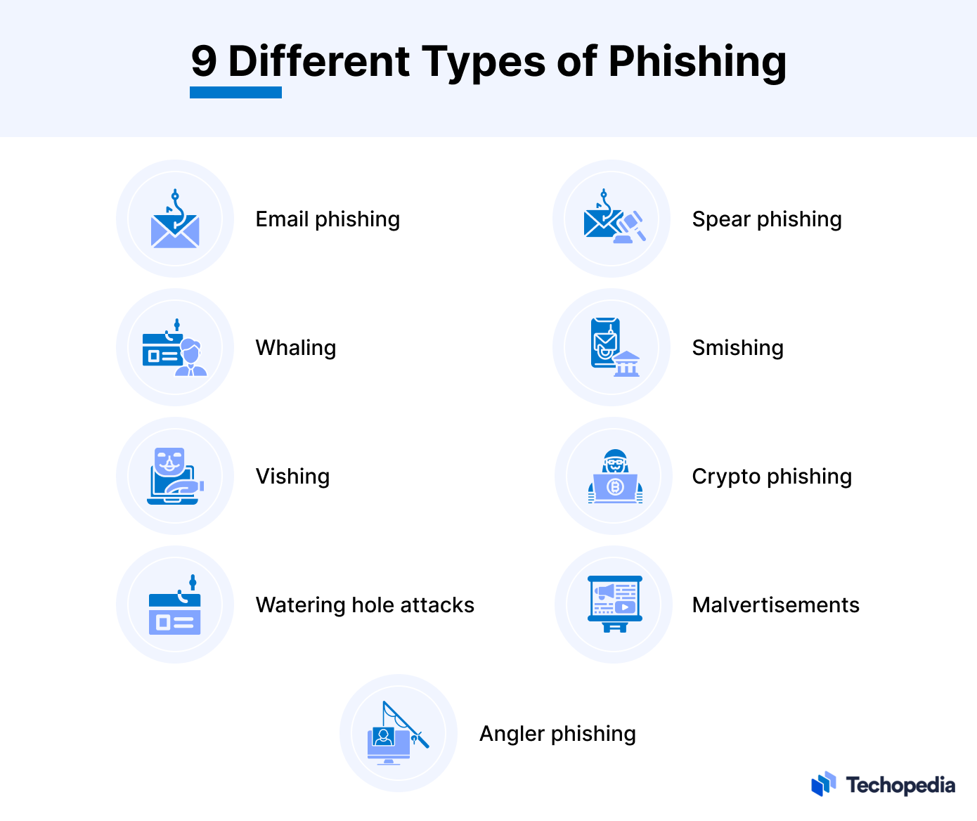

Slide 7

Why this project?
Cybersecurity Concerns
Protection of Sensitive Information
Financial Impact
User Trust and Confidence
Educational Value

Slide 8

HOW IT WORKS
Data Collection:
The spoofing URLs were gathered using the open source tool spoofing Tank.
This site provides a set of phishing URLs in a variety of forms, including csv, json, and others, which are updated hourly.
This dataset is used to train machine learning models with 5000 random phishing URLs

Slide 9

Feature Extraction
The below mentioned category of features are extracted from the URL data:
Address Bar based Features In this category 9 features are extracted.
Domain based Features In this category 4 features are extracted.
HTML & Javascript based Features In this category 4 features are extracted.

Slide 10
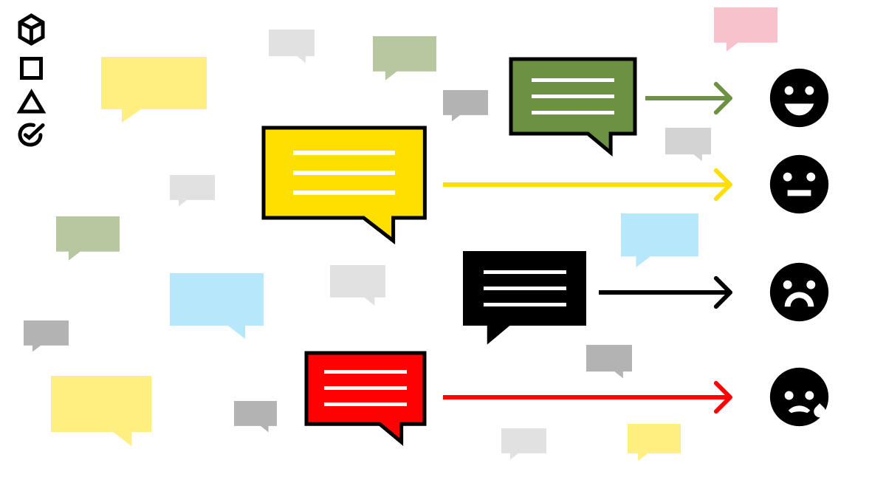
Labeling
Labeling systems are also a way of identifying websites where it's clear that the organization does not place a heavy emphasis on the needs of its users
Label each data point in the dataset as either legitimate or spoofing. This step is crucial for the supervised learning approach, where the model learns from labeled examples to make predictions on new, unseen data.

Slide 11
Models & Training
Decision Tree
Random Forest
Multilayer Perceptrons
XGBoost
Support Vector Machines
Logistic Regression
K-Nearest Neighbors
Naïve Bayes
Gradient Boosting
Cat Boost

Slide 12
Evaluation:
Assess the performance of the trained model using a separate set of data that it has not seen before (testing dataset). This evaluation helps determine the model's accuracy, precision, recall, and other relevant metrics.

Slide 13
Existing Method
Several existing methods and techniques are employed for spoofing website detection, both traditional and machine-learning-based.
Maintain a list of known spoofing websites and block access to or flag them when identified. However, this method is reactive and may not catch newly created phishing sites.
Monitor the behavior of websites and users to detect anomalies or suspicious patterns. Unusual user interactions, unexpected redirects, or rapid changes in content may signal a spoofing attempt.

Slide 14
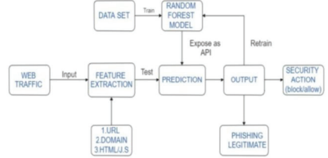
Proposed method:

Slide 15
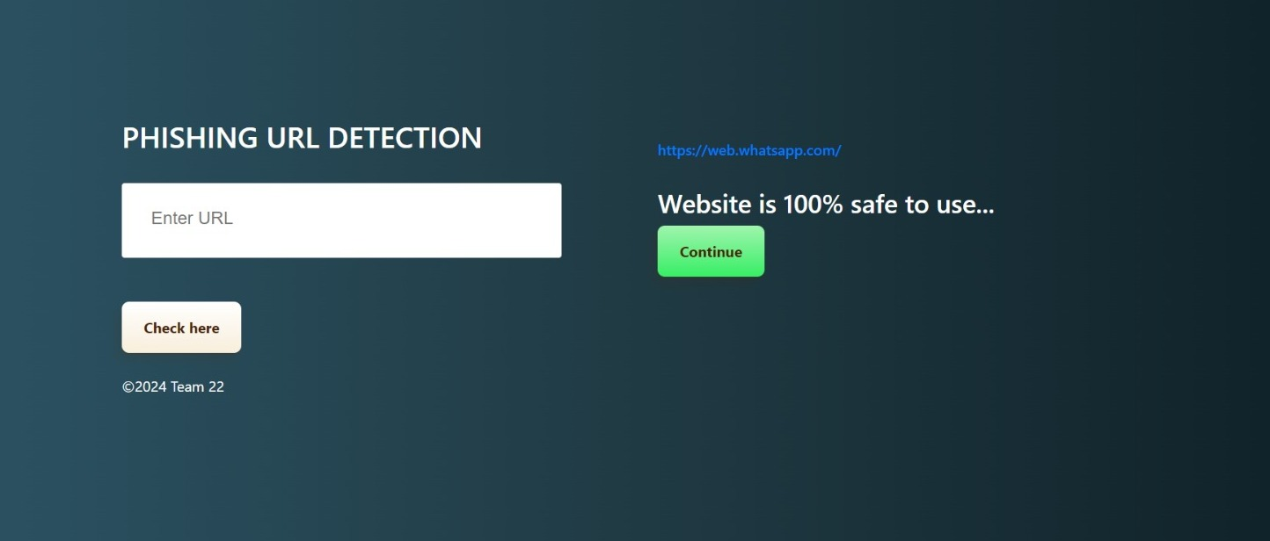
Result:

Slide 16
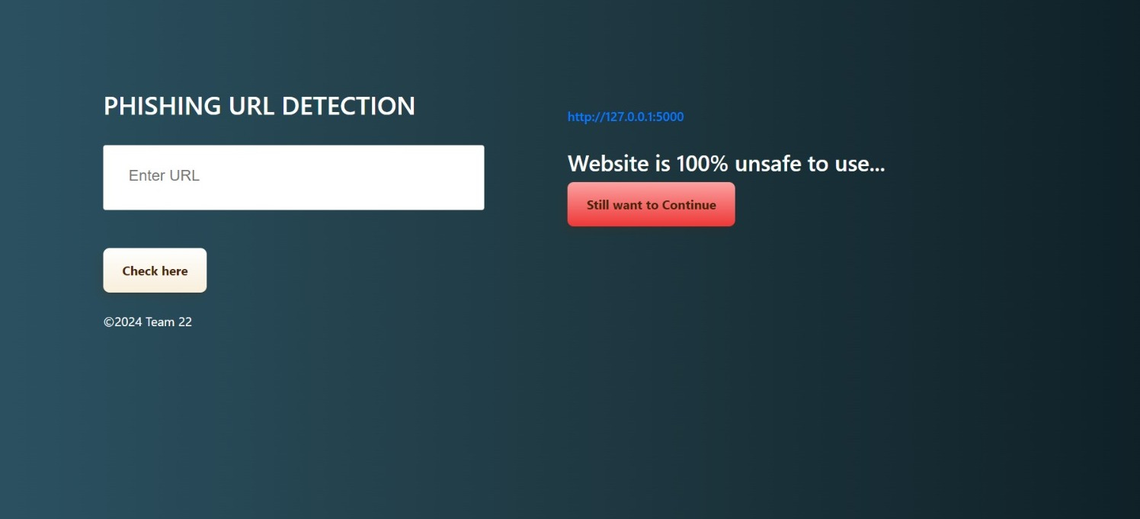

Slide 17
THANK YOU

