Slide 1




BINUS INTERNATIONAL
FINAL PROJECT
ALGORITHM DESIGN AND PROGRAMMING
RHEYNORICH - 2702350724
ALIF - 2702364950
SUWANDI - 2702350775

Slide 2



PROJECT TITLE:
Delivery Route Optimization
Route Optimization Using Greedy and Dynamic Programming Approaches
02

Slide 3


PROBLEM
03
In the era of rapid-ecommerce growth and increasing demand for efficient logistics solutions, delivery route optimization could be a significant challenge for delivery companies. Poor route planning can lead to higher fuel costs, longer delivery times, and inefficient resource utilization. This project aims to optimize the delivery route by implementing techniques like greedy algorithms, and dynamic programming. By focusing on these methodologies, we will analyze their effectiveness in minimizing travel distance, reducing delivery time, and optimizing overall logistics cost.

Slide 4


Solution:
we are going to make route optimization to reduce delivery distance by using Dijkstra’s algorithm and Dynamic programming approach to find the shortest paths for the drivers, and compare them to find the most efficient
Data sources
Distance Matrix API
Geocoding API
Directions API

Slide 5



METHODS
Greedy algorithm
(Dijkstra’s algorithm)
-
Compute the shortest path from a single source to all other vertices. A priority queue is used to efficiently find the nearest location.
The process continues until all cities are visited, and the route returns to the starting point.
Dynamic Programming
-
Use memoization to optimize the route and minimize the total distance. A bitmask representation is used to track visited locations, and the algorithm recursively calculates the optimal route.
API Usage
Google Maps APIs are used for fetching distance and duration matrices and decoding polyline data to visualize the routes on a map.
METHODS USED!

Slide 6
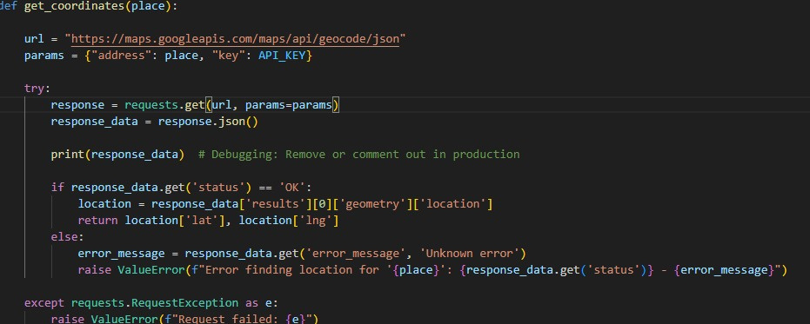
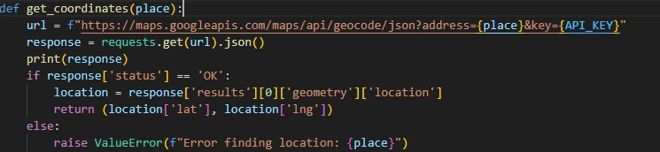

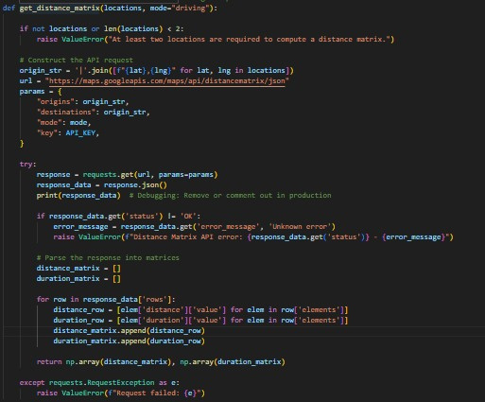
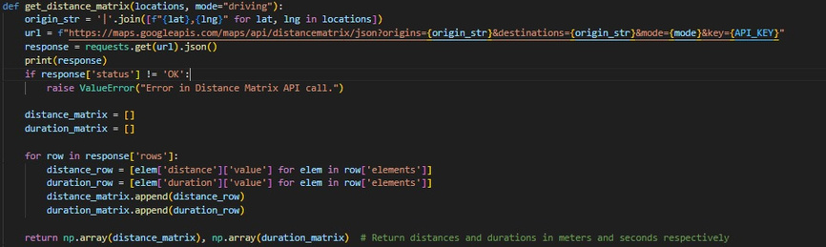
Code Refactoring

Slide 7
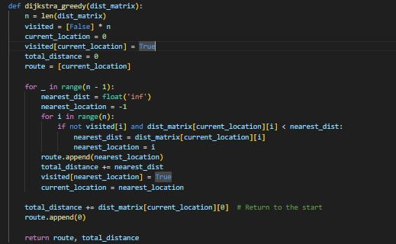
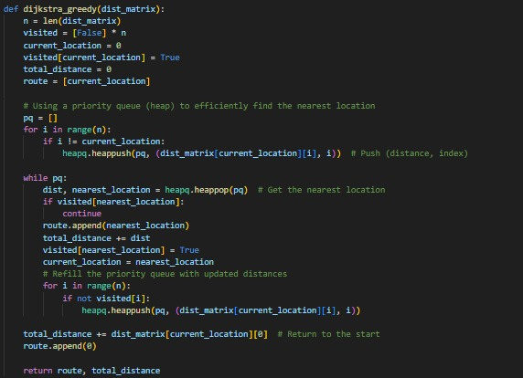
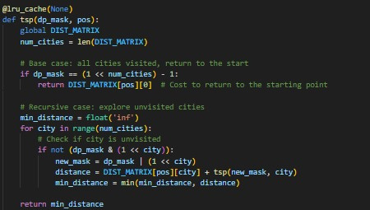
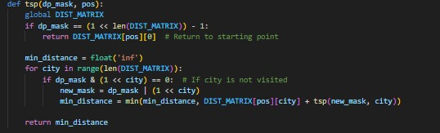
Code Refactoring

Slide 8

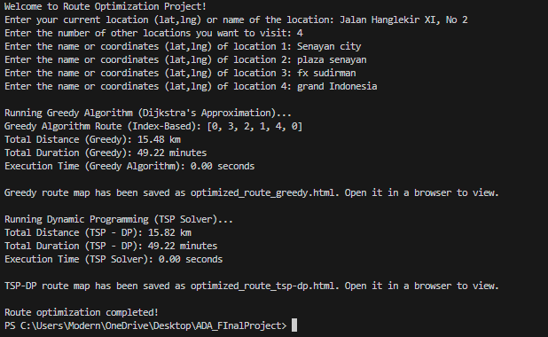
Result

Slide 9
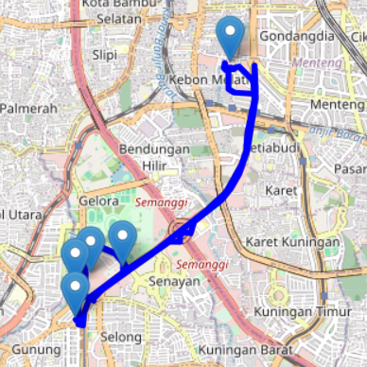
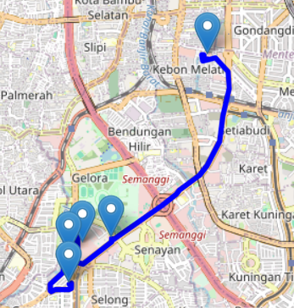
Result
Dijkstra’s Algorithm
Dynamic Programming

Slide 10
Conclusion
For small numbers of locations, both algorithms produced very similar results in terms of total distance and duration, with the Dynamic programming route being slightly longer. However, for larger datasets, the Greedy algorithm would provide fast results due to its relatively low time and space complexities, but it may not provide the optimal solution. On the other hand, dynamic programming would guarantee the more accurate result at the cost of higher computational time due to its recursive approach, and higher time complexities.

Slide 11
CODE DEMO

Slide 12


THANK YOU
FOR LISTENING
TERIMA KASIH, ARIGATO, GAMSAHABNIDA, DANKE

