Slide 1

BY
S.LOSHITHAA
COMPUTER SCIENCE PRESENTATION

Slide 2
CHAPTER 10
IMPACT OF COMPUTERS ON SOCIETY

Slide 3
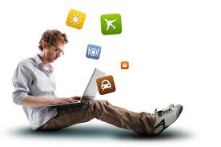

CONTENTS
10.1 Introduction
10.2 Computers for Personal Use
10.3 Computerized Homes
10.4 Home Banking and Shopping
10.5 Computers in Education
10.6 Computers in Entertainment
10.7 Computers in Healthcare
10.8 Computers in Agriculture
10.9 Internet in real time Applications

Slide 4
10.1 Introduction
To reach out the benefits of IT to the common man we need at least three technical elements : ·
1.Connectivity [Computer networks and Internet facility] ·
2. Affordable computers or other similar devices ·
3.Software .
Computers can do many more things for the common man than this. Quality IT education will enable the common man to put computers to a better use

Slide 5
10.2 Computers for Personal Use
Personal computers have totally changed the way we work, live and think. Word Processing, Databases, Spreadsheets and Multimedia presentation packages have increased the efficiency at work. There are many packages that are being used. Desktop Publishing and other impressive packages for graphics are adding value to the work done. Paint, games and a large set of similar packages are providing facilities for people of all age groups to use the computer. Browsing, e-mail and chat have changed our life style.

Slide 6
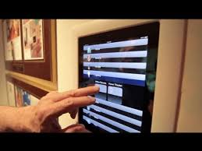
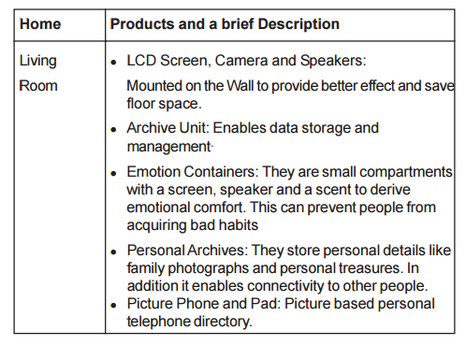
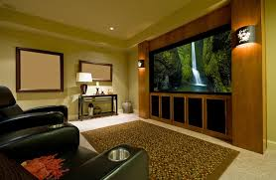
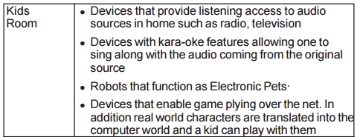
10.3 Computerized Homes

Slide 7
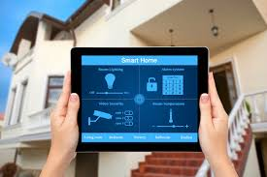
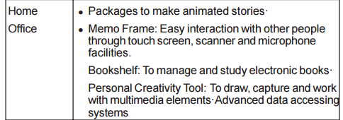
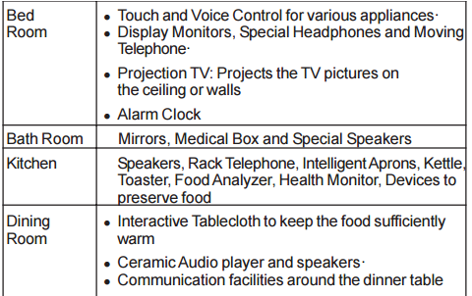
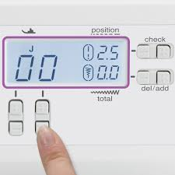

Slide 8
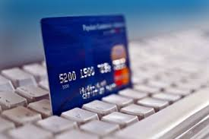
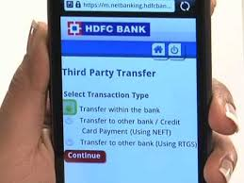
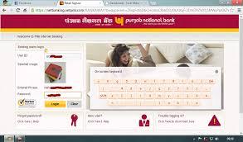
Choose Advanced machines like ATM enable withdrawal of money from the accounts in a particular bank anytime and anywhere.
e-Banking permits banking from the comfort of the home by using internet facilities
10.4 Home Banking and Shopping

Slide 9
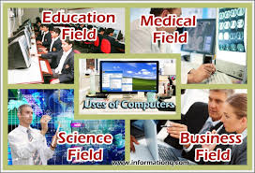
10.5 Computers in Education
Computers are used in many areas of Education including:
1· Buying and browsing the latest edition of books by both local & foreign authors Educational CDROMs
2· Computer Based Tutorials (CBT).
3. Spreading information about schools, colleges, universities and courses offered, admission procedures, accommodation facilities, scholarships, educational loans, career guidance.
4. e-Learning that enables online educational programs leading to degrees and certifications

Slide 10
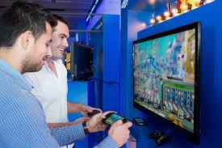
10.6 Computers in Entertainment
Computers contribute to entertainment also.
You can update your knowledge in fine arts like painting, music, dance, yoga, games, science, nature, latest news and events.
You can know more about various places of worship and places of interest for tourists.

Slide 11
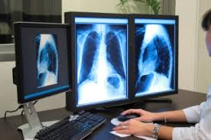
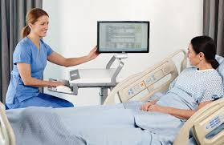
10.7 Computers in Health Care
Computers are used in many areas of healthcare including
· Hospital Management System
· Patient Tracking System
· Exchange of diagnostic records between healthcare units
· Tracking and Monitoring Communicable Diseases
· Decision support systems with highly advanced computing techniques

Slide 12
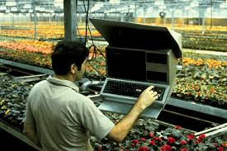
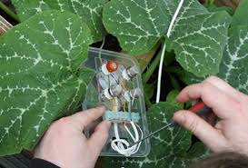
10.8 Computers in Agriculture
Some of the areas where software has been developed are:
• Agricultural Finances and Accounting
• Alternative farming techniques
• Animal Husbandry
• Buildings and Irrigation
• Chat with other agriculturists and scientists
• Farmland Assessment
• Fertilizer Analysis
• Finding links to farm resources, chat boards, classified advertisements, and other farm-related information
• Gardening
• Improving Cow Herds and Increasing revenues
• Land Management
• Livestock
• Milk production
• Use of satellite imagery to decide on the crops

Slide 13
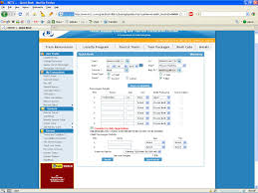
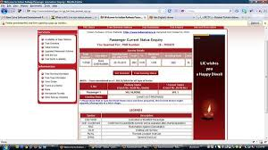
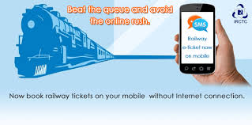
10.9 Computers in Real Applications
All applications mentioned above happen in real time and over the net.
You can reserve or book air and train tickets from your own place and at your own pace through computers.

Slide 14
CHAPTER 11
IT ENABLED SERVICES

Slide 15
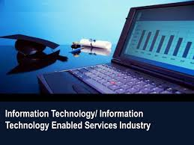
11.1. INTRODUCTION:
Information Technology that helps in improving the quality of service to the users is called IT Enabled Services [ITES].
IT Enabled Services are human intensive services that are delivered over telecommunication networks or the Internet to a range of business segments.

Slide 16
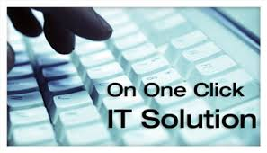
CONTENTS
Some of the IT enabled services presented in this chapter are:
11.2 e-Governance
11.3 Call Centers
11.4 Data Management
11.5 Medical [Telemedicine and Transcription].
11.6 Data Digitization
11.7 Website Services

Slide 17
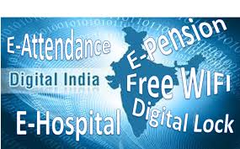
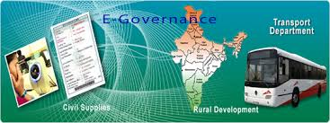
11.2 e-Governance
Computers help you to look at the government websites and the services provided by them.
The various websites provided by the government give the details about the departments, specific functions, special schemes, documents, contacts, links, IAS intranet, site map, search, what’s new, press releases, feedback.
These websites are both in English and Tamil.

Slide 18
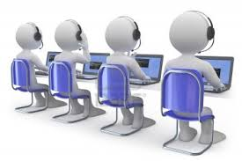
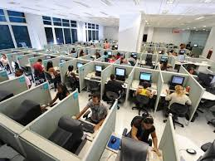
11.3 Call Centers
A call center is sometimes defined as a telephone based shared service center for specific customer activities and are used for number of customer-related functions like marketing, selling, information transfer, advice, technical support and so on.
A call center has adequate telecom facilities, trained consultants, access to wide database, Internet and other on-line information support to provide information and support services to customers.
It operates to provide round the clock and year round service i.e.24 x 365 service.

Slide 19
11.4 Data Management
Data Management is a category of IT Enabled Services pertaining to collection, digitization and processing of data coming from various sources.
Traditional data processing services comprise punching data from manually filled forms, images or publications; preparing databases and putting them together.
However, with the advent of multimedia and internet, sources have increased to include manually printed documents, images, sounds and video.
Data management is the key for effective and profitable use of IT in organizations.
The range of ITES in this category are:
• ASCII format for upload to your database
• Character Recognition and Processing

Slide 20
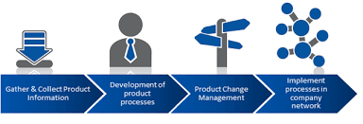
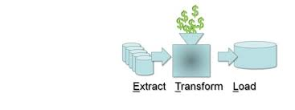
• Custom reports
• Data Entry
• Data entry front end edits
• Document Preparation
• Forms are imaged and transferred to CD ROM

Slide 21
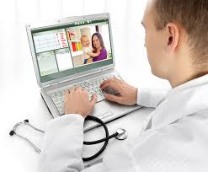
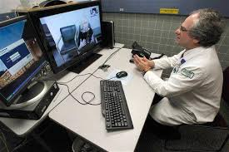
11.5 Medical [Telemedicine and Transcription].
Medical Transcription is a permanent, legal document that formally states the result of a medical investigation.
It facilitates communication and supports the insurance claims.
There are three main steps involved in Medical Transcription.

Slide 22
11.5 Medical [Telemedicine and Transcription].
These include:
Step 1:
Hospitals that want to use this form of ITES sign up with a service provider..
Step 2:
The sound is digitized and sent to the ITES provider.
Step 3:
The transcribed files are sent out to quality control persons, who listen to the dictation and check the transcription

Slide 23
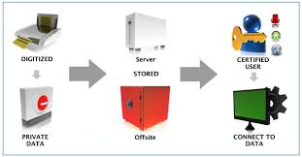

11.6 Data Digitization
Digitization refers to the conversion of non-digital material to digital form.
A wide variety of materials as diverse as maps, manuscripts, moving images and sound may be digitized.

Slide 24
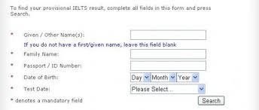
11.7 Website Services
Computers also help us in accessing website services such as: • Agriculture Marketing Network
• Career guidance
• Employment Online
• General Provident Fund
• Results of various Examinations

Slide 25
CHAPTER 12
COMPUTER ETHICS

Slide 26
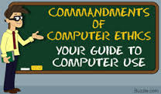
CONTENTS
Introduction
12.1 Data Security
12.2 Computer Crime
12.3 Cracking
12.4 Work, Family and Leisure

Slide 27
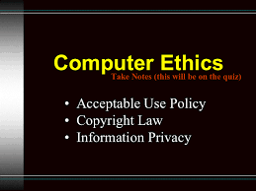
Introduction
Ethics is the set of rules for determining moral standards or what is considered as socially acceptable behaviors.
Today, many computer users are raising questions on what is and is not ethical with regard to activities involving information technology

Slide 28
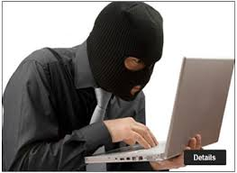
General guidelines on computer ethics are needed for:
1.Protection of personal data
2.Computer Crime
3.Cracking

Slide 29
12.1 Data Security
Personal data is protected by using an appropriate combination of the following methods:
Physical Security
Personal Security
Personnel Security

Slide 30
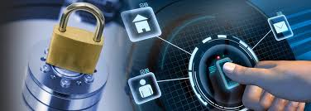
1.Physical Security
Physical security refers to the protection of hardware, facilities, magnetic disks, and other items that could be illegally accessed, stolen, damaged or destroyed.
This is usually provided by restricting the people who can access the resources.

Slide 31
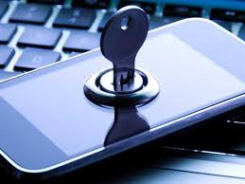
2.Personal Security
Personal security refers to software setups that permit only authorized access to the system.
User Ids and passwords are common tools for such purpose.
Only those with a need to know have Ids and password for access.

Slide 32
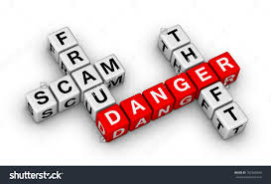
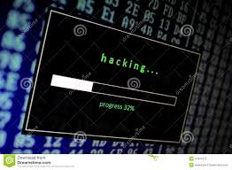
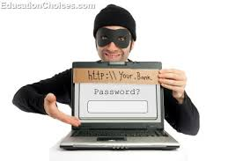
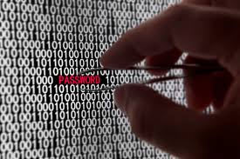
12.2 Computer Crime
A computer crime is any illegal activity using computer software, data or access as the object, subject or instrument of the crime
Common crimes include:
• Crimes related to money transfer on the internet
• Making long distance calls illegally using computers
• Illegal access to re
• Selling or misusing personal
• Hardware and software piracy
• Virus
• Cracking
• Theft of computer time

Slide 33
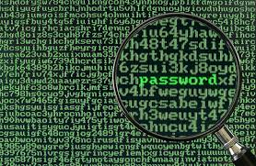
12.3 CRACKING
Cracking is the illegal access to the network or computer system.
Illegal use of special resources in the system is the key reason for cracking.
The resources may be hardware, software, files or system information.
Revenge, business reasons and thrill are other common reasons for committing this crime.

Slide 34
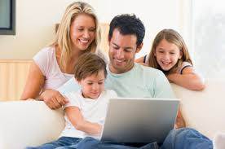
12.4 Work, Family and Leisure
Portable computers and telecommuting have created the condition where people can take their work anywhere with them and do it any time.
As a result, workers find their work is cutting into family time, vacations, leisure, weakening the traditional institutions of family and friends and blurring the line between public and private life.
This is becoming an important issue in computer ethics.

Slide 35
THANK YOU

