Slide 1
The Effect of COVID-19 Pandemic toward Stock Market
Group 2
Lishan Li Statistics
Sahil Mishra Mechanical
Sijia Li Statistics
Wayne Yin Industrial Engineering
Xueqing Wang Economics

Slide 2
Goal of the Project

Slide 3
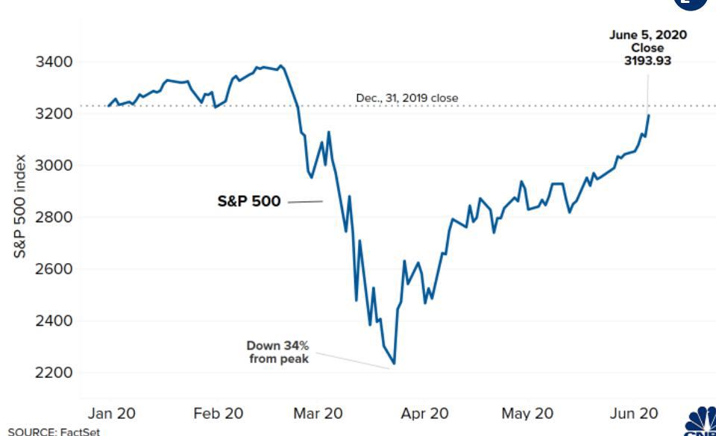

The COVID-19 has impacted the world in a painful way.
Everything was changed.
Stock market surged.

Slide 4
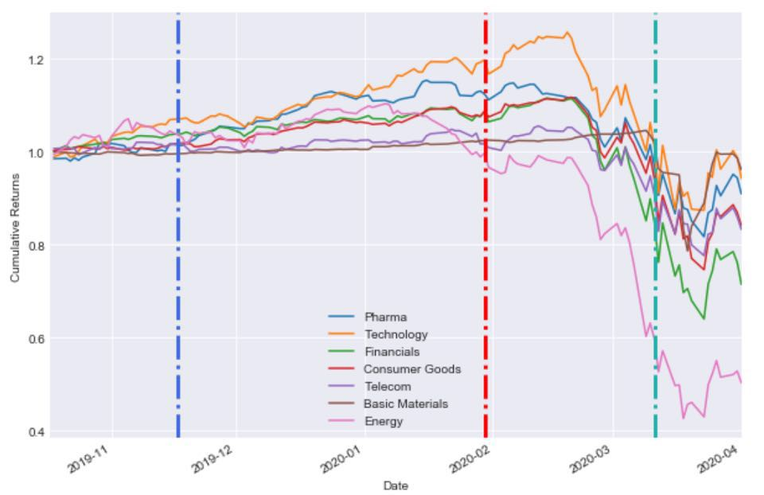
The goal of our project is to dig deeper than commonsense.
Is it the worst condition we faced from 1900?
Which industry is the most frangibility one during this crisis?
How does the COVID-19 affect the stock market step by step?

Slide 5
Introduction of the data

Slide 6
Stock Market Data
DOWs index, NASDAQ index, S&P500 index.
Industry and company data.
30-day cboe volatility index (VIX).

Slide 7
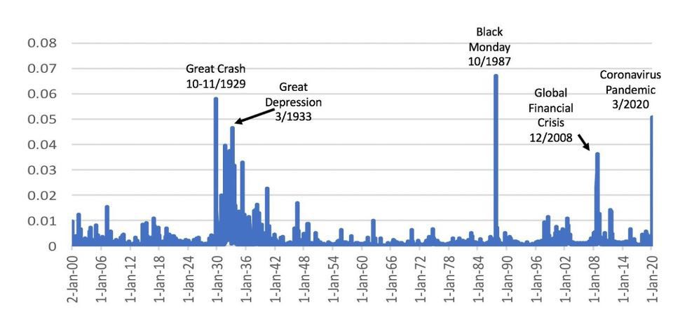
What’s VIX?
VIX is interpreted as annualized implied volatility of a hypothetical option on S&P500 with 30 days to expiration, based on the prices of near-term S&P500 options traded on CBOE.

Slide 8
VIX Calculation
Select the options to be included in VIX calculation – a range of call and put strikes in two consecutive expirations around the target 30-day mark. Calculate each option’s contribution to the total variance of its expiration. Calculate the total variance for the first and the second expiration. Calculate 30-day variance by interpolating the two variances, depending on the time to expiration of each. Take the square root to get volatility as standard deviation. Multiply the volatility (standard deviation) by 100.The result is VIX.

Slide 9
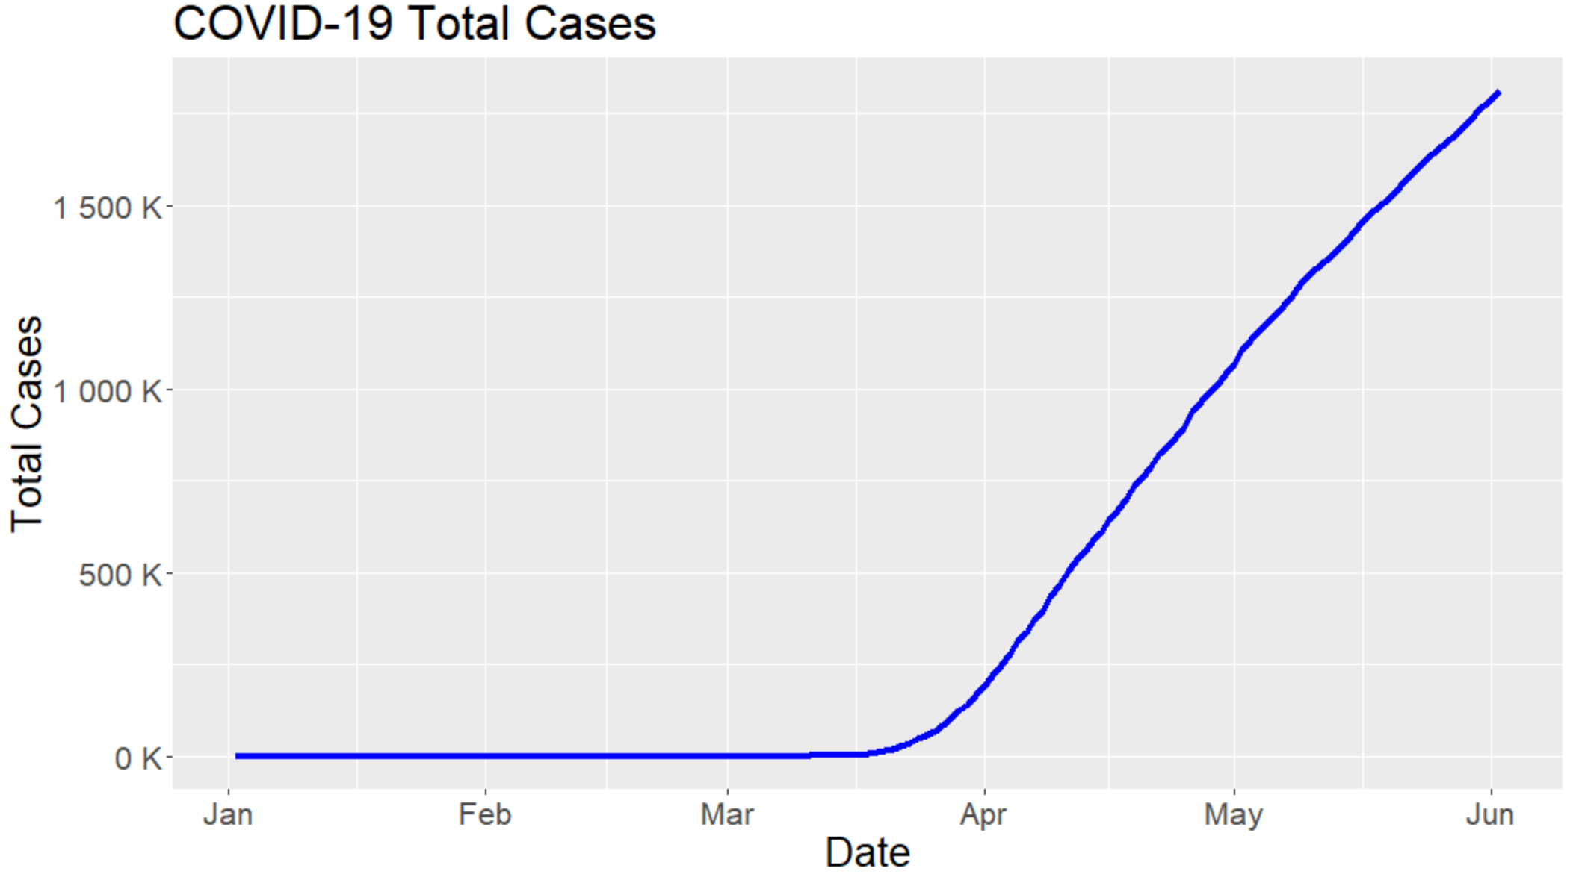
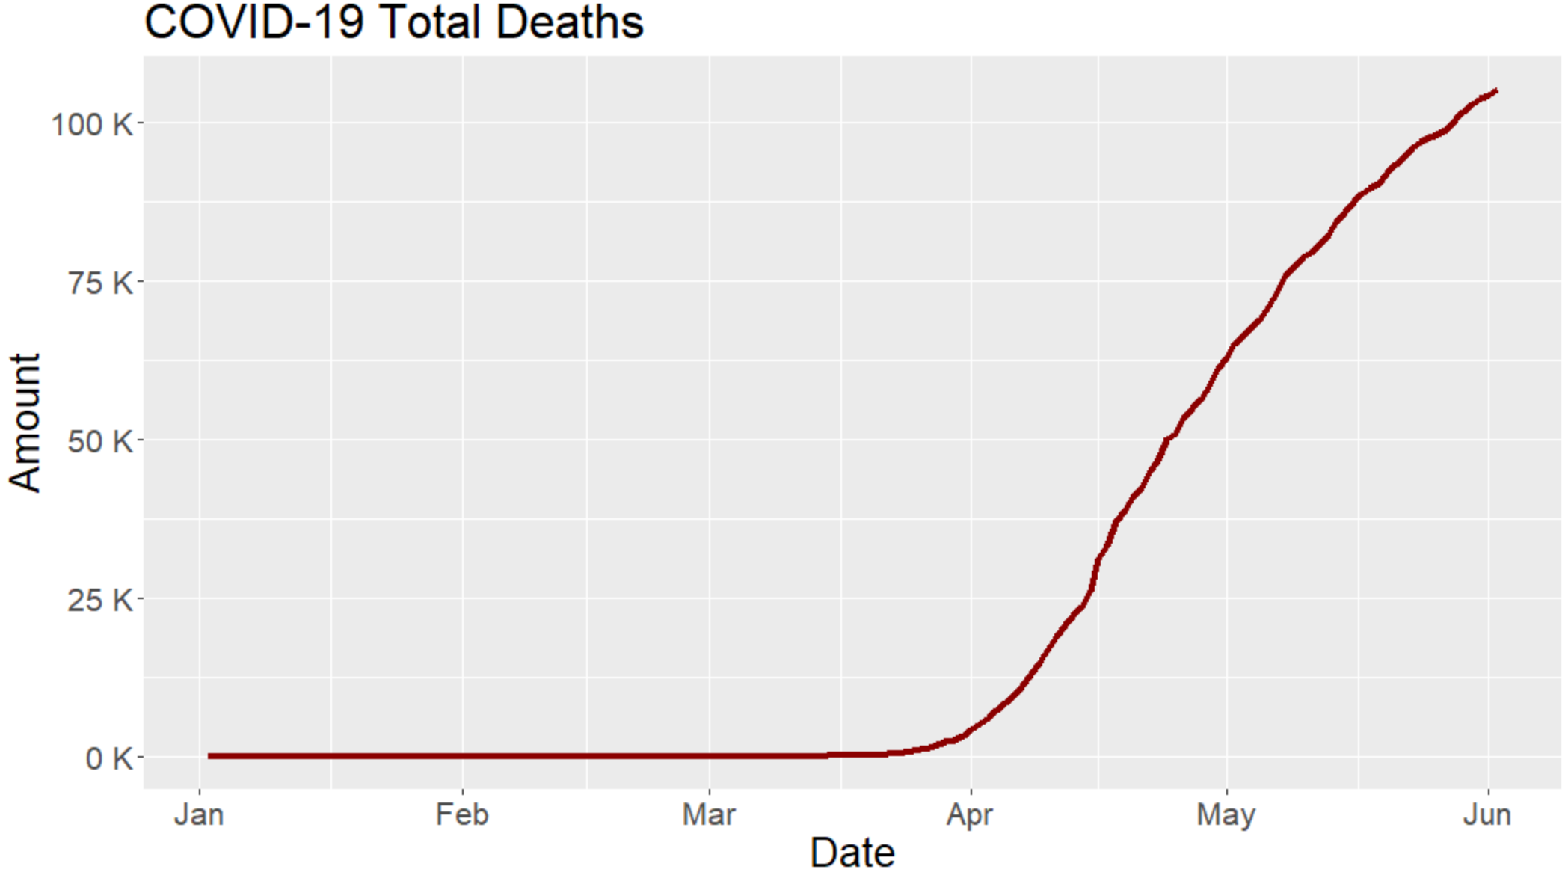
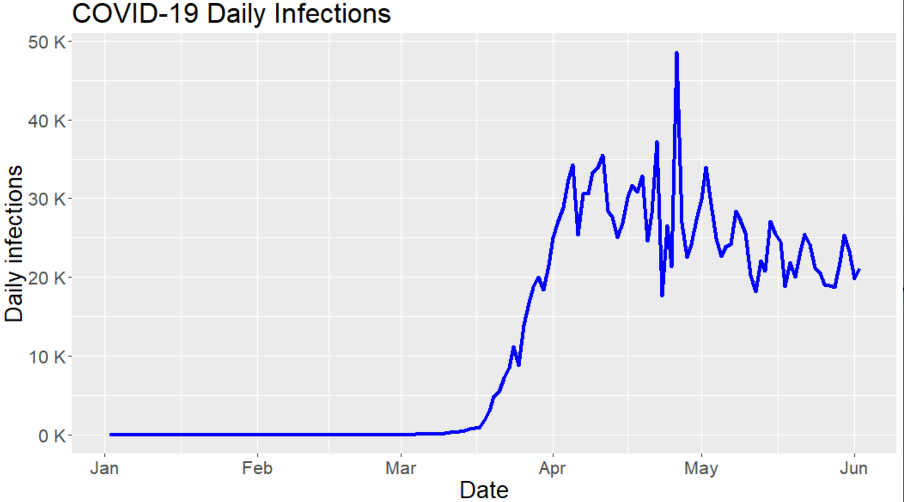
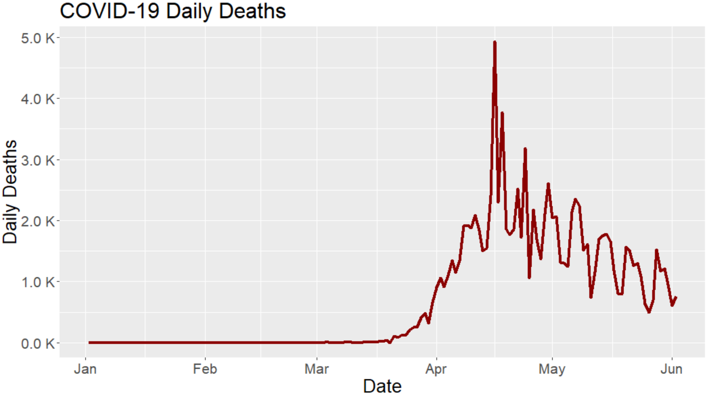
COVID-19 Data
The Daily number of confirmed infections
Death rate
Infection rate etc.

Slide 10
Data Source & Reference
Market data:
S&P 500, NASDAQ website
VIX: http://www.cboe.com/products/vix-index-volatility/vix-options-and-futures/vix-index/vix-historical-data
COVID-19 data:
https://covid19.healthdata.org/united-states-of-america
Reference:
“The Unprecedented Stock-Market Reaction to COVID-19” https://insight.kellogg.northwestern.edu/article/what-explains-the-unprecedented-stock-market-reaction-to-covid-19
VIX Calculation Explained: https://www.macroption.com/vix-calculation/

Slide 11
Thank You!

