Slide 1
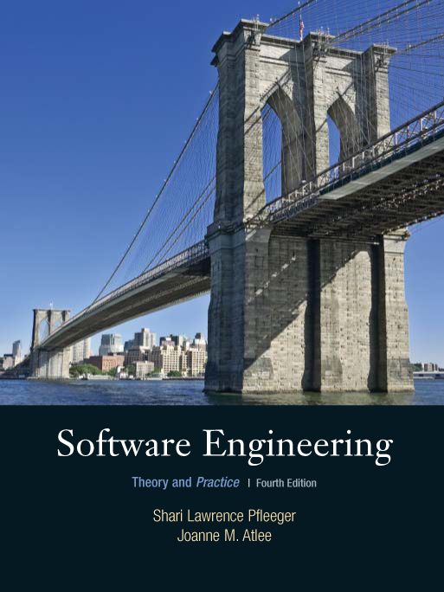
Chapter 4
Capturing
the Requirements
Shari L. Pfleeger
Joanne M. Atlee
4th Edition

Slide 2
Contents
4.1 The Requirements Process
4.2 Requirements Elicitation
4.4 Types of Requirements
4.4 Characteristic of Requirements
4.5 Modeling Notations
4.6 Requirements and Specification Languages
4.7 Prototyping Requirements
4.8 Requirements Documentation
4.9 Validation and Verification
4.10 Measuring Requirements
4.11 Choosing a Specification Technique
4.12 Information System Example
4.13 Real Time Example

Slide 3
Chapter 4 Objectives
Eliciting requirements from the customers
Modeling requirements
Reviewing requirements to ensure their quality
Documenting requirements for use by the design and test teams

Slide 4
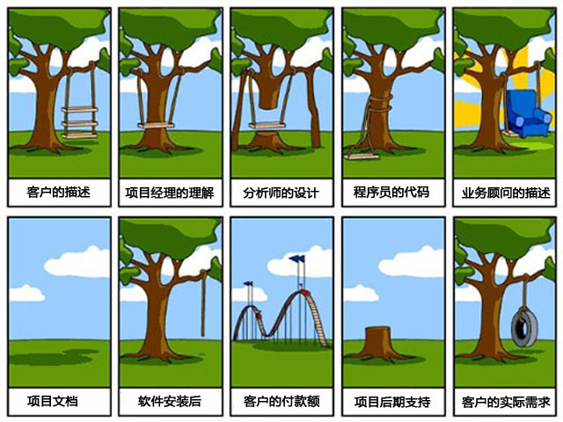

Slide 5
4.1 The Requirements Process
A requirement is an expression of desired behavior
A requirement deals with
  objects or entities
  the state they can be in
  functions that are performed to change states or object characteristics
Requirements focus on the customer needs, not on the solution or implementation
  designate what behavior, without saying how that behavior will be realized

Slide 6
4.1 The Requirements Process
Sidebar 4.1 Why Are Requirements Important?
Top factors that caused project to fail
  Incomplete requirements
  Lack of user involvement
  Unrealistic expectations
  Lack of executive support
  Changing requirements and specifications
  Lack of planning
  System no longer needed
Some part of the requirements process is involved in almost all of these causes
Requirements error can be expensive if not detected early

Slide 7
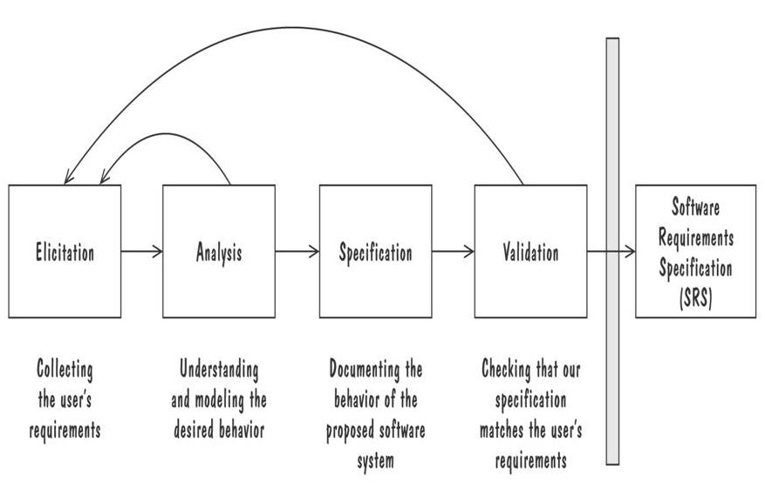
4.1 The Requirements Process
Process for Capturing Requirements
Performed by the req. analyst or system analyst
The final outcome is a Software Requirements Specification (SRS) document

Slide 8
4.1 The Requirements Process
Sidebar 4.2 Agile Requirements Modeling
If requirements are tighly coupled and complex, we may be better off with a “heavy” process that empasizes up-front modeling
If the requirements are uncertain, agile methods are an alternative approach
Agile methods gather and implement the requirements in increments
Extreme Programming (XP) is an agile process
  The requirements are defined as we build the system
  No planning or designing for possible future requirements
  Encodes the requirements as test cases that eventually implementation must pass

Slide 9
4.2 Requirements Elicitation
Customers do not always undertand what their needs and problems are
It is important to discuss the requirements with everyone who has a stake in the system
Come up with agreement on what the requirements are
  If we can not agree on what the requirements are, then the project is doomed to fail

Slide 10
4.2 Requirements Elicitation
Stakeholders
Clients: pay for the software to be developed
Customers: buy the software after it is developed
Users: use the system
Domain experts: familiar with the problem that the software must automate
Market Researchers: conduct surveys to determine future trends and potential customers
Lawyers or auditors: familiar with government, safety, or legal requirements
Software engineers or other technology experts

Slide 11
4.2 Requirements Elicitation
Sidebar 4.3 Using Viewpoints to Manage Inconsistency
No need to resolve inconsitencies early in the requirements process (Easterbrook and Nuseibah, 1996)
Stakeholders' views documented and maintained as separate Viewpoints through the software development process
  The requirements analyst defines consistency rules that should apply between Viewpoints
  The Viewpoints are analyzed to see if they conform to the consistency requirements
Inconsistencies are highlighted but not adressed until there is sufficient information to make informed decision

Slide 12
4.2 Requirements Elicitation
Means of Eliciting Requirements
Interviewing stake holders
Reviewing available documentations
Observing the current system (if one exists)
Apprenticing with users to learn about user's task in more details
Interviewing user or stakeholders in groups
Using domain specific strategies, such as Joint Application Design, or PIECES
Brainstorming with current and potential users

Slide 13
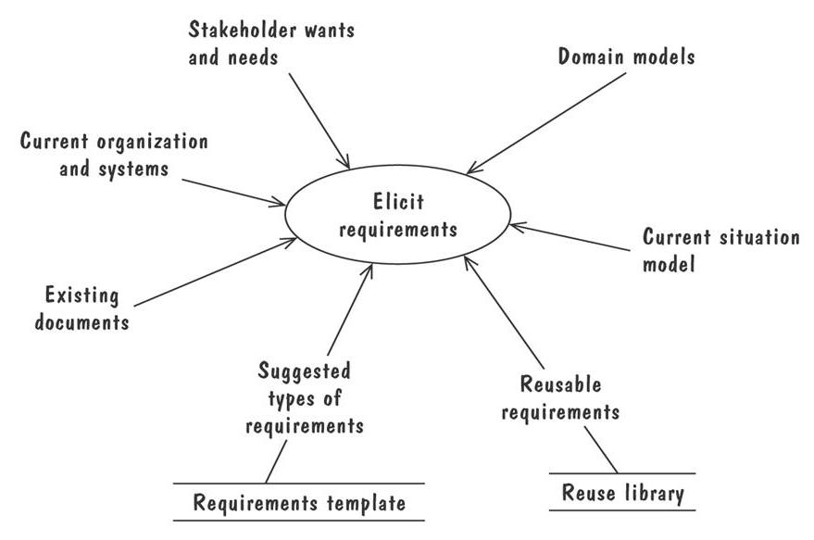
4.2 Requirements Elicitation
Means of Eliciting Requirements (continued)
The Volere requirements process model suggests some additional sources for requirements

Slide 14
4.3 Types of Requirements
Functional requirement: describes required behavior in terms of required activities
Quality requirement or nonfunctional requirement: describes some quality characteristic that the software must posses
Design constraint: a design decision such as choice of platform or interface components
Process constraint: a restriction on the techniques or resources that can be used to build the system

Slide 15
4.3 Types of Requirements
Sidebar 4.4 Making Requirements Testable
Fit criteria form objective standards for judging whether a proposed solution satisfies the requirements
  It is easy to set fit criteria for quantifyable requirements
  It is hard for subjective quality requirements
Three ways to help make requirements testable
  Specify a quantitave description for each adverb and adjective
  Replace pronouns with specific names of entities
  Make sure that every noun is defined in exaclty one place in the requirements documents

Slide 16
4.3 Types of Requirements
Resolving Conflicts
Different stakeholder has different set of requirements
  potential conflicting ideas
Need to prioritize requirements
Prioritization might separate requirements into three categories
  essential: absolutely must be met
  desirable: highly desirable but not necessary
  optional: possible but could be eliminated

Slide 17
4.3 Types of Requirements
Two Kinds of Requirements Documents
Requirements definition: a complete listing of everything the customer wants to achieve
  Describing the entities in the environment where the system will be installed
Requirements specification: restates the requirements as a specification of how the proposed system shall behave

Slide 18
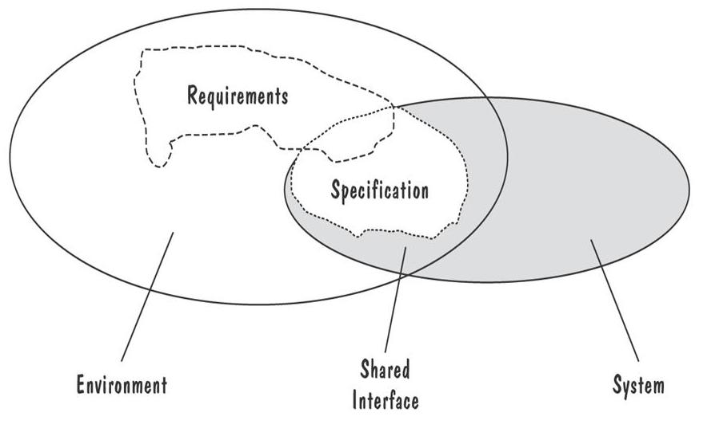
4.3 Types of Requirements
Two Kinds of Requirements Documents (continued)
Requirements defined anywhwere within the environment's domain, including the system's interface
Specification restricted only to the intersection between environment and system domain

Slide 19
4.4 Characteristics of Requirements
Correct
Consistent
Unambigious
Complete
Feasible
Relevant
Testable
Traceable

Slide 20
4.5 Modeling Notations
It is important to have standard notations for modeling, documenting, and communicating decisions
Modeling helps us to understand requirements thoroughly
  Holes in the models reveal unknown or ambiguous behavior
  Multiple, conflicting outputs to the same input reveal inconsistencies in the requirements

Slide 21
4.5 Modeling Notations
Entity-Relationship Diagrams
A popular graphical notational paradigm for representing conceptual models
Has three core constructs
  An entity: depicted as a rectangle, represents a collection of real-world objects that have common properties and behaviors
  A relationship: depicted as an edge between two entities, with diamond in the middle of the edge specifying the type of relationship
  An attribute: an annotation on an entity that describes data or properties associated with the entity

Slide 22
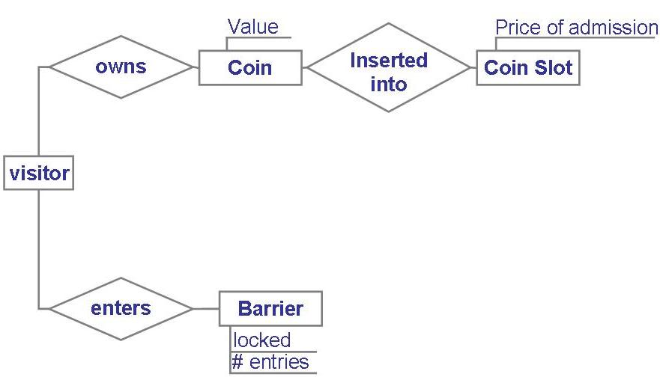
4.5 Modeling Notations
Entity-Relationship Diagrams (continued)
Entity diagram of turnstile problem

Slide 23
4.5 Modeling Notations
Entity-Relationship Diagrams (continued)
ER diagrams are popular because
  they provide an overview of the problem to be addressed
  the view is relatively stable when changes are made to the problem's requirements
ER diagram is likely to be used to model a problem early in the requirements process

Slide 24
4.5 Modeling Notations
ER Diagrams Example: UML Class Diagram
UML (Unified Modeling Language) is a collection of notations used to document software specifications and designs
It represents a system in terms of
  objects: akin to entities, organized in classes that have an inheritance hierarchy
  methods: actions on the object's variables
The class diagram is the flagship model in any UML specification
  A sophisticated ER diagram relating the classes (entities) in the specification

Slide 25
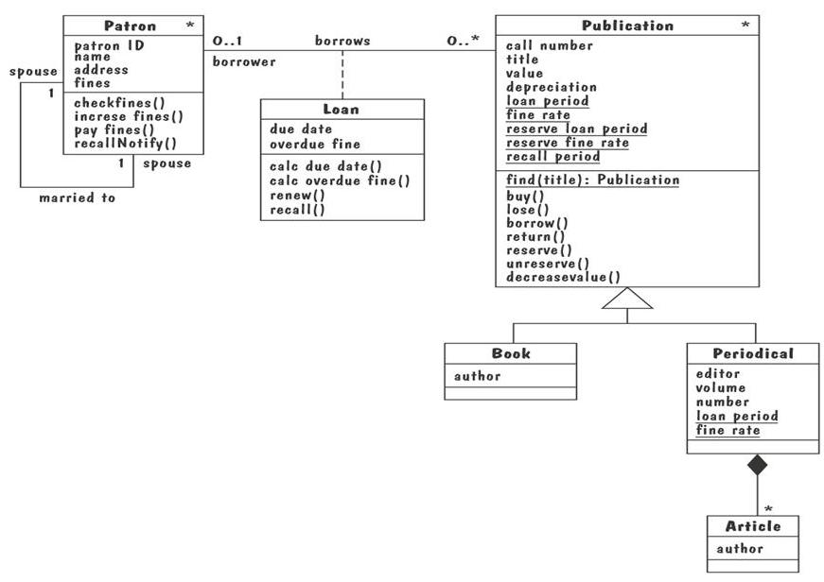
4.5 Modeling Notations
UML Class Diagram of Library Problem
∗
∗

Slide 26
4.5 Modeling Notations
UML Class Diagram (continued)
Attributes and operations are associated with the class rather than instances of the class
A class-scope attribute represented as an underlined attribute, is a data value that is shared by all instances of the class
A class-scope operation written as underlined operation, is an operation performed by the abstract class rather than by class instances
An association, marked as a line between two classes, indicates a relationship between classes' entities

Slide 27
4.5 Modeling Notations
UML Class Diagram (continued)
Aggregate association is an association that represents interaction, or events that involve objects in the associated (marked with white diamond)
  “has-a” relationship
Composition association is a special type of aggregation, in which instances of the compound class are physically constructed from instances of component classes (marked with black diamond)

Slide 28
4.5 Modeling Notations
Event Traces
A graphical description of a sequence of events that are exchanged between real-world entities
  Vertical line: the timeline of distinct entity, whose name appear at the top of the line
  Horizontal line: an event or interaction between the two entities bounding the line
  Time progresses from top to bottom
Each graph depicts a single trace, representing one of several possible behaviors
Traces have a semantic that is relatively precise, simple and easy to understand

Slide 29
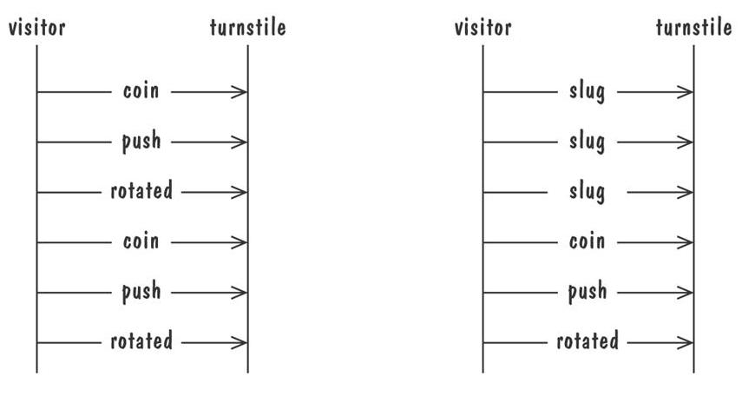
4.5 Modeling Notations
Event Traces (continued)
Graphical representation of two traces for the turnstile problem
  trace on the left represents typical behavior
  trace on the right shows exceptional behavior

Slide 30
4.5 Modeling Notations
Event Traces Exampe: Message Sequence Chart
An enhanced event-trace notation, with facilities for creating and destroying entities, specifiying actions and timers, and composing traces
  Vertical line represents a participating entity
  A message is depicted as an arrow from the sending entity to the receiving entity
  Actions are specified as labeled rectangles positioned on an entity's execution line
  Conditions are important states in an entity's evolution, represented as labeled hexagon

Slide 31
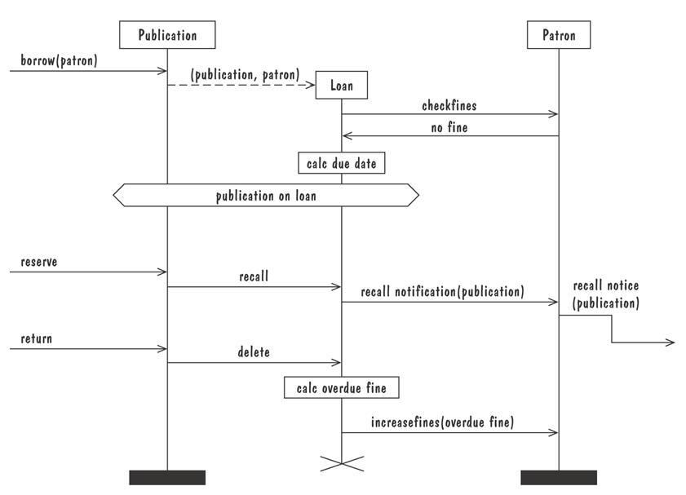
4.5 Modeling Notations
Message Sequence Chart (continued)
Message sequence chart for library loan transaction

Slide 32
4.5 Modeling Notations
State Machines
A graphical description of all dialog between the system and its environment
  Node (state) represents a stable set of conditions that exists between event occurences
  Edge (transition) represents a change in behavior or condition due to the occurrence of an event
Useful both for specifying dynamic behavior and for describing how behavior should change in response to the history of events that have already occurred

Slide 33
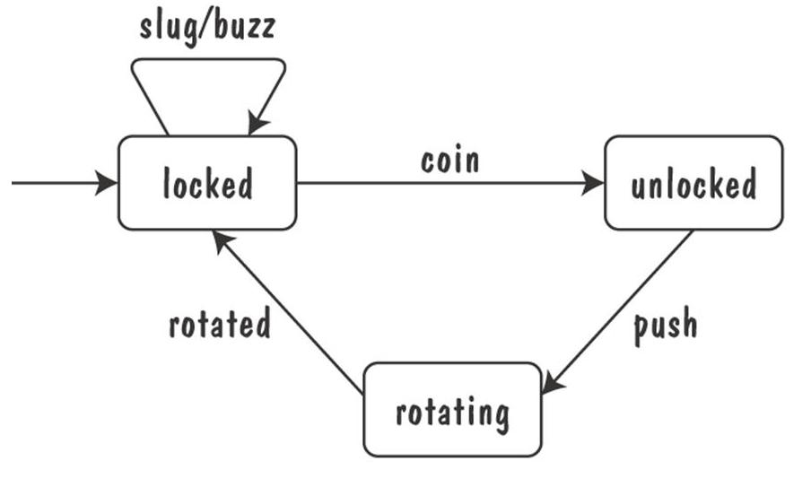
4.5 Modeling Notations
State Machines (continued)
Finite state machine model of the tunstile problem

Slide 34
4.5 Modeling Notations
State Machines (continued)
A path: starting from the machine's initial state and following transitions from state to state
  A trace of observable events in the environment
Deterministic state machine: for every state and event there is a unique response

Slide 35
4.5 Modeling Notations
State Machines Example: UML Statechart Diagrams
A UML statechart diagram depicts the dynamic behavior of the objects in a UML class
  UML class diagram has no information about how the entities behave, how the behaviors change
A UML model is a collection of concurrently executing statecharts
UML statechart diagram have a rich syntax, including state hierarchy, concurrency, and intermachine coomunication

Slide 36
4.5 Modeling Notations
UML Statechart Diagrams (continued)
State hierarchy is used to unclutter diagrams by collecting into superstate those states with common transitions
A superstate can actually comprise multiple concurrent submachines, separated by dashed line
  The submachines are said to operate concurrently

Slide 37
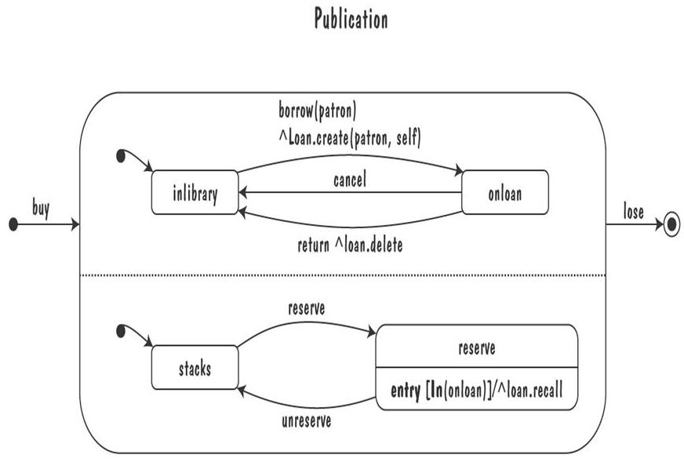
4.5 Modeling Notations
UML Statechart Diagrams (continued)
The UML statechart diagram for the Publication class from the Library class model

Slide 38
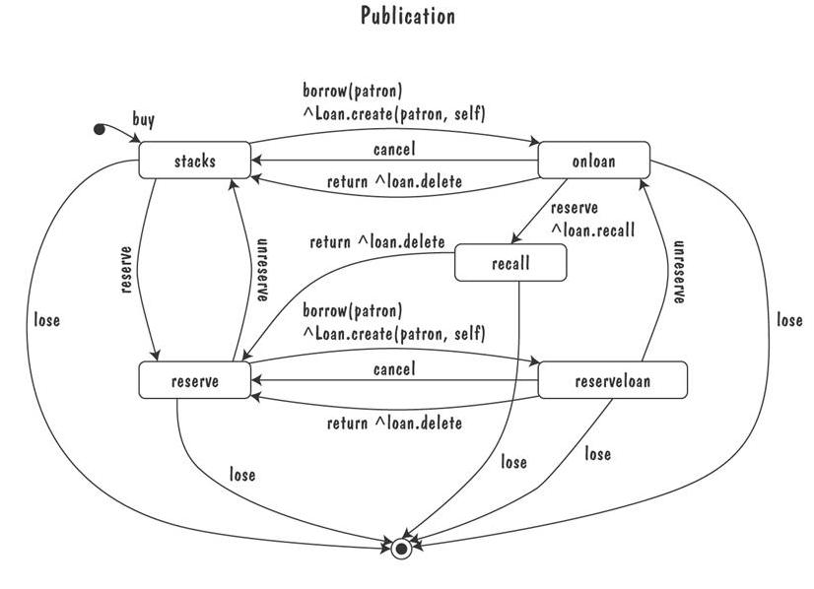
4.5 Modeling Notations
UML Statechart Diagrams (continued)
An equivalent statechart for Publication class that does not make use of state hierarchy or concurrency
  comparatively messy and and repetitive

Slide 39
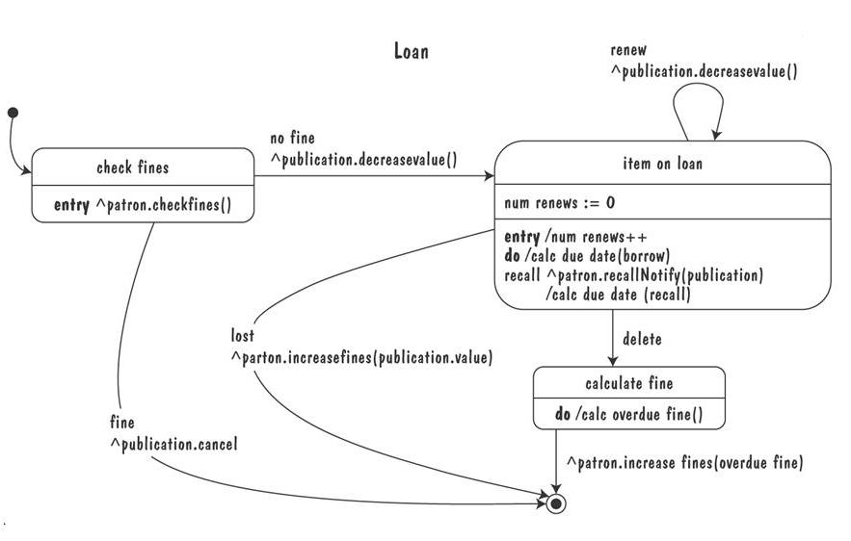
4.5 Modeling Notations
UML Statechart Diagrams (continued)
The UML statechart diagram for Loan association class illustrates how states can be annotated with local variables, actions and activities

Slide 40
4.5 Modeling Notations
State Machines: Ways of Thinking about State
Equivalence classes of possible future behavior
Periods of time between consecutive event
Named control points in an object's evolution
Partition of an object's behavior

Slide 41
4.5 Modeling Notations
State Machines Example: Petri Nets
A form or state-transition notation that is used to model concurrent activities and their interaction
  Circles (places) represent activities or conditions
  Bars represents transitions
  Arcs connect a transition with its input places and its ouput places
  The places are populated with tokens, which act as enabling conditions for the transitions
  Each arc can be assigned a weight that specifies how many tokens are removed from arc's input place, when the transition fires

Slide 42
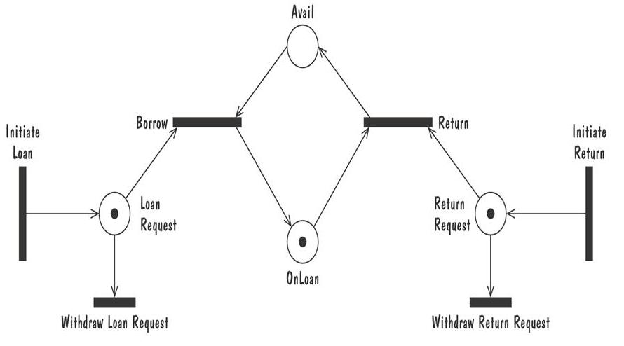
4.5 Modeling Notations
Petri Nets (continued)
Petri net of book loan

Slide 43
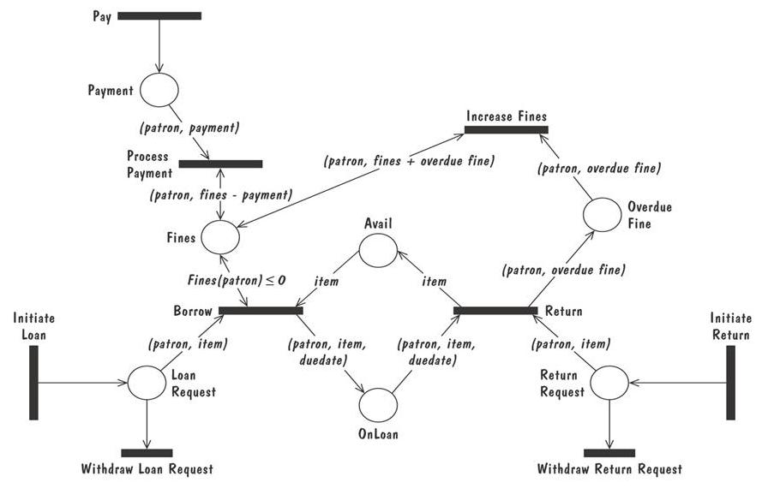
4.5 Modeling Notations
Petri Nets (continued)
A high level Petri net specification for the library problem

Slide 44
4.5 Modeling Notations
Data-Flow Diagrams
ER diagram, event trace, state machines depict only lower-level behaviors
A data-flow diagram (DFD) models functionality and the flow of data from one function to another
  A buble represents a process
  An arrow represents data flow
  A data store: a formal repository or database of information
  Rectangles represent actors: entities that provide input data or receive the output result

Slide 45
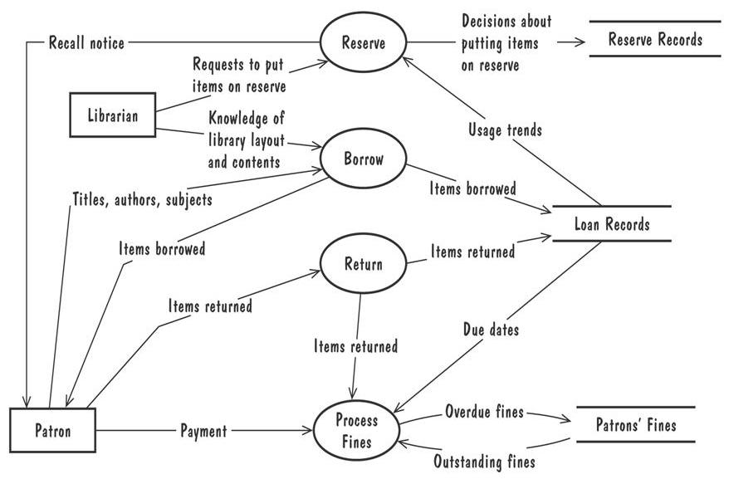
4.5 Modeling Notations
Data-Flow Diagrams (continued)
A high-level data-flow diagram for the library problem

Slide 46
4.5 Modeling Notations
Data-Flow Diagrams (continued)
Advantage:
  Provides an intuitive model of a proposed system's high-level functionality and of the data dependencies among various processes
Disadvantage:
  Can be aggravatingly ambiguous to a software developer who is less familiar with the problem being modeled

Slide 47
4.5 Modeling Notations
Data-Flow Diagrams Example: Use Cases
Components
  A large box: system boundary
  Stick figures outside the box: actors, both human and systems
  Each oval inside the box: a use case that represents some major required functionality and its variant
  A line between an actor and use case: the actor participates in the use case
Use cases do not model all the tasks, instead they are used to specify user views of essential system behavior

Slide 48
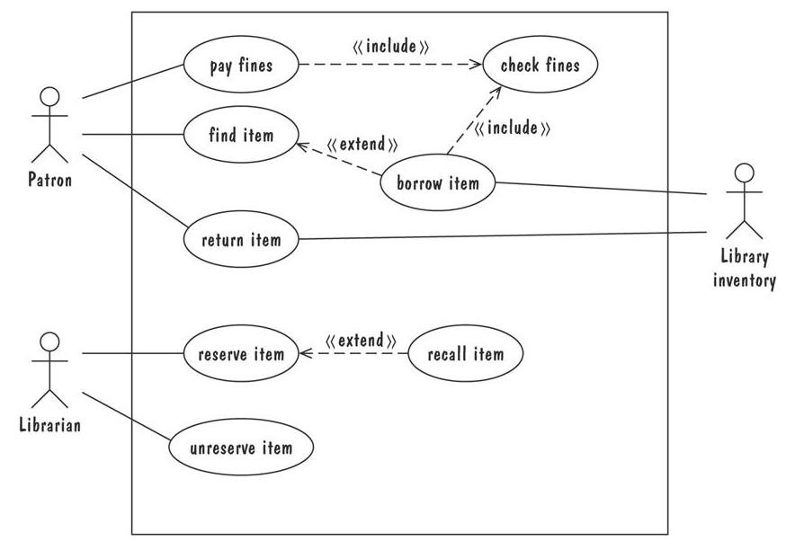
4.5 Modeling Notations
Use Cases (continued)
Library use cases including borrowing a book, returning a borrowed book, and paying a library fine

Slide 49
课堂练习
根据下面描述，画出相应的用例图。
在医生的办公室里，接待员、护士和医生使用病人记录和计划安排系统。当病人第一次来这里看病时，接待员使用该系统来输入病人信息，并且安排所有的预约。护士使用系统来跟踪病人每次看病的结果并输入护理病人的信息，如医疗和诊断。护士也可以访问这些信息以打印病人诊断结果或病人看病历史。医生主要用这个系统来查看病人的病史，偶尔也输入病人医疗信息，但通常让护士输入这些信息。

Slide 50
根据下面描述，画出相应的用例图。
在医生的办公室里，接待员、护士和医生使用病人记录和计划安排系统。当病人第一次来这里看病时，接待员使用该系统来输入病人信息，并且安排所有的预约。护士使用系统来跟踪病人每次看病的结果并输入护理病人的信息，如医疗和诊断。护士也可以访问这些信息以打印病人诊断结果或病人看病历史。医生主要用这个系统来查看病人的病史，偶尔也输入病人医疗信息，但通常让护士输入这些信息。

Slide 51
4.5 Modeling Notations
Functions and Relations
Formal methods or approach: mathematically based specification and design techniques
Formal methods model requirements or software behavior as a collection of mathematical functions or relations
  Functions specify the state of the system's execution, and output
  A relation is used whenever an input value maps more than one ouput value
Functional method is consistent and complete

Slide 52
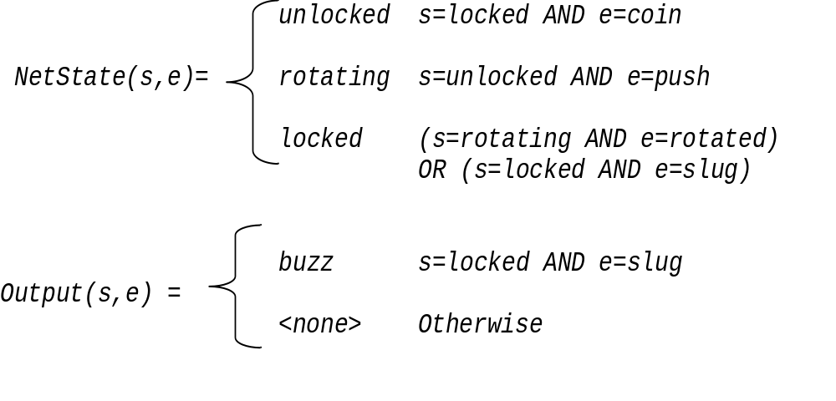
4.5 Modeling Notations
Functions and Relations (continued)
Example: representing turnstile problem using two functions
  One function to keep track of the state
  One function to specify the turnstile output

Slide 53
4.5 Modeling Notations
Functions and Relations Example: Decision Tables
It is a tabular representation of a functional specification that maps events and conditions to appropriate reponses or action
The specification is formal because the inputs (events and conditions) and outputs (actions) may be expressed in natural language
If there is n input conditions, there are 2^{n} possible combination of input conditions
Combinations map to the same set of result can be combined into a single column

Slide 54
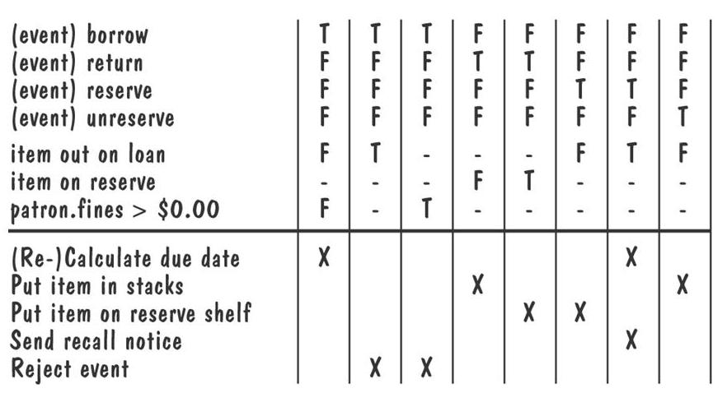
4.5 Modeling Notations
Decision Tables (continued)
Decision table for library functions borrow, return, reserve, and unreserve

Slide 55
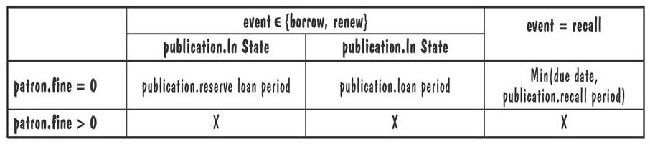
4.5 Modeling Notations
Functions and Relations Example: Parnas Tables
Tabular representations of mathematical functions or relations
  The column and row headers are predicates used to specify cases
  The internal table entries store the possible function results
  An entry “X” either could be invalid under the specified conditions or the combindation of conditions is infeasible
Calc due date(patron, publication, event, Today) =

Slide 56
4.5 Modeling Notations
Logic
An operational notation is a notation used to describe a problem or a proposed software solution in terms of situational behavior
  Model of case-based behavior
  Examples: state machine, event traces, data-flow diagram, functional method
A descriptive notation is a notation that describes a problem or a proposed solution in terms of its properties or its variant
  Example: logic

Slide 57
4.5 Modeling Notations
Logic (continued)
A logic consists of a language for expressing properties and a set of inference rules for deriving new, consequent properties from the stated properties
In logic, a property specification represents only those values of the property's variables for which the property's expression evaluates to true
It is first-order logic, comprising typed variables, constants, functions, and predicates

Slide 58
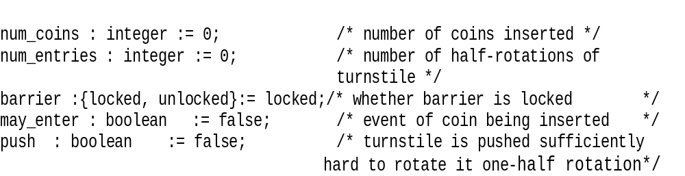
4.5 Modeling Notations
Logic (continued)
Consider the following variables of turnstile problem, with their initial value
The first-order logic expressions
num_coins > num_entries
(num_coins > num_entries ⬄ (barrier = unlocked)
(barrier = locked ) ⬄ ¬may_enter

Slide 59
4.5 Modeling Notations
Logic (continued)
Temporal logic introduces additional logical connectives for constraining how variables can change value over time
The following connectives constrain future variable values, over a single execution
  □f Ξ f is true now and throughout the rest of execution
  ⋄f Ξ f is true now or at some point in the execution
  ○f Ξ f is true in the next point in the execution
  f W g = f is true until a point where g is true, but g may never be true
Turnstile properties expressed in temporal logic
  □(insert_coin => ○ (may_enter W push))
  □(∀n(insert_coin ∧ num_coins=n) => ○(num_coins=n+1))

Slide 60
4.5 Modeling Notations
Logic Example: Object Constrain Language (OCL)
A constrain language that is both mathematically precise and easy for non-mathematicians to read, write, and understand
Designed for expressing constrains on object models, and expressing queries on object type

Slide 61
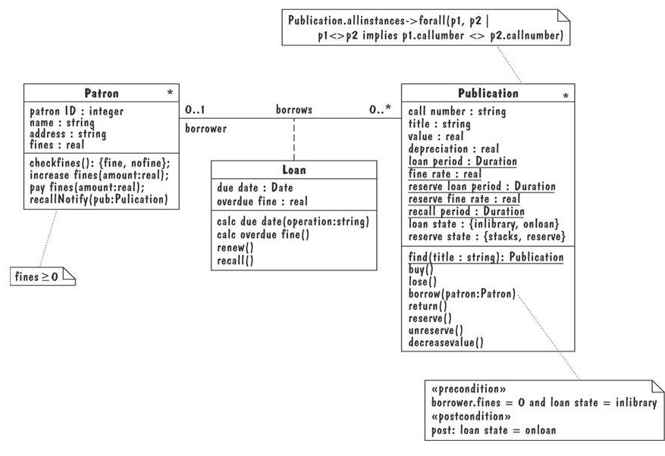
4.5 Modeling Notations
Library classes annotated with OCL properties

Slide 62
4.5 Modeling Notations
Logic Example: Z
A formal requirements-specification language that
  structures set-theoretic definitions of variables into a complete abstract-data-type model of problem
  uses logic to express the pre- and post-conditions for each operation
Method of abstractions are used to decompose a specification into manageable sized modules, called schemas

Slide 63
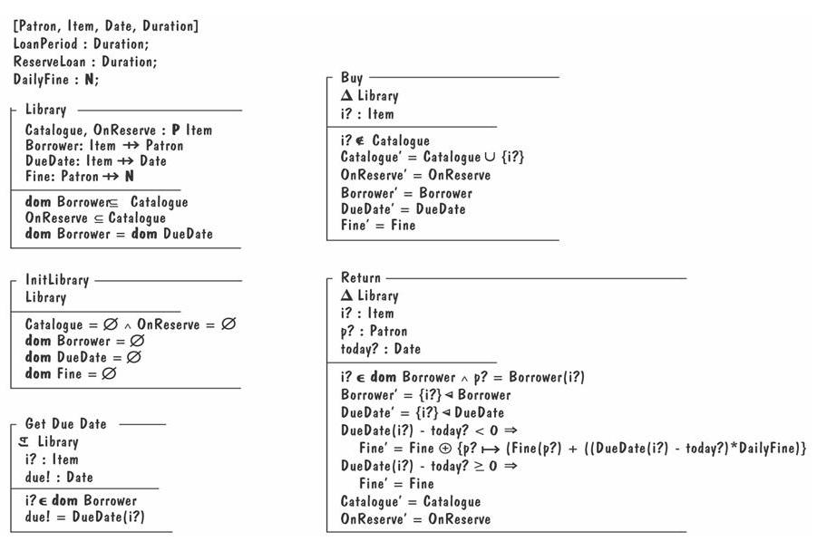
4.5 Modeling Notations
Partial Z specification for the library problem

Slide 64
4.5 Modeling Notations
Algebraic Specifications
To specify the behavior of operations by specifying interactions between pairs of operations rather than modeling individual operations
It is hard to define a set of axioms that is complete and consistent and that reflects the desired behavior

Slide 65
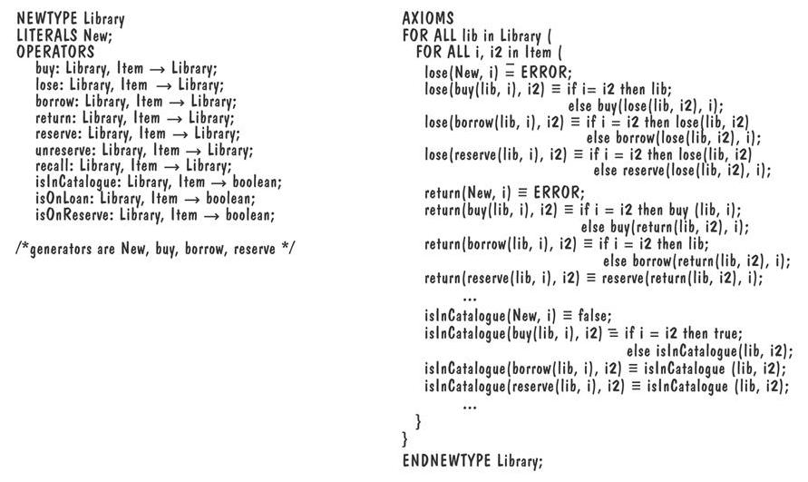
4.5 Modeling Notations
Algebraic Specifications Example: SDL Data
Partial SDL data specification for the library problem

Slide 66
4.6 Requirements and Specification Languages
Unified Modeling Language (UML)
Combines multiple notation paradigms
Eight graphical modeling notations, and the OCL constrain language, including
  Use-case diagram (a high-level DFD)
  Class diagram (an ER diagram)
  Sequence diagram (an event trace)
  Collaboration diagram (an event trace)
  Statechart diagram (a state-machine model)
  OCL properties (logic)

Slide 67
4.6 Requirements and Specification Languages
Specification and Description Language (SDL)
Standardized by the International Telecommunication Union
Specifies the behavior of real-time, concurrent, distributed processes that communicate with each other via unbounded message queues
Comprises
  SDL system diagram (a DFD)
  SDL block diagram (a DFD)
  SDL process diagram (a state-machine model)
  SDL data type (algebraic specification)
Often accompanied by a set of Message Sequence Chart (MSC)

Slide 68
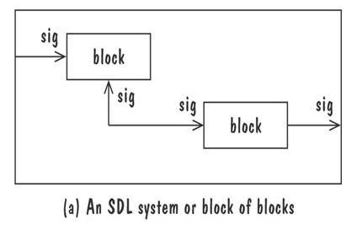
4.6 Requirements and Specification Languages
SDL System Diagram
The top-level blocks of the specification and communication channels that connect the blocks
Channels are directional and are labelled with the type of signals
Message is asynchronous

Slide 69
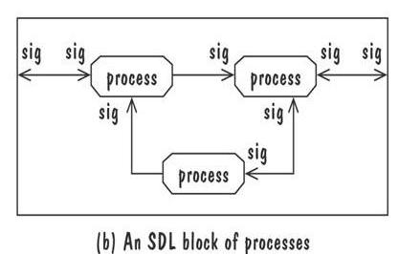
4.6 Requirements and Specification Languages
SDL Block Diagram
SDL block diagram Models a lower-level collection of blocks and the message-delaying channels that interconnect them
Figure depicts a collection of lowest-level processes that communicate via signal routes
Signal routes pass messages synchronously

Slide 70
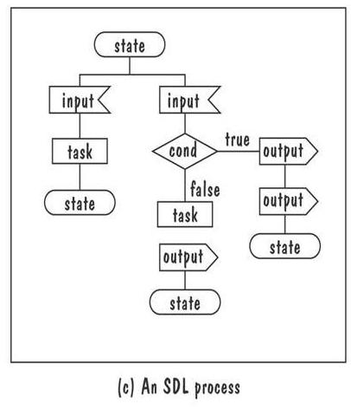
4.6 Requirements and Specification Languages
SDL Process Diagram
It is a state-machine whose transitions are sequences of language constructs (input, decisions, tasks, outputs) that start and end at state constructs

Slide 71
4.6 Requirements and Specification Languages
Software Cost Reduction (SCR)
Collection of techniques that were designed to encourage software developers to employ good software-engineering design principles
Models software requirements as a mathematical function, REQ, that maps monitored variables to controlled variables
  monitored variables: environmental variables that are sensed by the system
  controlled variables: environmental variables that are set by the system
The function REQ is decomposed into a collection of tabular functions

Slide 72
4.6 Requirements and Specification Languages
SCR (continued)
REQ is the result of composing the tabular functions into network (a DFD) as shown in the picture.
Edges reflect the data dependecies among the functions
Execution steps start with a change in the value of one monitored variable, then propagate through the network, in a single syncronized step
A
B
C
D
Mode
Condition
Mode
Condition
Mode
Condition
Mode
Condition
Off
True
X
Off
True
X
Off
True
X
Off
True
X
Heat, Maintain
Temp < 175
Temp ≥ 175
Heat, Maintain
Temp < 175
Temp ≥ 175
Heat, Maintain
Temp < 175
Temp ≥ 175
Heat, Maintain
Temp < 175
Temp ≥ 175
Warning’ =
off
on
Warning’ =
off
on
Warning’ =
off
on
Warning’ =
off
on
E
F
Mode
Condition
Mode
Condition
Off
True
X
Off
True
X
Heat, Maintain
Temp < 175
Temp ≥ 175
Heat, Maintain
Temp < 175
Temp ≥ 175
Warning’ =
off
on
Warning’ =
off
on

Slide 73
4.6 Requirements and Specification Languages
Other Features of Requirement Notations
Some techniques include notations
  for the degree of uncertainty or risk with each requirement
  for tracing requirements to other system documents such as design or code, or to other systems, such as when requirements are reused
Most specification techniques have been automated to some degree

Slide 74
4.7 Prototyping Requirements
Building a Prototype
To elicit the details of proposed system
To solicit feedback from potential users about
  what aspects they would like to see improve
  which features are not so useful
  what functionality is missing
Determine whether the customer's problem has a feasible solution
Assist in exploring options for otimizing quality requirements

Slide 75
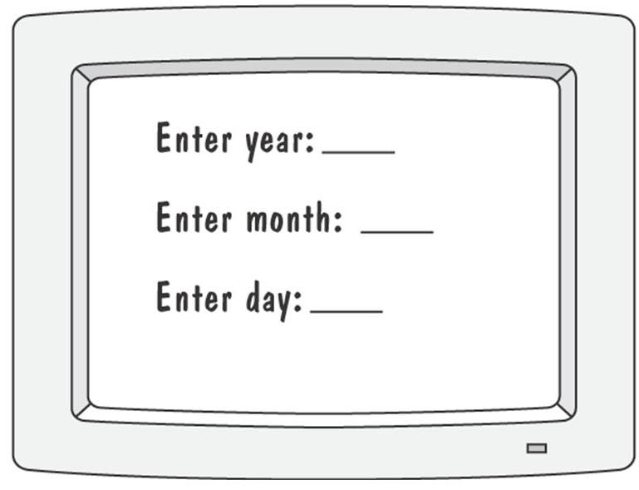
4.7 Prototyping Requirements
Prototyping Example
Prototype for building a tool to track how much a user exercises each day
Graphical respresentation of first prototype, in which the user must type the day, month and year

Slide 76
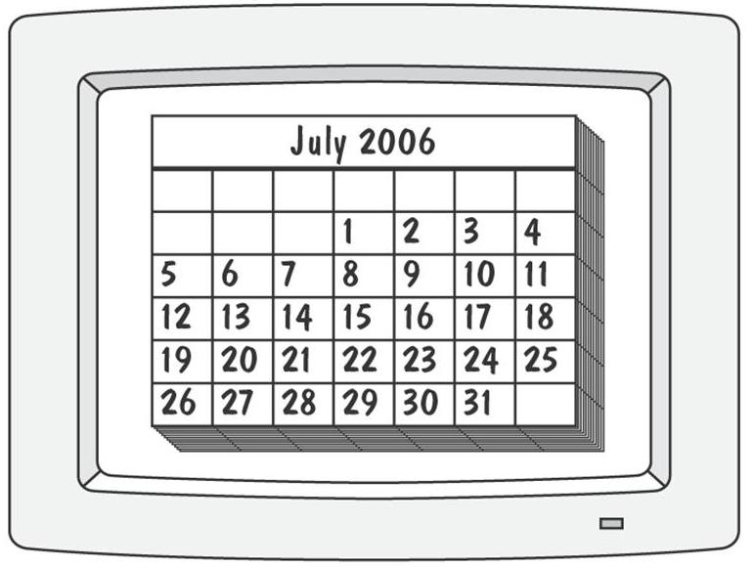
4.7 Prototyping Requirements
Prototyping Example (continued)
Second prototype shows a more interesting and sophisticated interface involving a calendar
  User uses a mouse to select the month and year
  The system displays the chart for that month, and the user selects the appropriate date in the chart

Slide 77
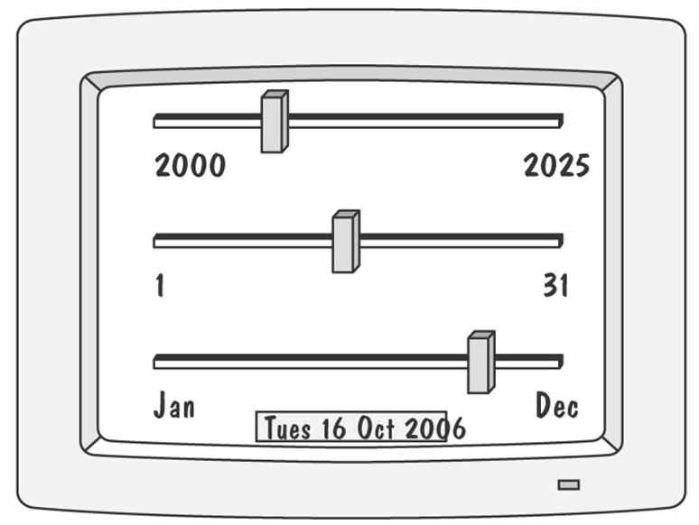
4.7 Prototyping Requirements
Prototyping Example (continued)
Third prototype shows that instead of calendar, the user is presented with three slide bars
  User uses the mouse to slide each bar left or right
  The box at the bottom of the screen changes to show the selected day, month, and year

Slide 78
4.7 Prototyping Requirements
Approaches to Prototyping
Throwaway approach
  Developed to learn more about a problem or a proposed solution, and that is never intended to be part of the delivered software
  Allow us to write “quick-and-dirty”
Evolutionary approach
  Developed not only to help us answer questions but also to be incorporated into the final product
  Prototype has to eventually exhibit the quality requirements of the final product, and these qualities cannot be retrofitted
Both techniques are sometimes called rapid prototyping

Slide 79
4.7 Prototyping Requirements
Prototyping vs. Modeling
Prototyping
  Good for answering questions about the user interfaces
Modeling
  Quickly answer questions about constraints on the order in which events should occur, or about the synchronization of activities

Slide 80
4.8 Requirements Documentation
Requirement Definition: Steps Documenting Process
Outline the general purpose and scope of the system, including relevant benefits, objectives, and goals
Describe the background and the rationale behind proposal for new system
Describe the essential characteristics of an accepatable solution
Describe the environment in which the system will operate
Outline a description of the proposal, if the customer has a proposal for solving the problem
List any assumptions we make about how the environment behaves

Slide 81
4.8 Requirements Documentation
Requirements Specification: Steps Documenting Process
Describe all inputs and outputs in detail, including
  the sources of inputs
  the destinations of ouputs,
  the value ranges
  data format of inputs and output data
  data protocols
  window formats and organizations
  timing constraint
Restate the required functionality in terms of the interfaces' inputs and outputs
Devise fit criteria for each of the customer's quality requirements

Slide 82
4.8 Requirements Documentation
Sidebar 4.6 Level of Specification
Survey shows that one of the problems with requirement specifications was the uneven level of specification
  Different writing sytles
  Difference in experience
  Different formats
  Overspecifying requirements
  Underspecifying requirements
Recommendations to reduce unevenness
  Write each clause so that it contains only one requirement
  Avoid having one requirement refer to another requirement
  Collect similar requirements together

Slide 83
4.8 Requirements Documentation
Sidebar 4.7 Hidden Assumptions
Two types of environmental behavior of interest
  desired behavior to be realized by the proposed system
  existing behavior that is unchanged by the proposed system
    often called assumptions or domain knowledge
Most requirements writers consider assumptions to be simply the conditions under which the system is guaranteed to operate correctly

Slide 84
4.8 Requirements Documentation
IEEE Standard for SRS Organized by Objects
Intodruction to the Document
  1.1 Purpose of the Product
  1.2 Scope of the Product
  1.3 Acronyms, Abbreviations, Definitions
  1.4 References
  1.5 Outline of the rest of the SRS
General Description of Product
  2.1 Context of Product
  2.2 Product Functions
  2.3 User Characteristics
  2.4 Constraints
  2.5 Assumptions and Dependencies
Specific Requirements
  3.1 External Interface Requirements
    3.1.1 User Interfaces
    3.1.2 Hardware Interfaces
    3.1.3 Software Interfaces
    3.1.4 Communications Interfaces
  3.2 Functional Requirements
    3.2.1 Class 1
    3.2.2 Class 2
    …
  3.3 Performance Requirements
  3.4 Design Constraints
  3.5 Quality Requirements
  3.6 Other Requirements
Appendices

Slide 85
4.8 Requirements Documentation
Process Management and Requirements Traceability
Process managemet is a set of procedures that track
  the requirements that define what the system should do
  the design modules that are generated from the requirement
  the program code that implements the design
  the tests that verify the functionality of the system
  the documents that describe the system
It provides the threads that tie the system parts together

Slide 86
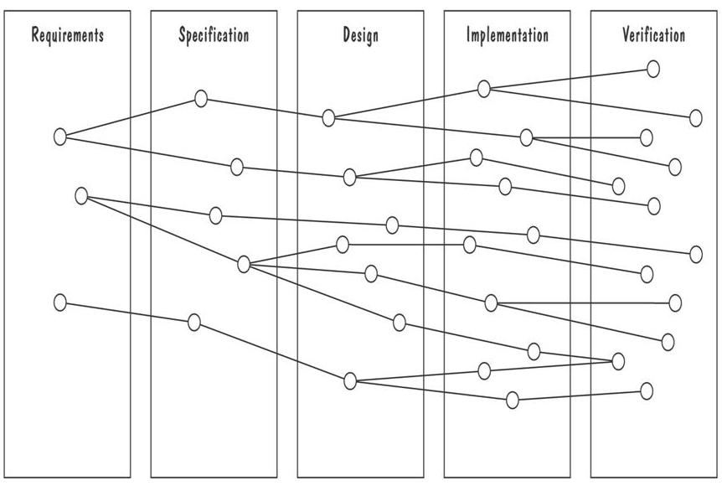
4.8 Requirements Documentation
Development Activities
Horizontal threads show the coordination between development activities

Slide 87
4.9 Validation and Verification
In requirements validation, we check that our requirements definition accurately reflects the customer's needs
In verification, we check that one document or artifact conforms to another
Verification ensures that we build the system right, whereas validation ensures that we build the right system

Slide 88
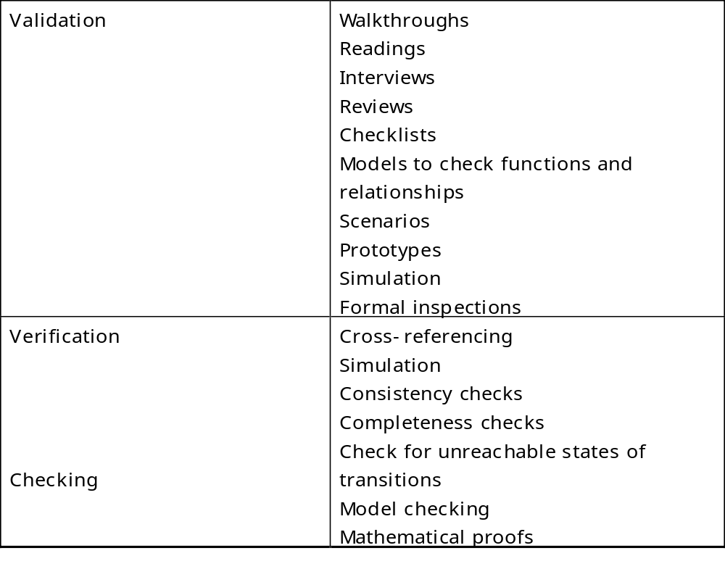
4.9 Validation and Verification
List of techniques to validate requirements

Slide 89
4.9 Validation and Verification
Requirements Review
Review the stated goals and objectives of the system
Compare the requirements with the goals and objectives
Review the environment in which the system is to operate
Review the information flow and proposed functions
Assess and document the risk, discuss and compare alternatives
Testing the system: how the requirements will be revalidated as the requirements grow and change

Slide 90
4.9 Validation and Verification
Sidebar 4.8 Number of Requirements Faults
Jone and Thayes's studies show that
  35% of the faults to design activities for project of 30,000-35,000 delivered source instructions
  10% of the faults to requirements activities and 55% of the faults to design activities for projects of 40,000-80,000 delivered source instructions
  8% to 10% of the faults to requirements activities and 40% to 55% of the faults to design activities for project of 65,000-85,000 delivered source instructions
Basili and Perricone report
  48% of the faults observed in a medium-scale software project were attribute to “incorrect or misinterpreted functional specification or requirements”
Beizer attributes 8.12% of the faults in his samples to problems in functional requirements

Slide 91
4.9 Validation and Verification
Verification
Check that the requirements-specification document corresponds to the requirements-definition
Make sure that if we implement a system that meets the specification, then the system will satisfy the customer's requirements
Ensure that each requirement in the definition document is traceable to the specification

Slide 92
4.9 Validation and Verification
Sidebar 4.9 Computer-Aided Verification
Model checking is an exhaustive search for a specification's execution space, to determine whether some temporal-logic property holds of the execution
  Atlee (1996) used the SMV model checker to verify five properties of an SCR specification of the A-7 naval aircraft
A theorem prover uses a collection of built-in theories, inference rules, and decision procedures for determining whether a set of asserted facts logically entails some unasserted fact
  Dutertre and Stavridou (1997) used theorem prover PVS to verify some of the functional and safety requirements of an avionic system

Slide 93
4.10 Measuring Requirements
Measurements focus on three areas
  product
  process
  resources
Number of requirements can give us a sense of the size of the developed system
Number of changes to requirements
  Many changes indicate some instability or uncertainty in our understanding of the system
Requirement-size and change measurements should be recorded by requirements type

Slide 94
4.10 Measuring Requirements
Rating Scheme on Scale from 1 to 5
You understand this requirement completely, have designed systems from similar requirements, and have no trouble developing a design from this requirement
Some elements of this requirement are new, but they are not radically different from requirements that have been successfully designed in the past
Some elements of this requirement are very different from requirements in the past, but you understand the requirement and can develop a good design from it
You cannot understand some parts of this requirement, and are not sure that you can develop a good design
You do not understand this requirement at all, and can not develop a design

Slide 95
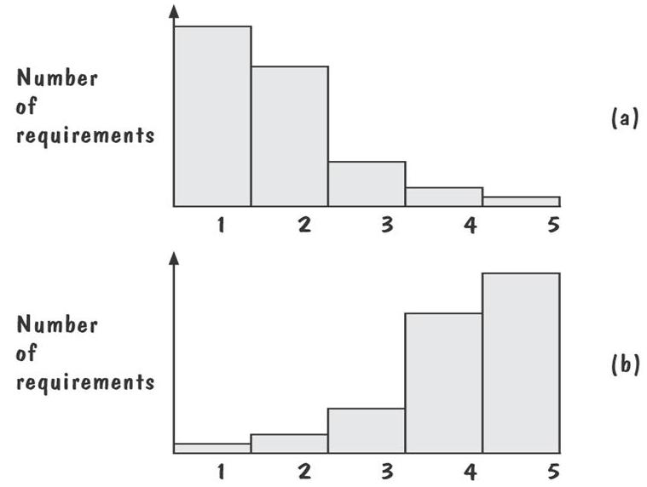
4.10 Measuring Requirements
Testers/Designers Profiles
Figure (a) shows profiles with mostly 1s and 2s
  The requirements are in good shape
Figure (b) shows profiles with mostly 4s and 5s
  The requirements should be revised

Slide 96
4.11 Choosing a Specification Technique
Criteria for Evaluating Specification Methods
Applicability
Implementability
Testability/Simulation
Checkability
Maintainability
Modularity
Level of abstraction
Soundness
Veriability
Run time safety
Tools maturity
Looseness
Learning curve
Technique maturity
Data modeling
Discipline

Slide 97
4.11 Choosing a Specification Technique
Steps
Determine which of the criteria are especially important
Evaluate each of the candidate techniques with respect to the criteria
Choose a specification technique that best supports the criteria that are most important to the problem

Slide 98
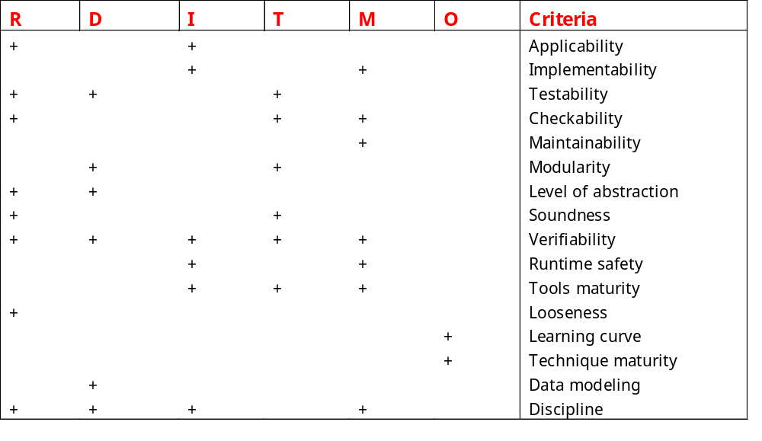
Important of Specification Criteria During Reactive-System Life Cyle
R=Requirements, D=Design, I=Implementation, T=Testing, M=Maintenance, O=Other

Slide 99
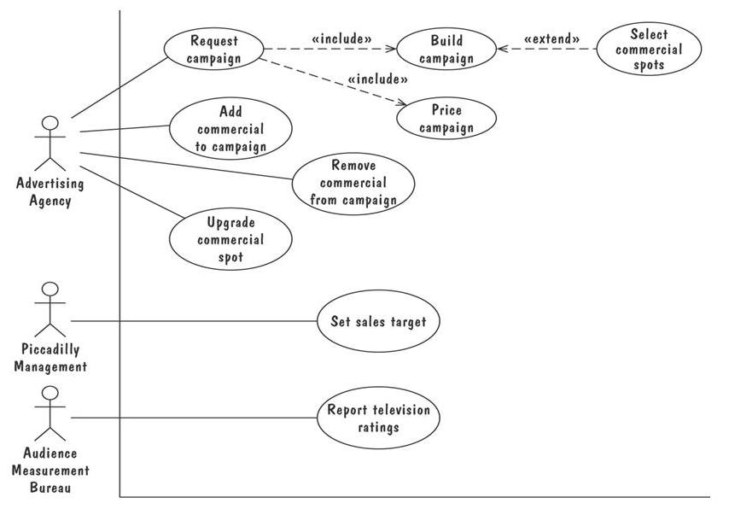
4.12 Information System Example
Picadilly Television System
High-level diagram captures the essential functionality
  Shows nothing about the ways in which each of these use cases might succeed or fail

Slide 100
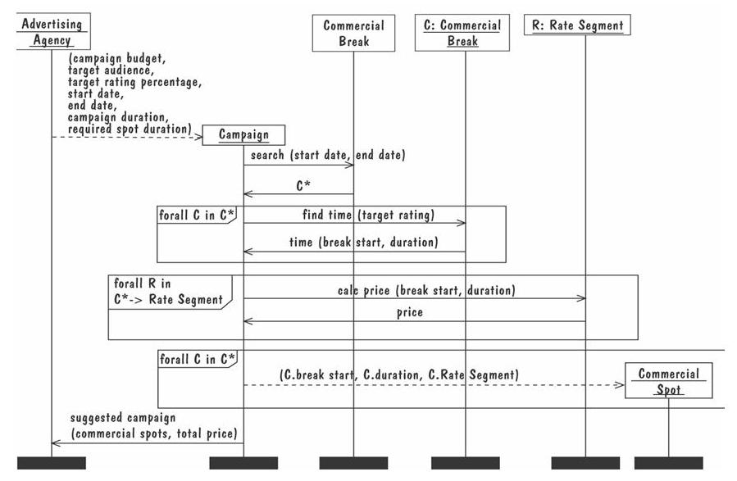
4.12 Information System Example
Picadilly Television System: Message Sequence Chart

Slide 101
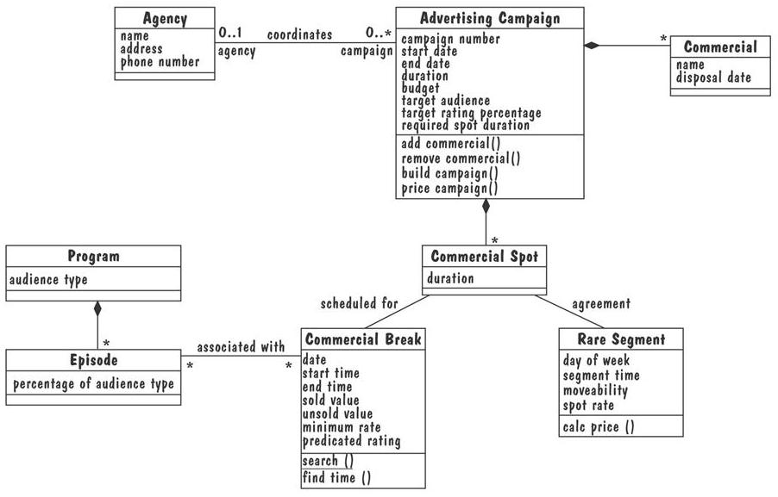
4.12 Information System Example
Picadilly Television System: Partial UML Class Diagram

Slide 102
4.13 Real-Time Example
Ariane-5 failed due to requirement validation not done properly
  Requirements validation could have played a crucial role in preventing the rocket's explosion
Two criteria that are especially important for specifying a system such as Ariane-5
  Testability/simulation and runtime safety
  SDL was rated “strong” for testability/simulation and runtime safety

Slide 103
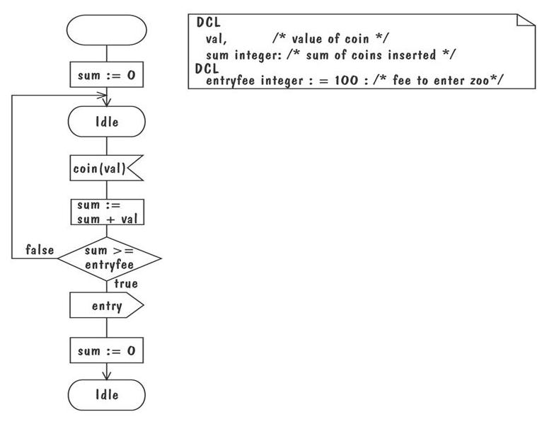
4.13 Real-Time Example
SDL Model
SDL model for coin slot process that consists of several concurrent communicating process

Slide 104
4.14 What This Chapter Means for You
It is essential that the requirements definition and specification documents describe the problem, leaving solution selection to designer
There are variety of sources and means for eliciting requirements
There are many different types of definition and specification techniques
The specification techniques also differ in terms of their tool support, maturity, understandability, ease of use, and mathematical formality
Requirements questions can be answered using models or prototypes
Requirements must be validated to ensure that they accurately reflect the customer's expectations

