Slide 1

Chapter 5
Designing
the Architecture
Shari L. Pfleeger
Joanne M. Atlee
4th Edition

Slide 2
Contents
5.1 The Design Process
5.2 Modeling Architectures
5.3 Decomposition and Views
5.4 Architectural Styles and Strategies
5.5 Achieving Quality Attributes
5.6 Collaborative Design
5.7 Architecture Evaluation and Refinement
5.8 Documenting Software Architectures
5.9 Architecture Design Review
5.10 Software Product Lines
5.11 Information System Example
5.12 Real-Time Example
5.13 What this Chapter Means for you

Slide 3
Chapter 5 Objectives
Examine different types of decomposition
Compare competing designs
Document the design
Verify architecture meets the requirements

Slide 4
5.1 The Design Process
Design is the creative process of figuring out how to implement all of the customer’s requirements; the resulting plan is also called the design
Early design decisions address the system’s architecture
Later design decisions address how to implement the individual units

Slide 5
5.1 The Design Process
Design is a Creative Process
Design is an intellectually challenging task
  Numerous possibilities the system must accommodate
  Nonfunctional design goals (e.g., ease of use, ease to maintain)
  External factors (e.g., standard data formats, government regulations)
We can improve our design by studying examples of good design
Most design work is routine design, solve problem by reusing and adapting solutions from similar problems

Slide 6
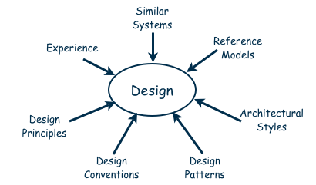
5.1 The Design Process
Design is a Creative Process (continued)
Many ways to leverage existing solutions
  Cloning: Borrow design/code in its entirety, with minor adjustments
  Reference models: Generic architecture that suggests how to decompose the system

Slide 7
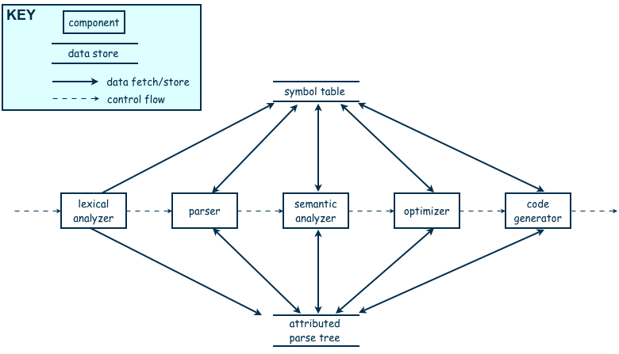
5.1 The Design Process
Design is a Creative Process (continued)
Reference model for a compiler

Slide 8
5.1 The Design Process
Design is a Creative Process (continued)
More typically, a reference model will not exist for the problem
Software architectures have generic solutions too, referred to as architectural styles
  Focusing on one architectural style can create problems
  Good design is about selecting, adapting, and integrating several architectural design styles to produce the desired result

Slide 9
5.1 The Design Process
Design is a Creative Process (continued)
Many tools for understanding options and evaluating chosen architecture, including:
  Design patterns: generic solutions for making lower-level design decisions
  Design convention or idiom: collection of design decisions and advice that, taken together, promotes certain design qualities
  Innovative design: characterized by irregular bursts of progress that occur as we have flashes of insight
  Design principles: descriptive characteristics of good design

Slide 10
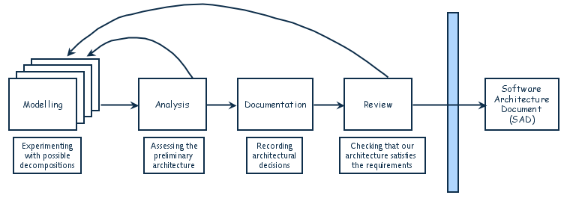
5.1 The Design Process
Design Process Model
Designing software system is an iterative process
The final outcome is the software architecture document (SAD)

Slide 11
5.1 Collaborative Design
Sidebar 5.1 Agile Architectures
Helpful to use agile process when there is a great deal of uncertainly about requirements
Agile architectures are based on four premises:
  valuing individuals and interactions over processes and tools
  valuing working software over comprehensive documentation
  valuing customer collaboration over contract negotiation
  valuing response to change over following plans
Possible problems with agile methods:
  complexity and change must be carefully managed
  programmers encouraged to write code as models are being produced
  the need for constant refactoring

Slide 12
5.2 Modeling Architectures
Collection of models helps to answer whether the proposed architecture meets the specified requirements
Six ways to use the architectural models:
  to understand the system
  to determine amount of reuse from other systems and the reusability of the system being designed
  to provide blueprint for system construction
  to reason about system evolution
  to analyze dependencies
  to support management decisions and understand risks

Slide 13
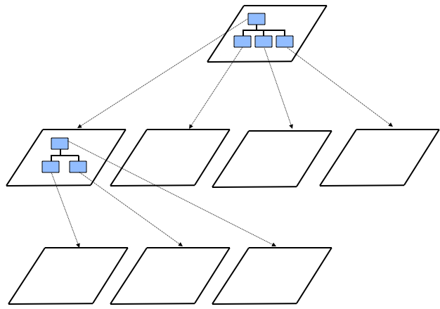
5.3 Decomposition and Views
High-level description of system’s key elements
Creating a hierarchy of information with increasing details
Top
level
First level of
decomposition
Second level of
decomposition

Slide 14
5.3 Decomposition and Views
Popular Design Methods
Some design problems have no existing solutions
  Designers must decompose to isolate key problems
Some popular design methods:
  Functional decomposition
  Feature-oriented decomposition
  Data-oriented decomposition
  Process-oriented decomposition
  Event-oriented decomposition
  Object-oriented design

Slide 15
5.3 Decomposition and Views
Popular Design Methods
Functional decomposition
  partitions functions or requirements into modules
  begins with the functions that are listed in the requirements specification
  lower-level designs divide these functions into subfunctions, which are then assigned to smaller modules
  describes which modules (subfunctions) call each other

Slide 16
5.3 Decomposition and Views
Popular Design Methods
  Feature-oriented decomposition
  assigns features to modules
  high-level design describes the system in terms of a service and a collection of features
  lower-level designs describe how each feature augments the service and identifies interactions among features

Slide 17
5.3 Decomposition and Views
Popular Design Methods
  Data-oriented decomposition
  focuses on how data will be partitioned into modules
  high-level design describes conceptual data structures
  lower-level designs provide detail as to how
    data are distributed among modules
    distributed data realize the conceptual models

Slide 18
5.3 Decomposition and Views
Popular Design Methods
  Process-oriented decomposition
  partitions the system into concurrent processes
  high-level design:
    identifies the system’s main tasks
    assigns tasks to runtime processes
    explains how the tasks coordinate with each other
  Lower-level designs describe the processes in more detail

Slide 19
5.3 Decomposition and Views
Popular Design Methods
  Event-oriented decomposition
  focuses on the events that the system must handle and assigns responsibility for events to different modules
  high-level design catalogues the system’s expected input events
  lower-level designs decompose the system into states and describe how events trigger state transformations

Slide 20
5.3 Decomposition and Views
Popular Design Methods
  Object-oriented decomposition
  assigns objects to modules
  high-level design identifies the system’s object types and explains how objects are related to one another
  lower-level designs detail the objects’ attributes and operations

Slide 21
5.3 Decomposition and Views
Popular Design Methods (continued)
A design is modular when each activity of the system is performed by exactly one software unit, and when the inputs and outputs of each software unit are well-defined
A software unit is well-defined if its interface accurately and precisely specifies the unit’s externally visible behavior

Slide 22
5.3 Decomposition and Views
Popular Design Methods (continued)
Component
Subsystem
Runtime process
Module
Class
Package
Library
Procedure
Software unit
Modular
Well-defined

Slide 23
5.3 Decomposition and Views
Sidebar 5.2 Component-based Software Engineering
Component-based software engineering (CBSE) is a method of software development whereby systems are created by assembling together preexisting components
A component is “a self-contained piece of software with a well-defined set of interfaces” that can be developed, bought, and sold as a distinct entity
The goal of CBSE is to support the rapid development of new systems, by reducing development to component integration, and to ease the maintenance of such systems by reducing maintenance to component replacement
At this point, CBSE is still more of a goal than a reality with considerable on-going research

Slide 24
5.3 Decomposition and Views
Architectural Views
Common types of architectural views include:
  Decomposition view
  Dependencies view
  Generalization view
  Execution view
  Implementation view
  Deployment view
  Work-assignment view

Slide 25
5.3 Decomposition and Views
Decomposition View
The decomposition view portrays the system as programmable units
This view is likely to be hierarchical
May be represented by multiple models

Slide 26
5.3 Decomposition and Views
Dependencies View
The dependencies view shows dependencies among software units
This view is useful in project planning
Also useful for assessing the impact of making a design change to some software unit

Slide 27
5.3 Decomposition and Views
Generalization View
The generalization view shows software units that are generalizations or specializations of one another
This view is useful when designing abstract or extendible software units

Slide 28
5.3 Decomposition and Views
Execution View
The execution view is the traditional box-and-arrow diagram that software architects draw, showing the runtime structure of a system in terms of its components and connectors
Each component is a distinct executing entity, possibly with its own program stack
A connector is some intercomponent communication mechanism, such as a communication channel, shared data repository, or remote procedure call

Slide 29
5.3 Decomposition and Views
Implementation View
The implementation view maps code units to the source file that contains their implementation
Helps programmers find the implementation of a software unit within a maze of source-code files

Slide 30
5.3 Decomposition and Views
Deployment View
The deployment view maps runtime entities, such as components and connectors, onto computer resources, such as processors, data stores, and communication networks
It helps the architect analyze the quality attributes of a design, such as performance, reliability, and security

Slide 31
5.3 Decomposition and Views
Work-assignment View
The work-assignment view decomposes the system’s design into work tasks that can be assigned to project teams
Helps project managers plan and allocate project resources, as well as track each team’s progress

Slide 32
5.4 Architectural Styles and Strategies
Pipes-and-Filter
Client-Server
Peer-to-Peer
Publish-Subscribe
Repositories
Layering

Slide 33
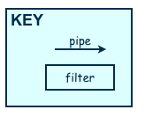
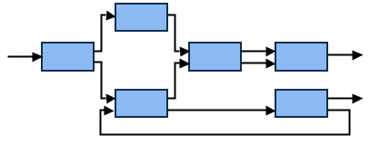
5.4 Architectural Styles and Strategies
Pipes-and-Filter
The system has
  Streams of data (pipe) for input and output
  Transformation of the data (filter)
KEY
pipe

Slide 34
5.4 Architectural Styles and Strategies
Pipes-and-Filter (continued)
Several important properties
  The designer can understand the entire system's effect on input and output as the composition of the filters
  The filters can be reused easily on other systems
  System evolution is simple
  Allow concurrent execution of filters
Drawbacks
  Encourages batch processing
  Not good for handling interactive application
  Duplication in filters functions

Slide 35
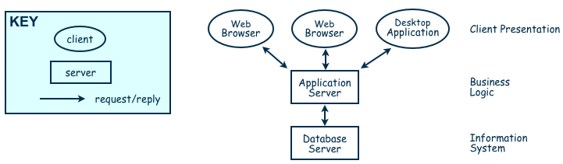
5.4 Architectural Styles and Strategies
Client-Server
Two types of components:
  Server components offer services
  Clients access them using a request/reply protocol
Client may send the server an executable function, called a callback
  The server subsequently calls under specific circumstances

Slide 36
5.4 Architectural Styles and Strategies
Sidebar 5.3 The World Cup Client-Server System
Over one month in 1994, the World Cup soccer matches were held in the United States. Design system issues:
  24 teams played 52 games
  nine different cities that spanned four time zones
  results of each game were recorded and disseminated to the press and to the fans
  To deter violence among the fans, the organizers issued and tracked over 20,000 identification passes
This system required both central control and distributed functions. Thus, a client-server architecture seemed appropriate.
The system that was built included a central database, located in Texas, for ticket management, security, news services, and Internet links. This server also calculated games statistics and provided historical information, security photographs, and clips of video action.
The clients ran on 160 Sun workstations that were located in the same cities as the games and provided support to the administrative staff and the press

Slide 37
5.4 Architectural Styles and Strategies
Peer-to-Peer (P2P)
Each component acts as its own process and acts as both a client and a server to other peer components.
Any component can initiate a request to any other peer component.
Characteristics
  Scale up well
  Increased system capabilities
  Highly tolerant of failures
Examples: Napster and Freenet

Slide 38
5.4 Architectural Styles and Strategies
Sidebar 5.4 Napster’s P2P Architecture
Peers are typically users’ desktop computer systems running general-purpose computing applications (email, word processors, Web browsers, etc.)
  Many user systems do not have stable Internet protocol (IP) addresses
  Not always available to the rest of the network
  Most users are not sophisticated; they are more interested in content than in the network’s configuration and protocols
  Great variation in methods for accessing the network, from slow dial-up lines to fast broadband connections
Napster’s sophistication comes from its servers, which organize requests and manage content, with actual content provided by users, shared from peer to peer, and the sharing goes to other (anonymous) users, not to a centralized file server
If the file content changes frequently, sharing speed is key, file quality is critical, or one peer needs to be able to trust another, a centralized server architecture may be more appropriate

Slide 39
5.4 Architectural Styles and Strategies
Publish-Subscribe
Components interact by broadcasting and reacting to events
  Component expresses interest in an event by subscribing to it
  When another component announces (publishes) that event has taken place, subscribing components are notified
  Implicit invocation is a common form of publish-subscribe architecture
    Registering: subscribing component associates one of its procedures with each event of interest (called the procedure)
Characteristics
  Strong support for evolution and customization
  Easy to reuse components in other event-driven systems
  Need shared repository for components to share persistent data
  Difficult to test

Slide 40
5.4 Architectural Styles and Strategies
Repositories
Two components
  A central data store
  A collection of components that operate on it to store, retrieve, and update information
The challenge is deciding how the components will interact
  A traditional database: transactions trigger process execution
  A blackboard: the central store controls the triggering process
  Knowledge sources: information about the current state of the system’s execution that triggers the execution of individual data accessors

Slide 41
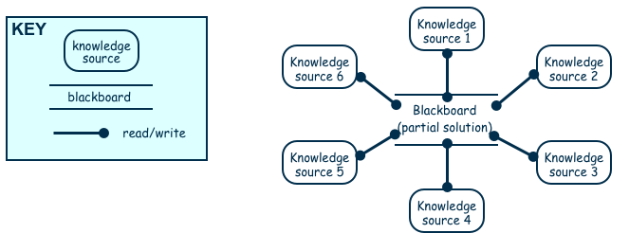
5.4 Architectural Styles and Strategies
Repositories (continued)
Major advantage: openness
  Data representation is made available to various programmers (vendors) so they can build tools to access the repository
  But also a disadvantage: the data format must be acceptable to all components

Slide 42
5.4 Architectural Styles and Strategies
Layering
Layers are hierarchical
  Each layer provides service to the one outside it and acts as a client to the layer inside it
  Layer bridging: allowing a layer to access the services of layers below its lower neighbor
The design includes protocols
  Explain how each pair of layers will interact
Advantages
  High levels of abstraction
  Relatively easy to add and modify a layer
Disadvantages
  Not always easy to structure system layers
  System performance may suffer from the extra coordination among layers

Slide 43
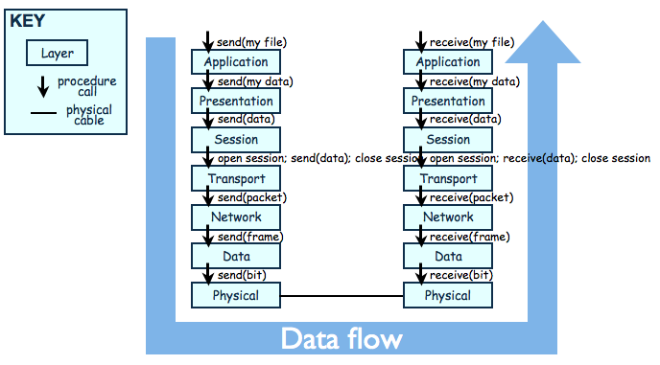
5.4 Architectural Styles and Strategies
Example of Layering System
The OSI Model

Slide 44
5.4 Architectural Styles and Strategies
Combining Architectural Styles
Actual software architectures rarely based on purely one style
Architectural styles can be combined in several ways
  Use different styles at different layers (e.g., overall client-server architecture with server component decomposed into layers)
  Use mixture of styles to model different components or types of interaction (e.g., client components interact with one another using publish-subscribe communications
If architecture is expressed as collection of models, documentation must be created to show relation between models

Slide 45
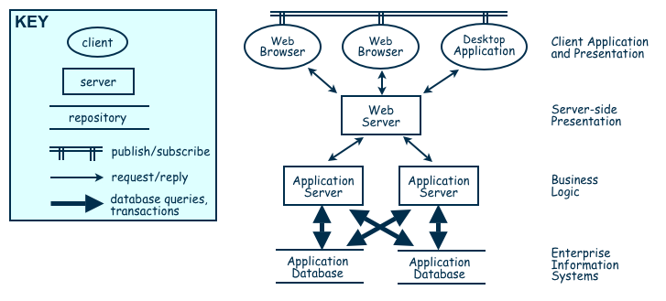
5.4 Architectural Styles and Strategies
Combination of Publish-Subscribe, Client-Server, and Repository Architecture Styles

Slide 46
5.5 Achieving Quality Attributes
Architectural styles provide general beneficial properties. To support specific quality attribute tactics are utilized:
  Modifiability
  Performance
  Security
  Reliability
  Robustness
  Usability
  Business goals

Slide 47
5.5 Achieving Quality Attributes
Modifiability
Design must be easy to change
Two classifications of affected software units:
  Directly affected
  Indirectly affected
Directly affected units’ responsibilities change to accommodate a system modification
Indirectly affected units’ responsibilities do not change, but implementations must be revised

Slide 48
5.5 Achieving Quality Attributes
Modifiability (continued)
Tactics for minimizing the number of software units affected by a change focus on clustering the anticipated changes:
  Anticipate expected changes: Identify design decisions that are most likely to change, and encapsulate each in its own software unit
  Cohesion: Keeping software units highly cohesive increases the chances that a change to the system’s responsibilities is confined to the few units that are assigned those responsibilities
  Generality : The more general the software units, the more likely change can be accommodated by modifying a unit’s inputs rather than modifying the unit itself

Slide 49
5.5 Achieving Quality Attributes
Modifiability (continued)
Tactics for minimizing the impact on indirectly affected units focus on reducing dependencies
  Coupling: Lowering coupling reduces the likelihood that a change to one unit will ripple to other units
  Interfaces: If a unit interacts with other units only through their interfaces changes to one unit will not spread beyond the unit’s boundary unless its interface changes
  Multiple interfaces: A unit modified to provide new data or services can offer them using a new interface to the unit without changing any of the unit’s existing interfaces

Slide 50
5.5 Achieving Quality Attributes
Sidebar 5.5 Self-managing Software
In response to increasing demands that systems be able to operate optimally in different and sometimes changing environments, the software community is starting to experiment with self-managing software
  Also referred to as autonomic, adaptive, dynamic, selfconfiguring, self-optimizing, self-healing, context-aware
The essential idea is the same: the software system monitors its environment or its own performance, and changes its behavior in response to changes that it

Slide 51
5.5 Achieving Quality Attributes
Sidebar 5.5 Self-managing Software (continued)
Some examples of sensor changes:
  Change the input sensors used, such as avoiding vision-based sensors when sensing in the dark
  Change the Web servers that are queried, based on the results and performance of past queries
  Move running components to different processors to balance processor load or to recover from a processor failure
Obstacles to building self-managing software:
  Few architectural styles
  Monitoring nonfunctional requirements
  Decision making

Slide 52
5.5 Achieving Quality Attributes
Performance
Performance attributes describe constraints on system speed and capacity:
  Response time: How fast does our software respond to requests?
  Throughput: How many requests can it process per minute?
  Load: How many users can it support before response time and throughput start to suffer?

Slide 53
5.5 Achieving Quality Attributes
Performance
Tactics for improving performance include:
  Improve utilization of resources
  Manage resource allocation more effectively
    First-come/first-served: Requests are processed in the order in which they are received
    Explicit priority: Requests are processed in order of their assigned priorities
    Earliest deadline first: Requests are processed in order of their impending deadlines
  Reduce demand for resources

Slide 54
5.5 Achieving Quality Attributes
Security
Two key architectural characteristics particularly relevant to security: immunity and resilience
Immunity: ability to thwart an attempted attack
  The architecture encourages immunity by:
    Ensuring all security features are included in the design
    Minimizing exploitable security weaknesses
Resilience: ability to recover quickly and easily from an attack
  The architecture encourages resilience by:
    Segmenting functionality to contain attack
    Enabling the system to quickly restore functionality

Slide 55
5.5 Achieving Quality Attributes
Reliability
A software system is reliable if it correctly performs its required functions under assumed conditions
  Is the software internally free of errors?
A fault is the result of human error, compared to a failure, which is an observable departure from required behavior
  Software is made more reliable by preventing or tolerating faults

Slide 56
5.5 Achieving Quality Attributes
Reliability (continued)
Passive fault detection: wait until fault occurs during execution
Active fault detection: periodically check for symptoms or try to anticipate when failures will occur
Exceptions: situations that cause the system to deviate from its desired behavior
Include exception handling in design to handle exception and return system to acceptable state
Typical exceptions include:
  Failing to provide a service
  Providing the wrong service
  Corrupting data
  Violating a system invariant (e.g.; security property)
  Deadlocking

Slide 57
5.5 Achieving Quality Attributes
Reliability (continued)
N-version programming
  If two functionally equivalent systems are designed by two different design teams at two different times using different techniques, the chance of the same fault occurring in both implementations is very small
  N-version programming has been shown to be less reliable than originally thought, because many designers learn to design in similar ways, using similar design patterns and principles

Slide 58
5.5 Achieving Quality Attributes
Reliability (continued)
Fault recovery: handling fault immediately to limit damage
Fault recovery tactics:
  Undoing transactions: manage a series of actions as a single transaction that are easily undone if a fault occurs midway through the transaction
  Checkpoint/rollback: software records a checkpoint of current state; rolls back to that point if system gets in trouble
  Backup: system automatically substitutes faulty unit with backup
  Degraded service: returns to previous state, offers degraded version of the service
  Correct and continue: detects the problem and treats the symptoms
  Report: system returns to its previous state and reports the problem to an exception-handling unit

Slide 59
5.5 Achieving Quality Attributes
Sidebar 5.6 The Need for Safe Design
From 1986 to 1997, over 450 reports filed with the U.S. Food and Drug Administration (FDA) detailing software defects in medical devices, 24 of which led to death or injury
  Numbers may be greater based on time to file report
The FDA established a software forensics unit in 2004 after noticing that medical device makers were reporting more and more software-based recalls
Software designers must see directly how their products will be used
Then designers can build in preventative measures to ensure their products are not misused

Slide 60
5.5 Achieving Quality Attributes
Robustness
A system is robust if it includes mechanisms for accommodating or recovering from problems in the environment or in other unit
Mutual suspicion: each software unit assumes that the other units contain faults
Robustness tactics differ from reliability tactics
Recovery tactics are similar:
  Rollback to checkpoint state
  Abort a transaction
  Initiate a backup unit
  Provide reduced service
  Correct symptoms and continue processing
  Trigger an exception

Slide 61
5.5 Achieving Quality Attributes
Usability
Usability reflects the ease in which a user is able to operate the system
  User interface should reside in its own software unit
  Some user-initiated commands require architectural support
  There are some system-initiated activities for which the system should maintain a model of its environment

Slide 62
5.5 Achieving Quality Attributes
Business Goals
Business Goals are quality attributes the system is expected to exhibit (e.g., minimizing the cost of development and time to market)
  Buy vs. Build
    Save development time, money
    More reliable
    Existing components create constraints; vulnerable to supplier
  Initial development vs. maintenance costs
    Save money by making system modifiable
    Increased complexity may delay release; lose market to competitors
  New vs. known technologies
    Acquiring expertise costs money, delays product release
    Either learn how to use the new technology or hire new personnel
    Eventually, we must develop the expertise ourselves

Slide 63
5.6 Collaborative Design
Usually the design of software systems is performed by a team of developers
Several issues must be addressed by the team:
  Who is best suited to design each aspect of the system
  How to document all aspects
  How to coordinate and integrate the software units
Important to view group interaction in its cultural and ethical contexts

Slide 64
5.6 Collaborative Design
Sidebar 5.7 The Causes of Design Breakdown
Each team member must be aware of the causes of design breakdowns and use the team’s strengths to address them
The main types of process breakdown are:
  Lack of specialized data schemas
  Lack of meta-schema about the design process
  Poor prioritization of issues
  Difficulty in considering constraints
  Difficulty in performing mental simulations
  Difficulty in tracking and returning to subproblems
  Difficulty in expanding or merging solutions

Slide 65
5.6 Collaborative Design
Outsourcing
Coordination becomes increasing difficult
Collaborative team may be distributed around the world
Four stages in distributed development:
  Project performed at single site with on-site developers from foreign countries
  On-site analysts determine system requirements, which are in turn provided to off-site groups
  Off-site developers build generic products and components that are used worldwide
  Off-site developers build products that take advantage of their individual areas of expertise

Slide 66
5.7 Architecture Evaluation and Refinement
Design is iterative: we propose design decisions, assess, make adjustments, and propose more decisions
Many techniques to evaluate the design:
  Measuring design quality
  Safety analysis
  Security analysis
  Trade-off analysis
  Cost-benefit analysis
  Prototyping

Slide 67
5.7 Architecture Evaluation and Refinement
Measuring Design Quality
Metrics being developed to access key aspects of design quality
  Chidamber and Kemerer
    General set of metrics applicable to object-oriented systems
  Briand, Morasca, and Basili
    Metrics for evaluating high-level design, including cohesion and coupling
  Briand, Devanbu, and Melo
    Build on above ideas to propose ways to measure coupling

Slide 68
5.7 Architecture Evaluation and Refinement
Safety Analysis
Several techniques during design to identify possible faults
Fault-tree analysis traces backwards through a design
  Trees then used to determine which faults to correct/avoid/tolerate
  Data-flow graph: depicts the transfer of data from one process to another
  Control-flow graph: depicts possible transfer of control among software units

Slide 69
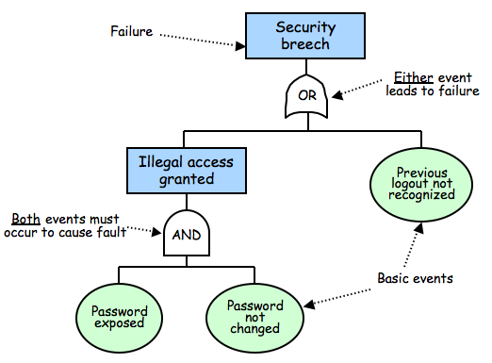
5.7 Architecture Evaluation and Refinement
Safety Analysis (continued)

Slide 70
5.7 Architecture Evaluation and Refinement
Safety Analysis (continued)
Once fault tree is constructed we search for weaknesses
Cut-set tree reveals event combinations can cause failure
  Rules for forming cut-set tree:
    Assign the top node of the cut-set tree to match the logic gate at the top of the fault tree.
    Working from the top down, expand the cut-set tree as follows:
      Expand an or-gate node to have two children, one for each or-gate child
      Expand an and-gate node to have a child composition node listing both of the and-gate children
      Expand a composition node by propagating the node to its children, but expanding one of the gates listed in the node
    Continue until all leaf nodes are basic events or composition nodes of basic events

Slide 71
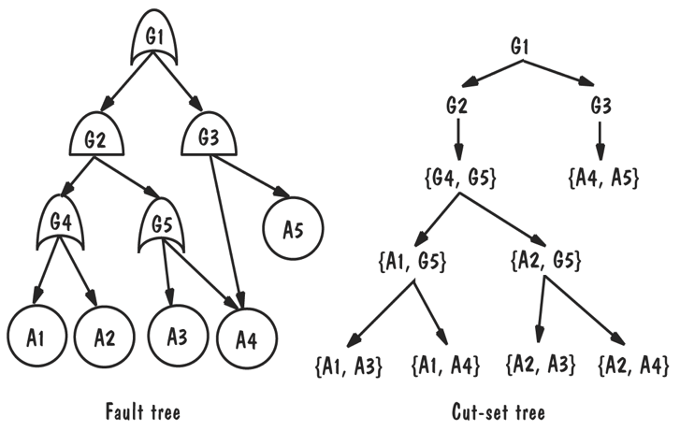
5.7 Architecture Evaluation and Refinement
Safety Analysis (continued)
Once fault is found in design:
  Correct the fault
  Add components or conditions to prevent
  Add components that detect fault and recover from damage

Slide 72
5.7 Architecture Evaluation and Refinement
Security Analysis
Six steps to performing security analysis:
  Software characterization: review documentation for understanding functionality of the system
  Threat analysis: look for threats (e.g., espionage, interception, disruption)
  Vulnerability assessment: includes failure to authenticate user or use of cryptological algorithm that is easy to break
  Risk likelihood determination: must consider motivation, ability of the threat to exploit, impact of the exploitation, and degree to which current controls can prevent
  Risk impact determination: business consequences
  Risk mitigation planning: planning to reduce likelihood and consequences of most severe risks

Slide 73
5.7 Architecture Evaluation and Refinement
Trade-off Analysis
Often several alternative designs to consider
  professional duty to explore design alternatives and not simply implement the first design that comes to mind
  different members of design team may promote competing designs
  need a measurement-based method for comparing design alternatives

Slide 74
5.7 Architecture Evaluation and Refinement
One Specification, Many Designs
One specification, many designs: to see how different designs can be used to solve the same problem
Shaw and Garlan present four different architectural designs to implement KWIC (Key Word in Context problem)
    shared data
    abstract data type
    implicit invocation
    pipe and filter

Slide 75
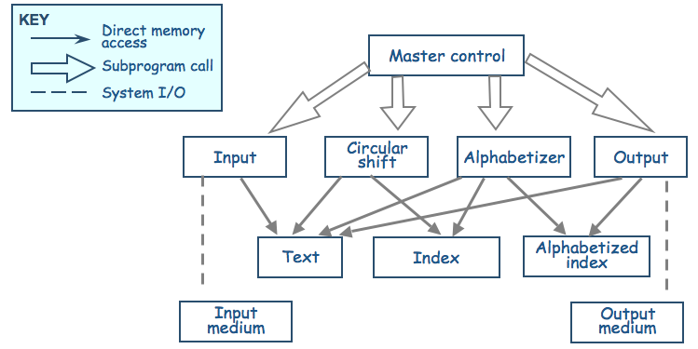
5.7 Architecture Evaluation and Refinement
One Specification, Many Designs (continued)
Shared data solution
Four functional parts: input, circular shift, alphabetize, and output

Slide 76
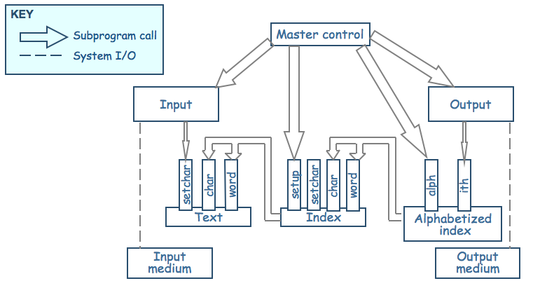
5.7 Architecture Evaluation and Refinement
One Specification, Many Designs (continued)
Data-module solution
Modules form data abstraction (hide data representation)

Slide 77
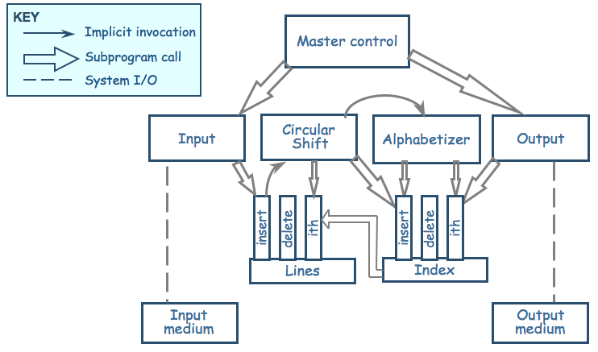
5.7 Architecture Evaluation and Refinement
One Specification, Many Designs (continued)
ADT solution: Data are no longer centralized, stored, and shared, but the decomposition process is similar

Slide 78
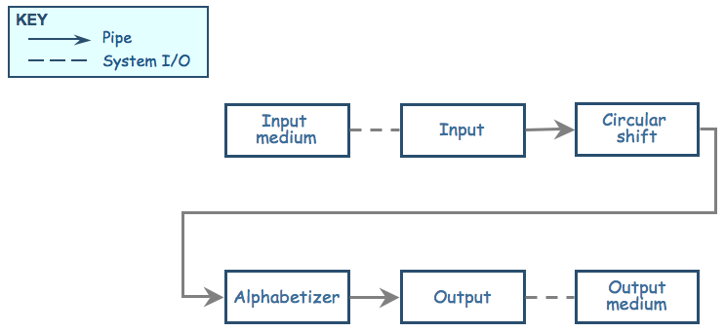
5.7 Architecture Evaluation and Refinement
One Specification, Many Designs (continued)
Pipe-and-filter solution: The sequence of processing is controlled by the sequence of filters

Slide 79
5.7 Architecture Evaluation and Refinement
One Specification, Many Designs (continued)

Slide 80
5.7 Architecture Evaluation and Refinement
One Specification, Many Designs (continued)
Comparison of KWIC solutions
Attribute | Shared Data | Data Abstraction | Implicit Invocation | Pipe and Filter
Easy to change Algorithm | - | - | + | +
Easy to Change Data | - | + | - | -
Easy to Add Functionality | + | - | + | +
Performance | - | - | + | +
Efficient Data Rep | + | + | + | -
Easy to Reuse | - | + | - | +

Slide 81
5.7 Architecture Evaluation and Refinement
One Specification, Many Designs (continued)
Weighted comparison of KWIC solutions
Attribute | Priority | Shared data | Abstract data type | Implicit invocation | Pipe and filter
Easy to change algorithm | 1 | 1 | 2 | 4 | 5
Easy to change data representation | 4 | 1 | 5 | 2 | 1
Easy to change function | 3 | 4 | 1 | 4 | 5
Good performance | 3 | 5 | 4 | 2 | 2
Easy to reuse | 5 | 1 | 4 | 2 | 5

Slide 82
5.7 Architecture Evaluation and Refinement
One Specification, Many Designs (continued)
Other attributes to consider
  Modularity
  Testability
  Security
  Ease of use
  Ease of understanding
  Ease of integration

Slide 83
5.7 Architecture Evaluation and Refinement
Cost-Benefit Analysis
Consider a proposal to improve KWIC performance because the number of KWIC indices have increased
  Eliminate noise word indices?
  Change representation of indices to bin of indices?
  Increase server capacity?
A cost–benefit analysis is a widely used business tool for estimating and comparing the costs and benefits of a proposed change

Slide 84
5.7 Architecture Evaluation and Refinement
Computing Benefits
A cost-benefit analysis contrasts financial benefits with financial costs
  Costs are one time capital expense
  Benefits accrue overtime
Return on Investment (ROI)
  ROI = Benefits/Cost
Payback period
  the length of time before accumulative benefits recover the costs of implementation

Slide 85
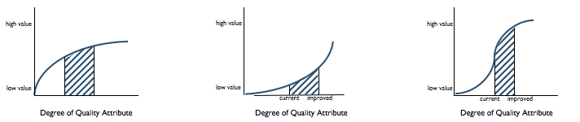
5.7 Architecture Evaluation and Refinement
Computing Benefits (continued)
Value may increase as quality attributes improve
The net value of an improvement is the area under the curve

Slide 86
5.7 Architecture Evaluation and Refinement
Prototyping
Some design decisions are best answered by prototyping
Prototype: an executable model of the system built to answer specific questions about the system
Throw-away prototype: meant to be discarded
Rapid prototyping: progressively refine the prototype until it becomes the final system
Potential risk: the customer may believe the operational prototype is the actual system and close to being finished

Slide 87
5.8 Documenting Software Architectures
System's architecture is vital to overall development and serves as the basis on decisions for:
  Design
  Quality assurance
  Project management
The SAD serves as the repository for design information and includes:
  System overview
  Views
  Software units
  Analysis data and results
  Design rationale
  Definitions, glossary, acronyms

Slide 88
5.8 Documenting Software Architectures
Mappings among Views
Structure of the system and intended measured attributes determine number and type of views to include in SAD
  should at least include decomposition and execution view
Design is collection of views; must show how views relate to one another

Slide 89
5.8 Documenting Software Architectures
Documenting Rationale
Document rationale: outlining critical issues and trade-offs
When to document the rationale behind decision:
  Significant time spent on decision
  Decision is critical
  Decision is counterintuitive
  Costly to change decision

Slide 90
5.9 Architecture Design Review
Design review is an essential part of engineering practice
SAD quality is evaluated in two ways:
  Validation: making sure the design satisfies all of the customer’s requirements (i.e., is this the right system?)
  Verification: ensuring the design adheres to good design principles (i.e., are we building the system right?)

Slide 91
5.9 Architecture Design Review
Validation
Several key people included in review:
  The analyst(s) who helped define the system requirements
  The system architect(s)
  The program designer(s) for this project
  A system tester
  A system maintainer
  A moderator
  A recorder
  Other interested developers not otherwise involved in this project

Slide 92
5.9 Architecture Design Review
Verification
Judge whether it adheres to good design principles:
  Is the architecture modular, well structured, and easy to understand?
  Can we improve the structure and understandability of the architecture?
  Is the architecture portable to other platforms?
  Are aspects of the architecture reusable?
  Does the architecture support ease of testing?
  Does the architecture maximize performance, where appropriate?
  Does the architecture incorporate appropriate techniques for handling faults and preventing failures?
  Can the architecture accommodate all of the expected design changes and extensions that have been documented?

Slide 93
5.9 Architecture Design Review
Verification (continued)
Active design review: exercise the design document by using is in ways the developers will use the final document in practice
Passive review process: reading the documentation and looking for problems

Slide 94
5.10 Software Product Lines
Organizations can find success by reusing their expertise and software assets across families of related products
The corporate strategy for designing and developing the related products is based on the reuse of elements of a common product line
A distinguishing feature of building a product line is the treatment of the derived products as a product family; their simultaneous development is planned from the beginning
The family’s commonalities are described as a collection of reusable assets (including requirements, designs, code, and test cases), all stored in a core asset base

Slide 95
5.10 Software Product Lines
Core Asset Base
Candidate elements in a core asset base:
  Requirements
  Software architecture
  Models and analysis results
  Software units
  Testing
  Project planning
  Team organization

Slide 96
5.10 Software Product Lines
Strategic Scoping
Product lines are based not just on commonalities among products but also on the best way to exploit them
  First, employ strategic business planning to identify the family of products we want to build, using knowledge and good judgment to forecast market trends and predict the demand for various products
  Second, scope the plans, so that the focus is on products that have enough in common to warrant a product-line approach to development. That is, the cost of developing the (common) product line must be more than offset by the savings we expect to accrue from deriving family members from the product line

Slide 97
5.10 Software Product Lines
Sidebar 5.8 Product-line Productivity
CelsiusTech AB, a Swedish naval defense contractor, motivated by desperation, transitioned from custom to product-line development. In 1985, the company, then Philips Elektronikindustier AB, was awarded two major contracts simultaneously, one for the Swedish Navy and one for the Danish Navy.
  senior managers questioned whether they would be able to meet the demands of both contracts, particularly the promised (and fixed) schedules and budgets, using the company’s current practices and technologies.
Development of the product line and the first system were initiated at the same time; development of the second system started six months later. The two systems plus the product line were completed using roughly the same amount of time and staff that was needed previously for a single product. Subsequent products had shorter development timelines. On average, 70–80 percent of the seven systems’ software units were product-line units (re)used as is.

Slide 98
5.10 Software Product Lines
Advantages of Product-Line Architecture
A product lines promotes planned modifiability
Examples of product-line variability:
  Component replacements
  Component specializations
  Product-line parameters
  Architecture extensions and retractions

Slide 99
5.10 Software Product Lines
Sidebar 5.9 Generative Software Development
Generative software development is a form of product-line development that enables products to be generated automatically from specifications
The domain engineer defines a domain-specific language (DSL) that application engineers then use to specify products to be generated
Lucent developed several product lines and generative tools for customizing different aspects of its 5ESS telephone switch

Slide 100
5.10 Software Product Lines
Product-Line Evolution
Key contributor to product-line success is having a product-line mindset
  Company’s primary focus is development and evolution of product-line assets as opposed to individual products
  Changes made to improve capability to derive products
  Backwards capability

Slide 101
5.11 Information System Example
Piccadilly System
What might be a suitable architecture for the Piccadilly systems?
Key components
  A repository of information
  Address multiple heterogeneous queries
A typical reference architecture for an information system
  n-tiered client-server architecture

Slide 102
5.12 Real-Time Example
Ariane-5 Failure
Inquiry found that the Ariane program had a “culture...of only addressing random hardware failures” and assuming the software was correct
Hardware failures are independent of one another
Software faults tend to be logical
  All redundant components will have the same faults
Redundancy in Ariane-5 is likely to recover only from hardware failures

Slide 103
5.13 What This Chapter Means For You
Systems need to be designed based on carefully expressed requirements
Design begins with a high-level architecture, where architectural decisions are based not only on system functionality and required constraints but also on desirable attributes and the long-term intended use of the system (including product lines, reuse, and likely modification)
Keep in mind several characteristics of good architecture as you go, including appropriate user interfaces, performance, modularity, security, and fault tolerance
The goal is not to design the ideal software architecture for a system, because such an architecture might not even exist. Rather, the goal is to design an architecture that meets all of the customer’s requirements while staying within the cost and schedule constraints

