Slide 1

Chapter 10
Delivering the
System
Shari L. Pfleeger
Joann M. Atlee
4th Edition
4th Edition

Slide 2
Contents
10.1 Training
10.2 Documentation
10.3 Information System Example
10.4 Real Time Example
10.5 What this Chapter Means for You

Slide 3
Chapter 10 Objectives
Training
Documentation

Slide 4
Chapter 10: Delivering the System
It is more than just putting the system in place
It is also helping users to understand and feel comfortable with the system
  Training
  Documentation

Slide 5
10.1 Training
Types of People Who Use a System
Users: exercise the main system functions
Operators: perform supplementary functions
  create back up copies of data files
  define who has access to the system

Slide 6
10.1 Training
User and Operators Functions
User Functions | Operator Functions
Manipulating data files | Granting user access
Simulating activities | Granting file access
Analyzing data | Performing backups
Communicating data | Installing new devices
Drawing graphs and charts | Installing new software
 | Recovering damage files

Slide 7
10.1 Training
Types of Training
User training
Operator training
Special training needs

Slide 8
10.1 Training
User Training
Introduces the primary functions
  Record management: record creation, deletion, retrieval, sorting
  Navigation thru the system
  No need to internal mechanism (e.g., sorting algorithms, data structures)
Relates how the functions are performed now, how to perform later with the new system
  Need to take into account the difficulty of transition learning

Slide 9
10.1 Training
Operator Training
Focuses on support functions and addresses how the system works rather than what the system does
Runs in two levels
  how to bring up and run the new system
  how to support users

Slide 10
10.1 Training
Special Training Needs
Infrequent vs. frequent users
  Certain functions may become forgotten
New users (who have replaced trained users)
Existing users interest in brush-up on things missed
Need for specialized traning

Slide 11
10.1 Training
Training Aids
Documents
  Formal documentation, manuals
  A small percentages of the users read them
Icons and online help
  Metaphors (for objects and functions)
  Online manuals provide hypertext links
Demonstrations and classes
  More individualized, more dynamic; uses of multimedia (hearing, seeing)
Expert users (and trained individuals)
  Role models can be convincing

Slide 12
10.1 Training
Guidelines for Training
Understand the personal preferences, work styles, and organizational pressures
Need to accommodate different types of students
  individualized system
Divide a training class or demonstration into presentation units with short, limited scope
Determines the type of training based on the location of the students
  Hundreds of students all over? Use web-based training

Slide 13
10.2 Documentation
Considering the Audiences
Need to understand the intended audience
  Users
  Operators
  Customer staff
  Other member of development team
Design different document for different audience
  Include a “gentle” introduction

Slide 14
10.2 Documentation
Types of Documentations
User’s manual
Operator’s manual
General system guide
Tutorials and automated overviews
Other documentation: Programmer guide

Slide 15
10.2 Documentation
User’s Manuals
Beginning with the general purpose, and progressing to detailed functional description
  system’s purpose or objectives
  system’s capabilities and functions
  system features, characteristics, advantages

Slide 16
10.2 Documentation
Operator’s Manuals
Hardware and software configuration
Methods of granting and denying access to a user
Procedures for adding and removing peripherals from system
Techniques for duplicating or backing up files and documents

Slide 17
10.2 Documentation
General System Guide
The system details in terms the customer can understand
The system hardware and software configuration
The philosophy behind the system’s construction
Provide cross-referencing

Slide 18
10.2 Documentation
Tutorials and Automated System Overviews
Multimedia-based, step-by-step, automated tutorials

Slide 19
10.2 Documentation
Other Documentation: Programmer’s Guide
An overview of how the software and hardware are configured
Software components detailed and their functions performed
System support functions
System enhancements

Slide 20
10.2 Documentation
User Helps and Troubleshooting
Failure message reference guide
Online helps files
Quick reference guide (a quick summary of primary uses, configuration)

Slide 21
10.2 Documentation
Guidelines for Failure Messages
The name of code component executing when the failure occurred
The source code line number in the component that was executing
The failure severity and its impact on the system
The contents of any relevant system memory or data pointers, such as registers or stack pointers
The nature of the failure, or a failure message number (for cross-reference with the failure message reference guide)

Slide 22
10.2 Documentation
Example Failure Messages
The failure message
    FAILURE 345A1: STACK OVERFLOW
    OCCURRED IN: COMPONENT DEFRECD
    AT LINE: 12300
    SEVERITY: WARNING
    REGISTER CONTENTS: 0000 0000 1100 1010 1100 1010 1111 0000
    PRESS FUNCTION KEY 12 TO CONTINUE
The reference guide entry
    Failure 345A1: Stack overflow.
    This problem occurs when more fields are defined for a record than the system can accommodate. The last field defined will not be included in the record. You can change the record size using the Record Maintenance function on the Maintenance menu to prevent this failure in the future.

Slide 23
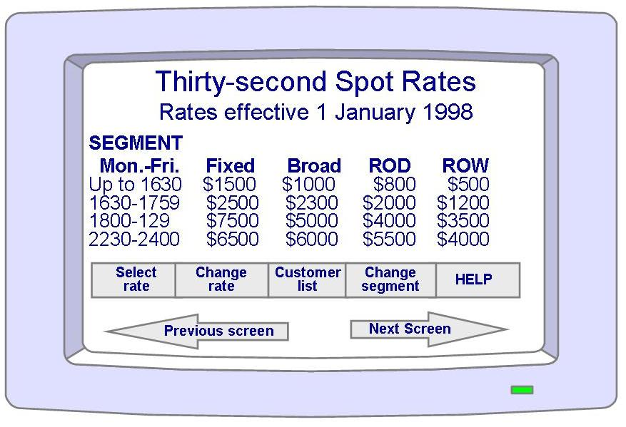
10.3 Information System Example
Piccadilly System
A training system can present users with the actual Piccadilly screen
Training software can be added to allow users to understand the nature and purpose of each system function

Slide 24
10.4 Real-Time Example
Ariene-5
Some of the assumptions about the reused Ariane-4 software were not present in the documentation
  The designers of Ariene-5 should have been able to read all of the underlying assumptions inherent in the code

Slide 25
10.5 What This Chapter Means for You
Training and documentation should be planned and tracked from the project’s beginning
Training and documentation software should be integrated with the regular system software
All training and documentation modules and documents should take into account the varying needs of different audiences

