Slide 1
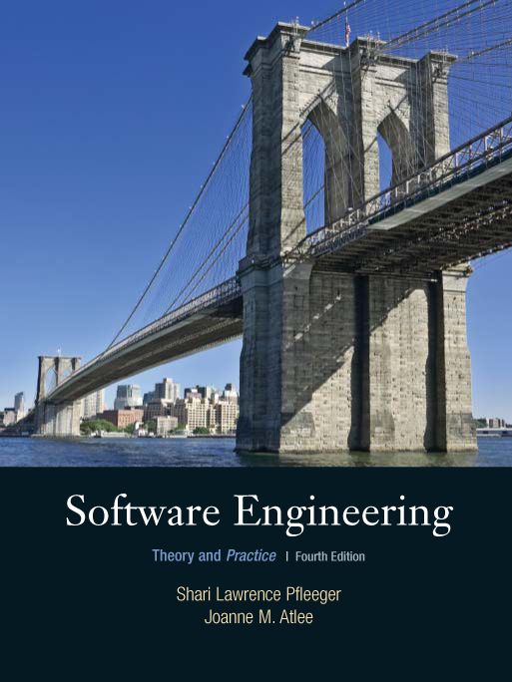
Chapter 7
Writing the
Programs
Shari L. Pfleeger
Joann M. Atlee
4th Edition

Slide 2
Contents
7.1 Programming Standards and Procedures
7.2 Programming Guidelines
7.3 Documentation
7.4 The Programming Process
7.5 Information System Example
7.6 Real Time Example
7.7 What this Chapter Means for You

Slide 3
Chapter 7 Objectives
Standards for programming
Guidelines for reuse
Using design to frame the code
Internal and external documentation

Slide 4
7.1 Programming Standards and Procedures
Standards for you
  methods of code documentation
Standards for others
  Integrators, maintainers, testers
  Prologue documentation
  Automated tools to identify dependencies
Matching design with implementation
  Low coupling, high cohesion, well-defined interfaces

Slide 5
7.2 Programming Guidelines
Control Structures
Make the code easy to read
Build the program from modular blocks
Make the code not too specific, and not too general
Use parameter names and comments to exhibit coupling among components
Make the dependency among components visible

Slide 6
7.2 Programming Guidelines
Example of Control Structures
Control skips around among the program’s statements
    benefit = minimum;
    if (age < 75) goto A;
    benefit = maximum;
    goto C;
    if (AGE < 65) goto B;
    if (AGE < 55) goto C;
    A: if (AGE < 65) goto B;
    benefit = benefit * 1.5 + bonus;
    goto C;
    B: if (age < 55) goto C;
    benefit = benefit * 1.5;
    C: next statement
Rearrange the code
      if (age < 55) benefit = minimum;
      elseif (AGE < 65) benefit = minimum + bonus;
      elseif (AGE < 75) benefit = minimum * 1.5 + bonus;
      else benefit = maximum;

Slide 7
7.2 Programming Guidelines
Algorithms
Common objective and concern: performance (speed)
Efficiency may have hidden costs
  cost to write the code faster
  cost to test the code
  cost to understand the code
  cost to modify the code

Slide 8
7.2 Programming Guidelines
Data Structures
Several techniques that used the structure of data to organize the program
  keeping the program simple
  using a data structure to determine a program structure

Slide 9
7.2 Programming Guidelines
General Guidelines to Preserve Quality
Localize input and output
Employ pseudocode
Revise and rewrite, rather than patch
Reuse
  Producer reuse: create components designed to be reused in future applications
  Consumer reuse: reuse components initially developed for other projects

Slide 10
7.2 Programming Guidelines
Consumer Reuse
Four key characteristics to check about components to reuse
  does the component perform the function or provide the data needed?
  is it less modification than building the component from scratch?
  is the component well-documented?
  is there a complete record of the component’s test and revision history?

Slide 11
7.2 Programming Guidelines
Producer Reuse
Several issues to keep in mind
  make the components general
  separate dependencies (to isolate sections likely to change)
  keep the component interface general and well-defined
  include information about any faults found and fixed
  use clear naming conventions
  document data structures and algorithms
  keep the communication and error-handling sections separate and easy to modify

Slide 12
7.3 Documentation
Internal documentation
  header comment block
  meaningful variable names and statement labels
  other program comments
  format to enhance understanding
  document data (data dictionary)
External documentation
  describe the problem
  describe the algorithm
  describe the data

Slide 13
7.3 Documentation
Information Included in Header Comment Block
What is the component called
Who wrote the component
Where the component fits in the general system design
When the component was written and revised
Why the component exists
How the component uses its data structures, algorithms, and control

Slide 14
7.4 The Programming Process
Programming as Problem-Solving
Polya’s (1957) four distinct stages of finding a good solution
  understanding the problem
  devising plan
  carrying out the plan
  looking back

Slide 15
7.4 The Programming Process
Extreme Programming
Two types of participants
  customers: who define the features using stories, describe detailed tests and assign priorities
  programmers: who implement the stories

Slide 16
7.4 The Programming Process
Pair Programming
The driver or pilot: controlling the computer and writing the code
The navigator: reviewing the driver’s code and providing feedback

Slide 17
7.4 The Programming Process
Whither Programming?
Documentation is still essential in agile-methods
  Assist the developers in planning, as a roadmap
  Helps describe key abstractions and defines system boundaries
  Assists in communicating among team members

Slide 18
/ position_x is the position x of object; position_y is the position y of object; /
if a>b then
a=b
else
if position_x>position_y then
b=position_y
else
a=position_x
end if
end if
if a>b
then
if x>y
then
b=y
else
a=x
end if
else
a=b
end if

