Slide 1
QISKIT FALL FEST 2026 · TRACK 1
Spacetime Sentinel
Protecting quantum circuits with checks in space AND time
Team: [TEAM NAME] · [NAMES] · [COLLEGE]

Slide 2
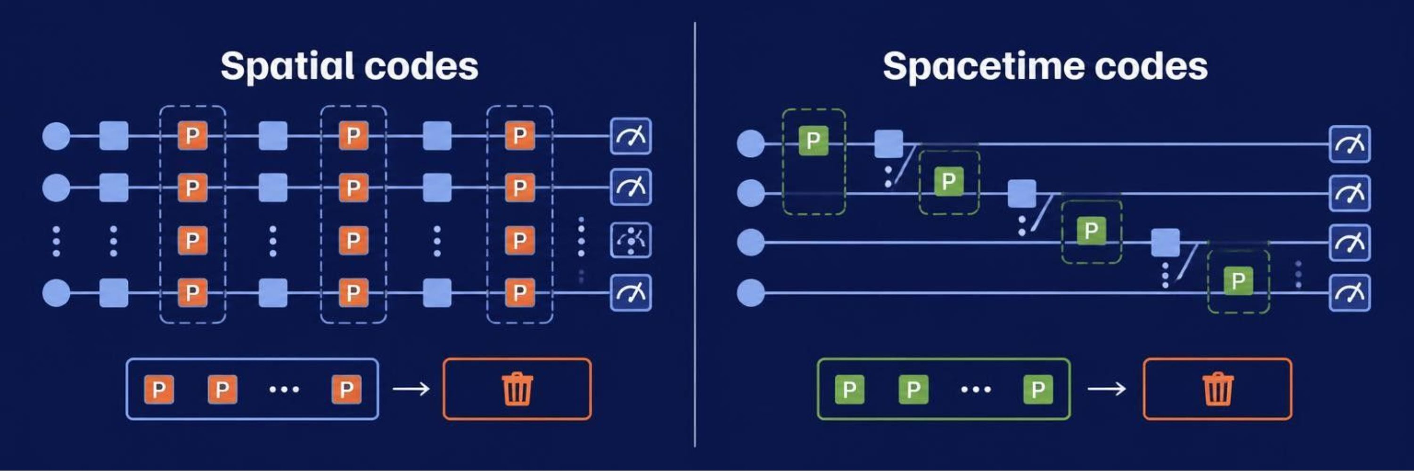
01 · THE PROBLEM
Quantum errors spread through time, not just across qubits
Every gate can introduce noise. Detection has to follow the circuit as it evolves.
Our task: add Controlled-Pauli checks, then discard corrupted shots.

Slide 3
02 · THE EXPERIMENT
Three requirements turn the idea into an experiment
Design
Checks
Filter
A VQE/QAOA-style circuit with dense T-gates.
Controlled-Pauli X/Y/Z operations at specific space-time coordinates.
Read ancilla syndromes and reject corrupted shots.
Scientific question
Judging
How does check separation change fidelity? Compare Clifford-only and T-doped circuits.
Qiskit add-ons 10% · Methodology 20% · Conceptual breakthrough 30% · Presentation 40%

Slide 4






03 · THE VOCABULARY
The vocabulary behind the sentinel
Six terms make the mechanism easier to read.
Qubit + noise
Pauli X/Y/Z
Clifford vs T
A qubit can be 0, 1, or both; noise flips or scrambles it.
The basic error operators.
Clifford gates preserve Pauli structure; T does not.
Ancilla + syndrome
Pauli check sandwich
Post-selection
A helper qubit reports 0 for clean, 1 for a detected error.
Checks at times A and B flag errors between them.
Keep all-zero syndromes to trade yield for fidelity.

Slide 5
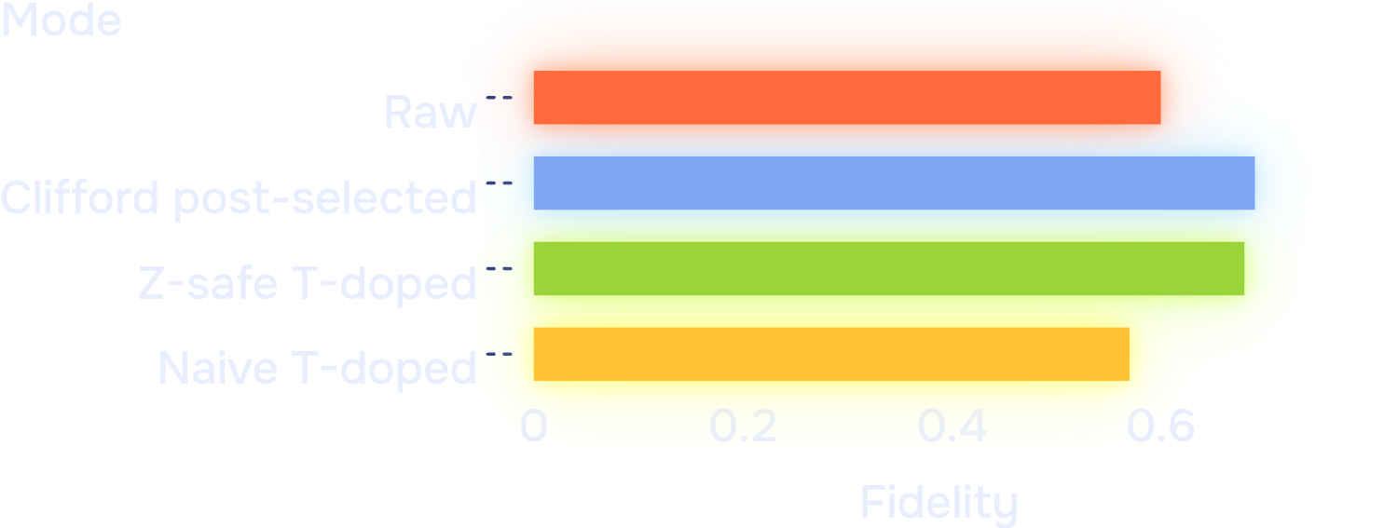
04 · THE INSIGHT
Z-safe T-doping keeps spacetime checks useful
Place T-gates where the checks remain safe, then measure the trade-off.
EXPERIMENT 1 · EXPERIMENT_1_CLIFFORD_VS_TDOPED.PNG
EXPERIMENT 2 · EXPERIMENT_2_SPACETIME_SEPARATION.PNG
Check separation sweep
Sweep separation dt = 2, 3, 4, 6, 12 across tiled check windows.
Circuit · 4-qubit, 12-layer echo circuit; ideal output is exactly |0000>.
Z-safe rule · T commutes with I/Z checks, but scrambles X/Y checks. Place T-gates only where checks stay Z-safe.
Noise · 2% two-qubit depolarizing, idle ancilla noise, and 1% readout error; Aer plus a built-in Controlled-Pauli fallback.
At dt=4: raw fidelity 0.60 → Clifford post-selected 0.69 at 71% yield → Z-safe T-doped 0.68 at 70% yield → naive T-doped 0.57 at 40% yield.

Slide 6
05 · THE BUILD
Each feature makes the experiment judgeable
Qiskit builder: creates the 4-qubit echo circuit and layer variants.
qiskit-paulice + fallback: inserts Controlled-Pauli checks at chosen coordinates.
Propagation tracker: computes the matching end-of-window check.
T modes: compares Clifford-only, naive, and Z-safe placement at equal T-count.
Aer noise model: adds two-qubit, idle, and readout noise.
Post-selection + dt sweep: reports fidelity/yield and exposes the check-window trade-off.
Spacetime Sentinel game: lets judges place checks and T-gates; live score = Fidelity × Yield^0.25.
Z-safe T placement keeps the power of spacetime checks on non-Clifford circuits.

