Slide 1

Humber Esports Website
IXD 5105 – Group 23

Slide 2


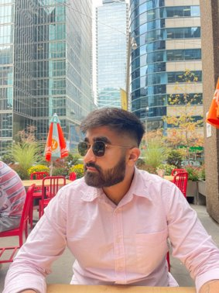

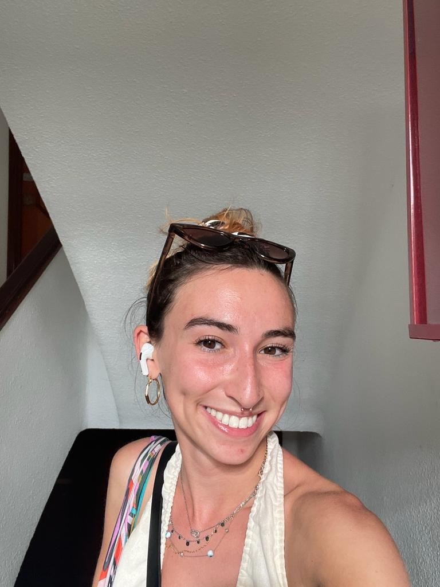
Team Bios
Hello, my name is Suyash and I am an experienced IT professional proficient in a spectrum of technologies including React.js, TypeScript, SharePoint SPFX, PowerShell, HTML, CSS, C# and .NET. Skilled in crafting seamless, user-friendly optimized solution. Passionate about continuous learning and staying updated with emerging tech trends. Ready to collaborate on projects that demand innovation and efficiency in the IT landscape.

Slide 3


Team Bios
Hello, I'm Diego Rivera, an Industrial Designer from Colombia. I'm passionate about web design, digital marketing, and dabble a bit in coding, specifically with React and React Native.
Currently, I'm delving into the Full Stack Developer world at Humber College in Canada. Beyond the tech stuff, I love arts, movies, and sports.

Slide 4
Team Bios
Hi, I’m Daksh Nagpal. I’m currently pursuing the Interactive Media Management - Creative Technologies course. I’m a graphic designer by profession and have a passion for creating visually appealing graphics that communicate complex ideas in a simple and effective manner. I’m also exploring new design trends and experimenting with new tools and techniques to create innovative designs in my free time.

Slide 5

Team Bios
Hello Everyone, I am Vishalini. I am UX Design student here. I completed my bachelor's in Computer Science from India. I have worked or couple of projects which like a wedding planning app, a fast food restaurant app. With the little knowledge that I have, I have collaborated with my team and we have come up with an esports website.

Slide 6
Team Bios
Hello, I’m Rachel Freedman, a UX design student here at Humber. I have a Bachelor’s degree in psychology from the university of Guelph and am new to the UX and technology field. I am passionate about learning new skills and meeting new people. My career goal is to blend my UX knowledge with fundraising and education to improve mental health supports. I am also interested in crocheting, knitting, and travelling.

Slide 7
Introduction
What is EGames ?
EGames is an interdisciplinary community that encompasses esports, game development, and gaming culture. It provides a platform for students to explore their interests, compete in tournaments, learn from industry professionals, and contribute to the vibrant gaming community at the college.
A generic term for any amusement or recreation using a stand-alone video game, desktop computer or over the Internet with one or more players.

Slide 8
Introduction
The evolution of esports (electronic sports or egames) over the last 10 years has been remarkable, with significant advancements in various aspects such as popularity, infrastructure, investment, and professionalization. Here are some key trends and developments:
Increased Popularity:
Esports has seen a tremendous surge in popularity, with a growing fan base around the world. Major tournaments and leagues attract millions of viewers, both online and in-person.
Professionalization:
Esports has become more organized and professional, with structured leagues, teams, and player contracts. Players are now recognized as professional athletes, and organizations operate similarly to traditional sports teams.

Slide 9
Introduction
Diversification of Games:
While games like League of Legends, Dota 2, and Counter-Strike: Global Offensive have maintained their popularity, new games, such as Fortnite, Overwatch, and Valorant, have entered the scene and gained massive followings.
Investment and Sponsorship:
There has been a significant increase in investment from traditional sports teams, celebrities, and large corporations. Sponsorship deals with major brands have become commonplace, contributing to the financial growth of the industry.

Slide 10
CMS (Content Management System)
Which CMS is best fit and Why?
Our choice for the Content Management System (CMS) is WordPress. WordPress stands out for its user-friendly interface, extensive plugin support, and a massive developer community. Its adaptability aligns with the dynamic nature of the EGames community, allowing seamless content management and future scalability.
Reasons for selecting this CMS is it provides following things: Customized Templates, User Management, E-Commerce, Chatroom and Chatbots.

Slide 11
Features
Live streaming.
Team and player info.
Social Media integration.
Game information.
User Account.
Chat rooms, Groups.
E-commerce

Slide 12



Features
What actions would you suggest confirming those features?
Research and Testing:
Conduct thorough research on WordPress capabilities and test its suitability for Egames' needs through a prototype or development environment.
Usability Testing:
Implement usability testing with a diverse group of users to ensure the website is intuitive and accessible.
Analyse user behaviour to refine and optimize the user experience.
Community Workshops:
Conduct workshops or webinars to showcase proposed features and gather feedback.
Utilize interactive polls and Q&A sessions for real-time input.
Prototype Testing:
Develop a prototype of key features for beta testing.
Encourage community members to explore and provide feedback.

Slide 13
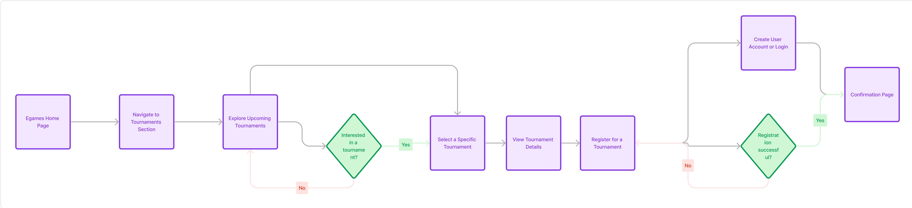
User Flow

Slide 14

Wire Frames

Slide 15
Conclusion
"The proposed EGames community website is not just a digital platform; it's a gateway to a more vibrant and interconnected gaming community at Humber College. By leveraging the power of WordPress and incorporating innovative features, our goal is to create an online space that transcends the boundaries of traditional gaming forums. This website is more than a collection of pages; it's a dynamic hub where passion meets technology, and where every member has the opportunity to contribute, connect, and celebrate the diverse world of electronic gaming. As a team, we are committed to building not just a website, but a virtual home for the EGames community—a space that evolves with its members, fostering collaboration, competition, and continuous growth. Together, let's take the EGames experience to new heights!"

Slide 16
"To proceed with the next steps and bring this vision to reality, we seek your approval and collaboration. Your insights and feedback are invaluable, and we are committed to working closely with you every step of the way to ensure the successful development and launch of the Egames website.
We are excited about the prospect of transforming Egames into a digital powerhouse, and we look forward to the opportunity to contribute to its continued success. Thank you for considering our proposal, and we are eager to embark on this journey together."

Slide 17
Thank You

