Slide 1
Feedback System
Suyash Sunil Patalbansi (2046491245052)
Amit Nandlal Jibhkate (2046491245003)
Shreya Maroti Raut (2046491245047)
Prof. Abhishek Kinhekar
Assistant Professor

Slide 2
1. Introduction
What is feedback system?
Feedback System is used for taking feedbacks, managing records, improving the existing feedback gathering systems, decreases faculty load.
Problems faced due to previous system:
Manual work / calculations.
Current system is inappropriate for analytics.
Student’s credentials are visible to the faculties after their responses.

Slide 3
1. Introduction
Why is feedback system?
It would be more accurate/error free as there would be automatic calculations rather than manual.
Anonymously response facility would be provided to the students.
The system also reduces the burden of efforts and keeping or maintaining the records on a manual base.
It requires a lot of space and safety to keep up such records.
It maintains the analytics for all the stakeholders and also displays the responses’ data in infographic format.
By the Feedback system, report generation consumes very less time.
No pre-requisite knowledge is needed for using our system.

Slide 4
2. Objectives & Scope of Project
The main objective of this feedback system is:
To record, classify, aggregate and analyse the students’ feedbacks
To provide, a simple, user friendly interface to manage all activities in a simpler manner.
To provide an automated system without any manual calculations.
To provide analysis of responses in infographic format.
Anonymous attempts of feedback forms.
Secure key based feedback system.

Slide 5




3. Stakeholders
Admin
Students
Teachers
Parent

Slide 6
4. Literature Survey.
Student Feedback Management System for evaluation and generate semester-wise reports [1].
We have developed a student feedback system to provide feedback in a quick and easy manner to the particular department [2].

Slide 7
5. Proposed Solution
Our proposed solution consist of a website where the students are able to give feedback for faculties, seminar & workshops, Add-on, VAP and to fill the course exit survey.
All the stakeholders are provided with their credentials where students are provided with the facility to login anonymously for faculty feedback.
Teacher will be able create questions for feedback.
Different types of answering modes available (MAQs, MCQs, One-line, etc).
Anonymous attempts of feedback form.
Different types of formats present for displaying data collected from responses.
Suggestions to teachers for improvements.
Different types of feedback forms present:
Academic feedback
Course Exit Survey
Add On, VAP feedback
Workshops and Seminars feedbacks

Slide 8
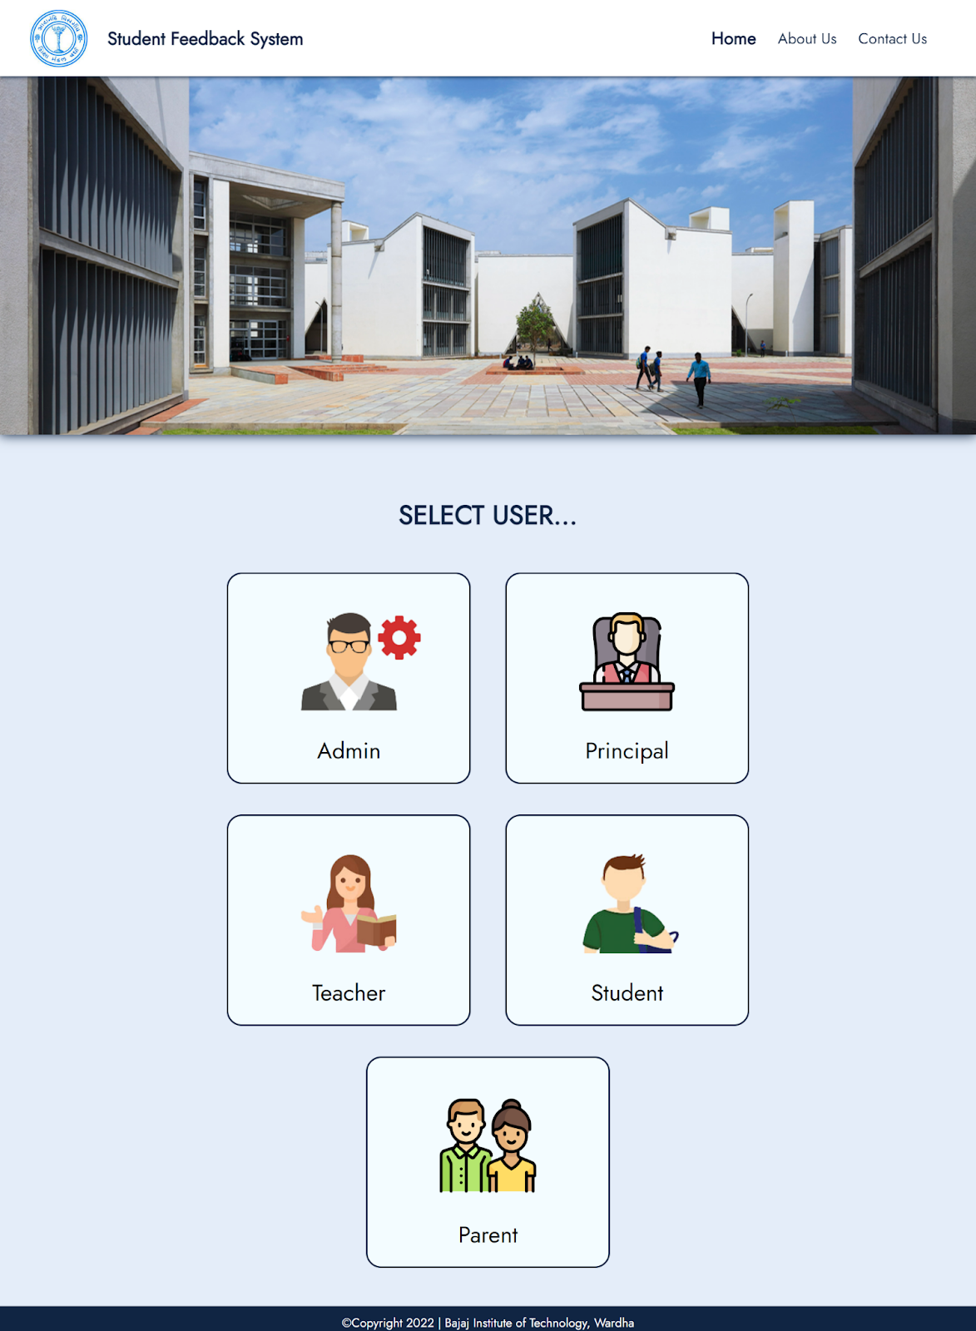
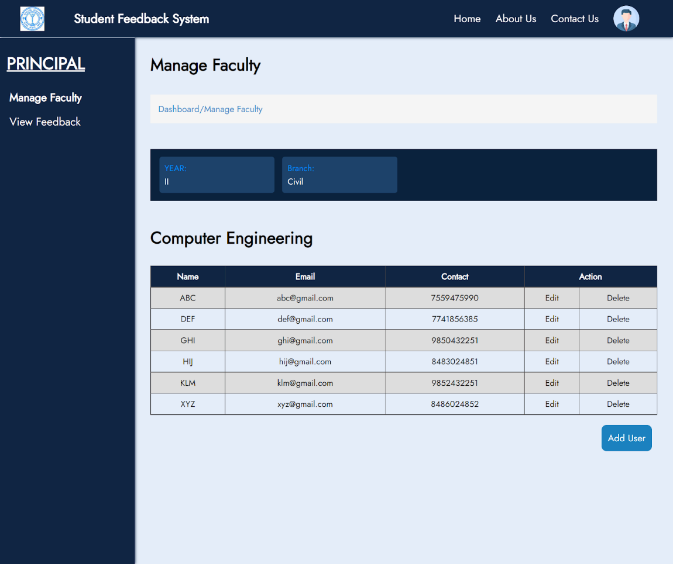
6. Expected Outcome/Results/Snapshots of Projects

Slide 9
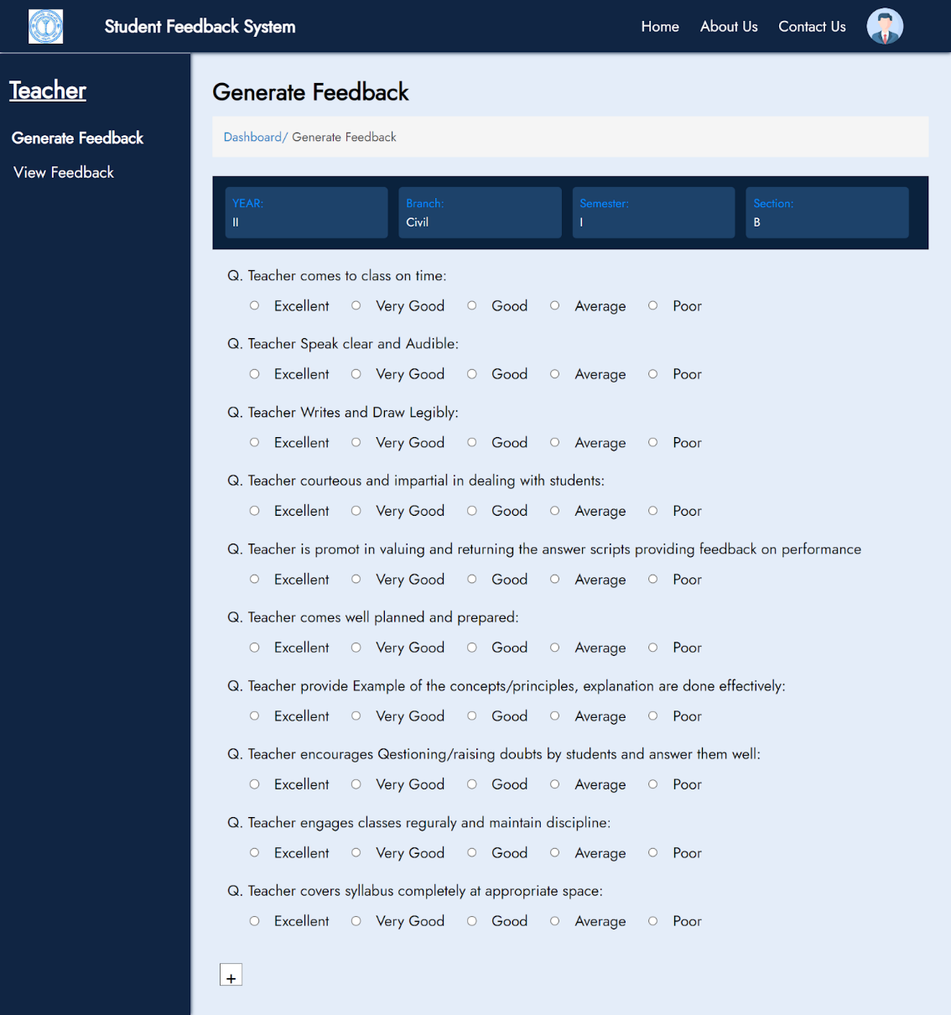
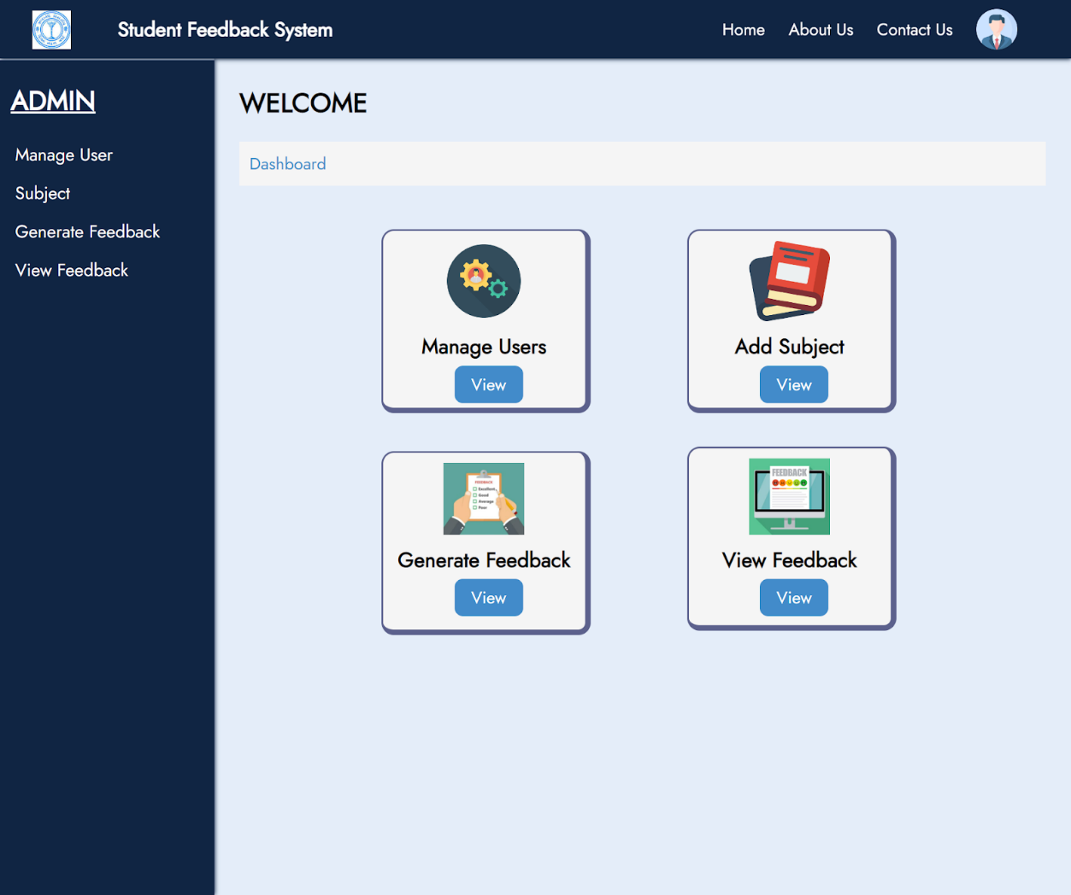
6. Expected Outcome/Results/Snapshots of Projects

Slide 10




7. Technologies Used
CSS
JS
HTML
Front-End:
PHP
MYSQL
BackEnd &
Database:

Slide 11
9. Conclusion
In this way, we will be providing a Web-Based solution for Student Feedback System through which faculties would be able to manage all the feedbacks, analyse feedbacks and provide reports to all the stakeholders accordingly.

Slide 12
10. References
Ankita Malkhandala, Archana Nashine, Komal Deulkar, Shraddha Raut, Yogita Gaidhane, Prof. Nitesh Hatwar, , Bhandara International Journal of Innovation in Engineering and Science, Volume 4, 2019.
http://www.ijies.net/finial-docs/finial-pdf/3103198.pdf
https://irejournals.com/formatedpaper/1700576.pdf
https://www.slideshare.net/raushan29/project-report-of-faculty-feedback-system

Slide 13
Thank You.

