Slide 1
Placement Preparation Module Focusing on DSA
Suyash Patalbansi (2046491245052)
2. Shreya Raut (20464912450547)
3. Susmita Kujur (2046491245051)
4. Shreya Chinchmalatpure (2046491245048)
Prof. Sheetal Kale
Professor and Head of the Department

Slide 2
1. Introduction
The placement preparation DSA module is a dynamic website for students to build a strong foundation in data structures and algorithms, providing them with structured learning resources, visualized learning materials, practice quizzes and challenging programming questions.
Overall, the placement preparation DSA progress tracking website can provide a comprehensive and supportive learning environment to the students to prepare better for the placements, and ultimately helping students master the essentials DSA concepts.
Some of the challenges/ obstacles faced by the students:
Features of the project:
1
Scattered materials/ resources present on different websites.
1
Engaging and interactive course materials
2
Lack of centralized dashboard to track user progress / involvement.
2
Structured and visual learning i.e Roadmaps.
3
Problem of inconsistency while preparation.
3
Practice quizzes and challenging coding problems at same place/ platform.

Slide 3
2. Objectives of Project
1
Interactive learning resources covering various DSA concepts.
5
Provide compiler supporting various programming languages(user can enter test cases)
Personalized Progress Tracking (via dashboards)
6
DSA Roadmap
2
3
Topic-wise learning level-wise practice quizzes.
7
Resource Centralization(less time for searching suitable resources by curating(select/organize) high quality content on user’s fingertips)
4
Cheat Sheet (covering additional information)
8
Email Notifications

Slide 4


3. Stakeholders
Admin
Users

Slide 5
4. Literature Survey.
Sr. No. | Paper Title | Authors | Summary
1 | Visualization, Assessment and Analytics in Data Structures Learning Modules | Matthew Mcquaigue, David Burlinson, Kalpathi Subramanian, Erik Saule, and Jamie Payton. 2017. | They have build a interactive teaching modules for data structures and algorithms courses. The modules are highly visual and interactive and training and assessment are tightly integrated within the same module and a data logging and analytic system that provides instantaneous student feedback and assessment. They also have interactive visual analytic system for the instructor to see students’ performance at the individual, sub-group or class level.
2 | Interactive Data Structure Learning Platform | Estevan B. Costa and Armando M. Toda and Marcell A. A. Mesquita and Fabio T. Matsunaga and Jacques D. Brancher. 2014 | The paper describes the development and implementation of an interactive web learning environment, called DSLEP (Data Structure Learning Platform). The system includes basic concepts taught in DSA and it also have gamification concepts, such as points, levels, and leaderboards, which motivates students.
3 | Active Learning through Game Play in a Data Structures Course | D. Dicheva and A. Hodge. 2018 | They have developed a game that targets all the three aspects of teaching data structures i.e. conceptualization, application and implementation. The application part of game targets the use of stacks to solve problems and the implementation part involves solving Parson’s problems and writing Java code for implementing the methods of the Stack. The results shows statistically significant learning gains for the students and a strong positive attitude.
4 | Design and architecture of an interactive eTextbook – The OpenDSA system | Eric Fouh a, Ville Karavirta b, Daniel A. Breakiron a, Sally Hamouda a, Simin Hall c, Thomas L. Naps d, Clifford A. Shaffer. 2013 | They have developed a highly interactive eTextbook that involves the use of many algorithm visualizations (AVs) and a wide range of interactive exercises with automated assessment. They used third-party and custom software components that make up a client/server-based web application. This an open source project.

Slide 6
5. Proposed Solution
The solution involves a website designed to help students get ready for job placements.
Cheatsheets and Roadmaps will be provided to users.
The system consists of various learning resources which will help users to learn different DSA concepts on the same platform.
Topic-wise quizzes and programming questions will be given to users which will help them to prepare for interviews.
The users will be provided with various different infographics to track their progress on personalized dashboards.
Daily reminders will be sent to users in the form of email notifications to keep them engaged.

Slide 7
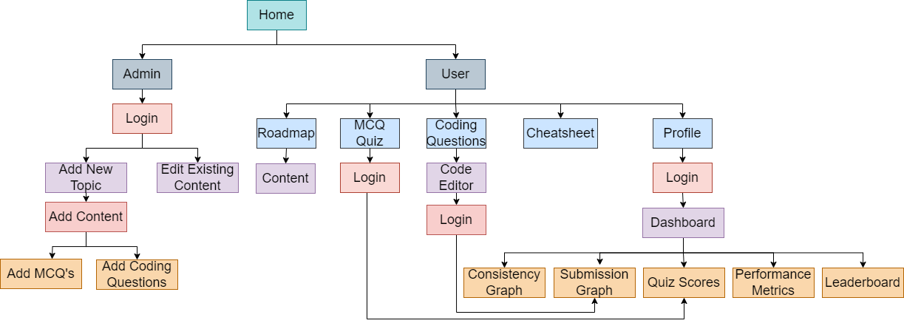
5. Proposed Solution

Slide 8
6. Expected Outcome
Project outcome include :
Provide guidance in learning Data Structures and Algorithms.
Track individual progress
Multiple-Choice Questions (MCQs) to help users prepare for Interview
All the scattered learning materials and resources are brought together at one place.
Help users to maintain consistency.
Support users in staying on track through helpful notifications.

Slide 9
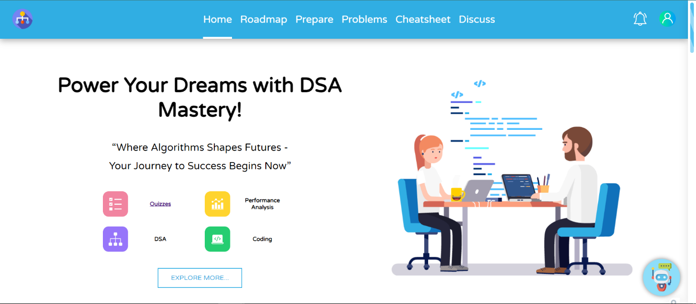
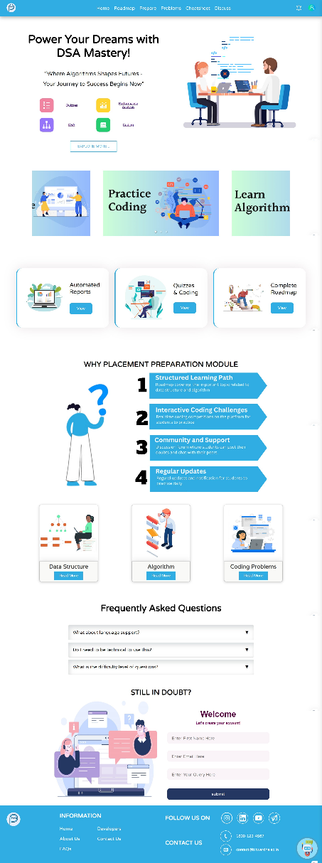

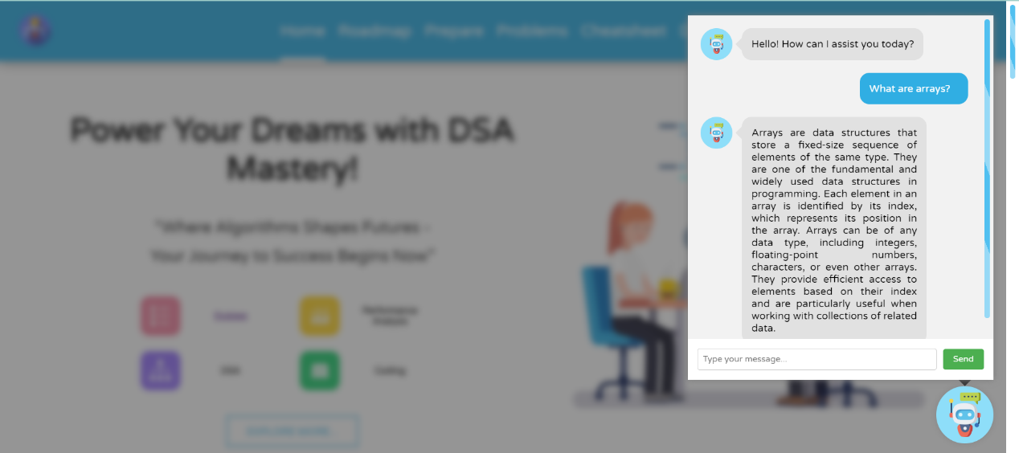
6. Expected Outcome
Fig. : Home Page
Fig. : Login Page
Fig. : Chatbot
Fig. : Home Page

Slide 10
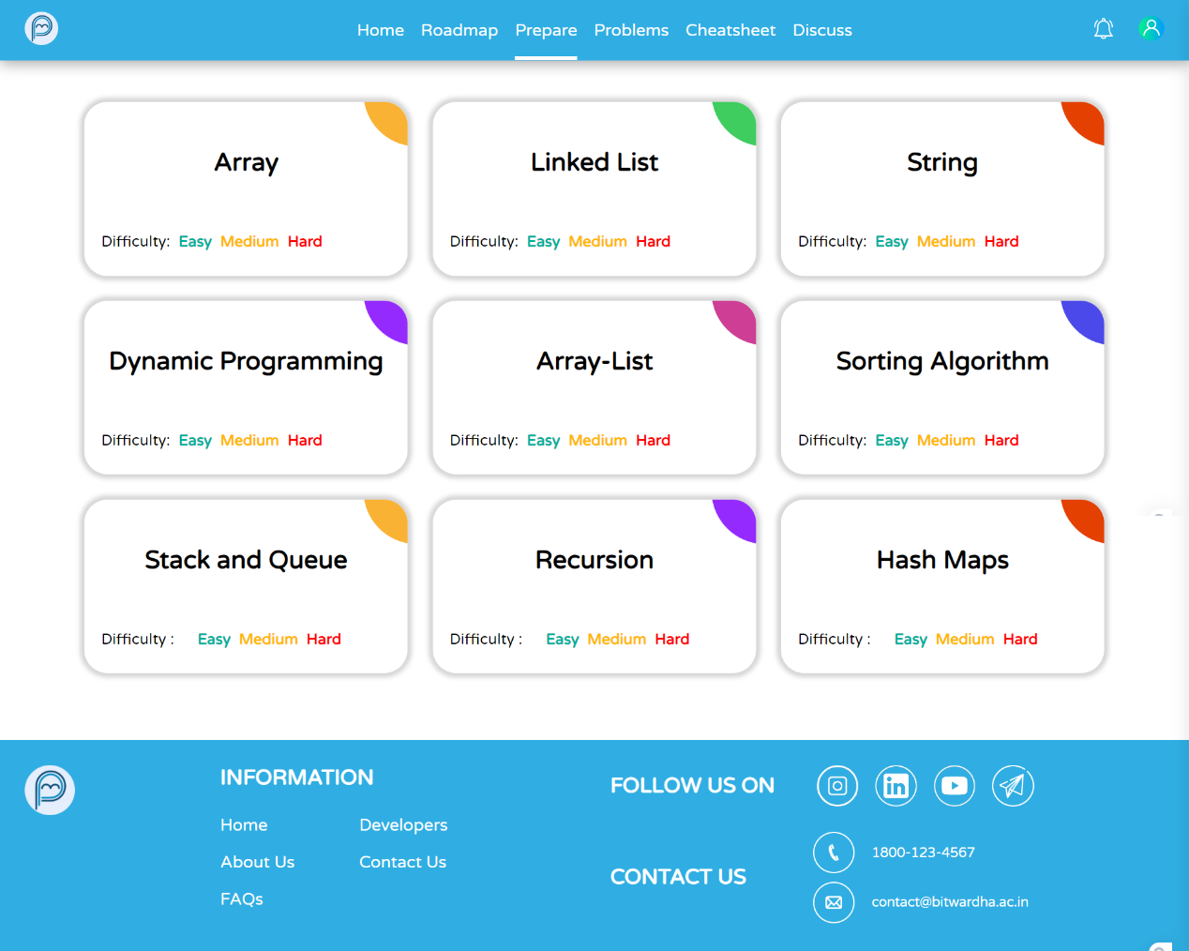
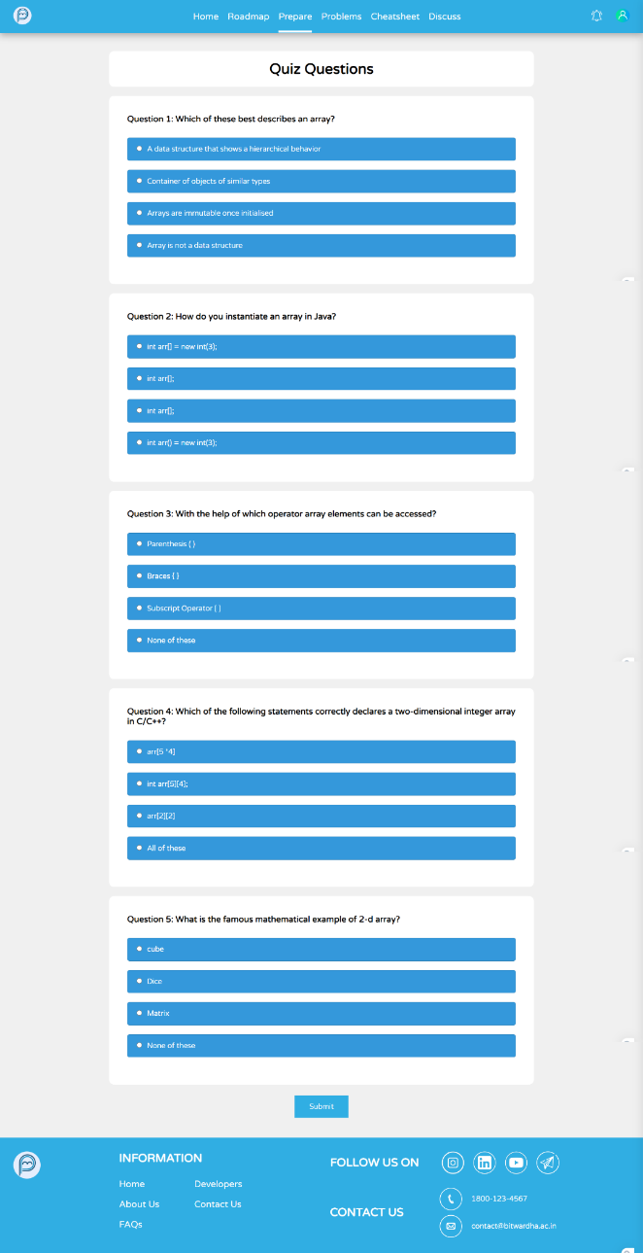
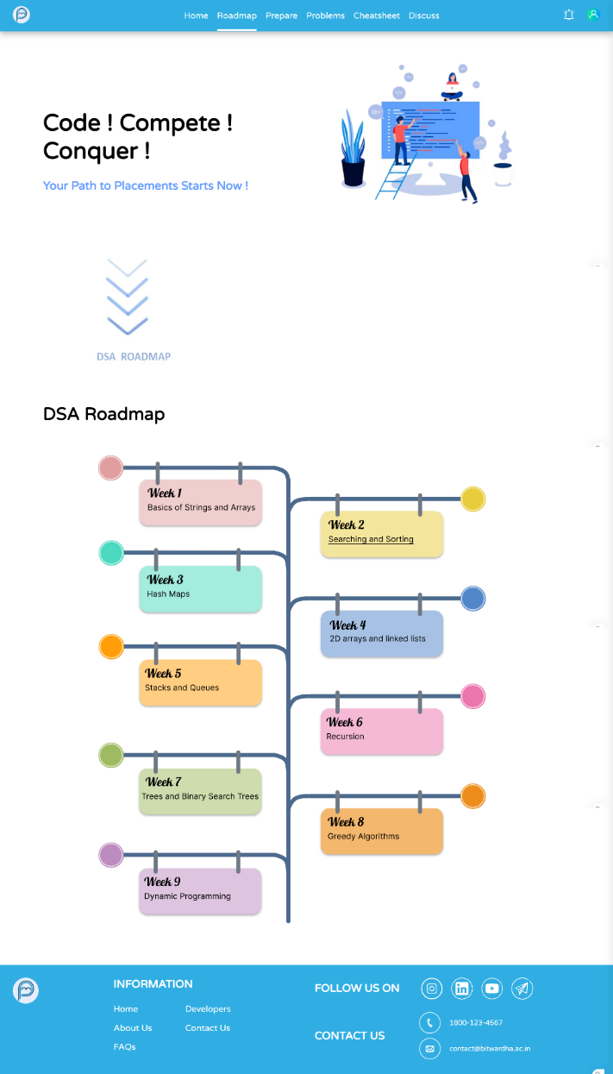
6. Expected Outcome
Fig. : Quiz Page
Fig. : Quiz Form Page
Fig. : Roadmap Page

Slide 11
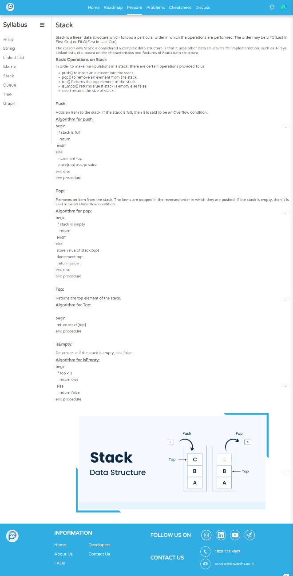
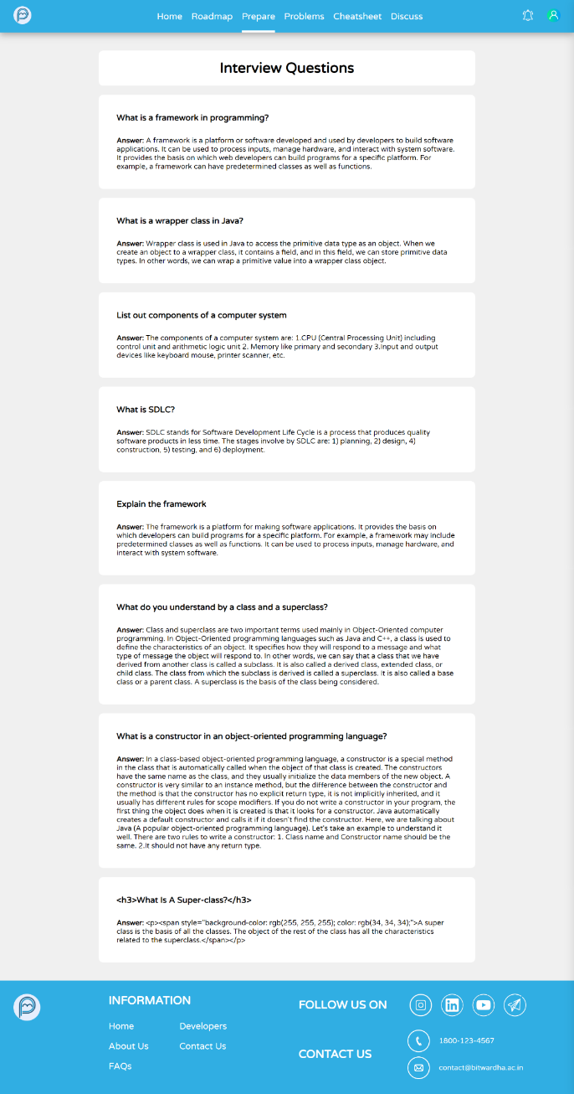
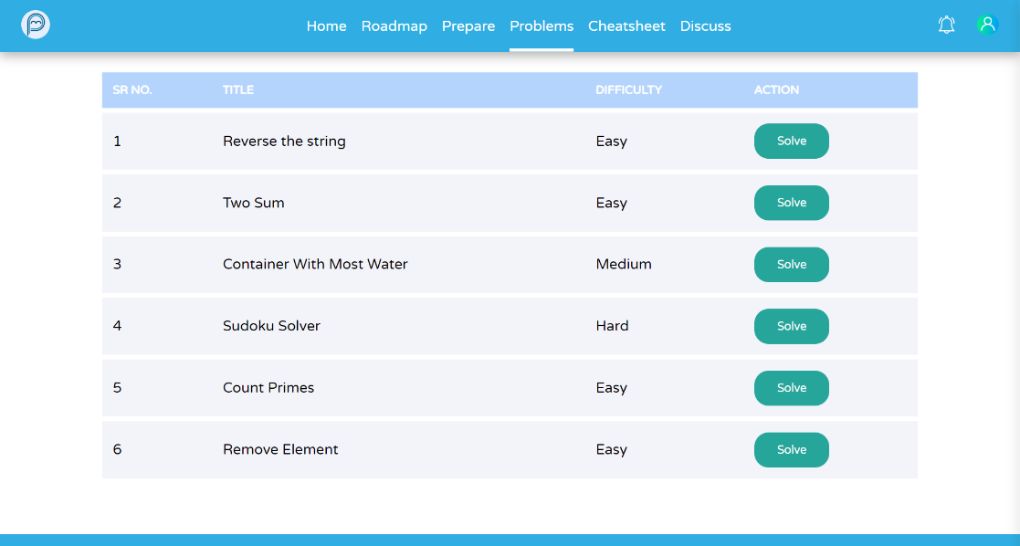
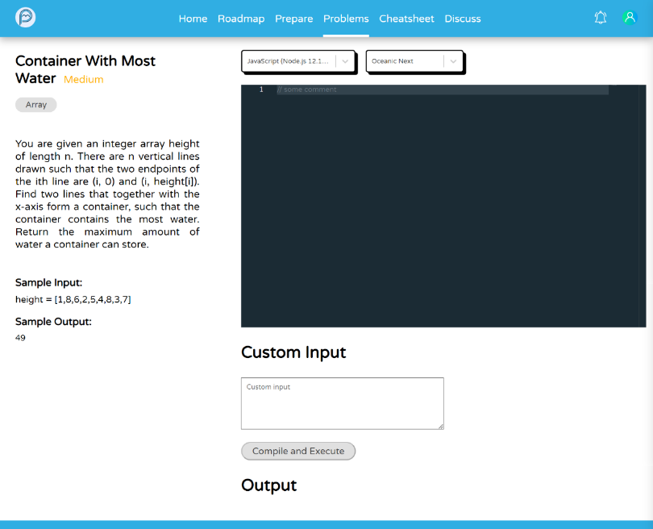
6. Expected Outcome
Fig. : Programming Problems Page
Fig. : Content and Interview Page
Fig. : Code Editor

Slide 12
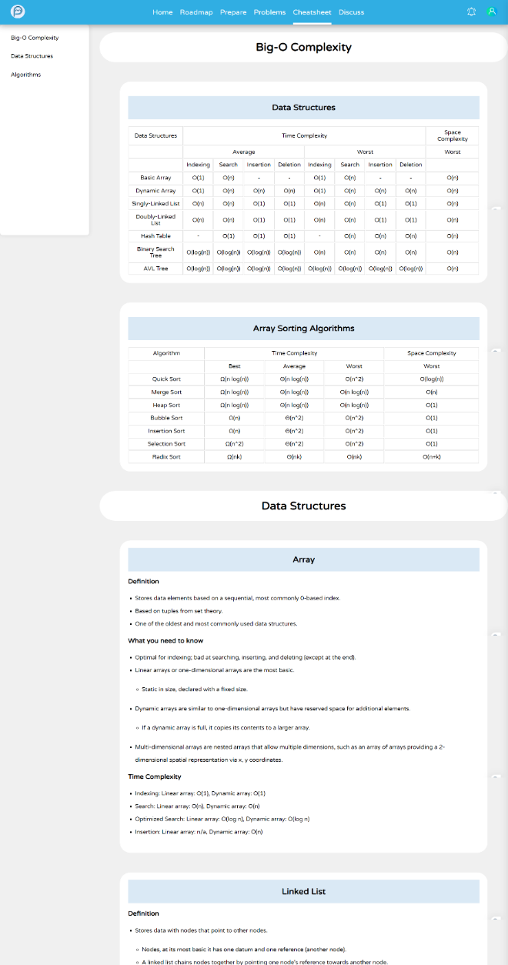
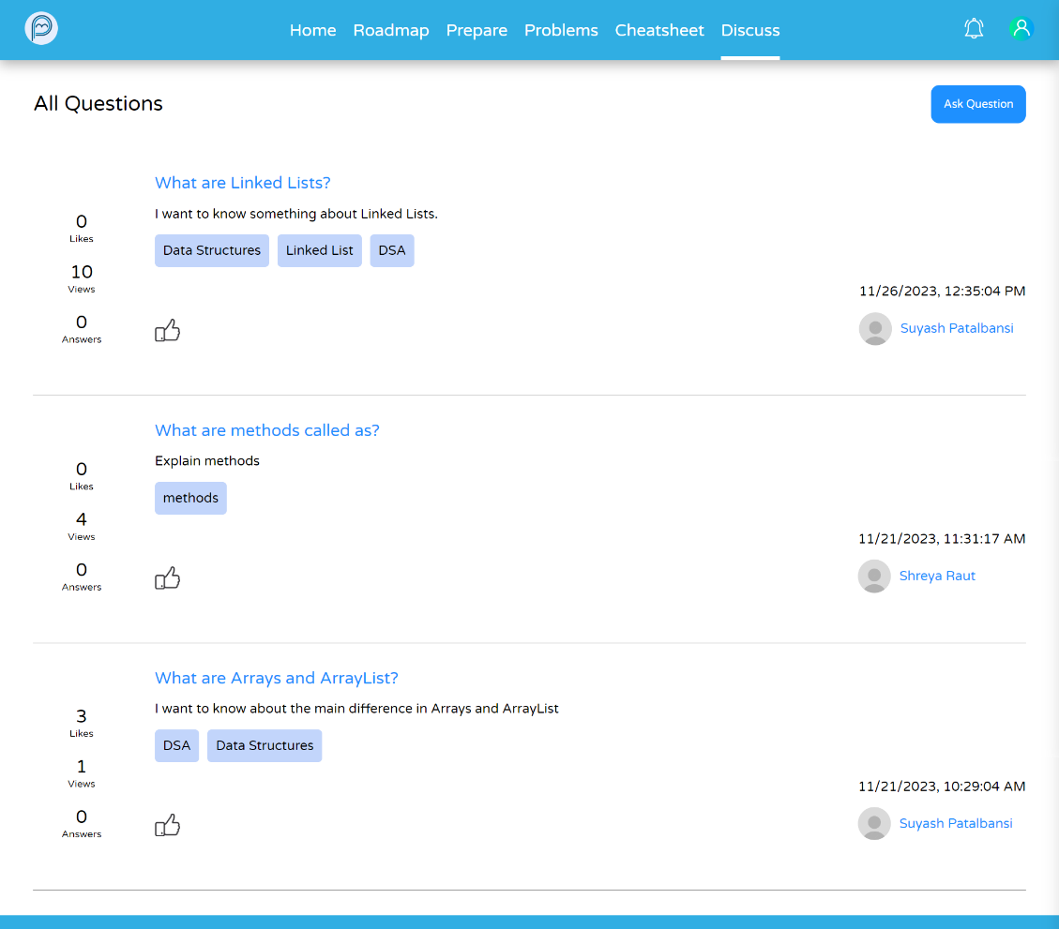
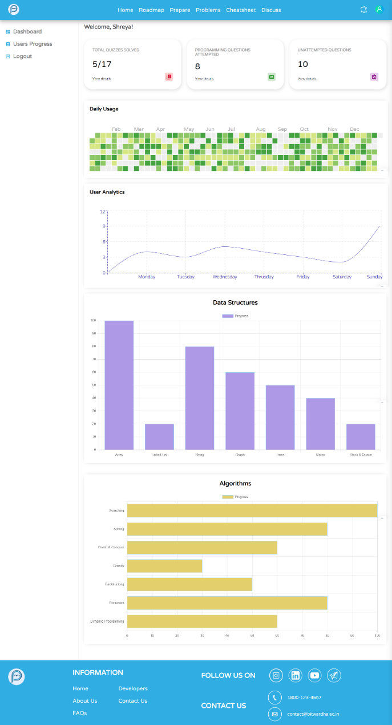
6. Expected Outcome
Fig. : Discussion Forum
Fig. : Cheatsheet Page
Fig. : User Dashboard

Slide 13
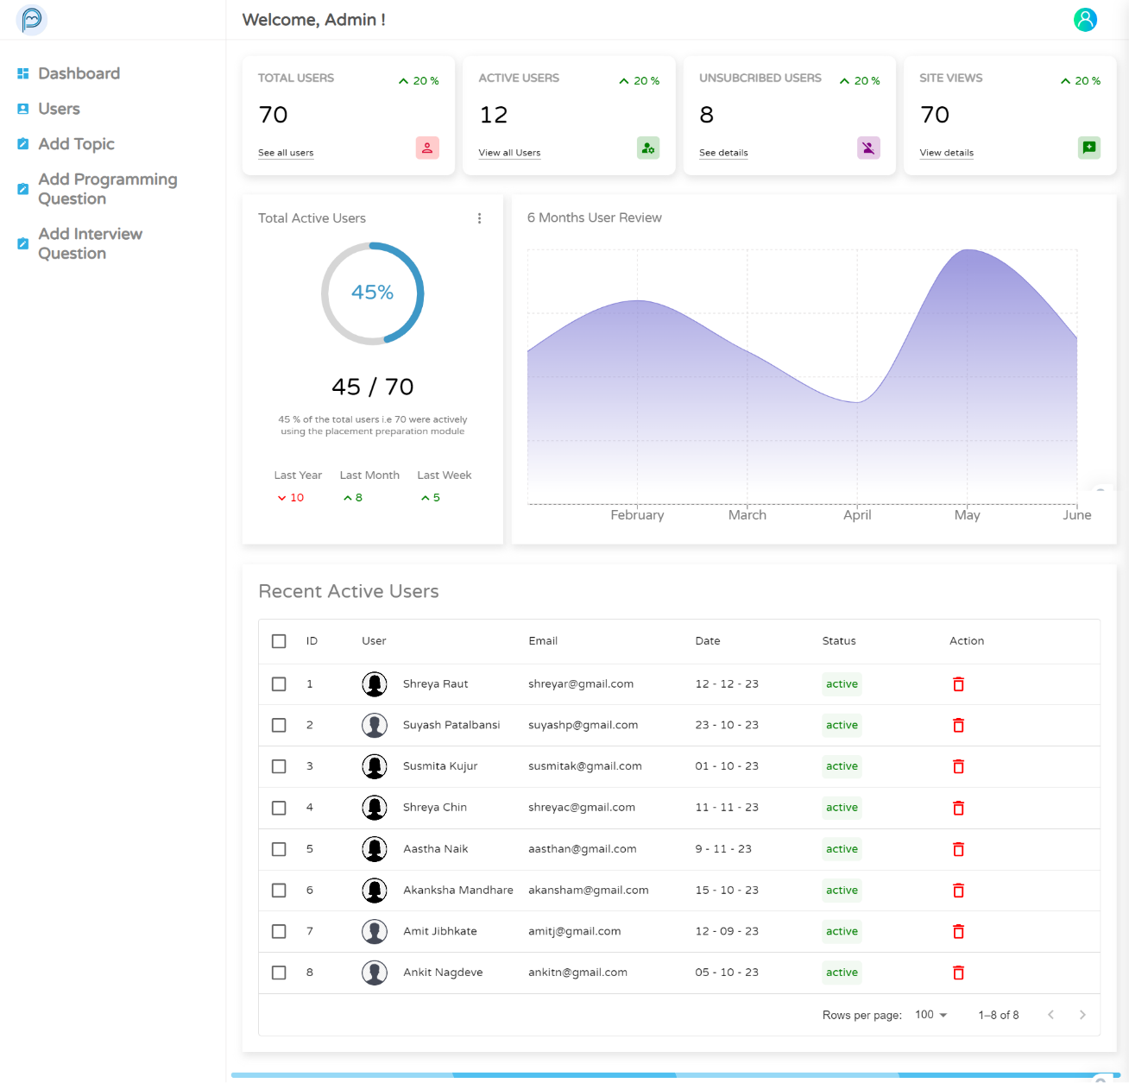
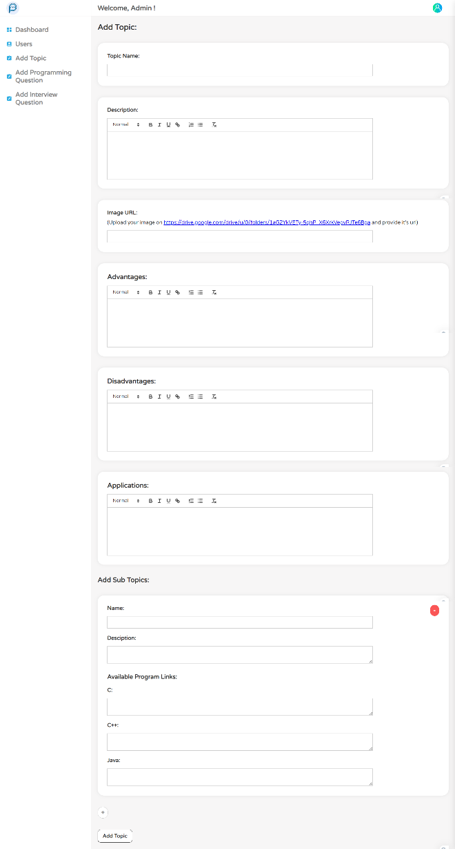
6. Expected Outcome
Fig. : Add Content page
Fig. : Admin Dashboard

Slide 14







7. Technologies Used
HTML
CSS
JS
React JS
Node JS
Express JS
Front-End
Back-End
MongoDB
Rapid API
Database
API

Slide 15
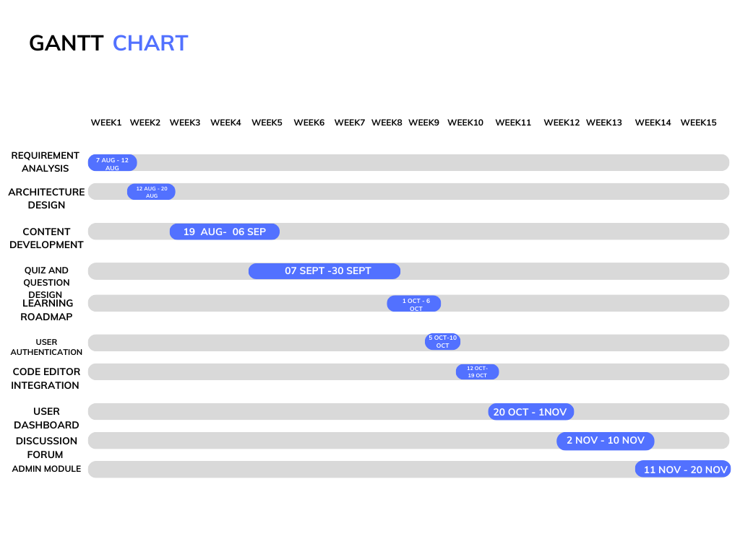
8. Project Timelines

Slide 16
9. Conclusion
Enhances coding skills and speed.
Helps you become better at solving tricky problems step by step.
Develops adaptability and creative thinking.
Provides valuable data to refine strategies and optimize learning.
Recognizes achieved milestones.
Sustains motivation through regular updates on daily accomplishments.
Facilitates a consistent and satisfying learning journey.

Slide 17
10. References
[1] M. Mcquaigue, D. Burlinson, K. Subramanian, E. Saule, and J. Payton, “Visualization, assessment and analytics in data structures learning modules,” Proceedings of the 49th ACM Technical Symposium on Computer Science Education, 2018. doi:10.1145/3159450.3159460
[2] E. B. Costa, A. M. Toda, M. A. Mesquita, F. T. Matsunaga, and J. D. Brancher, “Interactive Data Structure Learning Platform,” Computational Science and Its Applications – ICCSA 2014, pp. 186–196, June. 2014. doi:10.1007/978-3-319-09153-2_14
[3] D. Dicheva and A. Hodge, “Active learning through game play in a Data Structures course,” Proceedings of the 49th ACM Technical Symposium on Computer Science Education, 2018. doi:10.1145/3159450.3159605
[4] E. Fouh et al., “Design and architecture of an interactive etextbook – the opendsa system,” Science of Computer Programming, vol. 88, pp. 22–40, 2014. doi:10.1016/j.scico.2013.11.040

Slide 18
Thank You.

